Slide 1
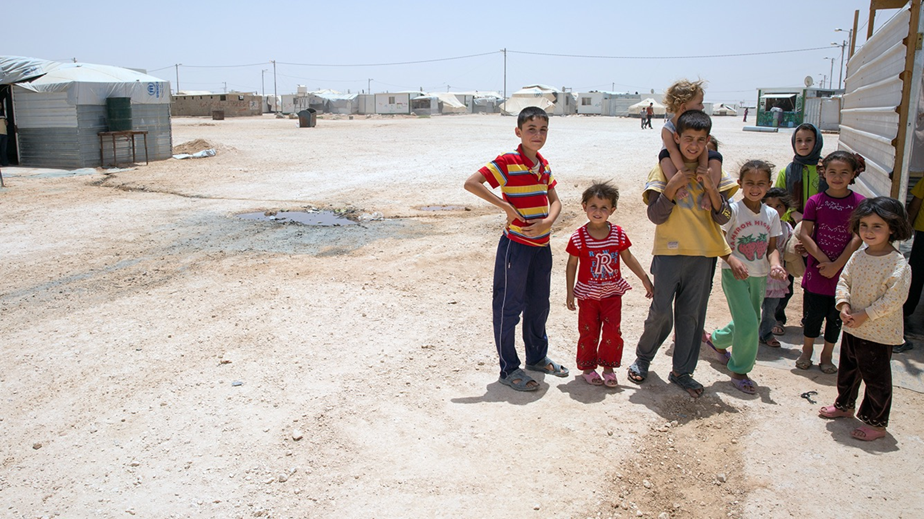


Introduction to the training course: Child and Adolescent Health in Humanitarian Settings
Notes:
#6ab94f - green
#1daaa1 – blue
#acc5b3 – light blue
#315745 – tree colour

Slide 2

Children and adolescents around the globe
Total population <18 years: 2.4 billion (30% world population)
Estimated 25% is affected by conflict or disaster
  31 million forcibly displaced
  13 million regarded as refugees
Notes:
How many children are there in the world? - UNICEF Data
Levels and trends in child mortality: report 2021 (who.int)

Slide 3
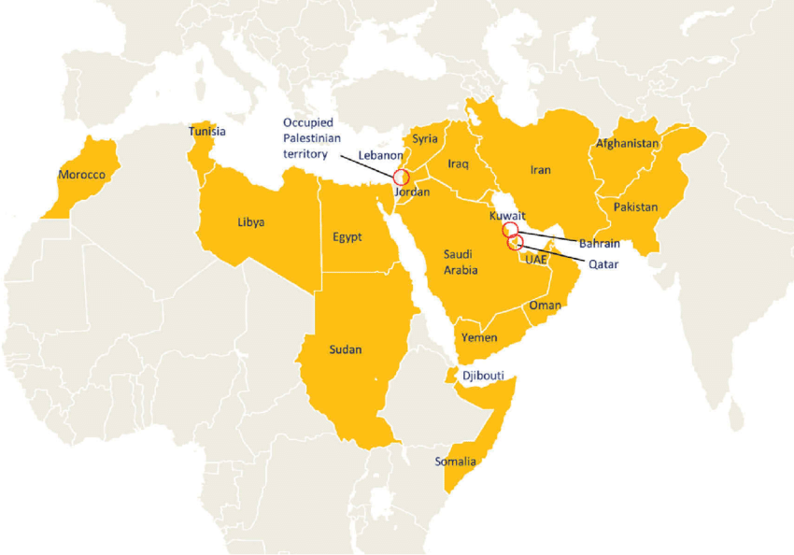
Children and adolescents in the Eastern Mediterranean Region
Children and adolescents >40% of population
Additional risks in humanitarian settings
Limited access to health facilities
Limited access to education
Limited access to WASH
Limited access to social protection
Higher chance of inter-personal or gender-based violence
Risk of military recruitment
Displacements from their home
Notes:
WHO EMRO | Adolescent health | Adolescent health | Child and adolescent health
WHO EMRO | Concept note | Mothers and children | About WHO

Slide 4
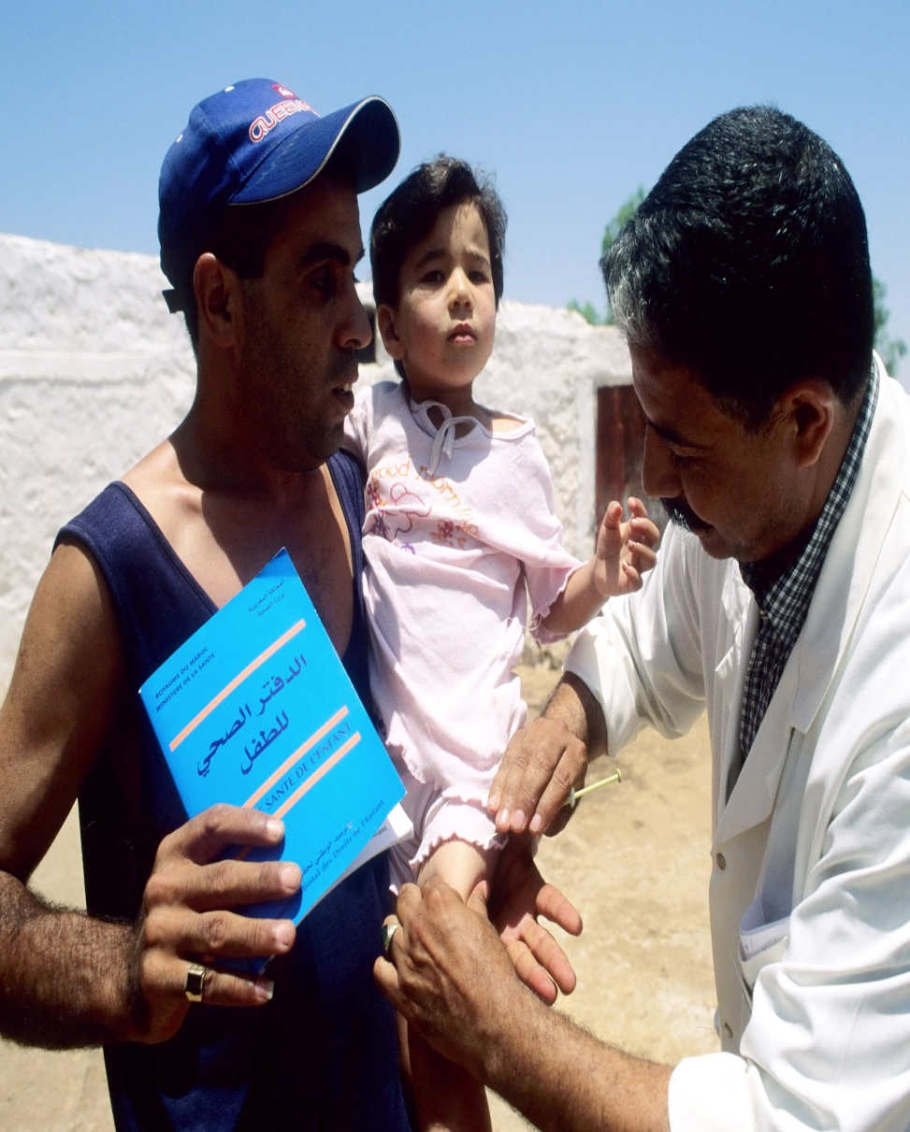
Situation:
Survive
29 million babies were born in humanitarian and fragile settings including refugees' communities in 2018
Worldwide, women and children are up to 14 times more likely than men to die in a disaster
60% of preventable maternal deaths, 53% of preventable under-5 deaths and 45% of newborn deaths take place in settings of conflict, displacement, and natural disasters
Mortality and morbidity rates of under-5 children are twenty times higher in emergency affected settings than less fragile settings.
At any time, 4 % of emergency-affected population are pregnant women while 15% of them will develop some complications
In Jordan, 50% of Syrian under-5 children do not have access to essential health services including vaccination and disability support.

Slide 5
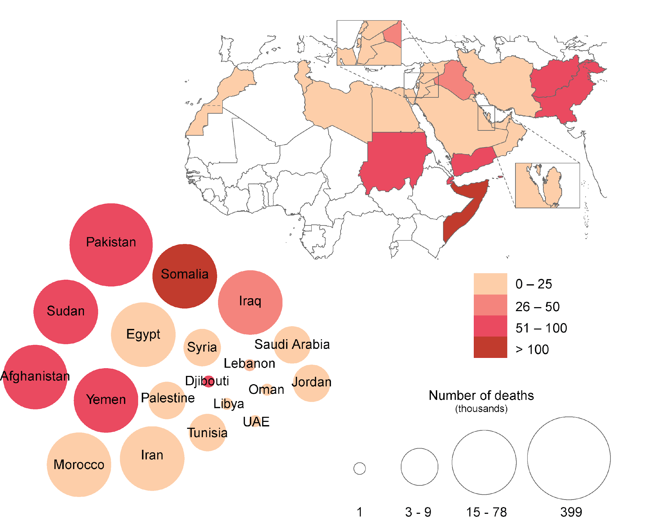
Under five mortality rate (U5MR) in the Eastern Mediterranean Region
(deaths per 1000 live births)
Source: IGCME Report, 2020

Slide 6
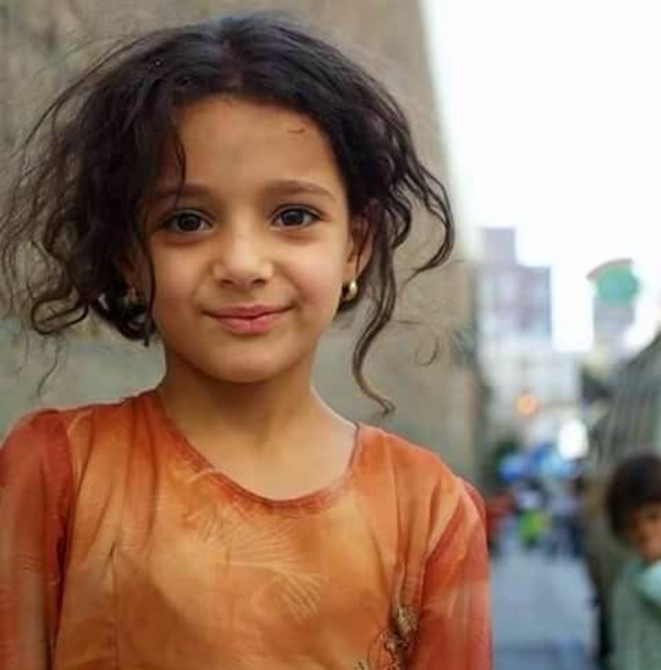
Situation:
Thrive
Including refugees' communities, 43% of under-5 children are at risk of poor development in low- and middle-income countries
Worse in sub-Saharan Africa (66%) representing a tremendous loss of social, education and economic potential
For parents and caregivers in conflict settings there is an increased risk of mental health challenges, including anxiety and depression.
10,000 Syrian refugee children are unaccompanied/separated
In Lebanon, 83% of refugee children (15-17 years) are out of school
Adolescent girls in refugees' settings are more vulnerable to harmful practices such as early and forced marriages resulting in early pregnancies in settings where access to services is an issue for all women, and particularly for young girls.
Among Syrian refugees in Jordan, child marriage increased from 11 % in 2011 to 25% in 2013

Slide 7
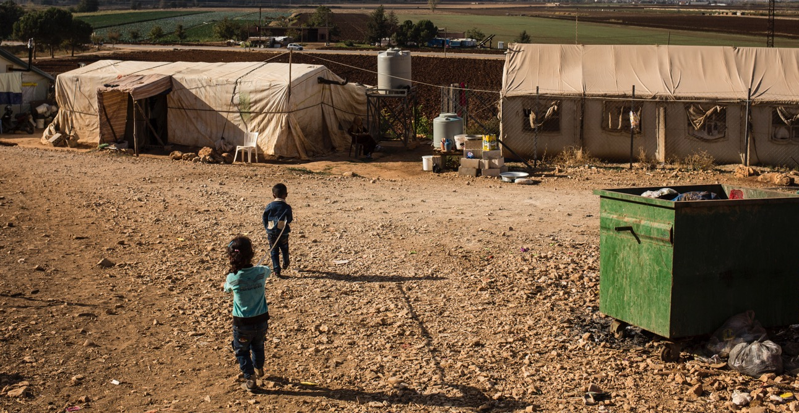
Humanitarian situation in the Region
127 million people in need of humanitarian assistance – 37% of people in need globally – 64% of the world’s refugees
Types of emergencies in EMR
Rapid onset: earthquakes, floods
Slow onset: drought, displaced populations
Complex: national / international conflict, displaced populations
Disease outbreaks: COVID-19, cholera, poliomyelitis, malaria
Notes:
WHO EMRO | Statement by Dr Ahmed Al-Mandhari, WHO Regional Director for the Eastern Mediterranean, on the occasion of World Humanitarian Day 2023 | News | Media centre

Slide 8
What do these data show us?
The continued high child mortality, with common infections remaining key causes of death, is an expression of increasing inequities and the multiple deprivations children in these countries face
Underperforming health systems
Accumulation of risk factors
Gaps in:
Availability
Access
Quality
Coverage of evidence-based interventions and services
Poverty
Food insecurity / malnutrition
Lack of access to clean water and sanitation
Air pollution
Conflict, insecurity, fragility

Slide 9
Health hazards of humanitarian settings in children and adolescents
Direct effects
Indirect effects
Trauma-related deaths and disability
Mental health challenges
Gender-based violence
Obstetric complications
Non-Communicable diseases (NCDs)
Infectious diseases
Malnutrition
Notes:
- Responding to health emergencies in the Eastern Mediterranean region in times of conflict - The Lancet
2224-4220-2023-1607-eng.pdf (who.int)

Slide 10
Global and Regional opportunities on child and adolescent health

Slide 11
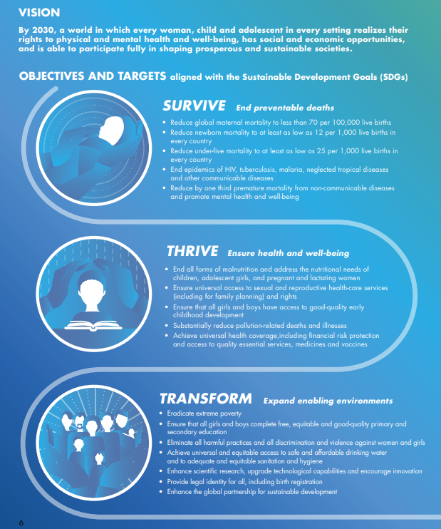
SDGs and the global strategy for women’s, children’s, and adolescents' health 2016 - 2030
1. SURVIVE
  End preventable deaths
2. THRIVE
  Ensure health and well-being
3. TRANSFORM
  Expand enabling environments
Source: EWEC Global Strategy for Women's Children's and Adolescents' Health, 2016 - 2030

Slide 12
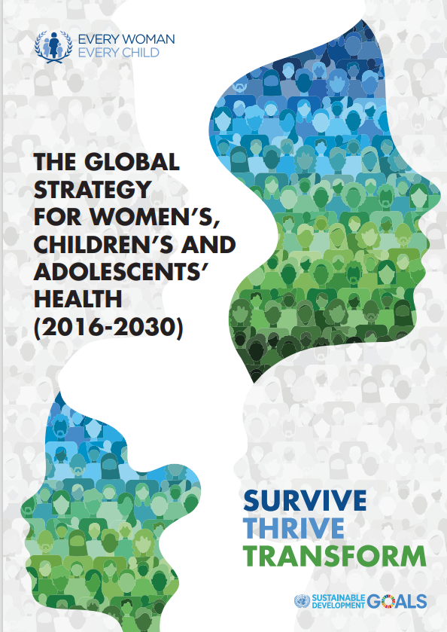
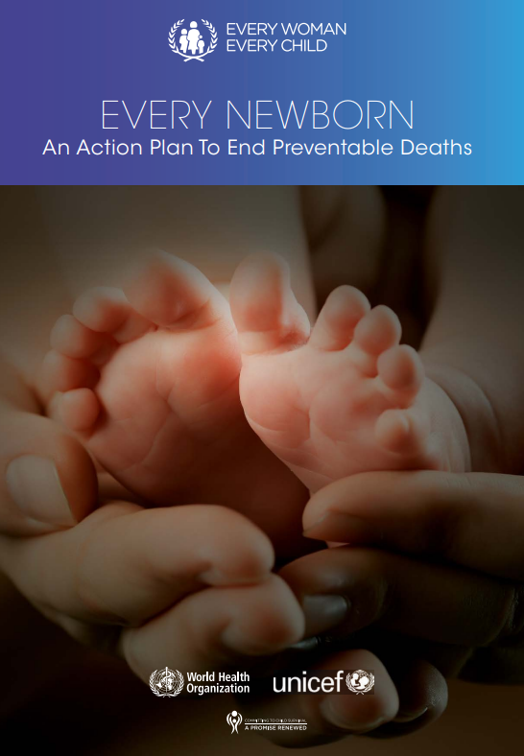
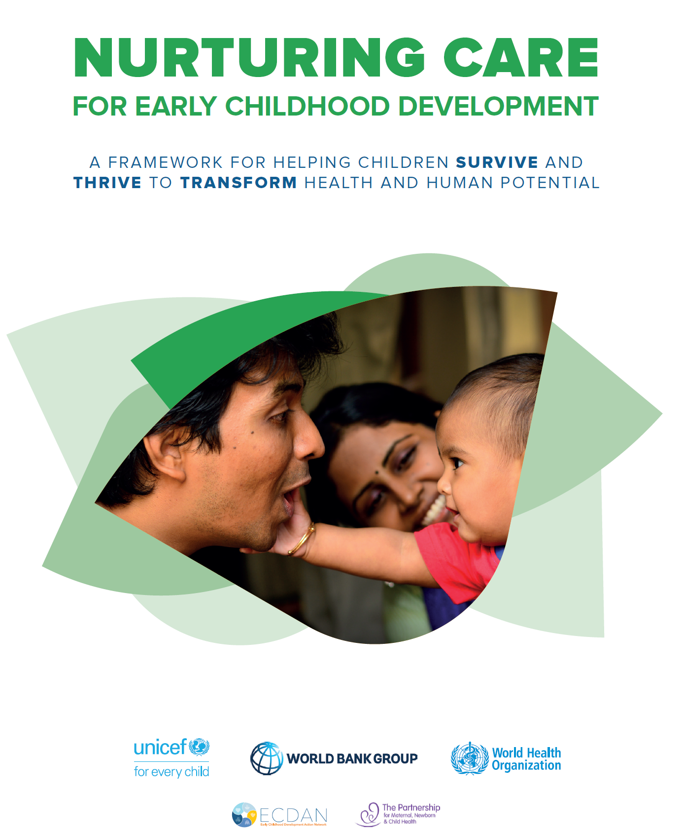
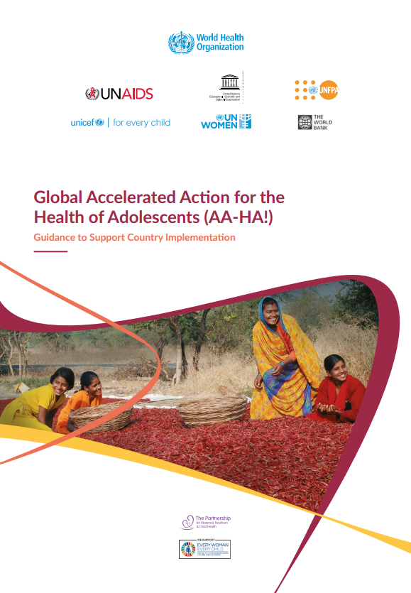
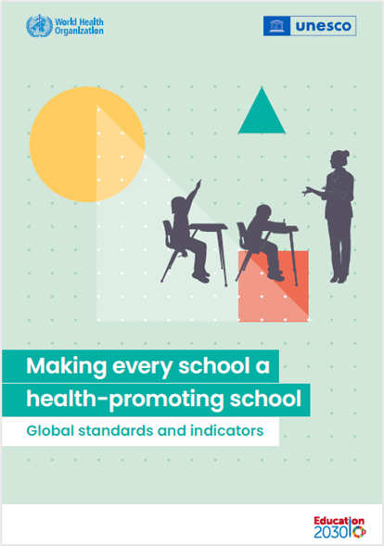
Global guidance on child and adolescent health
Notes:
- untitled (globalalliancematernalmentalhealth.org)
Every Newborn: an action plan to end preventable deaths (who.int)
Nurturing care for early childhood development (who.int)
Global Accelerated Action for the Health of Adolescents (AA-HA!) (who.int)
Making every school a health-promoting school – Global standards and indicators (who.int)

Slide 13
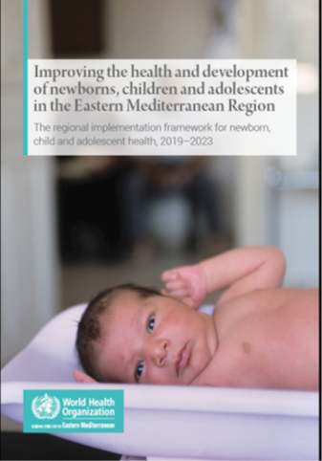
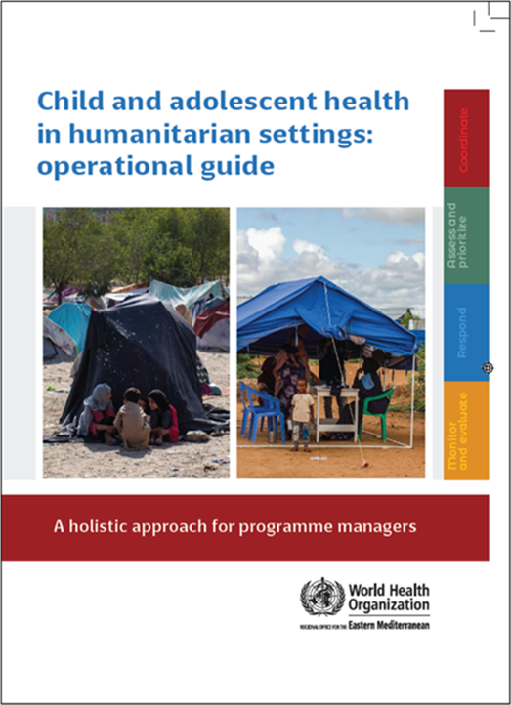
Regional guidance on child and adolescent health
Notes:
Improving the health and development of newborns, children and adolescents in the Eastern Mediterranean Region: the regional implementation framework for newborn, child and adolescent health, 2019-2023 (who.int)
Child and adolescent health in humanitarian settings: operational guide: a holistic approach for programme managers (who.int)

Slide 14
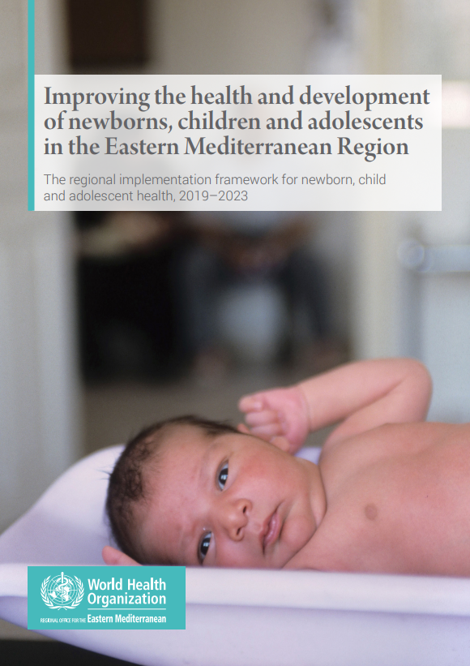
Improving the health and development of newborns, children and adolescents in the Eastern Mediterranean Region
The regional implementation framework for newborn, child and adolescent health, 2019-2023
Goals:
  Support cost-effective, evidence-based interventions within the framework of UHC and humanitarian action
  Implement age-specific interventions
  Prioritize adolescent health and development for a stronger focus
Notes:
Improving the health and development of newborns, children and adolescents in the Eastern Mediterranean Region: the regional implementation framework for newborn, child and adolescent health, 2019-2023 (who.int)

Slide 15
Strategic areas of the framework
ACCESS, EQUITY AND QUALITY FOR UHC
PROTECTION DURING HUMANITARIAN EMERGENCIES
STRATEGIC AREA 1
CHILD
STRATEGIC AREA 2
CENTRED
INTEGRATION AND MULTISECTORAL COORDINATION
15
STRATEGIC AREA 3

Slide 16
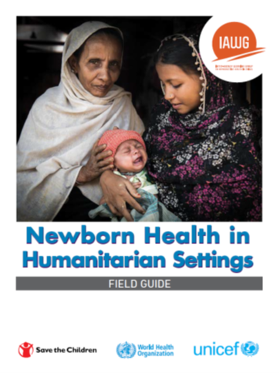
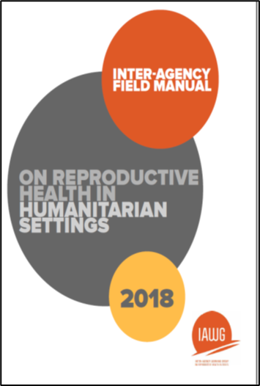







Rationale: Significant gap
Notes:
Diversity – types of emergency, duration and phase of emergency, players involved, political environment.
Existing resources – not being implemented. Unable to access or disseminate to users. Not appropriate to context – too complex, sociocultural factors, not practical…
Diverse current capacity, activities, and needs
Therefore, an operational field guide must include considerations across the diverse spectrum of humanitarian emergencies (and CAH).
Diversity – types of emergency, duration and phase of emergency, players involved, political environment.
Many activities happening – but challenges with coordination
Therefore, an operational field guide must be relevant and useful for health and non-health sectors (working with children / adolescents)
Activities – not tread on each others toes, or grab others’ territory.
Many information resources exist – but often not meeting needs
Therefore, an operational field guide must complement existing resources (not duplicate or compete).
Existing resources – not being implemented. Unable to access or disseminate to users. Not appropriate to context – too complex, sociocultural factors, not practical…

Slide 17
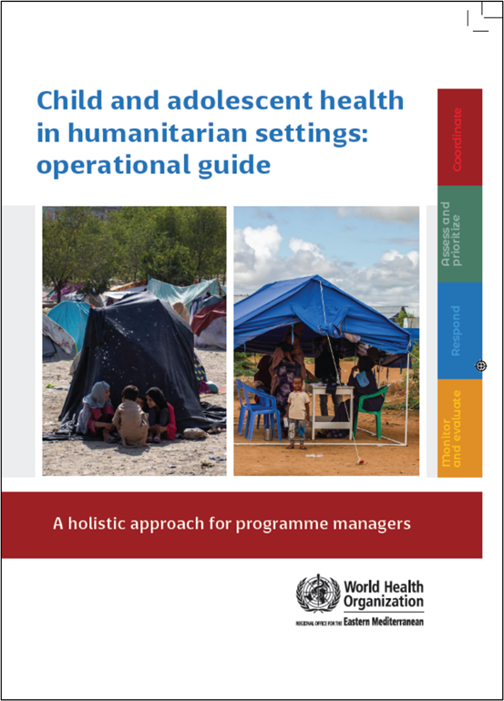
Child and adolescent health in humanitarian settings: operational guide
Notes:
Child and adolescent health in humanitarian settings: operational guide: a holistic approach for programme managers (who.int)
The Operational Guide is a synthesis of existing guidance, not a new guideline or a program (Figure 1). It incorporates existing standards and guidance documents, and presents them as a simple, systematic approach, together with links to tools and resources to support action. The Operational Guide complements existing humanitarian frameworks, and child and adolescent health strategies, including WHO’s regional implementation framework. It is a companion to existing guides on newborn, and sexual and reproductive health in humanitarian emergencies.
Audience:
Health sector and other sectors
Government and non-government (NGOs, UN agencies, funding agencies)
National and sub-national
Providing such breadth of guidance to such a broad audience is challenging, and has required careful balancing.
We wanted something that was as simple as possible, as we know users don’t have time to wade through hundreds of pages. We also wanted to make sure that it covered all the essentials for CAH programming in emergencies.
We wanted to include general guidance for a non-specialist audience, but also provide enough specifics that users could take clear actions.
We wanted to provide clear action-oriented guidance, but we also wanted it to be flexible enough for different users to use is very different situations.
So hopefully you will find the operational guide to be practical and useful for your CAH programming. But it won’t give you everything you need, and you will always need to adapt the guidance to your context.

Slide 18
Operational guide - background
In 2017, the WHO Regional Office for the Eastern Mediterranean initiated:
(i) A rapid review to identify the gaps in the current approaches in responding to child and adolescent health during humanitarian emergencies, and
(ii) Drafting of new guidance for child and adolescent health during humanitarian emergencies. Stakeholder feedback.

Slide 19
Operational guide - Summary of findings
Diverse current capacity, activities, and needs
  Awareness of limitations, and eager for support to improve
  Desire to expand beyond under 5s, infection, immunization, and nutrition
Many activities happening – but challenges with coordination
  Within and between sectors / clusters
Many information resources exist – but often not meeting needs
  Access / availability
  Appropriateness
Notes:
Diversity – types of emergency, duration and phase of emergency, players involved, political environment.
Existing resources – not being implemented. Unable to access or disseminate to users. Not appropriate to context – too complex, sociocultural factors, not practical…
Diverse current capacity, activities, and needs
Therefore, an operational field guide must include considerations across the diverse spectrum of humanitarian emergencies (and CAH).
Diversity – types of emergency, duration and phase of emergency, players involved, political environment.
Many activities happening – but challenges with coordination
Therefore, an operational field guide must be relevant and useful for health and non-health sectors (working with children / adolescents)
Activities – not tread on each others toes, or grab others’ territory.
Many information resources exist – but often not meeting needs
Therefore, an operational field guide must complement existing resources (not duplicate or compete).
Existing resources – not being implemented. Unable to access or disseminate to users. Not appropriate to context – too complex, sociocultural factors, not practical…

Slide 20
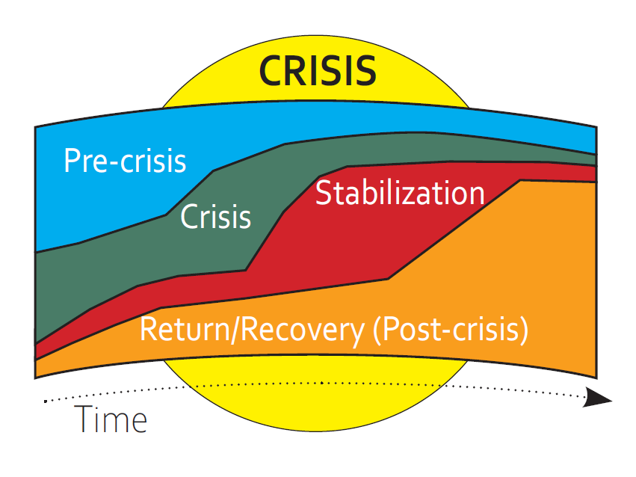
Operational guide - Purpose (1/3)
To provide programmatic guidance on child and adolescent health in humanitarian emergencies
Programmatic guidance – plan, implement, manage, evaluate
Preparedness
Response
Recovery
Notes:
The Child and Adolescent Health in Humanitarian Emergencies Operational Guide provides programmatic guidance to support the health care and protection of children during humanitarian emergencies. It is a programmatic guide, not a clinical guide. Its focus is on equipping staff to confidently plan, implement, manage, and evaluate child and adolescent health activities in all phases of humanitarian emergencies and humanitarian action (including preparedness, response and recovery).
The Operational Guide addresses the full spectrum of child health (“life cycle approach”, from birth to adolescence) and all humanitarian emergencies (“all-hazards approach”, including natural disasters, armed conflict, and political instability). Its primary purpose is to ensure that all children are fully included in humanitarian action.
The Operational Guide is a synthesis of existing guidance, not a new guideline or a program (Figure 1). It incorporates existing standards and guidance documents, and presents them as a simple, systematic approach, together with links to tools and resources to support action. The Operational Guide complements existing humanitarian frameworks, and child and adolescent health strategies, including WHO’s regional implementation framework. It is a companion to existing guides on newborn, and sexual and reproductive health in humanitarian emergencies.
The Sphere Project. Sphere Humanitarian Charter and Minimum Standards in Humanitarian Response, 2011. http://www.sphereproject.org.
WHO. Global Strategy for Women’s, Children’s and Adolescents’ Health (2016-2030): Survive, Thrive, Transform, 2015. http://globalstrategy.everywomaneverychild.org/
WHO EMRO. Implementation Framework for Newborn, Child and Adolescent Health 2018-2025. WHO; 2018.
UNICEF / STC. Newborn Health in Humanitarian Settings: Field Guide, 2018.
IAWG on Reproductive Health in Crises. Inter-agency Field Manual on Reproductive Health in Humanitarian Settings: 2010 Revision for Field Review, 2012.

Slide 21
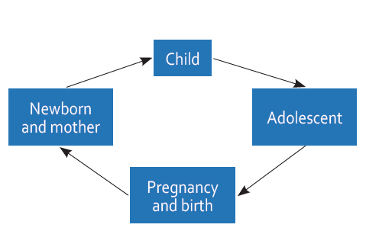
Operational guide - Purpose (2/3)
To provide programmatic guidance on child and adolescent health in humanitarian emergencies
Programmatic guidance – plan, implement, manage, evaluate
Make children visible – from birth to adolescence
Notes:
The Operational Guide addresses the full spectrum of child health (“life cycle approach”, from birth to adolescence) and all humanitarian emergencies (“all-hazards approach”, including natural disasters, armed conflict, and political instability). Its primary purpose is to ensure that all children are fully included in humanitarian action.

Slide 22
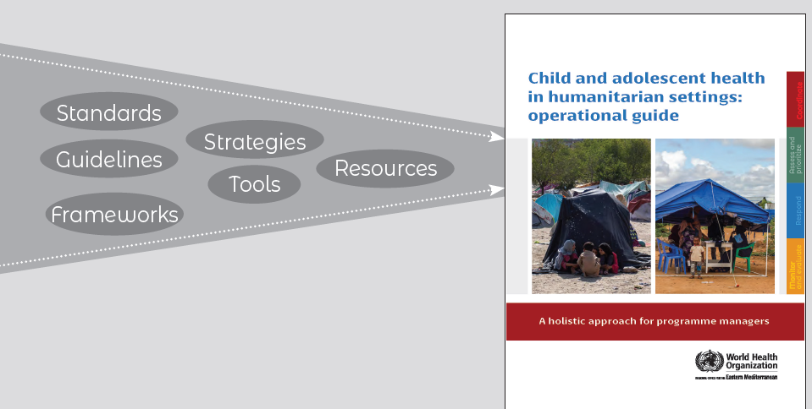
Operational guide - Purpose (3/3)
To provide programmatic guidance on child and adolescent health in humanitarian emergencies
Programmatic guidance – plan, implement, manage, evaluate
Make children visible – from birth to adolescence
Simple, action-oriented, structured approach that complements existing standards and resources
Notes:
The Operational Guide is a synthesis of existing guidance, not a new guideline or a program (Figure 1). It incorporates existing standards and guidance documents, and presents them as a simple, systematic approach, together with links to tools and resources to support action. The Operational Guide complements existing humanitarian frameworks, and child and adolescent health strategies, including WHO’s regional implementation framework. It is a companion to existing guides on newborn, and sexual and reproductive health in humanitarian emergencies.
The Sphere Project. Sphere Humanitarian Charter and Minimum Standards in Humanitarian Response, 2011. http://www.sphereproject.org.
WHO. Global Strategy for Women’s, Children’s and Adolescents’ Health (2016-2030): Survive, Thrive, Transform, 2015. http://globalstrategy.everywomaneverychild.org/
WHO EMRO. Implementation Framework for Newborn, Child and Adolescent Health 2018-2025. WHO; 2018.
UNICEF / STC. Newborn Health in Humanitarian Settings: Field Guide, 2018.
IAWG on Reproductive Health in Crises. Inter-agency Field Manual on Reproductive Health in Humanitarian Settings: 2010 Revision for Field Review, 2012.

Slide 23
Operational guide - Audience
Program managers and leaders in health (and related fields), at every stage of an emergency
Health sector and other sectors
Government and non-governments (NGOs, UN agencies, funding agencies)
National and sub-national
Notes:
Program managers and leaders in health (and many related fields) can have enormous influence on child and adolescent health outcomes through well-informed decision-making. This Operational Guide is intended to be your guide to promoting child and adolescent health during emergencies.
The Operational Guide provides practical guidance for program managers and health leaders who are involved in designing, implementing, managing, monitoring, and evaluating child and adolescent health activities in humanitarian emergency settings. This includes staff in local and national governments, United Nations (UN) agencies, non-governmental organizations (NGOs), academic, and funding institutions.
While the Operational Guide’s primary audience is health managers, it will also be relevant for staff in other sectors (e.g. social services), and especially for staff leading broader humanitarian/emergency and development activities – showing how children and adolescents can be integrated into humanitarian action. The Operational Guide will also be useful for local, national, and regional-level advocacy on child and adolescent health in humanitarian emergency settings – including to support funding proposals.

Slide 24
Content of the operational guide
❶ COORDINATE
How to take a coordinated approach to child and adolescent health in a humanitarian emergency
❷ ASSESS & PRIORITISE
How to obtain data on child/adolescent health (via needs assessment) and use it to prioritize actions
Step-by-step programmatic guide, providing a clear approach to child and adolescent health in emergencies
  Key concepts
  Key actions and indicators
  Resources and tools
❸ RESPOND
How to plan and enact a coordinated set of activities addressing the identified child and adolescent health priorities
❹ MONITOR, EVALUATE & REVIEW
How to use data systems to review and improve child and adolescent health-related activities
Notes:
Child and adolescent health in humanitarian settings: operational guide: a holistic approach for programme managers (who.int)
Getting started with the Guide – A, B, C, D.
The Operational Guide is designed to be practical, simple, and action-oriented, describing the essential programmatic actions necessary to protect and care for children and adolescents during humanitarian crises. All the actions depend on the local context and users must consider how to apply or adapt recommendations to fit local needs and circumstances.
The Operational Guide is structured around four key programmatic actions (Figure 2). These programmatic actions are part of a continuous cycle of activities. Each area of action is intimately connected with other areas (and activities within each will often occur simultaneously).
A. To get familiar with the guide, start from the beginning and read through each chapter in turn.
COORDINATE – how to take a coordinated approach to child and adolescent health in a humanitarian emergency. This is the foundation for actions #2-3-4.
ASSESS & PRIORITISE – how to obtain data on child and adolescent health and use it to prioritize actions. This builds on action #1 and is enacted in action #3.
RESPOND – how to plan and enact a coordinated set of activities addressing the identified priorities. This builds on action #2 and is reviewed in action #4.
MONITOR, EVALUATE & REVIEW – how to use data systems to review and improve child and adolescent health-related activities. This feeds back into actions #1-2-3.
Each programmatic action area guides user through three sections.
- Brief introduction of important concepts and guidance documents.
- Key Actions describe specific activities that should be considered in planning and implementing your programs.
- Resources and Tools provide a short list of documents for further information.
C. Start working through each section addressing the Key Actions to the best of your ability.
Don’t worry if there are some things that are impossible to address. Work on the things you can change. Build on what you are already doing well. Celebrate your small successes, and encourage others. Make note of areas you need to address more fully in the future.

Slide 25
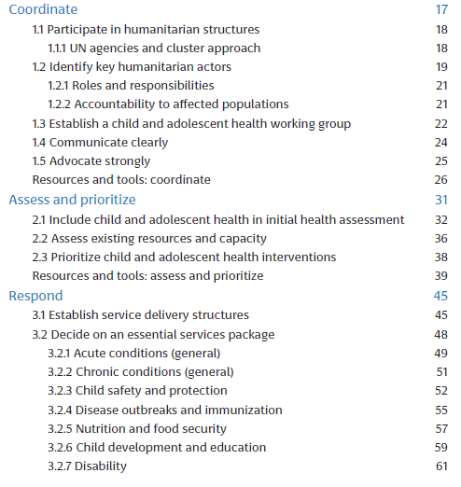
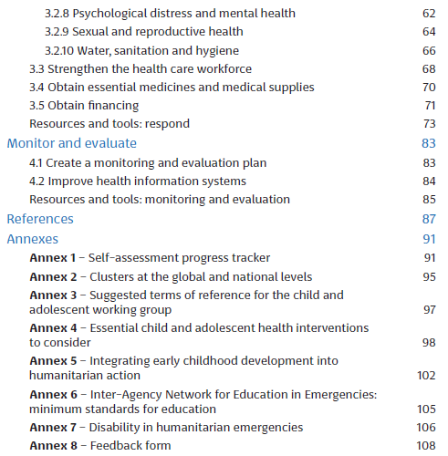

Slide 26
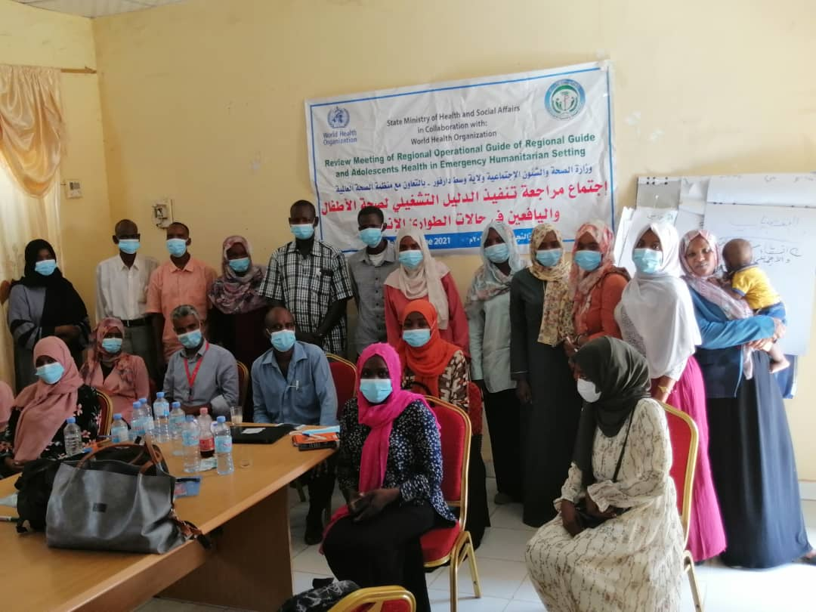
Review Meeting on the Implementation of the Operational Guide for Child and Adolescent Health in Humanitarian Setting – Sudan 2018

Slide 27

Lessons learnt in Sudan
The Operational Guide is user friendly, puts more emphasis on addressing child and adolescent health needs in a comprehensive manner
Using existing coordination platforms and widening inclusion of child and adolescent health partners approach in these platforms is sustainable and efficient
The operational guide facilitates and strengthens harmonization and alignment of the different CAH partners efforts in humanitarian and emergency setting

Slide 28
Next steps operational guide
Dissemination to health cluster, INGOs, NGOs, ..
Country-based workshops in focus countries in the Region
Online self-paced training accessible to everyone
Blended coach-based interactive e-training to broaden the audience and make it easy to access

Slide 29
Blended online training course on CAH in humanitarian settings
Training objectives
Equip program staff to meet child and adolescent health needs in humanitarian emergencies by:
Understanding comprehensive health needs from birth to adolescence
Strengthening emergency child and adolescent health capacity in the Eastern Mediterranean Region
Developing programmatic skills using a structure approach, based on key chapters of the operational guide: coordinate, assess and prioritize, respond, and monitor, evaluate and review

Slide 30
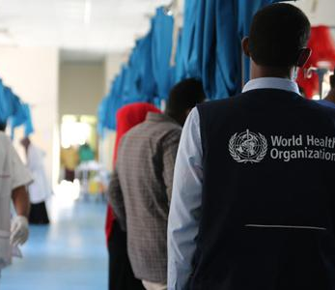
Course overview
Target Audience: Program managers and decision-makers in health and related fields
Applicability: Suitable for all stages of a humanitarian emergency
Participants: Individuals from various sectors, including health, government, NGOs, UN agencies, funding agencies, working in countries affected by emergencies in the Eastern Mediterranean Region

Slide 31
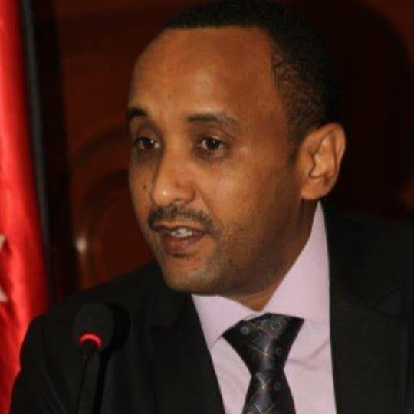








Our training team
Dr Khalid Siddeeg Regional advisor child and adolescent health
WHO EMRO
Ms Kim Beentjes Technical officer child and adolescent health in humanitarian settings WHO EMRO
Dr Raqibat Idris
GFMER Course Manager, Switzerland
Ms Fionna Poon
GFMER Course Administrator, Switzerland
Dr Hamish Graham
Pediatrician, The Royal Children’s Hospital Melbourne, Australia
Ms Manar Shukri
Regional Early Childhood Development (ECD) Technical Lead, International Rescue Committee (IRC), Jordan
Dr Ubah Farah Ahmed Advisor family health department, Ministry of Health, Somalia
Prof Huda Basaleem
Professor of Community Medicine and Public Health Advisor, International Child and Youth Care for Development, University of Aden, Yemen
Dr Samira Aboubakar
Reproductive, Maternal, Newborn, Child and Adolescent Health (RMNCAH) expert, Switzerland

Slide 32
Course schedule
Duration: 6 weeks
Week 1
Introduction webinar
Module 1: Coordinate – a coordinated approach to child and adolescent health in emergencies
Week 2
Module 2: Assess and prioritize – data gathering and action prioritization
Week 3
Module 3: Respond (Part 1) – planning for child and adolescent health priorities
Week 4
Module 3: Respond (Part 2) – continued planning for health priorities
Week 5
Webinar: Country experience – success stories
Week 6
Module 4: Monitor, evaluate, and review – using data systems to improve activities
End of course meeting

Slide 33
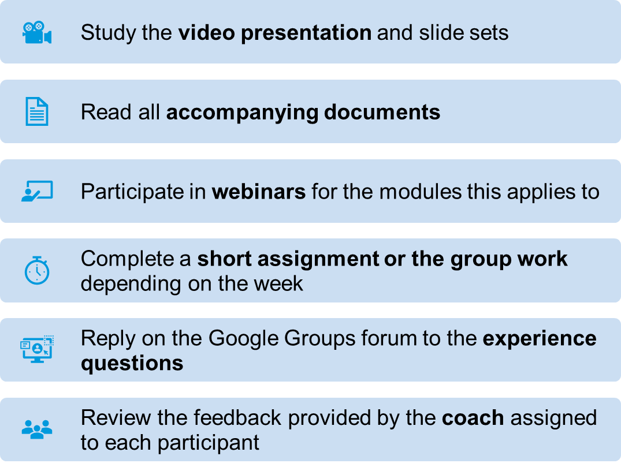
Requirements of participants for modules

Slide 34
Expected learning outcomes
Deepen understanding of complex child and adolescent health needs in emergencies
Acquire enhanced knowledge and skills on the modules: coordinate, assess and prioritize, respond, and monitor, evaluate and review.
Evaluate successful country experiences in advanced health interventions
Apply advanced knowledge to strengthen capacity for CAH in humanitarian settings

Slide 35
Thank you
For more information, please contact:
Khalid Siddeeg, Regional Advisor EMRO, siddeegk@who.int
Kim Beentjes, Technical Officer EMRO, beentjesk@who.int

