Slide 1
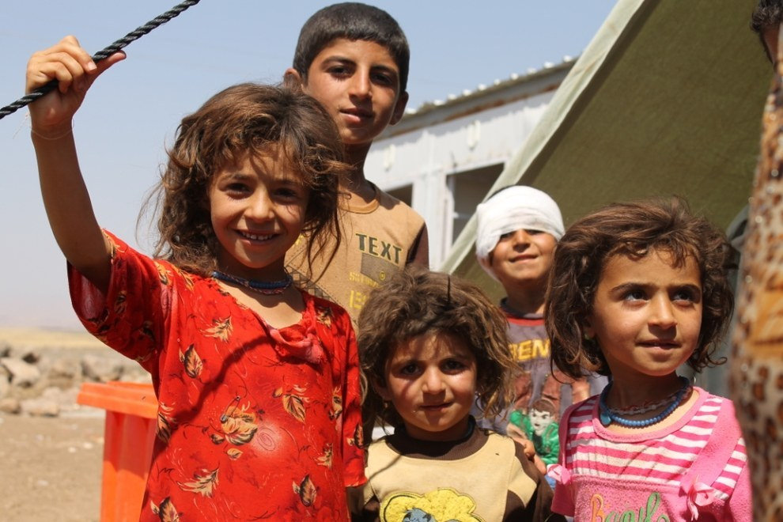
Module 1: Coordinate

Slide 2
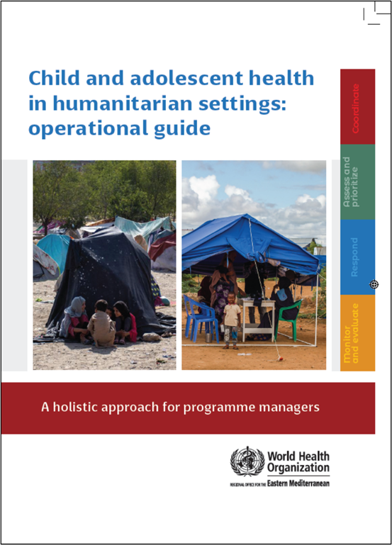
Child and adolescent health in humanitarian settings: operational guide
Notes:
Child and adolescent health in humanitarian settings: operational guide: a holistic approach for programme managers (who.int)
The Operational Guide is a synthesis of existing guidance, not a new guideline or a program (Figure 1). It incorporates existing standards and guidance documents, and presents them as a simple, systematic approach, together with links to tools and resources to support action. The Operational Guide complements existing humanitarian frameworks, and child and adolescent health strategies, including WHO’s regional implementation framework. It is a companion to existing guides on newborn, and sexual and reproductive health in humanitarian emergencies.
Audience:
Health sector and other sectors
Government and non-government (NGOs, UN agencies, funding agencies)
National and sub-national
Providing such breadth of guidance to such a broad audience is challenging, and has required careful balancing.
We wanted something that was as simple as possible, as we know users don’t have time to wade through hundreds of pages. We also wanted to make sure that it covered all the essentials for CAH programming in emergencies.
We wanted to include general guidance for a non-specialist audience, but also provide enough specifics that users could take clear actions.
We wanted to provide clear action-oriented guidance, but we also wanted it to be flexible enough for different users to use is very different situations.
So hopefully you will find the operational guide to be practical and useful for your CAH programming. But it won’t give you everything you need, and you will always need to adapt the guidance to your context.

Slide 3
How to use the guide
Get familiar with the entire guide
Identify areas most useful for your team (usually coordinate)
Review key actions and step by step approach to address the key actions (to the best of your ability)
Repeat the cycle, each time addressing things more fully
Work through the entire guide in preparation for an emergency
Quickly work through the guide in the first month of an emergency, then systematically revisit all the sections over the next 3-6 months.
Systematically review all of the guide every 6 months during a protracted emergency and into the recovery period.
Use the Self-Assessment Progress Tracker (Annex 1) to track your improvement.
Notes:
So how do we expect readers to use the guide?
Getting started with the Guide – A, B, C, D.
The Operational Guide is designed to be practical, simple, and action-oriented, describing the essential programmatic actions necessary to protect and care for children and adolescents during humanitarian crises. All the actions depend on the local context and users must consider how to apply or adapt recommendations to fit local needs and circumstances.
The Operational Guide is structured around four key programmatic actions (Figure 2). These programmatic actions are part of a continuous cycle of activities. Each area of action is intimately connected with other areas (and activities within each will often occur simultaneously).
A. To get familiar with the guide, start from the beginning and read through each chapter in turn.
COORDINATE – how to take a coordinated approach to child and adolescent health in a humanitarian emergency. This is the foundation for actions #2-3-4.
ASSESS & PRIORITISE – how to obtain data on child and adolescent health and use it to prioritize actions. This builds on action #1 and is enacted in action #3.
RESPOND – how to plan and enact a coordinated set of activities addressing the identified priorities. This builds on action #2 and is reviewed in action #4.
MONITOR, EVALUATE & REVIEW – how to use data systems to review and improve child and adolescent health-related activities. This feeds back into actions #1-2-3.
B. Once you are familiar with the contents of the guide, use these questions to work out which area your team (or organization) should focus on first.
We suggest you begin with the first section that scores less than 2. [Refer to the full Self-Assessment Progress Tracker (Annex 1) for more detail.]
C. Start working through each section addressing the Key Actions to the best of your ability.
Don’t worry if there are some things that are impossible to address. Work on the things you can change. Build on what you are already doing well. Celebrate your small successes, and encourage others. Make note of areas you need to address more fully in the future.
D. Work through the cycles of the Operational Guide repeatedly, each time seeking to address more of the Key Actions.
This guide can be used during preparedness, response, and recovery phases of humanitarian action. How you use it will depend on the emergency and context, but we suggest:
- Working through the entire guide in preparation for an emergency
- Quickly working through the guide in the first month of an emergency, then systematically revisit all the sections over the next 3-6 months.
- Systematically reviewing all of the guide every 6 months during a protracted emergency and into the recovery period.
- Use the Self-Assessment Progress Tracker (Annex 1) to track your improvement.

Slide 4
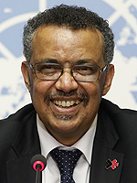
Implementing the guide
Dr Tedros on an organizational shift
“WHO is known for the quality of its normative work, but there is little value in publishing a guideline if nobody uses it. We need a much greater emphasis on making sure our world-class technical work is used at country level, and a much greater focus on measuring the impact of that work.”
Notes:
Interview with Dr Tedros: https://www.globalhealthnow.org/2018-09/inside-mind-tedros-qa-whos-director-general

Slide 5
Humanitarian Principles
Humanitarian action is guided by humanitarian principles: humanity, impartiality, neutrality, independence
These are grounded in human rights and international law:
The right to live with dignity
The right to receive humanitarian assistance
The right to protection and security
Children have additional rights
Convention of the Rights of the Child
Notes:
- The Geneva Conventions and their Additional Protocols. International Committee of the Red Cross (https://www.icrc.org/en/doc/war-and-law/treaties-customary-law/geneva-conventions/overview-geneva-conventions.htm, accessed 26 April 2020).
- International Bill of Human Rights. New York: United Nations; 1948 (https://www.ohchr.org/sites/default/files/Documents/Publications/Compilation1.1en.pdf, accessed 22 January 2024).
- Convention on the Rights of the Child. Office of the High Commissioner for Human Rights (UN Human Rights); 1989 (https://www.ohchr.org/en/professionalinterest/pages/crc.aspx, accessed 26 April 2020).
- Convention on the Rights of the Child. General comment No. 20 (2016) on the implementation of the rights of the child during adolescence. New York: United Nations; 2016 (CRC/C/GC/20) (https://digitallibrary.un.org/record/855544?ln=en, accessed 26 April 2020).

Slide 6
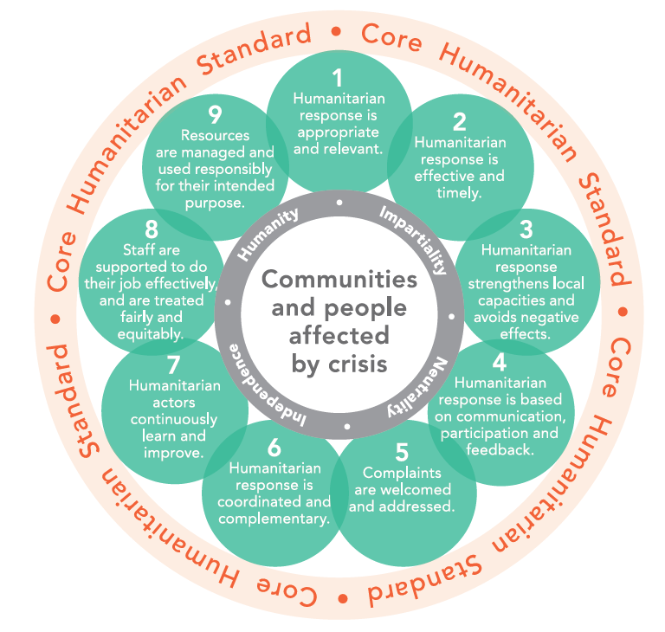
Core Humanitarian Standard
Consensus document setting the 9 principles to help humanitarian actors improve the quality and effectiveness of humanitarian action
Notes:
Core humanitarian standard on quality and accountability. Geneva: HAP International, People in Aid and the Sphere Project; 2014 (https://corehumanitarianstandard.org/files/files/ CHS%20in%20English%20-%20book%20for%20printing.pdf, accessed 26 April 2020).

Slide 7
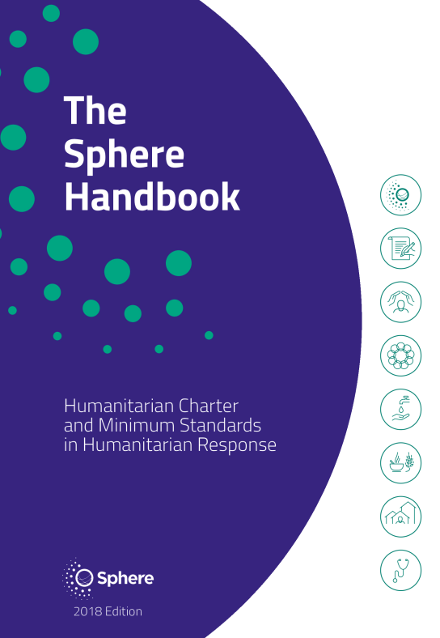
The Sphere Handbook
Main humanitarian guidance documents
Created by a broad group of humanitarian actors, accepted by most humanitarian agencies
Includes the Humanitarian Charter – outlines ethical and legal foundations of humanitarian action, and the Minimum Standards in the Humanitarian Response
Standards have been adopted by UN and other agencies
Main sources for key actions and indicators in the operational guide
Link
Notes:
The Sphere handbook: humanitarian charter and minimum standards in humanitarian response. Geneva: Sphere Association; 2018 (https://spherestandards.org/handbook-2018/, accessed 26 April 2020).

Slide 8
Effective Coordination in Humanitarian Emergencies
“Humanitarian coordination involves bringing together humanitarian actors to ensure a coherent and principled response to emergencies. The aim is to assist people when they most need relief and protection. Humanitarian coordination seeks to improve the effectiveness of humanitarian response by ensuring greater predictability, accountability, and partnership.”
Effective coordination is essential, yet challenging
Variations in approaches and perceived priorities among humanitarian actors
Importance of system-wide coordination for quick and efficient assistance
The coordination section guides you in setting up and participating effectively in coordination structures during humanitarian emergencies

Slide 9
The four interconnected programmatic action areas of the operational guide
❶ COORDINATE
How to take a coordinated approach to child and adolescent health in a humanitarian emergency
❷ ASSESS & PRIORITISE
How to obtain data on child/adolescent health (via needs assessment) and use it to prioritize actions
❸ RESPOND
How to plan and enact a coordinated set of activities addressing the identified child and adolescent health priorities
❹ MONITOR, EVALUATE & REVIEW
How to use data systems to review and improve child and adolescent health-related activities

Slide 10
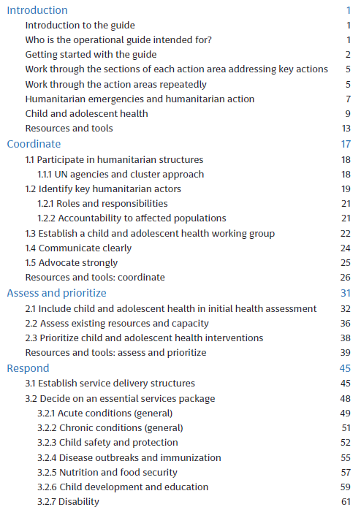
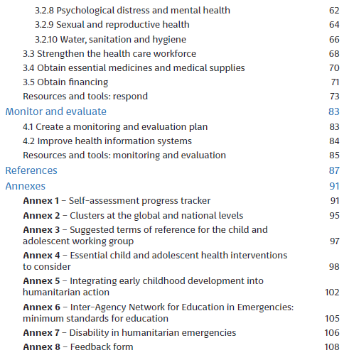

Slide 11
Coordinate – how to take a coordinated approach to child and adolescent health in a humanitarian emergency

Slide 12
1. Participate in humanitarian structures

Slide 13
Participate in humanitarian structures
To integrate child and adolescent health into humanitarian action effectively, governments and organizations must be able to navigate humanitarian structures
Global level
Inter-Agency Standing Committee (IASC)
Coordinates humanitarian action and is headed by the Emergency Relief Coordinator
Composed of UN agencies and international NGOs
Responsible for coordinating key agencies assigning responsibilities and sharing resources and information
Designates responsibility using a cluster approach

Slide 14
Cluster approach
A cluster approach may be used in humanitarian emergencies
The cluster approach is activated by the Emergency Relief Coordinator (ERC) at the request of the Humanitarian Coordinator, with the endorsement of the inter-agency standing committee (IASC) principals
All clusters have lead organisations, Cluster Lead Agencies, operating at the global and country levels
The cluster system spreads accountability for the delivery of services (health, shelter, etc) across different cluster lead agencies
Clusters are groups of humanitarian UN and non-UN organizations in each of the main sectors of humanitarian action (water, health, shelter, logistics etc)
They are designated by IASC and have clear responsibilities for coordination
Aim: to build capacity of national systems to respond to humanitarian situations with a protection and accountability lens and progressively hand over coordination to local entities
Notes:
Cluster Approach | UNHCR

Slide 15
Clusters and global lead agencies for humanitarian action
Notes:
IASC reference module for cluster coordination at the country level. Geneva: Inter- Agency Standing Committee; 2015 (https://interagencystandingcommittee.org/iasc-transformative-agenda/iasc-reference-module-cluster-coordination-country-level-revised-july-2015, accessed 22 January 2024).

Slide 16
Participate in humanitarian structures
To integrate child and adolescent health into humanitarian action effectively, governments and organizations must be able to navigate humanitarian structures
National level
Clusters are only activated by IASC when existing structures are unable or unwilling to meet the needs of a particular humanitarian emergency
In-country clusters are intended to be a temporary coordination solution with handover to local authorities as soon as feasible
United Nations Office for the Coordination of Humanitarian Affairs (UN OCHA) or national government usually oversees all clusters

Slide 17
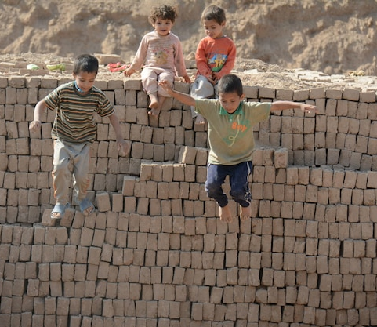
Participate in humanitarian structures
Humanitarian emergencies attract a wide range of actors
Governance structures may not always be clear, especially in the early stages of an emergency
Clusters should go beyond information sharing and make coordinated decisions about resources, activities, and strategic direction
A RMNCAH/child and adolescent health working group can fulfil the role of health cluster, preferably led by the ministry of health

Slide 18
Key actions – humanitarian structures
Identify and communicate - Contact the leading health cluster organization (national or subnational) to coordinate activities - Share your work areas and offer coordination support
Support coordination - Assist in establishing a coordination mechanism if existing ones are lacking or weak
Conduct coordination meetings - Conduct regular coordination meetings at different levels involving health-related organizations
Share information - Regularly share updates and bulletins, involving all health-related organizations
Notes:
Adapted from the Sphere Health Standards

Slide 19
Key indicator – humanitarian structures
Your organization is connected with the health sector/cluster in your region, actively communicates with partners and contributes to health (and other) sector/cluster updates

Slide 20
2. Identify key humanitarian actors

Slide 21
Identify key humanitarian actors
Most important actors: affected communities and individuals
Local community: health facilities, schools, civil society groups
Government: ministries of health, other ministries, district health directors
Local NGOs
Interagency: IASC, IAWG, International Military, SCHR
UN: UNOCHA, WHO, UNICEF, UNDP, UNFPA, UNHCR, WFP, UNRWA, OHCHR, FAO, UN-Habitat, Department of Peace Operations
International NGOs: CARE International, Caritas, ICRC, IFRC, MSF, IRC, Save the Children, World Vision, Oxfam, Islamic Relief, and more

Slide 22
Roles and responsibilities of major actors in the humanitarian field
UN Agencies: Coordination and technical expertise
Governments: Main responsibility for population protection, coordination, implementation, funding, local expertise
Local Community and NGOs: Main providers of humanitarian action, staff, local expertise
International NGOs: Implementation, coordination in specific areas, staff, technical expertise, advocacy and resource mobilisation

Slide 23
Accountability to Affected Populations
Taking Account: Enabling input from affected populations
Giving Account: Providing information on actions and reasons
Being Held to Account: Allowing communities to assess the quality of the response

Slide 24
Inter-Agency Standing Committee (IASC) Commitments on Accountability to Affected Populations
Leadership/Governance
Transparency
Feedback and Complaints
Participation
Design, Monitoring, and Evaluation
- Integrate feedback and accountability mechanisms into all aspects: strategies, proposals, monitoring, evaluations, recruitment, and reporting.
- Provide accessible and timely information to affected populations.
- Facilitate dialogue for informed decisions.
- Actively seek views of affected populations to improve policy and practice.
- Streamline robust feedback and complaint mechanisms.
- Enable active involvement of affected populations in decision-making processes.
- Establish clear guidelines for engagement and representation of marginalized groups.
- Engage affected populations in designing, monitoring, and evaluating program goals.
- Report and learn from the process to improve outcomes.

Slide 25
Key actions – humanitarian actors
Identify and engage partners - Identify and reach out to partners within child and adolescent health
- Work collaboratively to establish common systems and prevent duplication
Integrate Core Humanitarian Standards - Integrate the Core Humanitarian Standards into your operations
- Utilize these standards to hold yourselves (and others) accountable for humanitarian engagement

Slide 26
Key indicator – humanitarian actors
Health sector leads have identified and connected with the health sector lead agency and partners in child and adolescent health, and are committed to working together.

Slide 27
3. Establish or strengthen an RMNCAH/CAH working group

Slide 28
Establish or strengthen an RMNCAH/CAH working group
Importance of interagency RMNCAH/CAH working group: essential for effective and cooperative integration of RMNCAH/CAH activities into humanitarian action
Should operate under the health cluster
WHO and MoH are accountable for RMNCAH/CAH activities and should nominate a leading agency(ies) for the working group
Can be led by government bodies, local or international NGOs, or UN agencies collaborating effectively with MoH
Include members from various sectors/clusters (nutrition, protection, WASH, education) due to cross-cutting issues related to child and adolescent health
Important to coordinate activities locally and provide feedback, linked to both local health authorities and the national RMNCAH/CAH working group
Notes:
This working group may or may not include reproductive and maternal health (i.e. RMNCAH working group). It may be called a different name. For consistency, RMNCAH/CAH working group is used throughout the operational guide.

Slide 29
Key actions – working group
Identify lead agency(ies) to lead the RMNCAH/CAH working group
Establish working group at your level - Determine composition, including civil society members and young people
- Develop ToRs and roles
- Develop a plan for working group meetings, communication, and coordination with other humanitarian responders
Liaise with stakeholders - Clarify roles and integrate RMNCAH/CAH priorities into the humanitarian response plan
Engage partners and contribute updates - Meet regularly and contribute to health and other cluster/sector updates
Notes:
Adapted from the Sphere Health Standards

Slide 30
Key indicators – working group
At the onset of an emergency response, a national RMNCAH/CAH working group has been established (under the health cluster) with a nominated group lead and clear terms of reference. Subnational RMNCAH/CAH working groups have been established where needed.
The RMNCAH/CAH working groups meet regularly and communicate their activities with other agencies, clusters/sectors and the community
RMNCAH/CAH issues are fully included in humanitarian response plans

Slide 31
4. Communicate clearly

Slide 32
Communicate clearly
Effective communication strategies require an understanding of the situation, affected people, current response efforts, and available communication channels
It is important to address the needs and capacities of children in communication strategies
Useful Tool: UNICEF's Communication for Humanitarian Action Toolkit (CHAT) provides useful tools

Slide 33
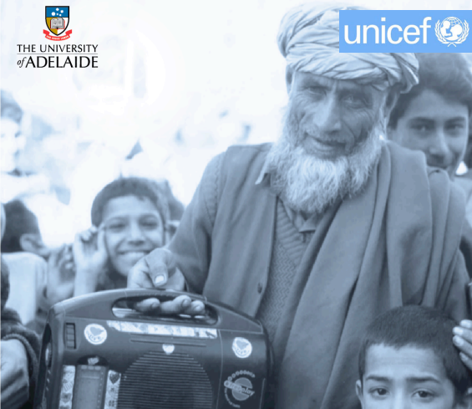
Communication for humanitarian action toolkit (CHAT) principles
Be prepared and communicate now
Work with partners and coordinate communication activities
Engage with communities
Build an evidence base through formative research
Promote awareness and action
Wherever possible, test your approach
Assess your impact
Notes:
Communication for Humanitarian Action Toolkit. New York: United Nations Children’s Fund; 2015 (https://aa9276f9-f487-45a2-a3e7-8f4a61a0745d.usrfiles.com/ugd/aa9276_a19c92905a944ce8b47eed1d9bee4ce2.pdf, accessed 22 January 2024).

Slide 34
Key actions – communication
Communicate - Communicate urgent messages to the affected population now – do not delay
Develop a communication strategy
- Assess the current situation to identify priorities, target populations and existing communications
- Involve children and young people
Coordinate Coordinate CAH-related health messages between agencies and sectors
Notes:
Adapted from the CHAT handbook

Slide 35
Key indicators – communication
The RMNCAH/CAH working group, and individual organizations, have
developed a communication strategy and are working together to implement it

Slide 36
5. Advocate strongly

Slide 37
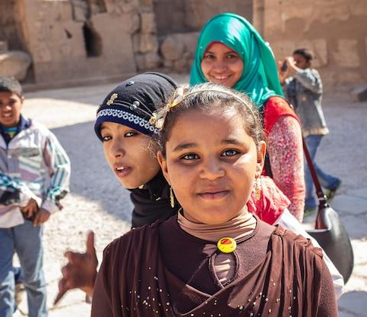
Advocate strongly
Advocate to decision-makers about the benefits of effective coordination
Target audience: government, NGOs, UN agencies, community leaders, donors, and health managers at all levels (local, national, global)
Be an effective change agent
Advocate for the health needs of children and adolescents to decision-makers
Engage children, adolescents, and parents

Slide 38
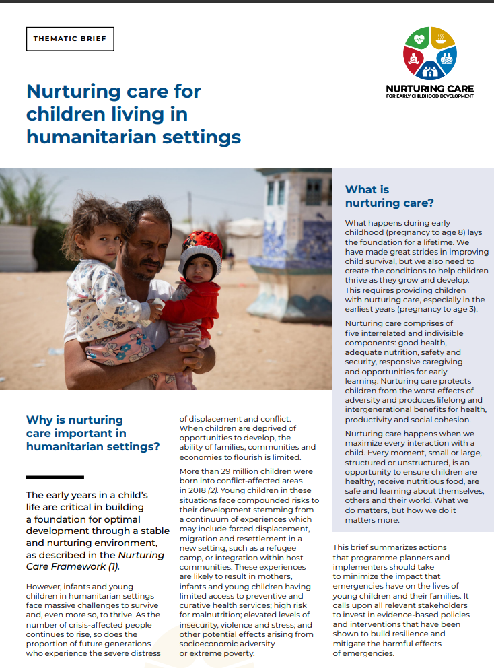
Nurturing care for children living in humanitarian settings
Humanitarian standards vary in their intention to children and their caregivers
In 2021 a thematic brief was launched to shed light on the need to better ensure children in humanitarian settings receive nurturing care
The brief summarizes what programme planners and implementers can do to minimize the impact that emergencies have on the lives of young children and their families
Notes:
Nurturing care for children living in humanitarian settings (nurturing-care.org)

Slide 39
Key actions – advocacy
Take the lead
- RMNCAH/CAH working group takes the lead in advocating for CAH in humanitarian settings
Work together - Health leaders / agencies in CAH work together to advocate for the needs of children and adolescents, including:
human rights, data, prioritization, funding, community, participation
Notes:
Adapted from the CHAT handbook

Slide 40
Key indicators – advocacy
The RMNCAH/CAH working group, and individual organizations, work together to advocate for the health needs of children and adolescents

Slide 41
Resources – Coordinate
Core Humanitarian Standard on Quality and Accountability. Geneva: HAP International, People in Aid and the Sphere Project; 2014 (https://corehumanitarianstandard.org/language-versions)
Health cluster guide: a practical handbook. Geneva: World Health Organization; 2020. Licence: CC BY-NC-SA 3.0 IGO’ (https://fctc.who.int/publications/i/item/9789240004726)
IASC Operational guidance for cluster lead agencies on working with national authorities. Geneva: Inter-Agency Standing Committee; 2011 (https://reliefweb.int/report/world/operational-guidance-cluster-lead-agencies-working-national-authorities-july-2011)
Reference module for cluster coordination at country level. Geneva: Inter-Agency Standing Committee; 2015 (https://interagencystandingcommittee.org/iasc-transformative-agenda/iasc-reference-module-cluster-coordination-country-level-revised-july-2015.

Slide 42
Tools – Coordinate
Humanitarian ID: Personalized ID for humanitarian workers, granting access to contact lists and platforms like Humanitarian Response and ReliefWeb.
Humanitarian Response: Central website for humanitarian tools and services, enabling information exchange among operational responders during emergencies. Provided by UN OCHA.
ReliefWeb: Leading source for global crises and disasters information, offering reports, maps, infographics, and videos. Provided by UN OCHA.
Humanitarian Data Exchange (HDX): Open platform for sharing humanitarian data, aiming to make it easily accessible for analysis. Provided by UN OCHA.
NGO Coordination Resource Centre: One-stop-shop for nongovernmental organizations during humanitarian emergencies. Provided by the International Council of Voluntary Agencies.
Accountability to Affected Populations: Tools to assist in implementing the IASC AAP commitments.
Operational Guidance on Accountability to Affected Populations (AAP): Health Cluster's guidance from August 2017.
Communicating Risk in Public Health Emergencies: WHO guideline for emergency risk communication (ERC) policy and practice.
Communication for Humanitarian Action Toolkit (CHAT): Toolkit by United Nations Children’s Fund containing strategy tool, survey tool, and additional useful information.
Behaviour Change Communication in Emergencies: Toolkit by UNICEF for behavior change communication during emergencies.
Using Social Media for Crisis Engagement: Guide by ICRC, IFRC, and UN OCHA on utilizing social media for engaging affected populations.

Slide 43
Thank you
For more information, please contact: Khalid Siddeeg, Regional Advisor EMRO, siddeegk@who.int Kim Beentjes, Technical Officer EMRO, beentjesk@who.int

