Slide 1
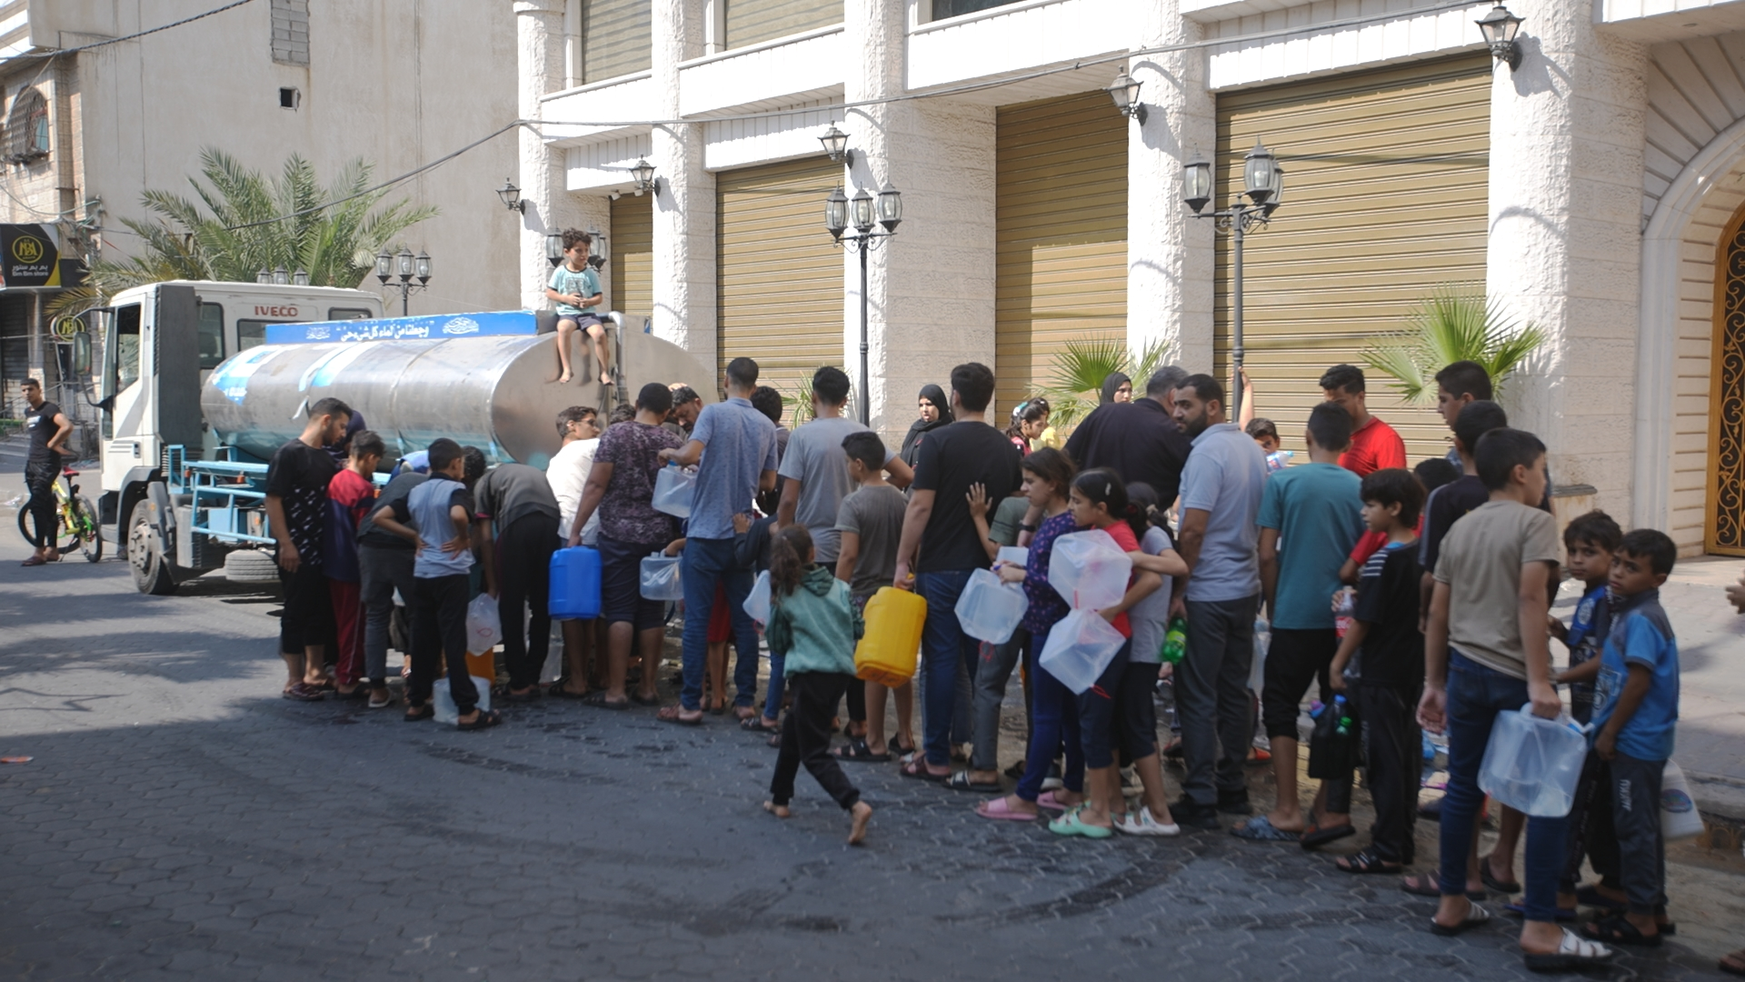
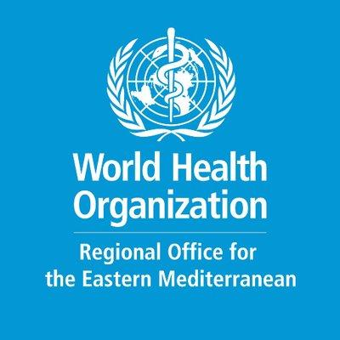
Module 2: Assess and prioritize

Slide 2
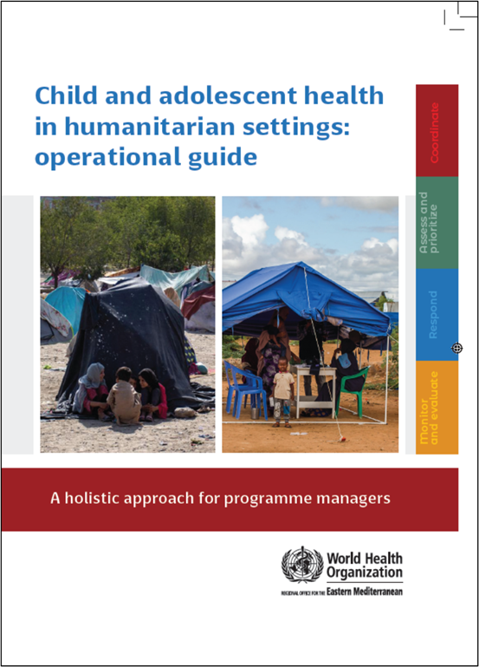
Child and adolescent health in humanitarian settings: operational guide
Notes:
Child and adolescent health in humanitarian settings: operational guide: a holistic approach for programme managers (who.int)
The Operational Guide is a synthesis of existing guidance, not a new guideline or a program (Figure 1). It incorporates existing standards and guidance documents, and presents them as a simple, systematic approach, together with links to tools and resources to support action. The Operational Guide complements existing humanitarian frameworks, and child and adolescent health strategies, including WHO’s regional implementation framework. It is a companion to existing guides on newborn, and sexual and reproductive health in humanitarian emergencies.
Audience:
Health sector and other sectors
Government and non-government (NGOs, UN agencies, funding agencies)
National and sub-national
Providing such breadth of guidance to such a broad audience is challenging, and has required careful balancing.
We wanted something that was as simple as possible, as we know users don’t have time to wade through hundreds of pages. We also wanted to make sure that it covered all the essentials for CAH programming in emergencies.
We wanted to include general guidance for a non-specialist audience, but also provide enough specifics that users could take clear actions.
We wanted to provide clear action-oriented guidance, but we also wanted it to be flexible enough for different users to use is very different situations.
So hopefully you will find the operational guide to be practical and useful for your CAH programming. But it won’t give you everything you need, and you will always need to adapt the guidance to your context.

Slide 3
The four interconnected programmatic action areas of the operational guide
❶ COORDINATE
How to take a coordinated approach to child and adolescent health in a humanitarian emergency
❷ ASSESS & PRIORITISE
How to obtain data on child/adolescent health (via needs assessment) and use it to prioritize actions
❸ RESPOND
How to plan and enact a coordinated set of activities addressing the identified child and adolescent health priorities
❹ MONITOR, EVALUATE & REVIEW
How to use data systems to review and improve child and adolescent health-related activities

Slide 4
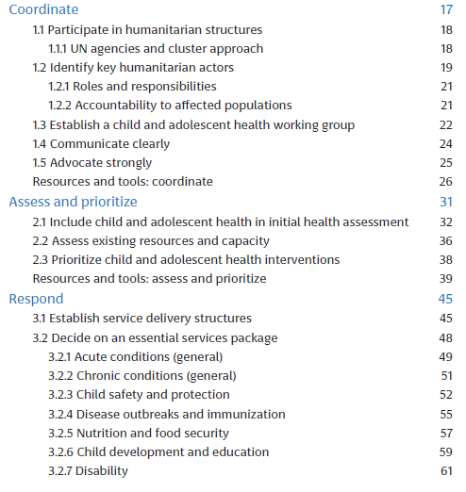
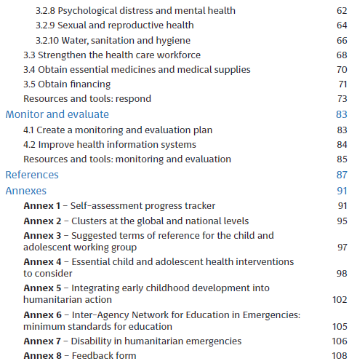

Slide 5
Assess and prioritize

Slide 6
1. Include child and adolescent health in initial health assessment

Slide 7
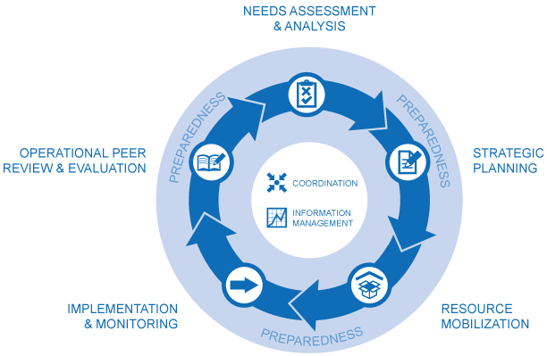
Humanitarian program cycle
Humanitarian emergencies are complex and chaotic
Key agencies should initiate a coordinated needs assessment at the start of a humanitarian emergency, including:
Assess how the situation may evolve
Identify gaps in response
Assess operational constraints
Notes:
OCHA services. Humanitarian response. Humanitarian Programme Cycle [website]. New York: United Nations Office for the Coordination of Humanitarian Affairs (https://www.ochaopt.org/coordination/hpc, accessed 29 January 2024).

Slide 8
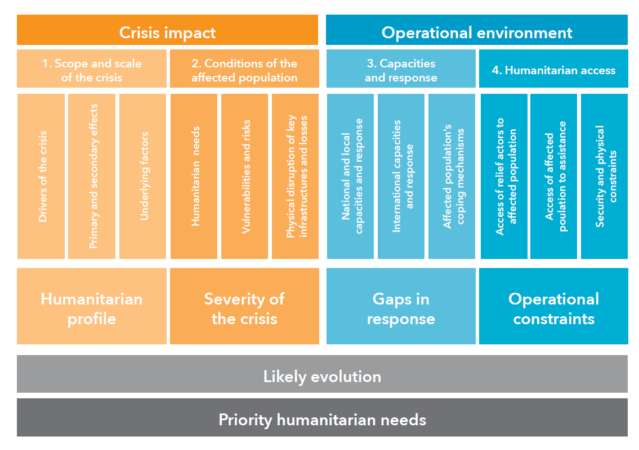
Components of a needs assessment
Careful, coordinated assessment of the situation and ongoing monitoring of the response and changing needs is critical to effective humanitarian action
Needs assessment should consider:
Crisis impact
Scope and scale crisis
Conditions affected population
Operational environment
Capacities and response
Humanitarian access
Notes:
Tool. Multi-sector initial rapid assessment (MIRA). Geneva: Inter-Agency Standing Committee; 2015 (https://interagencystandingcommittee.org/sites/default/files/migrated/2019-02/mira_manual_2015.pdf, accessed 29 January 2024).

Slide 9
Ten principles for conducting needs assessments
National leadership: Promote national and local government leadership in assessments for ownership
Preparedness planning: Incorporate assessments into emergency preparedness plans
Data utilization: Build assessments on existing CAH data, e.g. national demographic surveys and prior emergency response reports
Alignment with monitoring: Ensure a link between assessments and ongoing monitoring efforts
Data relevance: Collect data directly relevant to decision-making
Inclusive approach: Involve all stakeholders, utilizing technology, including social media, to engage with young people
At-risk groups: Address priority needs and groups, such as gender, age, disability, unaccompanied minors, and ethnic minorities
Information management: Implement effective information management strategies
Context analysis: Include an analysis of the overall context
Long-term perspective: Conduct assessments with an eye toward future recovery and development activities
Notes:
Guideline. Coordinated assessments in humanitarian crises. Geneva: Inter-Agency Standing Committee; 2012 (https://interagencystandingcommittee.org/system/files/legacy_files/operational_guidance_for_coordinated_assessments_in_humanitarian_crises.pdf, accessed 26 April 2020).

Slide 10
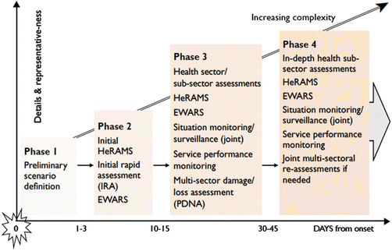
Coordinated assessment and phases in humanitarian crisis IASC operational guidance
The rapid health assessment will address:
Health status and risks
Health resources and service availability
Health system performance (including coverage, quality, access and utilization)
HeRAM: Health Resources Availability Monitorining System
EWARS: Early Warning, Alert, and Response System
PNDA: Post Disaster Needs Assessment
Notes:
Guideline. Coordinated assessments in humanitarian crises. Geneva: Inter-Agency Standing Committee; 2012 (https://interagencystandingcommittee.org/system/files/legacy_files/ operational_guidance_for_coordinated_assessments_in_humanitarian_crises.pdf, accessed 26 April 2020).
HeRAM: Health Resources Availability Monitorining System
EWARS: Early Warning, Alert, and Response System
PNDA: Post Disaster Needs Assessment

Slide 11
Role of the RMNCAH/CAH working group and individual agencies in the assessment stage
Active participation ensure that children and adolescents are counted and assessed accurately
Age disaggregation including newborns, < 5 years, 5–9 years, 10–14 years, and 15–19 years
Integration broader needs assessment activities
integrate child and adolescent needs within broader assessments

Slide 12
Specific CAH vulnerabilities and risks
Young children
(<5 years old)
Girls
Undocumented migrants, unaccompanied and separated children
Children and adolescents from ethnic or religious minority populations
Children and adolescents with disability or chronic health conditions
Child and adolescent caregivers or primary income earners
Children and adolescents in the armed forces (and ex-combatants) or justice system
Children and adolescents in forced or exploitative labour, including sex work
Child and adolescent survivors of physical, sexual and emotional abuse

Slide 13
Issues to consider for children at risk
Violence, trauma
Food insecurity, undernutrition
Disease outbreaks
Uncontrolled endemic disease
Mental health and psychological well-being
Gender
Age

Slide 14
Common data collection tools for humanitarian emergencies
Data collection method | Comments
IASC Multi-sector initial rapid assessment (MIRA) tool (26) | MIRA is the coordinated approach to overall assessment of a crisis situation, and is led by OCHA. It includes the rapid health assessment which is led by the health cluster.
WHO Health Resources Availability Monitoring System (HeRAMS) (27) | HeRAMS is a tool for initial assessment and ongoing monitoring of human resources for health, and is used by the health cluster.
WHO service availability and readiness assessment (SARA) (28) | SARA is an alternative tool for cross-sectional assessment of health service availability and readiness.
WHO rapid risk assessment (29) | Rapid risk assessment guides the initial rapid assessment of acute public health events.
WHO Early Warning and Response System (EWARS) (30) | EWARS is a system for early detection of crises. (See also action area 3 – Monitor, Evaluate, Review)
3W/4W/5W (31) | This tool assesses humanitarian response: who, what, when, where, and for whom.
WHO strategic tool for assessing risk (32) | The WHO strategic tool for assessing risk is mainly used for planning (preparedness).
SMART nutrition assessment (33) | SMART is a method for rapid assessment of nutrition in emergencies.
Notes:
IASC reference module for cluster coordination at the country level. Geneva: Inter- Agency Standing Committee; 2015 (https://www.humanitarianresponse.info/sites/www.humanitarianresponse.info/files/documents/files/cluster_coordination_reference_ module_2015_final.pdf, accessed 26 April 2020).

Slide 15
Key actions – needs assessment (1/2)
Review data - Members of the RNMCAH/CAH working group review the OCHA risk profile, all hazards response plans and other relevant information sources
Context assessment: Contribute to a systematic, objective, and ongoing assessment of the context and stakeholders (intersectoral)
- The RMNCAH/CAH working group coordinates input
- Advocate for disaggregation of data by sex and age
- Use pre-existing data as much as possible
For more details, please refer to the operational guide
Notes:
Adapted from the Sphere Health Standards

Slide 16
Key actions – needs assessment (2/2)
Assess safety and security - Focusing on children and young people, to identify threats, violence and human rights violations
- Consider using the child protection rapid assessment toolkit
Consider gender impact
- Consider gender roles/norms/stereotypes affecting children’s and adolescent’s experience of and response to a crisis
Share findings widely - Use multiple communication channels and share with affected populations as well
Notes:
Adapted from the Sphere Health Standards
- Child protection rapid assessment toolkit. Geneva: Global Protection Cluster, Child Protection Working Group; 2012 (https://resourcecentre.savethechildren.net/library/child-protection-rapid-assessment-toolkit, accessed 26 April 2020).

Slide 17
Key indicator – needs assessment
The health sector lead agency has conducted an initial rapid assessment, with active involvement of the RMNCAH/CAH working group.

Slide 18
2. Assess existing resources and capacity

Slide 19
Rapid assessment of health needs and response capacity
The rapid assessment offers a preliminary understanding of needs and response capacity
To gain a more comprehensive view, the health cluster and RMNCAH/CAH working group should conduct an in-depth assessment of health service resources and capacity

Slide 20
Key actions – health service assessment (1/2)
Coordinate CAH assessment The RMNCAH/CAH working group coordinates additional CAH assessment in collaboration with the health cluster lead and information management group
Review policies and protocols - Avoid duplication and conflicting recommendations with existing programs and protocols
- Facilitate government-NGO communication through UN if necessary
Update CAH guidelines and tools - Review and update CAH clinical guidelines, health promotion materials, and training tools
- Collaborate with government, UN agencies, and NGOs when creating new resources
Notes:
Adapted from the Sphere Health Standards

Slide 21
Key actions – health service assessment (2/2)
Health facility assessment - Map existing facilities, assess capacity, CAH services, and damage by using HeRAMS, SARA, 3W/4W, or field tools
Evaluate staffing and competency in all essential CAH services and document the number and type of skilled health providers and facilities
Access medicines and supplies: review essential medicines and procurement procedures
Create service map for coordination and decision-making and share it with decision-makers, partners and the community
For more details, please refer to the operational guide
Notes:
Adapted from the Sphere Health Standards

Slide 22
Key indicators – health service assessment
The RMNCAH/CAH working group has prepared a plan (with the health cluster
lead) to conduct additional assessments of CAH needs and response capacity.
The plan includes a timeline of activities and designates responsibility.
The RMNCAH/CAH working group has helped the health cluster lead to create
and disseminate a service map.

Slide 23
Elements of a service map
Geographical locations. Existing health care networks for RMNCAH/CAH.
Distances from affected communities. Distances between peripheral RMNCAH/CAH health facilities and larger hospitals.
Transport options between locations, and potential access issues (e.g. security risks, safety issues and cultural factors).
Communications systems (e.g. telephone and Internet).
RMNCAH/CAH services provided (preventative and curative). Medicines and medical supplies. Costs.
Staff-to-patient ratios

Slide 24
3. Prioritize child and adolescent health interventions

Slide 25
Health needs and prioritization of actions for humanitarian responders
01
02
03
04
Adaptable prioritization: prioritize to minimize suffering and adapt to changing contexts
High-risk groups: focus on vulnerable child and adolescent populations
Efficient resource use: balance the desire for more services with the need to reach more people within available resources
RMNCAH/CAH working group’s role: assist the lead health agency in prioritizing services
Notes:
This working group may or may not include reproductive and maternal health (i.e. RMNCAH working group). It may be called a different name. For consistency, RMNCAH/CAH working group is used throughout the operational guide.

Slide 26
Key actions – prioritization (1/2)
Coordinated prioritization
- The health cluster lead coordinates the systematic prioritization of health services and activities
- Advocacy by the RMNCAH/CAH working group for newborn, children and adolescent health
Data review and prioritization - RMNCAH working group review assessment findings, morbidity and mortality data, and service availability
Prioritize
- The most likely and largest causes of excess morbidity and mortality
- Population groups most affected
- Most effective interventions in reducing morbidity and mortality
- The most feasible interventions
For more details, please refer to the operational guide
Notes:
Adapted from the Sphere Health Standards

Slide 27
Key actions – prioritization (2/2)
Inclusive assessment and strategy development
Assess needs and capacities in hard-to-reach areas and at-risk groups, and develop strategies to include them in the humanitarian response
Access barriers identification and solutions
Identify barriers hindering access to prioritized CAH services, and seek practical solutions to overcome those
Adaptive prioritization
Revisit the prioritization as the response evolved to address changing needs
For more details please refer to the operational guide
Notes:
Adapted from the Sphere Health Standards

Slide 28
Key indicator – prioritization
The RMNCAH/CAH working group and health cluster lead have produced a
document explaining the identified CAH priorities, and disseminate it to health actors

Slide 29
Resources – Assess and prioritize
Guideline. Coordinated assessments in humanitarian crises. Geneva: Inter-Agency Standing Committee; 2012 (https://interagencystandingcommittee.org/system/files/legacy_files/operational_guidance_for_coordinated_assessments_in_humanitarian_crises.pdf).
World Health Organization. Health cluster guide: a practical handbook. Geneva: World Health Organization; 2020. (https://healthcluster.who.int/publications/i/item/9789240004726).

Slide 30
Tools – Assess and prioritize
Health Cluster Tools: Utilize global health cluster tools, including HeRAMS, the initial rapid assessment toolkit, and the UNHCR health information system.
Multi-Sector Rapid Assessment: Refer to the Multi-Cluster/Sector Initial Rapid Needs Assessment (MIRA).
Cluster Surveys: Access Multi-Indicator Cluster Surveys (MICS) by UNICEF.
Public Health Risk Assessment: Use the Rapid Risk Assessment of Acute Public Health Events by the World Health Organization.
Resource Availability Monitoring: Explore the Health Resources Availability Monitoring System (HeRAMS).
Risk Assessment Toolkit: Consider the Strategic Tool for Assessing Risk.
Information Coordination: Employ the 3W/4W/5W system for coordinating information.
Health Service Assessment: Utilize the Service Availability and Readiness Assessment (SARA).
Child Protection Assessment: Access the Child Protection Rapid Assessment Toolkit.
Health Information System: Implement the District Health Information Software (DHIS2).
Disease Outbreak Detection: Use the EWARS system for detecting disease outbreaks.
HIS Toolkit: Find guidance in the Health Information System (HIS) Toolkit by UNHCR.
SMART Methodology: Refer to the SMART Methodology Manual 2.0 for standardized monitoring and assessment.
Newborn Health Field Guide: Access the Newborn Health in Humanitarian Settings Field Guide for newborn assessment tools.

Slide 31
Thank you
For more information, please contact: Khalid Siddeeg, Regional Advisor EMRO, siddeegk@who.int Kim Beentjes, Technical Officer EMRO, beentjesk@who.int

