Slide 1
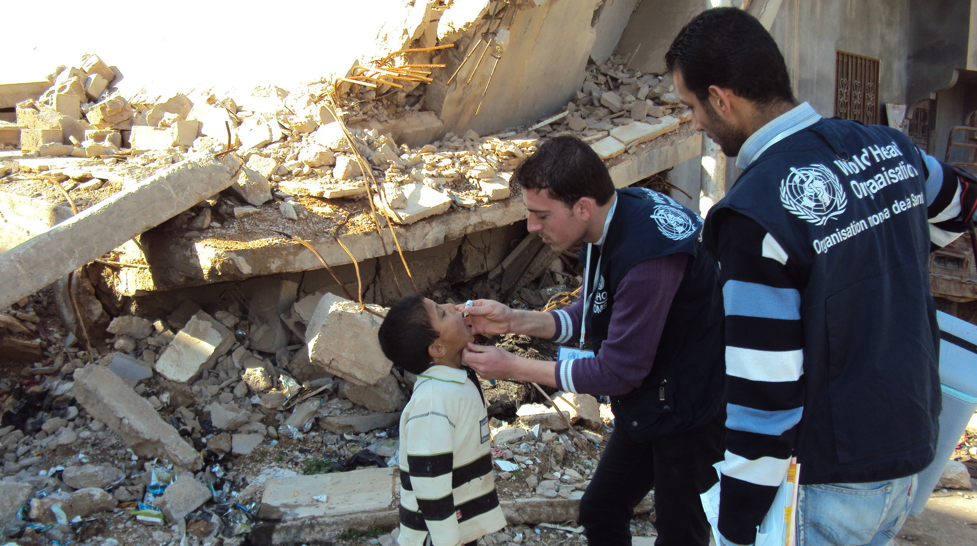


Module 3: Respond (part 2)

Slide 2
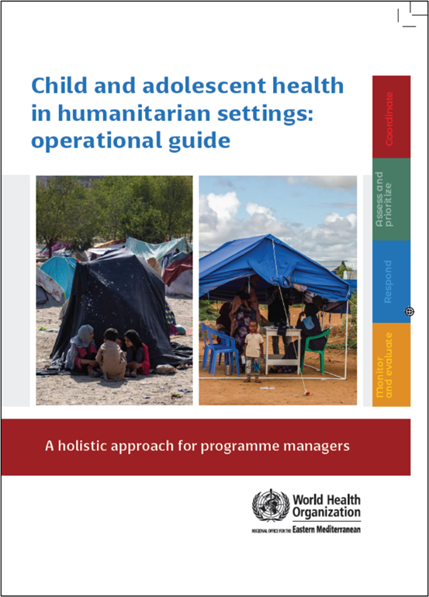
Child and adolescent health in humanitarian settings: operational guide
Notes:
Child and adolescent health in humanitarian settings: operational guide: a holistic approach for programme managers (who.int)
The Operational Guide is a synthesis of existing guidance, not a new guideline or a program (Figure 1). It incorporates existing standards and guidance documents, and presents them as a simple, systematic approach, together with links to tools and resources to support action. The Operational Guide complements existing humanitarian frameworks, and child and adolescent health strategies, including WHO’s regional implementation framework. It is a companion to existing guides on newborn, and sexual and reproductive health in humanitarian emergencies.
Audience:
Health sector and other sectors
Government and non-government (NGOs, UN agencies, funding agencies)
National and sub-national
Providing such breadth of guidance to such a broad audience is challenging, and has required careful balancing.
We wanted something that was as simple as possible, as we know users don’t have time to wade through hundreds of pages. We also wanted to make sure that it covered all the essentials for CAH programming in emergencies.
We wanted to include general guidance for a non-specialist audience, but also provide enough specifics that users could take clear actions.
We wanted to provide clear action-oriented guidance, but we also wanted it to be flexible enough for different users to use is very different situations.
So hopefully you will find the operational guide to be practical and useful for your CAH programming. But it won’t give you everything you need, and you will always need to adapt the guidance to your context.

Slide 3
The four interconnected programmatic action areas of the operational guide
❶ COORDINATE
How to take a coordinated approach to child and adolescent health in a humanitarian emergency
❷ ASSESS & PRIORITISE
How to obtain data on child/adolescent health (via needs assessment) and use it to prioritize actions
❸ RESPOND
How to plan and enact a coordinated set of activities addressing the identified child and adolescent health priorities
❹ MONITOR, EVALUATE & REVIEW
How to use data systems to review and improve child and adolescent health-related activities

Slide 4
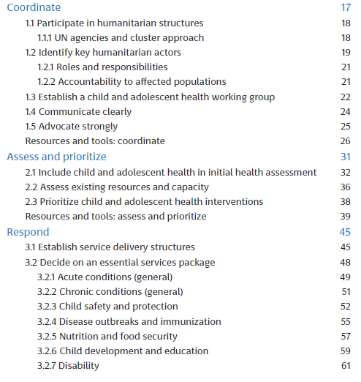
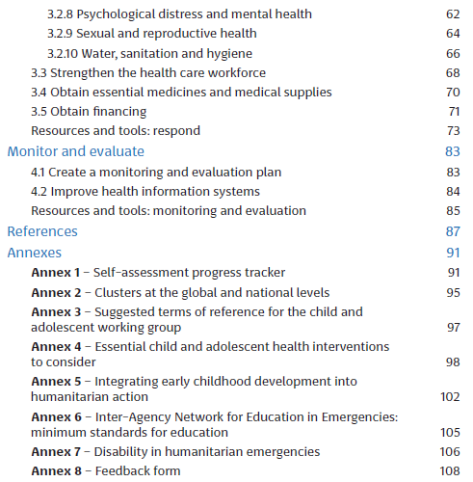

Slide 5
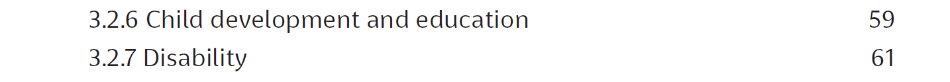
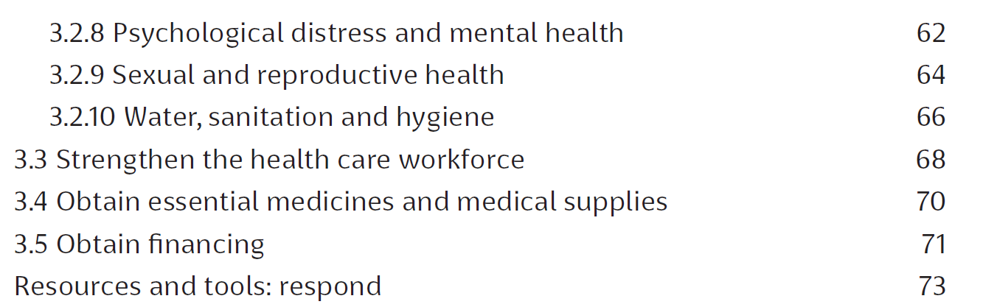
Respond

Slide 6
2. Decide on an essential services package

Slide 7
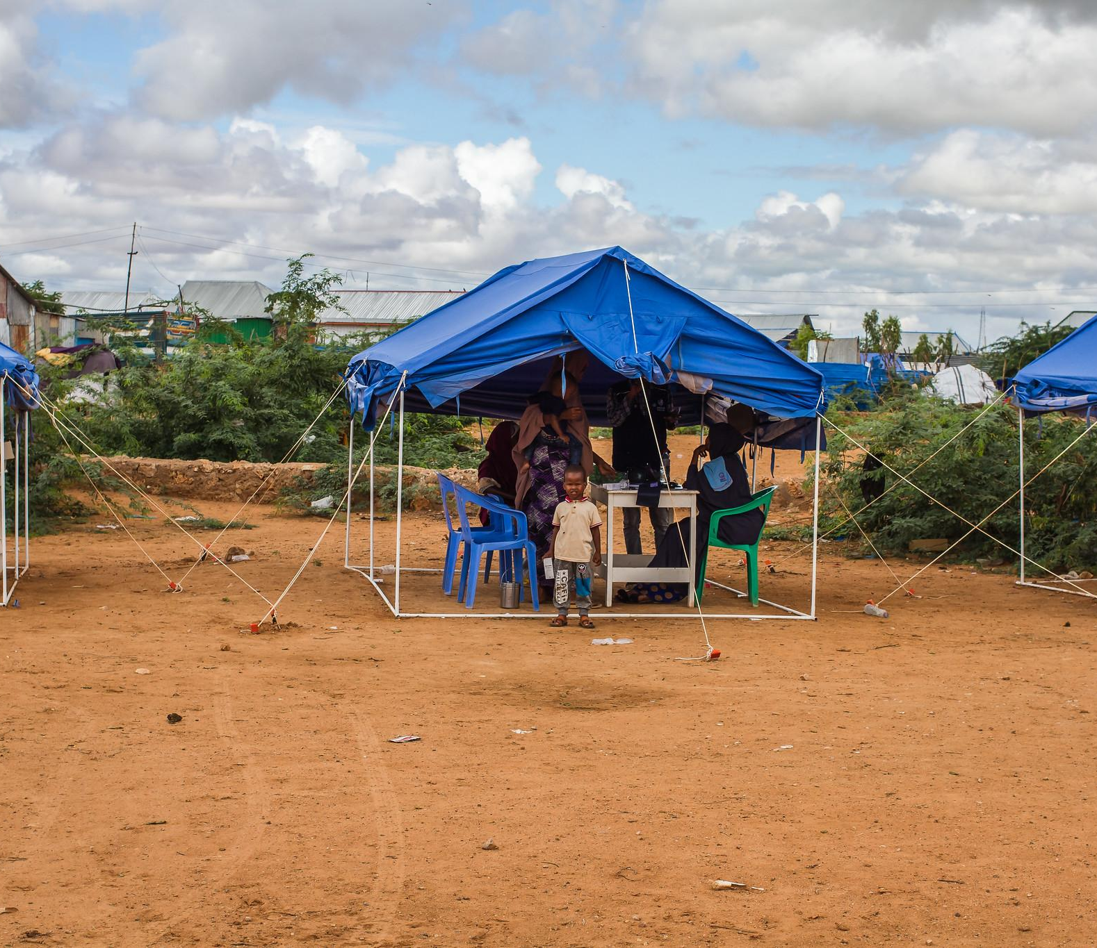
Important CAH fields for an essential service package
2.1 Acute conditions (general)
2.2 Chronic conditions (general)
2.3 Child safety and protection
2.4 Disease outbreaks and immunization
2.5 Nutrition and food security
2.6 Child development and education
2.7 Disability
2.8 Psychosocial distress and mental health
2.9 Sexual and reproductive health
2.10 WASH

Slide 8
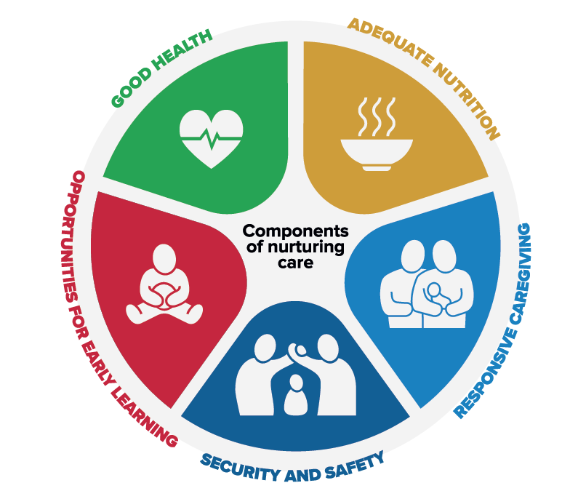

2.6 Child development and education
Nurturing care is essential for child development
Early childhood development (ECD) should be integrated into all humanitarian activities
Children in conflict face compounded risks to their development due to experiences like displacement, migration, and resettlement, which may include integration into new settings like refugee camps or host communities. This could cause toxic stress that affects child development in general.
Scan the QR code to do a puzzle based on this image

Slide 9





Nurturing care components
Good health of children and caregivers
Nurturing care: refers to the conditions needed by children to reach their full potential - keeping children safe, healthy and well nourished, paying attention and responding to their needs and interests, encouraging them to explore their environment and interact with caregivers and others.
Adequate nutrition – maternal and child
Safety and security – children and their families
Opportunities for early learning
Responsive caregiving

Slide 10
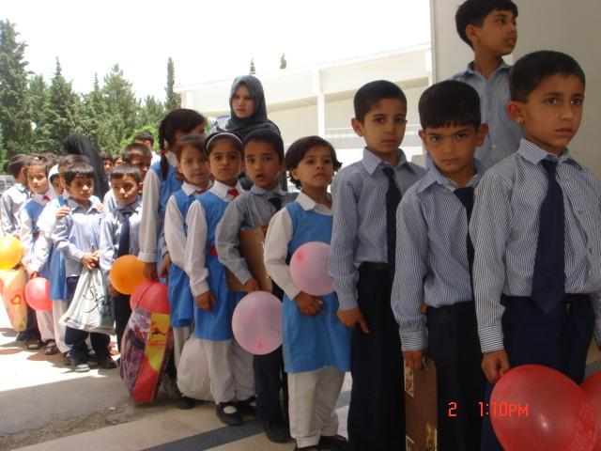
Education and early childhood development
Education is vital during emergencies, sustaining communities
Crucial for development and well-being
Provides physical, psychosocial, and cognitive protection
Enables early identification of at-risk children and those with additional needs
Shields children from dangers like exploitation, early marriage, and involvement in crime
Equips children with problem-solving and critical-thinking skills
Educational venues serve as hubs for delivering essential support (food, WASH education, health services)
Promotes inclusion and equality through equitable access for high-risk groups

Slide 11
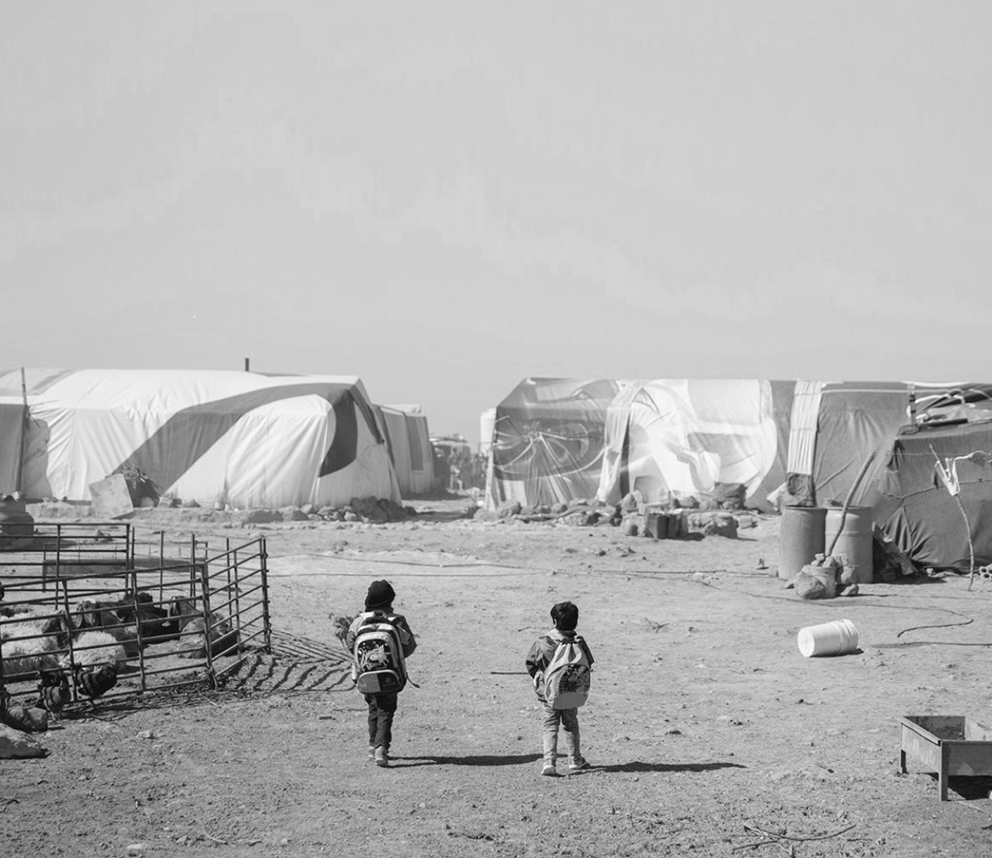
Nurturing care for children living in humanitarian settings – recommendations
Ensure responsive care for infants and children in the first 3 years
Encourage early learning activities with parents and caregivers during the first 3 years
Integrate support for responsive care and early learning into nutrition interventions for infants and young children
Integrate psychosocial interventions for maternal mental health into early childhood health and development services
Actions can be tailored to different phases of emergencies, adjusting interventions based on contextual factors such as duration and type of humanitarian or security issues
Notes:
Nurturing care for children living in humanitarian settings (nurturing-care.org)

Slide 12


Key actions – Child development and education
Integrate nurturing care in humanitarian action
- The RMNCAH/CAH working group collaborates with education and other sectors to integrate nurturing care for all children in humanitarian action (refer to annex 5 and 6)
- Share health promotion messages and information
For more details, please refer to the operational guide

Slide 13


Key indicator – Child development and education
The RMNCAH/CAH working group and lead education cluster agency have regular meetings to strengthen coordination of activities

Slide 14
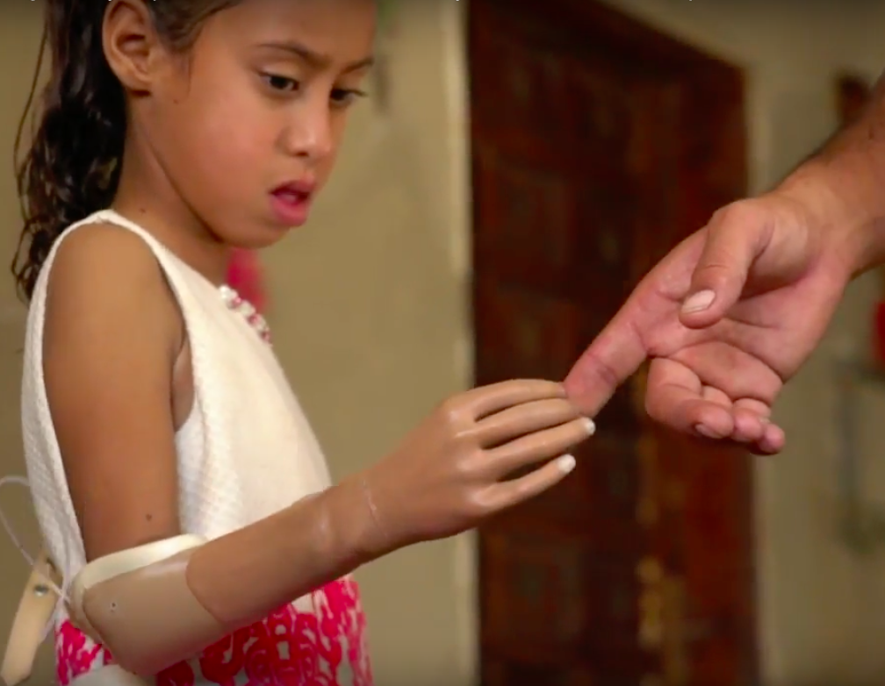
2.7 Disability
Disability is an umbrella term covering impairments, activity limitations, and participation restrictions
During crises, people with disabilities are more likely to be left behind, abandoned or neglected
Disasters and armed conflict increase the number of children and adolescents with disabilities, to increase resilience this should be considered in humanitarian preparedness
Often overlooked, resulting in inaccessible and inappropriate services
Humanitarian agencies must ensure inclusive and appropriate actions for children and adolescents with disabilities
Notes:
General Booklet_Final_interactive_24_10_2017 (unicef.org)

Slide 15
Children and adolescents with disabilities
Disability inclusion is crucial across all stages of humanitarian planning, delivery, and evaluation
Heightened risks when their coping mechanisms and support systems are compromised
Challenges include the loss of assistive devices, medications, and social supports, increasing dependency on caregivers
Accessibility issues, social stigma, and negative attitudes can prevent access to mainstream humanitarian services and food distribution
Particularly vulnerable to abuse and neglect
Consider the role of caregivers with disabilities so they can respond to the needs of their children

Slide 16




Key actions – Disability
Promote disability inclusion
- RMNCAH/CAH working group and partners promote disability-inclusive approaches in all activities (Annex 7)
Include children, adolescents, and families with disabilities in planning
- Promote independence and self-management
Ensure assistive devices are available for children and adolescents with mobility or communication issues
Challenge discriminatory attitudes and promote equity
For more details, please refer to the operational guide
Notes:
Adapted from the Sphere Health Standards

Slide 17
Key indicator – Disability
All health care providers and partner agencies have adopted policies on disability-inclusive action, and are translating these into concrete actions

Slide 18

2.8 Psychosocial distress and mental health in humanitarian settings
Humanitarian emergencies expose children and adolescents to psychosocial traumas such as displacement, food insecurity, and armed violence
Emergencies weaken familial and community supports, escalating the risks of psychosocial issues and exacerbating pre-existing problems
Children of all ages may express distress through developmental regression, anxiety, sleep problems, and changes in behavior both in and out of school

Slide 19
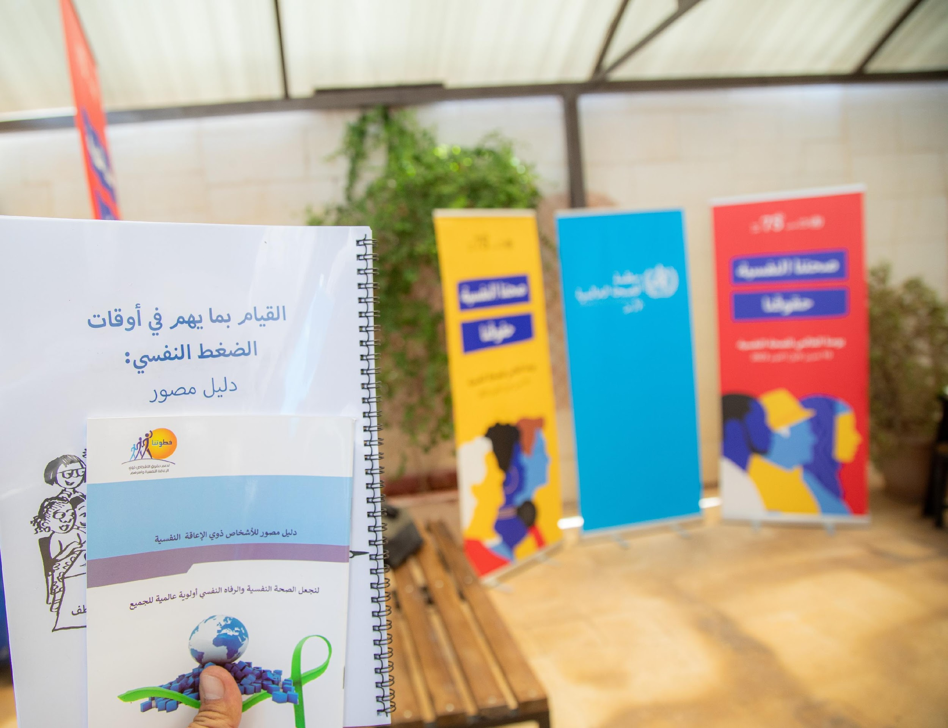
Psychosocial distress and mental health in humanitarian settings
Substance abuse is a significant concern, especially for individuals in the armed forces
Many young people face considerable loss and require support for grief and bereavement
Humanitarian emergencies can unmask, trigger or exacerbate serious mental health problems (depression, anxiety, or post-traumatic stress disorder)

Slide 20




Key actions – Psychosocial distress and mental health
Promote good mental health and wellbeing
- By the RMNCAH/CAH working group and partners work with child protection, education and other sectors
Ensure availability of basic clinical mental health care
- For priority conditions (including depression, anxiety, post-traumatic stress disorder) at every health facility
Protect the rights of people with severe mental health problems
- In the community, hospitals and institutions (e.g. schools and the workplace)
Strengthen pre-existing community networks for psychosocial support to children and adolescents
- Focusing on community networks can provide valuable support to the most vulnerable groups, helping them cope with stress and build resilience
For more details, please refer to the operational guide
Notes:
Adapted from the Child protection standards of the Child Protection Working Group (38)

Slide 21
Key indicator – Psychosocial distress and mental health
The RMNCAH/CAH working group and partners have identified mental health priorities for children, adolescents, and their carers and families, in collaboration with the health cluster
Basic mental health services are available at every facility

Slide 22
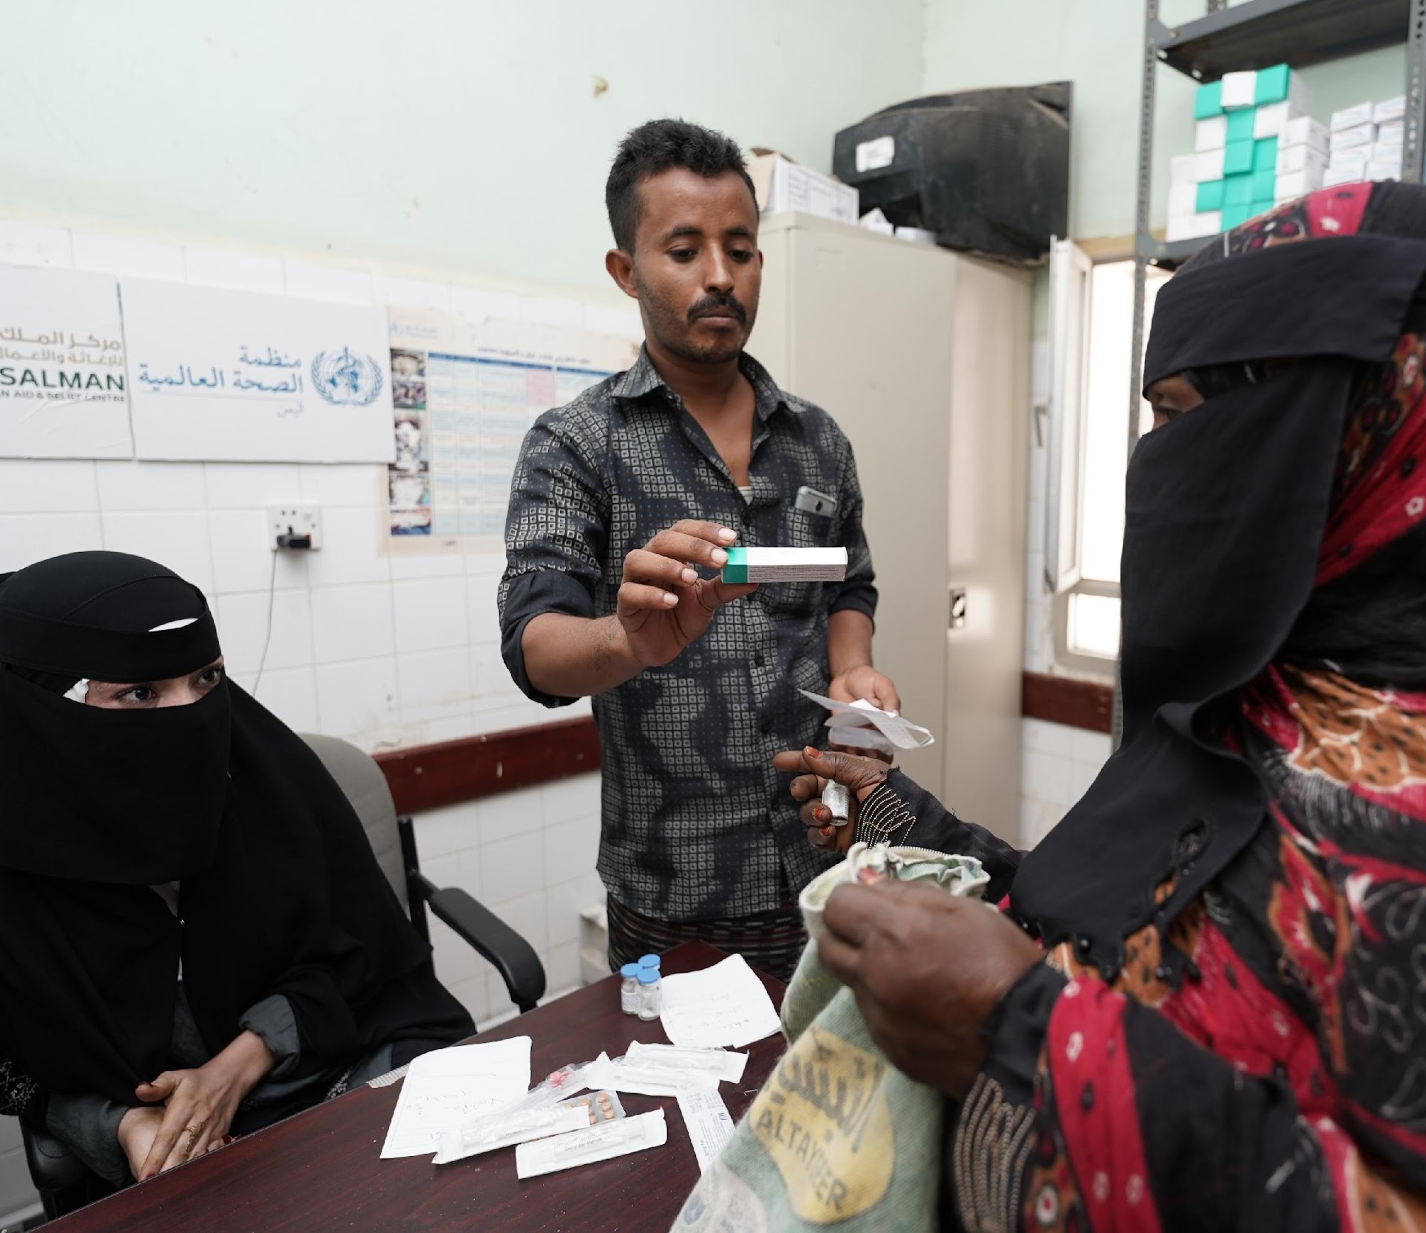
2.9 Sexual and reproductive health
Sexual and reproductive health affects children of all ages
Adolescents require culturally sensitive information for safeguarding their sexual and reproductive health
Children and adolescents face risks of sexual exploitation, violence, and forced marriage, requiring adolescent-friendly support
Pregnant adolescents are of greater risk for complications during pregnancy and childbirth

Slide 23
Sexually transmitted infections and unsafe abortions
50% new HIV infections occur in people aged 15–24 years, and 1/3th of new cases of curable STIs affect people <25 years
Annually, 5 million adolescents (15-18 years) have unsafe abortions, causing 70 000 abortion-related deaths

Slide 24
Children and adolescents increased risks during crisis
Early pregnancy
Unmet need for contraception and unwanted pregnancy
HIV/AIDS and other sexually transmitted infections
Unsafe abortion
Sexual and gender-based violence (in all forms)
Difficulties with the management of menstrual hygiene

Slide 25

Key actions – Sexual and reproductive health (1/2)
Promoting adolescent health
- Collaborate across clusters to establish education and referral services
- Source and procure contraceptive supplies, ensuring availability
- Train community workers for community-based family planning services
Addressing gender-based violence
- Coordinate health sector efforts against sexual violence
- Provide comprehensive care for survivors
- Raise community awareness about gender-based violence
For more details, please refer to the operational guide
Notes:
Adapted from the Minimum Initial Service Package (MISP) for Reproductive Health and Adolescent Sexual and Reproductive Health Toolkit for Humanitarian Settings (47,48)

Slide 26


Key actions – Sexual and reproductive health (2/2)
Enhancing maternal and newborn care for adolescents
- Establish a 24/7 referral system for obstetric emergencies
- Provide adolescent-friendly maternal and newborn care
- Coordinate identification of pregnant adolescents in communities among clusters
Preventing STIs in adolescents
- Provide discreet access to free condoms at adolescent-oriented points
- Establish comprehensive prevention and treatment services for STIs
- Offer care, support, and treatment for people living with HIV
For more details, please refer to the operational guide
Notes:
Adapted from the Minimum Initial Service Package (MISP) for Reproductive Health and Adolescent Sexual and Reproductive Health Toolkit for Humanitarian Settings (47,48)

Slide 27
Key indicators – Sexual and reproductive health
The RMNCAH/CAH working group and partners have developed and communicated a plan to address sexual and reproductive health issues across the lifespan
Gender-based violence programmes have been established, and referral pathways for children and adolescents are available and appropriate
All services, including obstetric and maternity services, are adolescent friendly

Slide 28
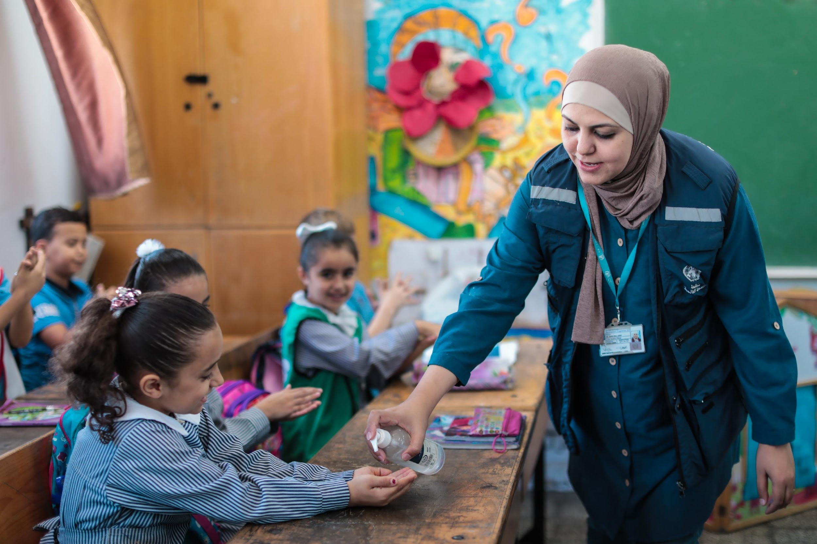
2.10 WASH
Faecal-oral diseases may contribute to over 40% of deaths in the acute phase of an emergency
Overcrowded WASH facilities can be a considerable threat to children’s safety
WASH implementation may enable children and adolescents, especially girls, to attend school
When designing refugee shelter and WASH facilities, ensuring safe access for women and girls is essential
Consider and meet the WASH needs of individuals with disabilities or chronic health conditions

Slide 29
Enhancing public health in humanitarian settings through WASH initiatives
The main objective of WASH programmes in humanitarian settings is to reduce the risk of faecal–oral diseases and exposure to vectors that can carry disease. This is achieved through:
Promotion of good hygiene practices
Provision of safe drinking water
Reduction of environmental health risks
Provision of conditions that allow people to live with health, dignity, comfort and security

Slide 30


Key actions – WASH (1/2)
Collaborate on holistic WASH programs
- RMNCAH/CAH group collaborates on comprehensive WASH with cluster leads
- Implement WHO’s WASH facility improvement tool for health facilities
Engage communities and assess risks
- Engage communities and stakeholders for WASH risks and coping strategies
- Identify public health threats, assess behaviors, and train for monitoring
For more details, please refer to the operational guide
Notes:
Adapted from the Sphere WASH standards (1). See Sphere Standards for detail
World Health Organization and United Nations Children’s Fund. Water and sanitation for health facility improvement tool (WASH FIT). Geneva: World Health Organization; 2018 (https://www.who.int/water_sanitation_health/publications/water-and-sanitation-for-health-facility-improvement-tool/en/, accessed 29 January 2020).

Slide 31
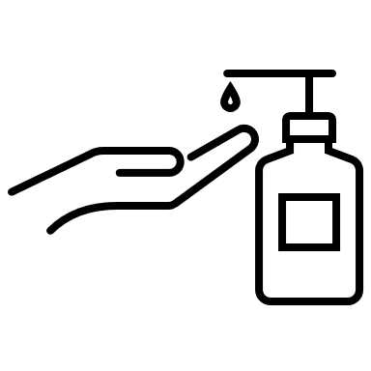

Key actions – WASH (2/2)
Promote hygiene and train behaviors
- Promote children’s WASH needs, emphasizing handwashing and safe water
- Consult for hygiene items, develop menstrual hygiene solutions, ensure appropriate facilities
Define infrastructure and manage environment
- Define structures for water management (short- and long-term)
- Determine safe excreta management (consider gender and culture)
- Collaborate for clean environment with waste and vector control
For more details, please refer to the operational guide
Notes:
Adapted from the Sphere WASH standards (1). See Sphere Standards for detail

Slide 32
Key indicators – WASH
The RMNCAH/CAH working group and partners have contributed to the WASH sector plan, and regularly meet to support programme implementation
Achieve 100% of affected populations have suitable hygiene items, use water and soap for handwashing
Achieve 100% satisfaction with the consultation on menstrual hygiene management systems, including toilets and disposal systems
For more details, please refer to the operational guide

Slide 33
3. Strengthen the health care workforce

Slide 34
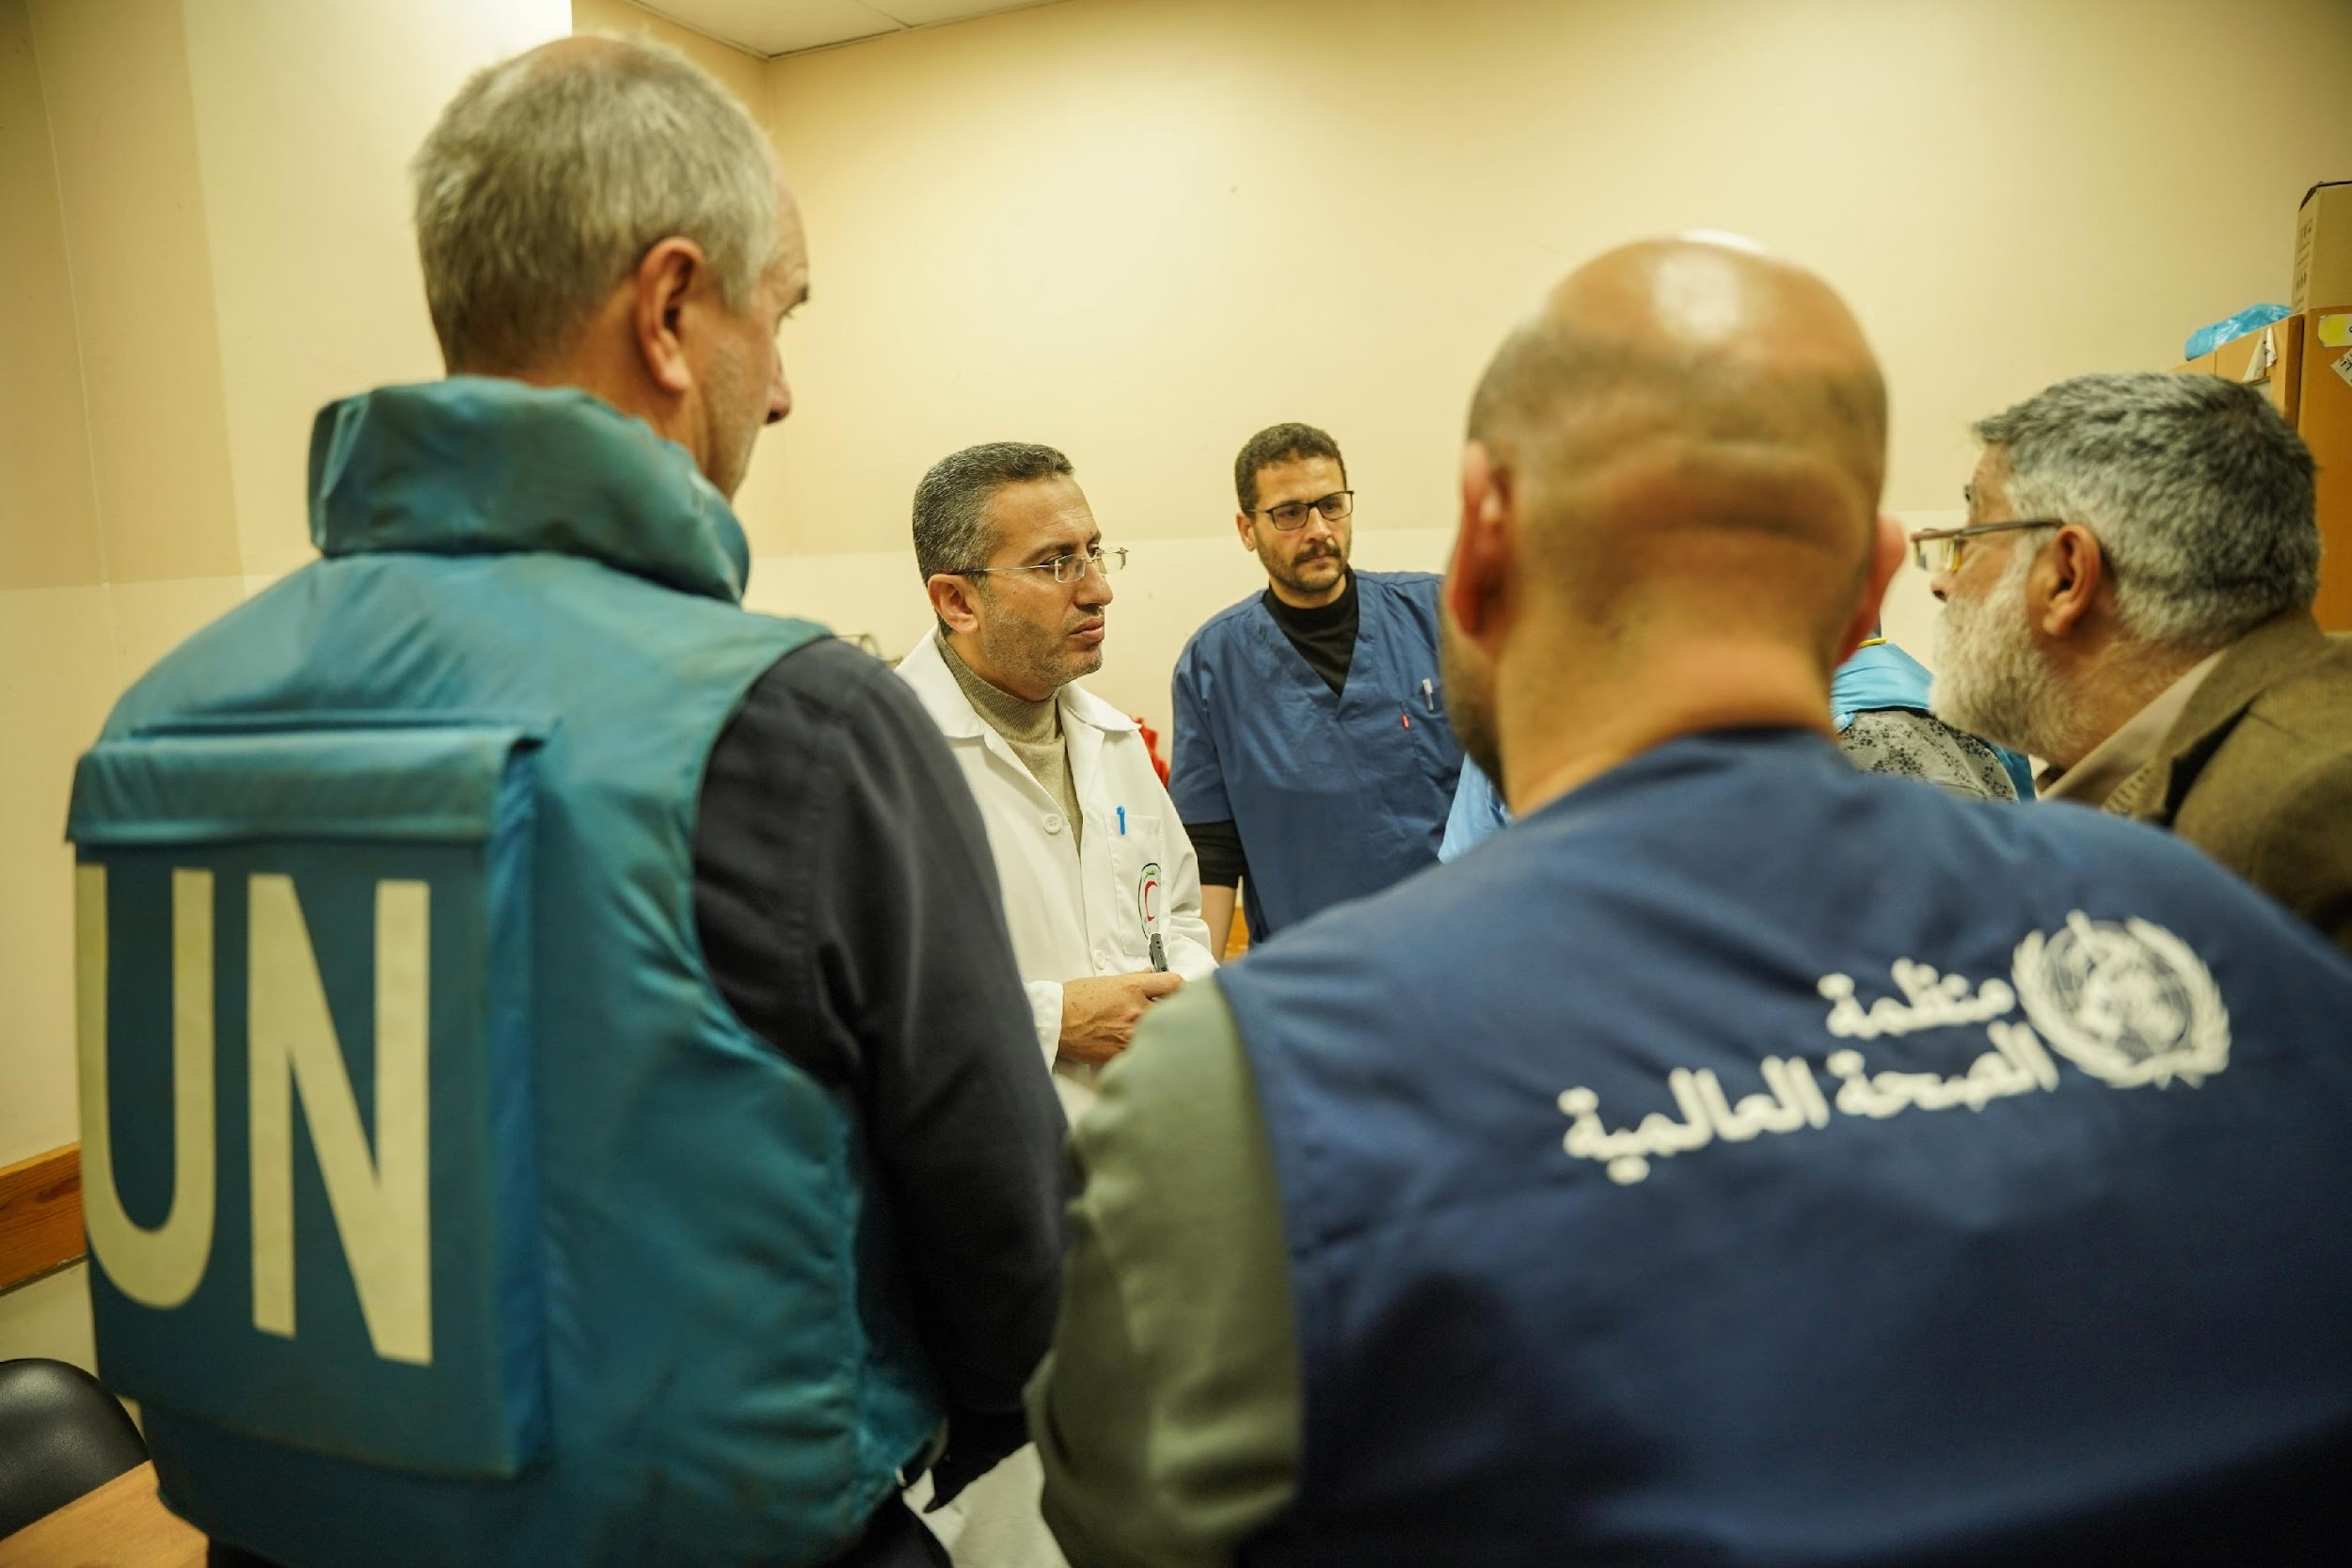
Challenges faced by local health care workers in emergencies
Local health care workers face a triple burden during emergencies:
  Recovering from personal injury and loss
  Assisting their family and friends
  Providing care to the broader population
The loss of skilled health care workers is a significant challenge in emergencies
Health needs during emergencies are often greater and different, requiring varied skill sets and expertise

Slide 35




Key actions – health workforce
Evaluate and plan workforce response
- Collaborate with the health cluster lead to assess current health workforce capacity and needs
Optimize staffing levels
- Review existing staffing levels using national standards adapted to the emergency setting
Coordinate recruitment and training
- Collaborate with government and health agencies for staff recruitment, training, and deployment
- Recruit a diverse staff matching skill needs, gender, and ethnic ratios, considering paid and volunteer roles
Integrate local health workers and provide support
- Include local health workers in the emergency response
- Provide flexible working conditions, training for new roles, and support during crisis situations
For more details, please refer to the operational guide
Notes:
Adapted from the Sphere Health Standards (1)

Slide 36
Key indicator – health workforce
The RMNCAH/CAH working group and partners have supported the health cluster to evaluate the current health workforce capacity and needs, and established a plan for response
Availability of health workers
1–2 community health workers per 1000 population
23 qualified health workers per 10 000 population
For more details, please refer to the operational guide

Slide 37
4. Obtain essential medicines and medical supplies

Slide 38
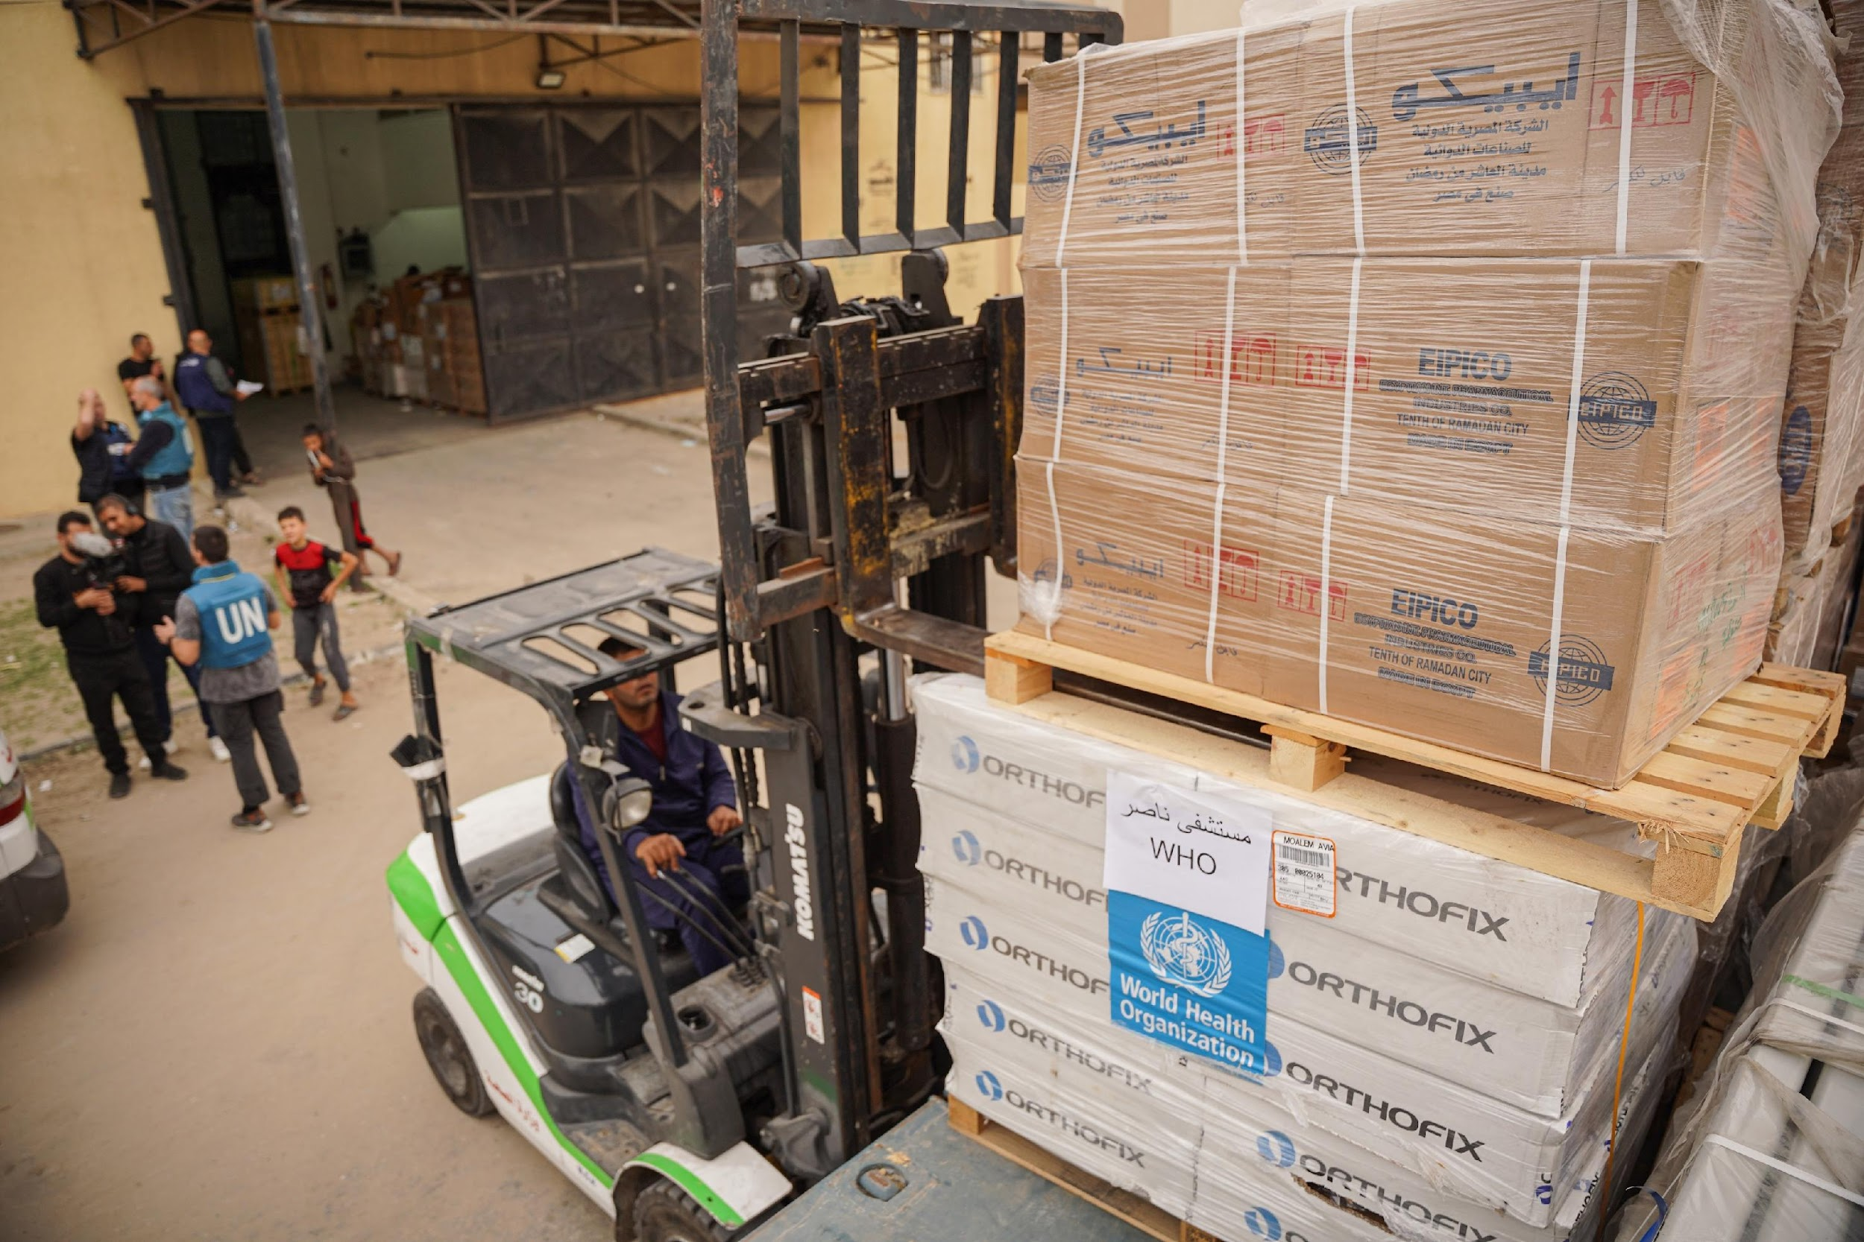
Efficient supply chain management
Assess current supply chains before acquiring more to avoid overstocking and understocking
Adjust orders based on potential disruptions and changing health needs
Collaborate with the WFP-led logistics cluster for effective coordination and information management
Consider UN emergency kits for acute crises with supply disruptions

Slide 39



Key actions – Medicine and supplies
Collaborate for prioritizing supplies
- The RMNCAH/CAH working group and partners should collaborate with health cluster and sector leads to assess and prioritize essential supplies for children and adolescents
Evaluate existing supply chains and order lists before rushing to obtain more
Establish and use a standardized essential medicines and medical device list based on the essential services package and service delivery plan. Advocate for critical inclusions.
Ensure the availability of safe, essential medical devices through an effective management system
Accept donations of medicine and medical equipment only if they adhere to internationally recognized guidelines
For more details, please refer to the operational guide
Notes:
Adapted from the Sphere Health Standards (1)

Slide 40
Key indicator – Medicines and supplies
Total number of days key medicines were not available in the past 30 days, e.g. paracetamol, amoxicillin, oxytocin and sodium valproate
Total number of days basic equipment was not available or not functional in the past 30 days, e.g. blood sugar machine, pulse oximeter, thermometer, scales, soap, chlorhexidine, mid-upper arm circumference bands and stethoscope.
For more details, please refer to the operational guide

Slide 41
5. Obtain financing

Slide 42
Essential services funding – recommendations
Health agencies should proactively identify funding needs for training, material development, procurement, salaries, and other service delivery costs
Acknowledge that the humanitarian funding process can be slow
Plan for delays from proposal development to fund approval and provision
Be proactive in seeking potential donors early in the process
Utilize experienced grant writers to enhance the effectiveness of funding proposals
The UN Central Emergency Response Fund (CERF) was established in 2006 to receive and disburse funds for the UN’s global emergency response

Slide 43
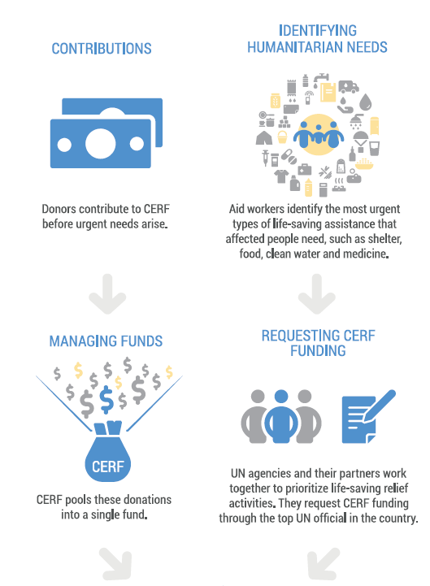
UN Central Emergency
Relief Fund (CERF)

Slide 44
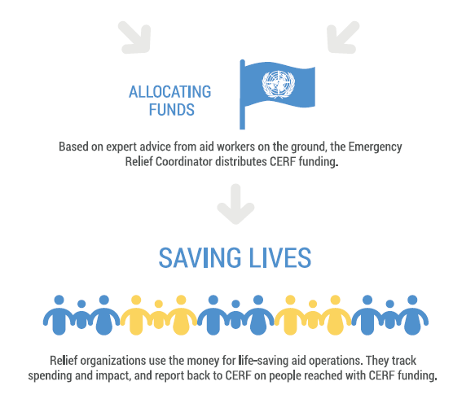
UN Central Emergency
Relief Fund (CERF)

Slide 45



Key actions – financing
Proactively identify funding needs
- The RMNCAH/CAH working group collaborates with partners and the health cluster lead to identify funding needs and potential donors proactively
Health service providers aim to identify and mobilize financial resources to offer free health care during emergencies
Health service providers aim to abolish or suspend user fees for the duration of the emergency
Organizations provide support to government health facilities to cover financial gaps resulting from the abolition and/or suspension of user fees
For more details, please refer to the operational guide
Notes:
Adapted from the Sphere Health Standards (1)

Slide 46
Key indicator – financing
Provision of primary health care to the affected people is free of charge at all government and nongovernmental organization facilities for the duration of the humanitarian response
For more details, please refer to the operational guide

Slide 47
Resources and tools
For general resources and tools, as well as specific information on the following topics, please refer to the operational guide (page 74-75 and 77-79):
  Child development and education
  Disability
  Psychosocial distress and mental health
  Sexual and reproductive health
  WASH
Notes:
Child and adolescent health in humanitarian settings: operational guide: a holistic approach for programme managers (who.int)

Slide 48
Thank you
For more information, please contact:
Khalid Siddeeg, Regional Advisor EMRO, siddeegk@who.int
Kim Beentjes, Technical Officer EMRO, beentjesk@who.int

