Slide 1
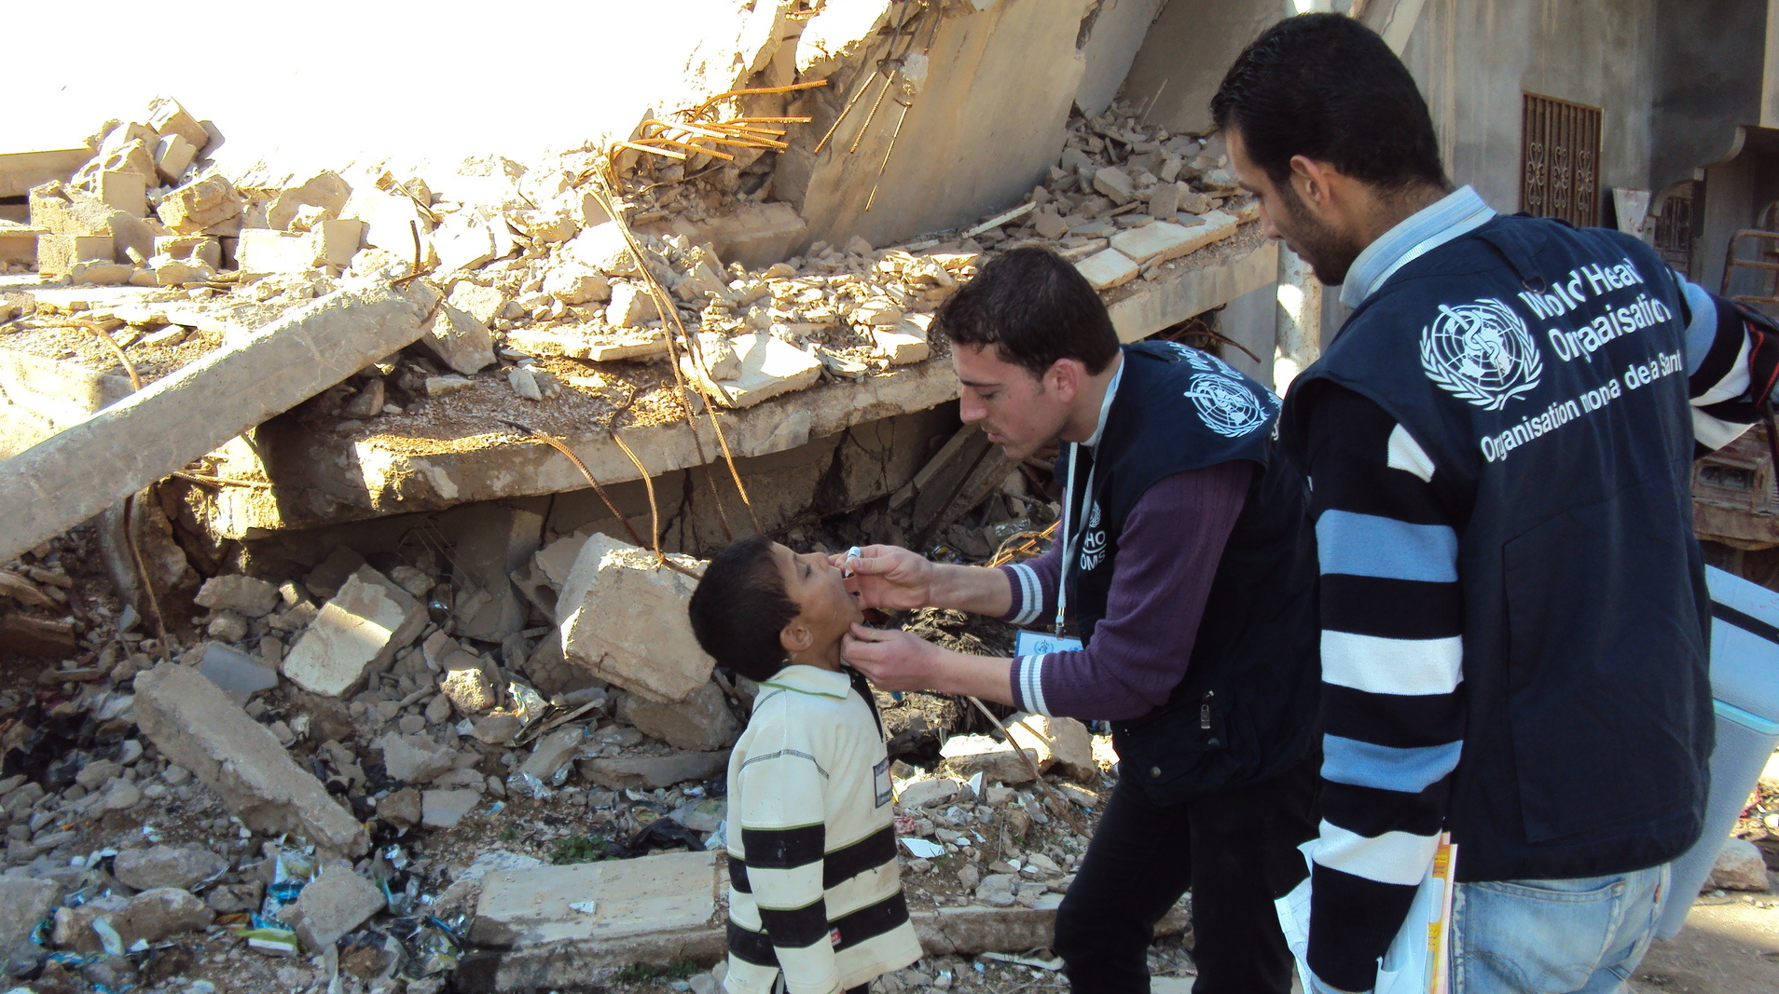
Module 3: Respond (part 1)

Slide 2
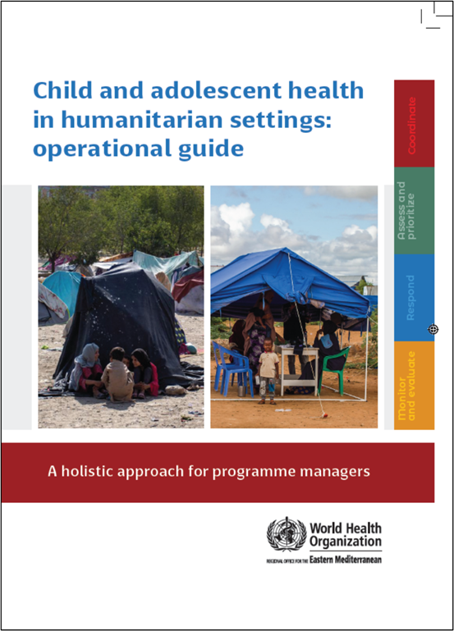
Child and adolescent health in humanitarian settings: operational guide
Notes:
Child and adolescent health in humanitarian settings: operational guide: a holistic approach for programme managers (who.int)
The Operational Guide is a synthesis of existing guidance, not a new guideline or a program (Figure 1). It incorporates existing standards and guidance documents, and presents them as a simple, systematic approach, together with links to tools and resources to support action. The Operational Guide complements existing humanitarian frameworks, and child and adolescent health strategies, including WHO’s regional implementation framework. It is a companion to existing guides on newborn, and sexual and reproductive health in humanitarian emergencies.
Audience:
Health sector and other sectors
Government and non-government (NGOs, UN agencies, funding agencies)
National and sub-national
Providing such breadth of guidance to such a broad audience is challenging, and has required careful balancing.
We wanted something that was as simple as possible, as we know users don’t have time to wade through hundreds of pages. We also wanted to make sure that it covered all the essentials for CAH programming in emergencies.
We wanted to include general guidance for a non-specialist audience, but also provide enough specifics that users could take clear actions.
We wanted to provide clear action-oriented guidance, but we also wanted it to be flexible enough for different users to use is very different situations.
So hopefully you will find the operational guide to be practical and useful for your CAH programming. But it won’t give you everything you need, and you will always need to adapt the guidance to your context.

Slide 3
The four interconnected programmatic action areas of the operational guide
❶ COORDINATE
How to take a coordinated approach to child and adolescent health in a humanitarian emergency
❷ ASSESS & PRIORITISE
How to obtain data on child/adolescent health (via needs assessment) and use it to prioritize actions
❸ RESPOND
How to plan and enact a coordinated set of activities addressing the identified child and adolescent health priorities
❹ MONITOR, EVALUATE & REVIEW
How to use data systems to review and improve child and adolescent health-related activities

Slide 4
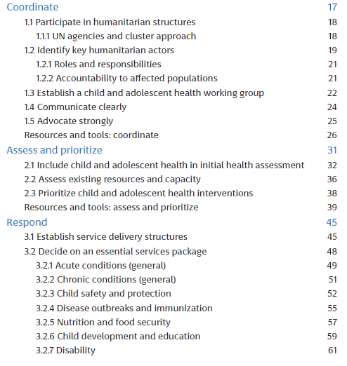
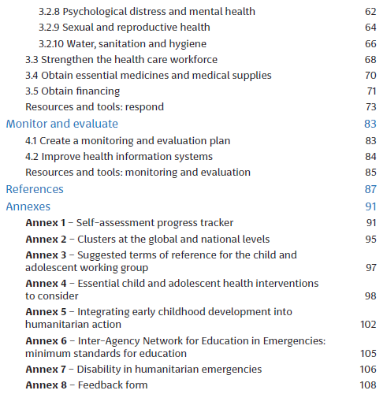

Slide 5
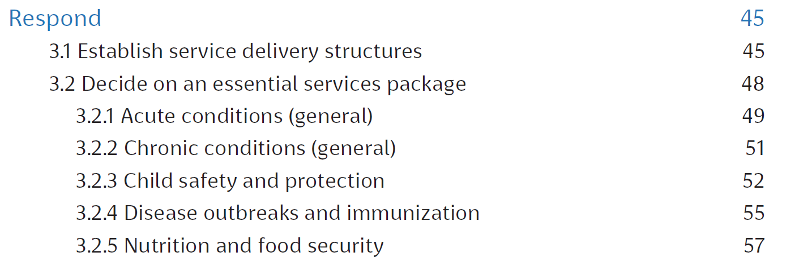
Respond

Slide 6
1. Establish service delivery structures

Slide 7
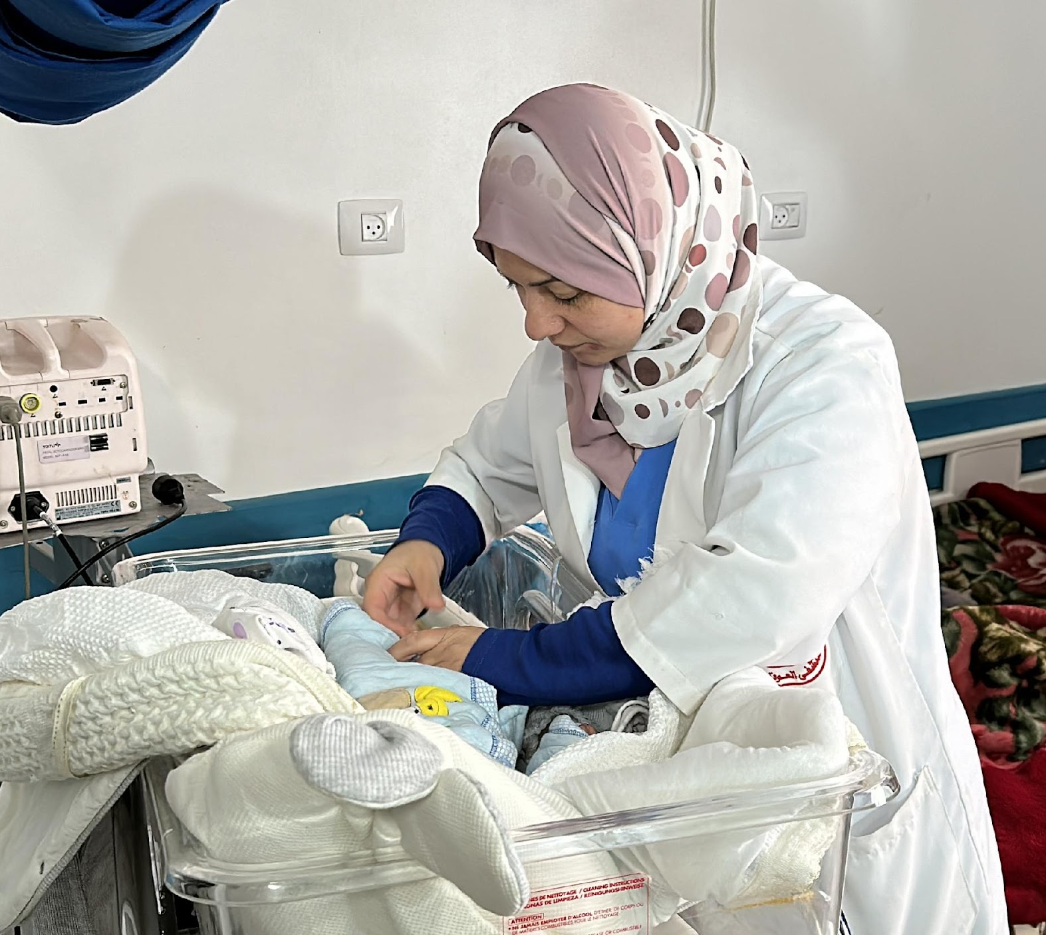
General health service delivery levels in emergencies
Household and community
Care in the community, including camps
Providers: community health workers, traditional birth attendants
Clinics/Primary Care Facilities
Care at small health facilities, mobile clinics
Providers: nurses, midwives, health assistants
Hospitals/Secondary and Tertiary Health Facilities
Care at established hospitals, including camp hospitals
Providers: full range of medical, nursing, and allied health professionals
Notes:
Box 12 operational guide

Slide 8
Challenges to delivery of CAH services during emergencies
Service disruption and facility destruction
Population movements
Competing priorities
Lack of safety
Essential health promotion and prevention services breakdown
Treatment activities disrupted
Supply chain disruptions
Loss of healthcare providers and affordability of essential services
Reduced access to water, power, sanitation, and food
Damaged roads and transportation challenges
Mobile and crowded populations
Loss of livelihoods
Rapid urbanization due to displacement
Overwhelming health systems with new issues (e.g. injury and epidemic disease)
Neglect of other essential services
Threats to security and safety of affected populations and healthcare workers
Impaired access due to mobility restrictions (e.g. curfews)

Slide 9
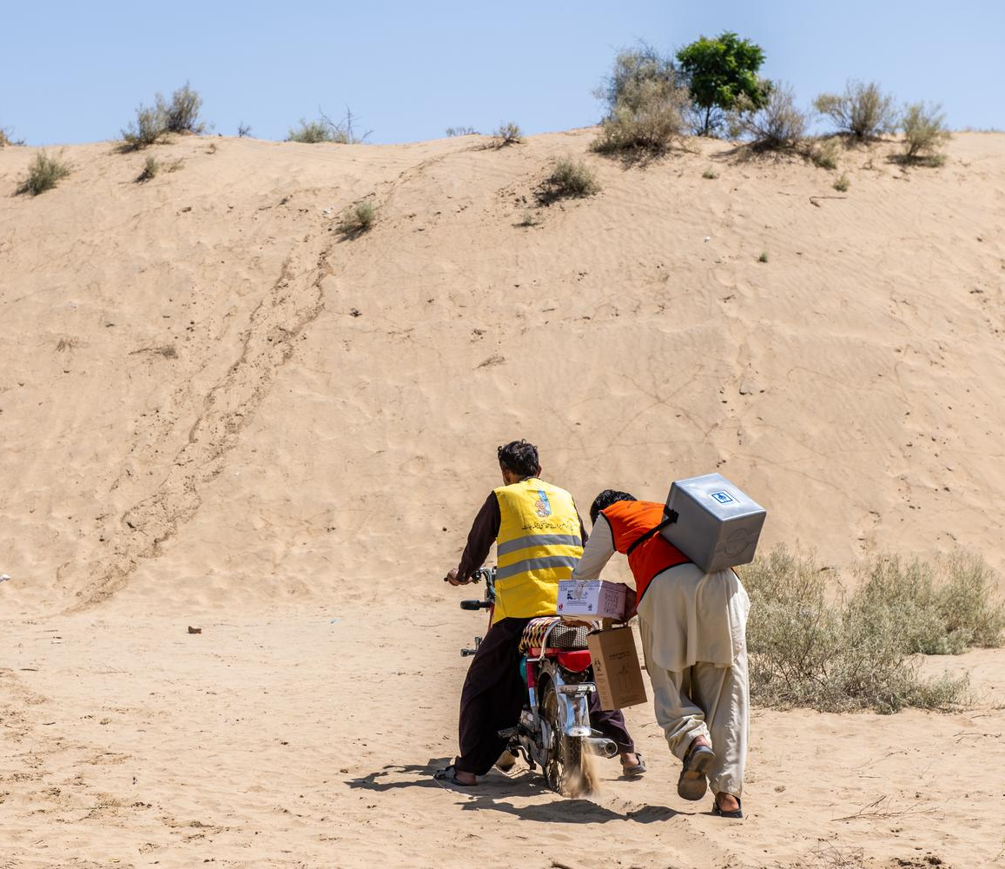
Health services for changing children and adolescent needs
Health service structures must undergo significant changes to respond effectively to evolving health needs for children and adolescents
This may involve:
- Changes in scopes of practice
- Introduction of new services (e.g., outreach)
- Modification of existing delivery methods

Slide 10
Key actions – health service structure
Lead coordination of priority health services
- The health cluster/sector lead advocates for CAH priorities through the RMNCAH/CAH working group
Review and adapt service delivery to effectively provide prioritized health services based on needs assessment
Engage the community in designing relevant health services, involving young people and women and incorporating accountability processes
Identify opportunities and threats to reach populations. Establish temporary health outposts, provide mobile services, deploy community workers, and strengthen referral pathways for essential services.
For more details please refer to the operational guide
Notes:
Adapted from the Sphere Health Standards

Slide 11
Key indicator – Health services structure
The RMNCAH/CAH working group and partners have worked with the health cluster lead to review service delivery capacity and develop an action plan
Availability of health facilities
Proportion of health care facilities using triage and referral system
Proportion of the population within 5km of the health facility
For more details please refer to the operational guide

Slide 12
2. Decide on an essential services package

Slide 13
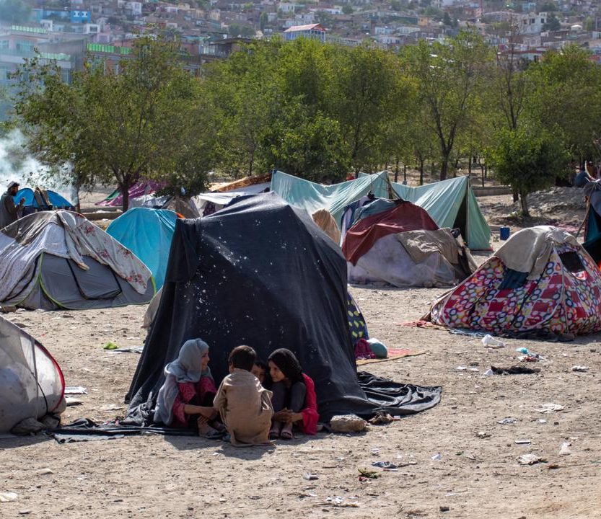
Essential services package for emergency situations - considerations
Lists the services delivered at each level: community, primary care, hospital
Links to minimum requirement for: staffing, medications, medical supplies
Should address needs of children of different ages
Should be based on priorities identified and realities of constraints of service delivery
Should be defined as part of preparedness, put in place during response, and expanded during recovery

Slide 14
Priority areas for children in humanitarian emergencies
Newborns (<28 days)
Biggest risks: prematurity, sepsis, birth asphyxia, small for gestational age and tetanus
Priority services: safe birth, essential newborn care, care for small and sick newborns, prompt recognition and treatment of infection
Young children (<5 years)
Biggest risks: respiratory infection, diarrhea, measles, undernutrition, meningitis
Priority services: prevention and treatment of common infections (incl immunization), nutritional deficiencies, child safety
Older children (5-9 years)
Biggest risks: infection, injury, mental health issues, nutrition
Priority services: prevention and treatment of common infections and illness, chronic conditions, child safety and psychological well-being
Young adolescents (10-14 years)
Biggest risks: injury, infection, mental health issues
Priority services: safety and violence, SRH, treatment of common infections, chronic conditions, psychological wellbeing
Older adolescents (15-19 years)
Biggest risks: injury, infection, mental health issues, substance abuse, pregnancy, childbirth
Priority services: safety and violence, SRH, treatment for common infections, chronic conditions, psychological wellbeing

Slide 15
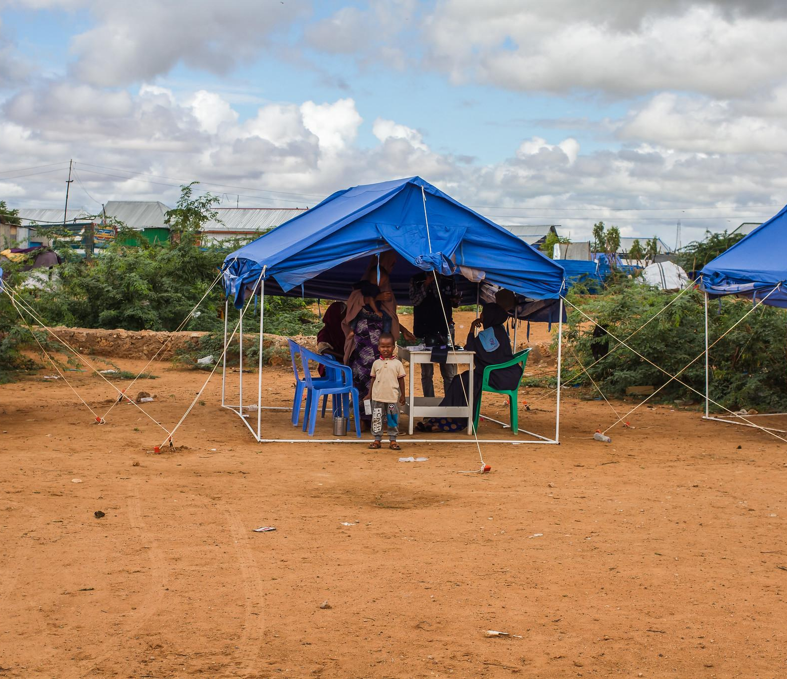
Important CAH fields for an essential service package
2.1 Acute conditions (general)
2.2 Chronic conditions (general)
2.3 Child safety and protection
2.4 Disease outbreaks and immunization
2.5 Nutrition and food security
2.6 Child development and education
2.7 Disability
2.8 Psychosocial distress and mental health
2.9 Sexual and reproductive health
2.10 WASH

Slide 16
2.1 Acute conditions (general)
Leading causes of death in all age groups during humanitarian emergencies: diarrhea, respiratory infections, measles, malaria
Newborns are at particularly high risk of death during emergencies because of poor antenatal care, maternal illness, undernutrition, and lack of safe birth options
Main cause of neonatal death: prematurity, infection and intrapartum complications
Most complications can be prevented or addressed by simple measures:
Clean delivery and cord care
Keeping the baby warm
Skin-to-skin contact
Supporting breastfeeding
Monitoring of danger signs (e.g. bleeding, hypertension)

Slide 17
Key actions – acute conditions (general) (1/2)
Developing prevention measures
- Prioritize safe water, hygiene, vector-borne infections, vaccines, public safety, safe delivery, and early illness recognition in children
- Develop public health education messages promoting early care-seeking and advocating for antenatal, skilled birth, and postnatal care
Provide health care at all first-level health facilities
Using standard case management protocols (like Integrated Management of Childhood Illness, IMNCI), with skilled staff and essential supplies
Implement standard operating procedure (SOP) at the community level, integrating community case management
For more details please refer to the operational guide
Notes:
Adapted from the Sphere Health Standards and the newborn health in humanitarian settings field guide

Slide 18
Key actions – acute conditions (general) (2/2)
Provide health care at hospitals based on standard case management protocols
- Provide standardized secondary/tertiary care, including emergency obstetric and newborn care, surgical services, and pediatric care, with trained staff and essential supplies
Implement triage, diagnostics and management protocols - For conditions like pneumonia, malaria, diarrhea, measles, meningitis, undernutrition, dengue, obstetric, and newborn complications. Provide staff training
Provide referral care for management of severe illness
- Create communication and transportation systems covering community, primary care, and hospitals to manage obstetric, newborn, and child emergencies
For more details please refer to the operational guide
Notes:
Adapted from the Sphere Health Standards and the newborn health in humanitarian settings field guide

Slide 19
Key indicator – Acute conditions (general)
The RMNCAH/CAH working group and partners outlined acute care priorities for newborns, children, and adolescents. They advocated for these within the health cluster, successfully integrating them into the cluster plan.

Slide 20
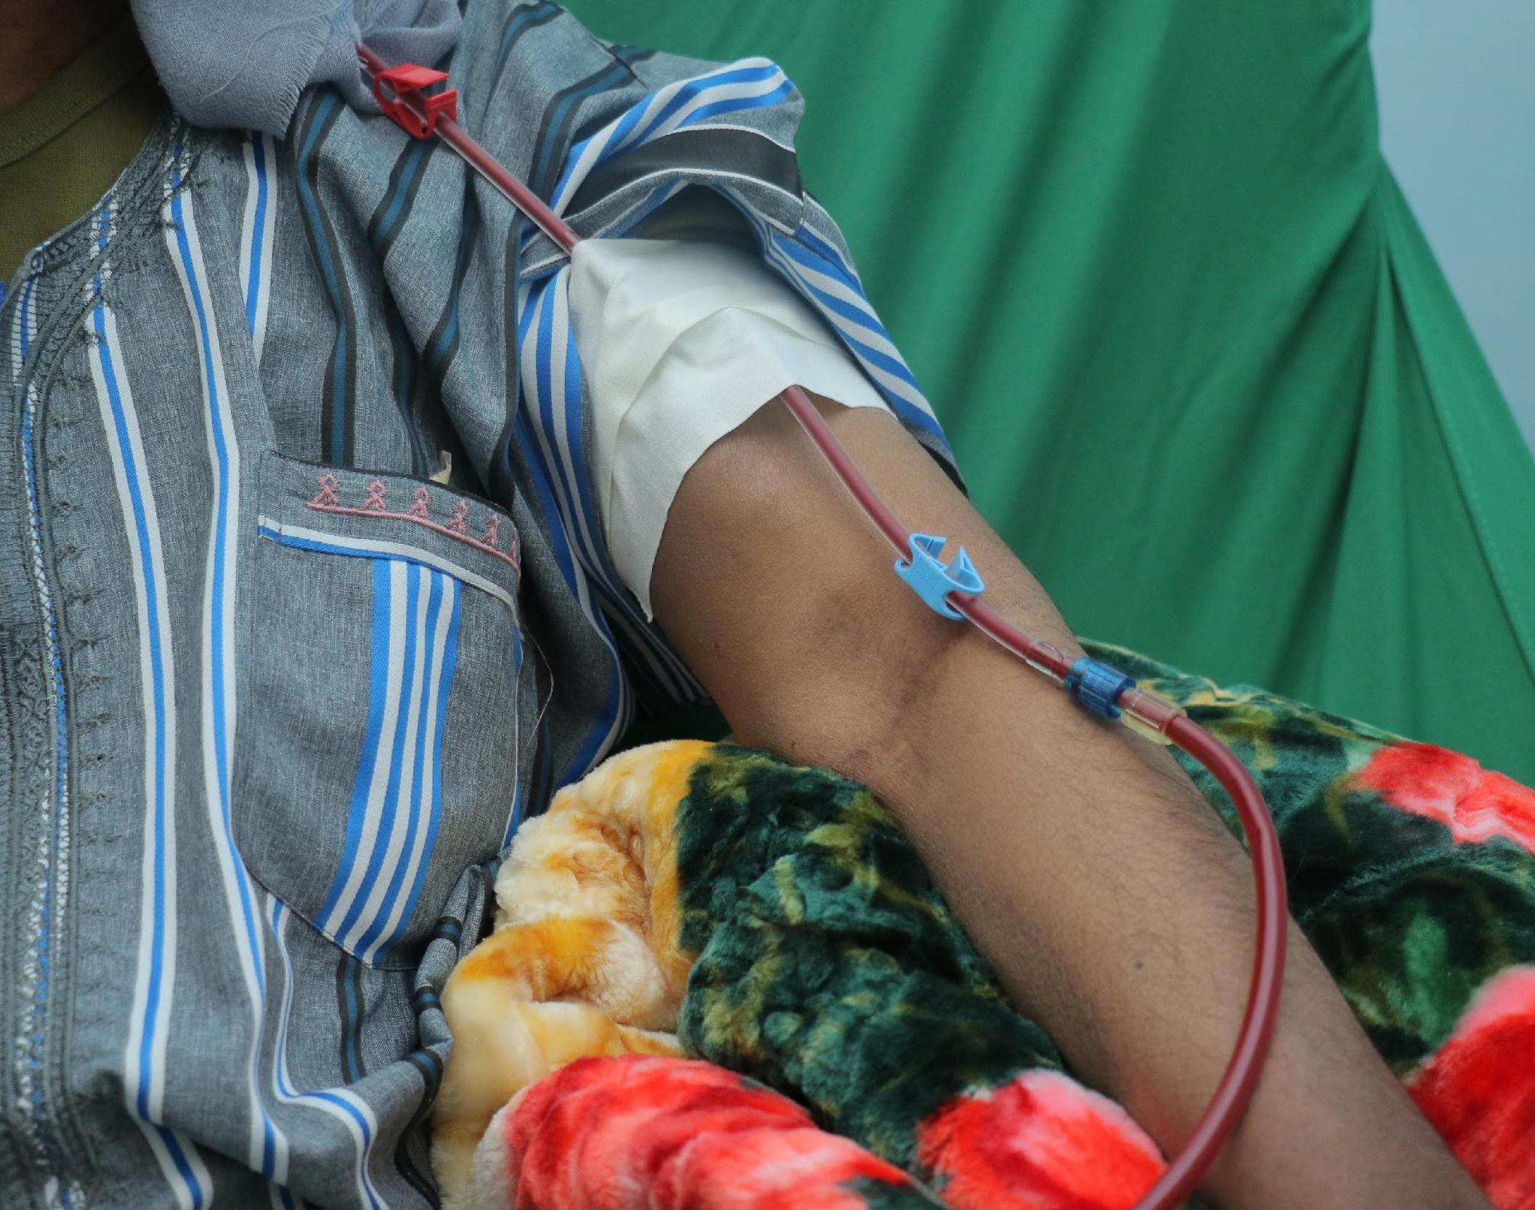
2.2 Chronic conditions (general)
Characterized by
Their prolonged duration (>3 months)
Substantial impact on the child and family's life
Specific healthcare service needs
Encompass various conditions: neurological, respiratory, cardiac, endocrine, sensory, etc.
Proper support enhances community resilience in crises

Slide 21
Key actions – chronic conditions (general)
Collaborate for access to care
The RMCAH/CAH working group and members cooperate with partners to ensure access to care for children and adolescents with chronic health conditions
Involve affected children and adolescents and their families in planning
Document and share prevalence data of chronic health conditions and disability for needs assessment and evaluation during disasters
Identify and ensure continued treatment for individuals with chronic conditions
- From before the emergency, avoiding sudden interruptions of treatment
- Establish clear procedures for chronic conditions during emergencies
- Ensure availability of essential diagnostic equipment and medication through primary care
For more details please refer to the operational guide
Notes:
Adapted from the Sphere Health Standards
Provide treatment for acute complications and exacerbations of chronic conditions, especially life-threatening situations and pain management.
Establish clear referral protocols for situations where treatments for chronic conditions are unavailable.
Ensure primary healthcare systems have necessary diagnostic tools, core tests, and essential medications for routine chronic condition management specified in the essential medicines list.

Slide 22
Key indicator – Chronic conditions (general)
The RMNCAH/CAH working group has identified priority chronic care needs, essential medicines and medical supplies, and communicated these to providers, in collaboration with the health cluster
Health facilities have adequate medication for children and adolescents who were receiving treatment for chronic conditions before the emergency to continue receiving this medicine

Slide 23
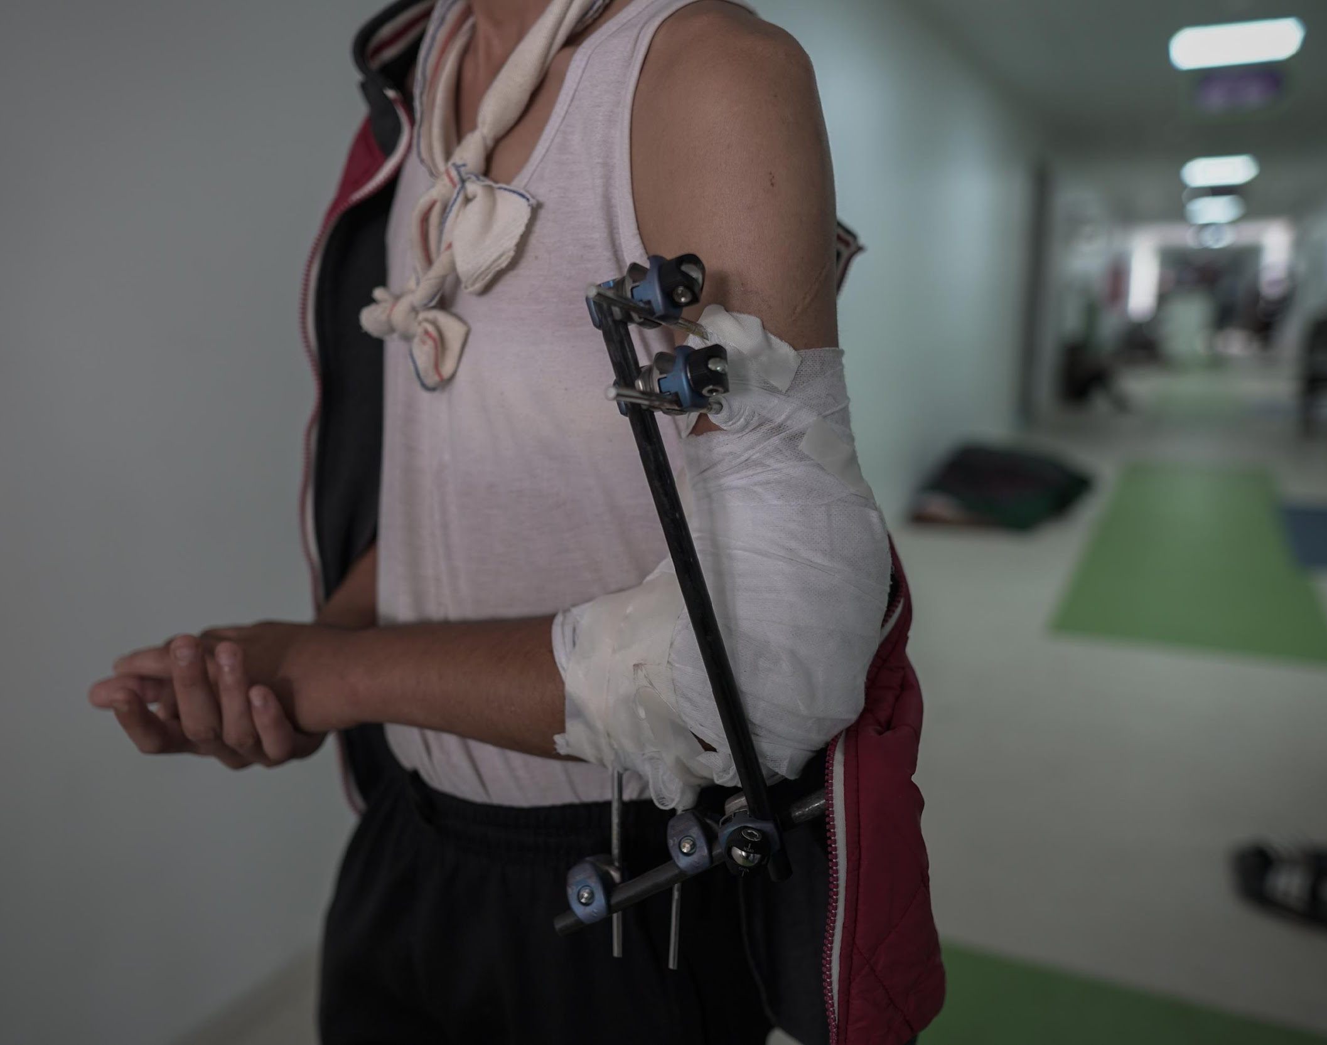
2.3 Child safety and protection issues
Unintentional injuries (falls, traffic incidents) contribute to 30-50% of deaths, heightened risks in humanitarian settings
Conflict-related deaths: 75% are intentional or unintentional harm to women and children (e.g. landmines, crossfire)
Violence after disasters may rise, affecting families and communities, with children facing extreme violence and lasting psychological effects
Sexual and gender-based violence: often concealed, but prevalent in all emergencies, causing injuries and death, unwanted pregnancies, mental health issues etc.
Other protection concerns: vulnerability to exploitation, trafficking, armed forces recruitment, risking abuse, addiction, and injury

Slide 24
Key actions – child safety and protection
Integrate child safety - Collaborate with the protection cluster for child safety in all sectors
- Strengthen child protection systems and raise awareness during emergencies
Contribute to protection cluster activities
- Advocate for diversity, inclusion, and children's agency
- Encourage CAH partners to establish child safety policies
- Involve children in responses, implement risk reduction, and map protection services
- Establish case management for high-risk children, ensure organizational codes, and create safe spaces
Develop coordination plans
- Address sexual violence, assess armed forces involvement, and support survivor assistance
- Prioritize action on child labor, assume caregiver presence, and promote diversion in justice systems
For more details please refer to the operational guide
Notes:
Adapted from the child protection standards of the Child Protection Working Group

Slide 25
Key indicators – Child safety and protection
The RMNCAH/CAH working group and partners have developed and adopted child safety and protection measures within their organizations
The RMNCAH/CAH working group works collaboratively with the protection cluster to support full integration of child safety into humanitarian action

Slide 26
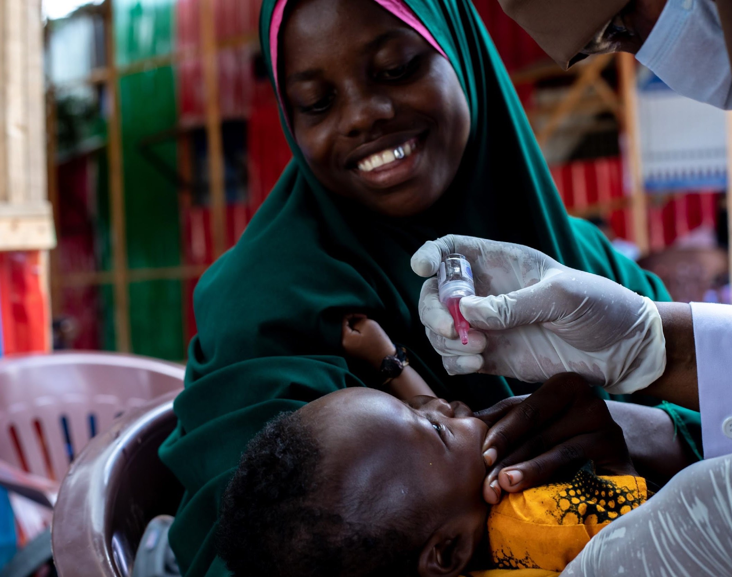
2.4 Disease outbreaks and immunization
Disease outbreaks in emergencies demand focus on immunization and prevention for all age groups
Measles is a major threat, full immunization coverage is essential across all age groups
Critical vaccine-preventable infections include cholera, meningitis, yellow fever, polio, tetanus, diphtheria, and pneumococcal infections
Collaboration across sectors is essential to assess risks, monitor outbreaks, and execute a coordinated response involving immunization, water and sanitation, communication, and supply chain efforts

Slide 27
Key actions – Disease outbreaks and immunization
Prepare for outbreaks - RMNCAH/CAH working group and partners collaborate on outbreak planning with the health cluster and other clusters
- Implement vector control and early warning systems
- Train healthcare staff and communities for outbreak detection
Immunization planning
- Estimate and improve vaccination coverage, conduct mass campaigns for at-risk age groups
- Establish vaccination systems for mobile populations.
Ensure vaccine supply and reactivity
- Address cold chain challenges, consider vaccination for imminent outbreaks
- Re-establish national immunization programs
Screen children attending health services for vaccination status. Administer any needed vaccinations.
For more details please refer to the operational guide
Notes:
Adapted from the Sphere Health Standards
"The Outbreaks and Immunization section has dozens of Key Actions. We won't go through them all now but you can read on pages XX to XX. You can also find more in the Sphere Health Standards, from which these are adapted. But do want to highlight XYZ..."

Slide 28
Key indicators – Disease outbreaks and immunization
RMNCAH/CAH working group and partners contributed to the creation and dissemination of the multisector outbreak response plan
RMNCAH/CAH working group and partners support re-establishment of the national immunization programme
Case fatality rate of measles: aim for < 5% in conflict settings
The national immunization programme has been re-established: 100% enrolment of infants in national immunization programmes
For more details please refer to the operational guide

Slide 29
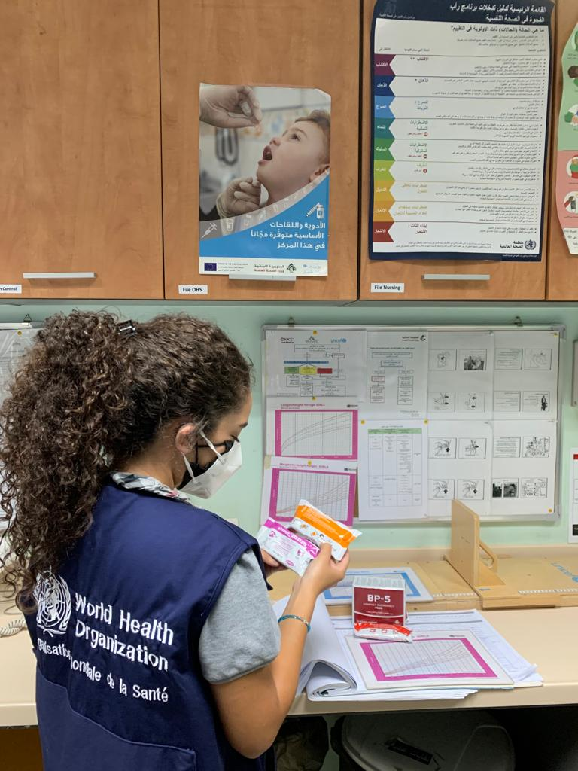
2.5 Nutrition and food security
Limited access to essentials in emergencies heightens acute undernutrition risks
Undernutrition rates surge during humanitarian crises, contributing to over a 1/3rd of deaths in children <5
A severely malnourished young child is 9 times more likely to die than a well-nourished counterpart
Undernutrition critically threatens child survival in emergencies due to displacement, food supply disruptions, crop issues, and challenges in cooking fuel, energy, privacy, and sanitation

Slide 30
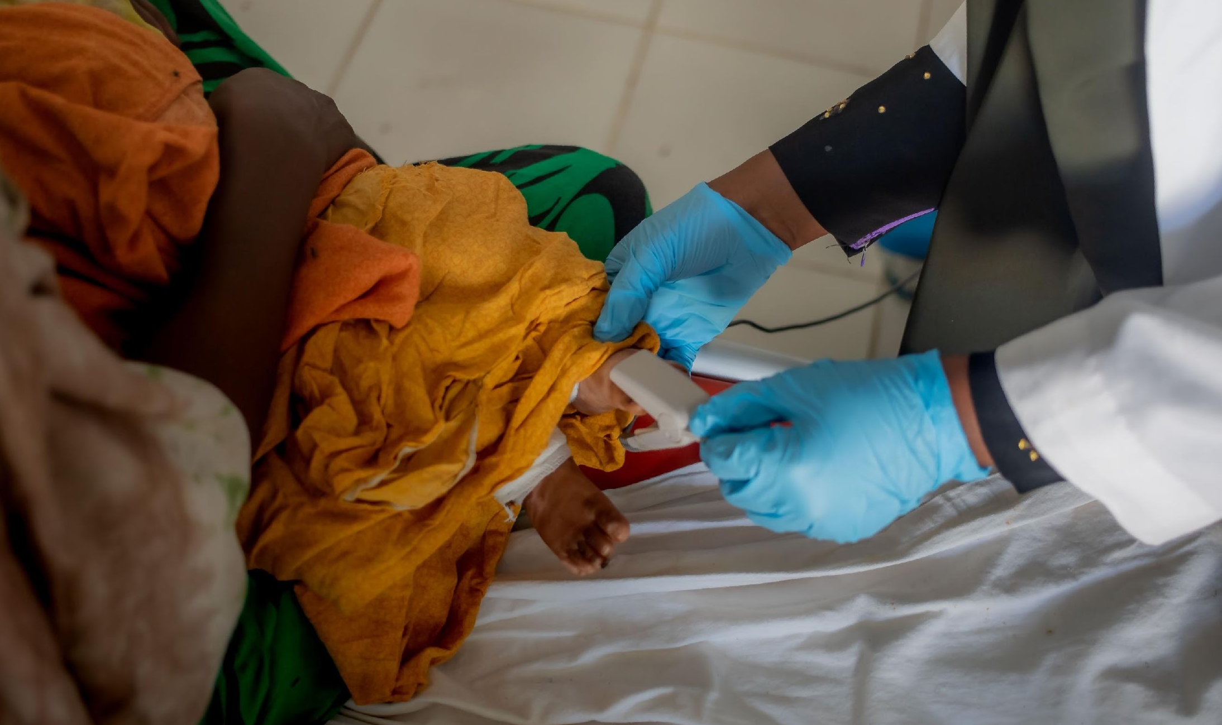
Nutrition and food security
Supporting breastfeeding is crucial; breastfed infants have at least 6 times higher survival rates in early months, preventing undernutrition and infant mortality in emergencies
Undernutrition survivors face long-term consequences affecting cognitive, social, motor skill, physical, and emotional development
Micronutrient deficiency in children heightens the risk of death from infectious diseases and impairs physical and mental development.
Maternal deficiency during pregnancy and breastfeeding raises the risk of poor health and development in children.
Providing fortified foods and micronutrient supplements is a key response to address micronutrient deficiency.

Slide 31
Key actions – Nutrition and food security
Assess and plan for nutrition
- RMNCAH/CAH working group and partners assist nutrition cluster lead in planning and implementing programs for priority nutrition needs
- Evaluate national and local capacity for the nutrition response
Address severe acute malnutrition
- Establish strategies for inpatient and outpatient interventions.
- Maximize access to interventions through community engagement
Manage micronutrient deficiencies - Determine common deficiencies and train health staff, providing necessary micronutrient supplements for age groups
Establish infant and young child feeding policies
- Set policies for infant and young child feeding during emergencies.
- Prioritize pregnant and breastfeeding women for support
For more details please refer to the operational guide
Notes:
Adapted from the Sphere Health Standards

Slide 32
Key indicators – Nutrition and food security
RMNCAH/CAH working group and partners have supported the nutrition cluster lead to assess, plan and implement preventative and curative programmes.
Conduct at least 1 systematic and objective food security needs assessments in the first week of an emergency response
Feeding programme outcomes: Died: < 3%. Recovered: > 75%. Defaulted: < 15%
National/organizational policies address infant and young child feeding in emergencies. During preparedness or within 4 weeks of the start of the emergency.
For more details please refer to the operational guide

Slide 33
Resources and tools
For general resources and tools, as well as specific information on the following topics, please refer to the operational guide (page 74-77):
General acute and chronic conditions
Danger, violence and child protection
Disease outbreaks and immunization
Nutrition and food security
Notes:
Child and adolescent health in humanitarian settings: operational guide: a holistic approach for programme managers (who.int)

Slide 34
Thank you
For more information, please contact: Khalid Siddeeg, Regional Advisor EMRO, siddeegk@who.int Kim Beentjes, Technical Officer EMRO, beentjesk@who.int

