Slide 1
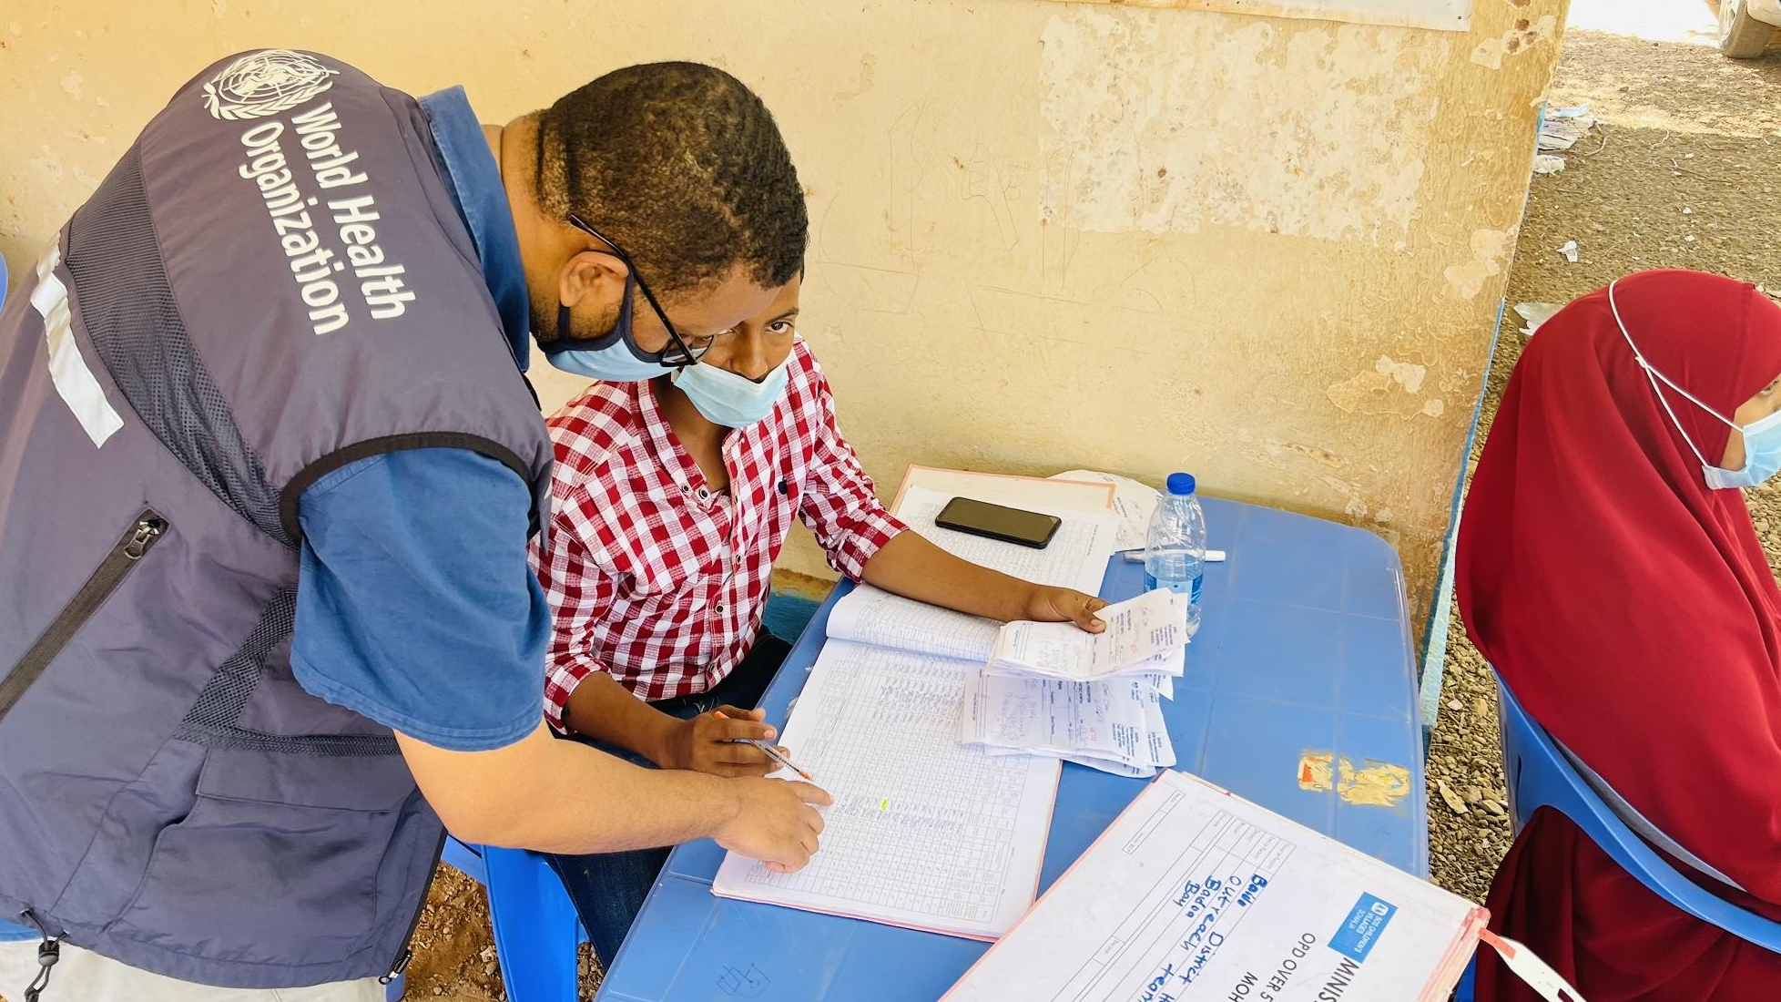
Module 4: Monitor, Evaluate and Review

Slide 2
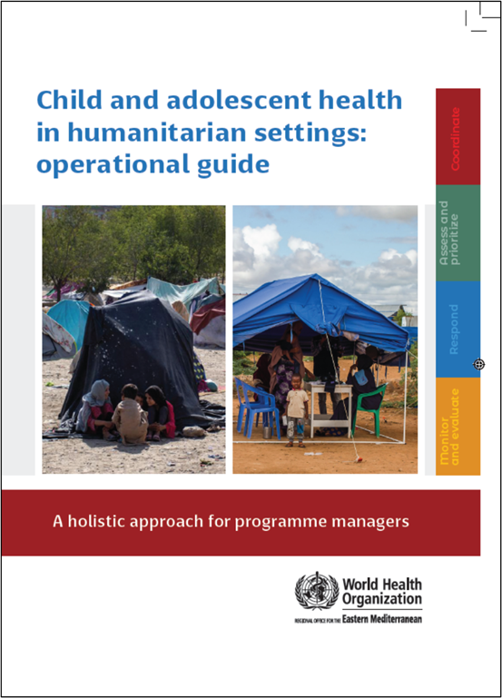
Child and adolescent health in humanitarian settings: operational guide
Notes:
Child and adolescent health in humanitarian settings: operational guide: a holistic approach for programme managers (who.int)
The Operational Guide is a synthesis of existing guidance, not a new guideline or a program (Figure 1). It incorporates existing standards and guidance documents, and presents them as a simple, systematic approach, together with links to tools and resources to support action. The Operational Guide complements existing humanitarian frameworks, and child and adolescent health strategies, including WHO’s regional implementation framework. It is a companion to existing guides on newborn, and sexual and reproductive health in humanitarian emergencies.
Audience:
Health sector and other sectors
Government and non-government (NGOs, UN agencies, funding agencies)
National and sub-national
Providing such breadth of guidance to such a broad audience is challenging, and has required careful balancing.
We wanted something that was as simple as possible, as we know users don’t have time to wade through hundreds of pages. We also wanted to make sure that it covered all the essentials for CAH programming in emergencies.
We wanted to include general guidance for a non-specialist audience, but also provide enough specifics that users could take clear actions.
We wanted to provide clear action-oriented guidance, but we also wanted it to be flexible enough for different users to use is very different situations.
So hopefully you will find the operational guide to be practical and useful for your CAH programming. But it won’t give you everything you need, and you will always need to adapt the guidance to your context.

Slide 3
The four interconnected programmatic action areas of the operational guide
❶ COORDINATE
How to take a coordinated approach to child and adolescent health in a humanitarian emergency
❷ ASSESS & PRIORITISE
How to obtain data on child/adolescent health (via needs assessment) and use it to prioritize actions
❸ RESPOND
How to plan and enact a coordinated set of activities addressing the identified child and adolescent health priorities
❹ MONITOR, EVALUATE & REVIEW
How to use data systems to review and improve child and adolescent health-related activities

Slide 4
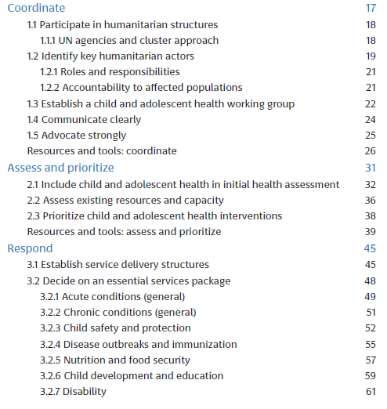
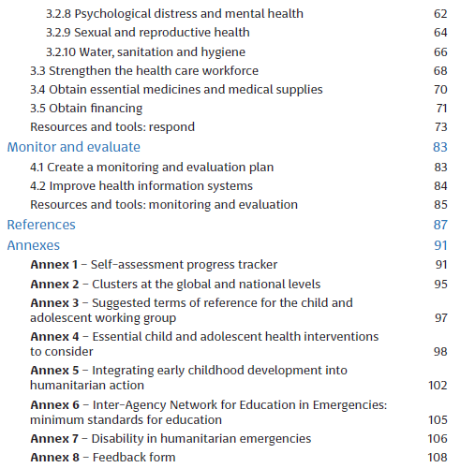

Slide 5
Monitor and evaluate

Slide 6
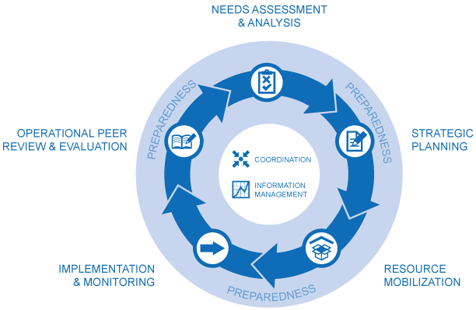
Monitor, evaluate and review
Monitoring, evaluation and review are essential to effective humanitarian action
This section builds on the previous sections:
Coordination (action area 1)
Assessment and prioritization (action area 2)
This module will specify how you monitor, evaluate and review the activities in the response (action area 3)

Slide 7
1. Develop a monitoring and evaluation plan

Slide 8
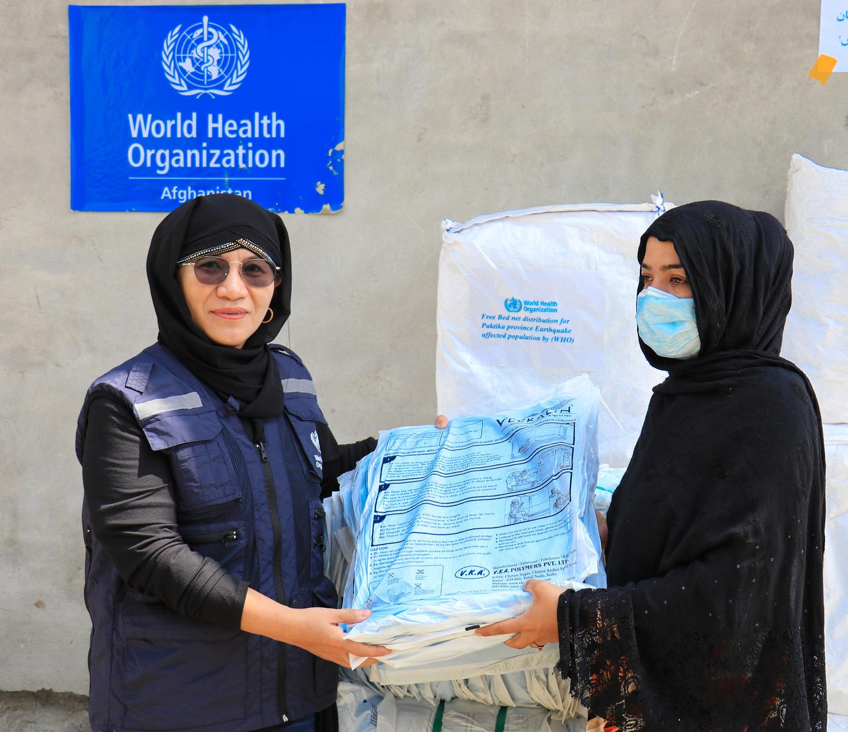
Develop a monitoring and evaluation plan
Assign a lead agency within the RMNCAH/CAH working group or collaborate with the health cluster’s M&E lead to create a comprehensive plan
Integrate agency-level data when possible, these can aid internal M&E and quality improvement
Using some of this detailed data for regional and national monitoring:
Improves overall data completeness
Encourages collaboration
Highlights success stories

Slide 9
Monitoring and evaluation - Key indicators
Key indicators provide a framework that identifies priorities, determines planning figures and coordinates across sectors
This helps sectoral responses to reinforce each other and support the population’s own capacity to meet their needs
Key indicators outline the quality of assistance that should be attained, adjusted to the emergency context
Example: access to education for children and adolescents in emergencies
Notes:
From the Sphere handbook 2018 https://www.spherestandards.org/handbook/editions/

Slide 10
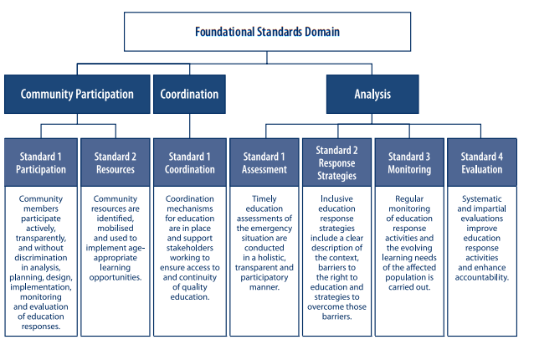
Inter-Agency Network for Education in Emergencies (INEE) Foundational Standards for education in emergencies
These foundational standards formulate the basis of indicators that could be used to monitor and evaluate education interventions in emergencies
It can guide the integration of nurturing care for all children into humanitarian action
Notes:
Minimum Standards for Education. Preparedness, Response, Recovery. New York: Inter-Agency Network for Education in Emergencies; 2010 (https://www.right-to-education.org/sites/right-to-education.org/files/resourceattachments/INEE_Minimum_Standards_2010.pdf).

Slide 11
Monitoring and evaluation from the minimum standards of education (INEE)
Ensure continuous monitoring of education response activities
Monitor to ensure safety of everyone in education
Involve vulnerable groups in monitoring activities
Systemic collection of disaggregated data to inform responses
Analysing and sharing education data with stakeholders
Conducting systematic and impartial evaluations of education activities
Involving all stakeholders, including community representatives
Sharing evaluation findings and lessons learned to inform advocacy programs and policies, in a form understandable to all, including community members
Notes:
Minimum Standards for Education. Preparedness, Response, Recovery. New York: Inter-Agency Network for Education in Emergencies; 2010 (https://www.right-to-education.org/sites/right-to-education.org/files/resourceattachments/INEE_Minimum_Standards_2010.pdf).

Slide 12
Key actions – Monitoring and evaluation plan
Plan development: work with the health sector’s agency lead to create a cohesive M&E plan for child and adolescent health, share joint assessments and consider academic partnerships
Data review: evaluate current data collection methods across health services, encompassing health status and risks, health resources and service availability, and health system performance
Key indicator selection: choose standardized key indicators to monitor implementation of priority CAH activities, considering population and age disaggregation
Reporting structure agreement: agree on reporting units (e.g. mobile clinics, field hospitals) and reporting pathways, and frequency of submission, analysis, report generation and dissemination
For more details please refer to the operational guide
Notes:
Adapted from the Sphere Health Standards

Slide 13
Key indicators – Monitoring and evaluation plan
Creation of a CAH-focused monitoring and evaluation plan by the health cluster/sector, with clear indicators
Early warning surveillance reports received from health facilities each week
Regular production of an overall health information report by the lead health actor
For more details please refer to the operational guide

Slide 14
2. Improve health information systems

Slide 15
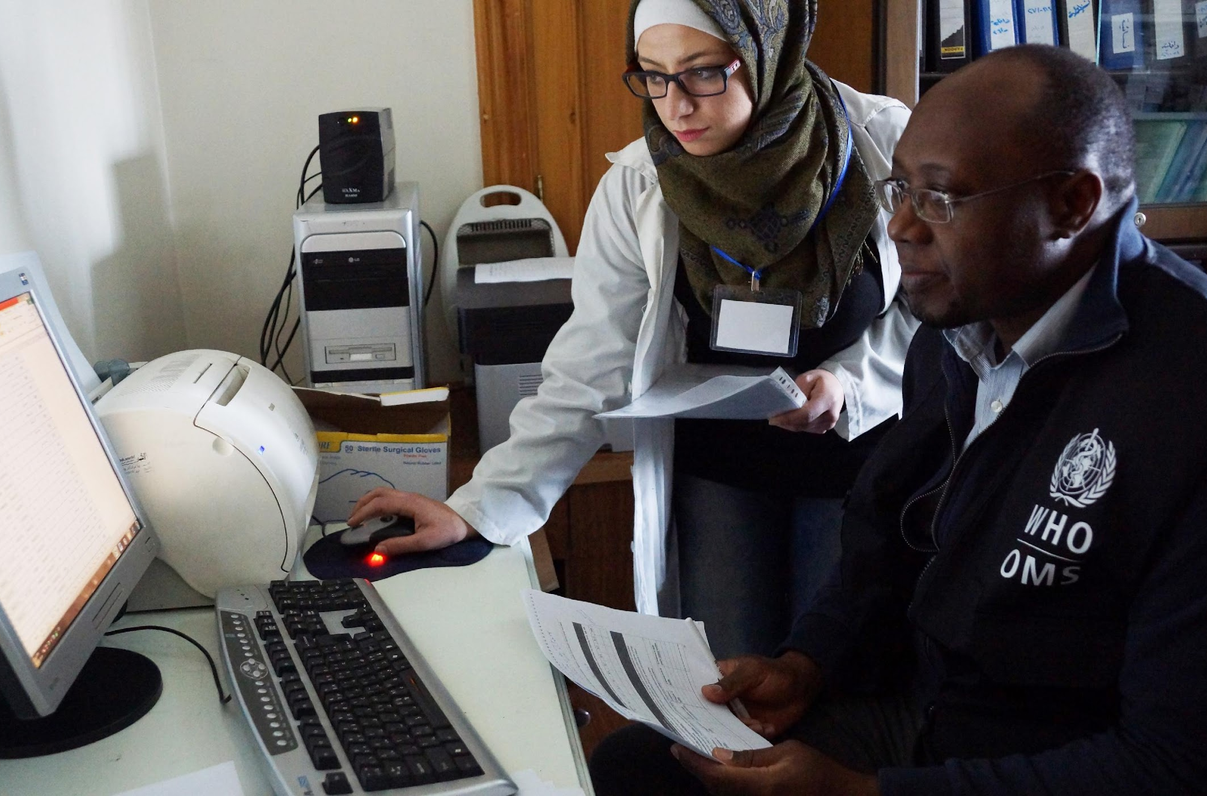
Early warning systems
Emergencies increase risk of spread of communicable diseases
Early warning systems are essential to respond to emerging diseases and deteriorating conditions
Crucial addition to regular surveillance systems
Will track up to 10 priority conditions such as cholera, dengue, Ebola, malaria
Data is collected from specific facilities to track spread and severity

Slide 16
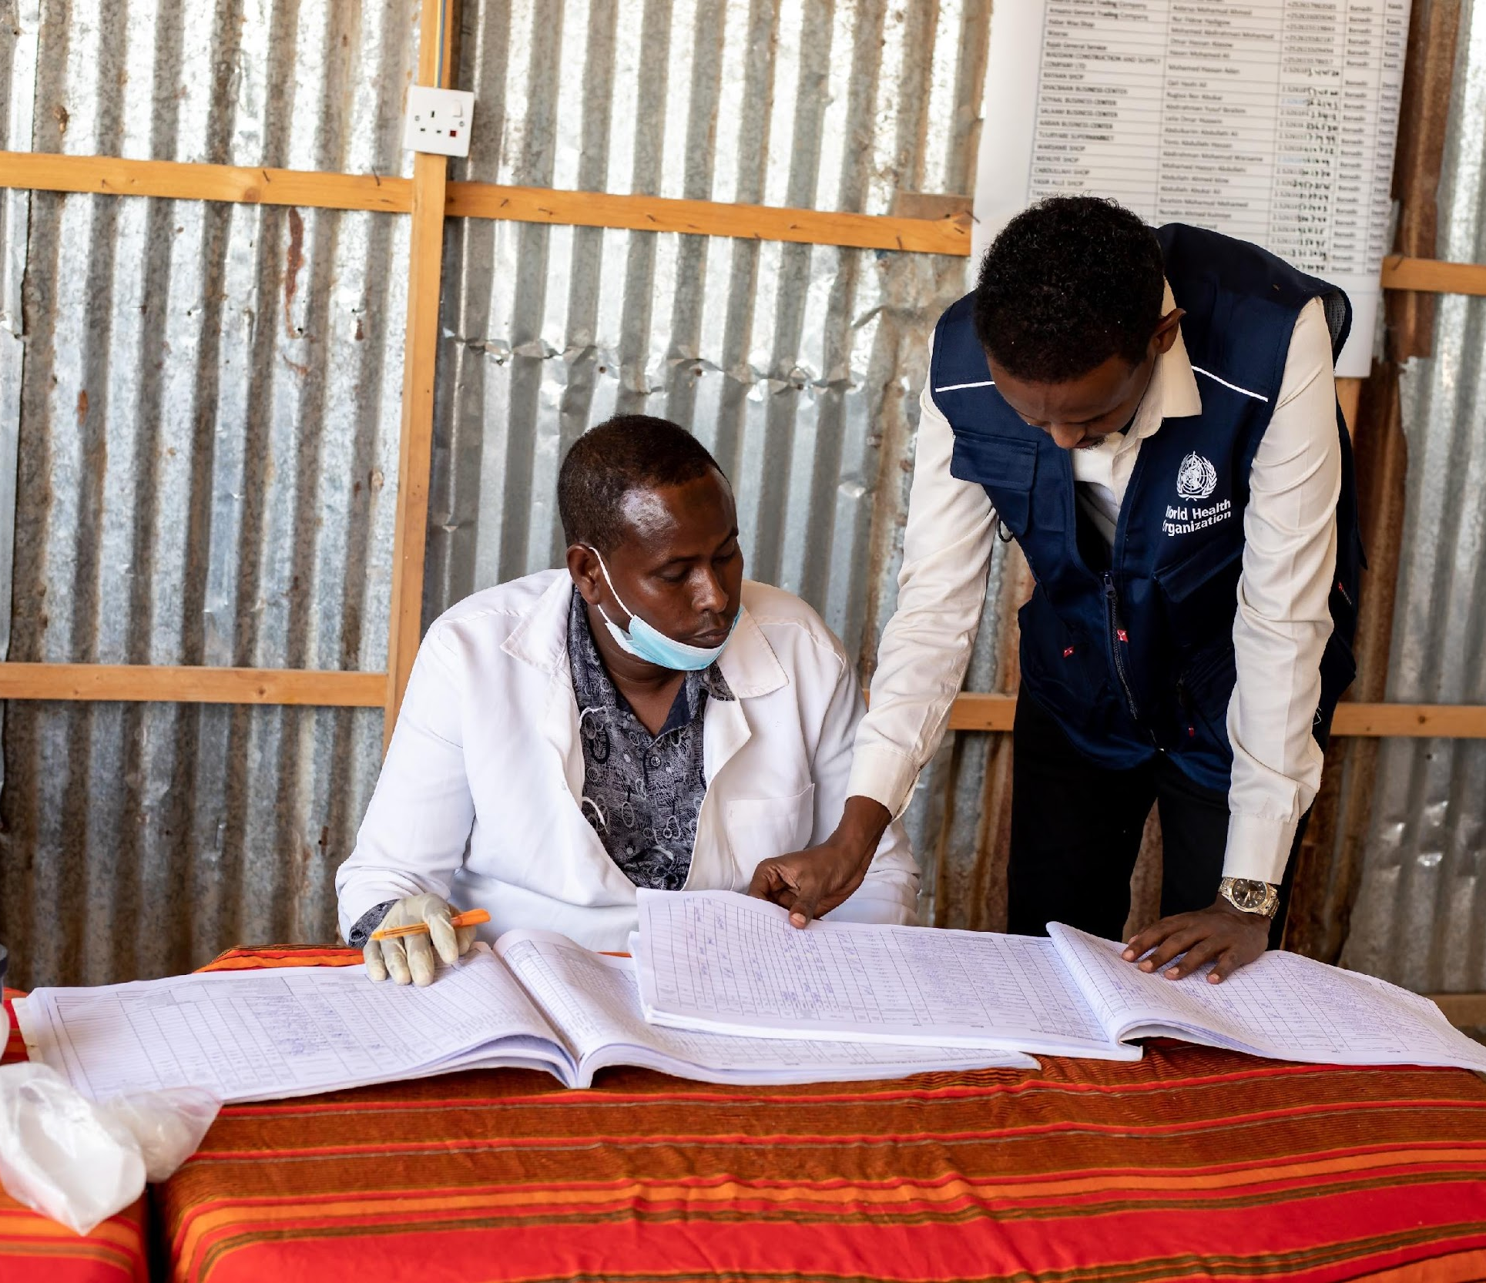
WHO Electronic Early Warning, Alert, and Response System (EWARS) in emergencies
“EWARS” in a box contains all equipment to establish surveillance and response activities
Designed for difficult and remote field settings without reliable internet or electricity
Includes 60 mobile phones, laptops and a local server to collect, report, and manage disease data
Single kit can support surveillance for 50 fixed or mobile clinics, serving around 500,000 people
Deployed during an emergency as an adjunct to the national disease surveillance system
After the emergency, EWARS should re-integrate back into the national system
Notes:
https://www.who.int/emergencies/surveillance/early-warning-alert-and-response-system-ewars

Slide 17
Child and adolescent health integration into EWARS
A rapid assessment precedes the implementation of EWARS, to tailor recommendations to the emergency context
This includes assessing affected populations, focusing on vulnerable groups such as children and adolescents
It also includes identification of major risk factors, such as child malnutrition
Indicators for CAH should be determined, e.g.:
Proportion of unvaccinated cases among measles cases in children <5
Integration of Early Childhood Development (ECD) activities into existing ECD programs and activities
EWARS employs standardized definitions and alert thresholds, adaptable to emergency settings, e.g. for suspected poliomyelitis/AFP: any child <15 years with AFP OR any paralytic illness in a person of any age if poliomyelitis is suspected
EWARS also includes system-generated alerts for increasing trends
Notes:
https://iris.who.int/bitstream/handle/10665/365730/9789240063587-eng.pdf?sequence=1
https://cdn.who.int/media/docs/default-source/documents/emergencies/ewars-presentation.pdf?sfvrsn=9bf14b42_2

Slide 18
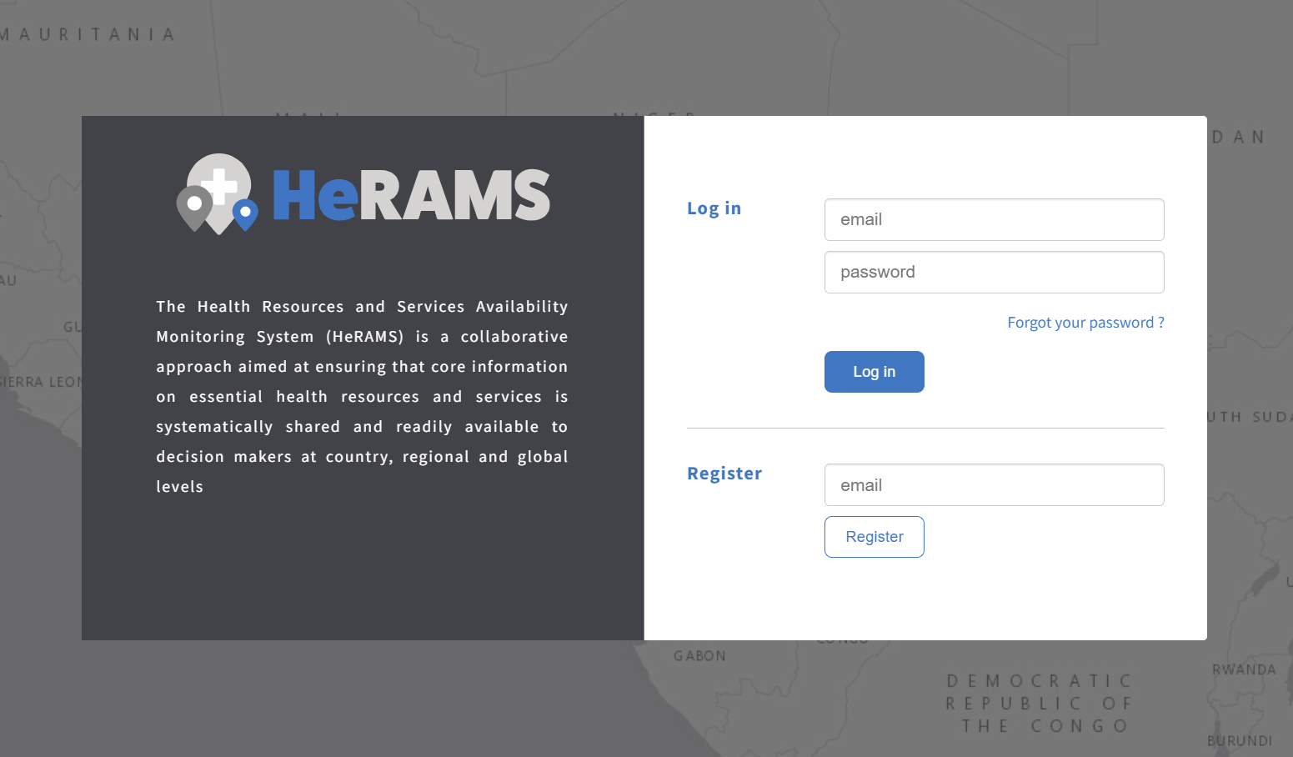
Health Resources and Services Availability Monitoring System (HeRAMS)
Aims to ensure that core information on essential health resources and services is readily available to decision makers at country, regional, and global levels
Involves support of countries on the standardizing and continuously collecting, analyzing, and disseminating information on essential health services and resources
Rapidly deployable and scalable for emergency response and fragile countries; can integrate into routine health information systems
HeRAMS has information on CAH, such as:
Information, education, and communications (IEC) for child caretaker, promotion of exclusive breastfeeding and referral of sick children
Notes:
https://www.who.int/initiatives/herams
https://herams.org/

Slide 19
Multi-cluster / sector Initial Rapid Needs Assessment (MIRA)
MIRA is a joint needs assessment tool for sudden onset emergencies
Besides using MIRA for needs assessment, it can also be used for M&E activities and analysis
It facilitates inter-agency collaboration to establish a common understanding of the situation and its likely evolution
Humanitarian actors utilize MIRA’s findings to develop a plan, mobilize resources, and monitor the situation
MIRA directs the development of subsequent needs assessments and analysis (often more detailed and operational)
MIRA provides an evidence base for response planning
Notes:
https://emergency.unhcr.org/coordination-and-communication/cluster-system/multi-cluster-sector-initial-rapid-needs-assessment-mira
https://reliefweb.int/report/world/multi-sector-initial-rapid-assessment-guidance-revision-july-2015-enru?_gl=1*1buivs6*_ga*MTk4NzU1MTgxOC4xNjgwNzA0ODg5*_ga_E60ZNX2F68*MTcwNTA0OTE2My4yNy4xLjE3MDUwNDkyMjcuNTkuMC4w

Slide 20
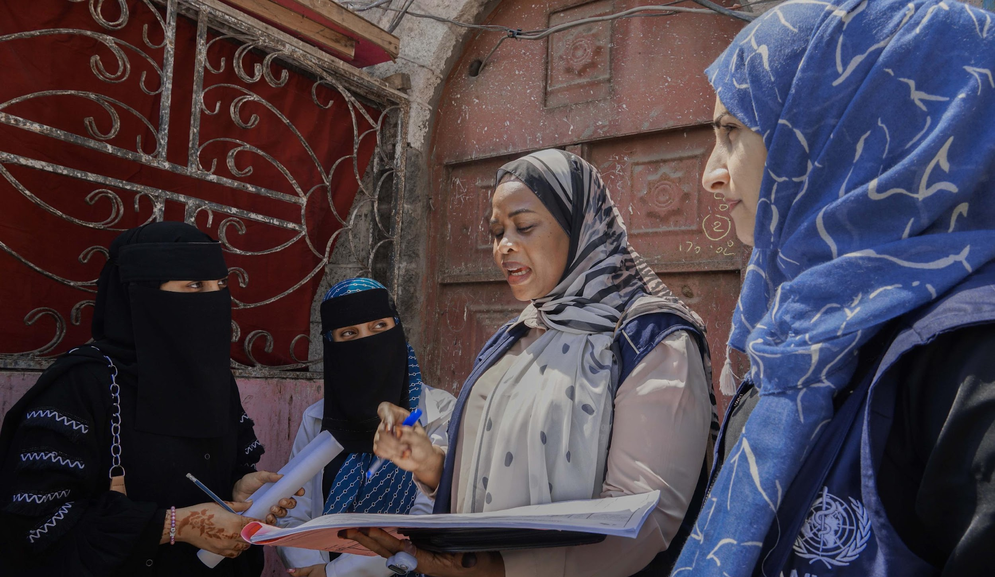
Impact of emergencies on health information systems
Routine health information systems and data flow are usually disrupted during emergencies
Adaptation is necessary to reflect the needs and capacities during the emergency
Emphasize the importance of data sharing and promoting its use at local, district, and national levels
Encourage health managers to consult the lead monitoring and evaluation agency for support if they lack the time or analytical skill to review data effectively
Highlight the critical role of collecting data to inform action and decision-making during emergencies

Slide 21
Programme reviews for maternal, newborn, child and adolescent health (MNCAH)
A programme review for MNCAH is:
A process for assessing mid- and/or end-term country progress in improving MNCAH
Conducted on periodic basis as part of regular programme planning and implementation cycle
Most useful if coordinated with other ongoing review and planning activities
Ideally incorporated into existing strategic and annual plans and processes
Using a continuum of care approach, covering all life stages (pre-pregnancy, pregnancy, childbirth, newborn, childhood, adolescence, post-reproductive), and all levels of the health system (household, community, health facilities, referral facilities)
Aim: to assess how well national and subnational MNCAH programme(s) implemented their plans and identify successes, lessons learned and good practices
These principles constitute the fundamental aspects of program review, adaptable for utilization in humanitarian settings with adjustments

Slide 22
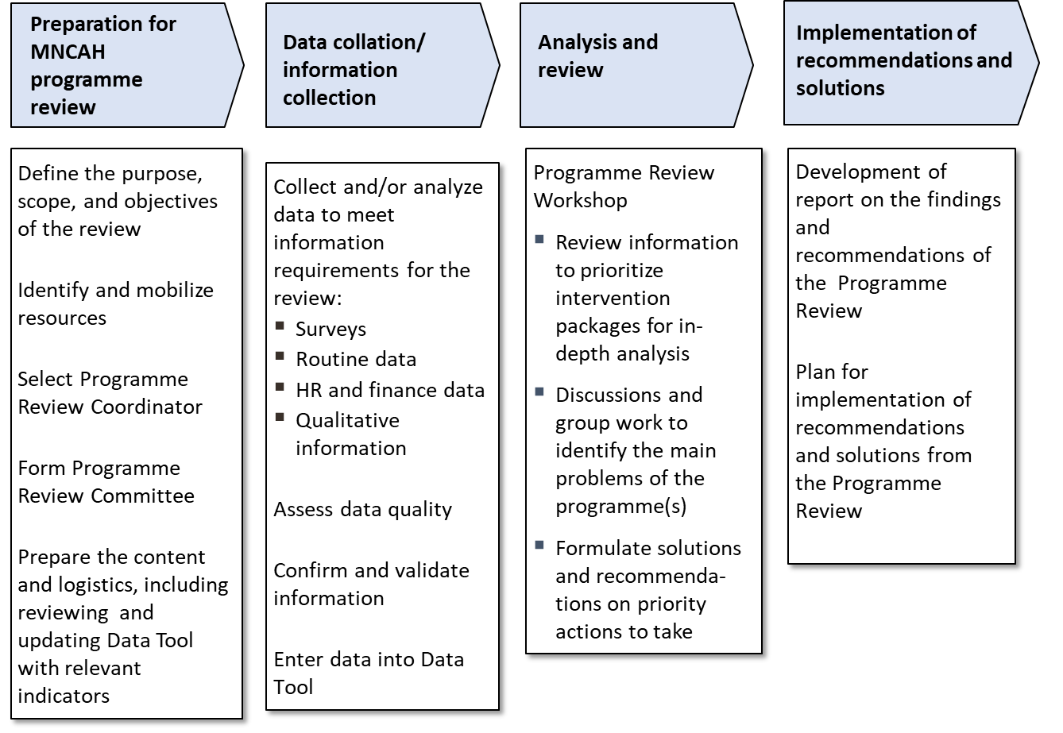
MNCAH programme review - activity flow
To be adjusted to emergency contexts as appropriate

Slide 23
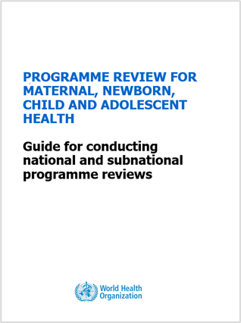
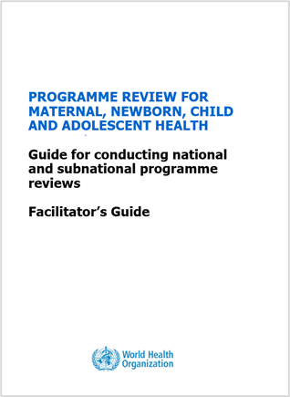
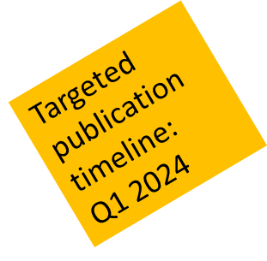
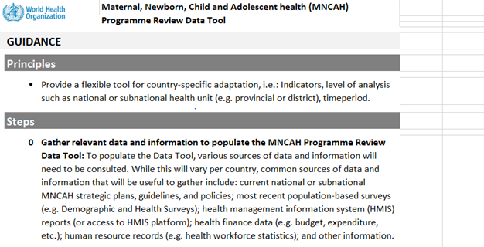
WHO materials to support an MNCAH Programme Review
Programme review for maternal, newborn, child and adolescent health: guide for conducting national and subnational programme reviews
Programme review for maternal, newborn, child and adolescent health: guide for conducting national and subnational programme reviews: facilitator's guide
Maternal, newborn, child and adolescent health programme review data tool

Slide 24
Key actions – Improve health information systems
Collaboration and information sharing
- RMNCAH/CAH working group cooperates with the health cluster lead to improve health information services for CAH
Indicator alignment and system adaptation
- Agree on indicators used and adapt or develop suitable health information system for the emergency context
Early warning system
- Establish or modify early warning systems to detect and respond to communicable disease outbreaks
Data utilization and protection - Analyze and disseminate health surveillance information timely, utilize supplementary data for decision-making, and ensure data protection measures
For more details please refer to the operational guide
Notes:
Adapted from the Sphere Health Standards

Slide 25
Key indicators – Improve health information systems
RMNCAH/CAH working group provides leadership to the health cluster to improve the health information system (including early warning systems), and regularly disseminates reports to partners
Early warning surveillance reports received from health facilities each week
Conduct regular health information reports addressing CAH priorities, including analysis and interpretation of epidemiological data disaggregated by age, coverage and use of health services. Make sure this does not only cover surviving, but also thriving (as nurturing care)
For more details please refer to the operational guide
Notes:
https://nurturing-care.org/nurturing-care-in-humanitarian-settings/

Slide 26
Resources – Monitoring and evaluation
IASC Operational Guidance for Coordinated Assessments in Humanitarian Crises (2012)
Health Cluster Guide: Practical Implementation at Country Level (2009)
Guideline: Common Operating Datasets in Disaster Preparedness and Response (2010)

Slide 27
Tools – Monitoring and evaluation
Global Health Cluster tools – Health Cluster
EWARS: a simple, robust system to detect disease outbreaks – World Health Organization (WHO) Emergencies
Health information system (HIS) toolkit – UNHCR, the UN Refugee Agency (2010)
Health information system (HIS) toolkit reference manual – UNHCR, the UN Refugee Agency (2010)
Multi-sector initial rapid assessment (MIRA) – Inter-Agency Standing Committee (2015)
Rapid risk assessment of acute public health events – World Health Organization (WHO) (2012)
Multi indicator cluster surveys (MICS) – UNICEF
Health Resources Availability Monitoring System (HeRAMS) – World Health Organization (WHO) Humanitarian Health Action
Strategic Tool for Assessing Risk – A comprehensive toolkit for public health risk assessment (in press)
3W/4W/5W – who, what, where, when, for whom – United Nations Office for the Coordination of Humanitarian Affairs
Service Availability and Readiness Assessment (SARA) – World Health Organization (WHO) (2015)
Child protection rapid assessment toolkit – Global Protection Cluster, Child Protection Working Group (2012)
dhis2 – District Health Information Software, version 2 is free health information system software
Newborn health in humanitarian settings: field guide – United Nations Children’s Fund (UNICEF) and Save the Children (2018) - (See annexes of the field guide for newborn assessment tools)

Slide 28
Thank you
For more information, please contact: Khalid Siddeeg, Regional Advisor EMRO, siddeegk@who.int Kim Beentjes, Technical Officer EMRO, beentjesk@who.int

