Slide 1

Case-control studies
Dr. Karim Abawi
Geneva Foundation for Medical Education and Research
Training course in research methodology,
research protocol development and scientific writing
Geneva, 2024

Slide 2
Case-control studies
Case-control studies are observational studies, where two groups determine the level of exposure to a risk or a disease, by identifying a group of individuals with disease and for purpose of comparison, a group of people without the disease.
The investigator collects retrospective information about exposure to the risk factor from both groups.
Case-control studies identify subjects by outcome.
Subjects with disease (or outcome) are called cases and subjects without disease (or outcome) are called controls.

Slide 3
Design of a case-control study
Study hypothesis
A specific hypothesis is the first and the most important step in an epidemiologic study design.
It must be clearly stated prior to the design of the case–control study.
Poor hypotheses lead to poor study design and problems in interpretation of results.

Slide 4
Definition and selection of cases
Case definition, based on precise and objective criteria is essential. For example, a histologically confirmed diagnosis should be required for most cancers.
With precise case definitions, the investigator avoids ambiguity about types of cases and stages of disease to be included or excluded from the study.
In case-control studies, the investigator should clearly define the eligibility criteria for both cases and controls (inclusion and exclusion criteria).
It is important to select both cases and controls from the same source of the population. This help to maximize the chance of detecting important association.

Slide 5
Source of cases
Patient attending health facilities
Medical records
Death certificates
Disease registries (e.g., cancer or birth defect registries)
Cross-sectional surveys

Slide 6
Definition and selection of controls
Controls must fulfil the same eligibility criteria defined for the cases, with the exception of the disease (outcome). For example, if the cases are women with cervical cancer, over 50 years-old and more, the controls must be selected from women in the same age group without the disease.
Source of controls
Controls should be selected from the population from which the cases are selected. This helps to provide an estimate of the exposure prevalence in the population from which the cases arise.

Slide 7
Matching
It is a method to ensure the comparability between cases and controls.
Each case is paired individually with a control according to background variables.
Age, sex, race, sociocultural factors are often used to match cases and controls.
Appropriate matching helps to reduce the confounders.
Confounders are variables associated with the both the exposure (risk factor) and the disease (outcome), but is not on the causal pathway between the two.
Confounders may provide alternative explanations for any associations observed.

Slide 8
Data collection
Data must be collected in the same way from both groups: cases and controls.
Investigators must be objective in the search for exposure, especially since the outcome is already known.
Sometimes it is necessary to interview patients about potential factors, such as smoking history, use of medicine. It may be difficult for some people to recall these details accurately.
Study participants with the disease (cases) remember details of exposure in the past better than participants without (controls).

Slide 9
Case control study design
Exposed
Cases (ill)
Not Exposed
Exposed
Control (Not ill)
Not Exposed

Slide 10
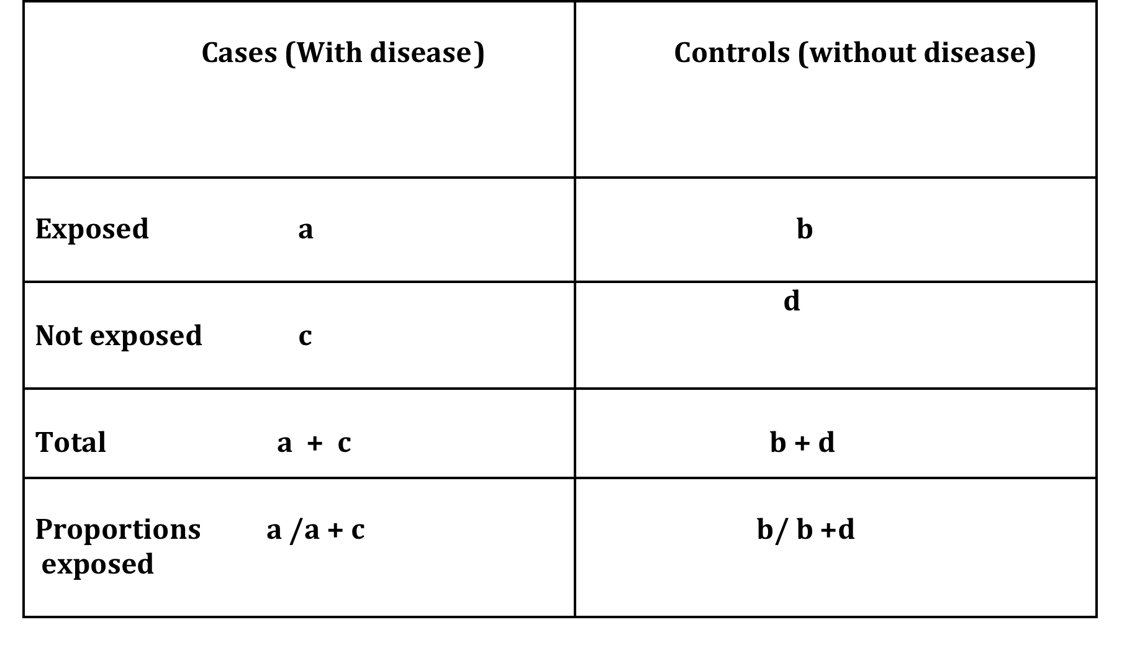
Schema of how case-control is conducted:

Slide 11
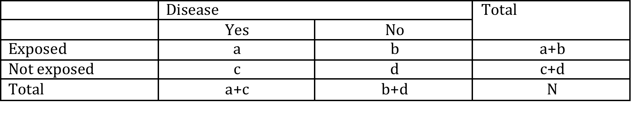
Measure of association in case-control studies
In case-control studies the odds ratio is used as a measure of association between exposure and outcome.
Odds ratio is the ratio of odds of exposure in cases to the odds of exposure in controls. In other words, it is a measure of association between an exposure and an outcome. It is calculated as follow:
ODDS of EXPOSURE in cases = a/c
ODDS of EXPOSURE in controls = b/d
ODDS RATIO = ratio of odds of exposure = (a/c)/(b/d) = ad/bc

Slide 12
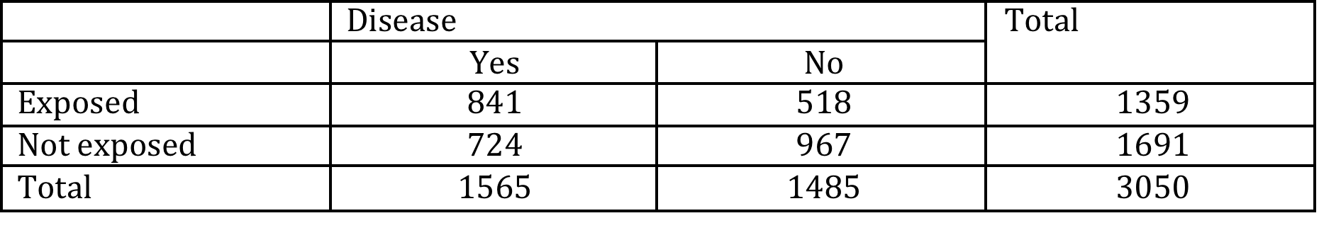
Example: Association between IUD use and PID
ODDS RATIO = (a/c)/(b/d) = ad/bc= 841 x 967 /724x 518 =2.2

Slide 13
Interpretation of ODDS ratio
An odds ratio of :
1.0 (or close to 1.0): There is no association between exposure and the disease.
Greater than 1.0: The exposure might be a risk factor for the disease.
Less than 1.0: The exposure might have a protective effect on the disease.
The magnitude of the odds ratio indicates the strength of association between exposure and the outcome (disease).

Slide 14
Biases in case-control studies
Selection bias
Selection bias occurs when the subjects in one group are different, or the cases and controls are not comparable (other than disease). In order to prevent this bias, precise selection criteria should be defined for both cases and controls.
Ascertainment bias
It may happen because:
Cases may recall exposure better than the controls
Investigators may search for exposure better in cases than in control.
Limitations for recalling past events
In case-control studies much data is collected from interviews. Human beings differ in their capacity to recall information. As mentioned above, cases may have better recall than controls. It is also possible that the person may not have the information requested.
Confounding
It occurs when the observed result between exposure and disease is distorted because of the influence of the third variable.

Slide 15
Strengths and weaknesses of case-control studies
Strengths
Case-control studies cost less than other studies, e.g. cohort studies.
Case-control studies are mostly retrospective; cases are identified at the beginning. There is no need to follow cases over a period of time, unlike cohort studies.
Case-control studies are more appropriate for rare diseases.
The association between diseases and multiple exposures can be studied at the same time.
Weaknesses
Case-controls are subject to multiple biases (especially selection and recall biases).
Case-control studies cannot estimate the incidence rate unless the rates are population based.
Case-control studies are difficult for determining the time period between the exposure and disease.

Slide 16
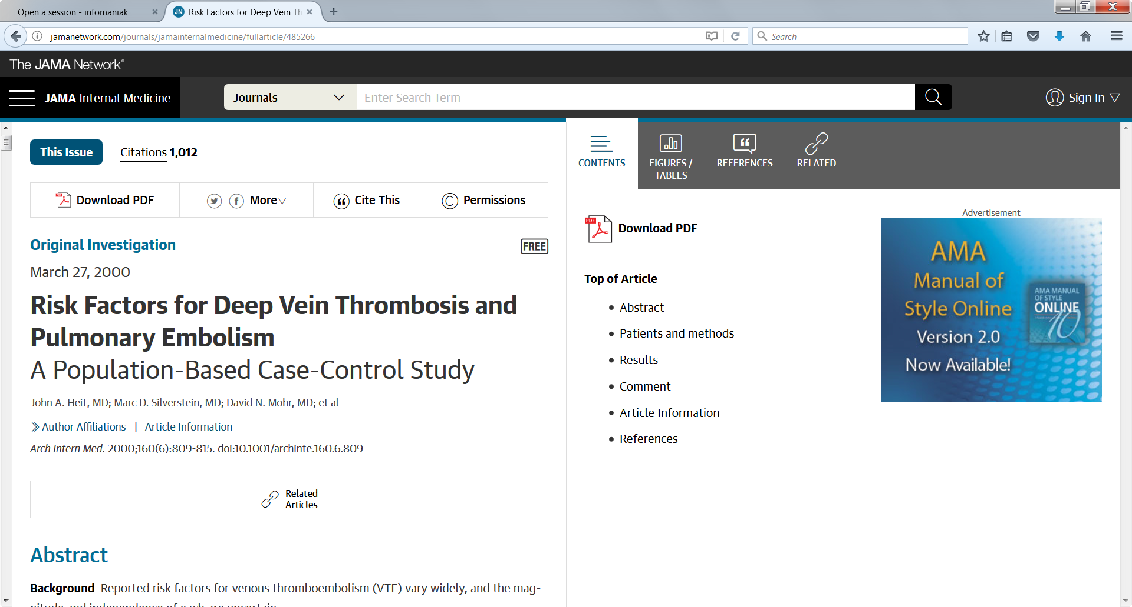
The link below provides access to an example of a case-control study
Article
Heit JA, Silverstein MD, Mohr DN, Petterson TM, O’Fallon WM, Melton LJ. Risk Factors for Deep Vein Thrombosis and Pulmonary Embolism: A Population-Based Case-Control Study. Arch Intern Med. 2000 Mar 27;160(6):809-15. https://dx.doi.org/10.1001/archinte.160.6.809

Slide 17
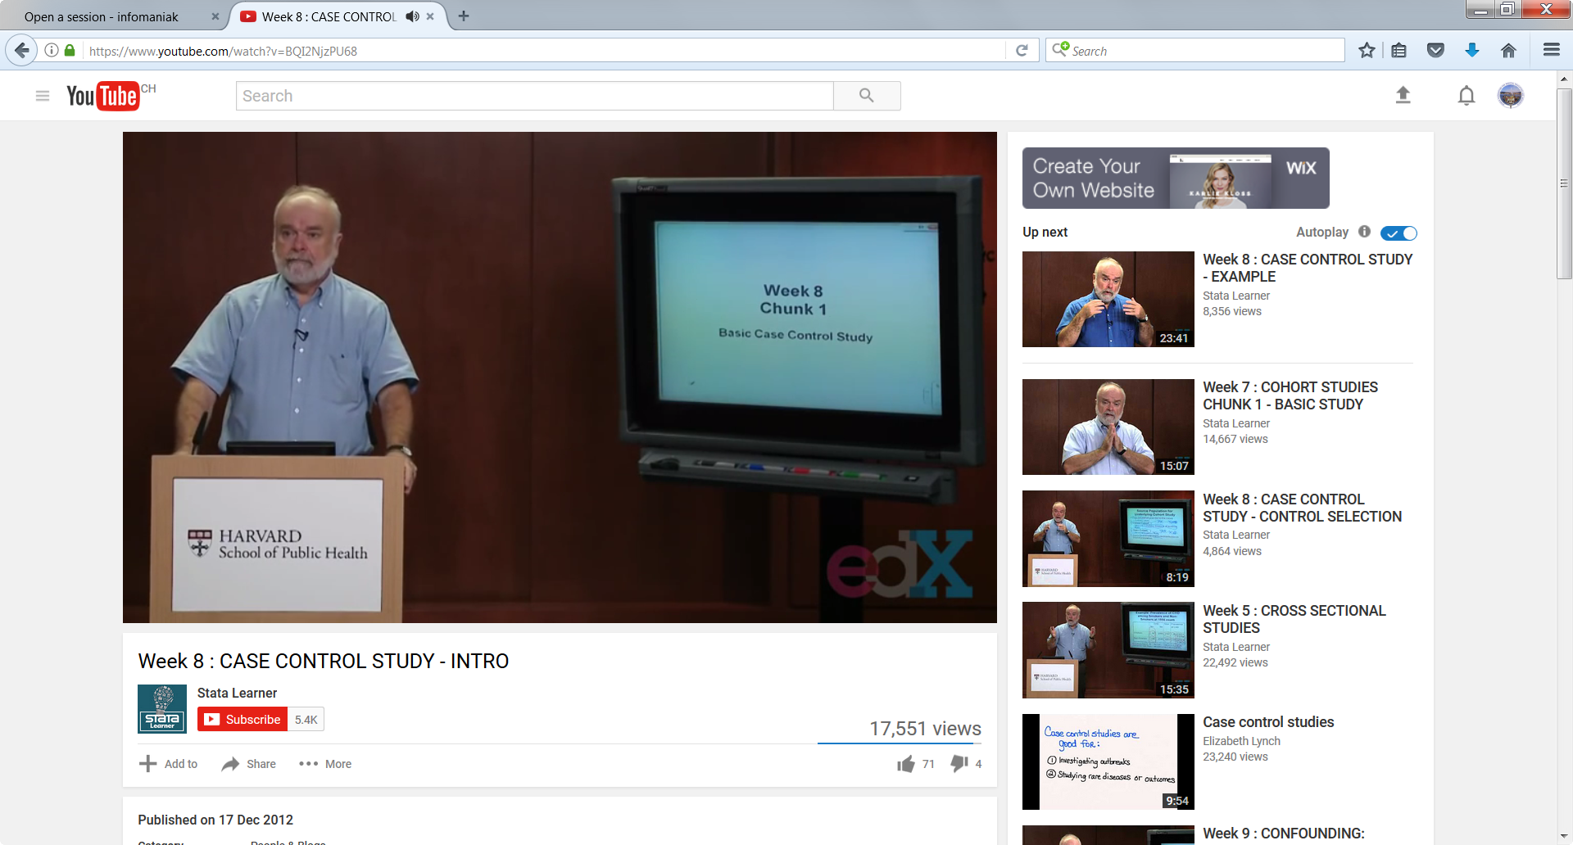
The link below provides access to a teaching session on case- control studies
Video
https://www.youtube.com/watch?v=BQI2NjzPU68

Slide 18
References
Aschengrau A, Seage GR. Essentials of epidemiology in public health. Jones & Bartlett Publishers; 2008.
CDC. Reproductive Health- Data and Statistics: Epidemiology Glossary [Internet]. CDC. 2015.
https://www.cdc.gov/reproductive-health/glossary/index.html
Evidence Based Medicine Toolkit: Clinical Epidemiology Glossary [Internet]. Buckingham Jeanette, Fisher Bruce, Saunders Duncan. c2008.
http://www.ebm.med.ualberta.ca/Glossary.html
Gordis L. Epidemiology. 4th ed. Saunders; 2008.

