Slide 1

Introduction to Qualitative Research
Training course in research methodology, research protocol development and scientific writing
Geneva 2024
Dr Khalifa Elmusharaf
MBBS, PgCert, PgDip, FRSPH, FFPH, MRSTMH, IPMA®C, PhD
Associate Professor in Public Health
Director of Public Health Programme
University of Birmingham Dubai, United Arab Emirates

Slide 2
Learning outcomes
By the end of the presentation, you should be able to:
Describe what is qualitative research
Demonstrate the differences between Qualitative & Quantitative research
Understand the basic concepts of Qualitative studies:
Characteristics of qualitative research
  Bias
  Triangulation
  Trustworthiness

Slide 3
Case study 1
Malaria
A group of researchers from University of Limerick worked in a village in South Sudan. They did a survey of villagers and asked them what were the most serious problems. The villagers said that one of the most serious problems was malaria.
The researchers tested the blood of some of the villagers and found that malaria was very common. They gave people in the village bed-nets soaked in insecticide and told them that using the nets would decrease malaria.
The people started using the nets. The research team tested the blood of the people and found that there was a big reduction in malaria for those people who used the nets. So they felt the program was successful.

Slide 4
Case study 1
Later some other researchers came to the village. They found the people no longer used the nets. They said that they didn’t work.
The villagers were sceptical of outsiders and were less interested in cooperating in programs to reduce malaria.
Question:
What are possible reasons that the people stopped using the nets?

Slide 5
Case study 1 the real reason:
In this case the reason the villagers stopped using the nets was a misunderstanding. By ‘malaria’ the researchers meant infection with the malaria parasite. But the villagers meant all fevers. Therefore, although the number of ‘malaria infections’ decreased, the total number of ‘all fevers’ did not change much in the community’s eyes.
For this reason, they felt the nets did not work against what the community called ‘malaria’ and abandoned using the nets.
Question:
Ask yourself: How could we have discovered the real reason?

Slide 6
Qualitative Research
Qualitative research is an approach to obtain a lot of in-depth information from people. The aim is to understand WHY people think and behave the way they do. Because we spend a lot of time with people to get this information we usually can only talk with a FEW people.
Qualitative research is a form of social inquiry that focuses on the way people interpret and make sense of their experiences and the world in which they live, and understand the social reality of individuals, groups and cultures.

Slide 7
Qualitative Research
This is different from quantitative methods like surveys and case control studies. In quantitative research we obtain relatively little detailed information from each person. This is because with quantitative methods we are interested in describing WHAT people do (things like how many people have had vaccinations) - without really wanting details about why the situation is like that. Because we need less time with people to get this information, we can interview A LOT OF people.
Both qualitative and quantitative methods are important, and whether we use one or the other depends on what we are trying to learn.
Quantitative approaches are important and solve many type of research problem. Qualitative research is appropriate for different type of questions.

Slide 8
Differences between qualitative & Quantitative research
 | Qualitative | Quantitative
1. Aim | Exploration of participants’ experiences and life world Understanding, generating theory from data Exploratory | Search for causal explanations Testing hypothesis, prediction Confirmatory
2. Approach | Broad focus Process oriented Context – bound Getting close to data | Narrow focus Product oriented Context free In artificial or laboratory setting

Slide 9
Differences between qualitative & Quantitative research cont’d
 | Qualitative | Quantitative
3. Sample | Participants & Informants Purposive and theoretical sampling Flexible sampling that develops during research | Respondents Randomised sampling Sample frame fixed before research starts
4. Data collection | In-depth non-standardised interviews Participant observation / fieldwork Documents, photographs, videos | Questionnaire, Standardised interviews Tightly structured observation

Slide 10
Differences between qualitative & Quantitative research cont’d
 | Qualitative | Quantitative
5. Analysis | Thematic, constant comparative analysis Content analysis Grounded theory Ethnographic analysis | Statistical analysis
6. Outcome | Story Ethnography Theory | Measurable results

Slide 11
Differences between qualitative & Quantitative research cont’d
 | Qualitative | Quantitative
7. Relationship | Direct involvement of researcher Research relationship close | Limit involvement of researcher Research relation distant
8. Rigour | Trustworthiness Authenticity Typicality Transferability | Internal validity External validity Reliability Generalisability

Slide 12
Basic concepts of Qualitative studies

Slide 13
Characteristics of qualitative research
The primacy of data | The theoretical framework is not predetermined but derives directly from the data
Contextualisation | Qualitative is context bound, and researchers must be context sensitive
Immersion in the settings | Researchers immerse themselves in the natural setting of the people whose thoughts and feelings they wish to explore
The ‘emic’ perspective | Focus on the views of the people involved in the research and their perceptions, meaning and interpretations
Thick description | Describing the location, people within it, visual picture of the setting, events, verbatim, etc
The research relationship | Based on the position of equality
Triangulation | Several methods, data collections, investigators

Slide 14
Aims of qualitative researchers
Qualitative researchers | Explore the behaviour, perspectives, feelings and experiences of people and what lies at the core of their lives
Ethnographers | Focus on culture and customs
Grounded theorist | Investigate social processes and interaction
Phenomenologist | Consider the meanings of experience and describe the life world

Slide 15
Be Flexible
We need to be FLEXIBLE when carrying out a qualitative study.
There are many methods we can use to achieve the same learning objective.
Also, we can ask different kinds of questions to learn the same information.
So, if we find that a method or question we are using isn’t being understood or isn’t working well, we can change methods or use a different question.
This is unlike a household survey where methods and questions are fixed before we start collecting data.

Slide 16
Bias
“Bias means having only part of the truth, but we use the information as if it were the whole truth”
Since bias is having only part of the truth, we reduce bias by getting more information.
We get more information by looking at something in different ways.

Slide 17
Case study 2
The Mountain
Think of a mountain. If you were standing in one place looking at a mountain and tried to describe it, you would only see one side.
So, your description would be biased. You would need to stand at different places to be able to see the whole mountain and really describe all of it.
But even then, the description would be biased because you may prefer to describe some things and not others.

Slide 18
Case study 2 cont’d
The Mountain
Therefore, we should bring in other people and ask them to describe the mountain also.
But even then, the description is biased because we are all looking at the mountain with the same method, our eyes.
We should use different methods, like using a telescope as well as our own eyes, to get a more complete description.

Slide 19
Case study 2 cont’d
The Mountain
But the description is still biased because we are all looking at the mountain at the same time of year.
Some months there may be snow on the mountain but not at other times, so we would want to look at different times of the year.
There is a name for reducing bias by using different ways to study the same thing. It is called TRIANGULATION. We do this, triangulation, in qualitative studies to describe populations instead of mountains.

Slide 20
Triangulation
Reduce bias by using team members with different experiences and perspectives
Continuously cross-checking information using different methods and types of informants
  Actively identify bias at the end of each day
  Decide how to manage bias in days ahead
  Levels of triangulation
  Data
  Investigators
  Methods
  Information

Slide 21
From different groups
Investigator triangulation
Multidisciplinary
Methodological triangulation
Types of Informants
women & men
Gender
Insiders / Outsiders
young & old
different ethnic groups
different SES groups
Data triangulation
Different locations
Different times
Within – method (intra – method)
Between method (across – method)

Slide 22
Trustworthiness
We sometimes say that we trust a person. With this we mean that his behaviour is predictable in that similar behaviour is expressed at different occasions and we believe that the person is not lying. A trustworthy person is someone who tells us the “truth” and dose so consistently.
What then, is trustworthy research?
How can we judge what findings are worth believing?
Several criteria have been established within both quantitative and qualitative research to judge their trustworthiness or rigor:

Slide 23
Four Criteria for assessing trustworthiness
Question asked | Issue | Qualitative | Quantitative
1. Have we really measured what we set out to measure | Truth value | Credibility | Internal validity
2. How applicable are our result to other subjects and other context | Applicability | Transferability | External validity
3. Would our findings be repeated if our research were replicated in the same context with the same subject | Consistency | Dependability | Reliability
4. To what extent are our findings affected by personal interest and biases | Neutrality | Conformability | Objectivity

Slide 24
1) Truth Value: Credibility
The ability of the study to capture what the research really aimed at studying, meaning that the result are not simply the product of research design errors, misunderstandings, or influence of unknown factors.
= Internal validity in quant

Slide 25
How can we improve the credibility of a study?
Prolonged Engagement (Stay in the field until data saturation occurs.)
  counters distortions from researcher's impact on the context
  limits researcher biases
  compensates for effects of unusual or seasonal events
Persistent Observations (Consistently pursue interpretations in different ways in conjunction with a process of constant and tentative analysis. Look for multiple influences. Search for what counts and what doesn't count)

Slide 26
How can we improve the credibility of a study? Cont’d
3. Triangulation (The best way to elicit the various and divergent constructions of reality that exist within the context of a study is to collect information about different events and relationships from different points of view.)
  ask different questions
  seek different sources
  utilize different methods
4. Referential adequacy (What materials are available to document your findings? Video tape provides a good record, but it can be obtrusive.)

Slide 27
How can we improve the credibility of a study? Cont’d
5. Peer Debriefing (This is done with a similar status colleague (not with a junior or senior peer) who is outside the context of the study and who has a general understanding of the nature of the study and with whom you can review perceptions, insights, and analyses.)
  tests working hypotheses
  helps develop next step
6. Negative case analysis: involves the conscious search for data that don’t fit the current working hypothesis, within existing data as well as in planned data collection.

Slide 28
How can we improve the credibility of a study? Cont’d
7. Member Checks : is an activity that entails brining back the results to the members of the studied group. At different levels:
  Transcripts
  Preliminary report
  corrects errors
  provides additional information
  puts respondent on record
  assesses the overall adequacy of the data in addition to individual data points

Slide 29
2) Applicability: Transferability
Thick Description
Because transferability is a naturalistic study depends on similarities between sending and receiving contexts, the researcher collects sufficiently detailed descriptions of data in context and reports them with sufficient detail and precision to allow judgments about transferability to be made by the reader.
Purposive Sampling
In contrast to random sampling that is usually done in a traditional study to gain a representative picture through aggregated qualities, naturalistic research seeks to maximize the range of specific information that can be obtained from and about that context by purposely selecting locations and informants that differ.

Slide 30
3) Consistency: Dependability
An inquiry must also provide its audience with evidence that if it were replicated with the same or similar respondents (subjects) in the same (or a similar) context, its finding would be repeated
Increasing Dependability
To enable readers of the research report to develop a thorough understanding of the methods and their effectiveness, the text should include sections devoted to:

Slide 31
3) Consistency: Dependability cont’d
The research design and its implementation, describing what was planned and executed on a strategic level;
The operational detail of data gathering, addressing the minutiae of what was done in the field;
Reflective appraisal of the project, evaluating the effectiveness of the process of inquiry undertaken.

Slide 32
4) Neutrality: Confirmability
To what extent are our findings affected by personal interest and biases
This is the degree to which the findings are the product of the focus of the inquiry and not of the biases of the researcher.)
Confirmability Audit Trail
An adequate trail should be left to enable the auditor to determine if the conclusions, interpretations, and recommendations can be traced to their sources and if they are supported by the inquiry

Slide 33
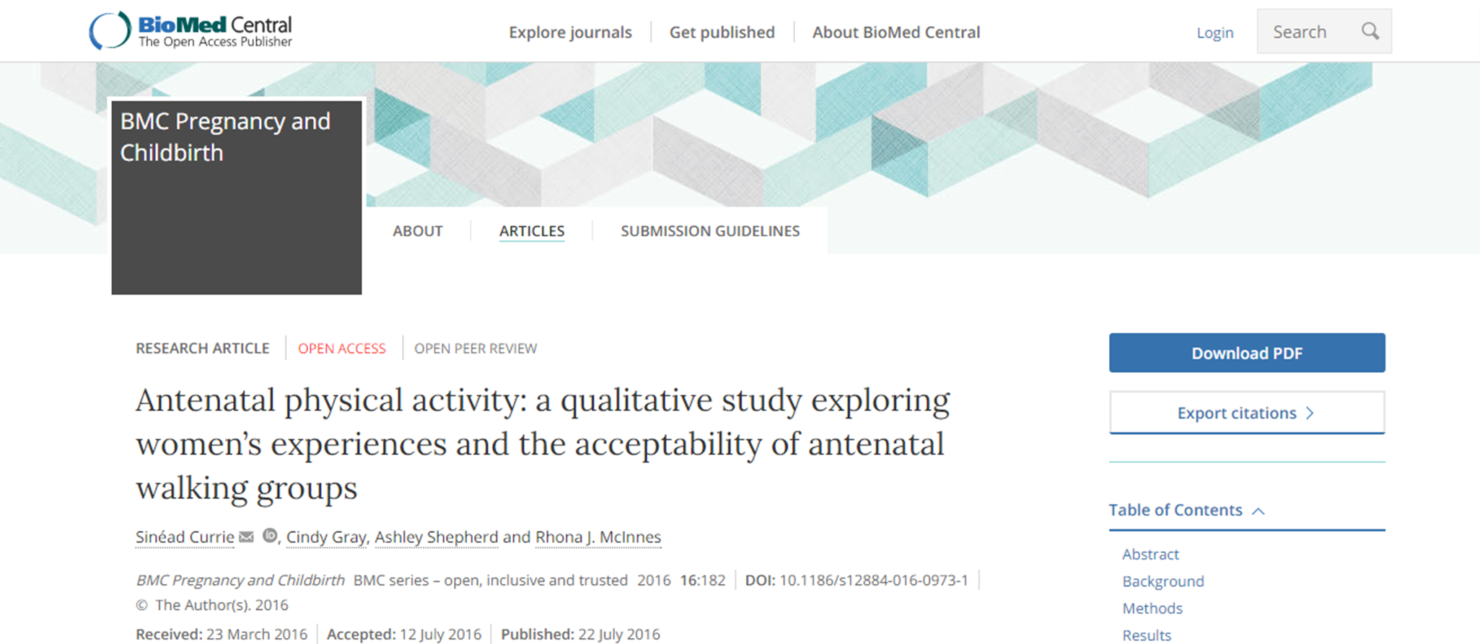
An example of a qualitative study
https://doi.org/10.1186/s12884-016-0973-1

