Slide 1


Critical appraisal
Jane Hirst
Associate Professor and UKRI Future Leaders Fellow
Nuffield Department of Women's & Reproductive Health, University of Oxford
Consultant Obstetrician, Oxford University Hospitals NHS Foundation Trust
Honorary Senior Research Fellow,The George Institute for Global Health, UK

Slide 2

What is critical appraisal?
Carefully and systematically evaluate research to assess:
  Validity (is these findings trustworthy?)
  Value (what do the results show?)
  Relevance (How do these results relate to my clinical practice?)
Burls 2009

Slide 3
Critical appraisal: a key component of evidence based medicine
Clinical Problem
Define the question
Search for the evidence
Critical Appraisal
Decide what action to take
Evaluate your new practice

Slide 4
Asking the right question
P
I
C
O
Population
Intervention
Comparator
Outcome

Slide 5
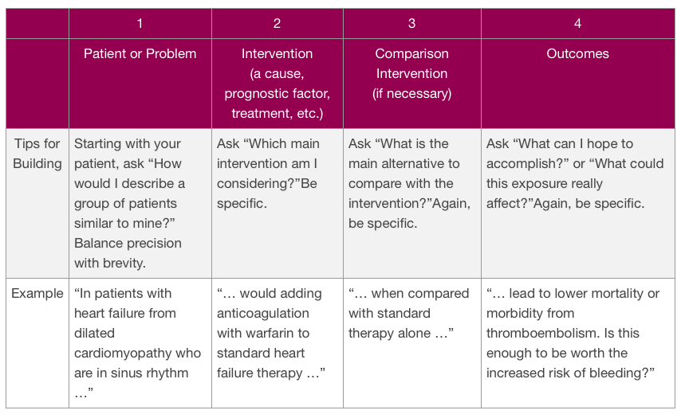
cebm.net

Slide 6

Choosing right study design
Some study designs are not appropriate to answer certain questions
All study designs are prone to different biases

Slide 7
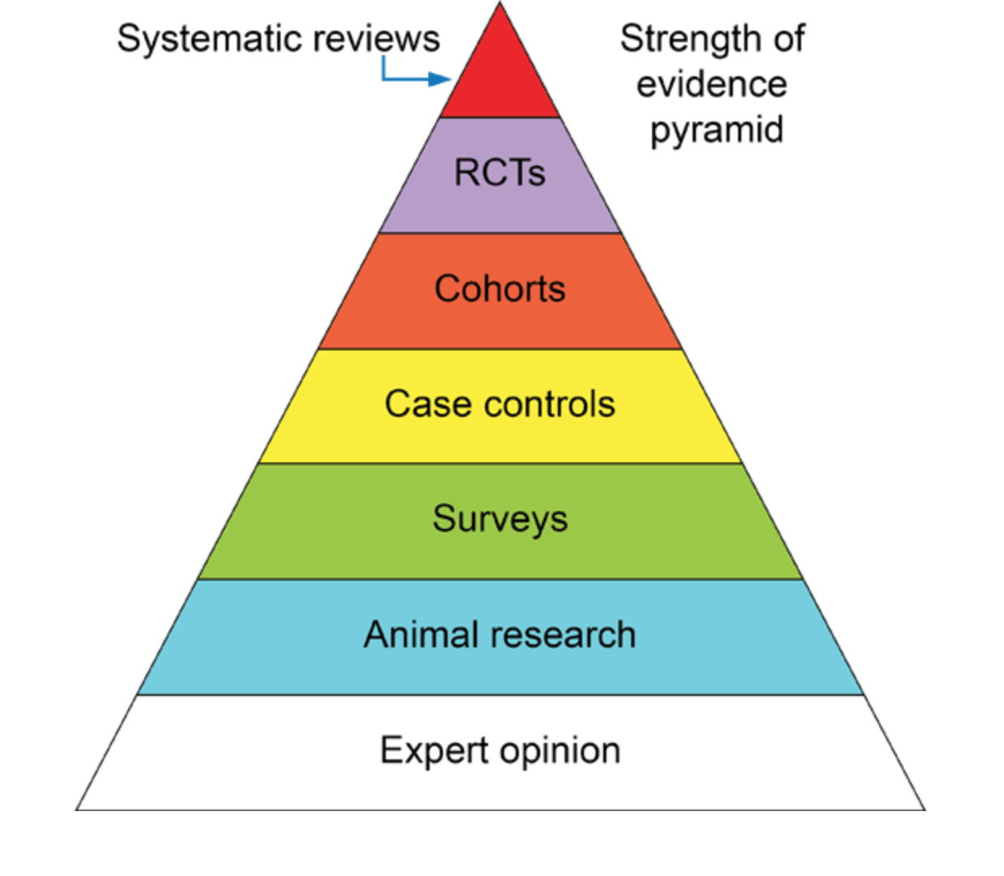
Pyramid of evidence

Slide 8

So are RCTs the gold standard for evidence?
…..depends
Slides from: K Mahtani, CEBM Oxford

Slide 9
Limitations of RCTs
Excellent vs Poor RCTs – quality varies
  Impact on interpretation of result (external validity)?
Expensive and time consuming
  £250k - £millions over 2-5 years+
May not always be the right study design to answer that question

Slide 10







A RCT to examine if smoking causes lung cancer
30 healthy Oxford Students
Randomise to 2 groups
  Gp1 smokes 20 cigarettes per day every day
  Gp2 no smoking
UNLUCKY
STRIKE
The Oxford Unlucky
Strike Trial

Slide 11
Types of research
What is the best study design for answering this type of question?
  Aetiology
  Diagnosis
  Prognosis
  Harm
  Effectiveness
  Qualitative

Slide 12
How to critically appraise an article
  Validity: methods to check that the biases for which that particular study design is prone have been minimised
  Results
  Clinical relevance

Slide 13


Validity
Internal
External

Slide 14
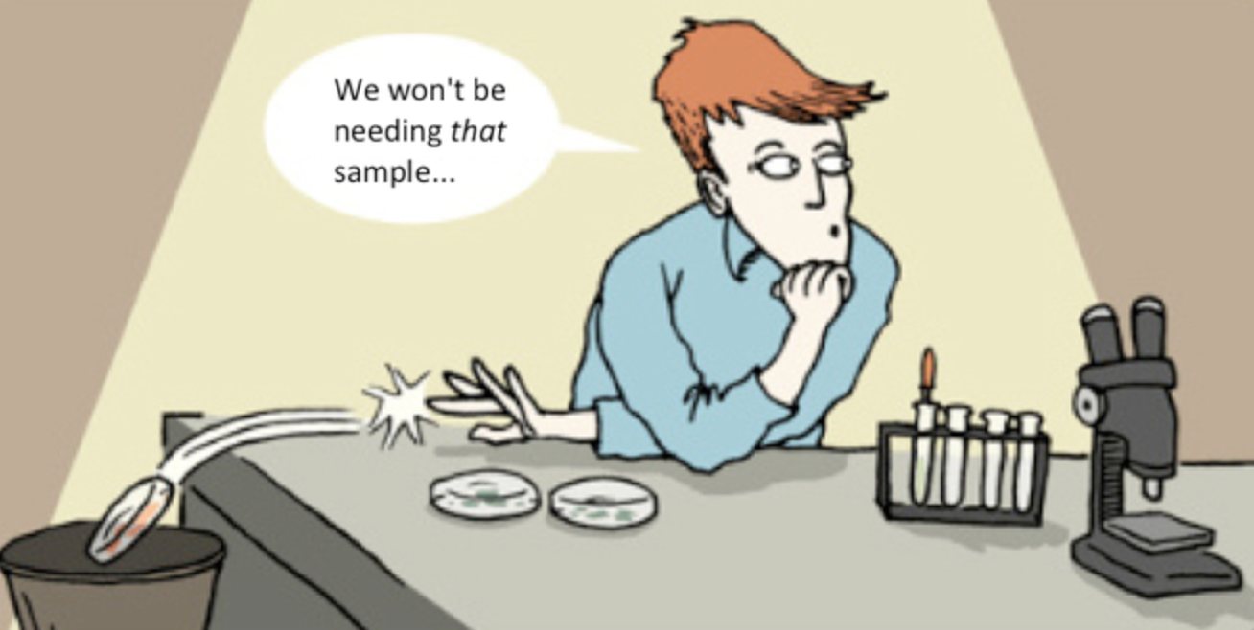
Bias
“the systematic deviation of the results of a study from the truth
because of the way it has been conducted, analysed or reported”
Burls, “What is Critical Appraisal” 2009

Slide 15
Confounding
Design
Recruitment
Citation
Bias
Selection
Exposure or Outcome Misclassification
Interviewer
Recall
Chronology

Slide 16
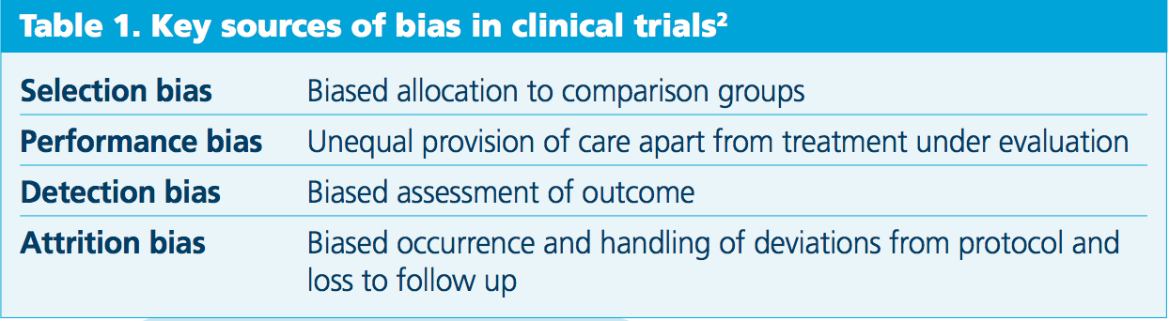
Sources of bias in clinical trials
Juni, BMJ 2001

Slide 17
Assessing Trials of effectiveness
Questions to ask:
Are the results of the trial valid?
What are the results?
Will the results help locally?
From: Critical Appraisal Skills Program, Oxford
www.casp-uk.net

Slide 18
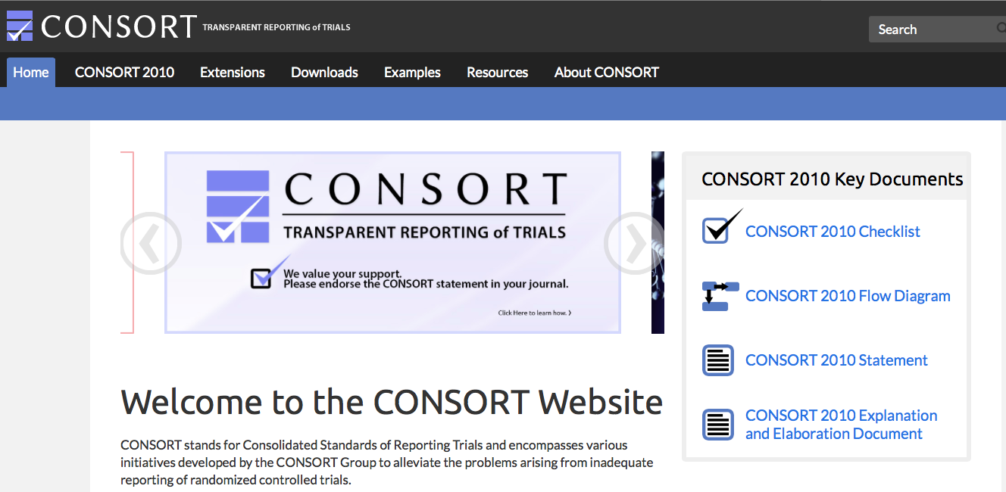


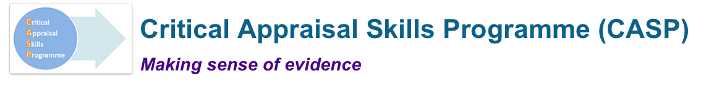
Checklists for clinical trials

Slide 19
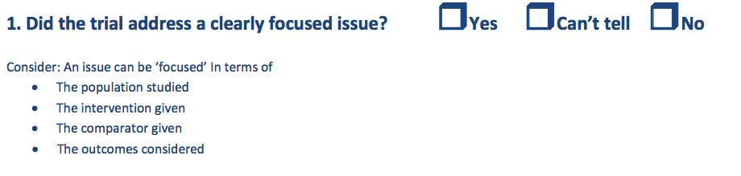
11 useful questions for critical appraisal of a randomised trial
Oxford Critical Appraisal Skills Programme (CASP)

Slide 20
Representative: Are the trial subjects representative of patients in this setting?
All people in study setting
Eligible participants
In trial

Slide 21
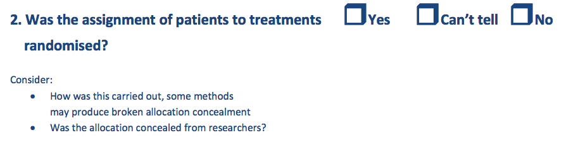

Slide 22

Why randomise?
Minimises measured and unmeasured confounding

Slide 23

Minimising allocation bias
Centralised computer randomisation the best
Other methods such as sealed envelopes doubtful
Non randomised: date of birth, alternate patients alternate days, etc

Slide 24

If answer to first two questions is no….

Slide 25
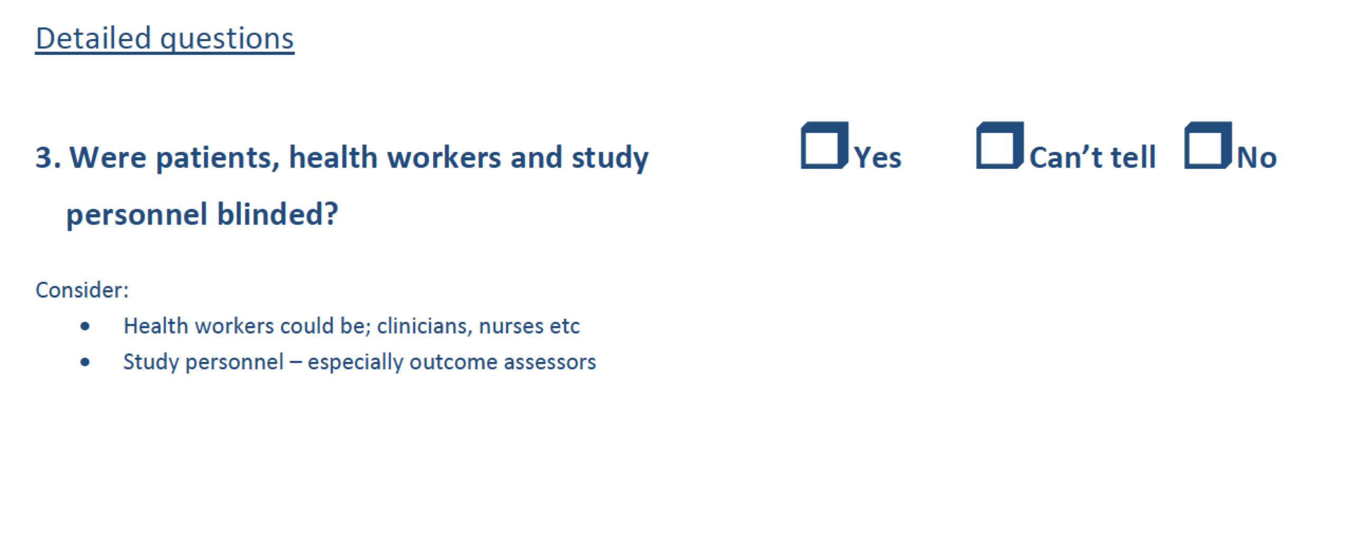
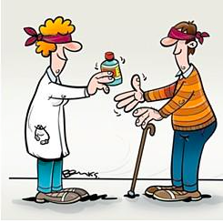

Slide 26
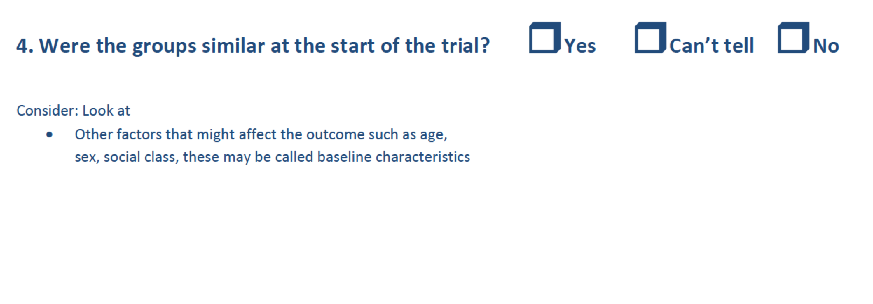


Slide 27
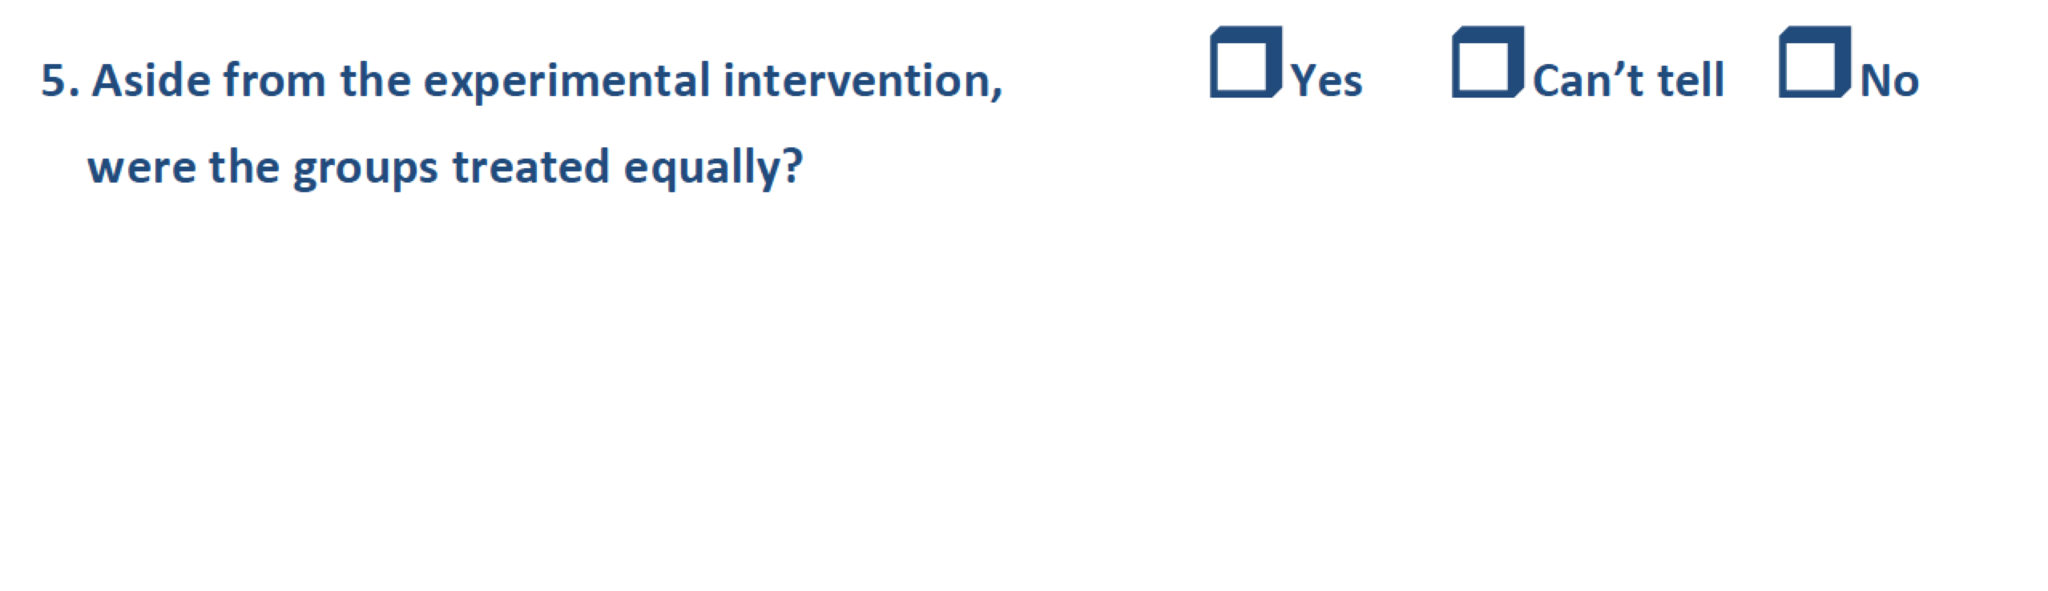
Maintenance: Were the groups treated equally?

Slide 28
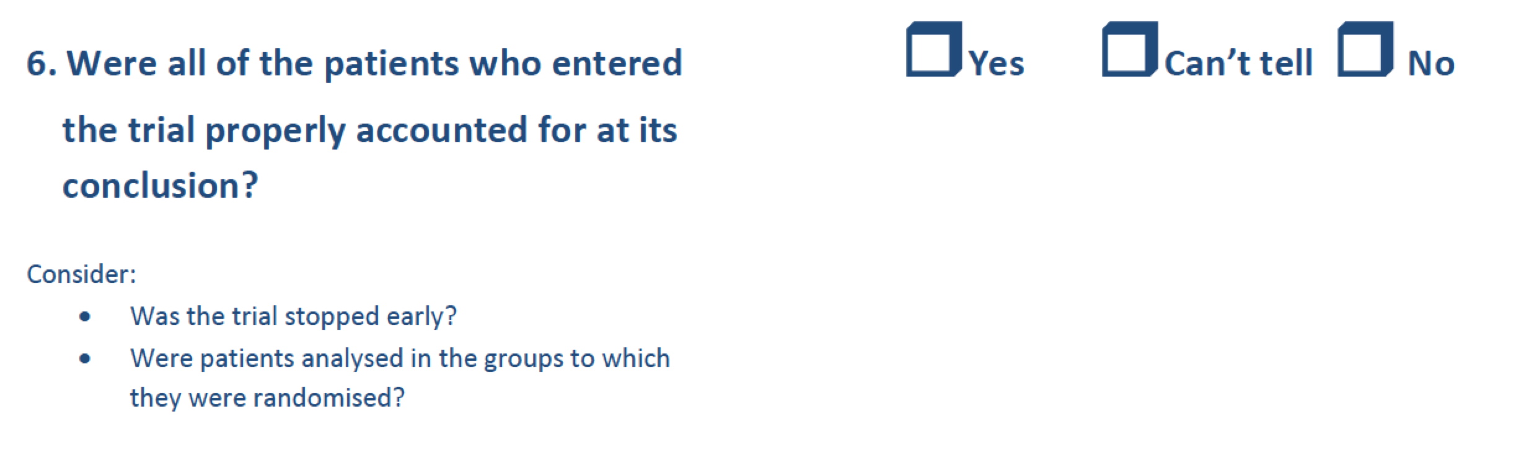

From: Critical Appraisal Skills Program, Oxford
www.casp-uk.net

Slide 29
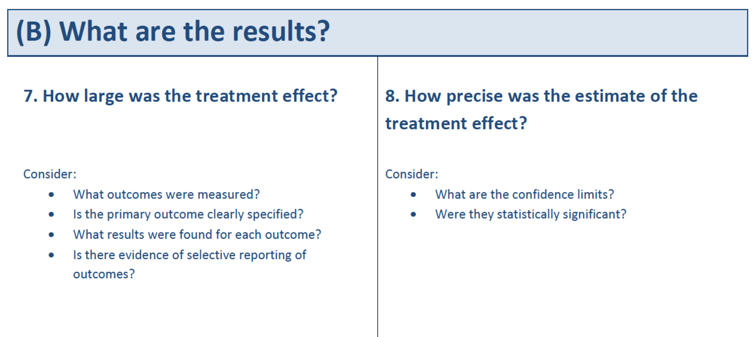
From: Critical Appraisal Skills Program, Oxford
www.casp-uk.net

Slide 30
Intention to treat
Once a participant is randomised, they should be analysed to the group they were assigned to
Pros
  Reflects “real life” e.g non compliance
  Unbiased estimate of true effect
  Maintains sample size thus maintaining statistical power
Cons
  Noncompliance provides little data on efficacy
  Treatment effect may be conservative
  Dropouts/non-compliant/compliant subjects are different
http://www.ncbi.nlm.nih.gov/pmc/articles/PMC3159210/

Slide 31
What does this study tell us?
P values (hypothesis testing):
  Tests to exclude the null hypothesis
Confidence intervals (estimation of effect)
  Range of values within which the true effect is likely to lie
  Wider the confidence interval, less precision in result
Relative Risk
Absolute Risk
Odds Ratios
Number needed to treat

Slide 32
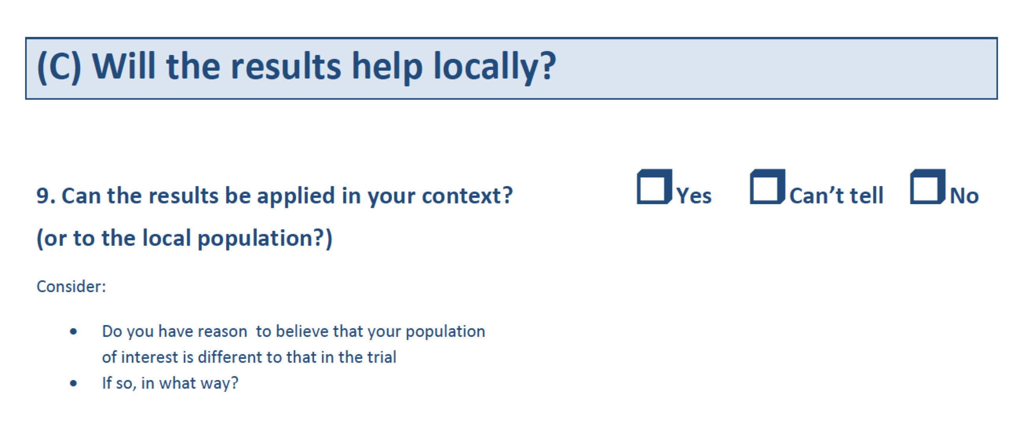



Slide 33
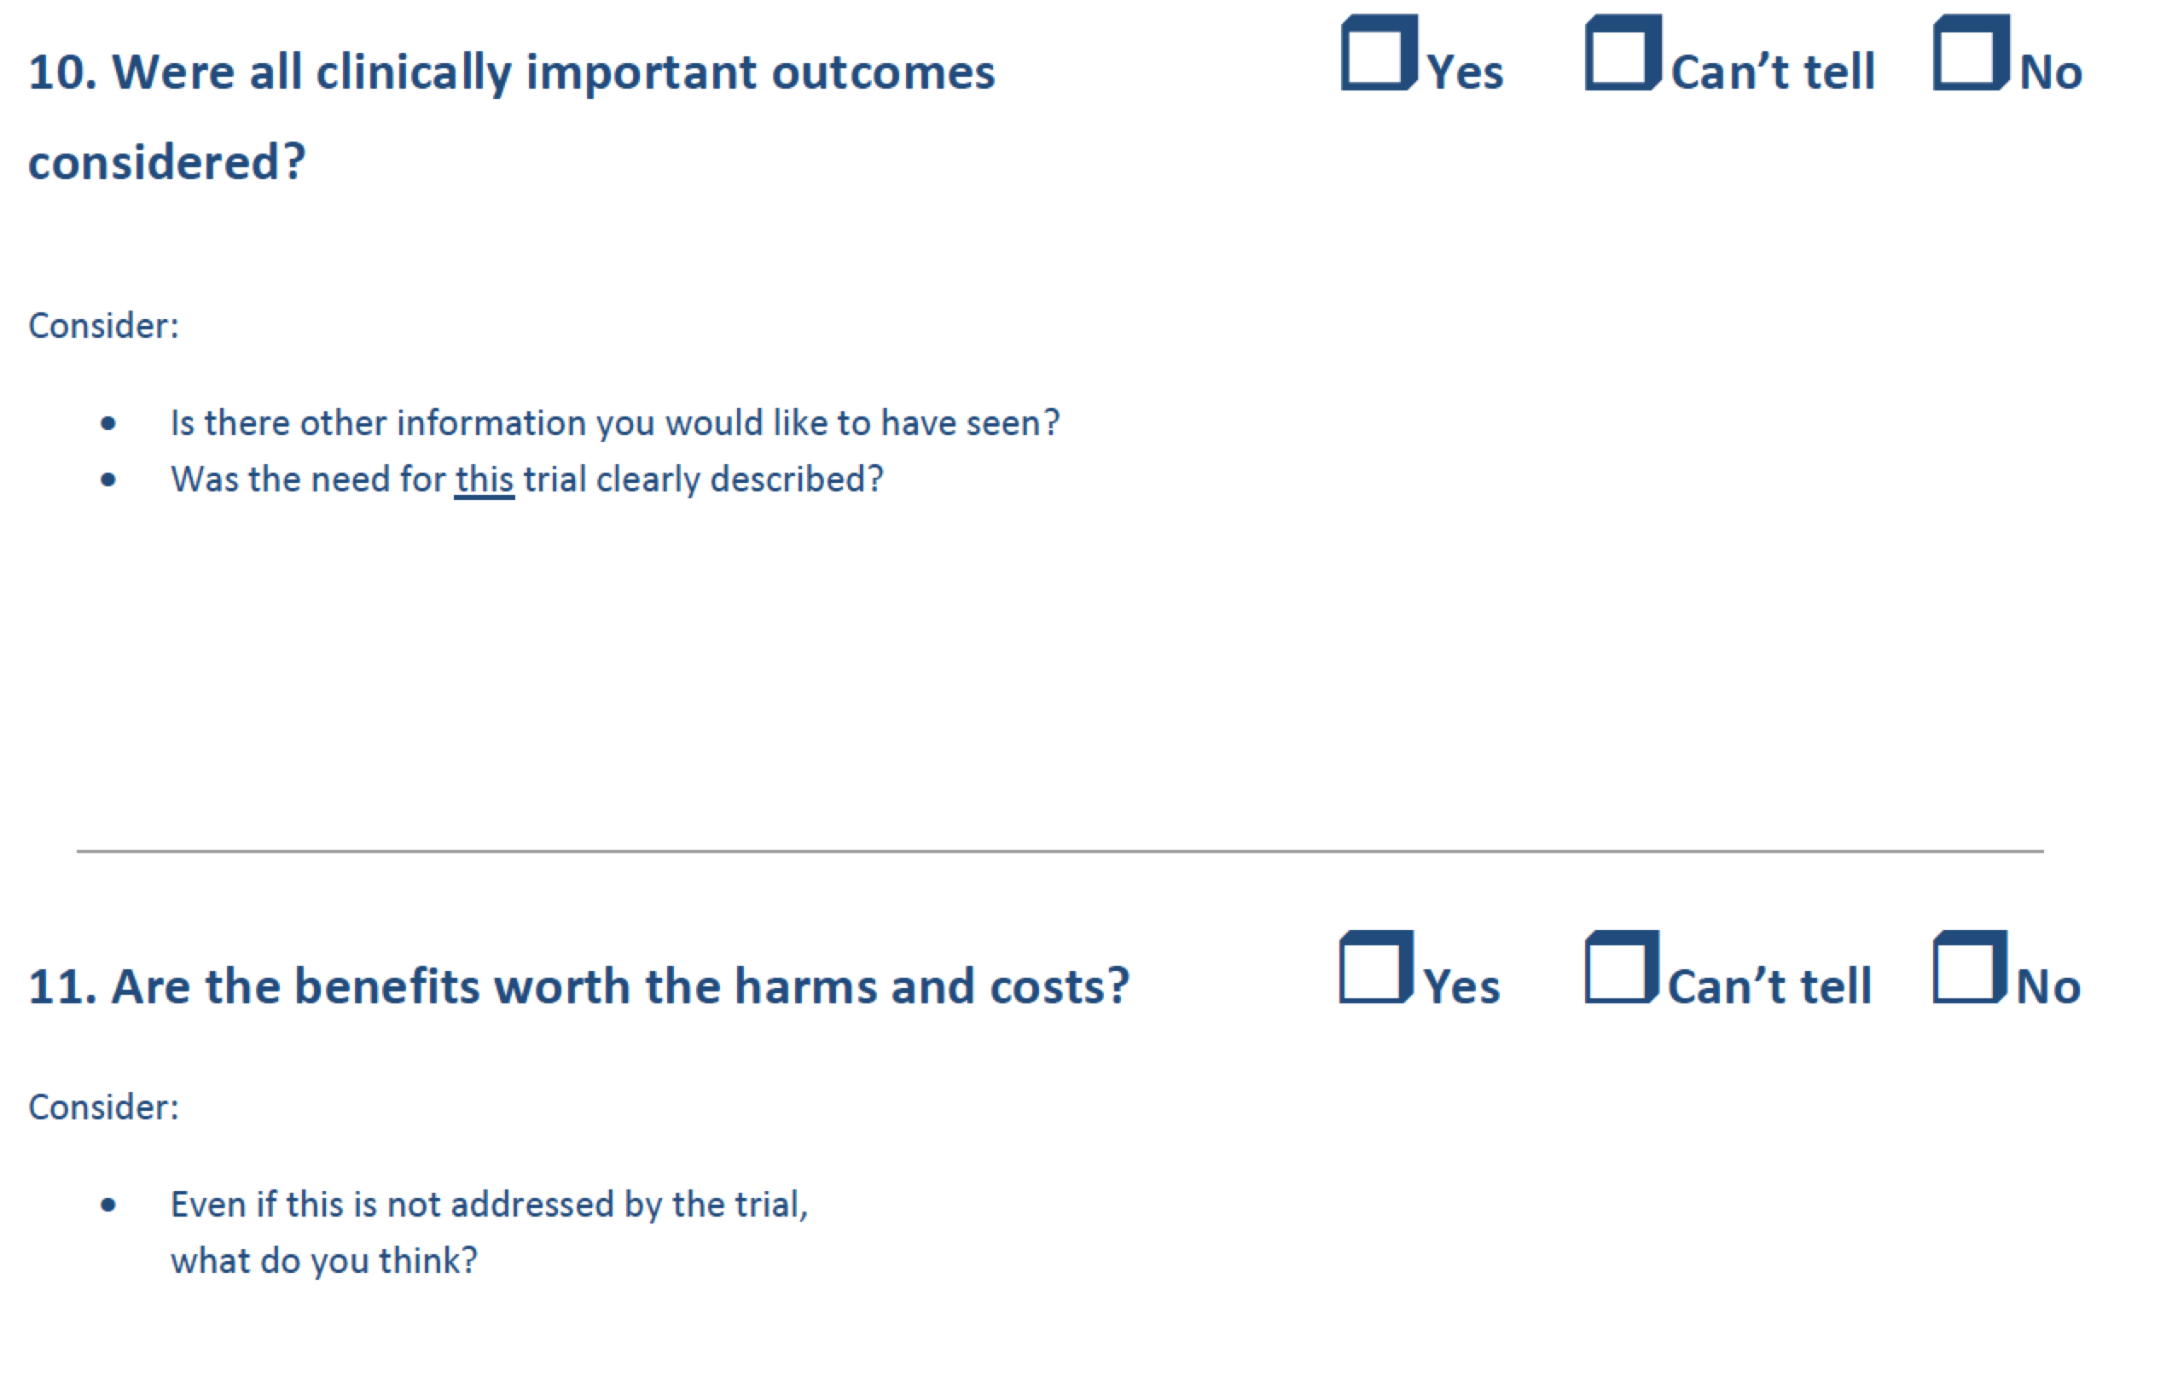
From: Critical Appraisal Skills Program, Oxford
www.casp-uk.net

Slide 34
Conclusion
Critical appraisal helps us decide whether evidence is valid, what the results tell us and whether the study is relevant to our setting
Checklists are available to help
Don’t believe everything you read in journals!

