Slide 1
Shaping the Future of SRHR: Emerging Trends and Research Directions
September 2025
GFMER
Dr Moazzam Ali MD, PhD, MPH
Department of Reproductive Health and Research

Slide 2
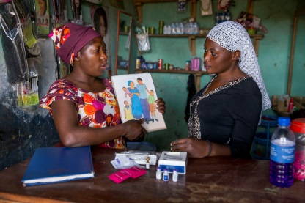
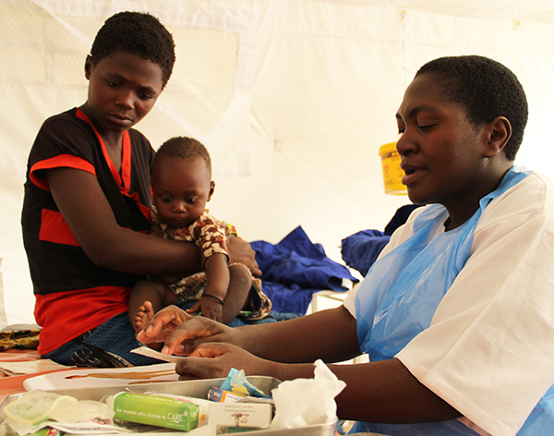
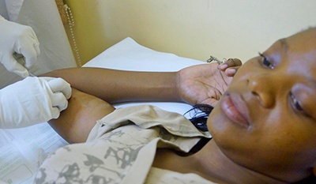
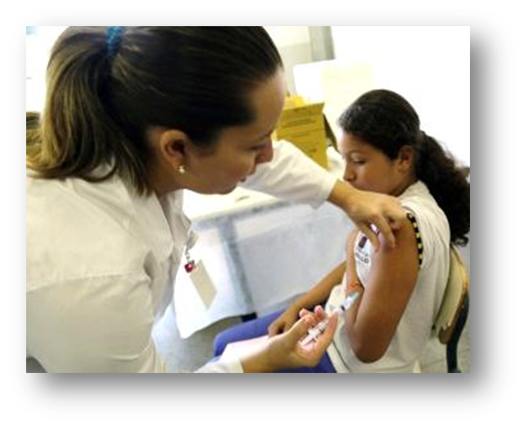
The Scope of Sexual and Reproductive Health Challenges
Maternal and Infant Mortality:
  In 2022, an estimated 152,000 women died from pregnancy-related causes
  Approximately 2.4 million babies died during the first 28 days of life in 2022
  Around 2.1 million babies were stillborn in 2022, with 98% of stillbirths occurring in low-income and middle-income countries
Child Marriages: 39 000 every day.
  Globally, about 32 million adolescent girls are living in countries with high child marriage rates
  Nearly 1 million girls under 15 give birth each year, mostly in low- and middle-income countries
Unmet Contraception Needs: As of 2024, 164 million women of reproductive age still lack access to contraception
Induced Abortions: Recent estimates indicate that approximately 73 million induced abortions occur each year worldwide
Sexually Transmitted Infections (STIs): Each year, there are an estimated 376 million new infections with one of four STIs: chlamydia, gonorrhea, syphilis, and trichomoniasis
Intimate Partner Violence: Approximately 1 in 3 women worldwide have experienced either physical and/or sexual intimate partner violence

Slide 3
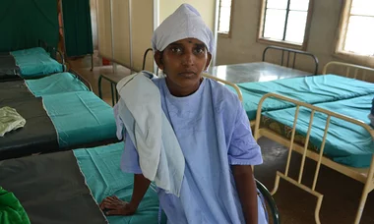
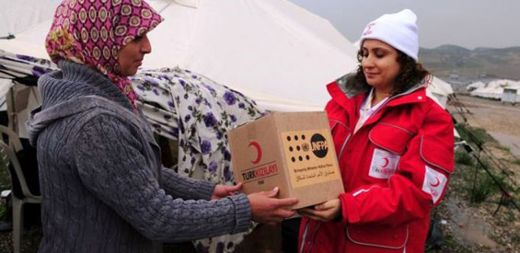
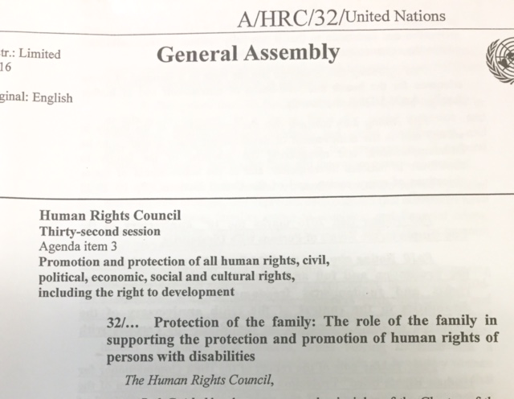
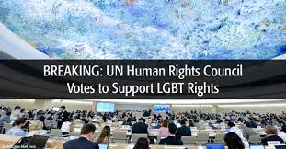
Several challenges to ensuring and protecting SRH rights remain
Addressing sexuality, sexual health, safe abortion, and gender relations continues to be politically challenging, with recent policy trends in various countries either advancing or restricting these rights
Integrating SRHR in humanitarian responses remains essential but complex, with ongoing efforts to develop clear modalities and frameworks to ensure effective implementation

Slide 4
WHO’s core functions
The right to attain the highest standard of sexual and reproductive health
Research
Capacity Strengthening
Global Leadership
Normative guidelines
Innovations
Indicator monitoring
Determinants & consequences
Institutional, organizations, individuals
Methodology development
SRHR advocacy
Convening credibility
Networking

Slide 5
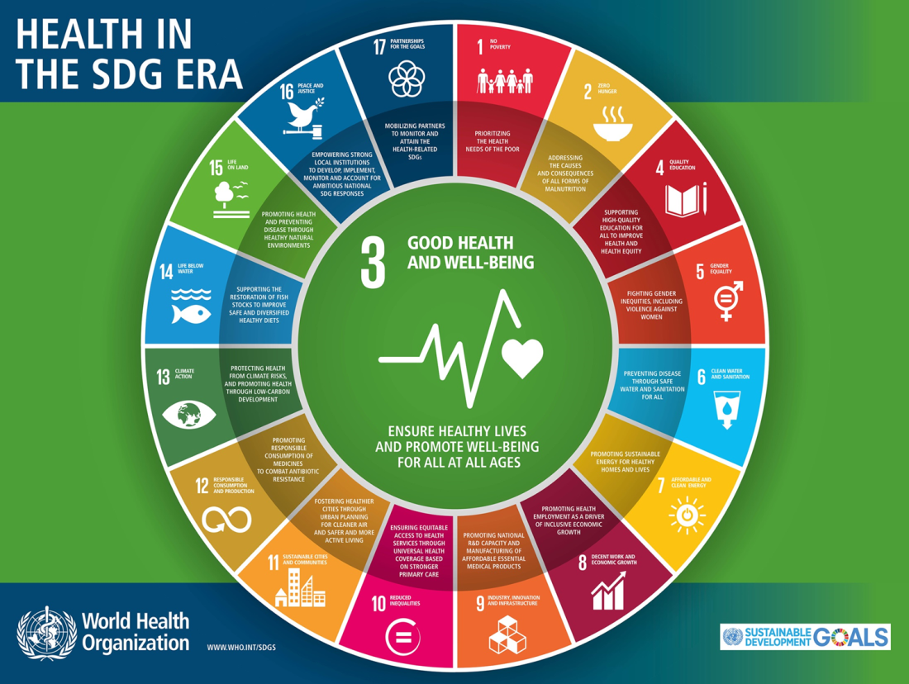
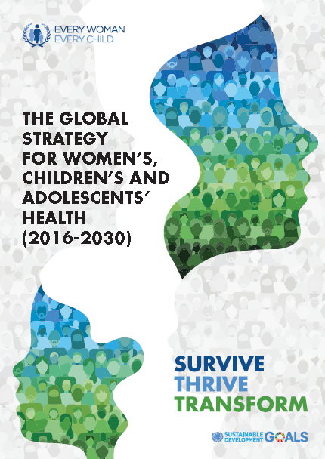

Aligning with the SDGs and Global Strategy for Women’s, Children’s and Adolescents’ Health

Slide 6
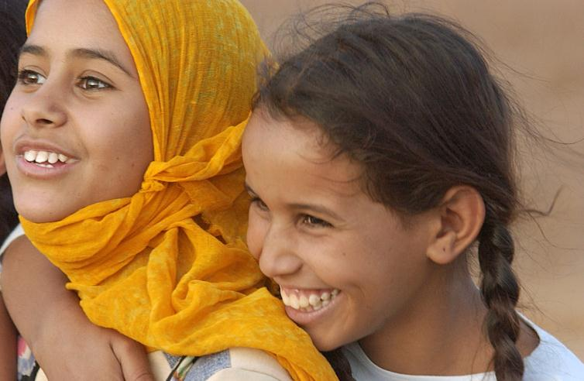
What is new?
Equity
Focus on reaching the most vulnerable and leaving no one behind
Universality
For all countries, with an explicit focus on humanitarian settings
Adolescents
The “SDG generation” –
a 10 year old in 2016
will be 24 in 2030
Life-course approach
Health and well-being interconnected at every age,
and across generations
Multisector approach
Joint progress across core sectors e.g. nutrition, education, WASH
Notes:
This Global Strategy is much broader, more ambitious, and more focused on equity than its predecessor.
It is universal and applies to all people (including the marginalized and hard-to-reach), in all places (including crisis situations), and to transnational issues. It explicitly focuses on safeguarding women, children and adolescents in humanitarian settings and upholding their human right to the highest attainable standard of health, even in the most difficult of circumstances.
Adolescents join women and children at the heart of the strategy
A “life course” approach that aims for the highest attainable standard of physical, mental and social health and well-being at every age. A person’s health at each stage of life affects their health at other stages and also has knock-on effects for the next generation.
Finally, the Global Strategy adopts an integrated and multisector approach, recognizing that non-health sectors—including nutrition, education, water, sanitation, hygiene, and infrastructure—are essential to improving health and well-being, reducing inequities, tackling new environmental challenges, achieving the SDGs and implementing the Global Strategy.

Slide 7
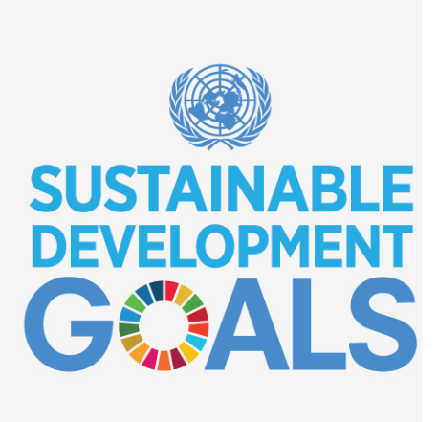
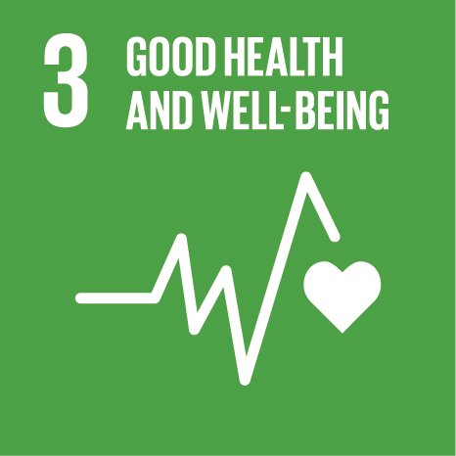
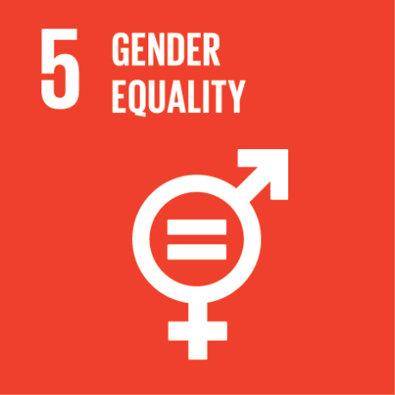
Contributing to SDG indicators related to SRHR
SDG 3.1.1 | Guidance on increasing access to contraception and improving maternal health services to reduce maternal deaths and improve well-being
SDG 3.1.2 | Guidance on strategies to increase access to SBA and quality of SBA services
SDG 3.2 | Research to improve quality of perinatal care and development of normative guidance
SDG 3.3 | Implementation research to support implementation of the global STI strategy and to strengthen SRHR-HIV linkages
SDG 3.7.1 | Implementation research to support scaling up of effective interventions to satisfy demand for contraception
SDG 3.7.2 | Implementation research to support reduction of unintended pregnancy among adolescents
SDG 5.2 | Implementation research to support the global plan of action to strengthen health systems response to violence against women, girls and children
SDG 5.3.1 | Research and technical support to parliamentarians to determine how to legislate effectively against CEFM
SDG 5.3.2 | Research to improve medical care and management of girls & women with FGM in accordance with WHO guidance
SDG 5.6 | Technical support to enable states to safeguard rights to universal access to SRH services
Notes:
To present SDGs indicators related to SRHR.
To present the responsible unit within WHO for reporting on the following indicators: MMR, preterm births, violence against women, STIs.

Slide 8
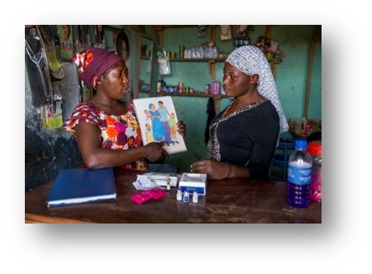
Strategic directions for WHO:
Transitions to align with trends
Global National
  Application of norms & standards, best practices
  Implementation research for institutionalization
  Capacity-building for production and use of evidence
Medical Systems
  Building blocks, especially financing (UHC)
  Integration, wherever appropriate
  Total Market Approaches
Protection Well-being
  Mortality, morbidities and rights
  Personal / couple desires
Level
Intervention
Outcomes

Slide 9

Framework of Evolution of SRHR Research:
Discovery to Delivery
Effective innovations
Effective
Implementation
Enabling
Contexts
Socially
Significant
Outcomes
Implementation research
Epidemiological and behavioural research
Scalable
Sustain
able
Basic science research

Slide 10
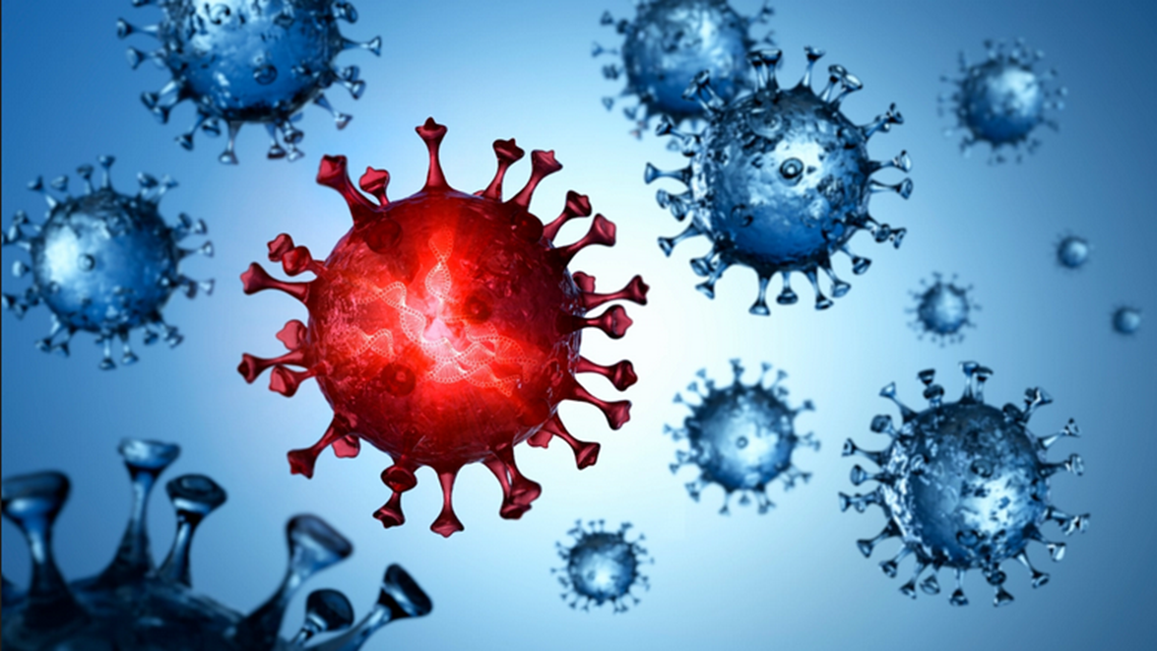
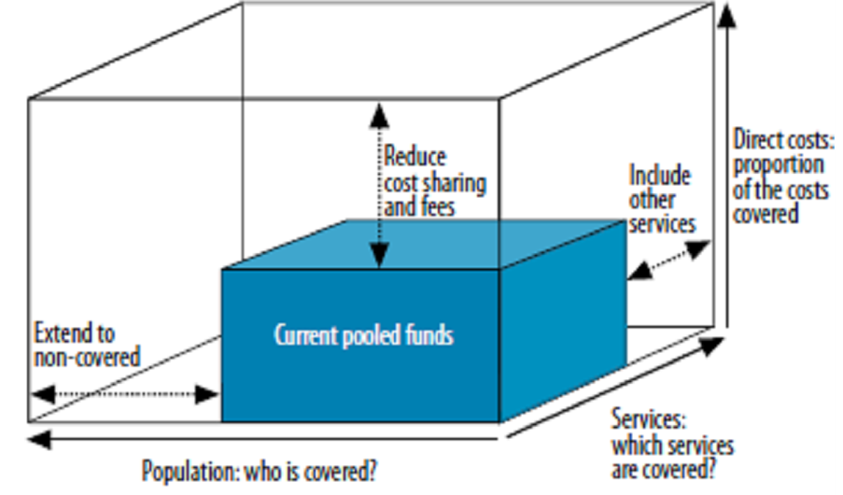
Strategic Alignment: Refining Focus for Greater Impact
UHC as a platform for an integrated approach for delivering SRH services; health security and greater consideration of socio- economic interactions needed
Intersectoral action: stronger integration with the economic, social and environmental determinants needed
Equity: critical, and for all countries; need for focus on sub-national data and actions
Gender Equality and Human Rights: need for stronger and deeper integration of gender equality and human rights
Financing shifts to greater domestic financing; least developed and fragile countries continue to need ODA assistance
Monitoring and accountability framework requirements enormous; increased role for HRP

Slide 11
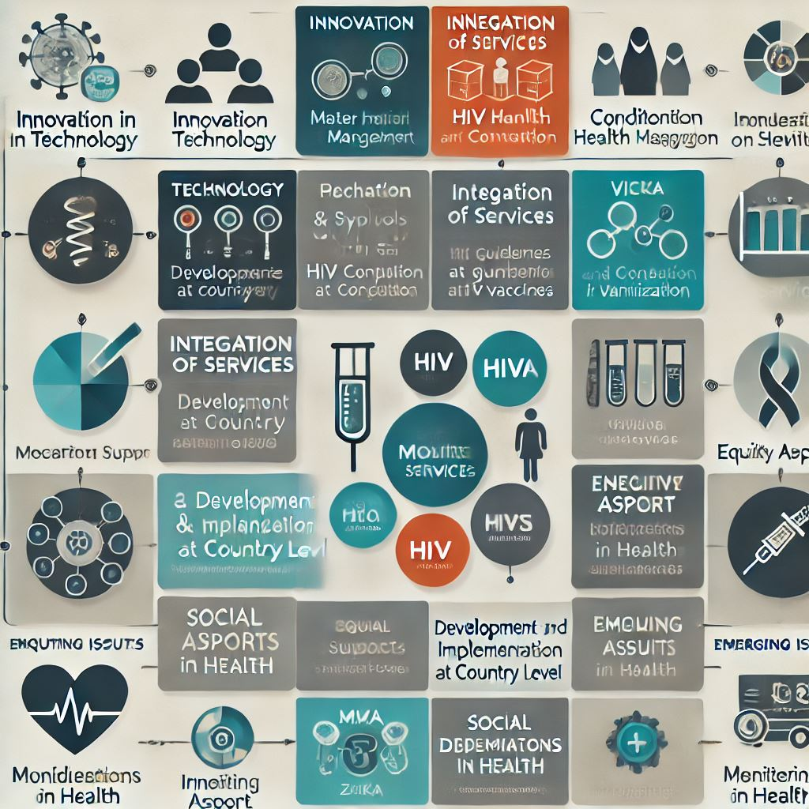

Key areas of research in SRH
Technological Innovation: (POCT, maternal health management, HPV vaccines)
Service Integration: Integration of services (HIV and syphilis, HIV and contraception, immunization)
Research for Guideline Development: Research to support development and implementation of guidelines at country level
Innovative Financing: (vouchers, conditional cash transfer)
Capacity building: (multipurpose workers, staff retention)
Addressing Social Determinants of Health: Equity aspect (adolescent health issues)
Monitoring and Accountability: (MMR, STI estimates)
Emerging Health Issues: (Zika, Ebola, covid)

Slide 12
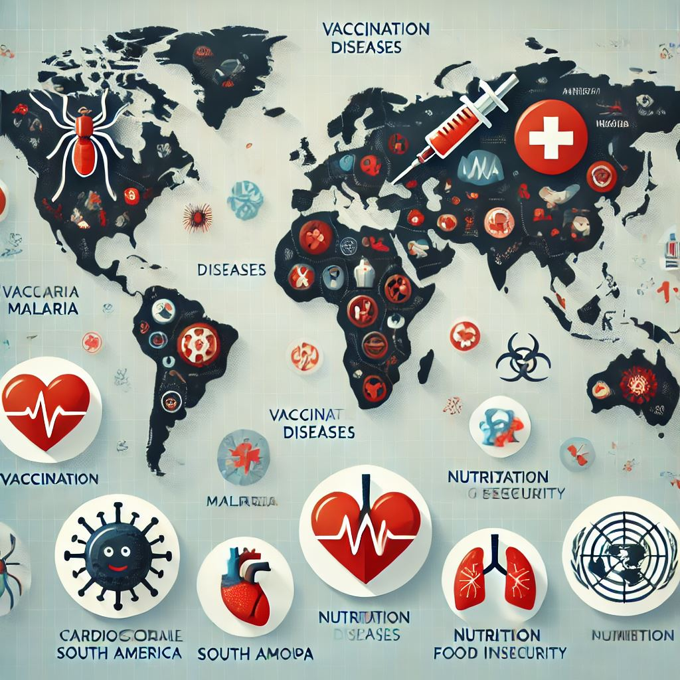
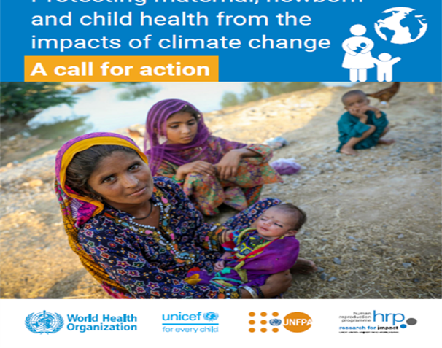
Ten key global health issues
Infectious Diseases (e.g., COVID-19, Zika, Tuberculosis, HIV/AIDS) Ongoing pandemic threats and emerging diseases, along with challenges related to antimicrobial resistance (AMR).
Non-Communicable Diseases (NCDs) Conditions like heart disease, diabetes, cancer, and chronic respiratory diseases are leading causes of death, often linked to lifestyle factors such as diet, lack of exercise, and tobacco use.
Mental Health Disorders Mental health issues such as depression, anxiety, and suicide rates are on the rise globally.
Health Inequality Disparities in healthcare access, especially among marginalized groups (e.g., women, rural populations, minorities).
Environmental Health (e.g., Air Pollution, Climate Change) Pollution, climate change, and natural disasters significantly affect public health, contributing to respiratory diseases, heat-related illnesses, and the spread of vector-borne diseases.

Slide 13
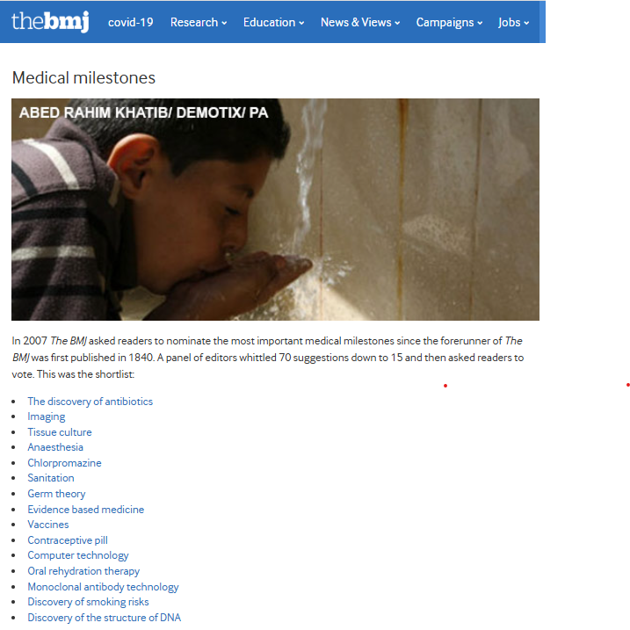
Ten key global health issues
Global Health Security Strengthening global preparedness for pandemics and disease outbreaks, ensuring rapid response mechanisms are critical to safeguarding public health.
Aging Population With longer life expectancies, many countries are facing an aging population, which increases the demand for elderly care, management of age-related diseases, and healthcare resources.
Malnutrition and Food Insecurity Both undernutrition (e.g., stunting and wasting) and overnutrition (e.g., obesity) are significant health challenges, along with issues like food insecurity and lack of access to nutritious food in vulnerable populations.
Access to Healthcare Many low- and middle-income countries still lack sufficient healthcare infrastructure, medical professionals, and affordable healthcare services, preventing millions from receiving necessary care.
Emerging and Re-emerging Diseases (e.g., Zoonotic Diseases) Diseases that jump from animals to humans, such as Ebola, Zika, and COVID-19, continue to pose a risk, especially in areas with high human-animal interaction, and climate change is exacerbating the spread of these diseases.

