Slide 1
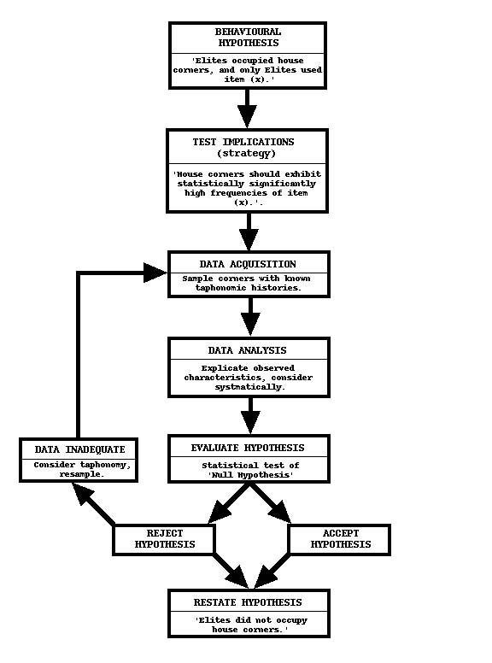
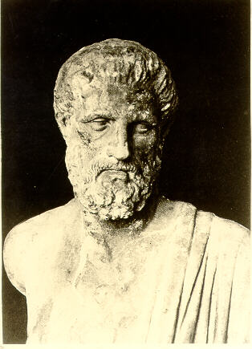




An Introduction to Research Designs and Developing
SRH Research Projects
Moazzam Ali MBBS, PhD, MPH
Department of Reproductive Health and Research
Geneva, September 2025
Notes:
1
Slide 1

Slide 2
Introduction
Definition of epidemiology
Brief history of epidemiology and classical studies
Uses of Epidemiology
      Disease Surveillance
      Risk Assessment
      Policy Development
      Evaluation of Interventions
The Evidence Pyramid
Introduction to Research Study Designs
Types of Epidemiological Studies

Slide 3
Epidemiology
The term epidemiology is derived from Greek words:
  Epi meaning "on" or "upon"
  Demos meaning "people"
  Logos meaning "study"
Epidemiology is the study of the distribution, dynamics, and determinants of health-related events in populations.
Determinants of Disease:
These are the causative agents of disease or disorder. Examples include:
  Biological agents: Viruses, bacteria, fungi, parasites.
  Physical agents: Radiation, extreme temperatures.
  Chemical agents: Toxins, pollutants.

Slide 4
Brief introduction to Epidemiology
Throughout history, diseases such as plagues, cholera, pneumonia, and influenza have shaped public health.
Hippocrates (c. 340-400 B.C.) asserted, "No disease is sent by devils or demons, but is the result of natural causes."

Slide 5
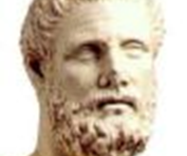
Epidemiology: Hippocrates (340 BC)
“Whoever wishes to investigate medicine properly should proceed thus; When he comes into a strange city, he ought to consider its situation, how it lies to the wind and sun, and consider the waters the people use. For if he knows these things well, he cannot miss knowing the diseases peculiar to the place”.

Slide 6
Classical studies
Scurvy Disease (1747): James Lind conducted one of the first clinical trials in 1747, demonstrating that citrus fruits could cure scurvy, a disease caused by vitamin C deficiency
Cholera in London (1854): John Snow's investigation of the 1854 cholera outbreak in London linked the disease to contaminated water from the Broad Street pump, pioneering the field of epidemiology
Nuclear Bombs at Hiroshima and Nagasaki: Studies on survivors of the atomic bombings in 1945 have provided extensive data on the long-term effects of radiation exposure, including increased cancer rates
Severe Air Pollution in London (1952): The Great Smog of 1952 caused a significant increase in deaths from heart and lung diseases, leading to the Clean Air Act of 1956
Minamata Disease: First identified in the 1950s, Minamata disease was caused by the consumption of fish contaminated with methylmercury from industrial wastewater
Itai-Itai Disease: This condition, identified in the mid-20th century in Japan, resulted from consuming rice contaminated with cadmium, leading to severe pain and bone damage
Legionnaires' Disease: An infectious disease caused by Legionella bacteria, often spread through ventilation systems and water supplies in large buildings

Slide 7

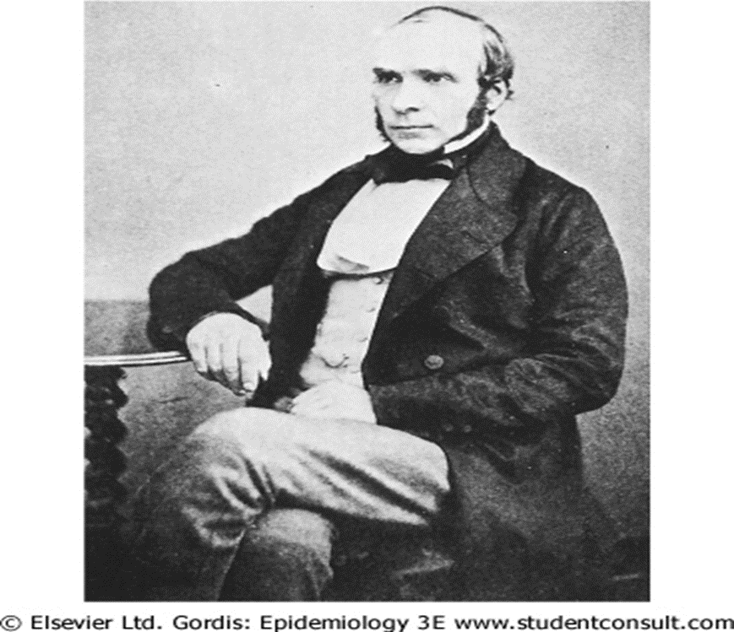
A sketch of water drop - London

Slide 8
Deaths from Cholera per 10,000 Houses by source of water supply, London (Snow, 1854)
Water supply | Number of houses | Cholera deaths | Deaths per 10,000 houses
Southwark & Vauxhall Co. | 40,046 | 1263 | 315
Lambeth Co. | 26,107 | 98 | 38
Other districts in London | 256,423 | 1422 | 56

Slide 9
The Evidence Pyramid
Systematic
Meta Analysis
RCT
Cohort Studies
Case-Control studies
Case series
Case reports
Ideas, editorials, Opinions
Invitro research
Evidence

Slide 10
Epidemiological studies
Observational studies
Experimental studies
Population based
Individual based
Randomized
control trial
Descriptive
Analytic
Case report
/series
Analytic
Quasi experimental trial
Ecological study
Cross-sectional
Cohort
Case control

Slide 11
Study Types
Study type: on the basis of intervention
Study type: on the basis of design
Study type: on the basis of time

Slide 12
Study types: on the basis of intervention
It divides the studies into two categories
Observational studies (no intervention)
Experimental studies / Interventional studies

Slide 13
On the basis of intervention: Observational studies
They are further divided into;
Descriptive
Descriptive is further sub divided into
1. Institutional surveys
2. Community surveys (Cross sectional surveys)
Analytic
Analytic is further sub divided into
1. Cohort
2. Case control

Slide 14
On the basis of intervention: Experimental studies
They are analytic type
It is further sub classified into
1. Randomized control trials
2. Community trials (community mass education program,
smoking prevention program in schools, dietary
intervention at family level)

Slide 15
Study types: on the basis of design
Another way is on the basis of design
• Qualitative study (Time, place, person)
• Quantitative study

Slide 16
Qualitative study
Qualitative field research usually focuses on:
Meanings = (culture, language, norms)
Practices = (various kinds of behavior)
Episodes = (divorce, crime illness)
Encounters = (2 people meeting and interacting)
Roles = (positions people occupy. Ethnic groups)
Relationships = (kinds of behaviors appropriate to pairs or sets of roles: mother-son, lovers, friends)
Groups => relationships = (work groups, teams)
Settlements = (small communities, villages, ghettoes, neighborhoods)

Slide 17
Study types: on the basis of time
Retrospective: Any design that looks at data that have already been gathered (e.g., Case-Control Study).
Prospective: Any design that collects data on groups of subjects over time, according to a carefully written protocol, beginning at time zero; this design yields data that enable comparisons of groups. (In ancient Rome, a cohort was a group of foot soldiers.)
Cross-sectional: A design that collects data from a variety of subjects (e.g., patients) at a given point in time.

Slide 18
Summary
Case Study: An in-depth analysis of a single case or a small number of cases.
Cohort Study: A prospective study that follows a group of people over time to determine how certain factors affect outcomes.
Cross-Sectional Study: A study that collects data from a population at a single point in time.
Descriptive Research: Research that aims to describe characteristics of a population or phenomenon.
Ecological Study: A study in which the units of analysis are populations or groups of people rather than individuals.
Ethnography: A qualitative research design aimed at exploring cultural phenomena.
Evaluation Research: Research that assesses the effectiveness of programs, policies, or products.
Experimental Research: Research that involves the manipulation of variables to establish cause-and-effect relationships.
Grounded Theory: A qualitative research method aimed at developing theory grounded in data systematically gathered and analyzed.
Historical Research: Research that involves studying past events to understand the present and anticipate potential future effects.
Longitudinal Study: A study that follows the same subjects over a period of time, observing them at multiple points.
Meta-Analysis: A statistical technique that combines the results of multiple studies to identify patterns among study results.
Phenomenology: A qualitative research approach focused on understanding the lived experiences of individuals.
Quasi-Experimental Research: Research that resembles experimental research but does not include random assignment of subjects.
Randomized Control Trials (RCTs): An experimental study design where participants are randomly assigned to either the treatment or the control group.
Systematic Review: A research method that involves systematically searching for, appraising, and synthesizing research evidence.

Slide 19
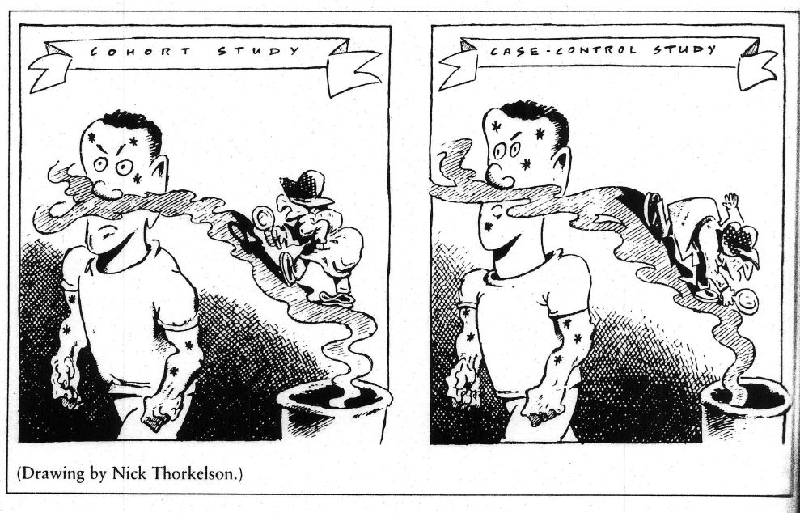

Slide 20
Cohort study: forward in time
Steps:
Identify and Select Study Population: Choose a group of individuals to study.
Classify Study Population: Categorize the population based on exposure status and other risk factors.
Follow Cohort Members Over Time: Track the cohort over a period to observe health outcomes based on exposure status sub-groups.
Advantages:
Establish Causality: Helps in determining cause-and-effect relationships.
Determine Incidence Rates and Risk: Useful for calculating the incidence of outcomes and associated risks.
Efficient for Studying Rare Exposures: Particularly beneficial for studying rare exposures such as:
  Nuclear bomb radiation
  Radiation for enlarged thymus
  Chernobyl nuclear accident
  Minamata disease
  Toxic chemical exposure (e.g., methyl isocyanides) from industrial accidents like Bhopal, India
Disadvantages:
Inefficient: Requires following many subjects over a long period.
Expensive: High costs associated with long-term studies.
Large Sample Size Needed for Rare Exposures: Requires a large number of participants to study rare exposures effectively.
Delayed Results: Results are not available for a long time due to the extended follow-up period.
Bias Due to Attrition and Loss to Follow-Up: Potential for bias if participants drop out or are lost during the study.

Slide 21
Design of a Cohort study
Time
No-disease
Exposed
Disease
Population
People
without
the disease
(healthy people)
Un-exposed
No-disease
Disease
Follow-up period

Slide 22
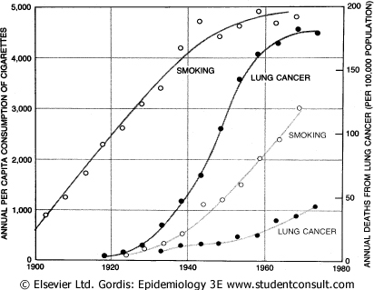

Slide 23
Case-control study: back in time
Steps:
Select Cases: Identify a group of patients with a particular disease (the cases).
Select Controls: Choose a comparison group without the disease (the controls).
Assess Prior Exposure Status and Other Risk Factors: Evaluate the exposure status and other risk factors for both cases and controls.
Examples:
Lung Cancer and Exposure to Radon: Studying the relationship between lung cancer and radon exposure.
Lung Cancer and Indoor Air Pollution in China: Investigating the link between lung cancer and indoor air pollution.
Leukemia and Radioactive Fallout: Examining leukemia in individuals exposed to radioactive fallout from nuclear testing in the USA.
Advantages:
Inexpensive and Efficient: Particularly useful for studying rare diseases.
Useful for Studying Diseases with Long Latencies: Effective for diseases that take a long time to develop.
Disadvantages:
Difficult to Select Appropriate Comparison Group: Challenges in finding a suitable control group.
Potential Bias in Measuring Exposure: Risk of recall bias due to the disease affecting memory of past exposures.

Slide 24
Design of a Case - Control study
Time
Inquiry
Exposed
Cases
(People
with
the disease)
Un-exposed
Population
Controls
(People
without
the disease)
Exposed
Un-exposed

Slide 25
Main difference between both designs
Case-Control Study
Description: The study begins with two groups of people: those who have the disease (cases) and those who do not have the disease (controls).
Steps:
  Select cases (diseased individuals).
  Select controls (non-diseased individuals).
  Assess prior exposure status and other risk factors for both cases and controls.
Cohort Study
Description: The study begins with two groups of healthy people: those who have been exposed to a certain factor (exposed) and those who have not been exposed (non-exposed).
Steps:
  Identify and select a healthy study population.
  Classify the population based on exposure status.
  Follow cohort members over time to determine health outcome occurrence by exposure status sub-groups.

Slide 26
Cross Sectional / Prevalence study
Description: Also called a "snap-shot study," as it captures a moment in time.
Steps:
  Choose Sampling Frame: Select a sampling frame for choosing study participants.
  Measure Exposure and Health Outcome Status: Assess both the exposure and health outcome status of the study participants at a single point in time.
  Health Outcomes Based on Prevalence: Health outcomes are measured based on prevalence (the proportion of individuals with a condition at a specific time), not incidence (the rate of new cases over time).
Limitation:
Cannot Prove Cause-Effect Relationship: This design cannot establish causality between exposure and outcome.

Slide 27
Meta-analysis
Description: A systematic method that uses statistical analyses to combine data from independent studies, providing a numerical estimate of the overall effect of a particular intervention or variable on a defined outcome. This study design aims to overcome much of the subjectivity inherent in narrative literature reviews.
Steps (According to Thacker):
Define the Problem and Criteria for Admission of Studies: Clearly outline the research question and establish criteria for including studies in the analysis.
Locate Research Studies: Conduct a comprehensive search to find relevant studies that meet the inclusion criteria.
Classify and Code Study Characteristics: Systematically categorize and code the characteristics of each study.
Quantitatively Measure Study Characteristics on a Common Scale: Use statistical methods to measure study characteristics in a standardized way.
Analyze, Interpret, and Report the Results: Perform statistical analyses, interpret the findings, and report the results.
Example:
Streptokinase Use in Myocardial Infarction (MI): Combining data from multiple studies to evaluate the overall effectiveness of streptokinase in treating myocardial infarction.

Slide 28
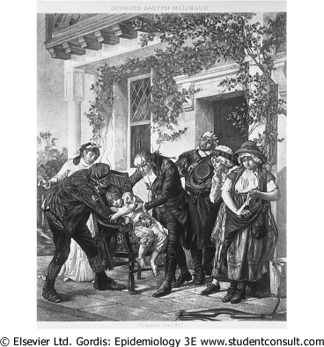
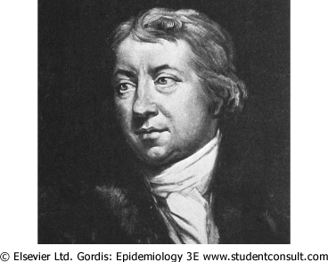
Randomized Clinical Trials

Slide 29
Randomized Clinical Trials
Population
Potential
Participants
Selection criteria
Non-
Participants
Improved
Invite
Participants
Non-
Participants
Obtain information
about them
Not
improved
Participants
Randomization
Improved
Controls
Treatment
Not
improved

Slide 30
Randomized Clinical Trials
Description: RCTs have become the accepted standard for evaluating therapeutic efficacy. These trials are performed in a prospective fashion to allow as much control of variables as possible.
Key Feature: The outstanding feature of RCTs is the use of randomization to help prevent bias in the assignment of subjects to specific intervention groups. If randomization is carried out properly, differences in outcomes observed among treatment groups tend to result from treatment effects and not from inherent differences among the groups.

Slide 31
Randomized Clinical Trials
Randomized Clinical Trials (RCTs) are often challenging to conduct. Many clinicians and patients are reluctant to accept randomization, especially if one of the proposed interventions is particularly desirable or undesirable, raising ethical considerations
Additionally, large numbers of patients may be required if the disease prevalence is low, necessitating the involvement of multiple institutions, which increases complexity and cost
For example:
Breast Cancer and Tamoxifen: RCTs have shown that tamoxifen significantly reduces the risk of recurrence in patients with ductal carcinoma in situ (DCIS) who undergo breast-conserving surgery
Hypertension Monitoring and Policy: RCTs in hypertension have demonstrated the effectiveness of blood pressure-lowering interventions in reducing cardiovascular events, influencing clinical guidelines and policies

Slide 32
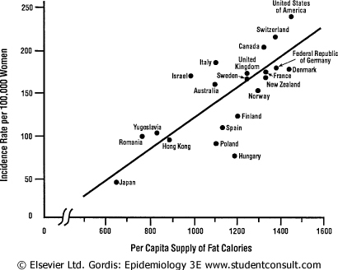
Breast cancer and fat intake

Slide 33
Ecological study
In ecological studies, the unit of analysis is a group or population (e.g., schools, factories, nations) rather than individuals. These studies compare aggregate measures of health outcomes with aggregate measures of exposure, typically using existing data.
Advantages
Quick and Inexpensive: These studies can be conducted rapidly and at a low cost
Range of Exposure: They may identify associations by examining a broader range of exposure levels
Disadvantages
Ecological Fallacy: It is not possible to link exposure with disease in individuals, leading to potential misinterpretations
Confounding Factors: Controlling for confounding factors is challenging, which can affect the validity of the findings

Slide 34
Research question and study type
(Reference: Leon Gordis)
State of the knowledge of the problem | Type of research questions | Type of study
Knowing that a problem exists but knowing little about its characteristics or possible causes | What is the nature/ magnitude of the problem? Who is affected? How do the affected people behave? What do we know think or believe about the problem and its causes? | Exploratory studies or Descriptive studies Descriptive case studies Cross sectional surveys

Slide 35
Research question and study type
State of the knowledge of the problem | Type of research questions | Type of study
Suspecting that certain factors contribute to the problem | Are certain factors indeed associated with the problem? (e.g. is low fiber diet related to carcinoma of large intestine?) | Analytical studies: Cross sectional comparative studies Case-control studies Cohort studies

Slide 36
Research question and study type
State of the knowledge of the problem | Type of research questions | Type of study
Having established that certain factors are associated with the problem: desiring to establish the extent to which a particular factor causes or contributes to the problem. | What is the cause of the problem? Will the removal of particular factor prevent or reduce the problem? (e.g., stopping smoking, providing safe water etc.) | Cohort studies Experimental or quasi experimental studies

Slide 37
Research question and study type
State of the knowledge of the problem | Type of research questions | Type of study
Having sufficient knowledge about causes to develop and assess an intervention that would prevent, control or solve the problem | What is the effect of a particular intervention/strategy? (e.g., treating with a particular drug, being exposed to a certain type of health education) Which of the two alternate strategies give better results? Which strategy is most cost-effective? | Experimental or Quasi-experimental studies

Slide 38
Thank you

Slide 39



