Slide 1

Data Management and Presentation
Julia Duvall BA, Bowdoin College MPH Candidate, UNC Gillings School of Global Public Health
Geneva Medical Foundation for Medical Research and Education
Training course in research methodology, research protocol development and scientific writing 2025

Slide 2
Learning Objectives
By the end of this presentation, participants will be able to:
Differentiate between qualitative and quantitative data
Understand basic data management steps
Identify different types of data presentation

Slide 3
Why is Data Necessary for Research?
Data are observations or measurements collected to answer a research question
Example: An individual is conducting a research study to see if a blood pressure medication is effective. To answer this question, blood pressure readings (numerical data) and patient experiences regarding the medication (categorical data) will be evaluated.

Slide 4
Types of Data: Qualitative and Quantitative
Discrete: Countable numerical values
Examples: Gravidity and parity, number of hospital visits
Continuous: Measured numerical values
Examples: Height, weight, temperature.
Distinct and whole numbers
Quantitative (Numerical)
Nominal: Unordered categories
Examples: Nationality, Ethnicity, Race, Blood type, etc…
Ordinal: Ordered categories
Examples: Socioeconomic status (low, medium, high), education level (high school, university, graduate school), Likert scales (dissatisfied, neutral, satisfied, very satisfied), etc…
Binary: Two categories
Examples: “Yes or No”, Success/Fail, etc…
Qualitative (Categorical)

Slide 5
What is Data Management?
Data management allows for the collection, organization, and security of data throughout a research project.
Allows for more efficient research
Reduces potential errors
Avoids misconduct and compliance with any regulations
Ensures study or research is reproducible

Slide 6
Data Management Overview
Collection
Process of collecting data for evaluation. This can be performed through measurements, questionnaires, interviews, health records, and so forth.
Encoding
Digitally exporting and updating collected data into programs such as Excel, SPSS, REDCap, and so forth.
Cleaning
Identification of missing, implausible, incorrect, or duplicate values.
Coding
Converting quantitative and qualitative data into a structured format (numerical code).
Data Presentation
Allows for the effective communication and visualization of collected data

Slide 7
Data Management: Encoding
Encoding allows for the conversion of collected data into digitally stored format (such as spreadsheets or software)
Qualitative
Quantitative
Qualitative data that comes from interviews or focus groups must be transcribed for sorting and analysis.
Measured and recorded data values must be converted into a digital format. This allows for for analysis, efficiency, record keeping, and accuracy.
Example: An interview of patients regarding their treatment of high blood pressure is transcribed for data analysis
Example: Written records of systolic blood pressure from a health clinic are encoded into an excel file for research.

Slide 8
Data Management: Cleaning
Editing and cleaning data entries are necessary as it contributes to accuracy as well as data quality
Qualitative
Quantitative
Proofreading and editing transcripts lead to further accuracy, clarification, and ensures that private information of participants is anonymized for confidentiality.
Allows for the detection and correction of incorrect data entry. To prevent misinterpretation from errors and inconsistencies.

Slide 9
Data Management: Coding
Coding converts raw data into a structured format that has meaning
Qualitative
Quantitative
Inductive → answers the ”why”
Deductive → answers the “what”
Qualitative data must be coded into themes for analysis
Quantitative data can be organized into numerical themes
Example: If a participant in an interview states, “I’m afraid to take blood pressure medication”, it could be coded under the theme “medication fear”
Example: Labeling medication adherence. 0 = No, 1 = Yes.

Slide 10
Data Presentation
After collecting and analyzing data, it is necessary that data is effectively presented and shared. Why?
Clearly communicate findings
Highlight trends and relationships among variables
Engage researchers, clinicians, policymakers, and communities
Data presentation can be done in a textual, tabular and graphical manner
The manner data is presented depends on method of communication and target audience

Slide 11
Data Presentation: Textual, tabular, and graphical
Textual
Useful for summarizing key findings or highlighting certain statistics
Provides context or interpretation alongside results
Commonly found in abstracts, results sections, executive summaries, and discussions
Tabular
Displays and shows comparisons between numerical values
Useful to show baseline characteristics, intervention outcomes, and trends
Graphical
Allows for visualization of data in a clear and engaging way
Simplifies complex information that is easier for public understanding
Highlights trends over time
Provides a quick and clear comparison between data
Example: Describing demographics such as, “most participants were health professionals”
Example: Utilizing a frequency distribution table
Example: Utilizing a histogram

Slide 12
Frequency Distribution Table
Purpose
Organizes data into categories and shows frequency of occurrence
Allows for a summary of raw data for analysis
Formatting
The table will have two or more columns
Category/Class interval (example: blood pressure range)
Frequency (the count of observations for each category)
Data can be sorted by size value, or importance
Advantages
Provides an overview of data distribution to understand trends
Can be used for categorical and numerical data
Disadvantages
There is a loss of detail as class intervals are required
Potential for misinterpretation if intervals are not selected appropriately

Slide 13
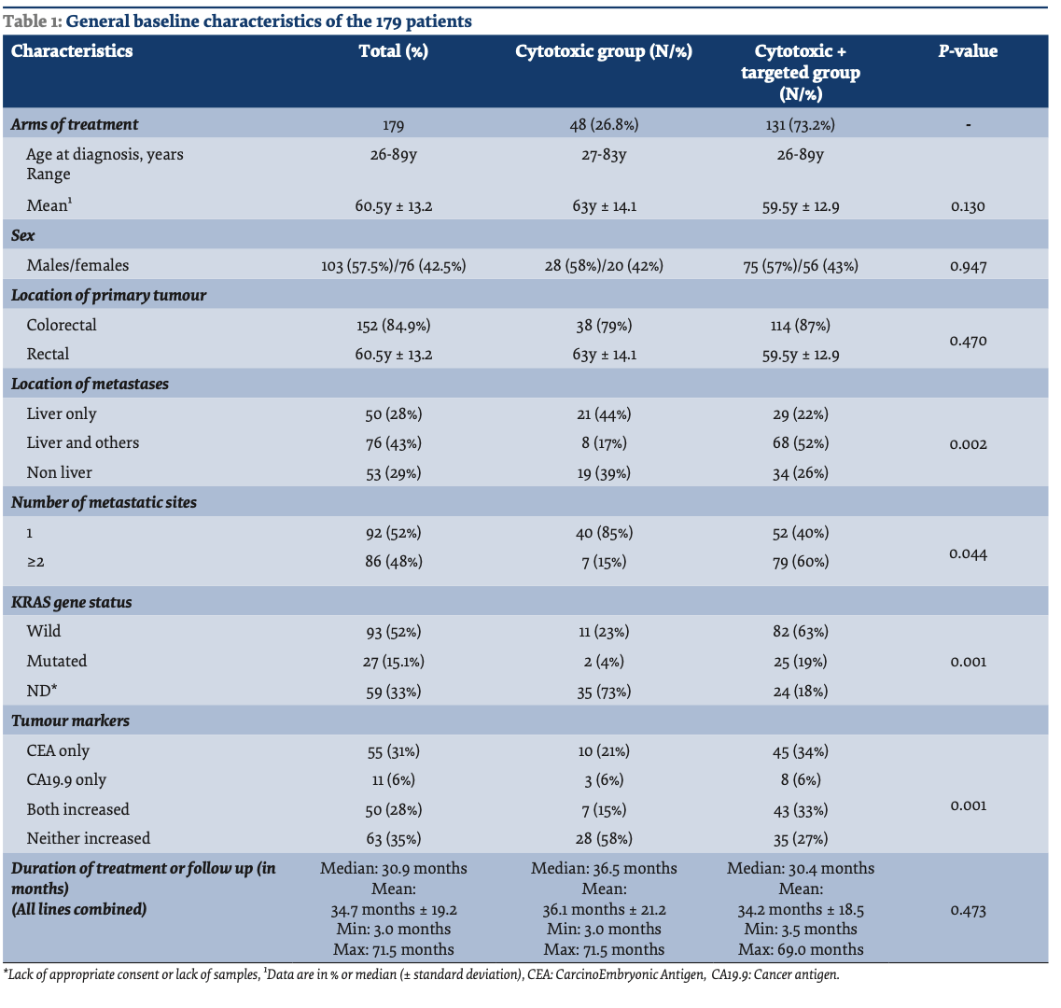
Frequency Distribution Table Example
Source: Henaine AM; Chahine G; Massoud M; Salameh P; Awada S; Lahoud N et al. Management of patients with metastatic colorectal cancer in Lebanese hospitals and associated direct cost: a multicentre cohort study. East Mediterr Health J. 2019;25(7):481-494. License: CC BY-NC-SA 3.0 IGO https://doi.org/10.26719/emhj.18.063

Slide 14
Bar Graph
A bar graph allows for the visual comparison of different groups. It is used for categorical data.
Purpose
Comparison of categories (example: age groups)
Data is discrete (separate and countable categories)
Need to visualize differences clearly and quickly
Formatting
Horizontal axis (X-axis) shows categories
Vertical axis (Y-axis) shows values (numbers or percentages)
Each distinct category is visualized with a bar
Each bar should be the same width
The height or length reflects the value it represents
The Y-axis must be scaled for accuracy
Must include a title and a legend (if applicable → grouped bars)

Slide 15
Bar Graph Continued
Advantages
Easy to process as they are a clear visualization of data
Disadvantages
Can be visually misleading (if y-axis is not scaled appropriately)
Demonstrates a clear comparison between groups
Effectively displaces discrete data
Does not show trend over time
Can become clustered if there are too many groups for comparison

Slide 16
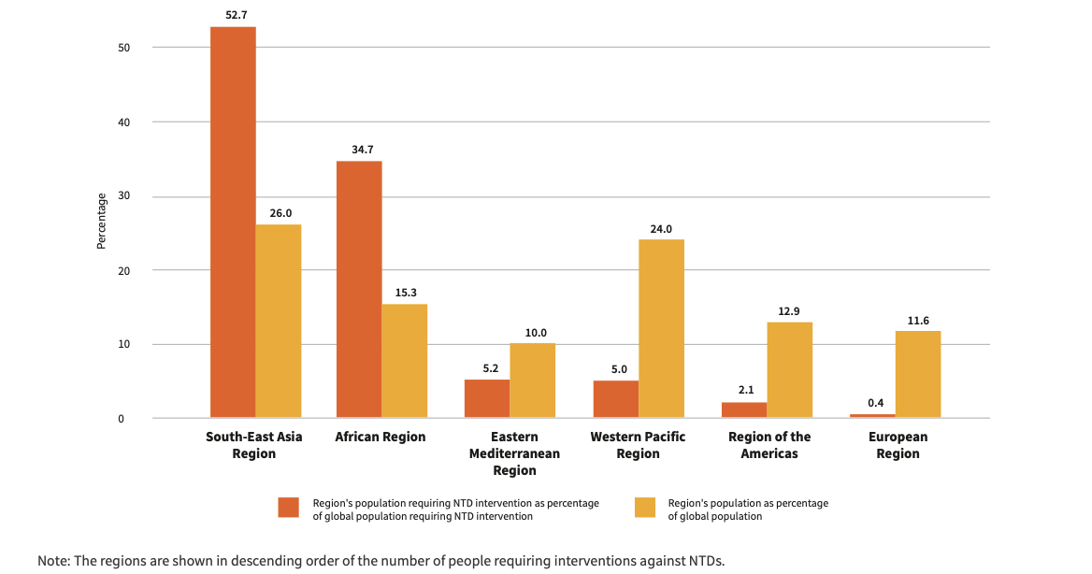
Bar Graph Example
Figure 1. Share of people requiring interventions against NTDs and share of population out of global total, by WHO region 2023.
Source: World health statistics 2025: monitoring health for the SDGs, Sustainable Development Goals.
Geneva: World Health Organization; 2025. License: CC BY-NC-SA 3.0 IGO
https://iris.who.int/bitstream/handle/10665/381418/9789240110496-eng.pdf?sequence=1

Slide 17
Histogram
A histogram allows for visualization of continuous variables over intervals
Purpose
Allows individuals to see distribution, i.e., if there is skew, normality, or outliers.
Formatting
Horizontal axis (x-axis) shows a range of values that are divided into intervals
Advantages
Shows shape of data distribution
Disadvantages
Can be visually misleading (depending on bin width)
Vertical axis (y-axis) shows frequency (number of observations)
There are no gaps between the bars
Useful if the dataset is large
Allows for assessing assumptions for statistical tests
Does not show exact values, rather, the frequency
Not beneficial for small datasets

Slide 18
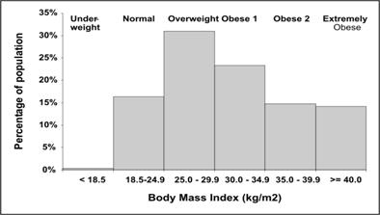
Histogram Example
Figure 2. Distribution of Body Mass Index Among Adults with Diagnosed Diabetes — United States, 1999-2002
Source: Lesson 4: Displaying Public Health Data – Section 3. In: Principles of Epidemiology in Public Health Practice, Third Edition. Centers for Disease Control and Prevention (CDC); 2012. https://archive.cdc.gov/www_cdc_gov/csels/dsepd/ss1978/lesson4/section3.html

Slide 19
Component Bar Graph (Stacked Bar Graph)
A component bar graph allows for the visualization of different categorical variables within a single bar to show magnitude and composition
Purpose
Allows to see how each categorical variable contributes to a total within a group
Formatting
X-axis demonstrates the overarching groups
In the previous example, this would be medication type
Y-axis shows percentages
Bars are divided into segments with each segment representing a sub-category within a group
Stacked format with color-coded sections
Example: If an individual is researching the effectiveness of different cardiac medications and different age groups (both variables being categorical), a component bar graph would show the percentage of patients by type of medication within each age group

Slide 20
Component Bar Continued
Advantages
Beneficial for stratified group comparisons of categories
Disadvantages
Can be more difficult for interpretation if there are many subgroups, leading to misinterpretation.
Shows proportions over different categories
Does not show groups over time

Slide 21
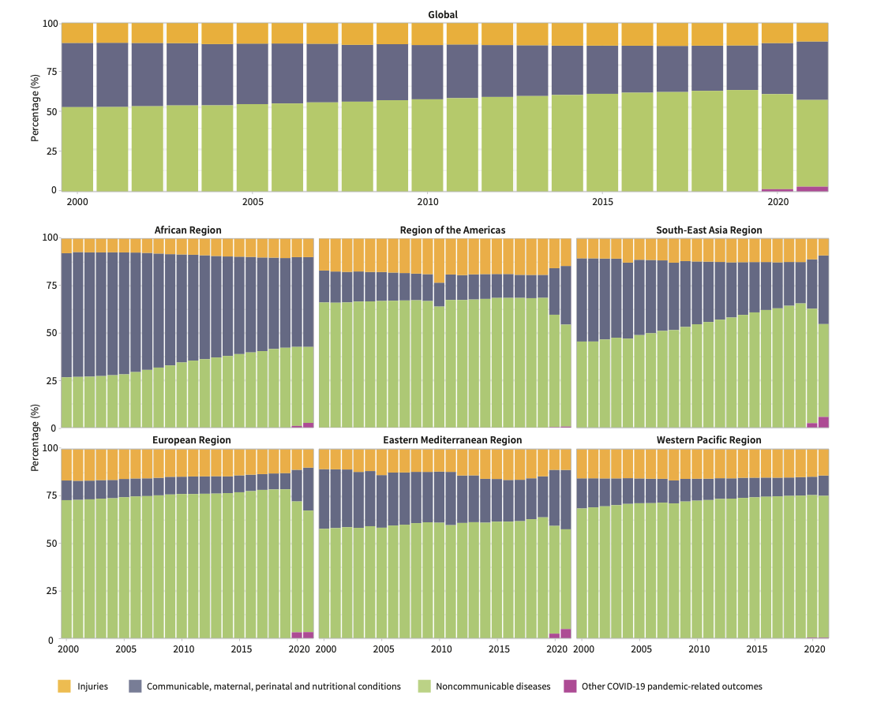
Component Bar Graph Example
Figure 3. Composition of causes of death in the age-standardized death rates for ages under 70 years, by WHO region, 2000-2021
Source: World health statistics 2025: monitoring health for the SDGs, Sustainable Development Goals.
Geneva: World Health Organization; 2025. License: CC BY-NC-SA 3.0 IGO
https://iris.who.int/bitstream/handle/10665/381418/9789240110496-eng.pdf?sequence=1

Slide 22
Pie Chart
A pie chart allows for the visualization of data proportionally as parts of a whole.
Purpose
Shows how a categorical variable is divided into categories
Formatting
A circular chart that is divided into “slices”
Advantages
Beneficial for stratified group comparisons of categories
Disadvantages
Can be more difficult for interpretation if slices are similar in size.
Example: Race is the categorical variable of interest with racial groups being the categories of interest
Highlights percentage-based comparisons
A “slice” represents a category and is proportional to its frequency.
Each slice must be labeled to appropriately designate the category
Shows relative proportions clearly to audience
Favorable visualization tool for larger public audience
Can become clustered and hard to interpret if there are many categories
Does not show values or trends over time
Can be misleading if slices are not scaled appropriately

Slide 23
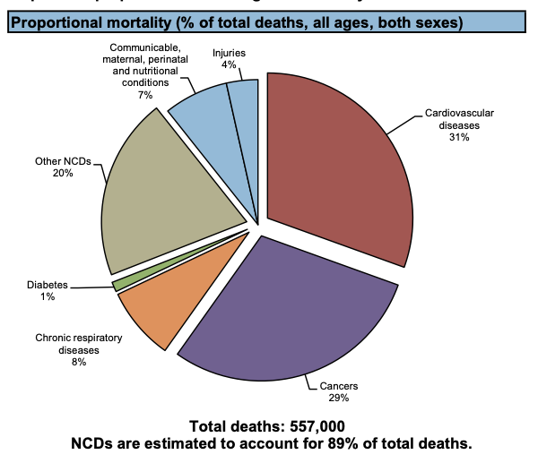
Pie Chart
Figure 4. Proportional mortality (% of total deaths, all ages, both sexes) — United Kingdom
Source: Noncommunicable Diseases Country Profiles 2014.
Geneva: World Health Organization; 2014. License: CC BY-NC-SA 3.0 IGO
https://iris.who.int/bitstream/handle/10665/128038/9789241507509_eng.pdf?sequence=1

Slide 24
Line Graph
A line graph allows for the visualization of changes in data over time
Purpose
Allows for comparisons of the variable of interest across time points
Formatting
Horizontal axis (X-axis): represents time
For evaluation of quantitative and continuous data
Beneficial for visualizing the impact of an intervention
Vertical axis (Y-axis): the variable of interest which is being measured
Each measured data point is represented with a point which are connected with a line.

Slide 25
Line Graph Continued
Advantages
Shows trends over time
Disadvantages
Can be misleading if time intervals are not uniform
Can demonstrate the effect of an intervention in comparison to a control
Only for visualization of quantitative variables

Slide 26
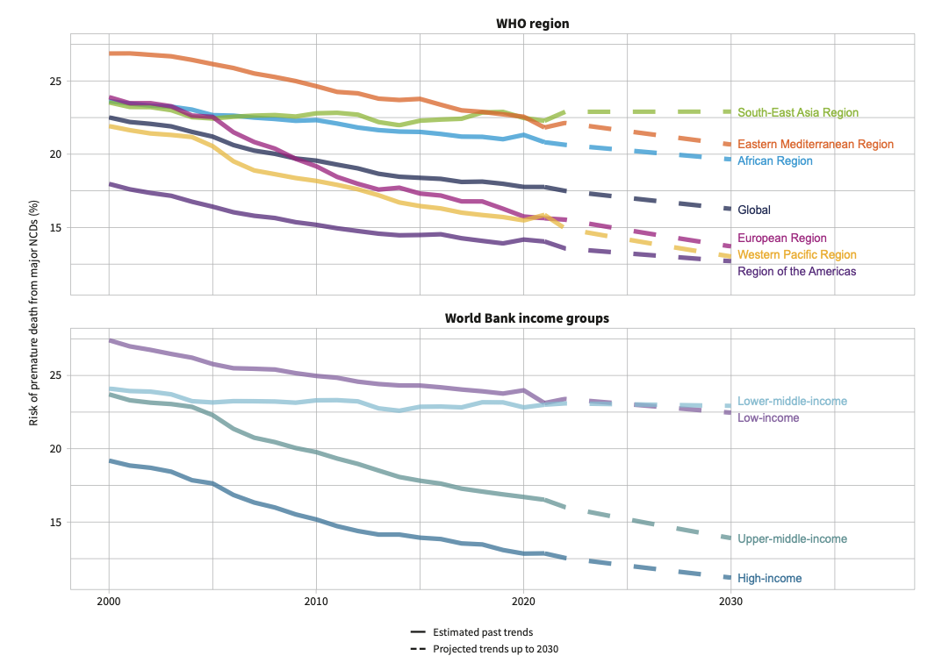
Line Graph Example
Figure 5. Observed and projected trends for risk of premature mortality from NCDs (%), by WHO region
Source: World health statistics 2025: monitoring health for the SDGs, Sustainable Development Goals.
Geneva: World Health Organization; 2025. License: CC BY-NC-SA 3.0 IGO
https://iris.who.int/bitstream/handle/10665/381418/9789240110496-eng.pdf?sequence=1

Slide 27
Frequency Polygon
A frequency polygon allows for the visualization of the distribution of continuous data
Purpose
Allows for comparing multiple datasets on the same graph
Formatting
Horizontal axis (X-axis): represents a class interval (like a histogram)
Advantages
Easier to compare multiple distributions unlike histograms
Disadvantages
Requires clear class intervals
Functions like a histogram
Vertical axis (Y-axis): represents frequency of each class
Points are plotted at the midpoint of each class interval and connected by a straight line
To close the line, each endpoint will touch the x-axis
Beneficial for trend analysis across intervals
Can be more difficult for a general audience (compared to a histogram)

Slide 28
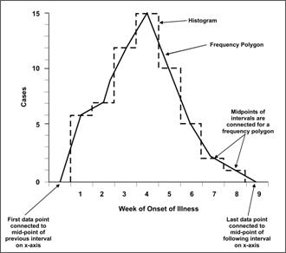
Frequency Polygon Example
Figure 6. Comparison of Frequency Polygon and Histogram
Source: Lesson 4: Displaying Public Health Data – Section 3. In: Principles of Epidemiology in Public Health Practice, Third Edition. Centers for Disease Control and Prevention (CDC); 2012.
https://archive.cdc.gov/www_cdc_gov/csels/dsepd/ss1978/lesson4/section3.html

Slide 29
Box Plot
A box plot allows for visualization of continuous data distribution
Purpose
Highlights central tendency, spread, skew, and outliers
Formatting
The box shows the interquartile range (IQR) which is the 25th percentile (Q1) to the 75th percentile (Q3).
A box plot shows the minimum, first quartile (Q1), median (Q2), third quartile (Q3), and the maximum
Useful for comparing distribution between groups of interest
The line inside the box is the median or 50th percentile (Q2).
”Whiskers” are the lines outside of the box that highlight the minimum and maximum (excluding outliers).
Outliers are denoted by singular data points beyond the “whiskers”.

Slide 30
Box Plot Continued
Advantages
Identifies outliers
Disadvantages
Not ideal for small datasets
Allows for the comparison of variability across different datasets
Does not show the exact distribution shape

Slide 31
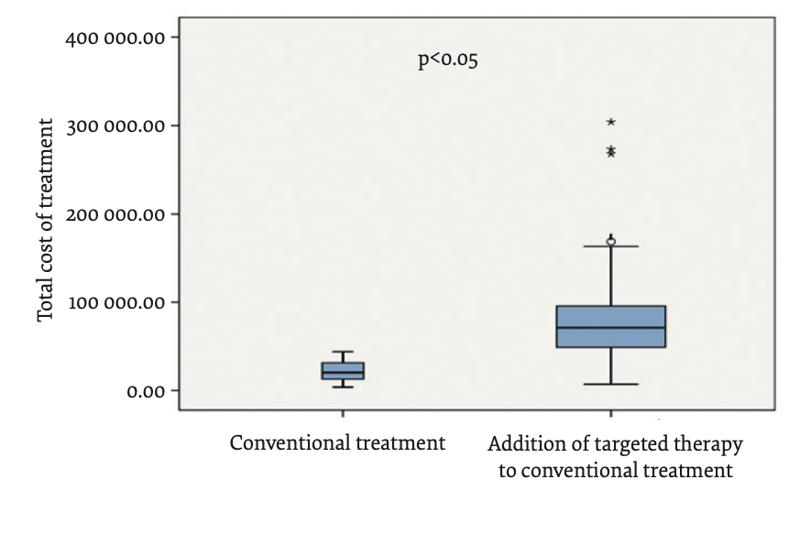
Box Plot Example
Figure 7. “Box-Plot” diagram of the total global costs in patients with mCRC in our study
Source: Henaine AM; Chahine G; Massoud M; Salameh P; Awada S; Lahoud N et al. Management of patients with metastatic colorectal cancer in Lebanese hospitals and associated direct cost: a multicentre cohort study. East Mediterr Health J. 2019;25(7):481-494. License: CC BY-NC-SA 3.0 IGO https://doi.org/10.26719/emhj.18.063

Slide 32
Stem-and-Leaf Plot
A stem-and-leaf plot allows for the visualization of distribution of a numerical dataset
Purpose
Allows for a quick visual analysis of shape and spread of dataset
Formatting
Numbers are split into a stem (the first digit of a number) and leaf (following digit)
Advantages
Beneficial for identifying outliers
Disadvantages
Not suitable for large datasets
May be harder to interpret upon first glance for larger public audiences
Easy to interpret for small datasets
Stems are listed in a vertical column while the leaves are listed horizontally for each stem

Slide 33
Stem-and-Leaf Example
Figure 8. Stem-and-Leaf Plot
You have a sample of 10 adults’ resting heart rate (bpm)
Raw Data (bpm): 58, 62, 66, 70, 72, 72, 76, 80, 84, 92
Stem | Leaf
----------------
5 | 8
6 | 2 6
7 | 0 2 2 6
8 | 0 4
9 | 2

Slide 34
Scatter Plot
Purpose
Identifies correlation and trends
Formatting
Both X-axis and Y-axis represent a variable (continuous)
Advantages
Beneficial for assessing if there is positive, negative, or no correlation between variables
Disadvantages
Does not show causation
Can be misleading if scaling is not appropriate
Shows outliers or clusters within dataset
Effective for bivariate analysis
A scatter plot allows for the visualization of the relationship between two continuous variables
Each point on the plot represents a single observation with two values
A regression line can also be used to show directionality and strength of the relation

Slide 35
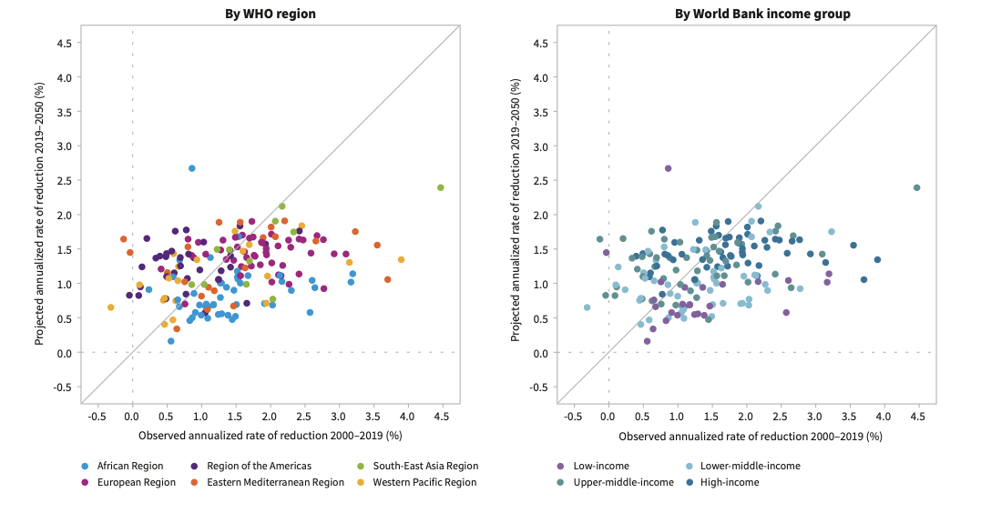
Scatter Plot Example
Figure 9. Annual rate of reduction in probability of death under 70 years of age, observed (2000–2019) versus projected (2019–2050)
Source: World health statistics 2025: monitoring health for the SDGs, Sustainable Development Goals.
Geneva: World Health Organization; 2025. License: CC BY-NC-SA 3.0 IGO
https://iris.who.int/bitstream/handle/10665/381418/9789240110496-eng.pdf?sequence=1

Slide 36
References
American Society for Quality. (n.d.). What is a scatter diagram? scatter plot graphs | ASQ. https://asq.org/quality-resources/scatter-diagram
Bingham, A. J. (2023). From data management to actionable findings: A five-phase process of qualitative data analysis. International Journal of Qualitative Methods, 22. https://doi.org/10.1177/16094069231183620
Data Management: What it is and why it matters. SAS. (n.d.). https://www.sas.com/en_us/insights/data-management/data-management.html
Data Management: What it is, importance, and challenges. Tableau. (n.d.). https://www.tableau.com/learn/articles/what-is-data-management
Harvard Medical School. (n.d.). What is Research Data Management. Data Management. https://datamanagement.hms.harvard.edu/about/what-research-data-management
Henaine AM; Chahine G; Massoud M; Salameh P; Awada S; Lahoud N et al. Management of patients with metastatic colorectal cancer in Lebanese hospitals and associated direct cost: a multicentre cohort study. East Mediterr Health J. 2019;25(7):481-494. License: CC BY-NC-SA 3.0 IGO https://doi.org/10.26719/emhj.18.063
Hoskin, T. (n.d.). Data types. Mayo Clinic Department of Health Sciences. https://www.mayo.edu/research/documents/data-types/doc-20408956
Hu, K. (2020). Become competent within one day in generating Boxplots and violin plots for a novice without prior R experience. Methods and Protocols, 3(4), 64. https://doi.org/10.3390/mps3040064
Ibe, O. C. (2014). Introduction to descriptive statistics. Fundamentals of Applied Probability and Random Processes, 253–274. https://doi.org/10.1016/b978-0-12-800852-2.00008-0
Lesson 4: Displaying Public Health Data – Section 3. In: Principles of Epidemiology in Public Health Practice, Third Edition. Centers for Disease Control and Prevention (CDC); 2012. https://archive.cdc.gov/www_cdc_gov/csels/dsepd/ss1978/lesson4/section3.html
Mohr, D. L., Wilson, W. J., & Freund, R. J. (2022). Data and statistics. Statistical Methods, 1–64. https://doi.org/10.1016/b978-0-12-823043-5.00001-1

Slide 37
References
Muscatello, D. J., Searles, A., Macdonald, R., & Jorm, L. (2006). Communicating population health statistics through graphs: A randomised controlled trial of graph design interventions. BMC Medicine, 4(1). https://doi.org/10.1186/1741-7015-4-33
Noncommunicable Diseases Country Profiles 2014. Geneva: World Health Organization; 2014. License: CC BY-NC-SA 3.0 IGO https://iris.who.int/bitstream/handle/10665/128038/9789241507509_eng.pdf?sequence=1
NSW Ministry of Health. (n.d.). Scatter plot. Clinical Excellence Commission. https://www.cec.health.nsw.gov.au/CEC-Academy/quality-improvement-tools/scatter-plot
Quantitative and qualitative data. Australian Bureau of Statistics. (n.d.). https://www.abs.gov.au/statistics/understanding-statistics/statistical-terms-and-concepts/quantitative-and-qualitative-data
Raskind, I. G., Shelton, R. C., Comeau, D. L., Cooper, H. L. F., Griffith, D. M., & Kegler, M. C. (2018). A review of qualitative data analysis practices in health education and Health Behavior Research. Health education & behavior : the official publication of the Society for Public Health Education. https://pmc.ncbi.nlm.nih.gov/articles/PMC6386595/
S, M. (2011). Frequency distribution. Journal of Pharmacology and Pharmacotherapeutics, 2(1), 54–56. https://doi.org/10.4103/0976-500x.77120
Streiner, D. (2010a). Line graph. Encyclopedia of Research Design. https://doi.org/10.4135/9781412961288.n220
Streiner, D. (2010b). Pie Chart. Encyclopedia of Research Design. https://doi.org/10.4135/9781412961288.n311
Sun, Y. (2017). Coding of data. The SAGE Encyclopedia of Communication Research Methods. https://doi.org/10.4135/9781483381411.n63
Trochim, W. (n.d.). Qualitative vs. quantitative. Loyola Marymount University. https://academics.lmu.edu/irb/qualitativeresearchandapproaches/qualitativevsquantitative/

Slide 38
References
UCLA. (n.d.). What is the difference between categorical, ordinal, and interval variables?. Advanced Research Computing Statistics. https://stats.oarc.ucla.edu/other/mult-pkg/whatstat/what-is-the-difference-between-categorical-ordinal-and-interval-variables/
World health statistics 2025: monitoring health for the SDGs, Sustainable Development Goals. Geneva: World Health Organization; 2025. License: CC BY-NC-SA 3.0 IGO https://iris.who.int/bitstream/handle/10665/381418/9789240110496-eng.pdf?sequence=1
Zeng, X., & Rouse, K. (2022). Using bar charts to compare data in categories. Journal of AHIMA. https://journal.ahima.org/page/using-bar-charts-to-compare-data-in-categories

Slide 39
Thank you!

