Slide 1
Introduction to adolescent health
& to adolescent sexual and reproductive health
September 2016
Dr V Chandra-Mouli
chandramouliv@who.int
Training Course in Sexual and Reproductive Health Research
Geneva 2016

Slide 2
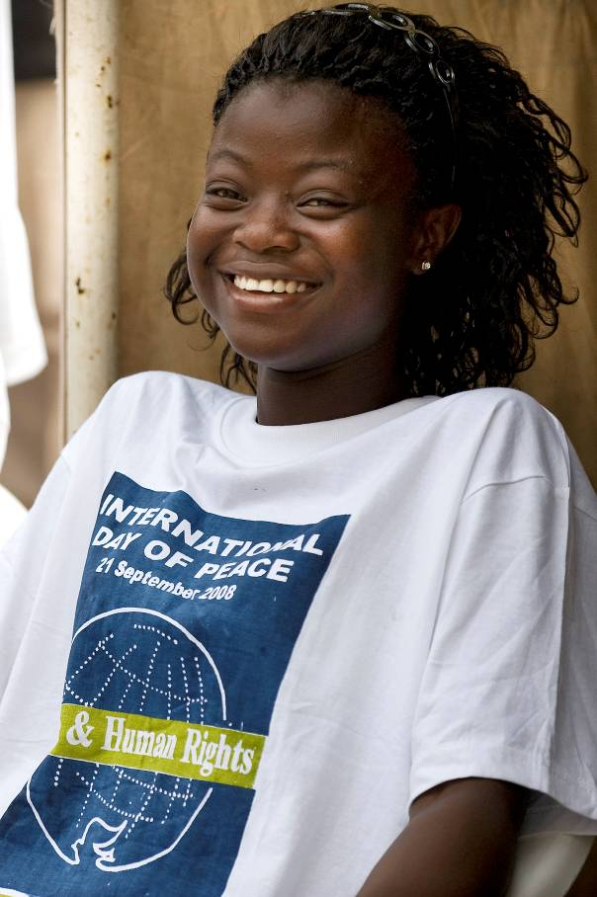
Key statement 1
WHO defines adolescents as individuals in the second decade of their lives – aged 10-19 years.
WHO recognizes that adolescence is a phase rather than a fixed time period in an individual’s life – a phase when enormous physical, psychological and social changes occur.
Notes:
WHO defines adolescents as individuals in the second decade of their lives – 10 to 19 years.
WHO recognizes that adolescence is a phase in an individual's life, rather than a fixed time period.
It is a phase during which rapid physical and psychological growth and development occur. It is a phase in which there are enormous changes in social relationships, expectations, roles and responsibilities.

Slide 3
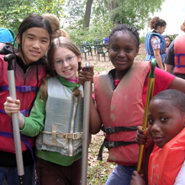

Key statement 2
Adolescents are a very diverse group.
They:
- Are in different stages of development
- Live in different circumstances
- Have very different needs and problems
Notes:
Adolescents are a very diverse group.
A boy of 12 is very different from a young man of 19.
A boy of 12 is also very different - physically but also psychologically from a girl of the same age.
A boy of 12 who is part of a caring and financially secure family is growing up in very different circumstances from another of the same age who has run away from home to escape physical violence.
Two boys of 12 who are growing up in very similar conditions may develop in very different ways.
All these categories of adolescents have different needs; different but also changing needs.

Slide 4
Key statement 3
Many individuals make the transition from childhood through adolescence into adulthood in good health.
Many others do not.
Deaths: An estimated 1.4 million adolescents die every year due to road traffic injuries, violence and pregnancy-related causes.
Illnesses: Tens of millions of adolescents experience health problems such as depression, anaemia and underweight, and HIV infection.
Unhealthy behaviours: Hundreds of millions of adolescents initiate behaviours - such as tobacco use, physical inactivity and unhealthy eating habits – that could result in lung cancer, cardiovascular disease and diabetes in the adulthood.
Notes:
Many individuals make the transition from childhood through adolescence into adulthood in good health. Many others do not.
An estimated 1.4 million adolescents die every year due to road traffic injuries, violence and pregnancy-related causes.
Tens of millions of adolescents experience health problems such as depression, anaemia and underweight, and HIV infection.
Hundreds of millions of adolescents initiate behaviours - such as tobacco use, physical inactivity and unhealthy eating habits – that could result in lung cancer, cardiovascular disease and diabetes in the adulthood.

Slide 5
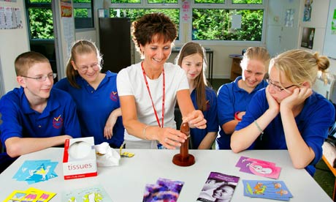
Key statement 4
Risk reduction approaches are important.
But they alone are not enough.
- Helping adolescents become aware of risks to their health (e.g. the risk of HIV infection)
- Teaching them how to avoid these risks (e.g. to refuse unwanted sex or to have safe safely)
- Giving them the means to protect themselves (e.g. condoms)
- Helping them if they experience problems (e.g. an unwanted pregnancy or sexually transmitted infection)
Notes:
Adolescent Health programmes have traditionally focused on avoiding risks to health.
For example, reducing the risk of HIV infection includes:
- Helping adolescents become aware of risks to their health (e.g. the risk of HIV infection)
- Teaching them how to avoid these risks (e.g. to refuse unwanted sex or to have safe safely)
- Giving them the means to protect themselves (e.g. condoms)
- Helping them if they experience problems (e.g. an unwanted pregnancy or sexually transmitted infection)
These risk reduction approaches have been proven to be effective and remain important. Alongside this, research has shown that they alone are not enough.

Slide 6
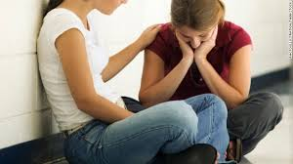
We need to build the core assets of adolescents so that they can take greater control of their lives
Competence
(abilities to do specific things)
Confidence
(positive sense of self worth)
Connection
(positive bonds with people & institutions)
Character
(sense of right & wrong, & respect for standards of right behaviour)
Caring
(sense of sympathy and empathy for others)
Notes:
There is growing recognition that we need to build the core assets of adolescents so that they can take greater control of their lives. Families, communities and societies need to create opportunities for adolescents to develop their core assets.

Slide 7
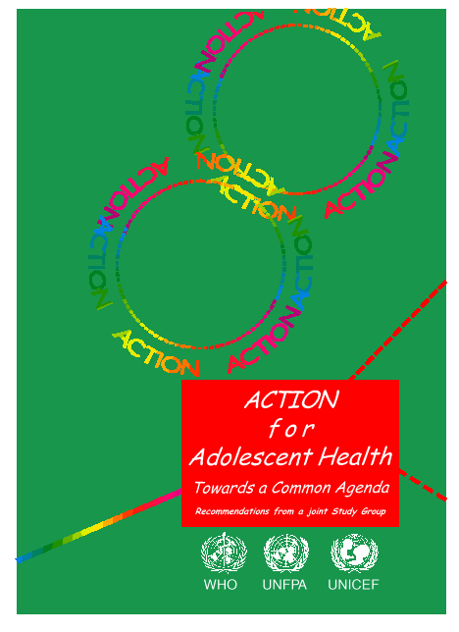
To grow & develop in good health, adolescents need
Information & skills
(they are still developing)
Safe & supportive environment
(they live in an adult world)
Health & counselling services
(they need a safety net)
Notes:
A useful framework brings these two elements – personal development and risk reduction together. It is the Common Agenda for Adolescent Health and Development endorsed by UNFPA, UNICEF and WHO in 1995.
It outlines what adolescents need to grow and develop in good health, and why they need these things.
A useful analogy is that of an 8 year old girl who needs to cross the road every day to get to school.
She needs information & skills: where to look, what to look for, when to walk across, when not to do so.
She needs a safe & supportive environment: a zebra crossing, traffic lights that work or a traffic warden in position, drivers who respect traffic rules or are punished if they do not do so.
She may also need health & counselling services, if she stumbles and falls, or is struck down by a vehicle.
One problem with this analogy is that it presents health services in a curative context alone. Health workers and health services have important roles to play in promotive and preventive health as well.

Slide 8
Key statement 5
Many individuals & institutions need to contribute to the health & development of adolescents
Politicians
Journalists
Bureaucrats
Relatives
Friends
Family friends
Teachers
Sports coaches
Healthcare providers
Religious leaders
Traditional leaders
Parents
Brothers/Sisters
Adolescents
Musicians
Film stars
Sports figures
Notes:
Who needs to contribute to the health and development of adolescents ?
To answer this question, it is useful to think of these players in concentric circles of contact & influence.
At the centre is the adolescent himself or herself. Parents, siblings and some other family members are in immediate contact with the adolescent & constitute the first circle.
The second circle includes people in regular contact with them such as their own friends, family friends, teachers, sports coaches, health workers and religious leaders.
The third circle includes musicians, film stars & sports figures who have a tremendous influence on them from afar.
Finally in the fourth circle, politicians, journalists and bureaucrats (within the government & private sectors) affect their lives in small & big ways, through their words and deeds.

Slide 9
Key statement 6
Adolescents face sexual and reproductive health problems
Notes:
The following four slides point to the sexual and reproductive health problems of adolescents in low and middle income countries.
These slides do not capture the enormous variation between and within countries.

Slide 10
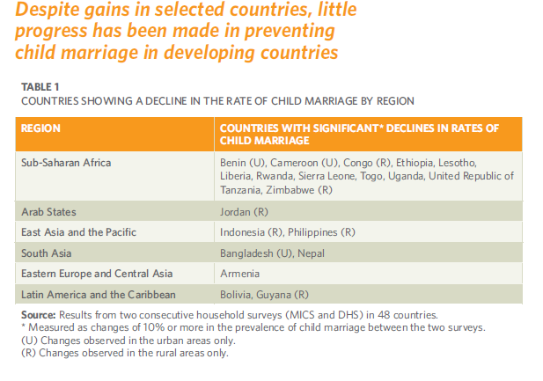
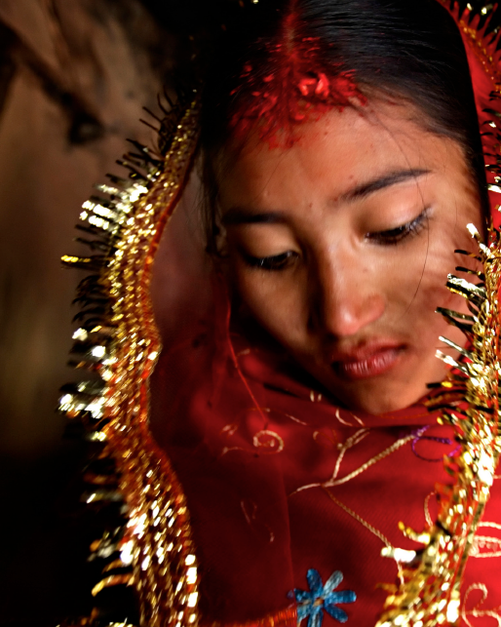
Limited & patchy progress
Source: UNFPA Marrying too Young: End Child Marriage. 2012.

Slide 11
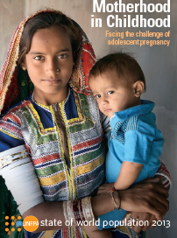
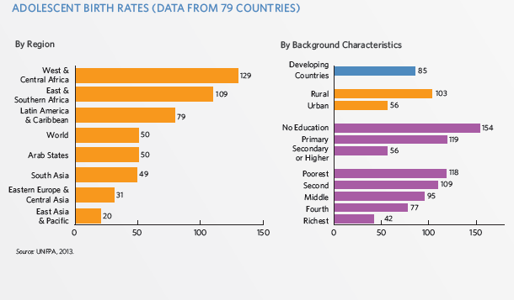
Limited & patchy progress -
Source: UNFPA. Motherhood in childhood. Facing the challenge of adolescent pregnancy. 2013.

Slide 12
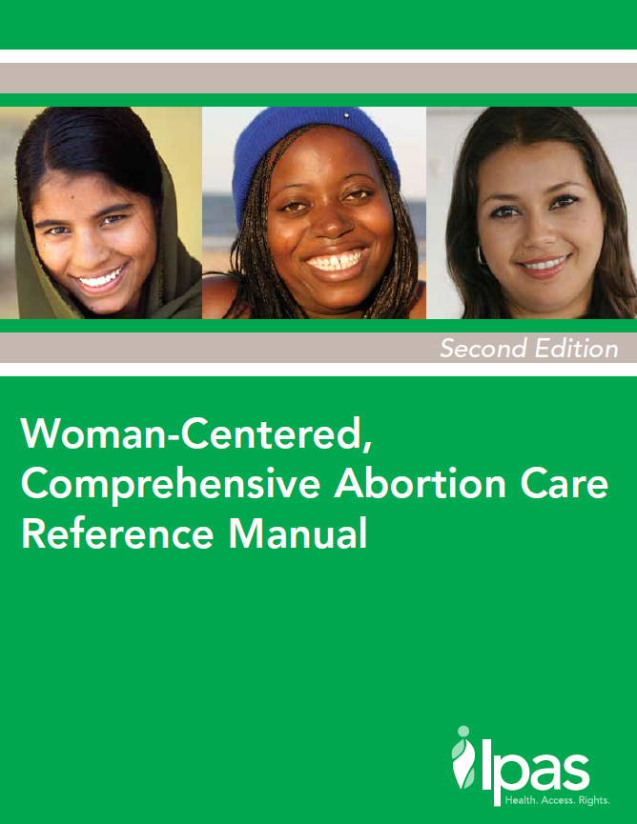
Limited & patchy progress
About 15 % of the estimated 22 million unsafe abortions that occur every year do so in 15-19 year olds.
Of the estimated 3.2 million unsafe abortions in women aged 15-19 years, 11% are in South Asia.
Source: I Shah, E Ahman. Unsafe abortion differentials in 2008 by age and developing country region: High burden among young women. Reproductive Health Matters, 2012; 20 (39): 169-173.

Slide 13
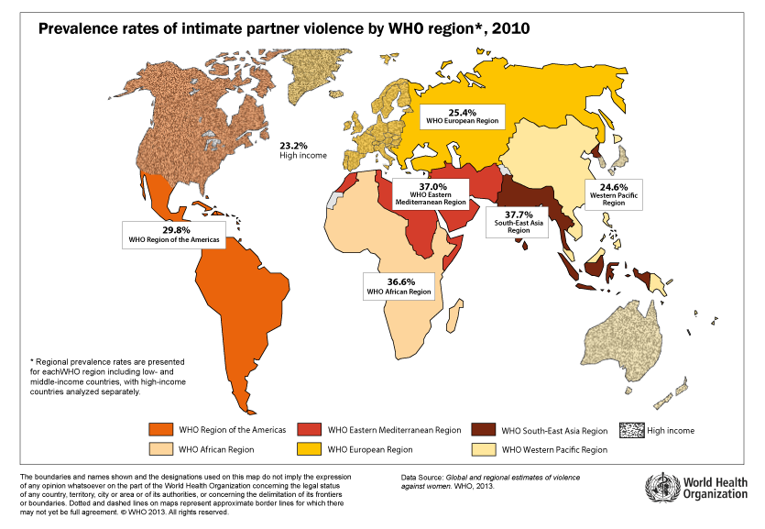
Limited & patchy progress
Globally, 1 in 3 women will experience physical and/or sexual violence by an intimate partner or sexual violence by someone other than their partner.
Such violence starts early in the lives of women with estimates showing that nearly 30% of adolescent girls (15–19 years) have experienced intimate partner violence.
Source: World Health Organization, London School of Hygiene and Tropical Medicine, South African Medical Research Council: Global and regional estimates of violence against women: prevalence and health effects of intimate partner violence and non-partner sexual violence. Geneva. WHO; 2013.

Slide 14
Key statement 7
Adolescent face these health problems:
- Because they are unprepared and unable to protect themselves
- Because they are under pressure to marry and bear children early
- Because they are unable to refuse unwanted sex or to resist coerced sex
- Because they are compelled to undergo female genital cutting
Notes:
Adolescents face sexual and reproductive health problems because of the four reasons listed on the slide.
They are unprepared and unable to protect themselves.
Worldwide, boys and girls are reaching puberty earlier, and are marrying later than their parents did. Many adolescents become sexually active at an early age when they do not know how to avoid sexually transmitted infections and unwanted pregnancies. Contextual factors such as the pressure to conform to media stereotypes and the norms of their peers as well as impaired judgement resulting from the use of alcohol and other psychoactive substances make them more likely to expose themselves to risks. Almost universally, they lack access to the health products (such as condoms and other contraceptives) that they need to protect themselves, or to the health services they need to get back to good health if they fall ill (e.g. with a sexually transmitted infection). Even if they have condoms, girls and young women are often powerless to insist on their use. This is particularly so when they feel compelled by economic pressures to exchange sex for money or favours.
They are under pressure to marry and bear children early.
In some parts of world, girls are still expected to marry and begin child bearing in their early or middle teenage years, well before they are physically or mentally ready to do so. Tragically, at a time of real need, many find themselves bereft of the social support that their natal families could provide them, and unable to obtain the health services that they and their babies need to survive. This greatly heightens their vulnerability.
They are unable to refuse unwanted sex or to resist coerced sex.
The sheer numbers of girls and young women around the world who are subjected to violence, including sexual violence, is staggering. In some cases, the perpetrators are strangers. In many other cases, they are peers or influential adults within - or in close contact with - their families. This makes it harder to refuse unwanted sex or to resist coerced sex. Many girls and young women bear this burden in silence. Even if they do gather the courage to tell someone what has happened, families are often reluctant to act because of fear of bringing shame and stigma upon themselves. The fact that law makers tend to look away from this problem, contributes to the continued existence of this scourge.
They are compelled to undergo female genital mutilation/cutting.
Despite the concerted efforts of programmes to eradicate female genital mutilation, the harmful practice continues to persist in some North African, West African and Arab nations. Families continue to seek out the ritual as a way of ensuring the acceptance of their daughters in the social life of their communities, in conformance with prevailing social and cultural norms.

Slide 15
- Individuals make choices to engage in specific behaviours
- Family and community norms, traditions, and economic circumstances influence these choices
- Policy and regulatory frameworks facilitate or hinder choices
POLICY
MACROENVIRONMENT
HEALTH FACILITY
FAMILY &
COMMUNITY
INDIVIDUAL
MICROENVIRONMENT
Notes:
Sexual and reproductive outcomes among adolescents are determined by a web of micro- and macro-level factors:
• Individuals make choices to engage in specific behaviours
• Family and community norms, traditions, and economic circumstances influence these choices
• Policy and regulatory frameworks facilitate or hinder choices
Actions are needed at each of these levels by different sectors.
Adolescents too have key roles to play.

