Slide 1
A never-before opportunity to strengthen investment and action on adolescent contraception, and what we must do to make full use of it: Part I
GFMER, June 2018
V Chandra-Mouli, P Parameshwar, M Parry, C Lane, G Hainsworth, S Wong, L Menard-Freeman, B Scott, E Sullivan, M Kemplay, L Say
Notes:
Greetings from WHO.
This is part 1 of a synthesis of key messages from a just-published paper titled A never-before opportunity to strengthen investment and action on adolescent contraception, and what we must do to make full use of it.
The individuals who contributed to the paper are listed on this slide.

Slide 2
1. What is this ‘never-before’ opportunity?
Notes:
In this paper we have posed and responded to five questions .
The first question is: What is this never-before opportunity ?

Slide 3
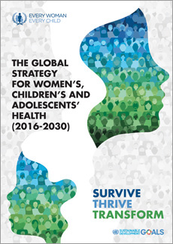
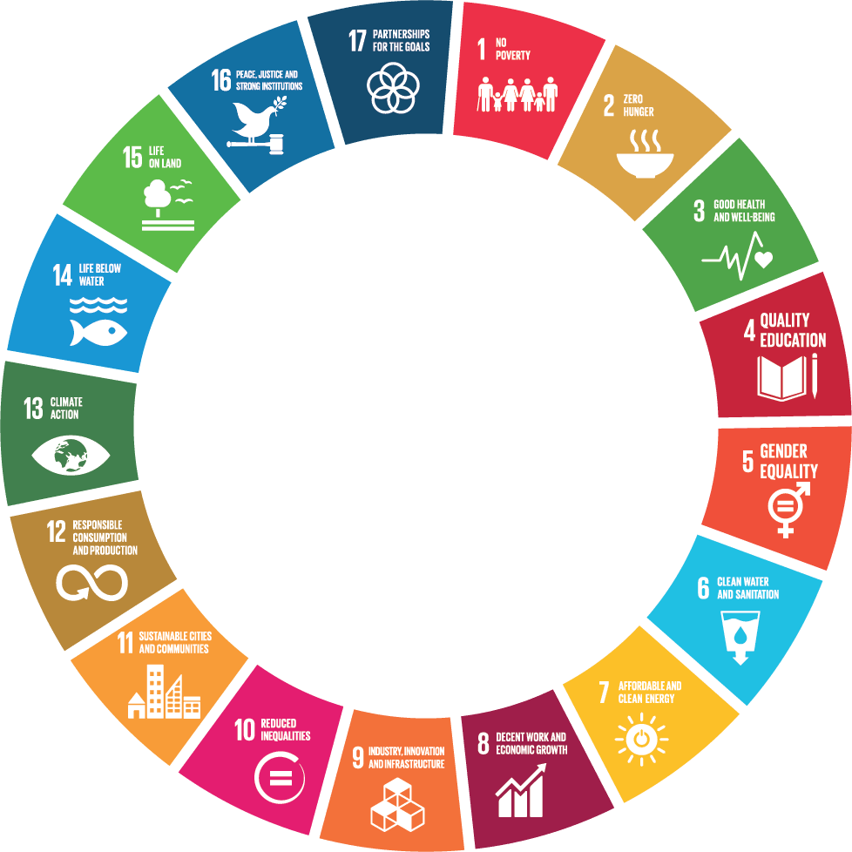


Increased global attention on adolescent health
“The updated Global Strategy includes adolescents because they are central to everything we want to achieve, and to the overall success of the 2030 Agenda. ”
-Former United Nations Secretary General Ban Ki-moon
Notes:
The Millennium Development Goals achieved many successes, for example reductions in childhood and maternal mortality , increased primary school enrollment and reduction of absolute poverty but they largely neglected adolescents.
One of the key themes of the Sustainable Development Goals is to leave no one behind. A key group that the SDGs address is adolescents.
This is reflected in the renewed Global Strategy on Women’s, Children’s and Adolescents’ Health. The strong focus on adolescents is reflected in the title and in the content of the document, as noted by the then Secretary General of the United Nations Ban Ki Moon.

Slide 4


Increased global attention on adolescent contraception
“Today, there are 1.2 billion adolescents aged 10-19 years living across the world. As the generation of the future, it is our collective responsibility to empower them to thrive, & doing so is central to achieving the FP2020 & broader Sustainable Development Goals…”
“In order to meet the diverse needs of youth & adolescents, countries & all stakeholders must examine their policies & programs, develop a process of evaluation & re-evaluation that genuinely reflects a youth perspective & implement evidence-based programs that work.”
Notes:
A number of adolescent health issues are in the global spotlight including child and early marriage, HIV/AIDS, violence and mental health.
Adolescent contraception is high on this list.
The FP2020 Partnership has identify it as a priority, and the Family Planning Summit held in July 2017 directed global attention to this group, for the reason listed on this slide.

Slide 5
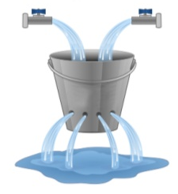
This ‘never-before’ moment for action to increase adolescent contraceptive use takes into account three critical factors.
1. Millions of adolescents who wish to postpone or space childbearing are not using an effective form of contraception.
2. Even where contraceptive use increases, adolescent use does not increase as much as among other age groups.
3. Even when adolescents do have access to and begin using contraceptives, challenges still persist. Adolescents are more likely than adult women to discontinue contraception, with unmarried adolescents exhibiting the highest levels of discontinuation.
“Leaky Bucket” Analogy
Bucket is only half full
Bucket does not fill up as quickly
3. Even when filled, bucket is leaking
Notes:
This slide lists the three reasons for the increased global attention to adolescent contraception.

Slide 6
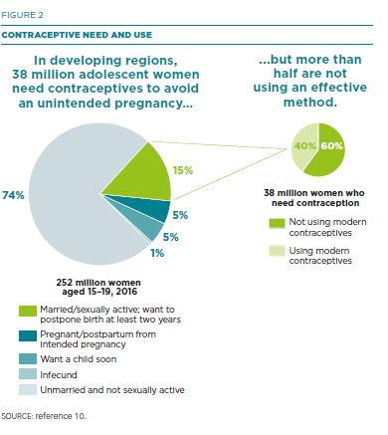

Many millions of adolescents who want to postpone birth are not using an effective method of contraception
Meeting the unmet need for modern contraception of women aged 15-19 would reduce unintended pregnancies among this group by 6 million annually. That would mean averting 2.1 million unplanned births, 3.2 million abortions & 5,600 maternal deaths.
The dramatic reduction in unintended pregnancies would spare women & their families the adverse consequences of early child bearing, reap savings in maternal & child health care, & boost women’s education & economic prospects.

Slide 7
Even when contraceptives are available & accessible, levels of use are less in younger than in older women
Married age 15-19
method mix
Source: Demographic and Health Surveys - DHS - STATcompiler
Notes:
Levels of use:
The youngest age group uses considerably less contraception than older women. This data is from Egypt, but illustrative of all the data we have. Method mix:
The method mix shows IUD and Pill preferences, that are reflected in many countries in the region. Pakistan is different, and there condom are the most used modern contraceptive.

Slide 8
2. Why are adolescents still unable to obtain and use contraceptives?
Notes:
Our second question is shown on this slide.

Slide 9

Many adolescents are not able to obtain the contraceptives they need
Contraceptives are not available at all, or are out of stock
Contraceptives are available but laws & policies prevent their provision. Even when there are no legal or policy restrictions, health workers do not provide them because of their biases
Adolescents do not know where they can get contraceptives, cannot afford them or cannot get to a service-delivery point easily
Notes:
This slide lists the reasons why adolescents are not able to obtain and to use contraception.
A key barrier is the knowledge, attitudes and practices of health workers.
Even were laws don't prohibit services to adolescents, health workers don't provide them because of personal biases or because they mistakenly believe that contraceptives should not be given to adolescents before they have children.

Slide 10
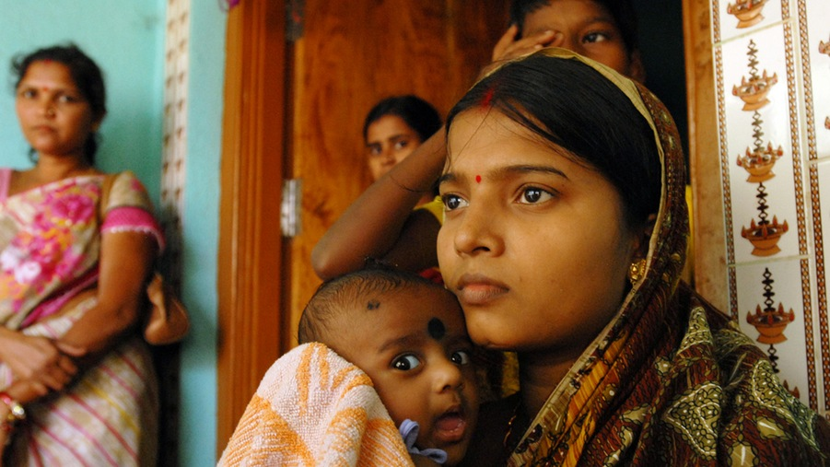
Even if they can obtain contraception, many adolescents are not able to use them – at all/consistently
Even when adolescents are able to obtain contraceptives, they may not use them/use them correctly because of:
Pressure to have children
Stigma surrounding obtaining/proposing contraceptive use
Fear of side effects
Even when adolescents use contraceptives, they may do so incorrectly/inconsistently
Notes:
In this slide we talk about the reasons why adolescents are not able to use contraceptives, even if they can obtain them.
The key issue here is power
Girls and young women in many contexts don't have power about contraceptive use. Decisions about when to use contraception is made by partners and mothers in law.
Our discussion so far has been about consensual sexual activity. Non-consensual sex is another matter altogether.

Slide 11
3. What do we need to do – or do differently - to increase correct and consistent contraceptive use by adolescents?
Notes:
Our third question is shown on the slide.

Slide 12
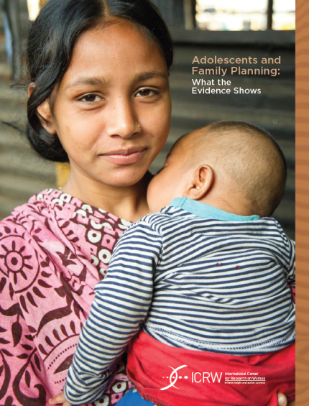

Understand the demand- and supply-side objectives to increase contraceptive access and uptake by adolescents, as well as contextual factors influencing these objectives
Demand for contraception
Desire to avoid, delay, space or limit child bearing
Desire to use contraception
Agency to use contraception
Supply of contraception
Access to contraceptive services
Provision of adolescent-friendly services
McCleary-Sills A, Sexton M, Petroni S, Kanesathasan A, Edmeades J, Warner A, et al. Understanding the Adolescent Family Planning Evidence Base. ICRW. Washington DC, 2014.
Contextual Factors
If early child bearing within marriage is socially accepted & even encouraged, interventions targeted at increasing contraceptive knowledge & availability, would do little to prevent wanted pregnancies.
Development agencies should continue their general economic & social development efforts to address the systematic poverty & disadvantage which breeds adolescent child bearing, including gender inequality, which can lower girls’ bargaining power over contraception & fertility decisions within marital & other sexual relationships.
McQueston, Silverman, Glassman. Adolescent Fertility in low & middle income countries: Effects & Solutions. Centre for Global Development, 2012.
Notes:
This slide addresses a critical issue.
First, we need to address the desire/willingness to use contraceptives and the ability to use them.
And then when there is desire and agency, we need to focus on providing contraceptives in a user-friendly manner.
Creating the desire/willingness to use contraceptives and to negotiate their use, on the one hand
And enabling girls and young women to obtain the method they want from the source that they prefer, on the other hand.
In contexts where there is huge pressure on girls to have a child, actively promoting contraceptive use does not take into account the context of their lives.

Slide 13
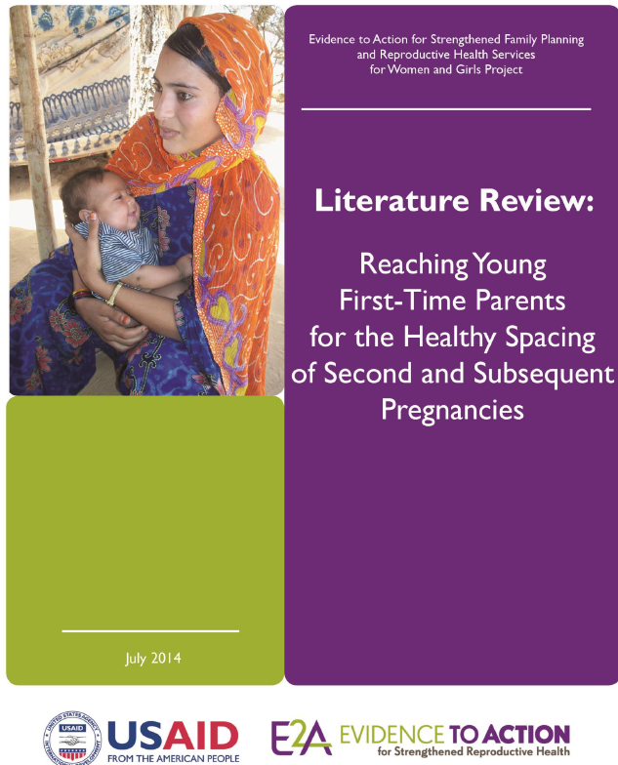
What we need to do differently to improve access to and provision of contraceptive services to adolescents
Examples: Unmarried ones & those married/in union, newly married ones, first-time parents, those living with HIV, & those who are disabled.
We must move from a one-size-fits-all approach to one that responds to the varying needs of different groups of adolescents
Notes:
There are five things that we need to do differently to improve access to and provision of contraceptive services to adolescents.
First, we must ensure that the approaches we use to deliver contraceptives recognize that different groups of adolescents have different needs and circumstances
For example, a young unmarried man who has sporadic sexual activity may need different contraceptives when compared to a young married women in a stable relationship and keen to space her second child.

Slide 14
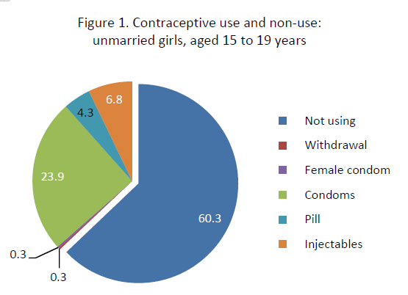
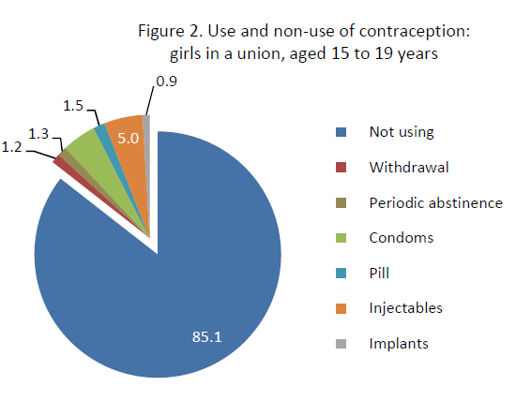
Adolescents – a heterogeneous group
United Republic of Tanzania: Adolescent contraception (WHO fact sheet based on DHS 2010)
Main reasons for non use:
Infrequent sex, not married,
fear of side effects
Main sources:
Shops, friends
Main reasons for non use:
Currently breastfeeding, not having sex,
fear of side effects
Main sources:
Government facilities, shops
Notes:
The data on this slide is from a set of fact sheets produced by WHO in the end of 2016.
The data points out that in the same setting, two different groups of adolescents have different levels of non use and reasons for non use. And among users, they contraceptives used and the places from where they are obtained are very different.
One size clearly does not fit all.

Slide 15

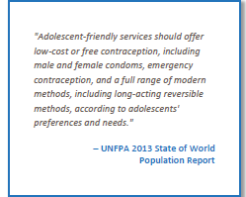
What we need to do differently to improve access to and provision of contraceptive services to adolescents
1. We must move from a one-size-fits-all approach to one that responds to the varying needs of different groups of adolescents.
2. We must expand the range of contraceptive choices offered to adolescents from ‘condoms only’ to a full range of methods.
Notes:
The second point is listed on the slide.
If contraceptives are offered at all to adolescents, they are condoms and pills.
We need to offer a whole range of methods. WHO clearly says that the only contraceptive method not recommended for adolescents is sterilization.

Slide 16
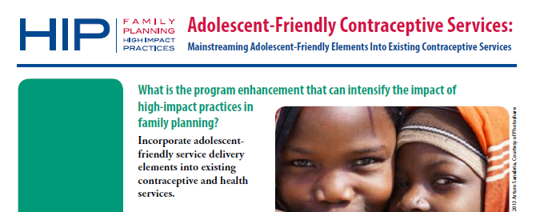
What we need to do differently to improve access to and provision of contraceptive services to adolescents
Separate services have been shown to be difficult to scale up and sustain in resource-constrained settings, so focusing on strengthening existing services is a pragmatic approach to reach large numbers of adolescents
We must make existing health services more adolescent friendly i.e. welcoming, non judgemental & guaranteeing confidentiality.
1. We must move from a one-size-fits-all approach to one that responds to the varying needs of different groups of adolescents.
2. We must expand the range of contraceptive choices offered to adolescents from ‘condoms only’ to a full range of methods.
3. We must move away from separate health services for adolescents, and instead make existing health services more adolescent friendly e.g. antenatal clinics & HIV care clinics.
Notes:
The third point is listed on the slide.
If we want to reach the enormous number of adolescents in LMICS with contraceptive information and services we need to use approaches that can be scaled up and sustained. This means making existing health services and facilities user friendly.

Slide 17
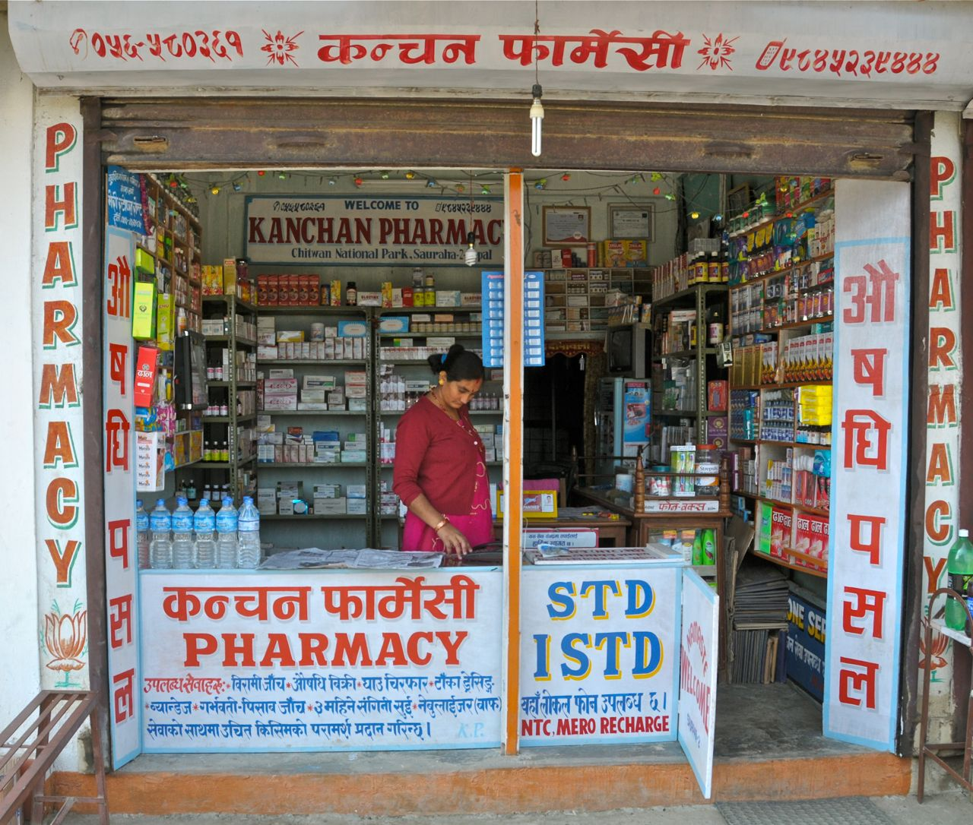
What we need to do differently to improve access to and provision of contraceptive services to adolescents
Adolescents in many places seek contraceptive information and services from pharmacies and shops. This is especially true for unmarried sexually active adolescents, & for products not easily obtained from government clinics e.g. emergency contraception.
1. We must move from a one-size-fits-all approach to one that respond to the differing needs & preferences of different groups of adolescents.
2. We must expand the range of contraceptive choices offered to adolescents from ‘condoms only’ to a full range.
3. We must move from separate health services for adolescents, and instead make existing services more adolescent friendly e.g. antenatal clinics & HIV care clinics.
4. We must work more actively with pharmacies & shops to expand contraceptive access and uptake.
Notes:
The fourth point is listed on this slide.
Many adolescents already obtain contraceptives from pharmacies and shops
This is often because of convenience. But in places where there it is hard for adolescents to obtain contraceptives from government clinics, then pharmacies and shops become preferred source for them.

Slide 18
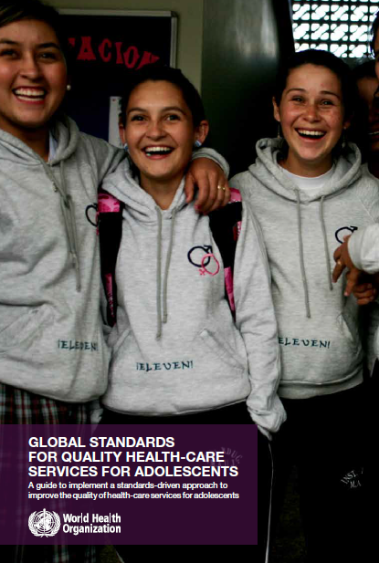
What we need to do differently to improve access to and provision of contraceptive services to adolescents
One-off training programmes (even if well conducted) have limited & short-lived effects
We need a package of actions - clear job descriptions, good quality training, desk reference tools, supportive supervision & collaborative learning.
1. We must move from a one-size-fits-all approach to one that respond to the varying needs of different groups of adolescents.
2. We must expand the range of contraceptive choices offered to adolescents from ‘condoms only’ to a full range of methods.
3. We must move from separate health services for adolescents to making existing services more adolescent friendly.
4. We must work more actively with pharmacies & shops to expand contraceptive access and uptake.
5. We must move from one-off in-service training for providers to a package of actions to ensure that all levels of health workers respond to adolescent clients effectively and with sensitivity.
Notes:
The fifth point is listed on this slide.
We recognize the importance of capable and empathic health workers for adolescent friendly contraceptive services.
In most cases, this has translated into one off training programmes which have proven to have limited lasting efforts.
This is why the package of actions listed on slide are needed.

Slide 19
A never-before opportunity to strengthen investment and action on adolescent contraception, and what we must do to make full use of it: Part II
July 2017
V Chandra-Mouli, P Parameshwar, M Parry, C Lane, G Hainsworth, S Wong, L Menard-Freeman, B Scott, E Sullivan, M Kemplay, L Say
Notes:
This is part 2 of a synthesis of key messages from a just-published paper titled A never-before opportunity to strengthen investment and action on adolescent contraception, and what we must do to make full use of it.

Slide 20
4. Expanding access to quality contraceptive services to adolescents, with equity:
What do we want to see in countries ?
Notes:
Now that we outlined what we need to do and to do differently, let us examine what we want to see happen in countries
Firstly, we need laws policies that enable the provision of contraception to adolescents without restriction by age, marital status or other social attributes.

Slide 21
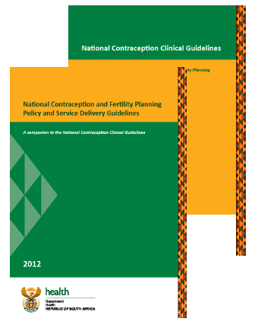
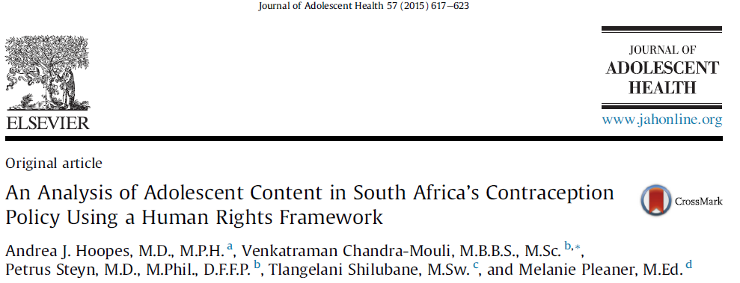
Expanding access to quality contraceptive services to adolescents, with equity: Five things we want to see in countries
i. Develop national laws and policies that require health workers to provide contraceptive services to adolescents without restrictions, and communicate them widely
Notes:
We also need laws and policies to be truly grounded in a human rights approach as recommended by WHOs guidelines.
From analyses of national laws and policies in a number of countries, by WHO and other organizations, we see that while there are positive elements, there are limitations that need to be addressed.
Laws and policies are very important because clear signal and provide basis for strategies and investment cases.

Slide 22
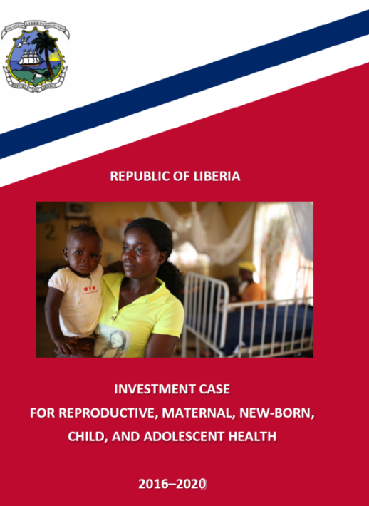
Expanding access to quality contraceptive services to adolescents, with equity: Five things we want to see in countries
i. Develop national laws and policies that require health workers to provide contraceptive services to adolescents without restrictions, and communicate them widely
ii. Design sound national adolescent SRH strategies that contain evidence-based and context-specific packages of interventions, budgets to deliver the package, and indicators to track progress that are disaggregated by age, sex, and socio-economic status
Choosing interventions that address local determinants, are feasible to implement, and have demonstrated effectiveness
Incorporating indicators to assess inputs, processes, and outputs
Notes:
Laws and policies cannot achieve much on their own.
We need strategies to translate them into action.
Strategies with clear line items and responsibilities for carrying them out.
And adequate human and financial resources.
Strategies are the bridge towards taking policies to action.

Slide 23
Expanding access to quality contraceptive services to adolescents, with equity: Five things we want to see in countries
i. Develop national laws and policies that require health workers to provide contraceptive services to adolescents without restrictions, and communicate them widely
ii. Design sound national adolescent SRH strategies that contain evidence-based and context-specific packages of interventions, budgets to deliver the package, and indicators to track progress that are disaggregated by age, sex, and socio-economic status
iii. Implement strategies with fidelity and careful monitoring, through functional systems and with the participation of civil society groups (including networks of youth organizations)
Notes:
In many places evidence-based policies and sound strategies remain as words on paper.
We need robust implementation so that large numbers of adolescents can be reached.
Alongside implementation we should monitor programmes to ensure that they meet defined standards of quality and are equitable.
We need to implement with quality, so that adolescents are reached with effective interventions. And we need to implement with equity, so that all adolescents, and not just a privileged few, are reached.

Slide 24
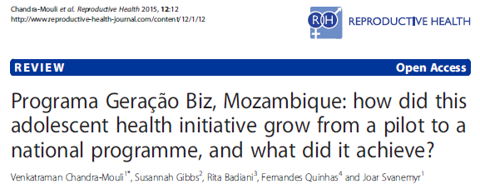
The case of Mozambique
Ministry of Health –
National & provincial levels
Health facilities
(Doctors, nurses & peer educators)
Coordinating committee
All 3 ministries & young people
Ministry of Youth & Sport –
National & provincial levels
Youth centres & community
(Peer educators & youth associations)
Ministry of Education –
National & provincial levels
Schools
(Teachers and peer educators)
Notes:
For robust implementation systems need to be put in place.
Mozambique’s Geracao Biz programme provides an excellent example of a system that was put in place to ensure coordinated action involving three sectors – health, education and youth.

Slide 25
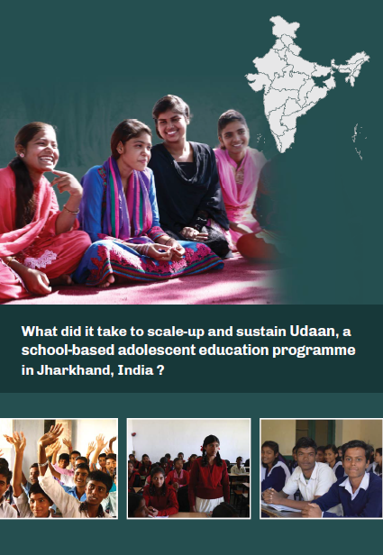
Udaan, a school-based adolescent education programme in Jharkhand, India engaged different players to play complementary roles
Government Departments
District level Education Officers Principals and teachers and UDAAN Mitras
Implementation, transaction and monitoring
The David and Lucile Packard Foundation
Resources and long term investment in the program
Centre for Catalyzing Change (C3)
Technical Assistance , Building Evidence for scale, and advocacy
Ownership, Leadership, integration into annual plan and budget; necessary administrative support
Notes:
For robust implementation different players should be involved.
The success of the Udaan programme in Jharkhand, India was based on a strong and sustained partnership between the state government and an NGO – Centre for Catalyzing Change.

Slide 26
Expanding access to quality contraceptive services to adolescents, with equity: Five things we want to see in countries
i. Develop national laws and policies that require health workers to provide contraceptive services to adolescents without restrictions, and communicate them widely
ii. Design sound national adolescent SRH strategies that contain evidence-based and context-specific packages of interventions, budgets to deliver the package, and indicators to track progress that are disaggregated by age, sex, and socio-economic status
iii. Implement strategies with fidelity and careful monitoring, through functional systems and with the participation of civil society groups (including networks of youth organizations)
iv. Conduct periodic programme reviews to build on strengths and address weaknesses
Notes:
Fourthly, from time to time, we must stand back and review our programmes, so that we can learn what has worked well and what has not And we must use that learning to build on strengths and address areas of weakness.

Slide 27
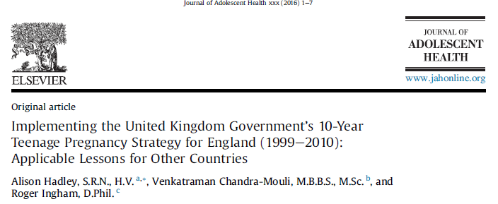
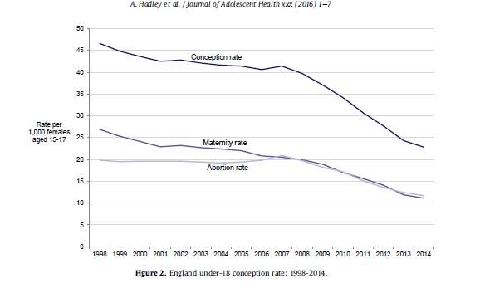
The case of England: Mid strategy review
Data & qualitative research were regularly reviewed to identify potential risk factors for early pregnancy, or poor outcomes for young parents & their children
Summaries were provided to local areas to inform targeted work, & strategy actions integrated nationally into relevant government programmes aimed at improving health and educational outcomes for the most disadvantaged young people.
Steady but slow decline in national under-18 conception
Wide variation in progress between local areas
In depth review comparing 6 areas with similar populations and deprivation: 3 with increasing rates and 3 with declining rates
Areas with good reductions were implementing the strategy effectively, supported by senior leadership
Progress accelerated by more prescriptive Government guidance, and Ministerial focus and additional support for poor performing areas
Notes:
England’s teenage pregnancy strategy owes its success to a mid term review which showed that poor progress was related to weak implementation. It contributed to changes which in turn led to stepped up implementation across the country.

Slide 28

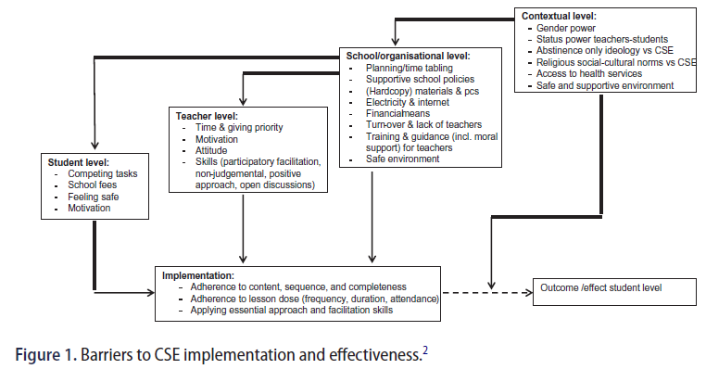
Expanding access to quality contraceptive services to adolescents, with equity: Five things we want to see in countries
i. Develop national laws and policies that require health workers to provide contraceptive services to adolescents without restrictions, and communicate them widely
ii. Design sound national adolescent SRH strategies that contain evidence-based and context-specific packages of interventions, budgets to deliver the package, and indicators to track progress that are disaggregated by age, sex, and socio-economic status
iii. Implement strategies with fidelity and careful monitoring, through functional systems and with the participation of civil society groups (including networks of youth organizations)
iv. Conduct periodic programme reviews to build on strengths and address weaknesses
v. Carry out research – with an emphasis on implementation research - to answer context-specific programmatic challenges
I Vanwesenbeeck, J Westeneng, T de Boer, J Reinder, R van Zorge. Lessons learned from a decade implementing CSE in resource poor settings: The world starts with me. Sex Education, 2015.
Notes:
Finally, we need research to answer context specific questions such as those that emerged when the World Starts with Me sexuality education programme was being implemented.

Slide 29
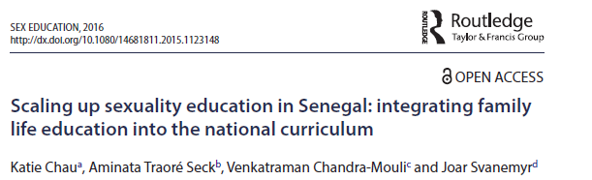
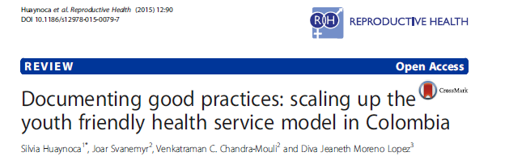
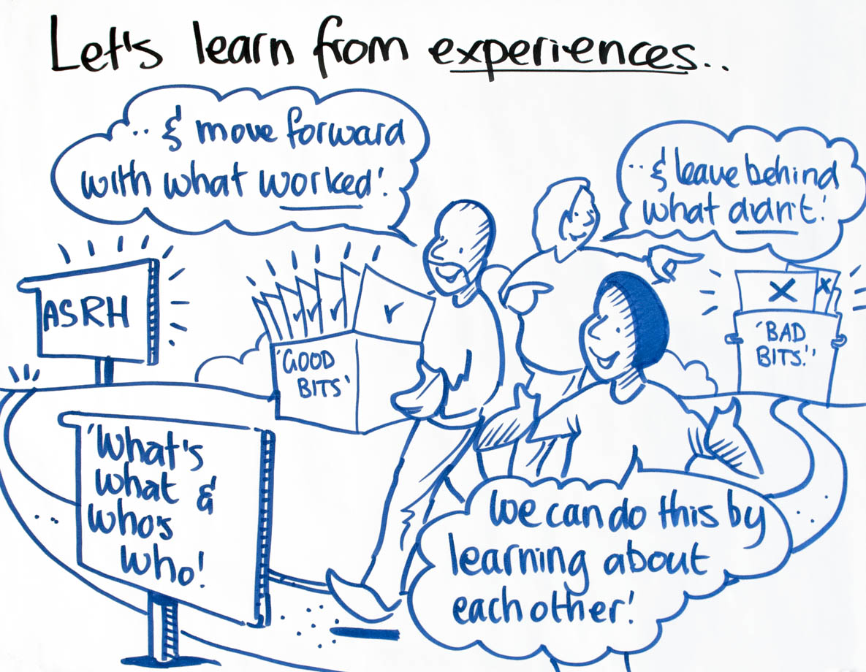
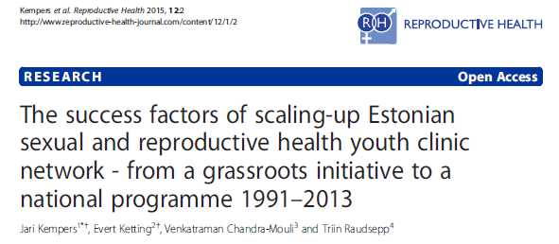
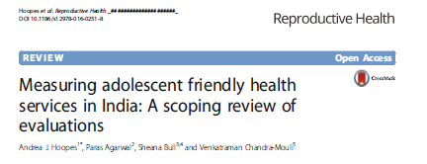
Notes:
As we move ahead, we must draw out the lessons being learned from projects and programmes in countries, and build on them.

Slide 30
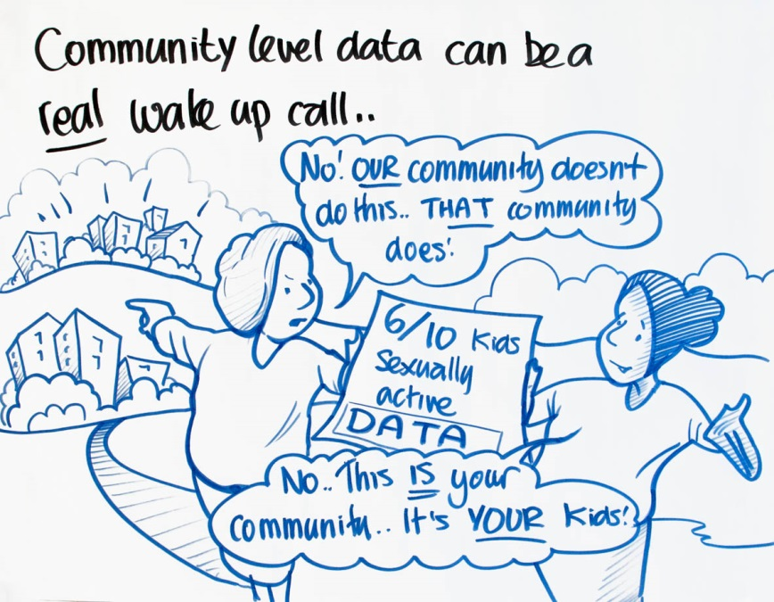
We need sound data to shape and reshape our efforts
Rates and outcomes of adolescent pregnancies
Contraceptive use & its determinants
Policies and programme performance
Adolescent sexuality and its context
Notes:
All our work must be based on sound data.
For this we need data on all four issues listed on this slide.
Disaggregated data must be gathered, analysed and use to shape and reshape our policies, strategies and programmes.

Slide 31
5. Outstanding examples of countries moving ahead with adolescent contraception
Notes:
There are a small but growing number of countries moving from small scale short lived projects to large scale, sustained programs.

Slide 32
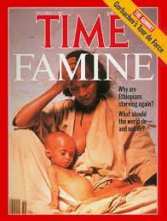
The case of Ethiopia
A widespread famine affected Ethiopia from 1983 to 1985.
In northern Ethiopia it led to more than 400,000 deaths...
Other areas of Ethiopia experienced famine for similar reasons, resulting in 10s of 1000s of additional deaths.
The tragedy as a whole took place within the context of more than two decades of insurgency & civil war.
Source: Wikipedia
Notes:
Ethiopia is a case in point.
Over 30 years ago, Ethiopia was the scene of civil war, famine, and deaths on an unimaginable scale.

Slide 33
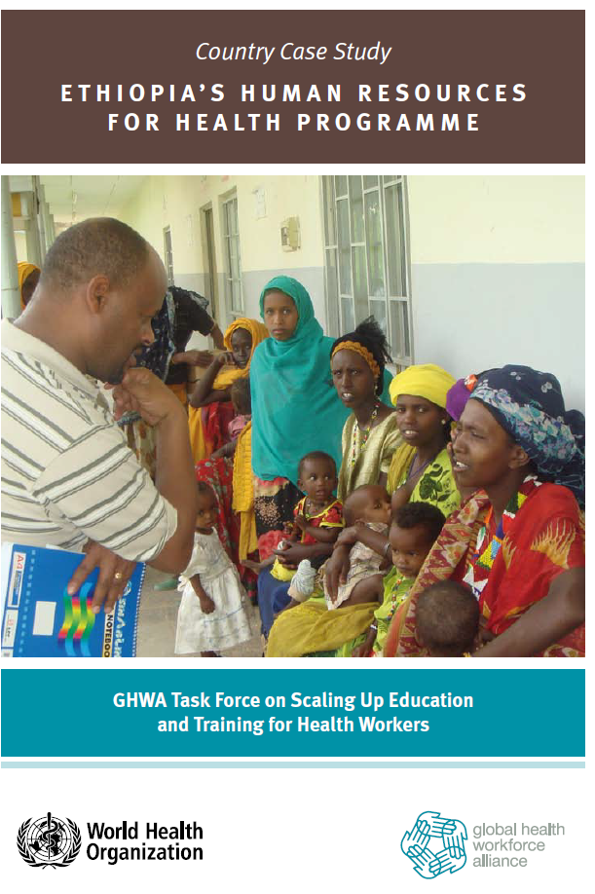
The case of Ethiopia
Main approach for general population
Health extension worker programme with national coverage
Over 35000 trained since 2005
Have received training in inserting implants since 2009
Reaching married women – adults & adolescents
Adolescent specific features
National adolescent strategy with minimum service package
Training public and private providers to meet the needs of young people
Notes:
Today, Ethiopia has transformed.
One concrete example is its national health extension worker program.
As shown in the slide, female outreach workers were identified, recruited, trained, and deployed in large numbers to reach women and girls in the rural areas with sexual and reproductive health services.

Slide 34
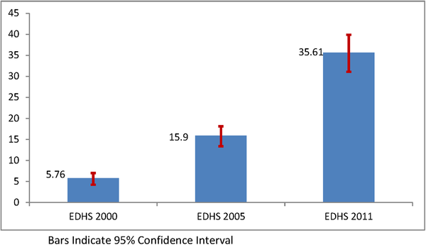
Trends in contraceptive use among Ethiopian young married women in the past 10 years, Ethiopia Demographic and Health Surveys 2000–2011.
Worku AG, Tessema GA, Zeleke AA (2015) Trends of Modern Contraceptive Use among Young Married Women Based on the 2000, 2005, and 2011 Ethiopian Demographic and Health Surveys: A Multivariate Decomposition Analysis. PLOS ONE 10(1): e0116525. https://doi.org/10.1371/journal.pone.0116525
http://journals.plos.org/plosone/article?id=10.1371/journal.pone.0116525
Notes:
The programme was not adolescent specific.
But give that adolescents represent a substantial proportion of the married population, they were reached by this program.
The results on this slide show impressive increases in contraceptive use, unmatched anywhere else in Africa.
The DHS of 2014 and 2016 confirm that trends continue to rise – married young women 15-24.

Slide 35
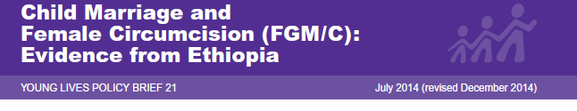
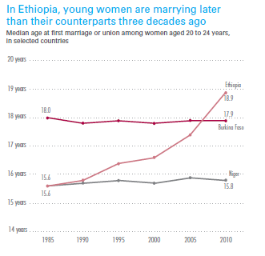
The case of Ethiopia
"Remarkable progress has been achieved in reducing both child marriage & Female Genital Mutilation/Cutting in Ethiopia, due to favourable legal frameworks, political will & campaigns with support from donor agencies, international organizations, local civil society & the media, alongside broader forces of modernization".
Source: UNICEF, 2014
Notes:
Alongside this, substantial reductions in Female Genital Mutilation and child marriage as confirmed by independent studies by the Young Lives project and UNICEF.
A number of factors, including strong and sustained government leadership contributed to this.

Slide 36
Key Messages
We have a never-before opportunity to address adolescent health. The work of FP2020 and the Family Planning Summit have placed adolescent contraception high on the global agenda.
We have a much better sense of what needs to be done to meet the needs of adolescents, and to enable them to realise their rights and exert agency over their sexual and reproductive decisions.
The big questions now revolve around how to orchestrate and sustain large-scale implementation, how to respond to the diverse needs of different groups of adolescents, and how to involve adolescents in these processes. We must move with countries to scale up adolescent contraceptive services.
Some countries are already moving forward. We need to recognize and celebrate their successes and share them widely.
Notes:
We conclude this presentation with four key messages.

