Slide 1

FP2020
UNDERSTANDING DATA ON ADOLESCENTS AND YOUTH
February 15, 2019
FAMILYPLANNING.ORG
#FP2020PROGRESS
@FP2020 GLOBAL
FACEBOOK.COM/FAMILYPLANNING2020
Notes:
Change to Emily Sullivan, Youth Engagement Manager. Ask Emily for input
Welcome! Thank you for joining us today. I’m Jason Bremner, Director of Data & Performance Management at FP2020. Today I’ll be providing an overview of our special analysis on adolescents and youth data, helping you understand the data and also looking at some of the challenges that we still face. You can find the special analysis online at progress.familyplanning2020.org. Before we start, I want to quickly hand it over to my colleague Emma Anderson who will review key logistics for today’s webinar.
--
Emma: Thank you for joining us in the webinar. Before we get started with the program, I would like to take several minutes to share key logistical notes with all of you.
First, you should be seeing in front of you a presentation and to the right of the presentation three pods:
One which shows all attendees
One where you can submit questions.
One where you can send chats to all attendees or to the meeting hosts. We encourage you to submit questions at any point during the webinar through the chat pod.
In the event you are unable to reach us or need to use email, please email info@familyplanning2020.org.
This webinar is being recorded. Thank you again for joining us and for your participation.

Slide 2

INCREASING DATA AVAILABLILTY ON ADOLESCENTS AND
YOUTH
UNDERSTANDING DATA ON ADOLESCENT AND YOUTH
Notes:
Ahead of the 2017 Family Planning Summit, partners who were focused on increasing information and services for adolescents and youth asked many questions about data, some of which we could answer and many of which we could not. In response, FP2020 and our measurement partners came together to write a commentary, entitled: Mind the Gap, a commentary on data gaps and opportunities for action in meeting the contraceptive needs of adolescents.
Since 2017, a number of FP2020 partners have worked to address the gaps in adolescent and youth data. One of the steps we’ve taken at FP2020 this year is to increase the data available in our FP2020 Progress Report. Here we report on a selection of themes and indicators recommended by FP2020’s Performance, Monitoring, and Evidence Working Group for tracking country progress. These indicators include the adolescent and youth population size, the percentages who are married and who are unmarried and sexually active, and patterns of key life events: age at marriage, first sex, and first birth. These indicators also include current levels of contraceptive use and unmet need among married and unmarried sexually active women⁴² aged 15–19 and 20–24, as these data help countries better understand the desire among these age groups to limit or space births and the progress toward meeting that contraceptive demand. The indicators reviewed here are not comprehensive, and countries should develop a longer list of national and sub-national adolescent and youth indicators within their own country and local contexts.

Slide 3
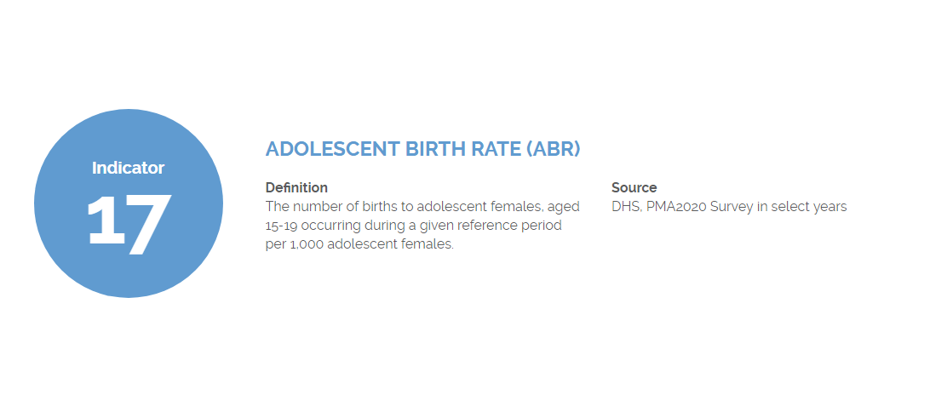
CORE INDICATOR 17: ADOLESCENT BIRTH RATES
UNDERSTANDING DATA ON ADOLESCENT AND YOUTH
Notes:
Core Indicator 17, Adolescent Birth Rates, is defined as the number of births to adolescent females, aged 15-19 occurring during a given reference period per 1,000 adolescent females. In general, the trend over the last 20 years has been toward a decline in the adolescent birth rate, but its important to note a few cautions in the interpretation of this measure. First, the declines have been very modest over the last decade, there has not been remarkable progress in most countries. Second, declines are not necessarily reflective of changes in behavior around contraception or improved reproductive health. Change may be due to declines in early marriage, delay of first sexual activity, increase in contraceptive use, or increased abortion rates.
Research from our partners at the Guttmacher Institute suggests that about half the pregnancies among adolescent women aged 15-19 in developing countries are unintended and about half of those unintended pregnancies end in abortion.
Cate note: one data point that has intrigued me is that rates of certain undesirable outcomes are declining, BUT the total number of adolescents will continue to increase. I’m no numbers person, but I guess the possibility is that overall rates will decline but actual numbers of adolescents giving birth could remain level or even increase as populations continue to grow?

Slide 4
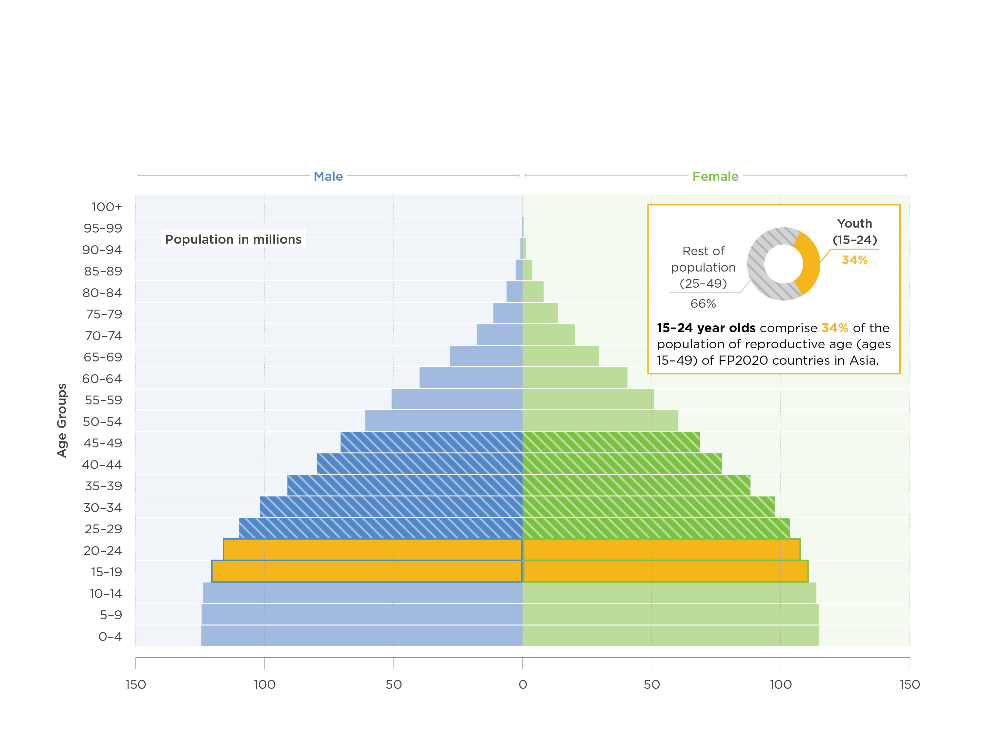
YOUTH POPULATION IN FP2020 COUNTRIES IN ASIA
Notes:
Empowering young people with the tools they need to thrive is central to achieving both FP2020 goals and the Sustainable Development Goals (SDGs). The youth population comprises a large proportion of the total number of women and men of reproductive age in the 69 FP2020 focus countries. In Asia, youth aged 15-24 make up 34% of all men and women of reproductive age in FP2020 focus countries.

Slide 5
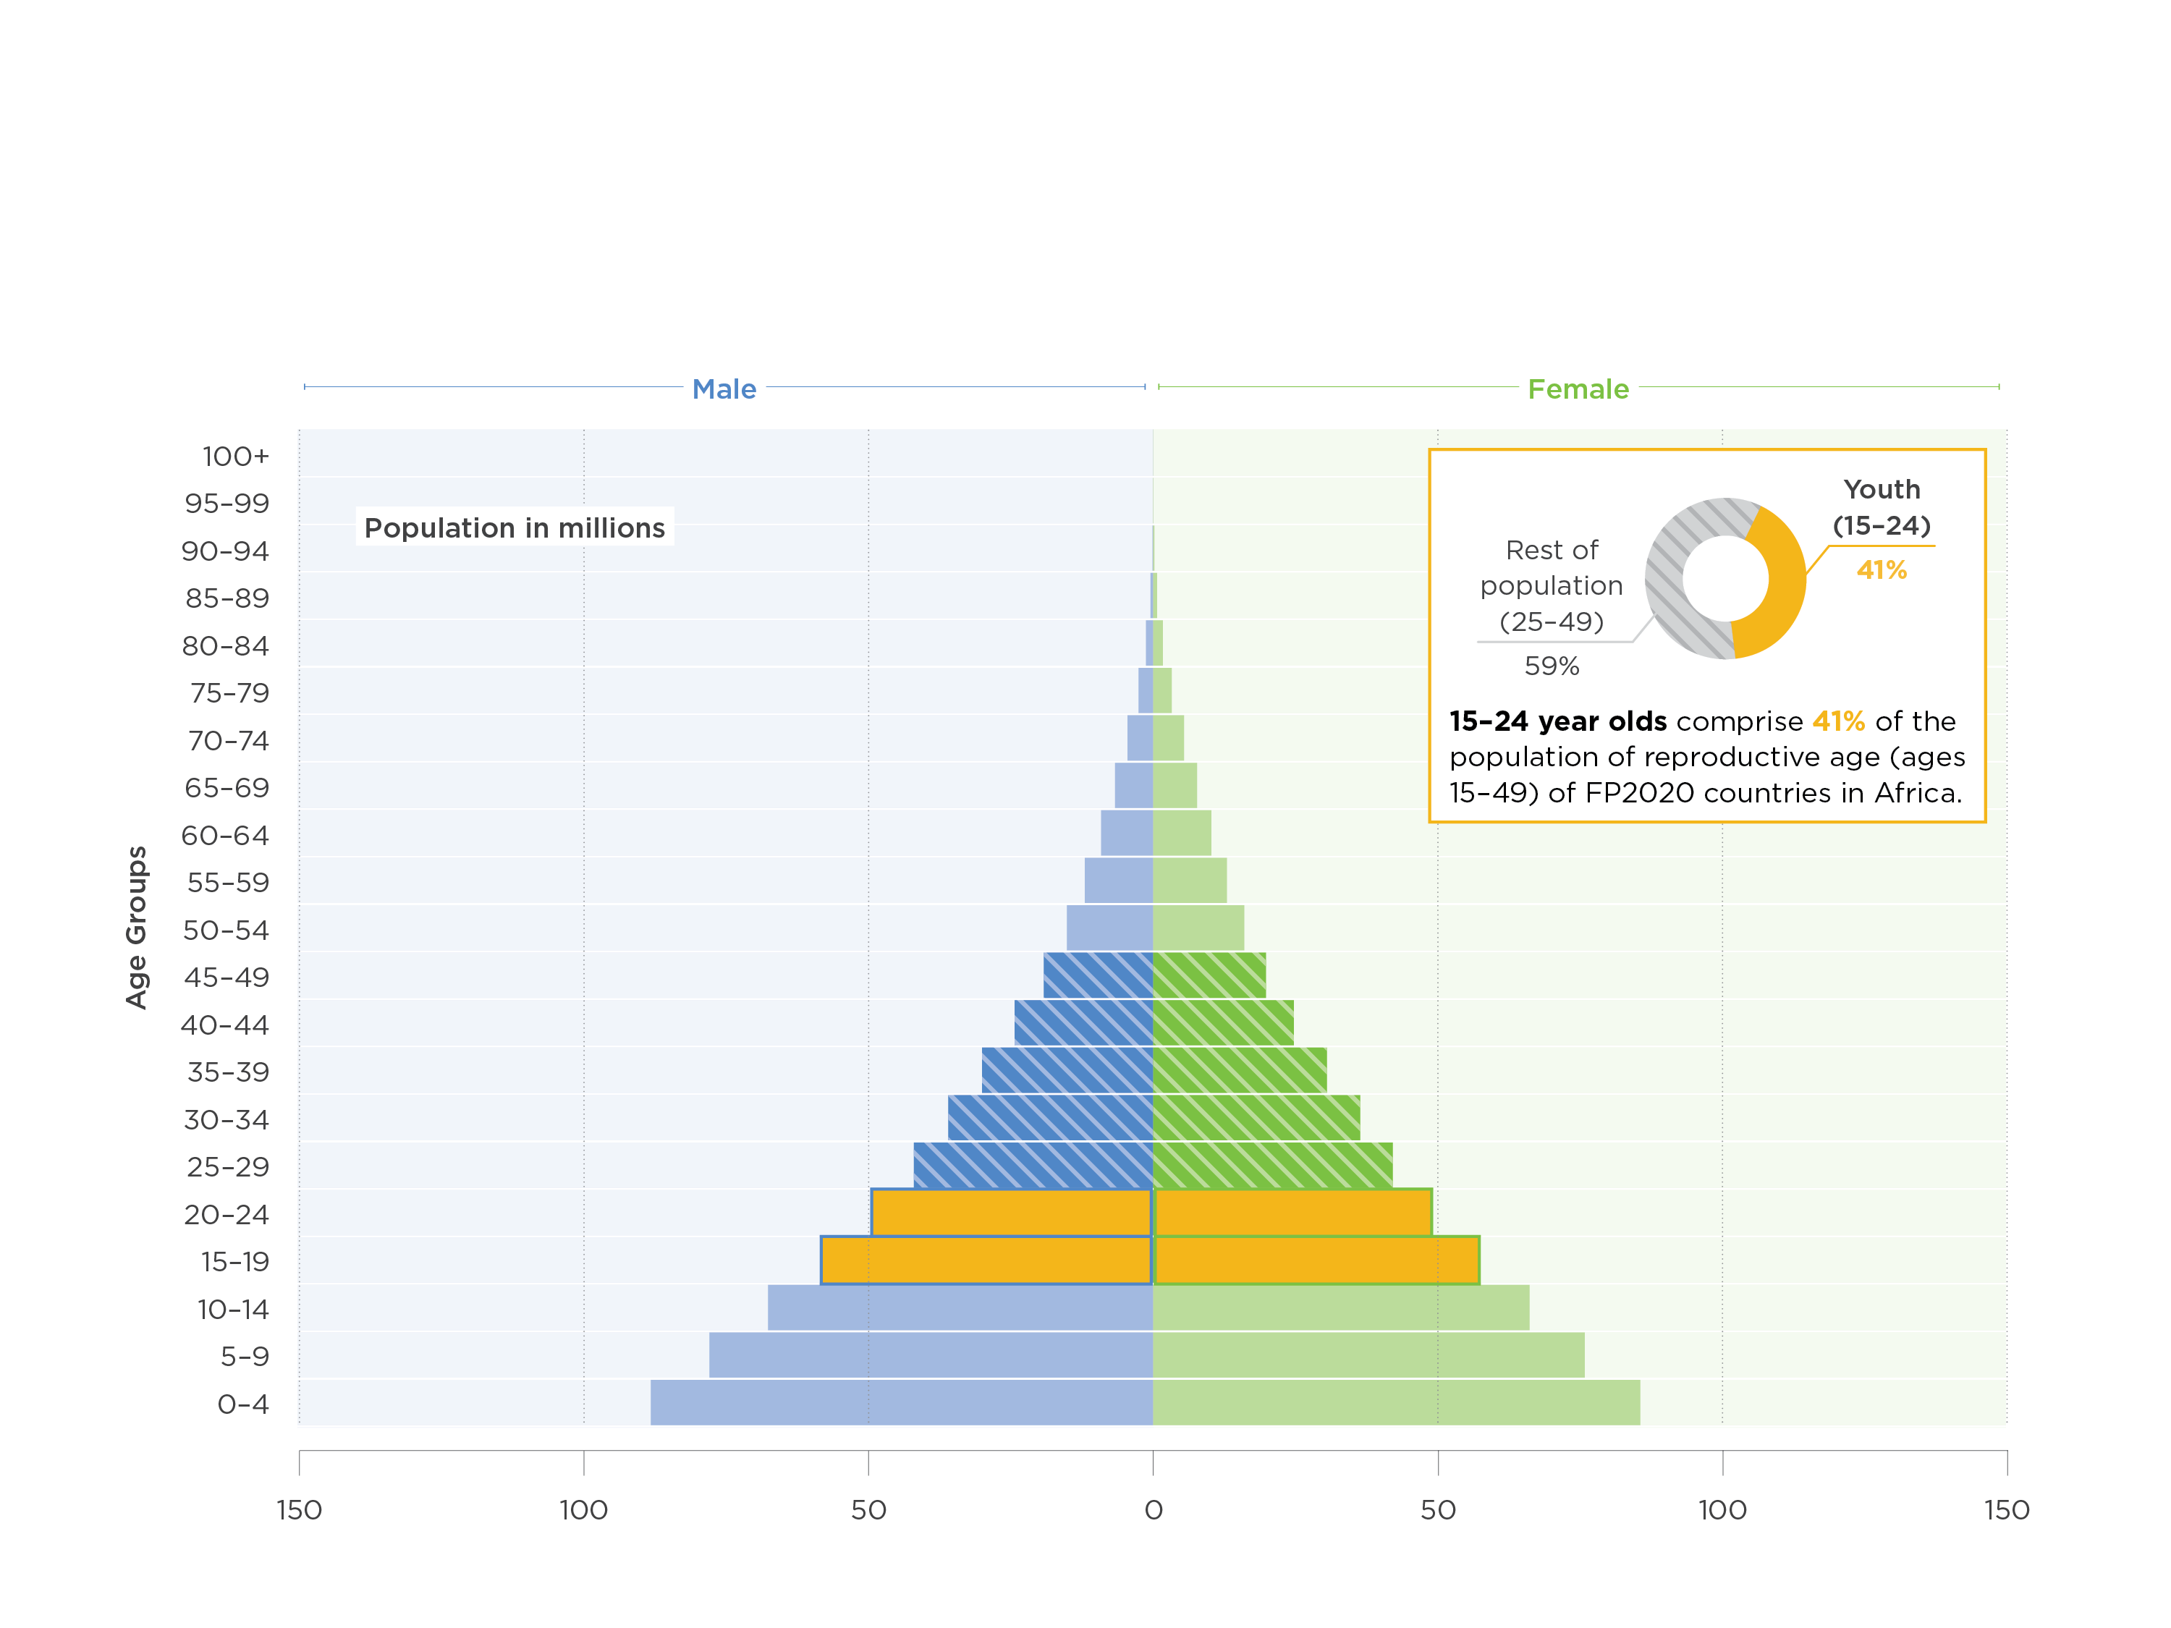
YOUTH POPULATION IN FP2020 COUNTRIES IN AFRICA
Notes:
And in Africa, adolescents and youth aged 15-24 make up 41% of all men and women of reproductive age in FP2020 focus countries in Africa. Understanding the lives of young people and their information and service needs is critical for developing effective health programs. Research on adolescents suggests that many patterns related to lifelong health behaviors are established during adolescence. The choices made and the patterns of behavior that young people develop today will affect the entire trajectory of their lives.

Slide 6
KEY LIFE EVENTS
^{Patterns of key life events:}
  ^{Age at first sex}
  ^{Age at marriage}
  ^{Age at first birth}
Understanding local patterns is critical for developing context-specific approaches
UNDERSTANDING DATA ON ADOLESCENT AND YOUTH
Notes:
Looking at key life events is important for understanding general social patterns in the life course of adolescents and youth, and the patterns that we can look at with available data include age at marriage, age at first sex, and age at first birth. Looking across countries we will see a wide variety of sequencing among these. These distinctions highlight the importance of understanding local patterns and developing approaches that are context-specific, timely, and effective.

Slide 7
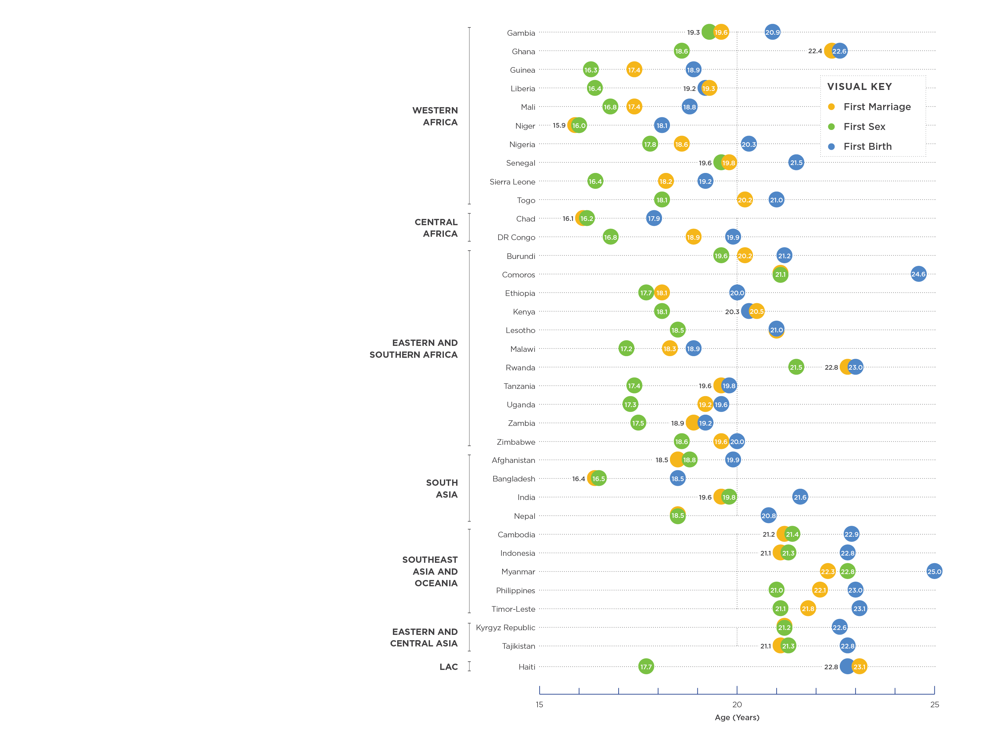
MEDIAN AGE AT KEY LIFE EVENTS AMONG WOMEN
Notes:
This graphic shows the median age for key life events represented by the age at which 50% of women ages 25–29 had experienced their first marriage, sexual intercourse and birth. First, let’s talk about the age group. Why are we reporting these events for women who are 25-29? Well if you want to look at a median for a group, it’s necessary that most of the group have experienced that event. For example, look at the median age of for Haiti, which is at the bottom of the graphic.

Slide 8
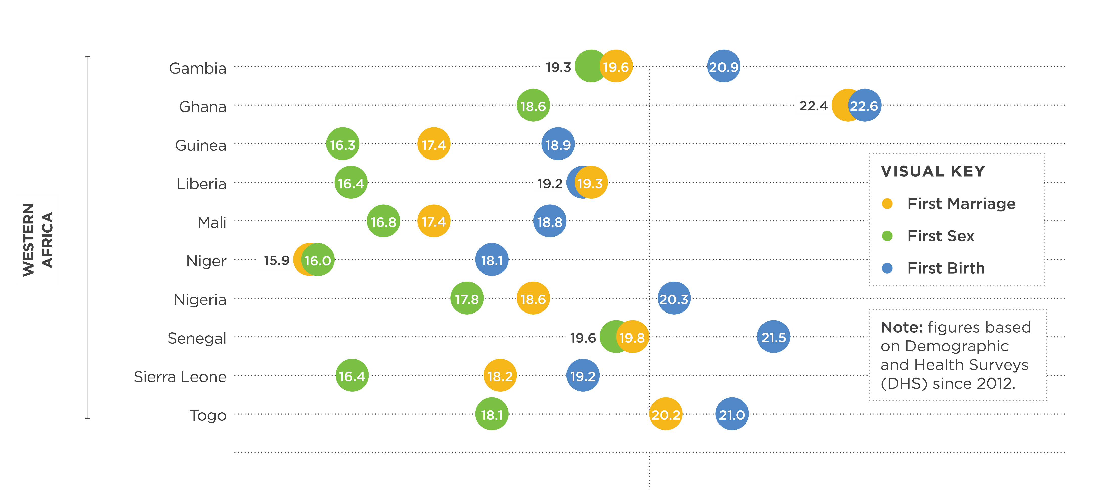

MEDIAN AGE AT KEY LIFE EVENTS: WEST AFRICA
UNDERSTANDING DATA ON ADOLESCENT AND YOUTH
Notes:
In West Africa you see that countries exhibit diverse patterns, with some interesting things to examine. You’ll notice that in many of these countries despite relatively low levels of contraceptive use, which aren’t shown here, the median age at first sex appears to be a few precede the average age at first birth by years after first sex.
In the graphic you can see that Ghana long period between the median age at first sex and the median age at first marriage, highlighting the importance of widespread access to health services and health education for adolescents and youth. In Niger, early marriage is common, and more than half of women are married by the age of 16. Efforts to delay marriage and delay first birth are critical in these contexts for a host of reasons, including improvements in maternal health outcomes, increasing girls’ education, and empowering women. In Senegal, the median age of marriage is later and is close to the median age at first sex, with first birth following soon after. This suggests that programs might prioritize the integration of maternal health and family planning services, including postpartum family planning.

Slide 9
CONTRACEPTIVE USE AND UNMET NEED
Levels of contraceptive use and unmet need range widely across countries:
Contraceptive use among married women aged 15–19 ranges from 1% in Nigeria to 53% in Myanmar
Contraceptive use among married women aged 20–24 is generally higher, ranging from 4% in Chad to almost 64% in Zimbabwe
UNDERSTANDING DATA ON ADOLESCENT AND YOUTH
Notes:
Low rates of contraceptive use among young married women suggest the social importance in many countries of bearing children early in the marriage. Despite these social norms, unmet need among married women aged 15–19 and 20–24 is in most cases higher than the national average, suggesting there is a desire and opportunity among youth to delay or space births. One way to better recognize the youth interventions that are needed is to look at the sexual activity and contraceptive use of the entire youth population of a specific country.

Slide 10
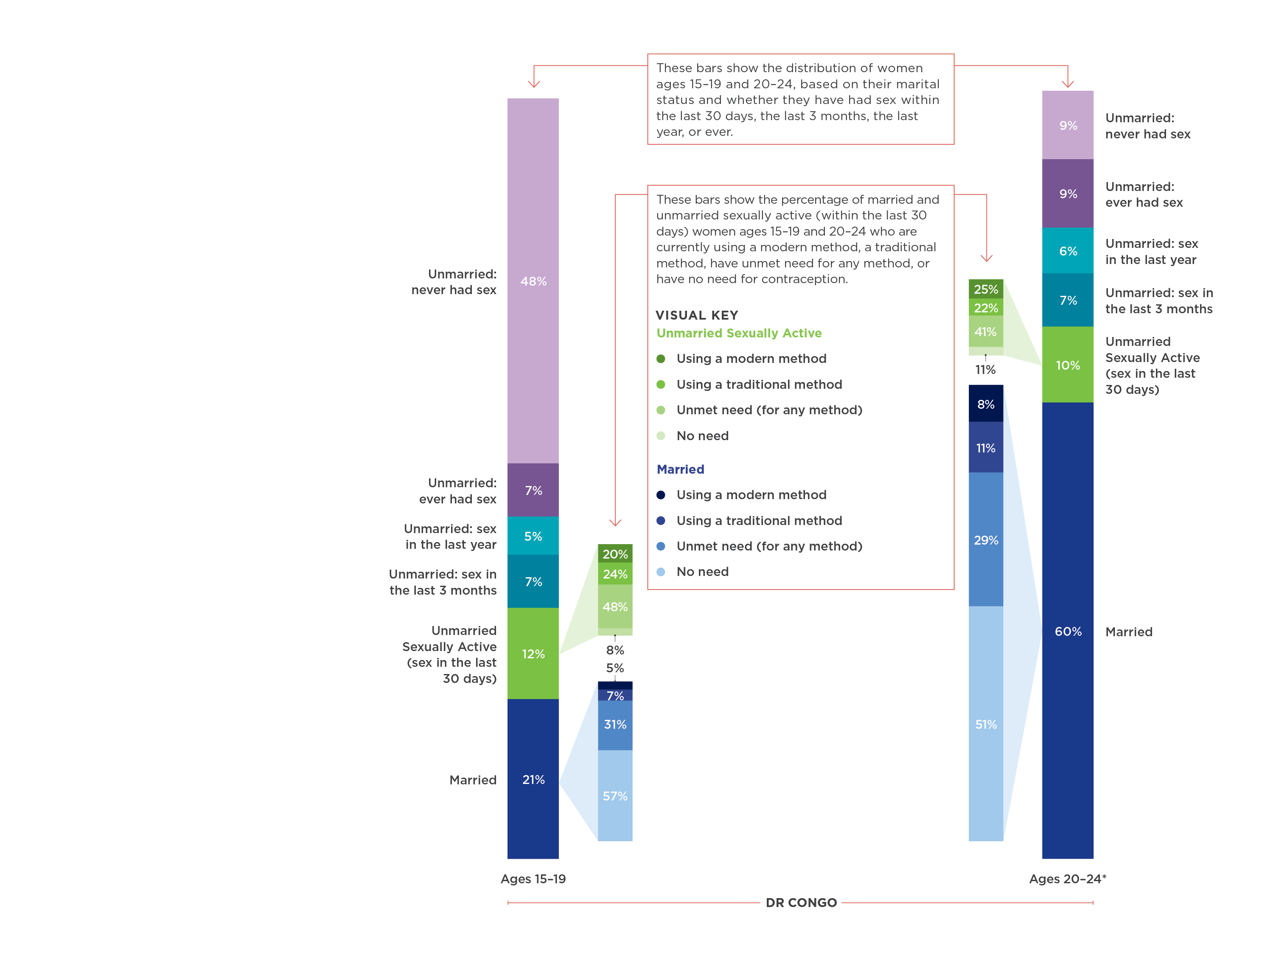
DISTRIBUTION OF YOUNG WOMEN IN THE DRC BY MARITAL STATUS AND SEXUAL ACTIVITY
Notes:
The two taller bars on the outside show the distribution of women ages 15–19 and 20–24, based on their marital status and whether they have had sex within the last 30 days, the last 3 months, the last year, or ever.
The four shorter bars on the inside show the percentage of married (shades of blue) and unmarried sexually active (shades of green) women ages 15–19 and 20–24 who are currently using a modern method, a traditional method, have unmet need for any method, or have no need for contraception.
*Ages 20-24: percentages do not exactly equal 100% due to rounding.
Examining this graphic, is challenging and it takes time, but you’ll start to notice some really interesting and important things. First, you should notice that women who are not currently sexually active need to be examined together with those who are currently sexually active to better understand the behaviors and needs of unmarried women for developing effective programs.

Slide 11
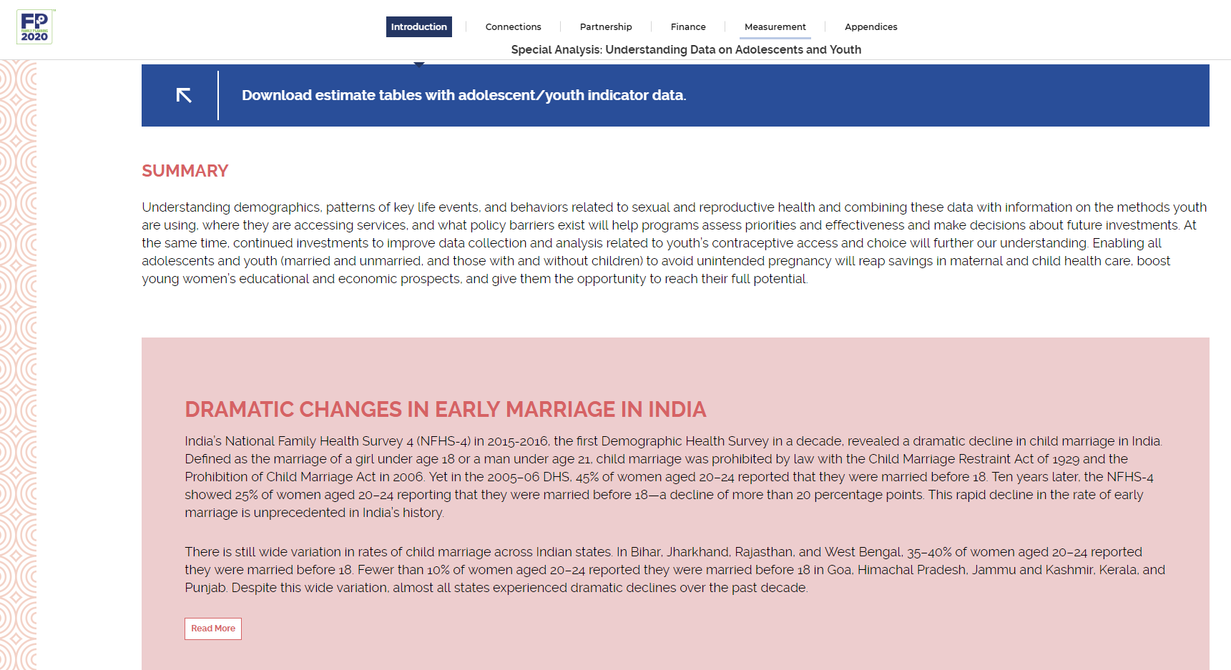
VISIT OUR ANNUAL PROGRESS REPORT SITE
progress.familyplanning2020.org/content/measurement
UNDERSTANDING DATA ON ADOLESCENT AND YOUTH
Notes:
Low rates of contraceptive use among young married women suggest the social importance in many countries of bearing children early in the marriage. Despite these social norms, unmet need among married women aged 15–19 and 20–24 is in most cases higher than the national average, suggesting there is a desire and opportunity among youth to delay or space births. One way to better recognize the youth interventions that are needed is to look at the sexual activity and contraceptive use of the entire youth population of a specific country.

Slide 12

CHALLENGES
UNDERSTANDING DATA ON ADOLESCENT AND YOUTH
Notes:
Understanding demographics, patterns of key life events, and behaviors related to sexual and reproductive health and combining these data with information on the methods youth are using, where they are accessing services, and what policy barriers exist will help programs assess priorities and effectiveness and make decisions about future investments

Slide 13
Continuing measurement challenges
Current Exclusion of unmarried women (including those aged 15-24) in many countries
Unmarried youth may be reluctant to report sexual activity in a household survey setting
Classifications of sexual activity and contraceptive use may obscure understanding of patterns of sexual activity and contraceptive use
Lack of data on very young adolescents
Age disaggregation in health management information systems
UNDERSTANDING DATA ON ADOLESCENT AND YOUTH
Notes:
In many countries particularly in Asia and North Africa, unmarried women (including those aged 15-24) are excluded from surveys about sexual and reproductive health due to sensitivities about sexual activity outside of marriage
Unmarried youth may be reluctant to report sexual activity especially at in-home surveys/interviews
In countries that do collect data among unmarried sexually active men and women, the classifications of sexual activity used in standard reporting may obscure understanding of youth contraceptive use.
Yet in many countries the percentage of youth who have had sex but not in the last month is equal to or greater than the percentage of youth who are currently sexually active.

Slide 14

Q&A
FAMILYPLANNING.ORG
#FP2020PROGRESS
@FP2020 GLOBAL
FACEBOOK.COM/FAMILYPLANNING2020

Slide 15
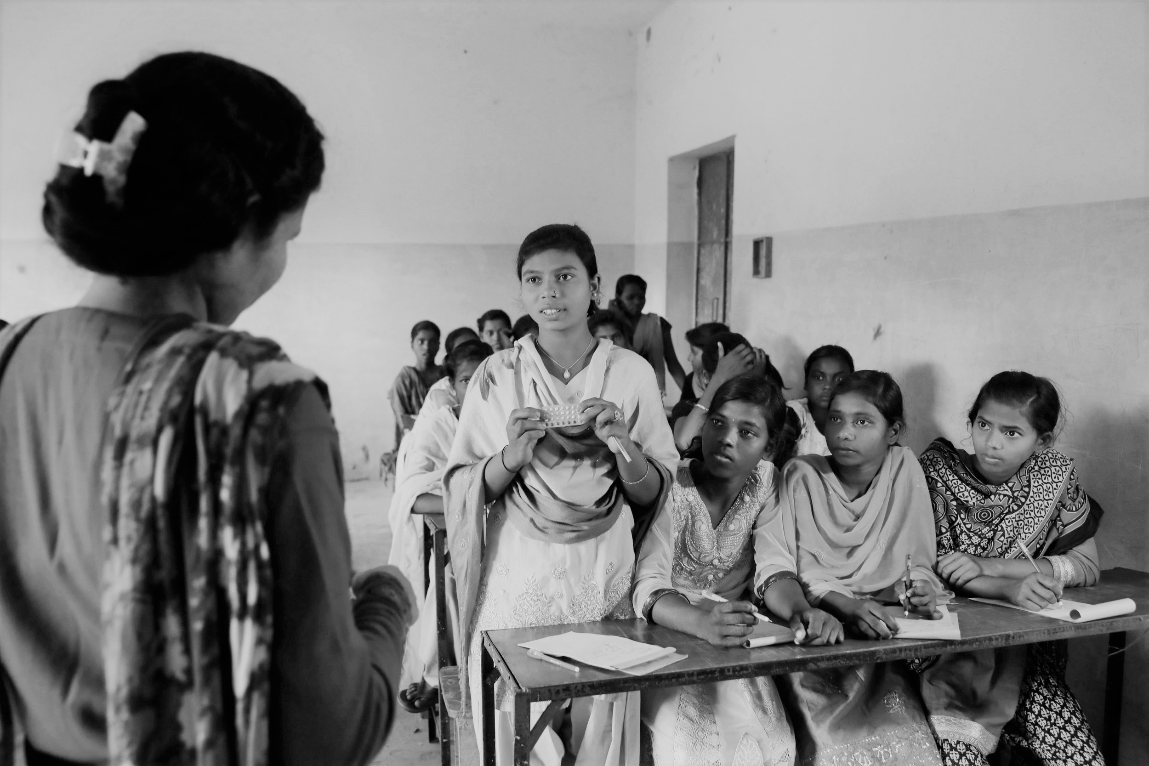
DATA HIGHLIGHT: INDIA
UNDERSTANDING DATA ON ADOLESCENT AND YOUTH
Notes:
Transitioning from challenges to reflections on positive data changes in the last couple of years. In this years progress report, we highlighted the rapid decline in the rate of early marriage in India.

Slide 16
DRAMATIC CHANGES IN EARLY MARRIAGE IN INDIA
India’s National Family Health Survey 4 (NFHS-4) in 2015-2016: 25% of women aged 20-24 reported being married before 18
India’s National Family Health Survey 4 (NFHS-4) in 2005-2006: 45% of women aged 20-24 reported being married before 18
There is still wide variation in rates of child marriage across Indian states:
Bihar, Jharkhand, Rajasthan, and West Bengal, 35–40% of women aged 20–24 reported they were married before 18.
Fewer than 10% of women aged 20–24 reported they were married before 18 in Goa, Himachal Pradesh, Jammu and Kashmir, Kerala, and Punjab
UNDERSTANDING DATA ON ADOLESCENT AND YOUTH
Notes:
India’s National Family Health Survey 4 (NFHS-4) in 2015-2016, the first Demographic Health Survey in a decade, revealed a dramatic decline in child marriage in India. Defined as the marriage of a girl under age 18 or a man under age 21, child marriage was prohibited by law with the Child Marriage Restraint Act of 1929 and the Prohibition of Child Marriage Act in 2006. Yet in the 2005–06 DHS, 45% of women aged 20–24 reported that they were married before 18. Ten years later, the NFHS-4 showed 25% of women aged 20–24 reporting that they were married before 18—a decline of more than 20 percentage points. This rapid decline in the rate of early marriage is unprecedented in India’s history.
There is still wide variation in rates of child marriage across Indian states. In Bihar, Jharkhand, Rajasthan, and West Bengal, 35–40% of women aged 20–24 reported they were married before 18. Fewer than 10% of women aged 20–24 reported they were married before 18 in Goa, Himachal Pradesh, Jammu and Kashmir, Kerala, and Punjab. Despite this wide variation, almost all states experienced dramatic declines over the past decade.
India’s dramatic decline in child marriage is a positive sign for adolescents’ reproductive health and likely a sign of more changes ahead. Later age at marriage and delays in childbearing will almost certainly lead to changes in decisions about education and employment as well as contraceptive use. As India looks to expand method choice, there are likely to be fewer women choosing female sterilization at a young age. All these factors point to a future in which young Indian women are able to exert more control over their reproductive lives and pursue greater educational and employment opportunities.

