Slide 1
HUMAN IMMUNODEFICIENCY VIRUS (HIV) PREVENTION & CARE
Geneva 2019
Dr Venkatraman Chandra-Mouli

Slide 2
DEFINITIONS
Human immunodeficiency virus (HIV): A virus that targets the immune system & weakens the body’s defense system against infections.
Antiretroviral medicines (ARVs): They are medicines used to treat HIV. They can be used for post-exposure prophylaxis (short term treatment started as soon as possible) & pre-exposure prophylaxis (for people tested negative for HIV but are at high risk of infection).
Antiretroviral therapy: Also known as combination antiretroviral therapy or highly active antiretroviral therapy is the use of a combination of three or more antiretroviral medicines to treat HIV infection. It involves lifelong treatment.

Slide 3
RATIONALE – 1/2
HIV among adolescents is an important problem, especially in sub-Saharan Africa: Adolescents accounted for 16% of new adult HIV infections in 2017. In Eastern & Southern Africa, girls accounted for 2 in every 3 new HIV infections among young people in 2017. This is underpinned by gender inequalities and harmful masculinities, violence, poor access to education & employment.
HIV among adolescents has major health consequences: AIDS-related deaths have declined in 10-14 year olds, largely due to the impact of Prevention in Mother to Child Transmission. AIDS-related deaths in 15-19 year olds have continued to rise because of growing autonomy & its impact on treatment adherence. Compared to children & adults living with HIV, adolescents have higher rates of mortality.
Notes:
This is the first of two slides on the rationale for investment and action in this area.

Slide 4
RATIONALE – 2/2
HIV prevention & management services have been shown to be effective: Packages of effective interventions are available for HIV prevention in adolescents and young people, and for key populations within the age groups. Similar packages of effective interventions are available for treatment & care.
Prevention strategies & their implementation, & access to high quality services need attention: These effective interventions are not reaching the many adolescents who need them.
Notes:
This is the second of the wo slides which sets out the rationale for investment in this area.

Slide 5
HUMAN RIGHTS OBLIGATIONS
States are obliged to ensure adolescents have access to confidential HIV testing & counselling services, & to evidence-based HIV prevention & treatment programmes by health personnel that acknowledge the rights of adolescents to privacy and non-discrimination.
States must ensure that right to health is not undermined as a result of discrimination including because of their HIV status.
Removal of barriers to access such as third-party consent requirements, are also part of states’ obligations.

Slide 6
KEY CONCEPTS TO CONSIDER
Many adolescents do not know how to prevent HIV or where to access HIV preventive services.
Many adolescents, especially those in key populations, do not know their HIV status.
Adolescents find it difficult to reach and obtain HIV prevention and care services.
HIV prevention & care services are often not adolescent friendly.
With regard to diagnosis & post-test counselling, receiving information about potential HIV exposure may be more challenging for adolescents than for adults.
With regard to treatment, frequent clinic visits, time spent waiting for services & having to miss school discourages adolescents’ engagement in care.
With regard to disclosure, this potential loss of social or economic support or loss of a partner may be especially difficult for adolescents, particularly, if the partner is older or has more power in the relationship.

Slide 7
WHO GUIDELINES
HIV & adolescents: guidance for HIV testing & counselling & care for adolescents living with HIV- recommendations for a public health approach and considerations for policy-makers and managers (2013).
Guidelines on HIV self-testing & partner notification (2016).
WHO consolidated guidelines on HIV testing services (2015).
Updated recommendations on first-line & second-line antiretroviral regimens & post- exposure prophylaxis & recommendations on early infant diagnosis of HIV: interim guidance (2018).
Guideline on when to start antiretroviral therapy & on pre-exposure prophylaxis for HIV (2015).
Guidelines on post-exposure prophylaxis for HIV & the use of cotrimoxazole prophylaxis for HIV-related infections among adults, adolescents & children (2014).
Consolidated guidelines on the use of antiretroviral drugs for treating & preventing HIV infection: recommendations for a public health approach (2016).
Guidelines for managing advanced HIV disease & rapid initiation of antiretroviral therapy (2017).
Consolidated guidelines on person-centered HIV patient monitoring & case surveillance (2017).
Integrating collaborative TB & HIV services within a comprehensive package of care for people who inject drugs: consolidated guidelines (2016).
Guidelines on the public health response to pretreatment HIV drug resistance (2017).
Consolidated guideline on sexual & reproductive health and rights of women living with HIV (2017).
Consolidated guidelines on HIV prevention, diagnosis, treatment & care for key populations: updated version (2016).
Responding to children and adolescents who have been sexually abused: WHO clinical guidelines (2017).

Slide 8
COMPLEMENTARY DOCUMENTS TO WHO GUIDELINES
Adolescent HIV testing, counselling & care: implementation guidance for health providers and planners. (WHO, 2014)
HIV prevention among adolescent girls & young women: putting HIV prevention among adolescent girls & young women on the Fast-Track and engaging men and boys. (UNAIDS, 2016)
Key considerations for differentiated antiretroviral therapy delivery for specific populations: children, adolescents, pregnant & breastfeeding women and key populations. (WHO, 2017)
The importance of sexual & reproductive health & rights to prevent HIV in adolescent girls & young women in eastern & southern Africa. (WHO, 2017)
Clinical manual for male circumcision under local anesthesia & HIV prevention services for adolescent boys & men. (WHO, 2018)
WHO implementation tool for pre-exposure prophylaxis of HIV infection. (WHO, 2017)

Slide 9
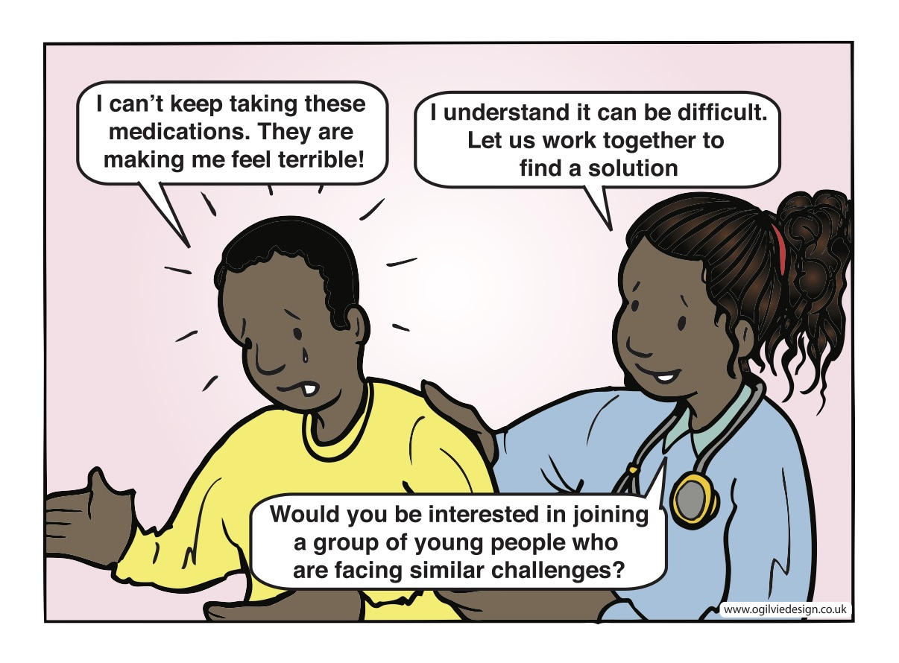
Notes:
Adolescents need support to continue their medication.

