Slide 1
HPV vaccination and Adolescent Sexual & Reproductive Health
Paul Bloem
Expanded Programme of Immunization/IVB
World Health Organization, Geneva

Slide 2
Outline
(1) Why is the HPV vaccine needed and what impact evidence exists
(ii) What is the current WHO policy and state of the roll out
(iii) How could HPV link to other interventions.
(iv) What is WHO doing with partners to extend the roll out the vaccine
Notes:
This slide set poses and responds to the five questions listed in this slide.

Slide 3
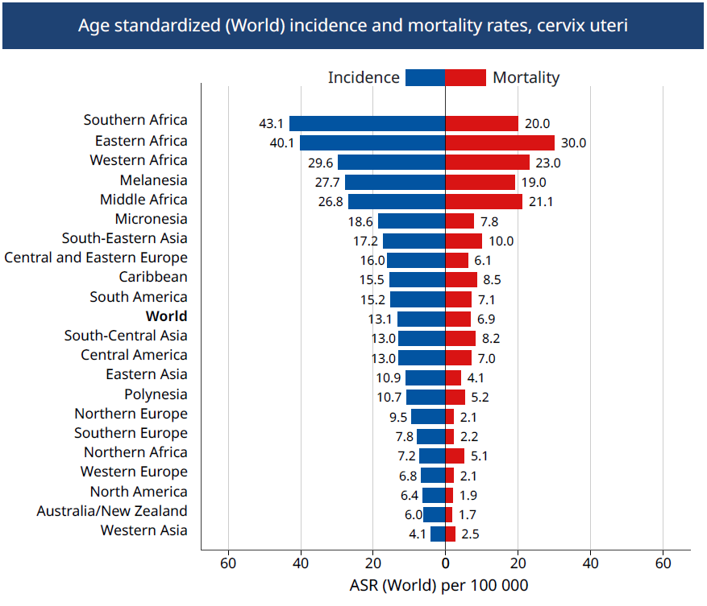
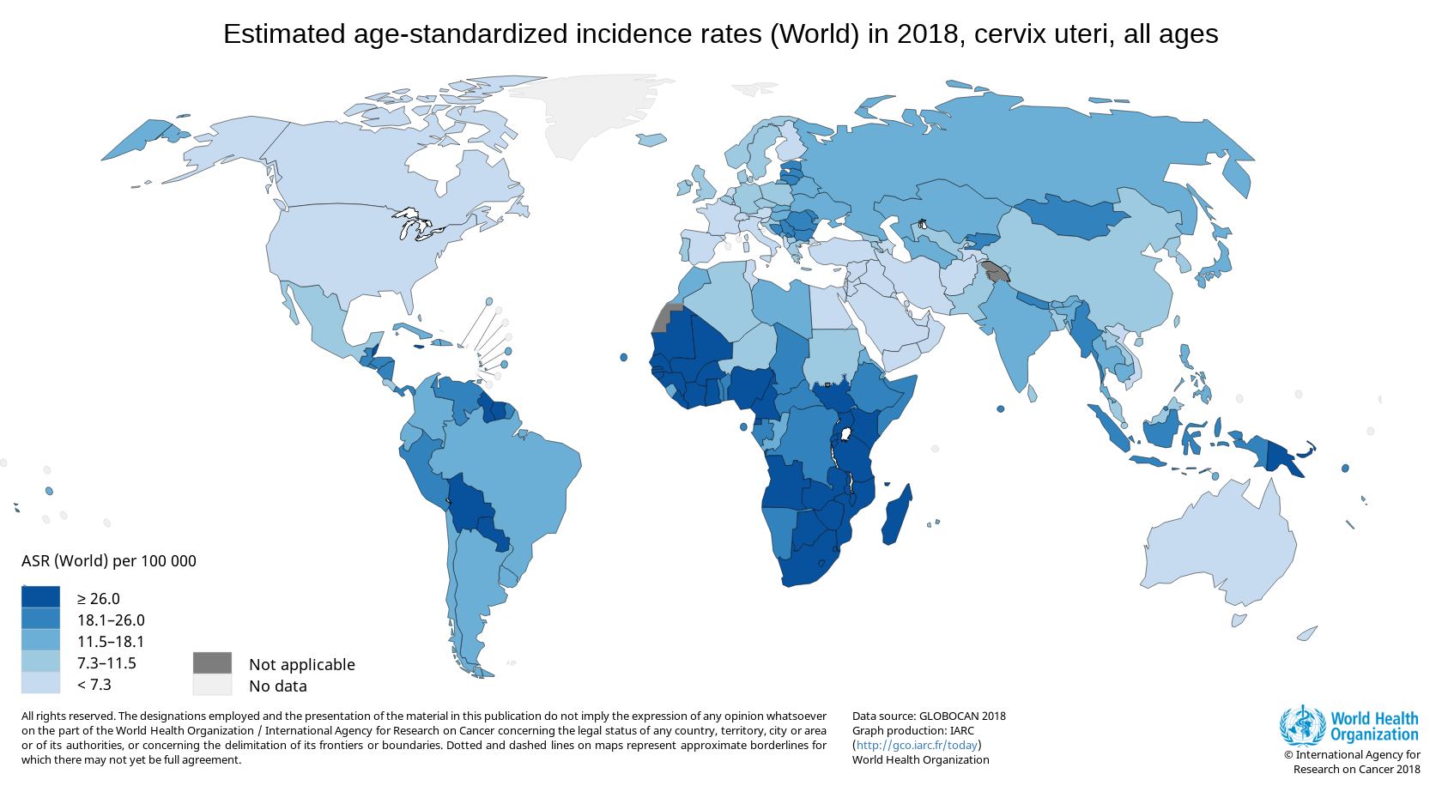
Global Cervical Cancer Incidence and Mortality 2018
Source: http://globocan.iarc.fr
Oman
Globally (2018): 569.847 cases
311.365 deaths
Source: WHO/IARC, Globocan 2018
Notes:
This slide points to the global and regional estimates of incidence and mortality due to cervical cancer.

Slide 4
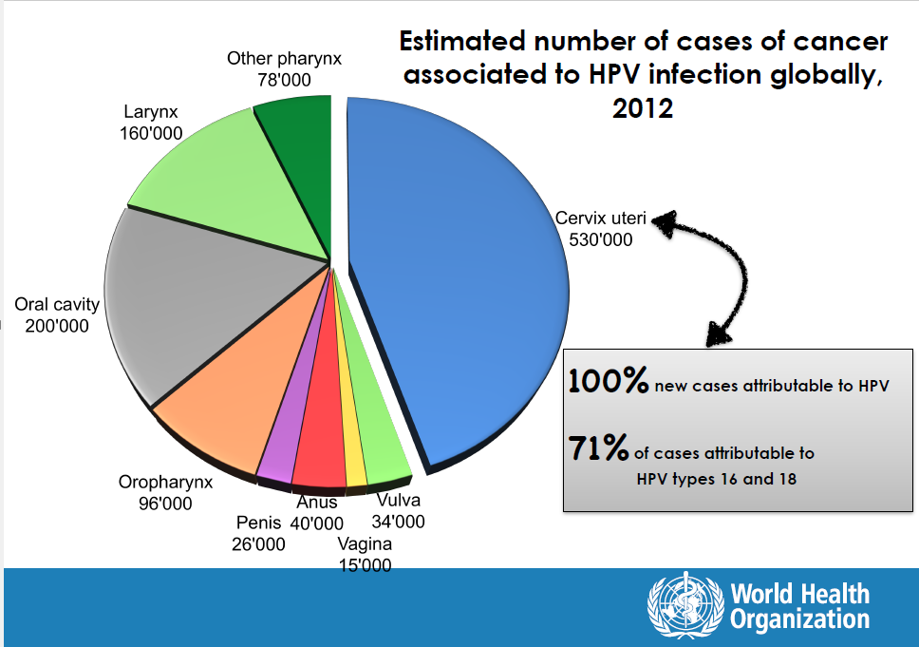
Notes:
This slide stresses that there is convincing evidence that cancer of the cervix is attributable to HPV infection.

Slide 5
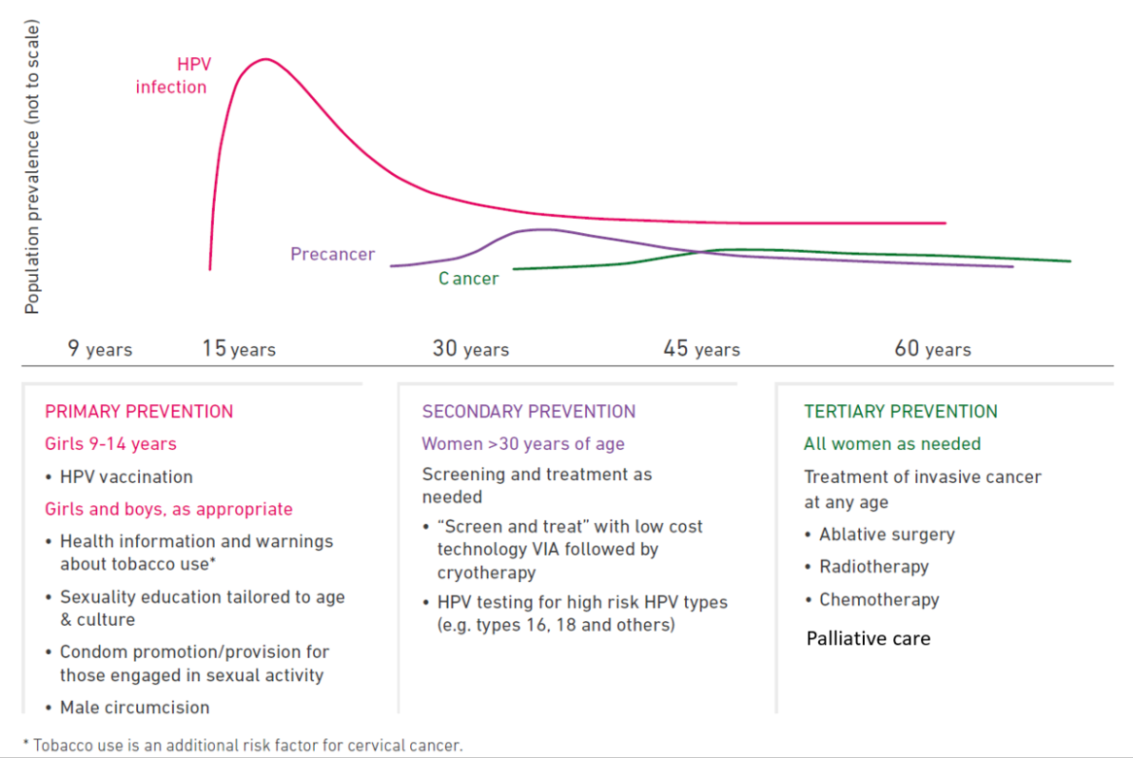
WHO comprehensive approach: programmatic intervention over the life course
Notes:
This slide sets out WHO recommendations for the primary, secondary and tertiary prevention of cervical cancer.

Slide 6
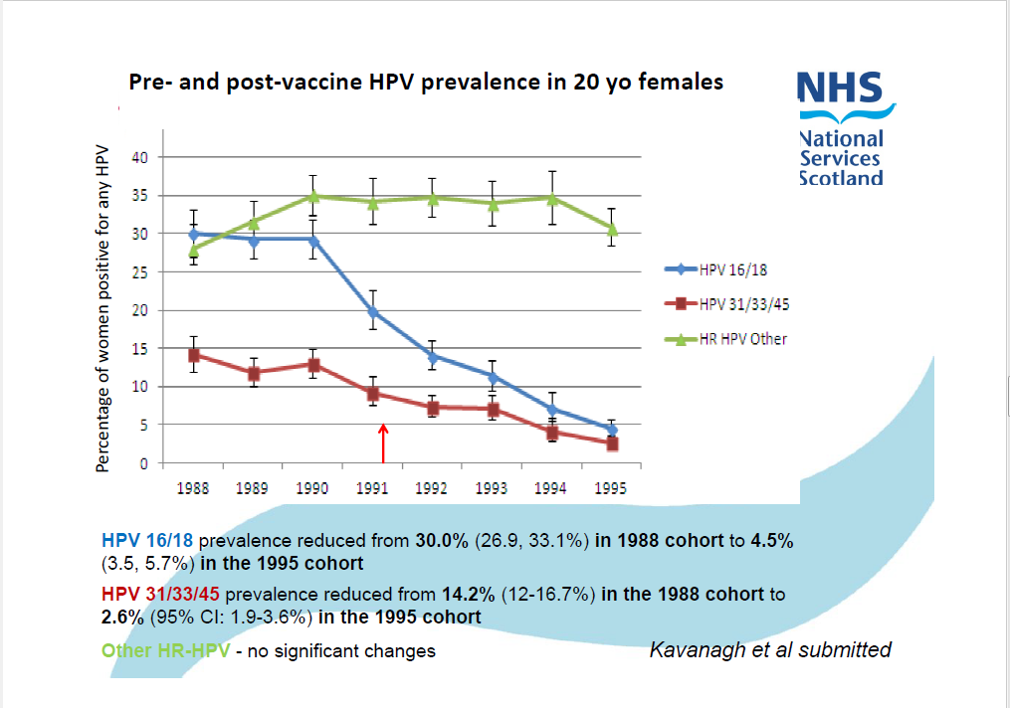
Early impact
Notes:
This slide presents data from Scotland to show that HPV vaccine has protected girls from HPV infection.

Slide 7
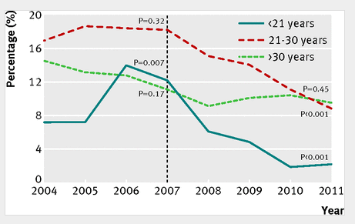
The vaccines are very effective: in the real world
Herd immunity
See also
Sando et al Acta Derm Venereol 2014
Tabrizi and Brotherton et al , Lancet Infect Dis 2014
Drolet et al, Lancet Infect Dis, 2015
Proportion of Australian born heterosexual men diagnosed as having genital warts at first visit
Males <21 years : 81.8% decline post vaccine introduction
Males 21-30 yrs : 51.1% decline post vaccine introduction
Ali et al., BMJ 2013
Notes:
This slide presents data from Australia to show that HPV vaccination has protected young men from genital warts.

Slide 8
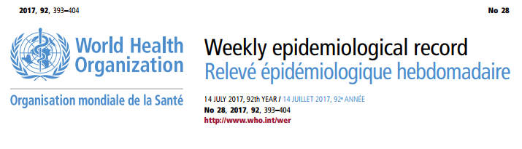
WHO Global Advisory Committee on Vaccine Safety (GACVS)
“Excellent Safety profile”
Statement on the continued safety of HPV vaccination (2017)
"Since licensure of HPV vaccines, GACVS has found no new adverse events of concern based on many very large, high quality studies. The new data presented at this meeting have strengthened this position."
Notes:
In addition to being efficacious, the vaccine has been shown to be extremely safe.

Slide 9
Outline
(1) Why is the HPV vaccine needed and what impact evidence exists
(ii) What is the current WHO policy and state of the roll out
(iii) How could HPV link to other interventions.
(iv) What is WHO doing with partners to extend the roll out the vaccine
Notes:
The next section of the presentation is on WHO’s current policy and the state of roll of HPV vaccination.

Slide 10
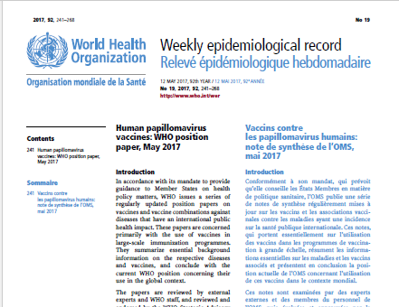
WHO Position paper on HPV vaccine
WHO recommendations (May, 2017) :
Primary Target: Girls, between 9 and 14 yr old
Doses: 2 doses
Interval : 6 months minimum
No maximum interval - suggested
until 12-15 months after first dose.
To maximize impact, vaccinate multiple age cohorts at introduction:
  All 9 -14 yr old girls
  15-18 yr old girls (if feasible/affordable)
Source: WER May, 2017
(www.who.int/immunization/documents/positionpapers/en/
Notes:
This slide sets out WHO’s recommendations for the administration of the HPV vaccine: the target group, the doses and the interval.

Slide 11
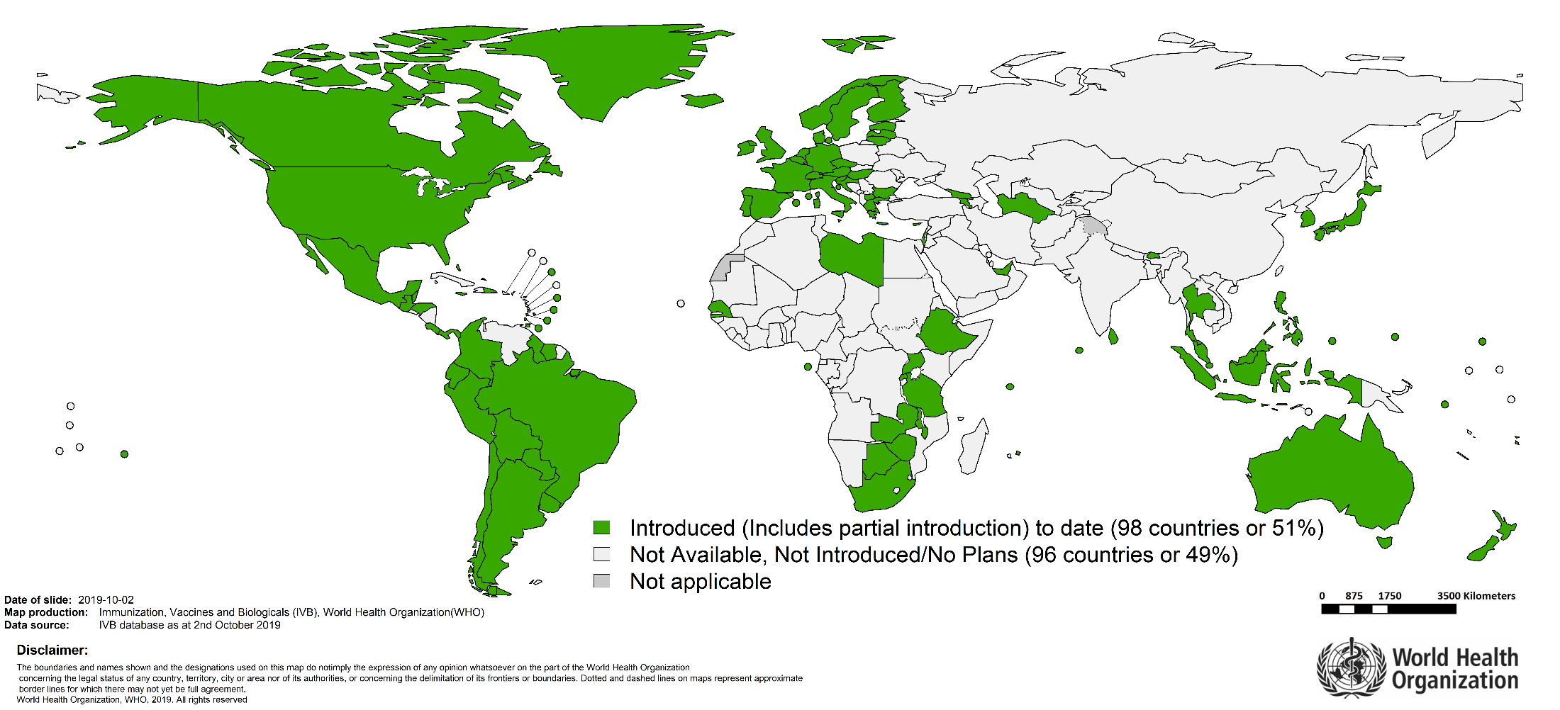

Countries with HPV vaccine in the National Immunization Programme
$\sim$30% of girls 9-14yr Globally
Notes:
The vaccine has been introduced to the countries listed below (as of the start of October):
Andorra Antigua and Barbuda Argentina Armenia Australia Austria Bahamas Barbados Belgium Belize Bhutan Bolivia Botswana Brazil Brunei Darussalam Bulgaria Canada Chile Colombia Cook Islands Costa Rica Croatia Cyprus Czech Republic Denmark Dominican Republic Ecuador Estonia Ethiopia Fiji Finland France Georgia Germany Greece Grenada Guatemala Guyana Honduras Hungary Iceland Ireland Israel Italy Jamaica Japan Latvia Libya Lithuania Luxembourg Malawi Malaysia Maldives Malta Marshall Islands Mauritius Mexico Micronesia (Federated States of ) Monaco Netherlands New Zealand North Macedonia Norway Palau Panama Paraguay Peru Portugal Republic of Korea Rwanda Saint Lucia Saint Vincent and the Grenadines San Marino Sao Tome and Principe Senegal Seychelles Singapore Slovenia Solomon Islands South Africa Spain Sri Lanka Suriname Sweden Switzerland Thailand Trinidad and Tobago Turkmenistan Uganda United Arab Emirates United Kingdom United Republic of Tanzania United States of America Uruguay Zambia Zimbabwe
Partial introductions:
Indonesia Philippines
Not Available, Not Introduced/No Plans:
Afghanistan Albania Algeria Angola Azerbaijan Bahrain Bangladesh Belarus Benin Bosnia and Herzegovina Burkina Faso Burundi Cabo Verde Cambodia Cameroon Central African Republic Chad China Comoros Congo Côte d'Ivoire Cuba Democratic People's Republic of Korea Democratic Republic of the Congo Djibouti Dominica Egypt El Salvador Equatorial Guinea Eritrea Eswatini Gabon Gambia Ghana Guinea Guinea-Bissau Haiti India Iran (Islamic Republic of) Iraq Jordan Kazakhstan Kenya Kiribati Kuwait Kyrgyzstan Lao People's Democratic Republic Lebanon Lesotho Liberia Madagascar Mali Mauritania Mongolia Montenegro Morocco Mozambique Myanmar Namibia Nauru Nepal Nicaragua Niger Nigeria Niue Oman Pakistan Papua New Guinea Poland Qatar Republic of Moldova Romania Russian Federation Saint Kitts and Nevis Samoa Saudi Arabia Serbia Sierra Leone Slovakia Somalia South Sudan Sudan Syrian Arab Republic Tajikistan Timor-Leste Togo Tonga Tunisia Turkey Tuvalu Ukraine Uzbekistan Vanuatu Venezuela Viet Nam Yemen

Slide 12
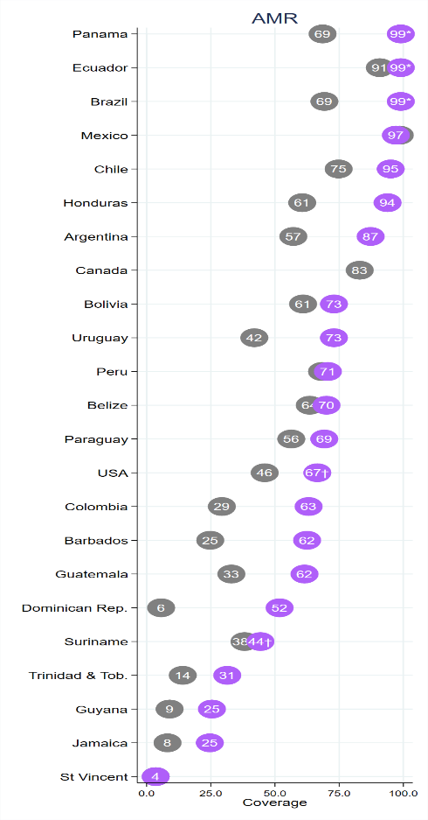
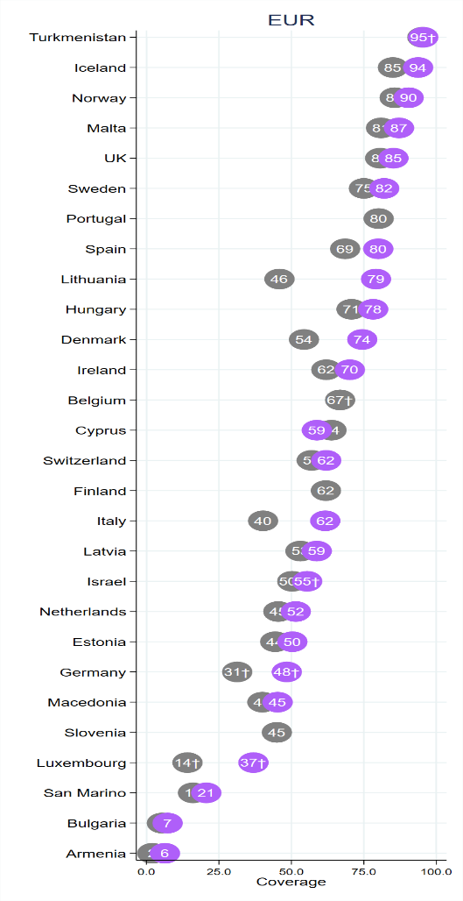
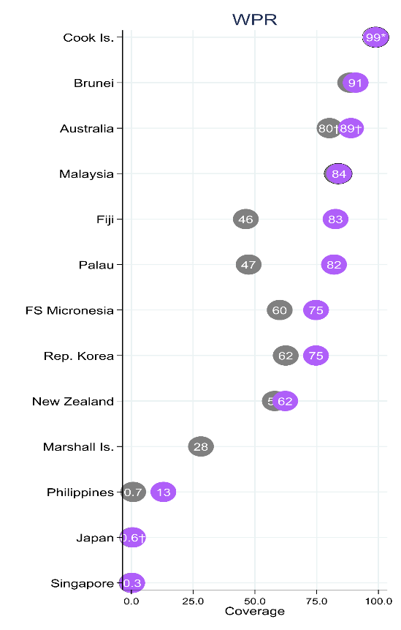
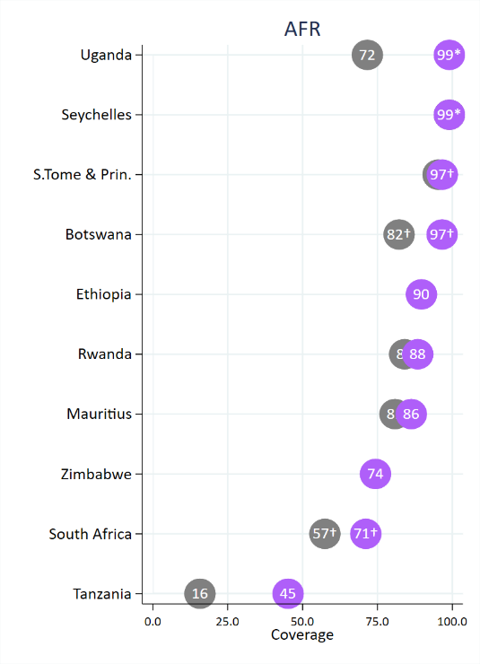
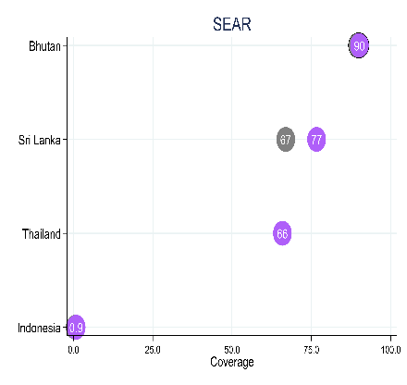
WHO ESTIMATES : HPV PROGRAM COVERAGE, FEMALES 2018
v
%
v
%
%
First dose
%
Last dose
Source: IVB Database, 15 July 2019
%
Notes:
This slide provides an overview of the status of coverage, as of July 2019.
While the picture is uneven, important progress is being made.

Slide 13
Outline
(1) Why is the HPV vaccine needed and what impact evidence exists
(ii) What is the current WHO policy and state of the roll out
(iii) How could HPV link to other interventions.
(iv) What is WHO doing with partners to extend the roll out the vaccine

Slide 14
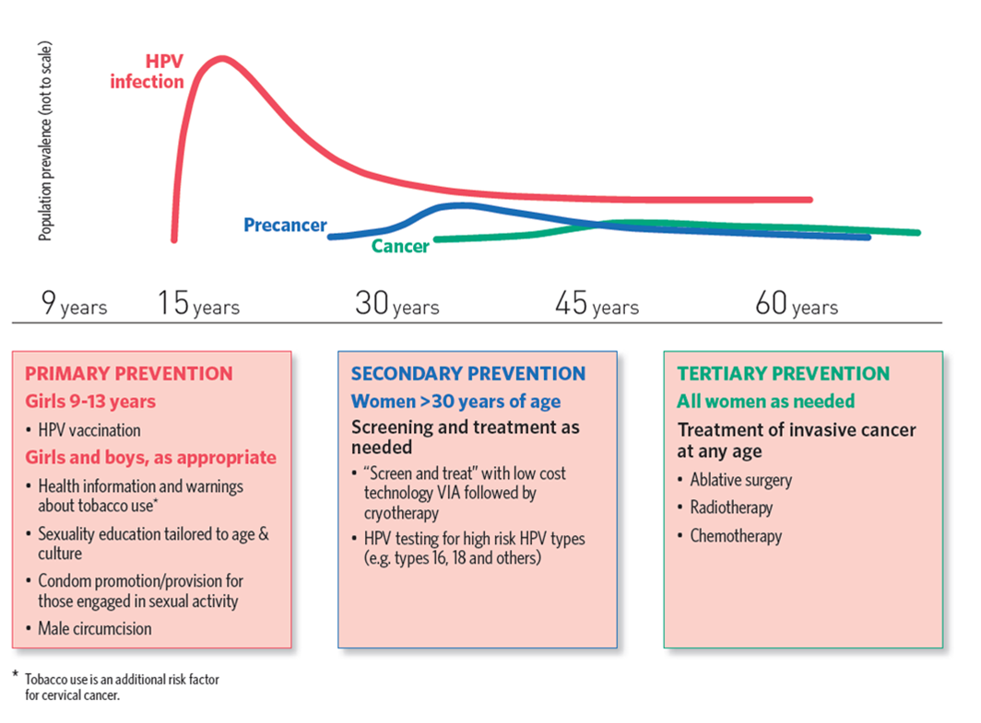
1. Comprehensive Cervical Cancer Prevention & Control
2.
ADO LESCENT
H
E
A
L
T
H
INTEGRATION
Notes:
The HPV vaccine protects against cervical cancer. As we can see from this graph the HPV infection may lead in some women to precancerous lesions or cancer much later in life.
Within the comprehensive approach to cervical cancer ( as reflected in the first blue arrow) HPV vaccination is a primary prevention approach and should be integrated with screening as secondary prevention and cancer treatment as tertiary prevention across the life course
The second arrow pertains to HPV as part of an integrated approach to adolescent health, that is during this life stage that covers 10 to 19 year olds. The main difference we will observe is that the interventions in this approach will not necessarily support prevention of cervical cancer later in life, but more generally support the overall health in this population group.

Slide 15
2030 CONTROL TARGETS
Global Strategy towards the Elimination of Cervical Cancer
VISION: A world without cervical cancer
THRESHOLD: All countries to reach < 4 cases 100,000 women years
Timeline
Submitted to EB 2020 (Oct 2019)
for discussion at WHA May 2020
90%
of girls fully vaccinated with HPV vaccine by 15 years of age
70%
of women screened with an high precision test at 35 and 45 years of age
90%
of women identified with cervical disease receive treatment and care
SDG 2030: Target 3.4 – 30% reduction in mortality from cervical cancer
Notes:
This slide contains the targets for the global strategy for the elimination of cervical cancer.

Slide 16
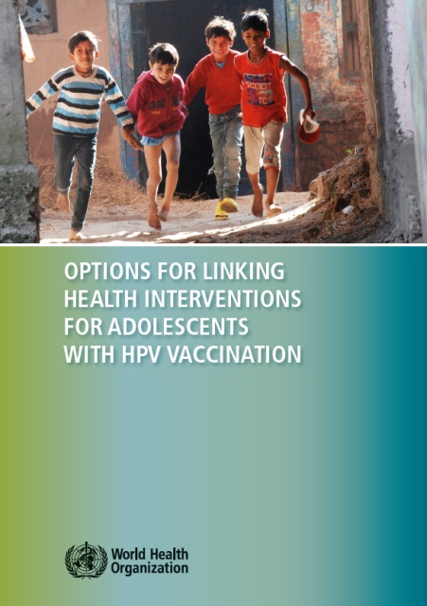
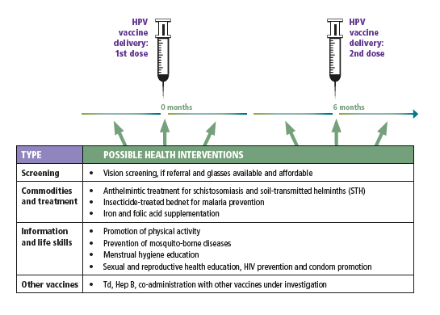
Integrating HPV vaccination with adolescent health interventions and programs
ADOLESCENT
H
E
A
L
T
H
An opportunity for reaching girls and boys with additional health interventions..
Broutet et al. JAH, 2013; Hindin et al. JAH, 2015
Notes:
WHO has published a list of evidence-based options for linking health interventions with the HPV vaccine.

Slide 17


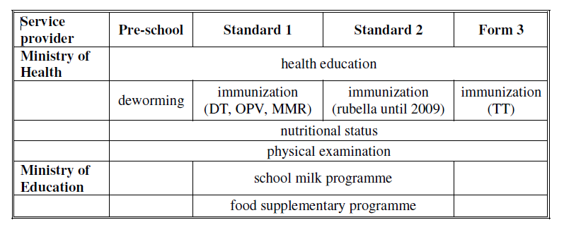
Malaysia :
HPV vaccine delivery
in school health package
HPV @ 13 years
Notes:
Here is an example from Malaysia in which HPV vaccine delivery in school has been combined in other vaccinations, health education, nutritional status assessment and supplementary feeding.

Slide 18
Outline
(1) Why is the HPV vaccine needed and what impact evidence exists
(ii) What is the current WHO policy and state of the roll out
(iii) How could HPV link to other interventions.
(iv) What is WHO doing with partners to extend the roll out the vaccine

Slide 19
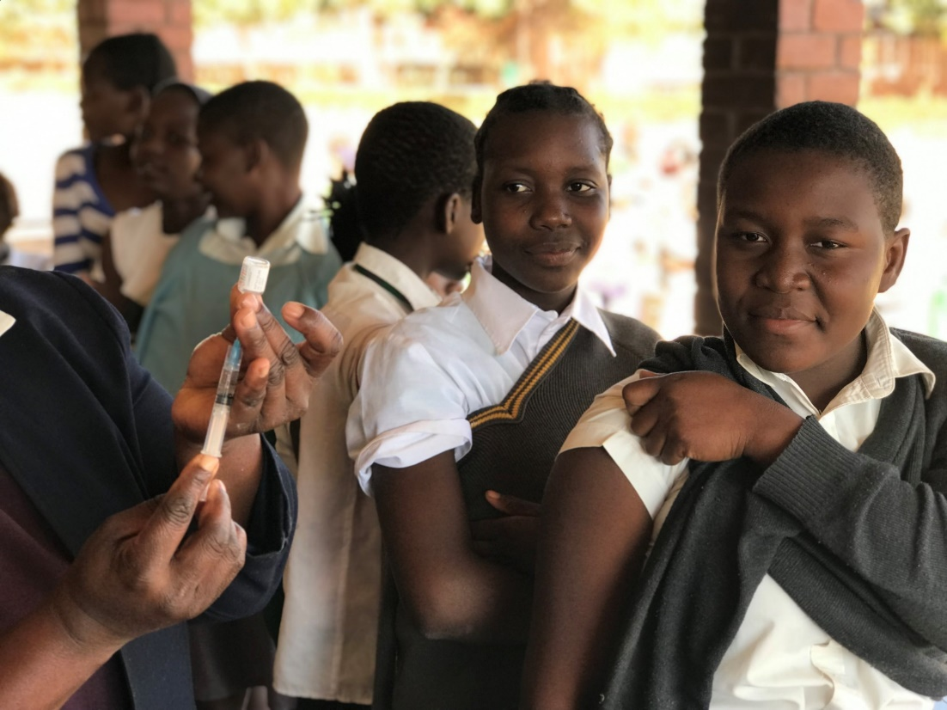
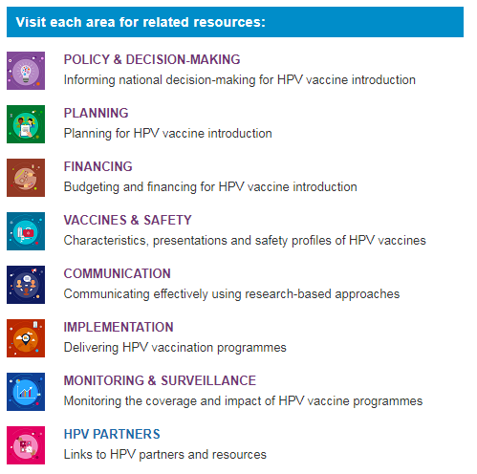
WHO roles
Update Policies on HPV vaccine
Developed technical guidance materials
Assist National Immunization Authorities to decide on HV introduction
Assist EPI programmes with introduction planning
Track introduction and coverage as well as HPV vaccine prices and supply to ensure health markets
WHO HPV Vaccine introduction
Clearing house
Visit: http://www.who.int/immunization/hpv/en/
Notes:
This slide lists the roles that WHO plays in working with ensure that the HPV vaccine reaches every adolescent it is intended to.

Slide 20









Alliance functions:
GAVI price of 4.5$ dose for eligible countries. UNICEF handles purchases.
Finance eligible countries (GNI<1500) to introduce HPV vaccine.
Technical Partners jointly provide technical support at planning, introduction and evaluation stages
Notes:
WHO works with a number of partners to do this.

