Slide 1
VIOLENCE AGAINST WOMEN & GIRLS: PREVENTION, SUPPORT & CARE
Geneva 2019
Dr Venkatraman Chandra-Mouli

Slide 2
DEFINITIONS
Gender-based violence (GBV): Violence directed towards a woman, because she is a woman, or violence that affects women disproportionately.
Violence against women: Any act of gender-based violence that results in, or is likely to result in physical, sexual or psychological harm or suffering to women.
Intimate partner violence: Behaviour by a current or former intimate partner that causes physical, sexual or psychological harm.
Sexual violence: Any sexual act, attempt to obtain a sexual act, or other act directed against a person’s sexuality using coercion, by any person regardless of their relationship to the victim.
Notes:
This slide sets out key definitions.

Slide 3
RATIONALE 1/2
Gender-based violence against adolescents is an important problem: Among ever-partnered girls aged 15-19, the lifetime prevalence of intimate partner violence is 29%. The prevalence of child sexual abuse worldwide is estimated to be approximately 18% for girls and 8% for boys.
Gender-based violence against adolescents has major health & social consequences: It increases girls’ risk of unintended pregnancies, induced abortion (often unsafe), the acquisition of HIV and STIs in some settings, adverse mental health outcomes, & is a risk factor for unhealthy behaviour during adolescence & adulthood.
Notes:
This is the first of two slides that set out the rationale for investment and action in this area.

Slide 4
RATIONALE 2/2
Gender-based violence prevention, support & care programmes have been shown to be effective: Parenting support programmes, school-based dating violence prevention programmes, & community based interventions to build equitable gender norms & attitudes in boys & girls have been shown to be effective. Effective programmes incorporate multisectoral & multilevel action, foster intersectoral coordination, use longer term investments, that repeat exposure to ideas in different settings over time, that place gender power interplay at the core of the content, & respond to those who experience violence with empathy & in a timely manner.
However, laws & policies, prevention strategies & their implementation, & access to high quality care & support services need attention: There is much that needs to be done.
Notes:
This is the second of two slides that set out the rationale for investment and action in this area.

Slide 5
HUMAN RIGHTS OBLIGATIONS
States are obliged to prevent and address violence against women and girls, providing them with support and care.
States are obliged to immediately pursue all appropriate means of eliminating gender-based violence.
Notes:
This slide sets out the human rights rationale for investment and action in this area.

Slide 6
KEY CONCEPTS TO CONSIDER
Where GBV prevention & response services exist, they are often implemented on a pilot basis & not scaled up; they are piecemeal and not integrated into existing platforms. Further intersectoral coordination is weak: Support and care for adolescent girls who experience IPV & sexual violence need to be integrated into sexual & reproductive health, HIV, mental health and adolescent health programmes & services.
Many health care providers are not prepared to deal with GBV, including on the reporting of sexual abuse: Training & ongoing support to health care providers are imperative to ensure that care is child-and adolescent centered, age appropriate, responsive to needs of adolescents. & takes into account their evolving capacity in decision making about involving parents and other care givers.
Adolescents often do not seek GBV prevention, support and care services: Raising public awareness on the signs, symptoms & health consequences of IPV & sexual abuse, & on the need , and overcoming stigma is key to changing the situation.
Notes:
This slide points to three key concepts to consider.

Slide 7
WHO GUIDELINES
Responding to children and adolescents who have been sexually abused: WHO clinical guidelines (2017).
Responding to intimate partner violence and sexual violence against women: WHO clinical and policy guidelines (2013).
WHO guidelines on preventing early pregnancy and poor reproductive outcomes among adolescents in developing countries (2011).
Consolidated guideline on sexual and reproductive health and rights of women with HIV (2017).

Slide 8
COMPLEMENTARY DOCUMENTS TO WHO’s GUIDELINES
Global plan of action: health systems address violence against women and girls (WHO, 2017).
INSPIRE: seven strategies for ending violence against children (WHO, 2016).
Global guidance on addressing school-related gender-based violence (UNESCO, 2016).
Sixteen ideas for addressing violence against women in the context of the HIV epidemic: a programming tool (WHO, 2013).
What works to prevent partner violence? An evidence overview. (London School of Hygiene and Tropical Medicine; 2011).

Slide 9
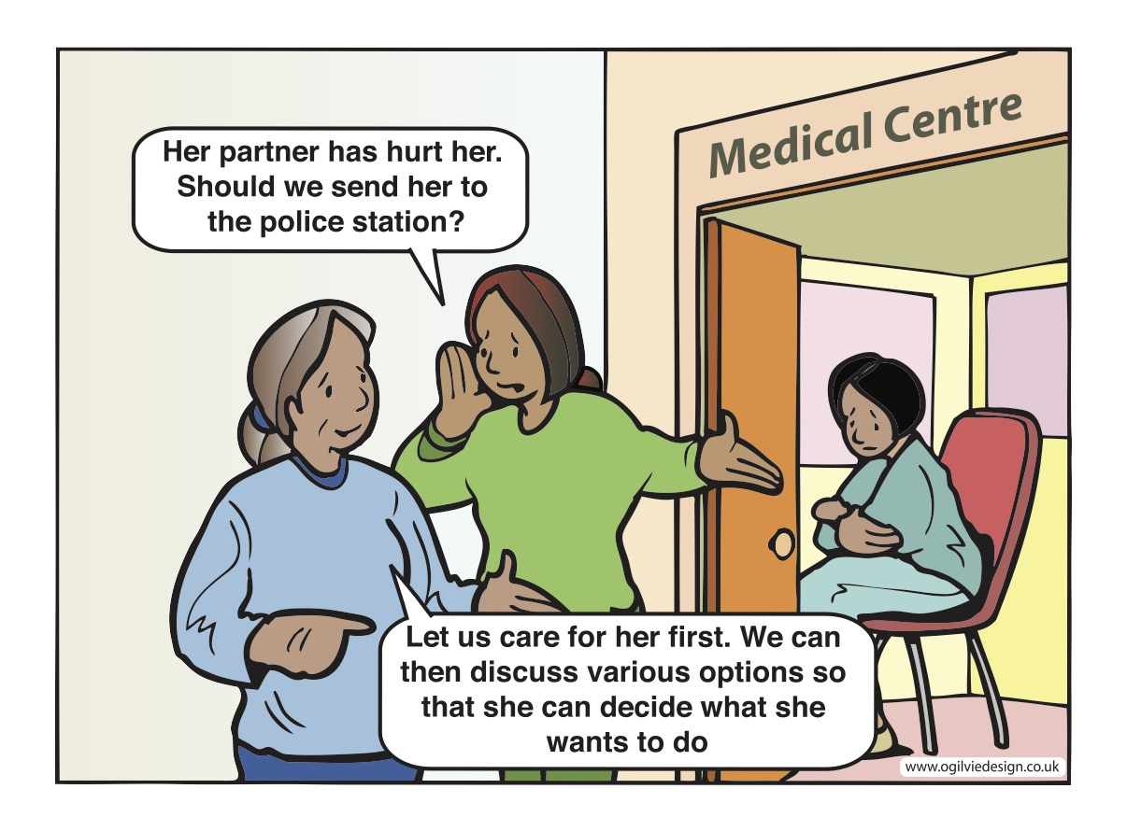
Notes:
Health workers need training and support to respond to adolescent girls and young women who have experienced gender-based violence.

