Slide 1
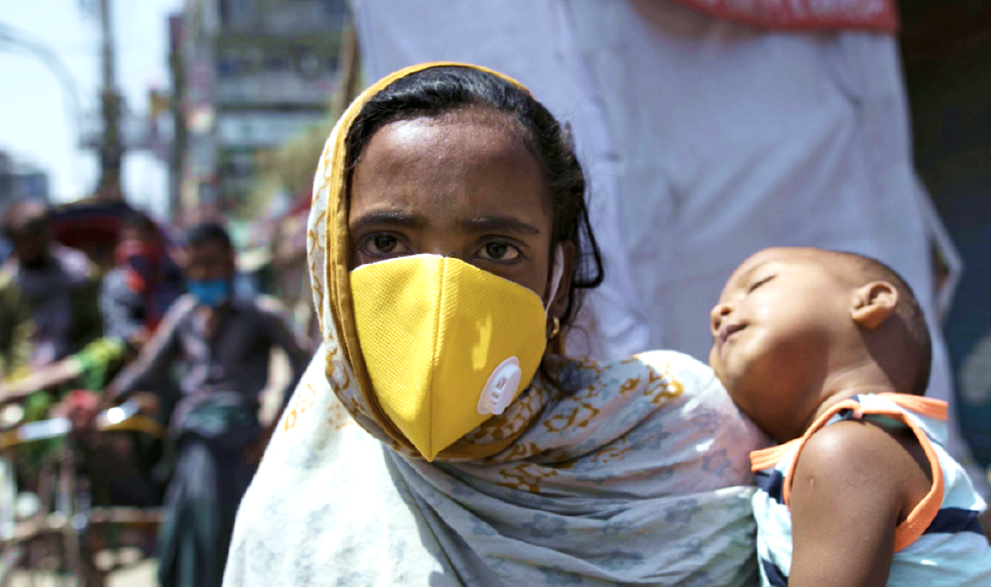
ADOLESCENT HEALTH AND WELLBEING DURING The COVID-19 PANDEMIC
EVIDENCE FROM THE POPULATION COUNCIL’S GLOBAL COHORT SURVEYS
Presented by:
Ashish Bajracharya, Ph.D., Deputy Director, Country Strategy and Co-Lead, Humanitarian Task Force
POPULATION COUNCIL
On behalf of Population Council Study Teams in Bangladesh, India, Kenya and Mexico
Training e-Course on Adolescent Sexual and Reproductive Health 2020
Geneva Foundation for Medical Education and Research (GFMER)
October 2020

Slide 2

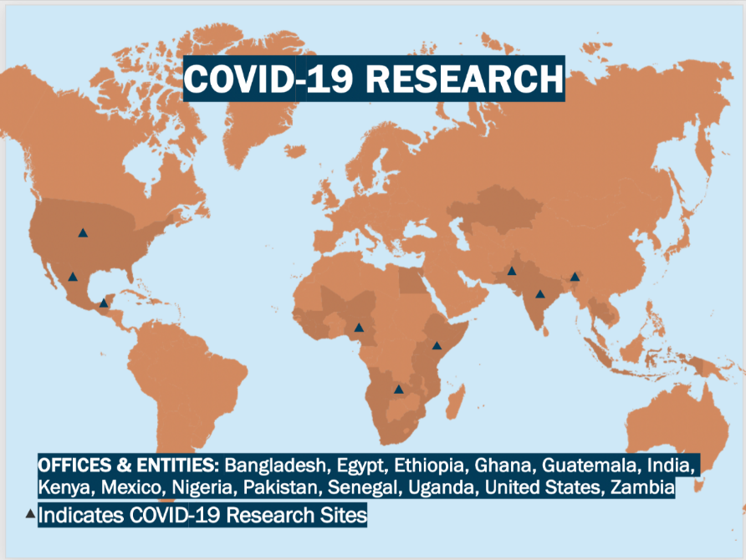
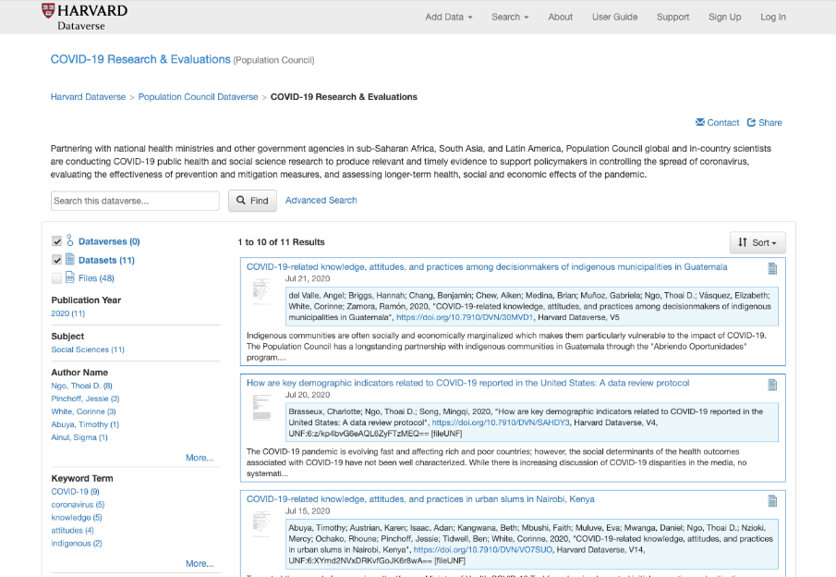
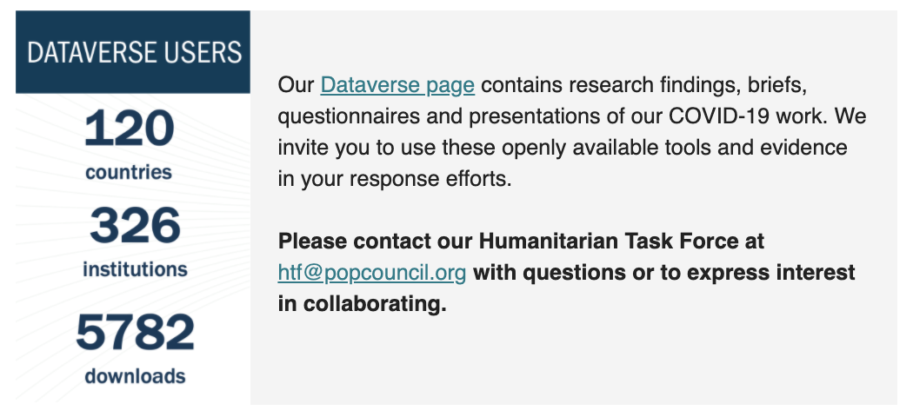
Population Council’s COVID-19 Research
The Population Council’s Research in Humanitarian Settings Taskforce is coordinating our global work on COVID-19
20 Research Activities in 15 countries
Over 50 research publications including peer-reviewed journal articles, research and policy briefs, evidence reviews and commentaries since mid-March – Visit our website to access these resources
Population Council’s COVID-19 Dataverse
Notes:
The Population Council’s convened its Research in Humanitarian Taskforce in early 2020 to understand the Council’s work in emergency settings. As COVID-19 spread around the world, the HTF took on the responsibility of coordinating the Council’s work on COVID-19.
The Council rapidly shifted gears rapidly in March 2020, and our researchers have been producing relevant and timely evidence to support policy makers to evaluate the effectiveness of prevention and mitigation measures, and assess immediate and longer-term health, social and economic effects of the COVID-19 pandemic. We have conducted over 20 research activities in over 15 countries on COVID-19 globally since the beginning of the pandemic.
We are committed to open science and we have made all of our research protocols, tools and instruments, and datasets for use by anyone who is interested on the Population Council’s Dataverse. Researchers and stakeholders from over 300 institutions in over 120 countries have been accessing our materials on the Dataverse. Please check out the link.

Slide 3
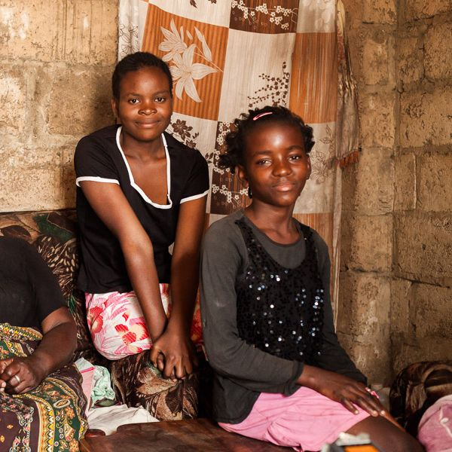
Global Cohort Studies
Objective: Understand the social, economic, education and health effects of COVID-19 on vulnerable adolescents globally
Repeated structured surveys conducted with participants of the Council’s pre-pandemic studies with adolescents (10-19) conducted remotely over mobile phone
Includes girls and boys to allow for understanding of gendered impacts of COVID-19. Vulnerable groups such as indigenous adolescents, informal settlement dwellers, adolescent girls included
Multiple rounds conducted in each country with questionnaires adapted as the pandemic evolved to cover relevant topics
Received expedited ethical reviews
First survey: immediately following the COVID-19 related lockdowns in Nairobi informal settlements: April
Generate data and evidence to guide post-COVID-19 adolescent programming and policy globally
Notes:
An important part of our global work has been the cohort studies we have conducted in a number of countries in Asia, Africa and Latin America with the objective of understanding the social, economic, education and health effects o the COVID-19 pandemic on vulnerable populations. In this presentation we focus on surveys that included data collection from adolescents aged 10-19 from four countries – Bangladesh, India, Kenya and Mexico.
We utilized cohorts that were part of pre-pandemic studies and activities that were being conducted by the Council and at the very early stages of the pandemic, we conducted these surveys on mobile phones, rapidly mobilizing our data collection teams across regions.
We have conducted multiple rounds of surveys in each country to better understand how impacts have changed as the pandemic has evolved.
To ensure that our research is ethically sound and our participants and our researchers were protected, we worked with our IRB to ensure that all studies received careful ethical review but given the urgency of this research, we also expedited our processes and timelines.
Our data collection teams were able to act very rapidly and we conducted among the very first surveys related to COVID in Kenya in April.

Slide 4
Global Cohort Studies
Country | Location | Number of Rounds completed | Sample Size | Primary population of interest | Underlying Cohort Study
Bangladesh | Bogura, Sherpur, Kushtia, Chapainawabganj | 3 Apr, Jun, Sep | R1: 959 girls R2 and R3: 453 girls | Rural adolescent girls (12-19) | UNICEF Ending Child Marriage Project
India | Bihar and Uttar Pradesh | 2 Apr, May | R1: 1389 Girls 652 Boys R2: 881 Girls 376 Boys | Girls and boys who were 15-19 in 2015-16 | UDAYA Cohort
Kenya | Nairobi, Wajir, Kilifi, Kisumu | 3 Jun, Jul, Aug | R1: 859 Girls 1163 Boys R2: 754 Girls 480 Boys R3: 1202 Girls 463 Boys | Girls and boys aged 10-19 | AGI-K, NISITU, Nia, DREAMS
Mexico | Yucatan, Chiapas | 1 Jun | 88 Girls, 34 Boys | Girls and Boys aged 14-17 | Abriendo Futuros
Notes:
These are the sample details of our studies in the four countries.
Note that in all of these countries, the intention is to continue to conduct periodic surveys to track the impacts of a rapidly evolving pandemic on this very vulnerable group.
The far right column indicates the projects/cohorts that were leveraged to conduct these studies. Our donors for these various projects were supportive of repurposing of the funding to take on these urgent studies.
All studies but the Bangladesh study included both adolescent boy and girl respondents.

Slide 5
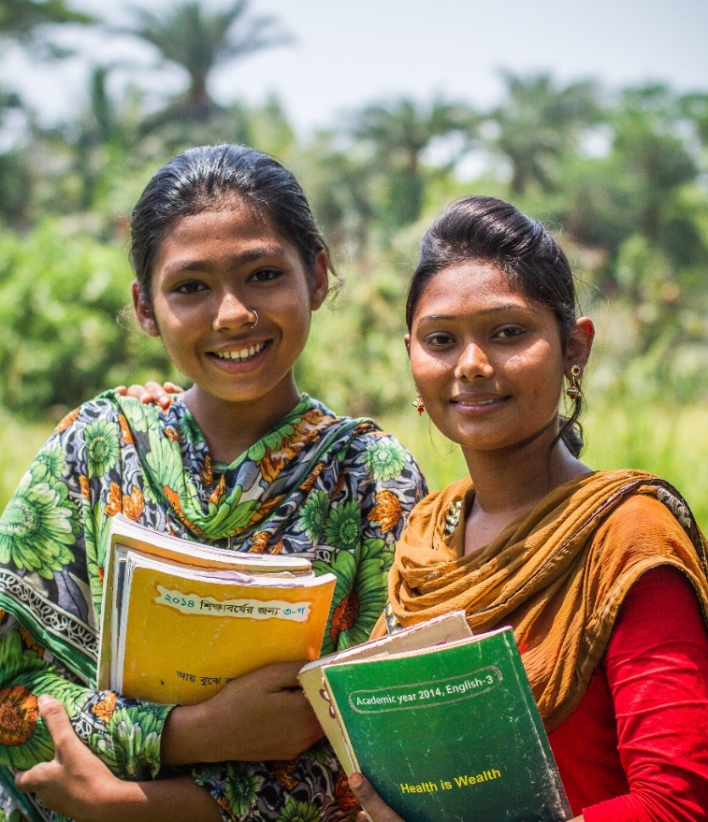
Adolescent Health and Wellbeing
All studies unique to each context - but all covered a common set of topics across countries/regions
Young people’s risk perceptions, and knowledge, attitudes and prevention practices related to COVID-19 over the course of the pandemic
The effect of COVID-19 and containment/ mitigation measures on (including gendered impacts on):
  Education/Schooling
  Employment/livelihoods
  Food Insecurity
  Mental health
  Sexual and reproductive health services
  Sexual and gender based violence
Notes:
All studies were unique to each country context and our national research teams carefully designed the tools of the study with a nuanced understanding of the state of the pandemic during the time of they surveys.
However, there were several common elements to the studies that are covered in each country that provides us a cross country and cross regional perspective on how COVID-19 and related mitigation measures affected adolescents.
They are: (as listed on slide)

Slide 6
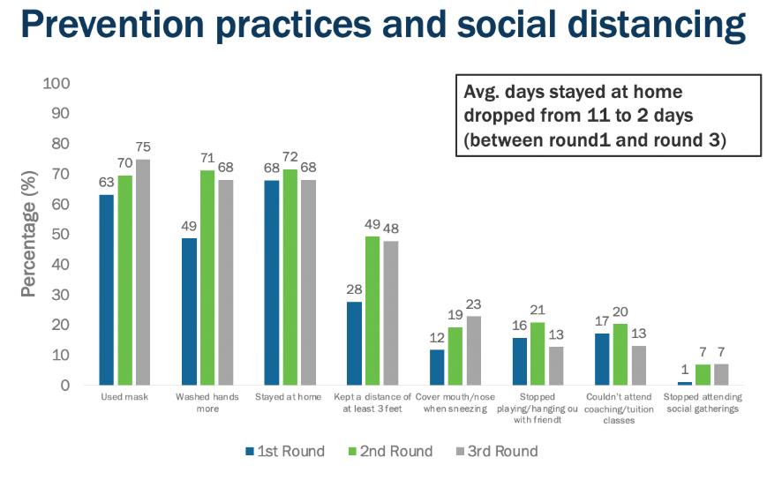
Perceived Risks, KAPs related to COVID-19
Knowledge of common symptoms of COVID-19 generally high among adolescent across surveys. Prevention practices were lower, but showed improvement over time.
India: Young people are increasingly perceiving that they are not at risk from COVID-19 over time.
  By Round 2, 78% of male and 90% of female respondents reported being at “No Risk” from COVID-19
Mexico: Adolescent generally correctly identified common symptoms as well as most at risk groups to COVID-19
  Results on prevention practices were mixed. Mask-wearing intentions were low. Fewer than 5 out of 10 adolescents identified that, if they experienced symptoms of COVID-19, they would wear a mask.
Bangladesh: Prevention practices such as wearing a mask and handwashing generally improved between R1 and R2, with some drop off from R2 to R3.
Notes:
Knowledge of common symptoms of COVID-19 generally high among adolescent across surveys. Prevention practices were lower, but showed improvement over time.
Some areas of concern are emerging, which are evident with time. In India and Mexico, there is evidence that over time, fewer young people are perceiving less risk related to COVID or that prevention practices were declining over time.
In Bangladesh, even though practices generally improved from Round 1 to 2, a slight drop off was seen between Round 2 to Round 3.
Despite the levels of knowledge regarding COVID-19 being high across surveys among adolescents, the indication that young people may be faltering in their prevention/mitigation practices is a cause of concern.

Slide 7
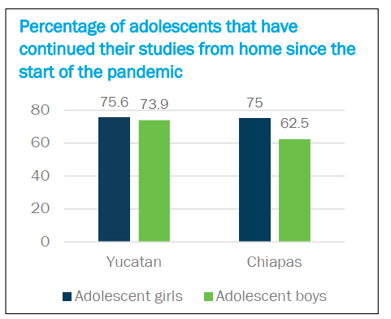
Education
Disruptions to education are evident across surveys and countries, particularly with prolonged school closures. Much of the learning has moved to the home, and adolescents reported perceiving significant risks of dropout.
Kenya: Almost all (92%) of adolescent respondents have been learning or doing schoolwork from home. Use of tablets or computers was minimal.
School work at home is challenging: the main reason for not doing schoolwork included needing to help with chores (37%) followed by not being able to access the lessons provided (19%).
Bangladesh: Schools have remained closed since the beginning of the lockdowns in March. The Government initiated digital classes through television but less than 35% of adolescents reported following lessons in the latest round of our survey.
  Students indicating “not studying at all” at home has increased from Round 1 to Round 3, from 1% to 10%
Mexico: Nearly a quarter of adolescent respondents in Chiapas and Yucatan discontinued their education since the start of the pandemic, with boys faring slightly worse
  75% of adolescents in Chiapas and Yucatan states, do not have internet access in their homes.
Notes:
Disruptions to education are evident across surveys and countries, particularly with prolonged school closures. Much of the learning has moved to the home, and adolescents reported perceiving significant risks of dropout.
With learning having moved into the home, in our study countries, remote learning is being implemented to provide continuity for young people, however with limited success. There are issues of access to materials, to platforms and the internet that are required for digital learning, and competing responsibilities at home are challenging young people from continuing to learn.
In some cases, like in Bangladesh, young people reporting that they are not studying at all is increasing over time as the pandemic continues.
In all study countries, schooling had come to an initial halt and mostly remain closed. Some adolescents responded that they feared not being able to return to school (having to drop out) even after the pandemic ends. This is a major risk given the significant progress that has been made in school enrolment globally.
Moving into the digital realm for education during this “learning from home” modality will continue to be a challenge as access to the internet, or to tablets and computers, remain a challenge for the most vulnerable and poor adolescents. Interventions aimed at providing continuity to adolescents may need to focus on these aspects to ensure distance learning is effective and accessible to all.

Slide 8
Economic insecurity, income, livelihoods
Respondents consistently reported significant economic insecurity and loss of household income across surveys, often resulting in increased household responsibilities, and care burden of adolescents within HHs
India: Majority of respondents reported that at least one household member lost his/her job/livelihood.
  On average, adolescent females were less likely to report they have sufficient resources to survive more than 1 month.
Kenya: Half of adolescent girls surveyed said their household earned no income at all during lockdown. Almost a quarter (21%) of adolescents said they were participating in income generating activities since COVID-19; 32% of older adolescent boys and 20% of older adolescent girls.
  These are risk factors for dropping out or failing to return to schools when they reopen.
Bangladesh: 69% of adolescents reported partial or complete loss of HH income immediately following the lockdown.
Subsequent surveys in Bangladesh and India reported decreased economic insecurity and rebounds in income, although HH’s continue to report cutting on expenditures including on food and education.
Bangladesh HH income (%) | R1 | R 2 | R3
Completely lost/ reduced severely | 69 | 49 | 44
Notes:
Respondents consistently reported significant economic insecurity and loss of household income across surveys, often resulting in increased household responsibilities, and care burden of adolescents within HHs
Girls, compared to boys, appear to face economic insecurity more acutely. In India for example, adolescent females were more likely to report, than boys, that they don’t have sufficient resources to survive for more than a month. In Kenya, a smaller proportion of female participants were participating in income generating activities compared to boys in the face of severe economic insecurities.
With the withdrawal of lockdowns or mitigation measures, subsequent surveys in Bangladesh and India reported decreased economic insecurity and rebounds in income, although HH’s continue to report cutting on expenditures including on food and education.

Slide 9
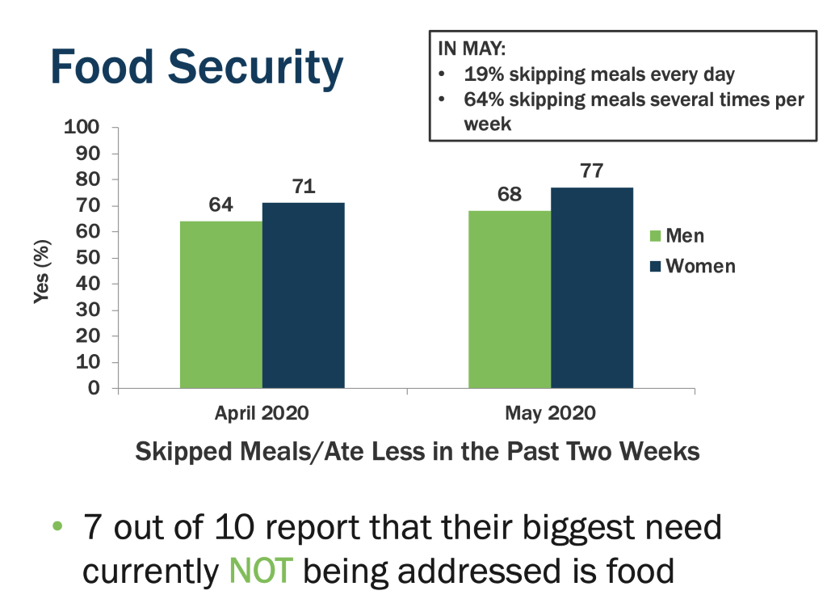
Food Insecurity
Food Insecurity was one of the first immediate consequences of the pandemic, and was reported consistently across surveys, particularly in the earlier rounds.
Kenya: One-fifth of adolescent respondents reported an urgent need for food.
  Nearly half, (45%) were skipping meals a couple times per week. 58% said they received food through school before the closures, highest among older adolescent girls (64%).
India: 35% of respondents reported experiencing food shortages, 52% reduced food intake
  More females than males reported reducing food intake (56% to 40%).
Mexico: A higher proportion of individuals report skipping a meal in May (74%) compared to April (68%).
  Those that skipped a meal, 64% say they skipped a meal a couple times per week and 19% every day.
Notes:
Food Insecurity was one of the first immediate consequences of the pandemic, and was reported consistently across surveys, particularly in the earlier rounds.
Skipping meals was commonly reported and reducing food intake.
There is some indication that food insecurity has a clear gendered dimension with more female adolescents reporting having to reduce good intake/or skip meals in India and in Mexico
Mexico Graphic:: A higher proportion of individuals report skipping a meal in May (74%) compared to April (68%), which is concerning as this indicates that food insecurity wasn’t just an issue immediately following the beginning of the lockdowns, but that it may have continued to remain high or gotten worse with time.
Those that skipped a meal, 64% say they skipped a meal a couple times per week and an nearly one in five indicated they skipped a meal every day.

Slide 10
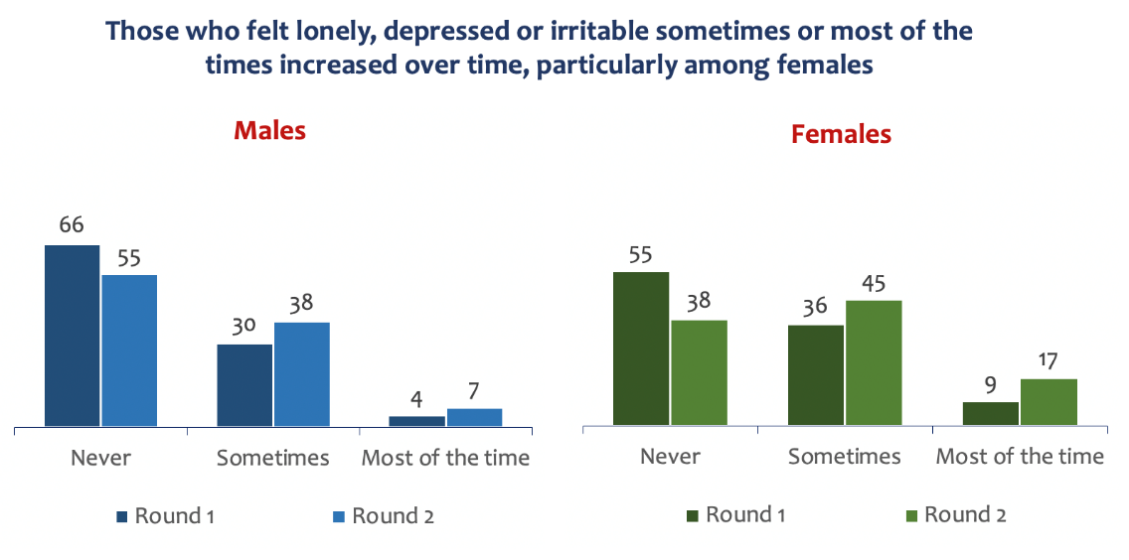
Mental Health
Adolescent respondents reported decreases in mental health quality across countries resulting from lockdowns and prolonged school closures due to COVID-19
Bangladesh: The vast majority of adolescent girls (74%) reported feeling of loneliness or sadness.
  A higher percentage of married adolescents reported constant depression compared to their unmarried peers during lockdown (23% vs. 14%).
Kenya: In Kisumu, nearly half of respondents (47%) reported feeling down or depressed in the week preceding the survey.
  Over half strongly agreed COVID-19 made them feel threatened or concerned (64%) and that they were worried they or someone they love would get COVID-19 (62%).
India: Adolescent respondents who reported feeling lonely, depressed or irritable sometimes or most of the times increased over time, particularly among females
Notes:
Adolescent respondents reported decreases in mental health quality across countries resulting from lockdowns and prolonged school closures due to COVID-19.
Our results from study countries indicate that COVID-19 is taking a toll on the mental health of adolescents, with a majority of adolescents across countries indicating that they were feeling sad or lonely or down and depressed during the COVID-19 pandemic.
Many adolescents perceived feeling threatened of concerned by the pandemic and girls appeared to feel more concerned and worried about the pandemic than boys (reported in Mexico, result not shown).
In India, proportions of adolescents reporting poor mental health outcomes such as loneliness, depression or irritability increased over time (Round 1 to Round 2). These increases were slightly more pronounced for girls than for boys.

Slide 11
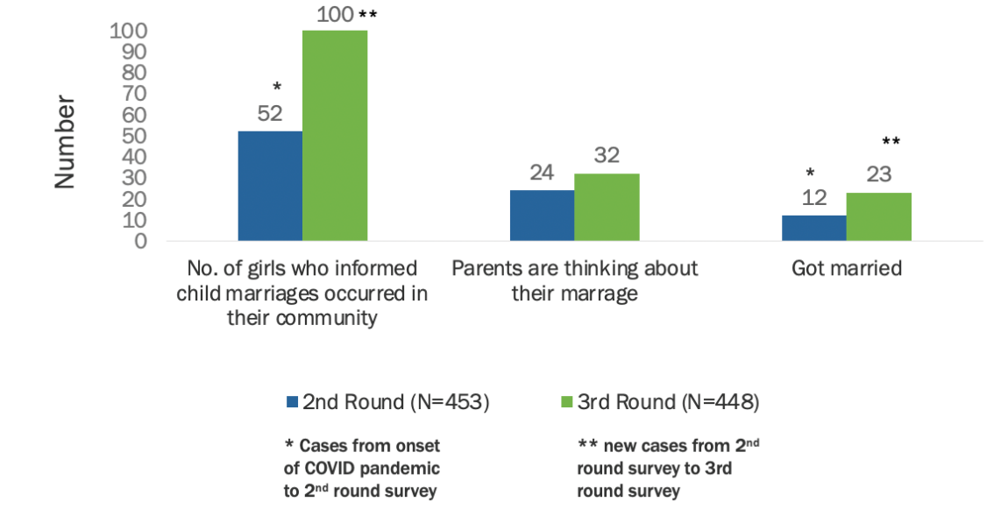
Sexual and Reproductive Health
Limited evidence available on the effect of COVID-19 on sexual and reproductive health of adolescents. Service disruptions are likely to have exacerbated unmet need for SRH and FP services and information among young people globally.
Kenya: Despite risk factors of school closures and economic stress, there is no evidence that COVID-19 was associated with higher levels of adolescent pregnancy (<1% pregnancy rate in sample)
  Nearly half of adolescent girls in the study reported difficulty in accessing menstrual hygiene management products since the start of the pandemic.
Bangladesh: Older out of school girls were at significantly higher risk of child marriage. Nearly 25% of respondents reported child marriages in their communities since COVID-19 in R3
  None of the respondents of the survey across rounds reported seeking SRH, mental health, or GBV services.
Notes:
Limited evidence available on the effect of COVID-19 on sexual and reproductive health of adolescents. Service disruptions are likely to have exacerbated unmet need for SRH and FP services and information among young people globally.
Our studies collected limited information on SRH and access to SRH services from among adolescents. The Council is working to include more questions around ASRH in upcoming surveys.
In the limited evidence that we have, we did not see, in Kenya for example, that the COVID-19 pandemic was associated with higher levels of adolescent pregnancy or fertility. However the data show some indications that commodities such as menstrual hygiene management products became difficult to access with the pandemic.
Related to SRH is Child Marriage, which is common in Bangladesh. With school closures, girls especially who are in older adolescents and who were out of school at significantly higher risk of child marriage, particularly with high economic insecurity in place. Although a small number of girls got married over the pandemic, a large proportion of respondents indicated that child marriages were occurring in their communities and this was particularly true for the latest round of the survey, indicating some manifestations of stress showing on this indicator.

Slide 12
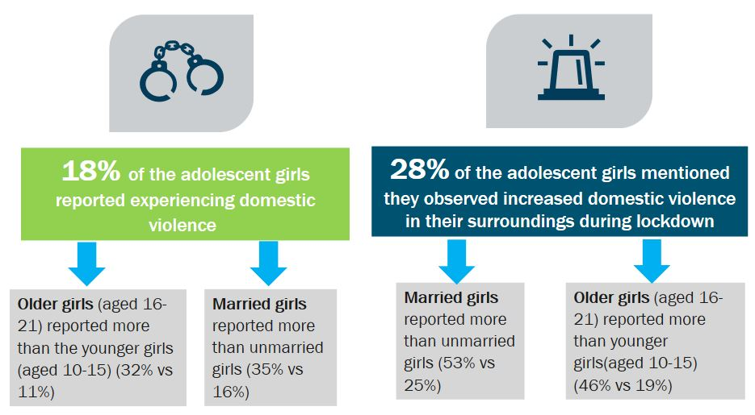
Gender-based Violence (GBV)
Survey findings showed increased incidence of violence against adolescent girls following prolonged lockdown measures
Bangladesh: On average, adolescent girls faced increased violence at home and in their neighborhoods during the pandemic(18% and 28%).
  Married adolescents are significantly more vulnerable to violence compared to unmarried (35% vs. 16%) – Intimate Partner Violence
Kenya: Over half (53%) of adolescents who experienced emotional violence in the month preceding the survey reported that it had increased since COVID-19 started
  Nearly a third (28%) of those who experienced physical violence report that the violence had occurred more often since COVID-19 began.
Notes:
Survey findings showed increased incidence of violence against adolescent girls following prolonged lockdown measures across countries and surveys. Adolescent girls reported that they faced some form of violence (rebuke, scolding, beating).
The risk to violence was higher in their homes compared to neighborhoods (in Bangladesh)
Girls in Kenya, over half of respondents connected the rise in violence to the COVID-19 pandemic.
There are small pockets of highly vulnerable adolescents that are forced to work, engage in transactional sex and/or are experiencing violence. These adolescents are in need of
immediate social protection and assistance. While the numbers are small, these extreme outcomes should be monitored and addressed as they are likely rise with prolonged social
and economic hardship.

Slide 13



Research Uptake
Council staff are partnering with national health ministries, government agencies, and national and international non-governmental organizations to inform the international response efforts
Our evidence is being utilized for improving programmatic responses, policies, and decision-making in the COVID-19 response by:
Office of the President, Kenya
Ministries of Health, Kenya
National COVID-19 Taskforce, Indian Council for Medical Research
UNICEF, UNFPA and other UN Agencies.
Notes:
Our research is intended to be utilized and we have placed significant emphasis on research uptake. In order to do so, in the countries that we have conducted these studies in, we have partnered with national health ministries, government agencies, national and international non-governmental organizations and UN partners to inform international response efforts.
We have engaged our partners strategically from the inception of our studies to ensure that partners have trust in the evidence that is generated and they are taken up for program and policy improvement or for decision-making
Our partners in our studies include :
Office of the President, Kenya
Ministries of Health, Kenya
National COVID-19 Taskforce, Indian Council for Medical Research
UNICEF, UNFPA and other UN Agencies.

Slide 14

Notes:
These are photos of members of our teams on the ground in the different countries where we have conducted the cohort studies.
Please access our COVID-19 Research and Evaluation Dataverse at this link for data, information and tools and instruments from all of our featured studies and more at this link:
https://dataverse.harvard.edu/dataverse/Covid19researchandevaluation
All of our publications to date can be found on our website here: https://www.popcouncil.org/research/responding-to-the-COVID-19-pandemic
If you are interested in collaborations or want more information, we can be reached at our Humanitarian Task Force email.
For regular updates on what the Population Council is doing on COVID-19, please sign up for our monthly newsletter.
Here are the last two monthly newsletters that we have sent out:
September: https://us19.campaign-archive.com/?u=11dc8bba91a268be4ffaabfc1&id=ea63b1e7ce
August: https://us19.campaign-archive.com/?u=11dc8bba91a268be4ffaabfc1&id=de17d40828

