Slide 1
The effects of COVID-19 on the lives of adolescents Module 3
Valentina Baltag, WHO
Department of Maternal, Newborn, Child & Adolescent Health & Ageing

Slide 2
Adolescents face many challenges as a result of this pandemic
Physical health
COVID-19 infection
Disruption of nutrition and physical activity
Violence
Disrupted immunizations
FGM
Social consequences
School closures
Social isolation
Child abuse
Online harassment
Adolescent pregnancies and child marriage
Mental health problems
Direct effects – mortality, morbidity
Indirect effects
Notes:
While attention is currently focused on those most immediately affected by the virus, there are many indications that the COVID-19 pandemic will have long-lasting social, cultural, economic, political and multidimensional impacts on the whole of societies, including and especially young people.
Health and non-health impacts on adolescents young people are proving to be significant. The repercussions of COVID-19 will extend beyond health and well beyond the pandemic time frame.
This global crisis is exacerbating existing vulnerabilities and inequalities. All of these impacts are further amplified in humanitarian contexts where fragility, conflict, and emergencies have undermined institutional capacity and limited access to services. The impacts of COVID-19 are, and will continue to be, felt most harshly by adolescents already living in difficult and/or disadvantaged circumstances.

Slide 3
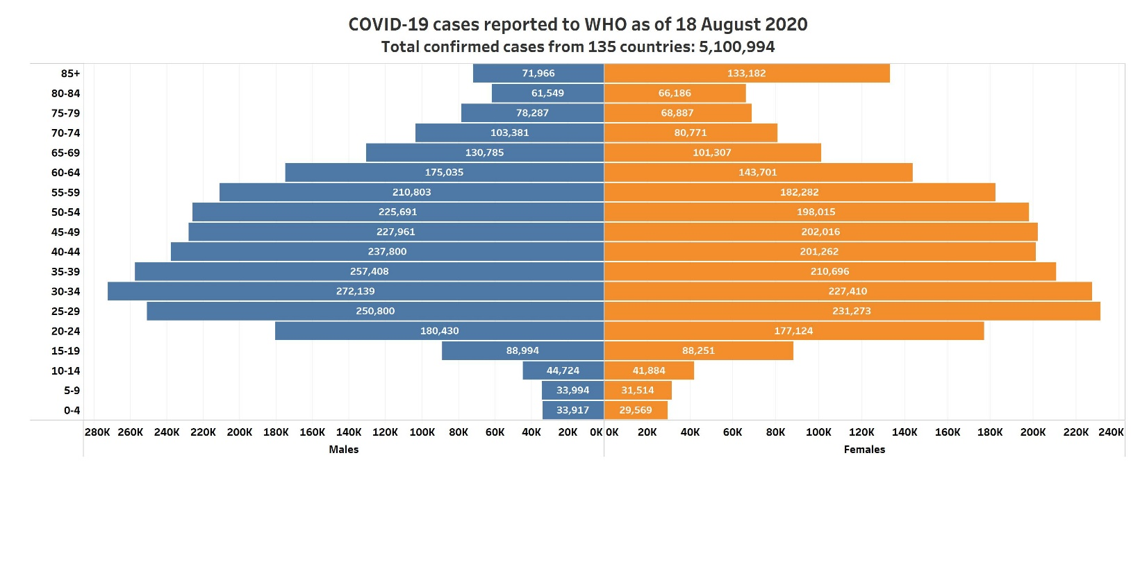
COVID-19 in adolescents
Notifications of disease in children <18 years account for only 1 – 8 % of all cases globally - even though this age group makes up 29% of the world’s population
Case-fatality ratios (CFRs) are lowest in children, adolescents and young adults
Very few severe cases and deaths in children have been reported.
The relatively lower number of cases reported in children largely reflect the generally milder (and hence less reported/undiagnosed) infections in younger age groups or asymptomatic/subclinical infection compared with adults, but may also stem from a lower susceptibility to infection in young age groups
Much remains unknown about the epidemiology of COVID-19 in children and adolescents, and their role in SARS-CoV-2 transmission.
Notes:
Young people are being infected by COVID-19, are transmitting the virus to others, and in some cases are being hospitalized with serious cases. However, compared with older adults, young people and adolescents are less likely to develop serious illness.
Notifications of disease in children <18 years account for only 1 – 8 % of all cases globally - even though this age group makes up 29% of the world’s population
Very few severe cases and deaths in children have been reported.
The relatively lower number of cases reported in children largely reflect the generally milder (and hence less reported/undiagnosed) infections in younger age groups or asymptomatic/subclinical infection compared with adults, but may also stem from a lower susceptibility to infection in young age groups
Much remains unknown about the epidemiology of COVID-19 in children and adolescents, and their role in SARS-CoV-2 transmission.

Slide 4
The risks of violence that women and children their face during the current COVID-19 crisis cannot be ignored
How does COVID-19 increase risks of violence for women?
Reports from across the world suggest a significant increase in domestic violence cases related to the COVID-19 pandemic.
Reports also suggest a reduction in survivors seeking services due to a combination of lockdown measures and not wanting to attend health services for fear of infection.
In addition, access to sexual and reproductive health services will likely become more limited. Other services, such as hotlines, crisis centers, shelters, legal aid, and protection services, may also be reduced, making it difficult for women to access the few sources of help that would usually be available.
https://www.who.int/reproductivehealth/publications/emergencies/COVID-19-VAW-full-text.pdf
Notes:
Stress, the disruption of social and protective networks, loss of income and decreased access to services all can exacerbate the risk of violence for women and children.
In many countries, where people are encouraged or required to stay at home, the risk of intimate partner violence is likely to increase.
Reports from across the world suggest a significant increase in domestic violence cases related to the COVID-19 pandemic.
Reports also suggest a reduction in survivors seeking services due to a combination of lockdown measures and not wanting to attend health services for fear of infection.
In addition, access to sexual and reproductive health services will likely become more limited. Other services, such as hotlines, crisis centers, shelters, legal aid, and protection services, may also be reduced, making it difficult for women to access the few sources of help that would usually be available.

Slide 5
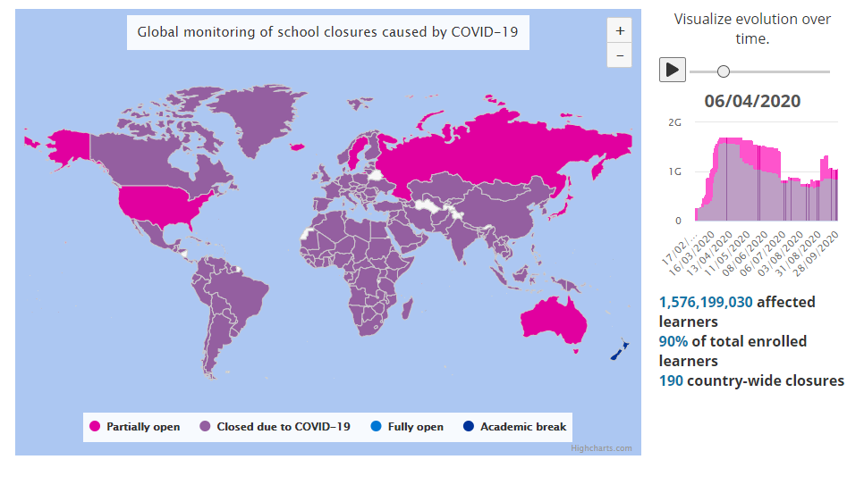
COVID-19 Impact on Education
06/04/2020
28/09/2020
Source: UNESCO Institute for Statistics. https://en.unesco.org/covid19/educationresponse
Notes:
Over 90 per cent of the world’s students, 1.5 billion young people in 188 countries, have been kept away for months from school and universities due to physical distancing measures.
Young people are additionally affected by closures of non-formal education opportunities. Youth in humanitarian contexts especially rely on informal learning, online courses (where feasible), and social interaction as means of personal development. This large-scale interruption of learning, including non-formal and informal learning, may have severe consequences – from compromising nutrition to limiting access to health care, raising dropout rates, and depriving young people of social support and resources. These negative consequences will be exacerbated in cases of students living with disabilities, by lack of access to assistive devices, accessible materials, and platforms as well as lack of trained teaching personnel.
For adolescents and youth, connecting with one another is key to their sense of belonging and overall well-being. Long-term confinement and isolation from educational spaces will erode the social support networks young people build with each other.
While young people are generally very connected digitally, large numbers do not have regular and affordable Internet access and may fall behind as learning and participation shift to online platforms. Online learning limits the pedagogical tools available to educators, placing an extra burden on students and caretakers. This may lead to anxiety, frustration, and elevated dropout rates.
Distance learning is also a driver of existing inequities. Fewer than 40 per cent of low-income countries have announced distance-learning education programmes, compared with 90 per cent of high-income countries. Girls and young women have comparatively less access to digital technology than boys and young men, so they can expect to miss out on additional learning.

Slide 6
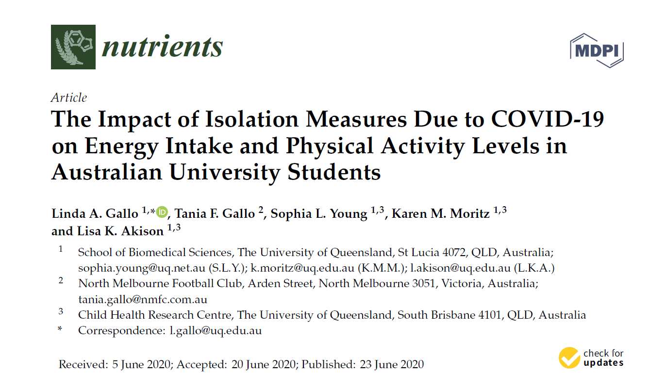
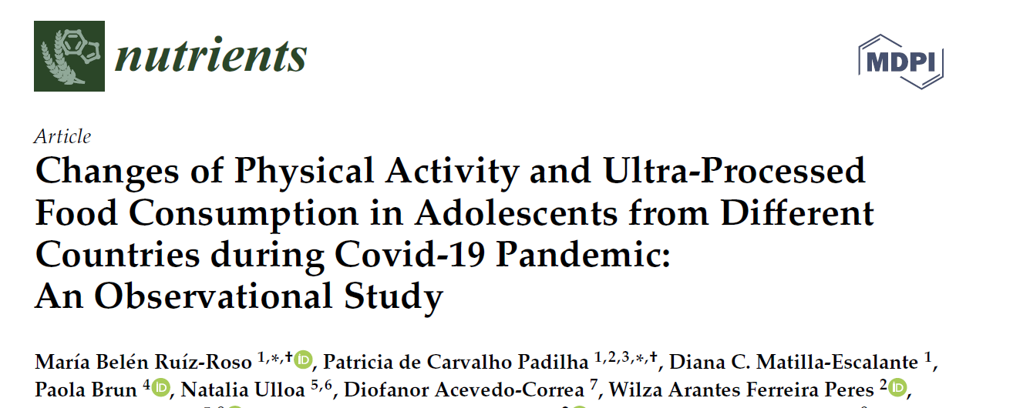
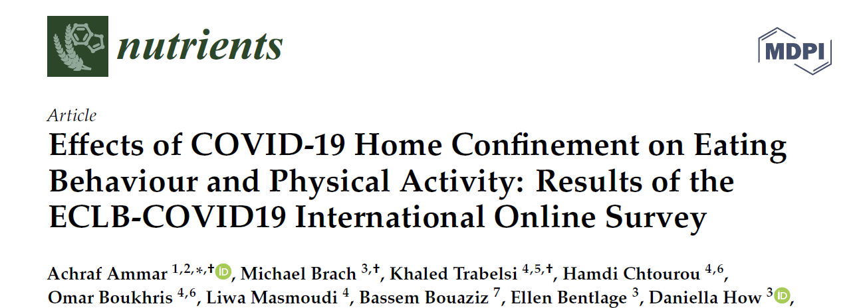
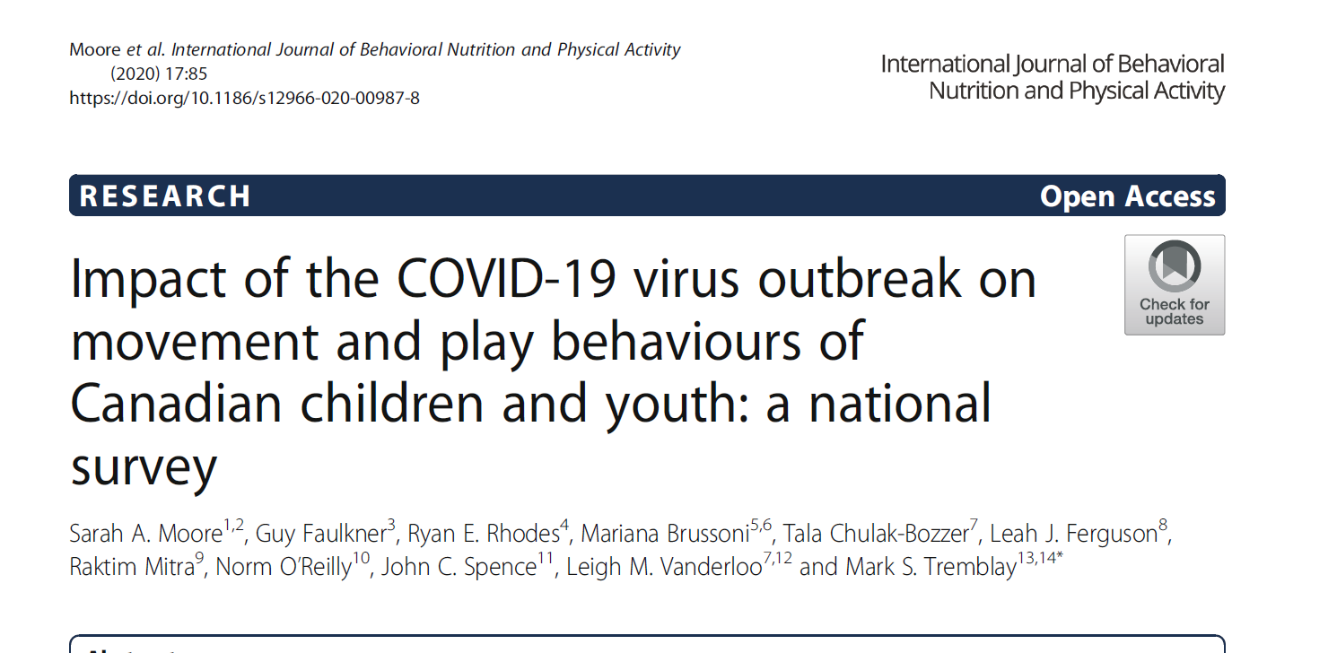
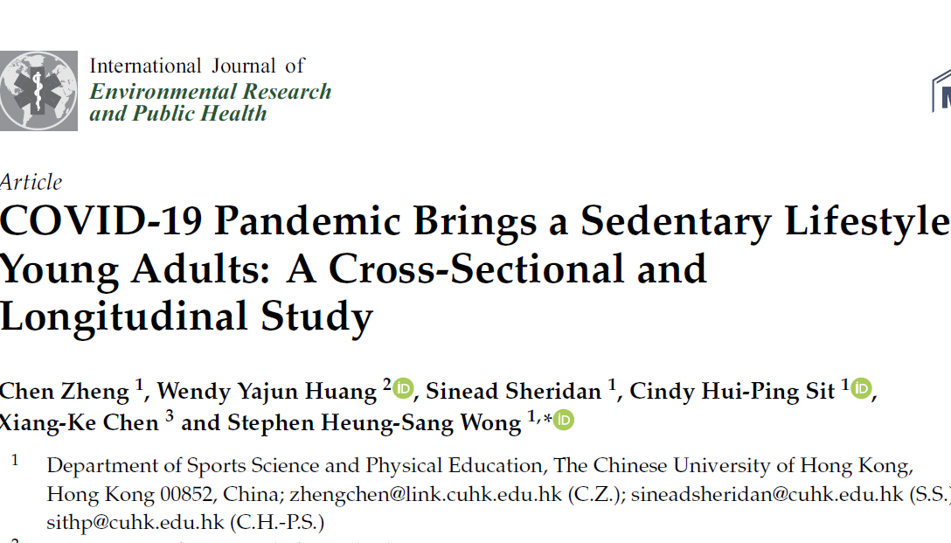
Physical activity and sedentary behaviours
Notes:
Dramatically reduced opportunities for physical activity, and increased tobacco, alcohol and drug use may have long-term impacts on preventing NCDs.
2020_COVID-19 pandemic…. : from China, on young adults aged 18-35 and shows a decline in PA during the pandemic.
- 2020_Changes of PA….: from Italy, Spain, Brazil, Chile, Colombia, on adolescents aged 16-19 and shows a decline in PA during the pandemic, more pronounced in the Latin American countries
- 2020_Impact of the COVID-19….: from Canada, parents of 5-17 year old children and adolescents responded, shows low levels of PA during pandemic
- 2020_Effect of COVID-19 home confinement…: international, many countries, all ages 18+ years, shows decline of PA and increase of sitting
- 2020_The impact of isolation….: from Australia, on University Students 19-27 years, shows decline in PA
Declines in PA during the pandemic are found across all age groups. In adolescents, the multi-country study from Italy, Spain, Brazil, Chile, Colombia and the study from Canada are the most relevant.
It is important to reinforce health-promoting behaviours during COVID-19 pandemic for children and adults and to maintain population-level interventions for tobacco and alcohol control, diet and physical activity.

Slide 7
Disruption of health services for adolescents
Limited access to sexual and reproductive health services
Disrupted immunization schedules
Access to essential antiretroviral medications and services for young people living with HIV may be deprioritized and disrupted
Interrupted home, community, and social services and support services for adolescents with disabilities
Health services delivered through schools and universities are cut off
Notes:
The COVID-19 response is already putting immense stress on health systems around the world. It is disrupting the delivery of routine health services and information to young people,
With the observed disruption of health services, young people who need essential, time-sensitive, and life-saving medication and services may be at risk of not being able to access them, thereby increasing the likelihood of developing complications when infected. Specifically:
sharply limited access to sexual and reproductive health services
disrupted immunization schedules
Cut off young people’s access to health services delivered through schools and universities (including continuation of preventive measures such as physical exercise), now shut because of physical distancing measures. access to essential antiretroviral medications and services for young people living with HIV may be deprioritized and disrupted in the coming months, and the health impacts on this segment of the population, who are already immunocompromised, may be significant.
Young people with disabilities may be disproportionately affected by interrupted home, community, and social services and support, including personal assistance
Many young people do not have adequate levels of health literacy to enable them to gain access to, understand, and use information in ways that protect their health and well-being.

Slide 8
Indirect impact of COVID-19 Pandemic
The impact of COVID-19 on ending unmet need for family planning
For every 3 months the lockdown continues, assuming high levels of disruption, up to 2 million additional women may be unable to use modern contraceptives
If the lockdown continues for 6 months and there are major service disruptions due to COVID-19, an additional 7 million unintended pregnancies are expected to occur
The impact of COVID-19 on ending child marriage
COVID-19 will disrupt planned efforts to end child marriage and cause wide-reaching economic consequences
An additional total 13 million child marriages taking place that otherwise would not have occurred between 2020 and 2030
The impact of COVID-19 on ending female genital mutilation
COVID-19 could have far-reaching impacts on the effort to end female genital mutilation
A 1/3 reduction in the progress towards ending FGM by 2030
2 million FGM cases could occur over the next decade that would otherwise have been averted
* Impact of the COVID-19 Pandemic on Family Planning and Ending Gender-based Violence, Female Genital Mutilation and Child Marriage
Pandemic threatens achievement of the Transformative Results committed to by UNFPA
114 priority low- and middle-income countries
For internal use only – not for distribution
Notes:
Modelling Indirect impact of COVID-19 Pandemic Suggests that there may be Other Long Term Consequences on Children of School Age in LMICs
The impact of COVID-19 on ending unmet need for family planning
For every 3 months the lockdown continues, assuming high levels of disruption, up to 2 million additional women may be unable to use modern contraceptives
If the lockdown continues for 6 months and there are major service disruptions due to COVID-19, an additional 7 million unintended pregnancies are expected to occur
The impact of COVID-19 on ending child marriage
COVID-19 will disrupt planned efforts to end child marriage and cause wide-reaching economic consequences
An additional total 13 million child marriages taking place that otherwise would not have occurred between 2020 and 2030
The impact of COVID-19 on ending female genital mutilation
COVID-19 could have far-reaching impacts on the effort to end female genital mutilation
A 1/3 reduction in the progress towards ending FGM by 2030
2 million FGM cases could occur over the next decade that would otherwise have been averted

Slide 9
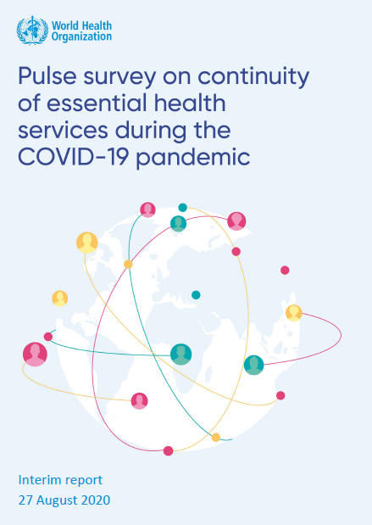
THE IMPACT OF THE COVID-19 PANDEMIC ON UP TO 25 ESSENTIAL HEALTH SERVICES IN COUNTRIES
Questionnaires were sent to 159 countries and 105 responses were received (66% response rate).
Disruptions of essential health services were reported by nearly all countries
The great majority of service disruptions were partial, which was defined as a change of 5–50% in service provision or use.
Notes:
WHO conducted a key informant survey among ministry of health officials in five WHO regions between May and July 2020 to assess the impact of the COVID-19 pandemic on up to 25 essential health services
in countries. Questionnaires were sent to 159 countries and 105 responses were received (66% response rate). Almost every country (90%) experienced a disruption to some extent, with greater disruptions being reported in low- and middle-income than in high-income countries. On average, countries reported disruptions to half of the tracer health services on which they reported.

Slide 10
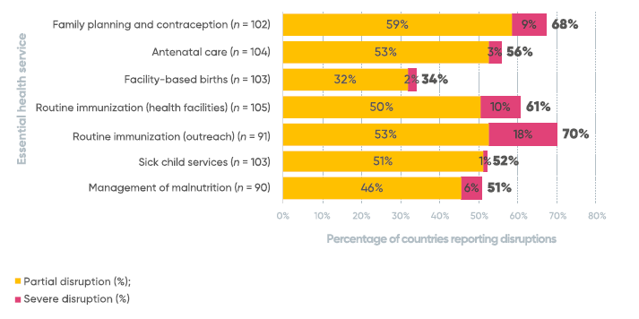
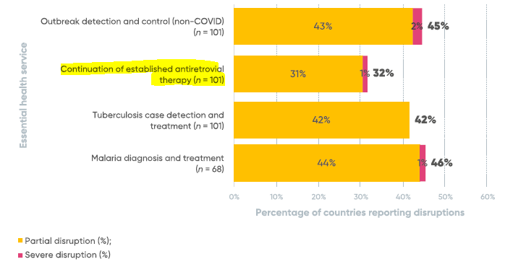
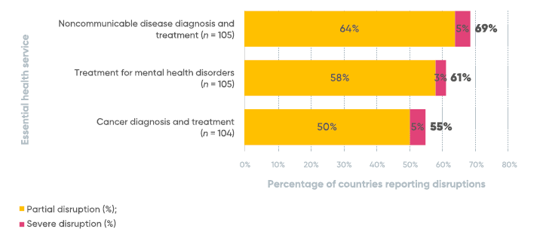
PERCENTAGE OF COUNTRIES REPORTING DISRUPTIONS ACROSS SERVICE AREAS
Source: https://www.who.int/publications/i/item/WHO-2019-nCoV-EHS_continuity-survey-2020.1
Notes:
Essential health services were affected across the board. The most frequently disrupted services included routine immunization services – outreach services (70%) and facility-based services (61%) – noncommunicable disease diagnosis and treatment (69%), family planning and contraception (68%), treatment for mental health disorders (61%), antenatal care (56%) and cancer diagnosis and treatment (55%).

Slide 11
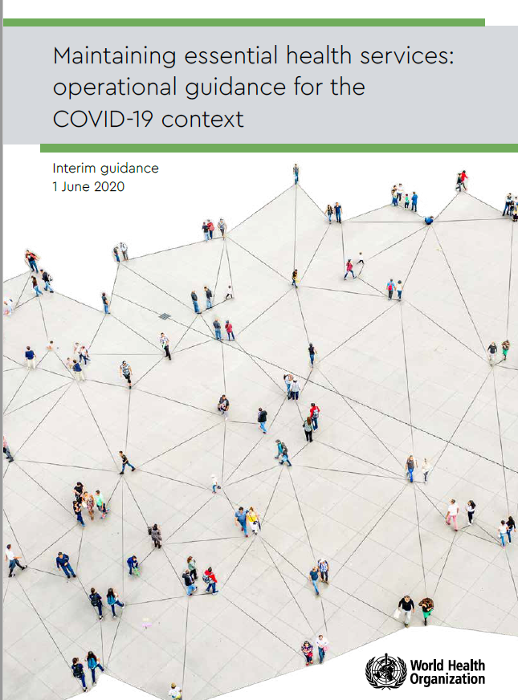
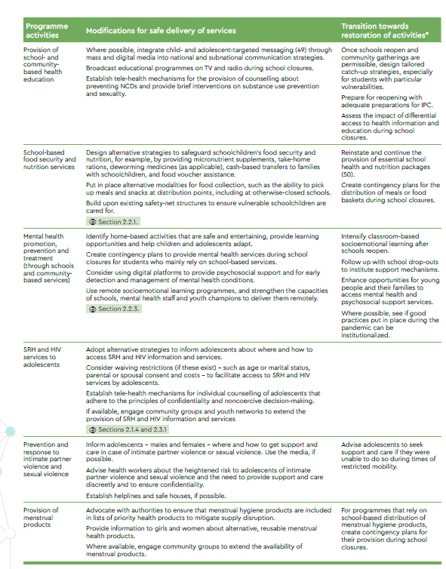
WHO GUIDANCE ON MAINTAINING ESSENTIAL HEALTH SERVICES
Source:https://www.who.int/publications/i/item/10665-332240
Notes:
Countries are making difficult decisions to balance the demands of responding directly to the COVID-19 pandemic with the need to maintain the delivery of other essential health services. Establishing safe and effective patient flow (including screening for COVID-19, triage and targeted referral) remains critical at all levels.
As the outbreak is brought under control and restrictive public health measures are gradually eased, some adaptations in service delivery may need to be reversed, others continued for a limited time, and yet others that are found to be effective, safe and beneficial can be incorporated into routine post-pandemic practice. The course of the outbreak is likely to wax and wane, and the strategic response will need to be dynamic and calibrated. Decision-makers should anticipate the need to start, stop and restart adaptations.
The WHO guidance on MAINTAINING ESSENTIAL HEALTH SERVICES supports country implementation of targeted actions at the national, subnational and local levels to reorganize and maintain access to safe and high-quality essential health services. It outlines the adaptations needed to keep people safe and maintain continuity of essential health services during the response to the COVID-19 pandemic. It is intended for decision-makers and managers at the national and subnational levels. Part 1 outlines basic principles and practical recommendations that support decision-making to ensure the continuity of select essential health services, highlighting key actions that countries should consider. Part 2 contains brief sections addressing specific adaptations and considerations for life course and disease programmes in the context of COVID-19. These sections are intended to be used in conjunction with — and do not replace — existing WHO programme guidance in these areas

Slide 12
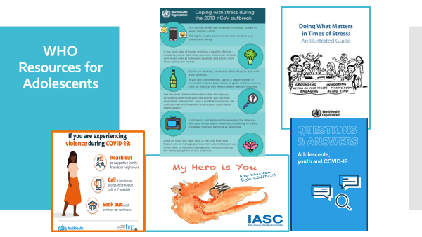
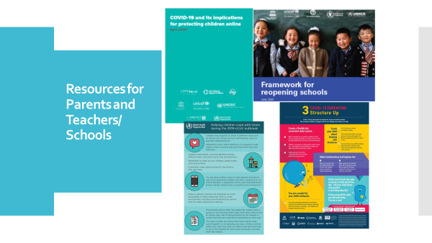
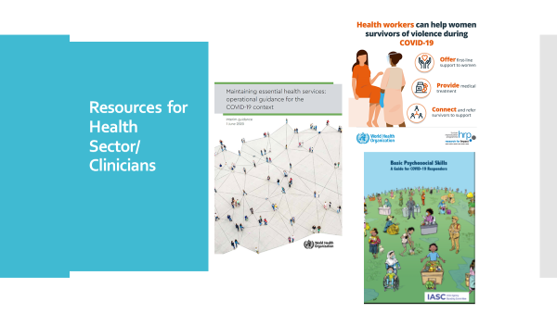
WHO RESOURCES
Department of Maternal, Newborn, Child & Adolescent Health & Ageing ,
World Health Organization, Geneva

Slide 13
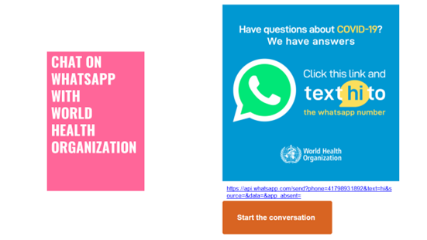
Thank you!
Department of Maternal, Newborn, Child & Adolescent Health & Ageing ,
World Health Organization, Geneva

