Slide 1
From Bad to Worse:
The COVID-19 Pandemic Risks Further Undermining Adolescents’ SRHR
Notes:
This presentation covers new work from the Guttmacher Institute modeling the potential impacts of COVID-19 on adolescent SRH outcomes in low- and middle-income countries.
Previous public health emergencies have shown that the impact of an epidemic on sexual and reproductive health often goes unrecognized, because the effects are often not the direct result of the infection, but instead the indirect consequences of strained health care systems, disruptions in care and redirected resources. Adolescents, in particular, may be particularly vulnerable, as health emergencies exacerbate pre-existing inequities in SRH care and outcomes.
What we do know from past pandemics is that SRHR services can be disrupted and the scale of these effects are large. For example, in Sierra Leone, one of the countries most affected by Ebola, decreases in maternal and newborn care due to disrupted services and fear of seeking treatment during the two years of the outbreak contributed to an estimated 3,600 maternal and neonatal deaths—a quantity that approaches the number of deaths directly caused by the Ebola virus in the country.
We have never lived through a crisis like COVID before. In many respects, these findings from the Ebola outbreak in West Africa are a warning about what is possible, and they are a modest warning at that. There are a range of pandemic-related issues that could lead to detrimental effects on adolescents’ sexual and reproductive health and rights. First, lockdown measures are disrupting contraceptive supply chains and the ability to travel to health facilities, putting young people at greater risk of unintended pregnancy by reducing their access to information and contraceptive services. Second, school closures are leading to reduced access to sexual and reproductive health supplies and information for adolescents, including critical interventions offered in school settings, such as comprehensive sexuality education. Third, the economic crisis has driven increases in gender-based violence, child marriage and other rights violations that threaten young people’s health and well-being. But preventative action can also be taken to mitigate these harms – these preventative policy actions will also be covered in this presentation.

Slide 2
Unmet need for sexual and reproductive health services is already disproportionately high among adolescents in low- and middle-income countries
Notes:
The data in this presentation come from the Adding It Up model, produced by the Guttmacher Institute, which measures the need for, impact and cost of sexual and reproductive health services in low- and middle-income countries (See https://www.guttmacher.org/adding-it-up).
Our recent report found that as of 2019, adolescents faced vast unmet need for sexual and reproductive health services.
Among those who want to avoid a pregnancy, adolescent women aged 15-19 have much higher unmet need for modern contraceptives than do all women of reproductive age - they have an unmet need of 43% compared to 24% among women 15-49.
In addition, among the 12 million adolescents who give birth each year, 5.2 million do not receive the recommended four of more antenatal care visits, and 3.9 million do not deliver in a health facility, where they would be able to access life saving care.
It is this context – of already unequal SRH care – that COVID-19 is further impacting adolescents' access to SRH care.

Slide 3
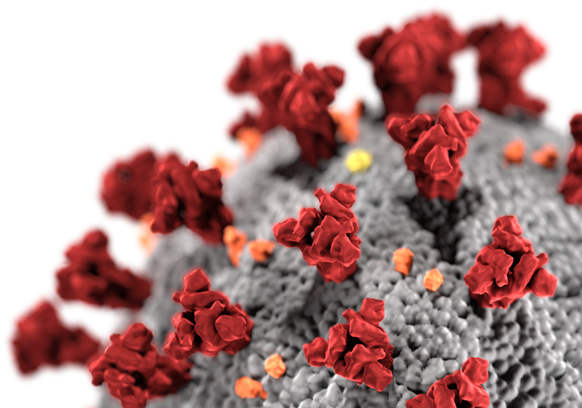
SRH services and outcomes potentially impacted by COVID-19
Modern contraception
Unmet need
Unintended pregnancies
Pregnancy-related care
Women and newborns with major complications* not receiving treatment
Maternal deaths
Safe abortion care
Unsafe abortions
*Major obstetric complications were severe preeclampsia, antepartum hemorrhage, obstructed labor, eclampsia, maternal sepsis case management and postpartum hemorrhage. Major newborn complications were asphyxia, sepsis and infection, congenital syphilis and complications from preterm labor.
Notes:
To understand the potential impact of COVID-19 on adolescent SRH care and outcomes in low- and middle-income countries, we modeled potential service disruptions across three main areas of service provision: modern contraceptive care, pregnancy-related care, and safe abortion care. Within each of these service domains, we focused on changes in the number of people in need of and not receiving care, and the impact this would have on unintended pregnancies or maternal deaths.
We still don’t know a lot about how COVID is impacting SRH services, so we used data from other COVID-19 models that laid out likely scenarios for how services may change.
Model-based estimates can play a really important role in these situations, where we can show the relationship between service changes and outcomes for people, to make clear what is at stake. This type of data can be particularly helpful for advocacy and pushing for preventative efforts aimed at minimizing impact.

Slide 4
Potential annual impacts among adolescents from COVID-19–related disruptions:
Modern contraception
12%
average decline in
use of modern contraception
2 million
additional adolescent women with unmet need
734,000
additional unintended pregnancies among adolescents
Assumed no change in demand for contraception
Disruptions assumed to be different by contraceptive method
Notes:
First , we looked at the impact of potential declines in adolescents' modern contraceptive use. We used assumptions on the disruptions we may see for each specific modern contraceptive method. Data on these assumed disruptions come from a recent analysis by the United Nations Population Division (https://gatesopenresearch.org/articles/4-102/v1). While the average annual disruption is 12% across all methods, this ranged from a 2% decline in female and male sterilization, 4-5% decline for IUDs and implants, 10% decline for pills and condoms, and 20% decline for injectables.
We also assumed that there was no change in the demand for contraception. However, the pandemic, and the associated economic downtown, may be increasing adolescents’ desire to delay childbearing, potentially increasing the overall demand for modern contraception.
However, if we assume even just a modest 12% decline in adolescents’ use of modern contraception over the year, this would result in 2 million additional adolescent women with an unmet need for modern contraception, and 734,000 additional unintended pregnancies among adolescents.

Slide 5
Pregnancy-related care
Potential annual impacts among adolescents from COVID-19–related disruptions:
25%
average decline in pregnancy-related care
134,000
additional adolescent women experiencing major obstetric complications without care
3,400
additional maternal deaths among adolescents
Notes:
We also looked at the impact of reductions in pregnancy-related care services among adolescents. To measure service disruptions, we used data from a medium-scenario of service disruption to maternal and newborn health services recently published by Roberton et al. in The Lancet Global Health (https://www.thelancet.com/journals/langlo/article/PIIS2214-109X(20)30229-1/fulltext). This results in an average decline of 25% in service coverage. This disruption may be driven by changes in access for some interventions (e.g., delivery in a facility) and changes in the content or quality of care for others (e.g., provision of magnesium sulfate for eclampsia treatment).
If we saw an average of a 25% decline in adolescents’ pregnancy-related care, it would result in 134,000 more pregnant adolescents with major obstetric complications not receiving the treatment they need. This decline across antenatal care, delivery and postnatal care, and post-abortion care would result in 3,400 additional maternal deaths among adolescents.
Definitions:
Pregnancy-related care: care for miscarriage at 14–27 weeks' gestation, postabortion care for abortion complications needing comprehensive emergency obstetric care, safe abortion care, management of ectopic pregnancy, tetanus toxoid immunization, malaria prevention with insecticide-treated bed net and intermittent preventive treatment in pregnancy, malaria treatment during antenatal care, hypertensive disease case management during antenatal care, delivery in a health facility, delivery in a basic or comprehensive emergency obstetric care facility, management of severe preeclampsia and eclampsia, antibiotics for preterm premature rupture of membranes, and maternal sepsis case management.
Major obstetric complications were severe preeclampsia, antepartum hemorrhage, obstructed labor, eclampsia, maternal sepsis case management and postpartum hemorrhage.

Slide 6
Potential annual impacts among adolescents from COVID-19–related disruptions:
Safe abortion care
23%
shift in abortions from
safe to unsafe
491,000
additional unsafe abortions among adolescents
Only modeling changes to safe abortions
Demand for abortion also likely to increase
Increasing need for post-abortion care
Notes:
The last key SRH service we examine is safe abortion care. Abortion is a time sensitive, life-saving, essential health service and should not be denied to those in need. Every year, tens of millions abortions happen safely, but during the COVID-19 pandemic, we’re concerned about many of those suddenly becoming unsafe. We know from prior work that inhibiting access to safe abortion doesn’t make it go away – it only makes it unsafe.
We look at a scenario where 23% of abortions that are currently performed safely would become unsafe – that is, abortions that do not use a WHO-recommended method appropriate to the pregnancy duration or are not done by a trained provider, or both. This includes what are classified as less safe as well as least safe abortions. The estimate of a 23% reduction in safe abortion care was based on the childbirth care coverage reduction (23.1%) in scenario 2 of Roberton et al., assuming a similar lack of access to facilities and providers for people seeking safe abortions.
We found that if 23% of adolescents’ safe abortions globally are compromised--that is, made less safe due to lack of access to a providers or supply chain disruptions -- we would see 491,000 more unsafe abortions.
This analysis just looked at what would happen if there were a reduction in the proportion of abortions that women could obtain safely. This could occur through a few mechanisms - facilities may be closed, women may be unable to travel for services during a lockdown, staff and resources may be diverted to COVID-related services, and there may be shortages in misoprostol and mifepristone due to global supply chain disruptions.
However, this is just looking at what would happen to changes in safe abortion, which underestimates the impact of COVID on abortion. First, there are many countries where safe abortions are hard to obtain and women instead are having less safe or least safe abortions. These types of abortions may also be impacted by the pandemic. Global supply chain disruptions in medical abortion pharmaceuticals will also impact use of medical abortion outside the health system. And people's ability to pay for abortions will be impacted in the economic crisis that COVID has precipitated.
What we are estimating here are really just what happens when the direct health system provision of safe abortions is impacted. The scale of impact of COVID on abortion is likely much greater.
In addition, some of the other services discussed earlier will have upstream and downstream effects on abortion care. Reductions on modern contraception will result in more unintended pregnancies and increase in the demand for abortion services. In turn, the increasing lack of access to safe abortions will result in more complications, and an increasing need for post-abortion care. However, post-abortion care is likely to also be impacted by COVID, resulting in an increasing need and less access for this critical life-saving treatment.

Slide 7
Policy actions
Define and promote sexual and reproductive health care—including safe abortion, contraception, and maternal and newborn care—as essential
Shore up and strengthen national and regional supply chains
Repeal restrictive policies such as parental consent requirements, which pose an even greater burden during the pandemic
Leverage young people’s use of digital platforms to promote telehealth options that make care available to patients in their own homes
Address the unique needs of vulnerable and marginalized adolescent populations
Notes:
The pandemic is forcing us to work differently, more collaboratively than ever before, and highlighting both weak points and opportunities for ensuring stronger health systems in the future. I’m going to talk about a few of these opportunities, in thinking about where we go from here in protecting the agenda for ensuring comprehensive SRHR
Policymakers need to prioritize sexual and reproductive health care that meets young people’s needs, both during and after the pandemic.
First, they must define and promote sexual and reproductive health care—including safe abortion, contraception, and pregnancy-related care—as essential, particularly for young people. This would allow adolescents to travel for services, even in areas under stay-at-home orders or with travel restrictions, without fear of legal consequences.
Second, alongside private-sector actors, address supply issues by shoring up supply chains to avoid stock-outs, making contraceptives available without a prescription, and facilitating multimonth dispensing of contraceptives.
Third, repeal restrictive policies such as parental consent requirements, which pose an even greater burden during the pandemic.
Fourth, leverage young people’s use of digital platforms to promote telehealth options that make care available to patients in their own homes.
And finally, address the unique needs of vulnerable and marginalized adolescent populations, such as those who are unhoused, those with disabilities, those who are migrants, refugees or living in humanitarian settings, and those who identify as LGBTQ+.
In order for these actions to be successful both during the pandemic and beyond, young people must be meaningfully engaged in their design, implementation, monitoring and evaluation. Also, services must be affordable, nondiscriminatory, medically accurate, and developmentally and culturally appropriate. By prioritizing young people’s diverse sexual and reproductive health needs and ensuring that they are at the forefront in identifying effective solutions, policymakers can prevent these harms to young people and strengthen our collective future.

Slide 8
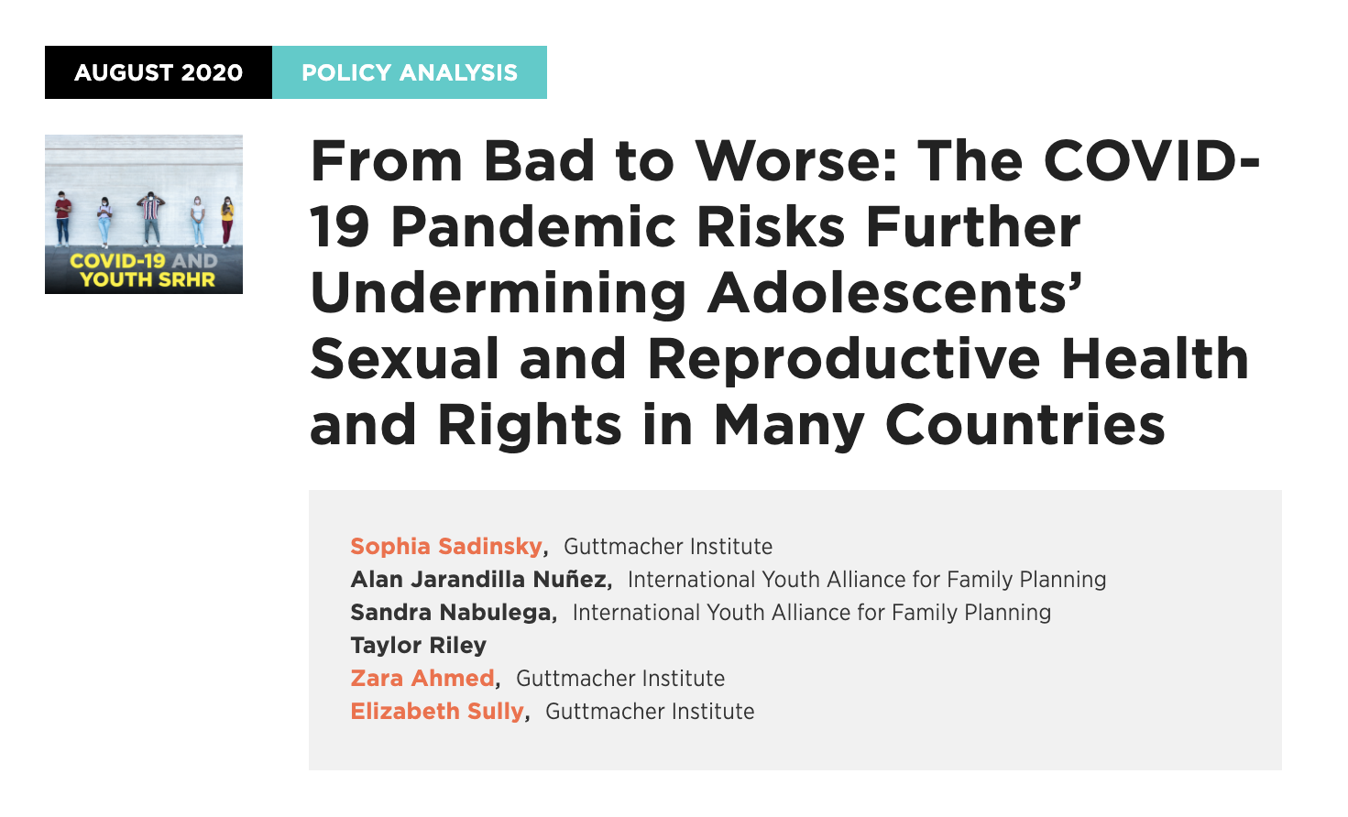
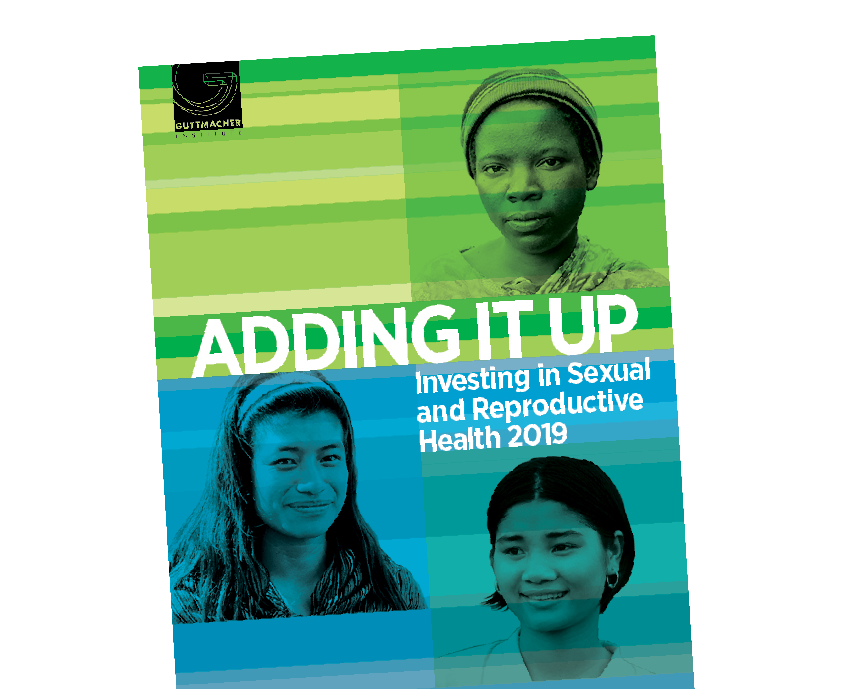
Find out more
Policy analysis –
COVID-19 and SRHR among adolescents: gu.tt/32uqMXJ
Adding It Up 2019 report:
Gu.tt/AddingItUp
Notes:
For more information on the content of this presentation, please see:
Our policy analysis presenting the findings of contained in this presentation
Adding It Up 2019 report (Ch 5 focuses specifically on the SRHR needs, impact and costs among adolescents).
Other ways to connect with us:
Website: https://www.guttmacher.org
Facebook: https://www.facebook.com/guttmacher
LinkedIn: https://www.linkedin.com/company/guttmacher-institute
Twitter: @Guttmacher
Instagram: guttmacherinstitute

