Slide 1
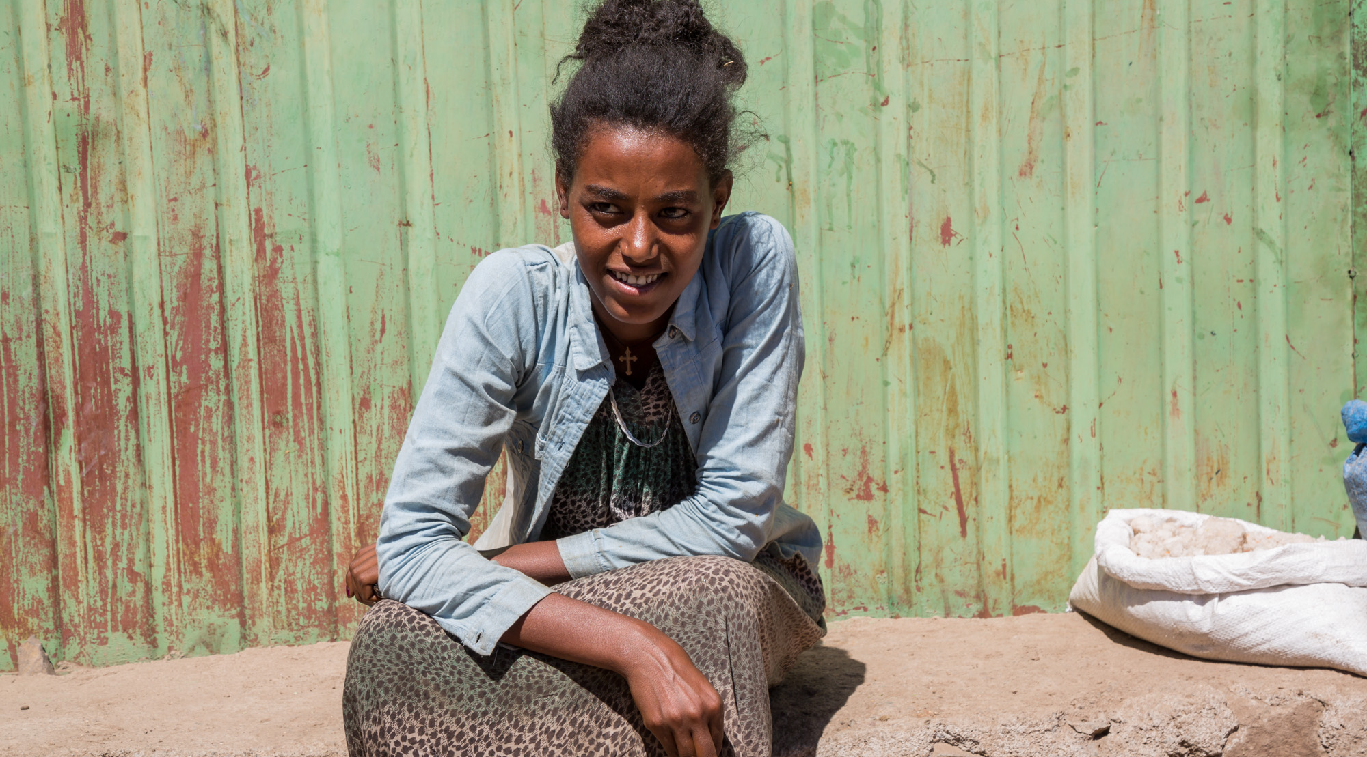
The impacts of covid-19 on adolescents:
Evidence from GAGE
An adolescent girl selling vegetables, Ethiopia © Nathalie Bertrams/GAGE 2020
Dr Nicola Jones, September 2020

Slide 2
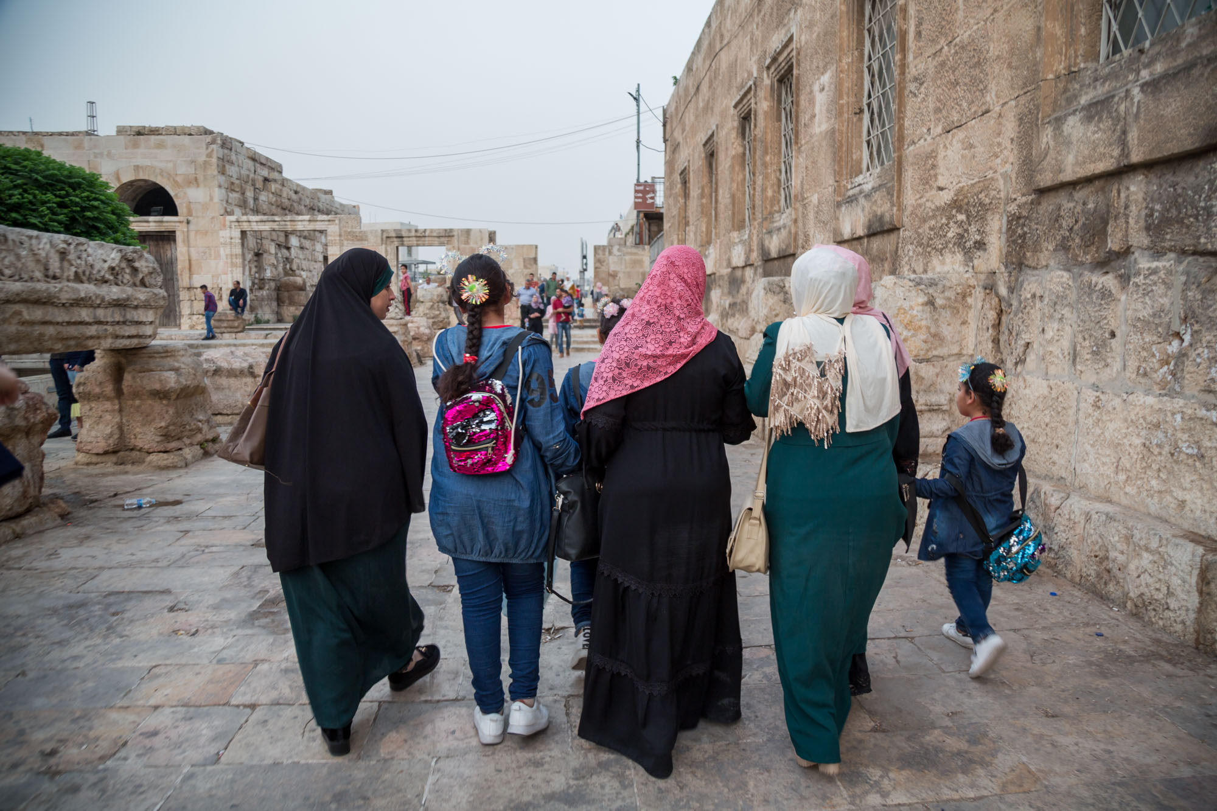
Group of girls in Jordan © Natasha Bertrams / GAGE 2020
Please note that the following photographs of adolescents DO NOT capture GAGE research participants and consent was gained from their guardians for the photographs to be used for GAGE communications purposes.
1
GAGE Overview

Slide 3
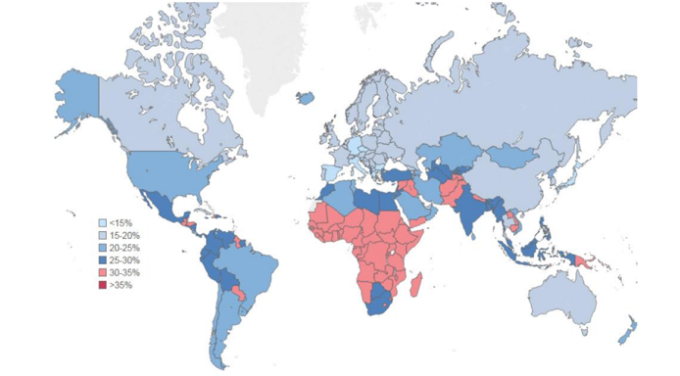
Why adolescence?
An age of opportunity but also of risk-taking
The demographic imperative
ADOLESCENCE 10-19 years
Rapid neuro-development changes
Growing adoption of adult-like roles, e.g. work, intimate relationships
Increased salience of gender norms in daily life
Increased interaction with peers vs parents
Psycho-emotional and self-identity changes
Physical and reproductive changes
% total population 10-24 years in 2013
Source: Accelerating adolescent girls’ education and empowerment: G7 Whistler Meeting 2018 | May 2018
Notes:
Adolescence has powerful impacts on children’s capabilities. This is in part because of the physical transformations wrought by puberty and in part because of how children’s place in the family and broader community shifts as they approach maturity.
Adolescence is increasingly recognised as a window of opportunity—with pubertal changes reworking not only the body, but the brain.
The adolescent brain is especially vulnerable to a wide variety of risk-taking that jeopardises longer-term outcomes—but also opens new routes for intervening because of the way teens process social information.
Social norms become more rigidly enforced and personally salient in early adolescence—girls’ worlds often shrink as boys’ worlds expand

Slide 4
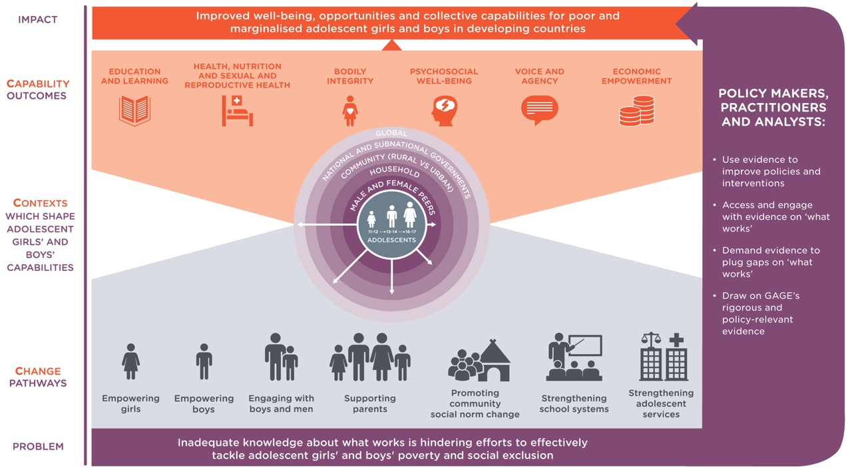
GAGE 3Cs Conceptual Framework
Notes:
Our conceptual framework recognizes that adolescents’ contexts—at the household, community and national levels—shape their capabilities.
Our conceptual framework is built around six core capability domains:
Education and learning
Health, nutrition, and sexual and reproductive health
Bodily integrity and freedom from violence
Psychosocial wellbeing
Voice and agency
Economic empowerment
Our framework recognizes the importance of reaching adolescents through a wide variety of change pathways—ranging from empowering adolescents at the individual level through working to effect change at the systems level.
3 CS Conceptual Framework

Slide 5
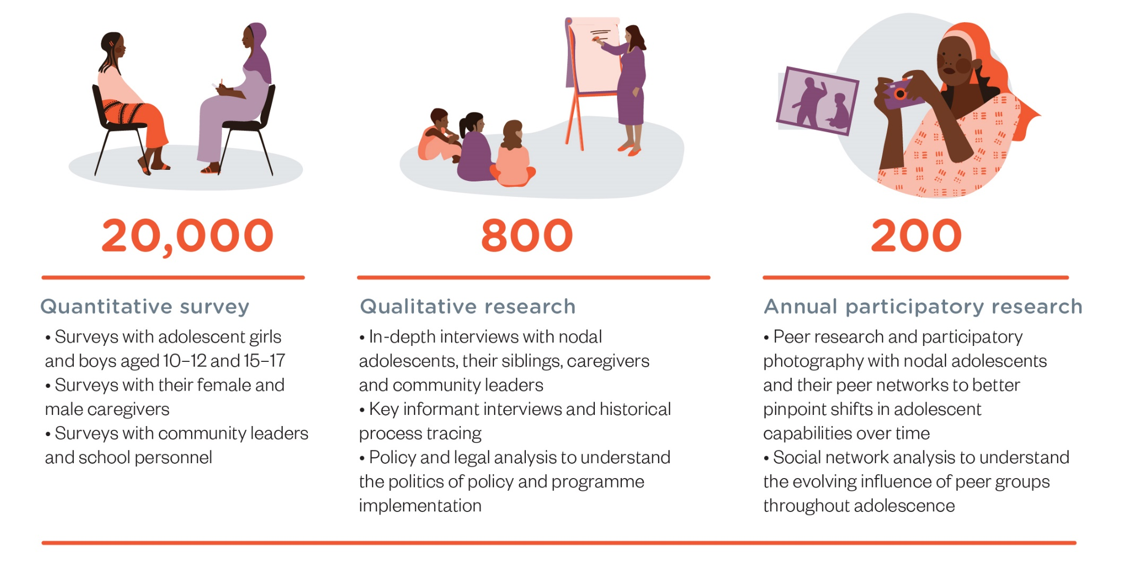
Mixed methods virtual research on adolescent experiences of covid-19, leveraging GAGE’s longitudinal research design
PHONE SURVEYS WITH 9500 ADOLESCENTS
ETHIOPIA - Panel survey w/ 2000 urban adolescents
JORDAN - Panel survey w/ 3500 adolescents in camps/ host communities
GAZA and WEST BANK - Survey research with 1000 adolescents
BANGLADESH - Panel survey w/ 3000 urban + rural Bangladeshis, Rohingya refugees
PHONE/WEB-BASED INTERVIEWS WITH 550 ADOLESCENTS + 150 KEY INFORMANTS
BANGLADESH - IDIs w/ 30 adolescents in 3 low-income settlements in Dhaka, + 30 Rohingya adolescents
JORDAN - IDIs and FGDs w/ 110 adolescents from refugee and host communities, 45 service providers
GAZA - IDIs, FGDs with 56 adolescents from urban + camp settings, 8 service providers
ETHIOPIA - IDIs w/ 174 nodal adolescents from urban, rural + pastoralist areas, and 154 socially vulnerable youth, 50 service providers
PHONE/ WEB-BASED PARTICIPATORY RESEARCH WITH 140 ADOLESCENTS
LEBANON , JORDAN, GAZA
Participatory photography, digital and audio diaries, blogs authored by adolescents
Notes:
GAGE COVID research builds on our longitudinal research.
It includes adolescent boys and girls from five countries:
Ethiopia
Palestine (Gaza Strip)
Jordan
Lebanon
Bangladesh
Care has been taken to ensure that the most vulnerable—including married girls and adolescents with disabilities—are included in our sample.
Our COVID research is virtual.
It includes phone surveys with 9500 young people.
It also include web-based interviews with adolescents and key informants.
In MENA countries, where GAGE is running participatory research groups and connectivity is better, adolescents are using photography and blogs to track their experiences.

Slide 6
Research is sequenced to capture the evolution of covid-19 impacts
2 rounds of quantitative and qualitative data collection with adolescents and their caregivers prior to covid-19
To assess slower onset implications and medium changes in adolescent wellbeing
January - April - June
2020
Late 2017-2018
September - November 2020
January - July
2021/ 2023
Late 2019/2020
To understand the effects of initial onset of the covid-19 pandemic
To assess longer-term impacts of the pandemic on adolescent:
health,
education
bodily integrity (freedom from violence, child marriage, FGM/C)
psychosocial wellbeing
voice & agency
econ empowerment/ social protection.
Notes:
GAGE data collection around covid-19 has been organized in three key phases in order to capture the evolution of COVID-19 impacts on vulnerable young people :
Those that emerged immediately in the first weeks and months of the pandemic.
Those that are emerging as the pandemic has dragged on into fall 2020.
Those that will take years to visibilise and understand.
Following our conceptual framework, we will be exploring—at each point in time-effects on all six capability domains.

Slide 7
National covid-19 responses and outcomes are varied
Bangladesh
Ethiopia
Gaza
Jordan
Lebanon
High migration, population density, under- resourced services, and a slow and fragmented government response contributed to high rates that are declining in recent weeks.
Poor connectivity in rural areas, a large numbers of migrants, and growing politicalization of precautions are challenges. Case counts have declined in the last few weeks, after increasing in August.
Densely populated and with years of under-investment in services, proactive restrictions helped to stem local transmission until late August.
Early decisive action and a hard lockdown limited spread—though cases are now climbing.
The pandemic exacerbated existing severe economic and political crises. Case counts have been climbing since August.
Notes:
How countries have responded to—and been impacted by—COVID has varied considerably.
Some countries (e.g. Bangladesh) saw early spikes now coming under control. Other countries employed hard lock downs (e.g. Jordan and Gaza) that appeared effective at first but have become increasingly less so over time.
The only similarity thus far has been that all countries closed schools.

Slide 8
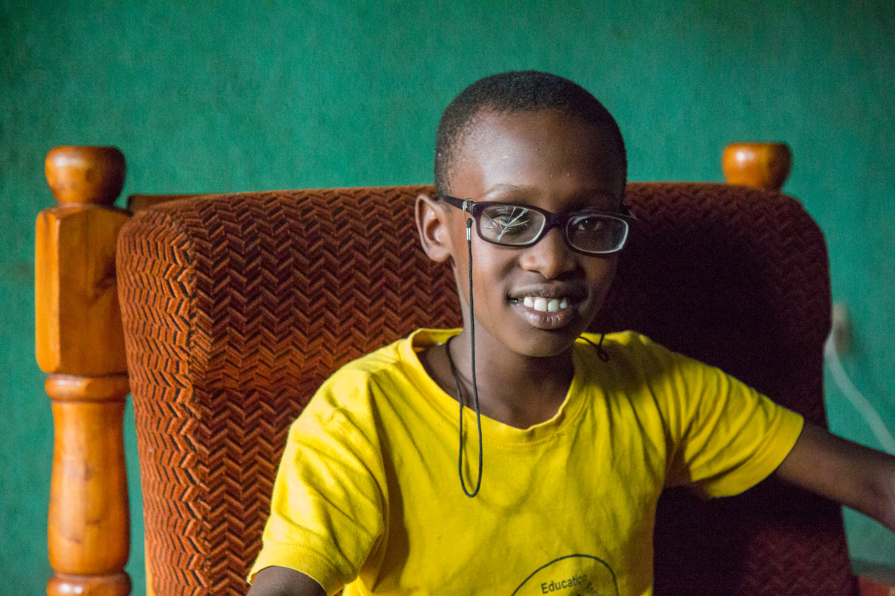
2
GAGE covid-19 findings
An adolescent boy with vision impairment in Rwanda © Nathalie Bertrams/GAGE 2020

Slide 9
Adolescents’ covid-19 knowledge and practices— generally good, but….
In Jordan:
81% of adolescents in host communities—and 56% of those in camps—report wearing a mask
74% of working adolescents report their job has implemented safety measures
Overcrowding makes hygiene and distancing difficult.
‘There's a lot of people staying at my house. There are 14 families, 14 rooms [and] two bathrooms. Everyone uses the two bathrooms together.’ (18 year old married girl, Bangladesh)
PPE is not affordable for many.
‘I can’t buy gloves, I can’t buy a face mask … We are not able to afford bread to eat, how can we buy face masks and gloves? If we will die because we do not buy the gloves and the masks, then that will be it.’ (17 year old Syrian boy, Lebanon)
In urban Ethiopia:
91% of adolescents report maintaining social distance
95% of adolescents report hand washing
Water access is severely limited in some contexts—and poses challenges in others.
‘One of our main challenges for this disease is shortage of water. We have only one water point…We cannot protect ourselves at the water source. We are going to die en masse at the water point since there are so many people.‘ (15 year old married girl, Ethiopia)
Notes:
Adolescents across contexts report that they, their families, and their communities are trying to stay safe from COVID.
Across countries, most report wearing a mask, trying to stay back six feet, and stepped up hygiene.
However, the contexts in which GAGE adolescents live often preclude safe practices.
Social distancing is all but impossible for many, due to overcrowding and shared toilets and water access points.
In addition, personal protective gear such as masks are not affordable for many, esp given job losses and price increases.
Overall, girls tend to have better practices than boys—in part because they already faced mobility restrictions and in part because boys are more likely to be breadwinners and required to have more interactions out of this house.

Slide 10
Social protection is not offsetting income losses
  In urban Ethiopia, 45% of households lost employment due to covid-19.
Breadwinning adolescents are doing all they can to keep their families afloat.
  In Jordan, 91% of working adolescents reported having lost hours due to covid-19.
‘I am the main breadwinner in my family and I am not working and we do not have money. I borrow money when I can to get food for my family and on top of everything we were evicted from our house, we moved to small house with two rooms only and we are 11 members in my family.’
(18-year-old Syrian boy, Lebanon)
Across countries, adolescents report that they—and their family members—have lost work due to covid.
In MENA, boys are more likely to have lost work than girls, because of social norms that limit girls’ work.
In Ethiopia, boys and girls have lost jobs and hours—including as domestic workers and at multi-national industrial parks.
Home loss—and homelessness—are increasing.
Social protection responses are varied—and insufficient.
In Jordan, UNICEF is offering cash to thousands of vulnerable households with children.
In Ethiopia, existing beneficiaries report decreased support.
Covid-19 has disrupted social protection in some countries.
‘Previously we were getting food aid bi-weekly. But now it has been two months since we got food aid’ (18-year-old IDP girl, Ethiopia)
Notes:
Across countries, household economies have been devasted by COVID.
Many caregivers and adolescents lost jobs entirely and others had their hours and incomes severely cut.
This holds true for both those in the formal economy (such as in Ethiopia’s industrial parks) and those in the informal economy (working jobs such as construction).
Households have done what they can to reduce costs—including moving, often in with others despite greater risks.
However, homelessness is increasing in urban contexts as there is simply no way to balance income and expenses.
Country responses have varied—but are in general far from sufficient.
In Jordan, UNICEF has been providing a new emergency cash transfer to vulnerable households with children.
In Ethiopia, existing social protection has been delayed, leaving those already at extreme risk with nothing.

Slide 11
Poverty and food insecurity have risen sharply
In Bangladesh, 21% of adolescents reported going hungry in the last month due to covid-19—girls far more at risk than boys.
In urban Ethiopia, 45% of households lost employment due to covid-19.
‘What is the relevance of staying healthy if hunger is going to kill you any day? ... If corona kills me, it would be a relief from this life, I just feel sorry for my son.’
(18-year-old mother, Ethiopia)
‘We’ve changed our meals. We used to take at least a good meal everyday like fish or something but now we manage with whatever we can afford.’
(19-year-old girl, Bangladesh)
‘It really affected us as we don’t have vegetables and bread all the time.’ (17-year-old Palestinian girl, hearing disability, Jordan)
Notes:
Job losses related first to lockdowns-- and later to economic contraction-- have resulted in increased poverty and food insecurity.
Households have not only cut back on the quality of food they eat, especially proteins, but are in some cases severely restricting quantity.
Girls appear far more at risk than boys, in part because they have greater restrictions on their mobility - meaning they have no opportunity to acquire calories outside of the household.
In some cases, they are also de-prioritized for feeding within the household.

Slide 12
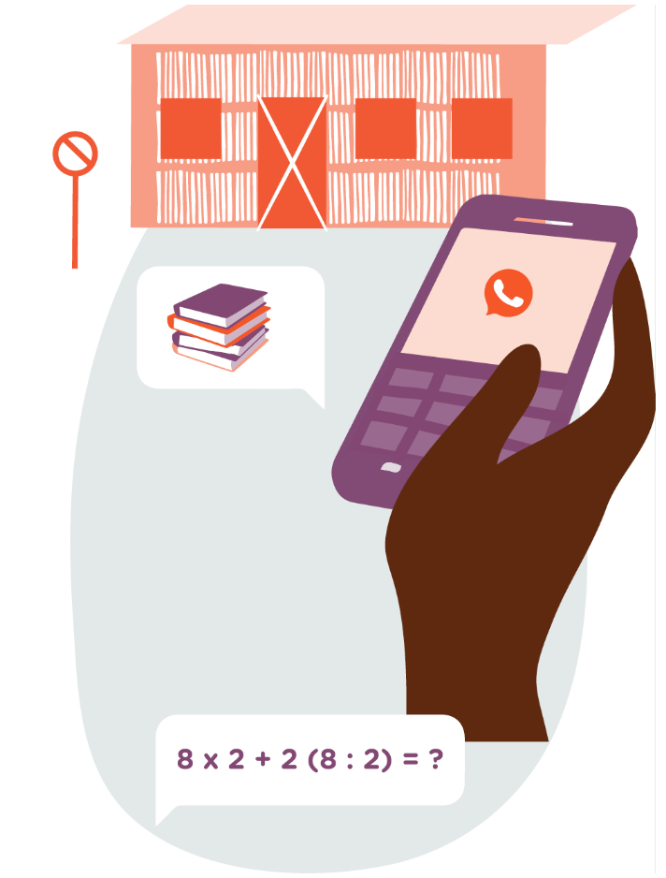
Learning has been severely disrupted
Our survey in urban Ethiopia found:
only 8% of students were able to access education via TV or radio
only 7% of students were studying lessons provided by their school
Our survey in Bangladeshi host communities found:
only 6% of students were receiving learning support from their schools
only 14% had been in contact with a teacher in the last week
Distance learning is limited by lack of hardware
(radios, phones, computers), lack of connectivity (electricity, wifi, mobile data) and lack of human support.
Rural and poor students are disadvantaged— as are those with disabilities.
The economic consequences of covid-19 reduce the likelihood of the most vulnerable young people returning to education.
‘In our village we do not have any TV. So I can't watch the TV classes.’ ( 14-year-old girl, Bangladesh)
‘I can't follow up on my studies after school closed because we have one mobile phone at home and the internet connection is very weak and limited. We have a package with limited internet speed. …There is no mobile phone, no computer, no laptop.’ (14-year-old girl, Gaza)
Notes:
As noted earlier, an immediate response to COVID in all GAGE countries was the closing of schools.
This has resulted in widespread and severe disruptions to learning.
Some countries, such as Ethiopia, have no way to deliver distance education to most students. In rural areas, families still lack electricity for even radio broadcasts.
Other countries, such as Jordan, have tried to move school online and to TV platforms.
Unsurprisingly, the poorest adolescents have been shut out entirely—as they lack the devices and the connectivity required to access learning platforms.
Across the board, there have been only the most limited attempts to use classroom teachers to support distance education. Very few students report having had recent contact with teachers.
This again has left the poorest adolescents behind—as their parents are the last prepared to support home education.
With poverty increasing, and child labor a more prevalent coping strategy as lockdowns have eased, it is extremely likely that many young people who were sent home in March will never return to the classroom.

Slide 13
Girls’ access to education has been especially negatively impacted
Domestic responsibilities have burgeoned
Girls have less access to technology.
‘Since the school closed, I work throughout the day. I can’t reject my parents’ order even if I get tired, because it is not good to disobey parents.’ (14-year-old adolescent girl, Afar, Ethiopia)
‘School told us to contact them through their Facebook page, …my father does not allow girls to have Facebook accounts…’
(14-year-old girl, Gaza)
Girls’ education is seen as less important—esp. now.
Adolescent pregnancy truncates education.
Married girls are under increased pressure from marital families to conceive.
Unmarried girls are at risk of unplanned pregnancy—because their time is unstructured, and their odds of transactional sex increased – at least in some contexts.
‘People say to me “this is in vain, it’s fake studying”. I try as much as possible not to listen to them or even respond.’
(18-year-old married Syrian girl, Jordan)
Notes:
COVID has reduced girls' access to education even more than boys.
Girls not only have less time than boys, because they are responsible for increased domestic and care work, they have less access to the technology they need to utilize learning platforms, and less support to pursue education.
Lack of access to sexual and reproductive health care, alongside increased pressure to conceive and too much unstructured time, has in many cases resulted in adolescent pregnancy that is likely to permanently truncate educational trajectories.

Slide 14
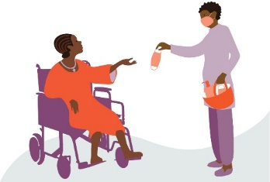
Access to health care—especially SRH—has been disrupted
In urban Ethiopia, 20% of households reported that access to
health care had been disrupted by covid-19.
‘In this evil situation of the covid-19 pandemic, women are suffering due to childbirth and in our locality are dying due to excessive bleeding after they give birth.’
(district health worker, Afar, Ethiopia)
‘The thing that worries me the most during the corona[virus] outbreak is the disruption of my treatment plan…My prosthesis needs maintenance as the silicon has been torn and no one can help me to fix it.’
(13-year-old girl, physical disability, Gaza)
‘I can't even go to the doctor because the clinic is closed. I went to the hospital, but they only receive emergency cases. I suffered from severe fatigue due to my pregnancy and I was not able to get my regular check-up.‘
(17-year-old Syrian, Jordan)
Notes:
Across countries, adolescents reported that COVID has made it more difficult to access health care.
This was esp true of SRH care.
In GAGE focal countries, where adolescent pregnancy is overwhelmingly associated with child marriage, married girls reported that they were unable to access contraception, under increased pressure to conceive, unable to access antenatal care, and very worried about how and where they would deliver.
Girls also reported decreased access to feminine hygiene supplies.
While in part this was due to increased household costs in the context of declining household income—it appears more often due to fathers, brothers and husbands deprioritizing girls’ needs.
Young people with disabilities also reported disruptions to care.
Specialist care was difficult to come by even before the pandemic and has gotten more so given that travel restrictions are in place and household incomes are reduced.

Slide 15
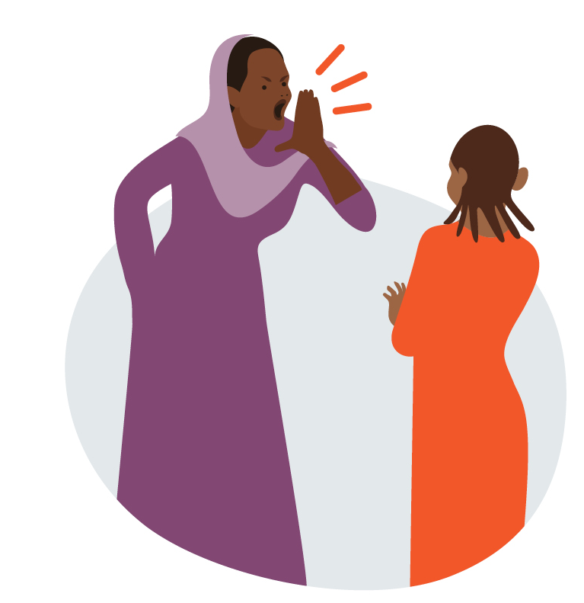
Age- and gender-based violence has risen
In urban Ethiopia, 66% of adolescents report increased household stress.
In Bangladesh, 22% of married Rohingya girls reported that GBV has become more common.
‘Girls during the lockdown are exposed to violence by their parents or older boys because of the authority of men. So they are exposed to physical or psychological violence.’
(18-year-old girl, Gaza)
‘There is no love in the house. Because they do not have money, there is no peace in the house. They no longer get along. Not having money makes them frustrated.‘ (20-year-old female domestic worker, Ethiopia)
Notes:
Because survey interviews were telephone based, and therefore not private, we were unable to ask adolescents direct questions about their own experiences with age- gender-based violence at the hands of those in the household. We did not want to put them at greater risk.
More general questions, however, suggest that violence in the home has become markedly more common since Covid began.
Young people are at risk from their caregivers.
Married girls are at risk from their husbands and in-laws.
Increases are in part due to growing financial stress — and in part due to increased hours together,.
Adolescents –esp refugees—reported increased violence at the hands of police.
During the weeks and months of the strictest lockdown, the threat of violence was a near constant for those who could not afford to stay home.

Slide 16
Pandemic effects on child marriage are mixed
In Ethiopia, out-of-school girls cannot refuse
‘In our locality if girls are not learning they can’t reject the marriage arranged by their parents; however, those who are in school can say ‘No’ and everyone will support them... Since the school is closed many girls who were learning will marry in this season.’
(17-year-old boy, Zone 5, Afar)
In Bangladesh, 19% of Rohingya girls are worried that covid-19 will expedite their marriage.
In Jordan, 13% of older adolescents are worried that covid-19 will expedite their marriage—but even more report that it may decrease pressure to marry (26% of boys vs 15% of girls).
In Ethiopia, adolescents are engaging in risky behaviour
‘Both boys and girls now all rush together to shegoye [traditional dance] in the evenings. Many of them started love relationship among themselves. The school closure has created good opportunity for them.’ (19-year-old boy, E. Hararghe)
In Ethiopia, girls have no reporting options
‘Previously, girls had their teachers to whom they could report if they were being forced into marriage and the teachers can even take the parents to justice. However, now, children do not have these opportunities, as schools are closed and teachers are not in the locality.’
(17-year-old boy, S. Gondar)
Notes:
The effects of COVID on child marriage vary across and within counties.
In Ethiopia, we have found troubling evidence that child marriage is resurgent.
Over the last decade, as access to education has expanded, the youngest girls have been relatively protected from child marriage by dint of the fact that they were enrolled in school.
When girls were sent home in March, that protection disappeared.
Girls also lost access to their protectors, given that teachers were most often the first link in the reporting chains that could see arranged marriages canceled.
In the regions of Ethiopia where child marriage is increasingly adolescent driven, rather than parent arranged, too much free time is resulting in risky behavior likely to culminate in child marriage.
In the Middle East, adolescents were more likely to report that pressure to marry was likely to decline—because weddings are expensive and household finances stretched.
Reports from Rohingya adolescents in Bangladesh were similar.

Slide 17
Adolescents are anxious and depressed
Of adolescents in Jordan:
59% are afraid about covid-19
20% report decreased emotional support from family
32% report providing more support to family
They are worried about finances.
They are worried about educational disruptions.
They are cut off from services.
Girls are at higher risk
‘Our financial situation is bad… I constantly feel depressed. I try not to look nervous so that my dad would not feel sad, but I always have pain in my head.’
(16-year-old girl, Lebanon)
‘Our exams are coming up. What will I do? I can’t get good results in this way, if the school is closed. We are poor. If I don’t bring good results in the exam, I won’t get a chance anywhere.’ (17-year-old girl, Bangladesh)
‘I used to get a very crucial counselling service …whenever I faced any life challenge, I used to consult them and they used to give me fruitful advice.’
(19-year-old boy Ethiopia)
‘I noticed that I have symptoms of depression. I sleep all day, I don't like talking to anyone, I don’t laugh, I hate myself and I don't like the things I do. Sometimes I can't sleep until dawn.’ (18- year-old Syrian girl, Jordan)
Notes:
Depression and anxiety are growing, as months of increased stress takes a toll on adolescents.
Across countries, young people are worried about COVID.
They are worried about poverty and food insecurity.
They are worried about lost learning and whether they will be knocked off track in the longer term.
At the same time, they have also lost access to the informal and formal sources of support that they relied on to help them deal with the ups and downs of adolescence.
In general, girls are at higher risk, in part because of biological factors (estrogen has been linked to depression) and in part because of social factors (they are more isolated).

Slide 18
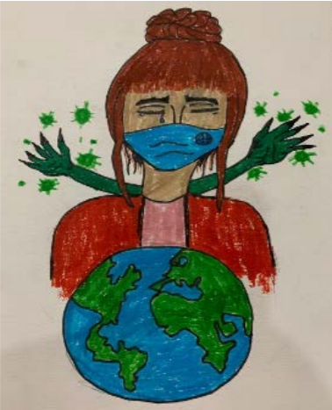
Social isolation can be extreme—esp for some
In urban Ethiopia, only 28% of girls (vs 48% of boys) have interacted with a friend in the last week and 49% reported feeling moderately scared of covid-19
‘I miss my friends, but I can't contact them because I don’t have a mobile phone or a Facebook account. My father said that only males can use it… because it may affect girls’ morals badly.’ (14-year-old girl, Gaza)
‘I am alone, even though I am locked down with my family. I am deaf and no one at home understands sign language. I sketch to keep myself occupied, remember happier days—when I could take drawing classes—and to encourage others to ‘stay at home’ by painting messages on my clothes.’
(18-year-old Palestinian girl with a hearing disability, Jordan)
Notes:
Adolescents’ anxiety and depression are closely related to the social isolation that has resulted from COVID.
Girls are far more at risk than boys of being isolated from their peers, due to greater restrictions on their mobility and their use of technology.
Restrictions are born of caregivers’ concerns about girls’ reputations and how they reflect on family honour.
Adolescents with disabilities are often especially isolated.
Across countries, many of those who have hearing impairments report that their family members do not sign—so even as they are surrounded by people, they are isolated.
In Ethiopia, many adolescents with disabilities live apart from their families, attending special needs schools in urban areas. Some of those young people were entirely shut off from human contact during lock down.

Slide 19
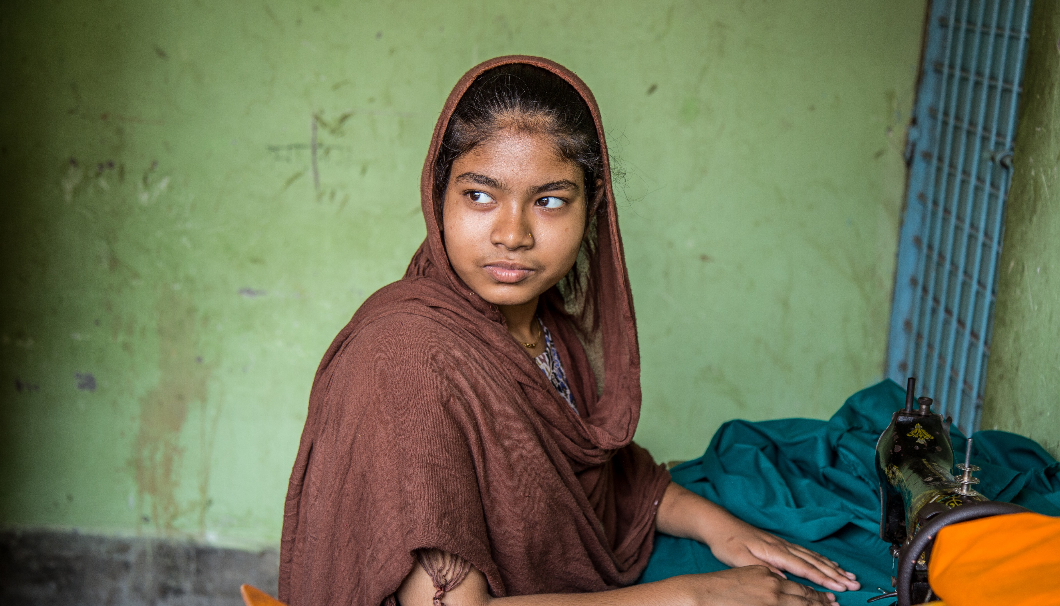
3
Policy and practice implications
An adolescent girl working in a tailor shop in Dhaka, Bangladesh © Nathalie Bertrams/GAGE 2020

Slide 20
Implications for policy and programming
1
2
3
4
The most vulnerable adolescents are not being reached by emergency social protection programming; scaled up cash transfer plus programmes to address economic vulnerability, food insecurity, and hygiene supplies (including menstrual hygiene supplies) are urgently needed – targeting families as well as adolescents living alone/ married adolescents
Returns to school need to include outreach to the most vulnerable, esp. girls and adolescents with disabilities, as well as catch-up tutorials.
Resuming and expanding GBV and child protection reporting mechanisms and services given heightened household tensions are essential.
Resuming health and SRH services esp. for pregnant girls and adolescent mothers, adolescents with disabilities requiring specialist services and adolescents living with HIV need to be prioritised.
Investments in strengthening accessible distance learning options for all in case of future lockdowns are also key – including through bridges with non-formal education programmes.
Given high levels of anxiety and fear, investing in low-cost peer-to-peer and community-based psychosocial support at scale should also be considered.
Measures are needed to address growing community violence – by citizens and state authorities.
Similarly, reporting channels and support services for girls (and boys) at risk of child marriage need to be re-activated, esp. during cultural wedding seasons.
Notes:
1
The most vulnerable adolescents are not being reached by emergency social protection programming; scaled up cash transfer plus programmes to address economic vulnerability, food insecurity, and hygiene supplies (including menstrual hygiene supplies) are urgently needed – targeting families as well as adolescents living alone/ married adolescents
2
Returns to school need to include outreach to the most vulnerable, esp. girls and adolescents with disabilities, as well as catch-up tutorials.
Investments in strengthening accessible distance learning options for all in case of future lockdowns are also key – including through bridges with non-formal education programmes.
3
Resuming health and SRH services esp. for pregnant girls and adolescent mothers, adolescents with disabilities requiring specialist services and adolescents living with HIV need to be prioritised.
Given high levels of anxiety and fear, investing in low-cost peer-to-peer and community-based psychosocial support at scale should also be considered.
4
Resuming and expanding GBV and child protection reporting mechanisms and services given heightened household tensions are essential.
Measures are needed to address growing community violence – by citizens and state authorities.
Similarly, reporting channels and support services for girls (and boys) at risk of child marriage need to be re-activated, esp. during cultural wedding seasons

Slide 21
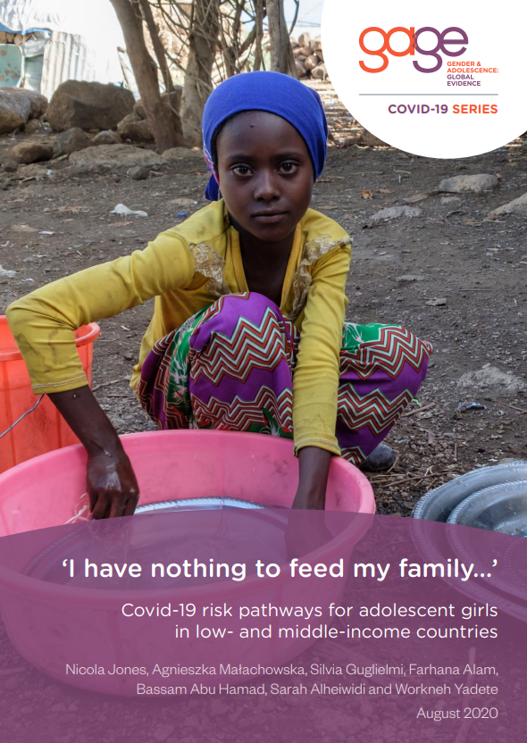
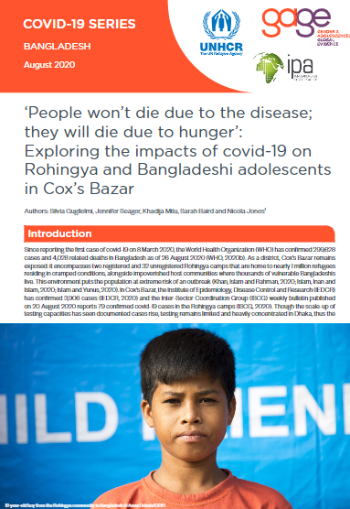
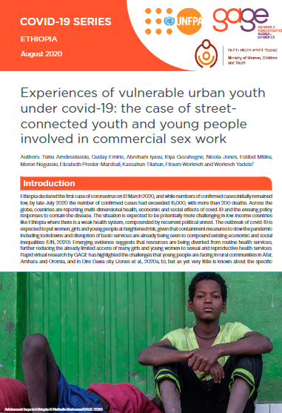
Reading assignment
For more resources see: https://www.gage.odi.org/adolescent-experiences-of-covid-19/
Jones, N., Małachowska, A., Guglielmi, S., Alam, F., Abu Hamad, B., Alheiwidi, S. and Yadete, W. (2020) ‘I have nothing to feed my family…’ Covid-19 risk pathways for adolescent girls in low- and middle-income countries. Report. London: Gender and Adolescence: Global Evidence
https://www.gage.odi.org/publication/i-have-nothing-to-feed-my-family-covid-19-risk-pathways-for-adolescent-girls-in-low-and-middle-income-countries/
Guglielmi, S., Seager, J., Mitu, K., Baird, S. and Jones, N. (2020) ‘“People won’t die due to the disease; they will die due to hunger”: Exploring the impacts of covid-19 on Rohingya and Bangladeshi adolescents in Cox’s Bazar.’ Policy brief. London: Gender and Adolescence: Global Evidence.
https://www.gage.odi.org/publication/people-wont-die-due-to-the-disease-they-will-die-due-to-hunger-exploring-the-impacts-of-covid-19-on-rohingya-and-bangladeshi-adolescents-in-coxs-bazar/
Amdeselassie, T., Emirie, G., Iyasu, A., Gezahegne, K., Jones, N., Mitiku, E., Negussie, M., Presler-Marshall, E., Tilahun, K., Workneh, F. and Yadete, W. (2020) ‘Experiences of vulnerable urban youth under covid-19: the case of street- connected youth and young people involved in commercial sex work.’ Policy brief. London: Gender and Adolescence: Global Evidence.
https://www.gage.odi.org/wp-content/uploads/2020/08/Experiences-of-vulnerable-urban-youth-under-covid-19-the-case-of-street-connected-youth-and-young-people-involved-in-commercial-sex-work.pdf
Notes:
Please read these short reports and policy briefs and summarise
The multi-dimensional vulnerabilities to which adolescents are exposed as a result of covid-19
Three examples of the ways in which gender and other social inequalities shape these vulnerabilities
Identify three cross-cutting policy and programming implications, and suggest which actors would be best placed to enact these priority actions.

Slide 22
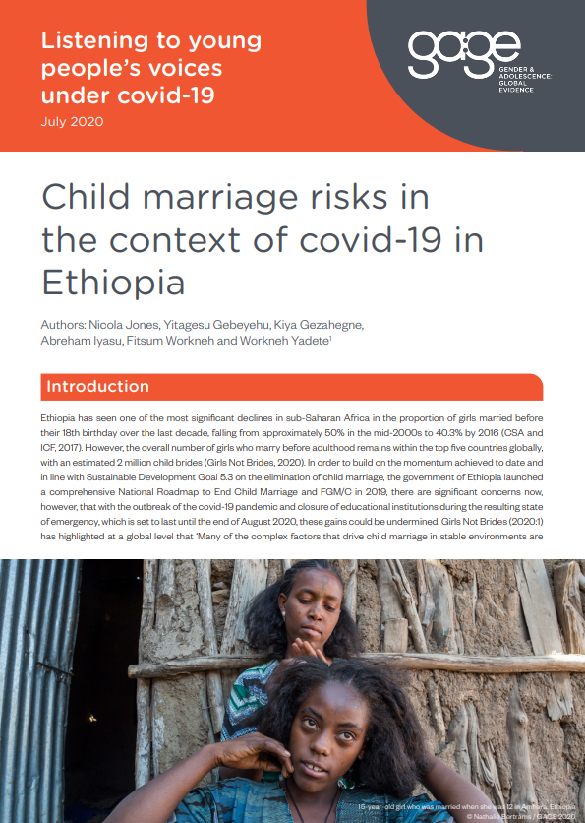
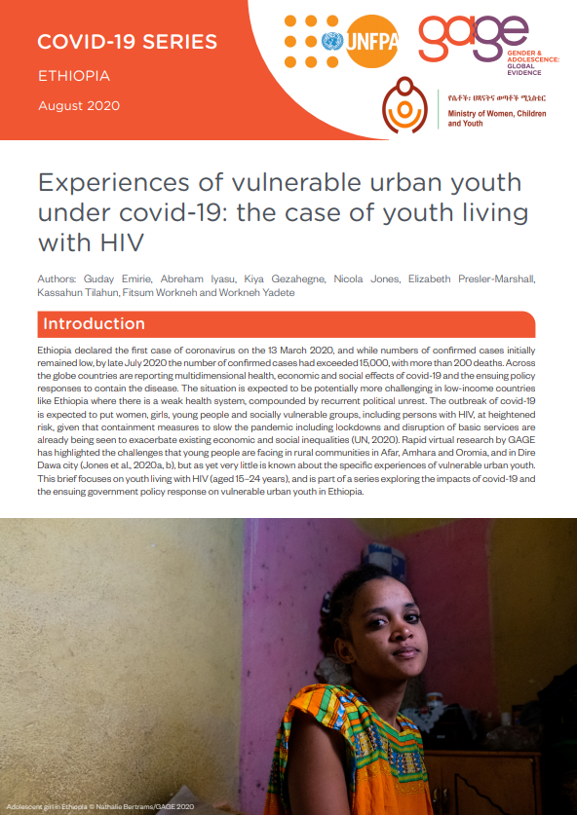
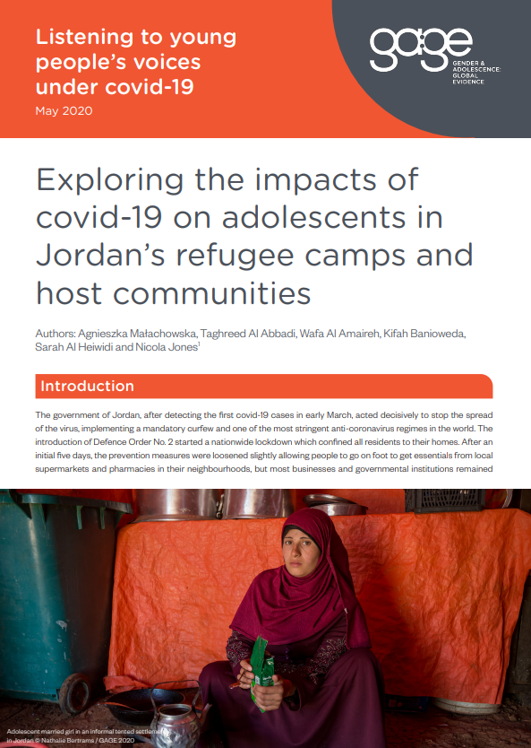
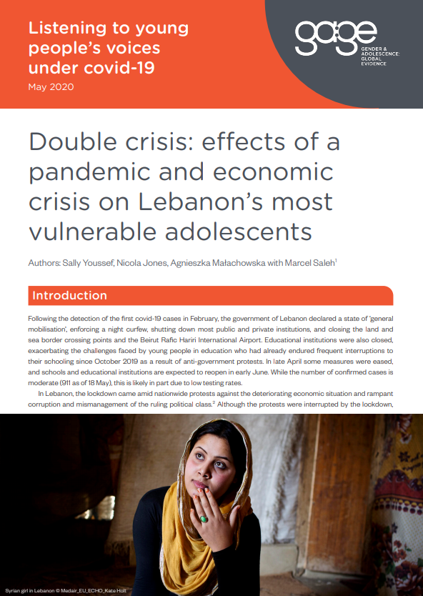
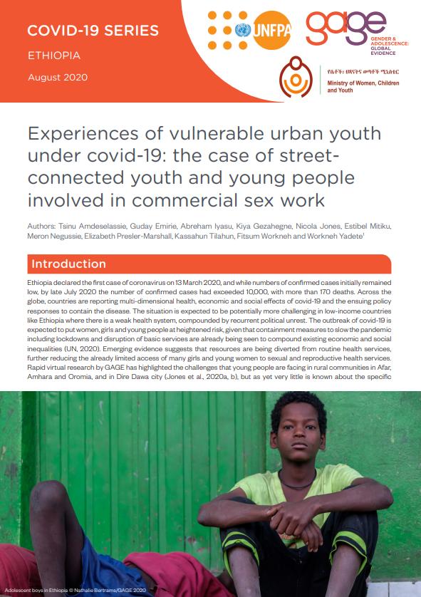
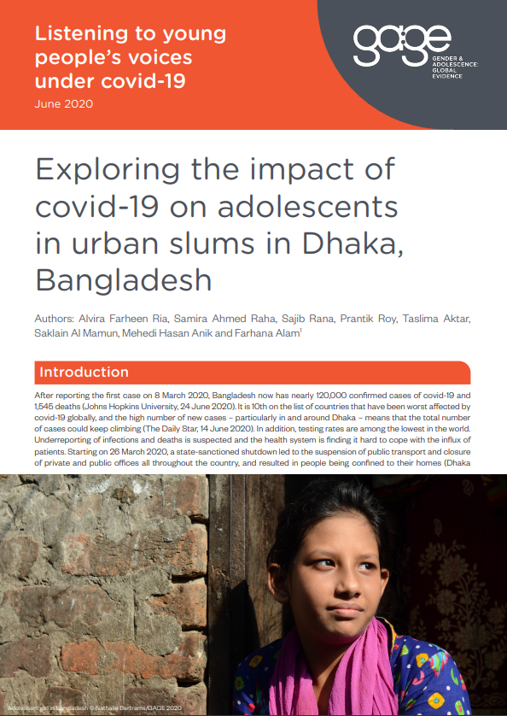
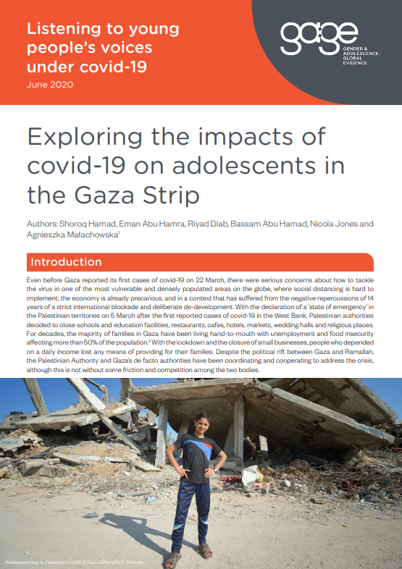
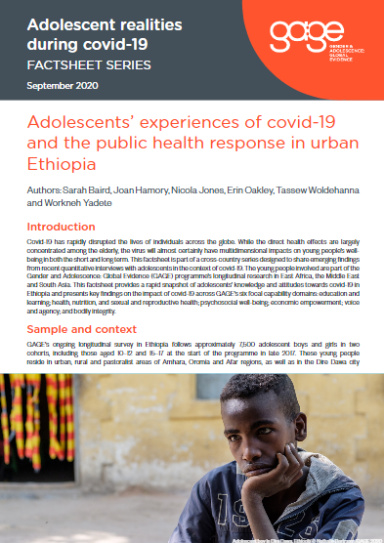
GAGE publications on covid-19 impacts
For more resources see: https://www.gage.odi.org/adolescent-experiences-of-covid-19/
Notes:
For more information please explore our covid-19 resources page on our website

Slide 23
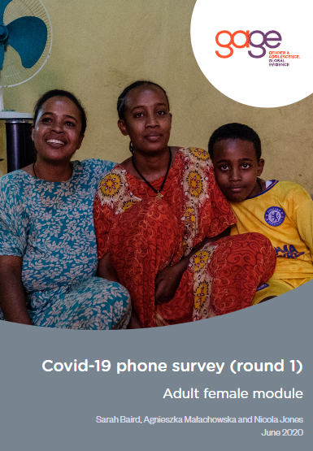
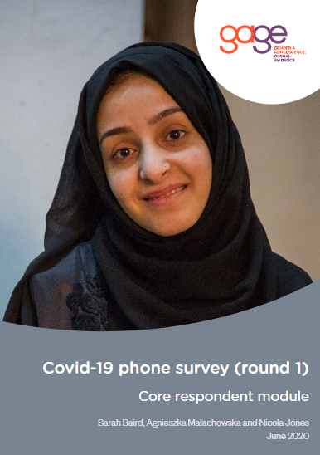
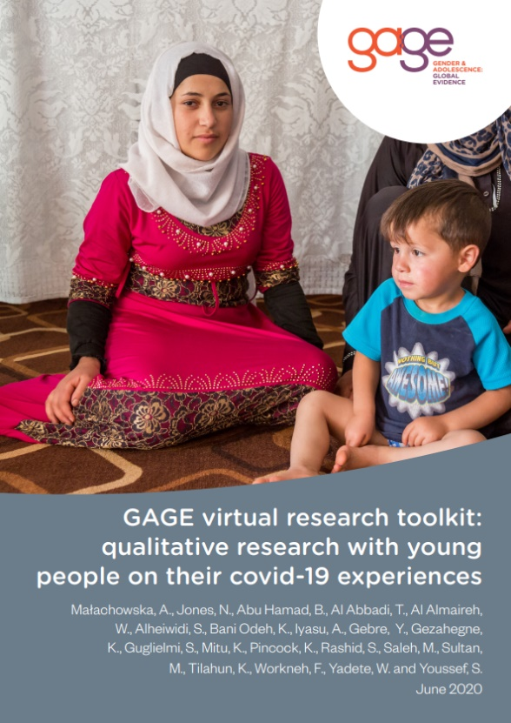
GAGE publications on covid-19 research methods
For more resources see: https://www.gage.odi.org/adolescent-experiences-of-covid-19/
Notes:
For more information please explore our covid-19 resources page on our website

Slide 24

Contact Us
Dr Nicola Jones
n.jones@odi.org.uk
WEBSITE
www.gage.odi.org
TWITTER
@GAGE_programme
FACEBOOK
GenderandAdolescence
About GAGE:
Gender and Adolescence: Global Evidence (GAGE) is a nine-year (2015-2024) mixed-methods longitudinal research programme focused on what works to support adolescent girls’ and boys’ capabilities in the second decade of life and beyond.
We are following the lives of 20,000 adolescents in six focal countries in Africa, Asia and the Middle East.

