Slide 1
CONTRACEPTION COUNSELLING AND PROVISION
Geneva 2021
Dr Venkatraman Chandra-Mouli & Ms Marina Plesons
Notes:
This module addresses the provision of contraceptive counselling and services.

Slide 2
DEFINITION
Contraception is the intentional prevention of pregnancy by artificial or natural means.
It enables people to attain their desired number of children, & to determine the spacing of their pregnancies by delaying or preventing child bearing.
Contraceptive methods are designated by duration & context of use (permanent, long acting, short-term or emergency) & by mode of operation (hormonal, non-hormonal, barrier or fertility awareness-based).
Notes:
This slide carries a definition of contraception.

Slide 3
RATIONALE – 1/2
Early pregnancies, both intended or unintended, among adolescents are an important problem: An estimated 21 million girls aged 15-19 years become pregnant.¹ An estimated 12 million girls aged 15-19 years and 2.5 million girls under age 16 in LMICs give birth every year. ^{1,2} Approximately half of pregnancies to girls aged 15–19 years in developing regions are unintended.¹
Early pregnancies among adolescents have major health and social consequences: Pregnancy & childbirth complications are the leading cause of deaths among girls aged 15-19 years globally.³ Girls aged 10-19 face higher risks of eclampsia, puerperal endometritis and systemic infections than women aged 20-24.⁴ An estimated 5.7 million girls aged 15-19 have an abortion, the majority of which are unsafe.¹ Babies born to mothers under 20 years of age face higher risks of low birth weight, preterm delivery and severe neonatal conditions.⁴
Notes:
References:
Guttmacher Institute. Fact sheet: Adding it up: Investing in adolescents’ sexual and reproductive health in low- and middle-income countries. New York: Guttmacher Institute; 2019.
Neal S, Matthews Z, Frost M, Fogstad H, Camacho AV, Laski L. Childbearing in adolescents aged 12–15 years in low resource countries: a neglected issue – new estimates from demographic and household surveys in 42 countries. Acta Obstet Gynecol Scand. 2012;91(9):1114–1118.
WHO. Adolescents: Health Risks and Solutions. Geneva: WHO; 2018. Available from: www.who.int/news-room/fact-sheets/detail/adolescents-health-risks-and-solutions
Ganchimeg T, Ota E, Morisaki N, Laopaiboon M, Lumbiganon P, Zhang J, et al. Pregnancy and childbirth outcomes among adolescent mothers: a World Health Organization multicountry study. BJOG. 2014;121(Suppl. 1):40–48.

Slide 4
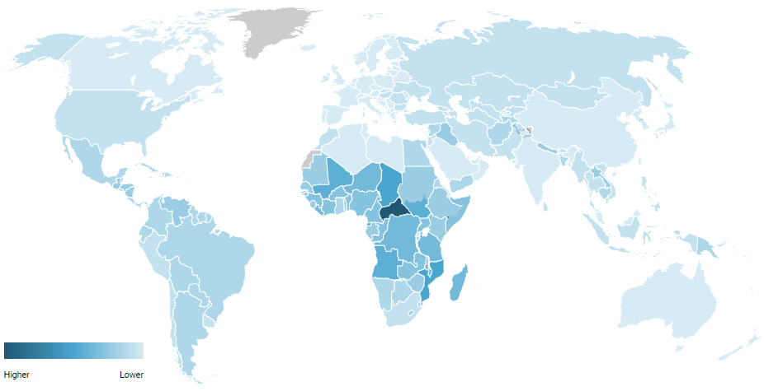
Adolescent birth rate per 1,000 women aged 15-19 years
Central and Southern Asia | 26.2
Eastern and South-Eastern Asia | 20.4
Latin America and the Caribbean | 63.0
Northern Africa and Western Asia | 40.5
Sub-Saharan Africa | 104.4
Reference 2
Reference 1
Notes:
References:
UNFPA. World Population Dashboard: Adolescent birth rate. New York: UNFPA; 2020. Available from: https://www.unfpa.org/data/world-population-dashboard
UNPD. Adolescent birth rate per 1,000 women aged 15-19 between 2010-2017. New York: UN Population Division (no date). Available from: https://www.un.org/development/desa/pd/node/3282

Slide 5
RATIONALE – 2/2
Promotion of contraceptive use to address early pregnancies among adolescents has been shown to be effective: When correctly & consistently used, contraceptives can prevent unintended pregnancies & thereby reduce maternal & newborn mortality & morbidity. Male & female condoms can protect against both unintended pregnancies & HIV/STI.
Laws & policies, & the provision of good-quality services need attention: 14 million girls aged 15-19 years have an unmet need for modern contraception.¹ Contraceptive use in sexually active adolescents is lower than in other age groups because of lack of knowledge, knowledge gaps and misconceptions, difficulties in being able to obtain contraceptive services/commodities, & difficulties in wanting to/being able to use them correctly & consistently.
Notes:
References:
Guttmacher Institute. Fact sheet: Adding it up: Investing in adolescents’ sexual and reproductive health in low- and middle-income countries. New York: Guttmacher Institute; 2019.

Slide 6
HUMAN RIGHTS OBLIGATIONS
States are obliged under human rights law to provide contraceptive information & services to adolescents, & to adopt legal & policy measure to ensure their access to affordable, safe and effective contraception.
Contraceptive information & services should be free, confidential, adolescent-responsive and non-discriminatory; barriers such as third party authorization requirements should be removed.
Adolescents should have easy access to the full range of contraceptive; such access must not be hampered by marital status or providers’ conscientious objections.
Notes:
This slide lists the human rights obligations of countries in relation to contraception.

Slide 7
KEY CONCEPTS TO CONSIDER -1/2
Laws & policies prevent the provision of contraception based on age or marital status in many countries: Critical to adolescent-friendly service provision are laws & policies that support their access to contraception regardless of age or marital status, & without third-party authorization/notification.
Many adolescents have misconceptions about contraception or do not know where & how to obtain contraceptive information & services: CSE is an effective way to reach & inform adolescents about contraception. It should be complemented by reaching out to parents, teachers & other gatekeepers.
Notes:
This is the first of two slides that set out key concepts to consider in planning and implementing programmes.

Slide 8
KEY CONCEPTS TO CONSIDER – 2/2
Contraceptive services & health-care providers are often not adolescent friendly: There is a need to overcome health-care provider biases and misconceptions regarding contraceptive use by adolescents.
The contraceptive needs of adolescents are diverse & evolving: Complementary strategies must be used to respond to the differing needs & preferences of adolescents. Additionally, programmes must address the needs of special population of adolescents (e.g., those with disabilities, migrants and refugees).
Notes:
This slide continues with key concepts to consider in planning and implementing programmes.

Slide 9
WHO GUIDELINES
WHO guidelines on preventing early pregnancy & poor reproductive outcomes among adolescents in developing countries (2011)
Medical eligibility criteria for contraceptive use, 5th edition (2015)
Selected practice recommendations for contraceptive use (2016)
Ensuring human rights in the provision of contraceptive information & services: guidance & recommendations (2014)
WHO consolidated guideline on self-care interventions for health: sexual and reproductive health and rights (2019)
Consolidated guideline on sexual & reproductive health & rights of women living with HIV (2017)
Guidance statement: hormonal contraceptive eligibility for women at high risk of HIV (2017)
WHO recommendations on health promotion interventions for maternal & newborn health (2015)
Responding to children & adolescents who have been sexually abused: WHO clinical guidelines (2017)
Responding to intimate partner violence & sexual violence against women: WHO clinical and policy guidelines (2013)
Notes:
This slide lists the array of WHO guidelines which address contraception in adolescents – either exclusively or as part of a broader treatment of the subject. All these guidelines are available online.

Slide 10
COMPLEMENTARY GUIDELINES TO WHO’s GUIDELINES
Medical eligibility criteria application for contraceptive use (WHO, 2019)
Medical eligibility criteria wheel for contraceptive use (WHO, 2015)
Family planning: a global handbook for providers, 2018 edition (WHO, 2018)
Information note on self-administration of injectable contraception (WHO, 2020)
Training resource package for family planning (WHO, 2021)
Task sharing to improve access to family planning/contraception: summary brief (WHO, 2017)
Compendium of WHO recommendations for postpartum family planning (WHO, 2016)
Reducing early and unintended pregnancies among adolescents: evidence brief (WHO, 2017)
Adolescents and family planning: what the evidence shows (ICRW, 2014)
High-impact Practices (HIPS) in family planning: Adolescent-friendly contraceptive services - mainstreaming adolescent-friendly elements into existing contraceptive services (USAID, 2015)
Youth contraceptive use: effective interventions- a reference guide (PRB, 2017)
Global consensus statement for expanding contraceptive choice for adolescents and youth to include long-acting reversible contraception (FP 2020, 2017).

Slide 11
Specific measures for delivery of services in the context of COVID-19 – 1/2
Inform adolescents where and how to access contraceptive counselling and services, including changes, if any, to service delivery times, location, etc. during the COVID-19 response.
In health facilities, ensure that adolescents have access to the full range of contraceptive methods, including condoms and emergency contraception.
Ensure that forecasting for commodities and procurement planning are taking adolescents’ needs into account, and adjust for potential alterations in method choice.
In case the preferred method is not available, support the adolescent to identify an alternative method that meets his/her needs and preferences.
Consider waiving restrictions (if restrictions exist), such as those based on age, marital status or parental/spousal consent, and providing services free of charge within the relevant legal jurisdiction and in line with international guidelines.
Notes:
This slide continues with key concepts to consider in planning and implementing programmes.

Slide 12
Specific measures for delivery of services in the context of COVID-19 – 2/2
Consider providing multi-month supplies with clear information about the method and how to access referral care for adverse reactions.
Counselling and services should continue to be provided discreetly and confidentially to adolescents, especially if someone else accompanies the adolescent to the consultation’.
Consider establishing alternative delivery modalities for contraceptives that are more accessible to adolescents (such as through pharmacies, shops or community-based delivery).
Consider setting up hotlines for adolescents providing information and advice on contraception self-use, side effects, method choice and other questions on SRHR.
Notes:
This slide continues with key concepts to consider in planning and implementing programmes.

Slide 13
Considerations for resumption of normal services in the context of COVID-19
Enable adolescents who had to pause contraceptive use or change methods, because their preferred method was unavailable, to return to it.
Where possible, promote the institutionalization of good practices in improving accessibility and quality that were put in place during the period of closures and disruption.
Notes:
This slide continues with key concepts to consider in planning and implementing programmes.

Slide 14
Notes:
Health workers in many places do not provide contraceptives to adolescents before they have children, falsely believing that this can contribute to infertility.

Slide 15
CONTRACEPTION , COUNSELLING AND
PROVISION
A REGIONAL PERSPECTIVE
Access to contraceptives for adolescents has been shown to promote autonomy and decision-making abilities, improve partner communication, and empower young women to lead healthy and productive lives (UNFPA, 2013).

Slide 16
Key facts from the Region
Key Indicators
The Eastern Mediterranean Region has the second lowest contraceptive prevalence rate (CPR) (48%) and the second highest unmet need for family planning (FP) globally, after the African Region. ¹
Ten Member States have an unmet need for FP exceeding 20%.
Nine Member States (Afghanistan, Djibouti, Oman, Pakistan, Qatar, Saudi Arabia, Somalia, Sudan and Yemen) have a lower CPR than the regional average.¹
Much of the unmet need for FP in the Region is among married women and girls. This is compounded by the high rate of early marriages (women aged 20-24 who are married or in union before the age of 18) in many Member States like Somalia (45.3%), Sudan (34.2%), Yemen (31.9%), Afghanistan (28.3) and Iraq (27.9%).²
Sudan (87), Yemen (67), Somalia (64), and Afghanistan (62) have the highest adolescent fertility rate (15-19 years) per 1000 girls in the Region.³
Policy and programmatic situation in the Region
Three countries in the Region have a national policy/guideline on contraception that prohibits access to adolescents on the basis of age.⁴
Only 7 out of 16 surveyed countries in the Region have contraception policies that require the disaggregation of data for the adolescent age group^{.4}
The Region has the lowest proportion of countries that include adolescent health in pre-service training for clinicians, nurses, and community health workers (33%).⁵

Slide 17
Regional challenges in provision of contraceptive services
Sociocultural challenges
High rate of early marriages: As noted on slide 2, much of the unmet need for FP in the Region is among married women and girls. This is a particular challenge as the Arab Region is home to 40 million young brides,⁶ and a number of countries have high rate of early marriage including Somalia (45%), Sudan (34.2%), Yemen (32%), Afghanistan (28%) and Iraq (27%).²
Sociocultural barriers: Social norms and myths and misconceptions about contraception are important barriers to the provision of contraceptive services in the Region. For example, there is strong belief that young married couples should not use any contraception before they have their first baby. Likewise, many people believe that long-acting hormonal methods and intra-uterine devices adversely affect fertility in young people. Similarly, many people believe that condoms are the only safe contraceptive method.^{7,8}
Humanitarian crises: More than 62 million people across the Region are in need of health care as a result political conflict and humanitarian crises.⁹ Interruption of health services for adolescents, including the provision of contraceptive services, increases the risk of unintended pregnancies, STIs, and unsafe abortions. ¹⁰
Policy and programmatic challenges
Laws and policies regarding provision of contraception: Legal and policy restrictions related to age, marital status, parental/spousal consent, and provider authorization exist in many countries in the Region. For example, in Morocco there is a legal age for married adolescent to provide consent for emergency contraception without spousal consent.¹¹
Access to and quality of services: Lack of infrastructure, supply shortages, provider biases and lack of competencies, and cost of contraceptive methods impede access to contraceptive services for adolescents in the Region.^{7,8}
Lack of data: There is an important lack of age-disaggregated data on knowledge, attitudes and practices related to contraception, due to the sensitive nature of these issues in the Region. This impedes programme planning, monitoring, and evaluation.

Slide 18
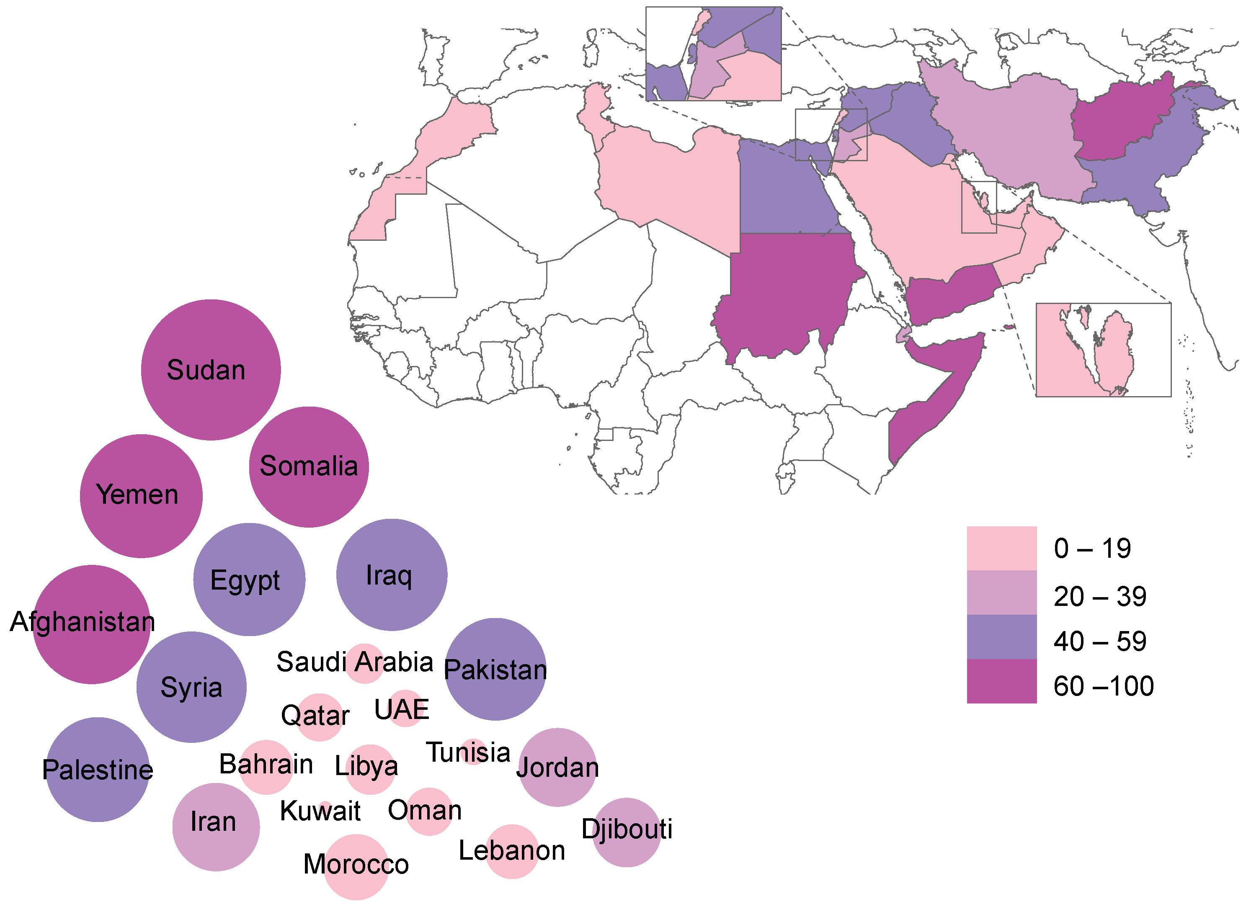
Adolescent (15-19 years) fertility rate (per 1000 girls) ¹²

Slide 19
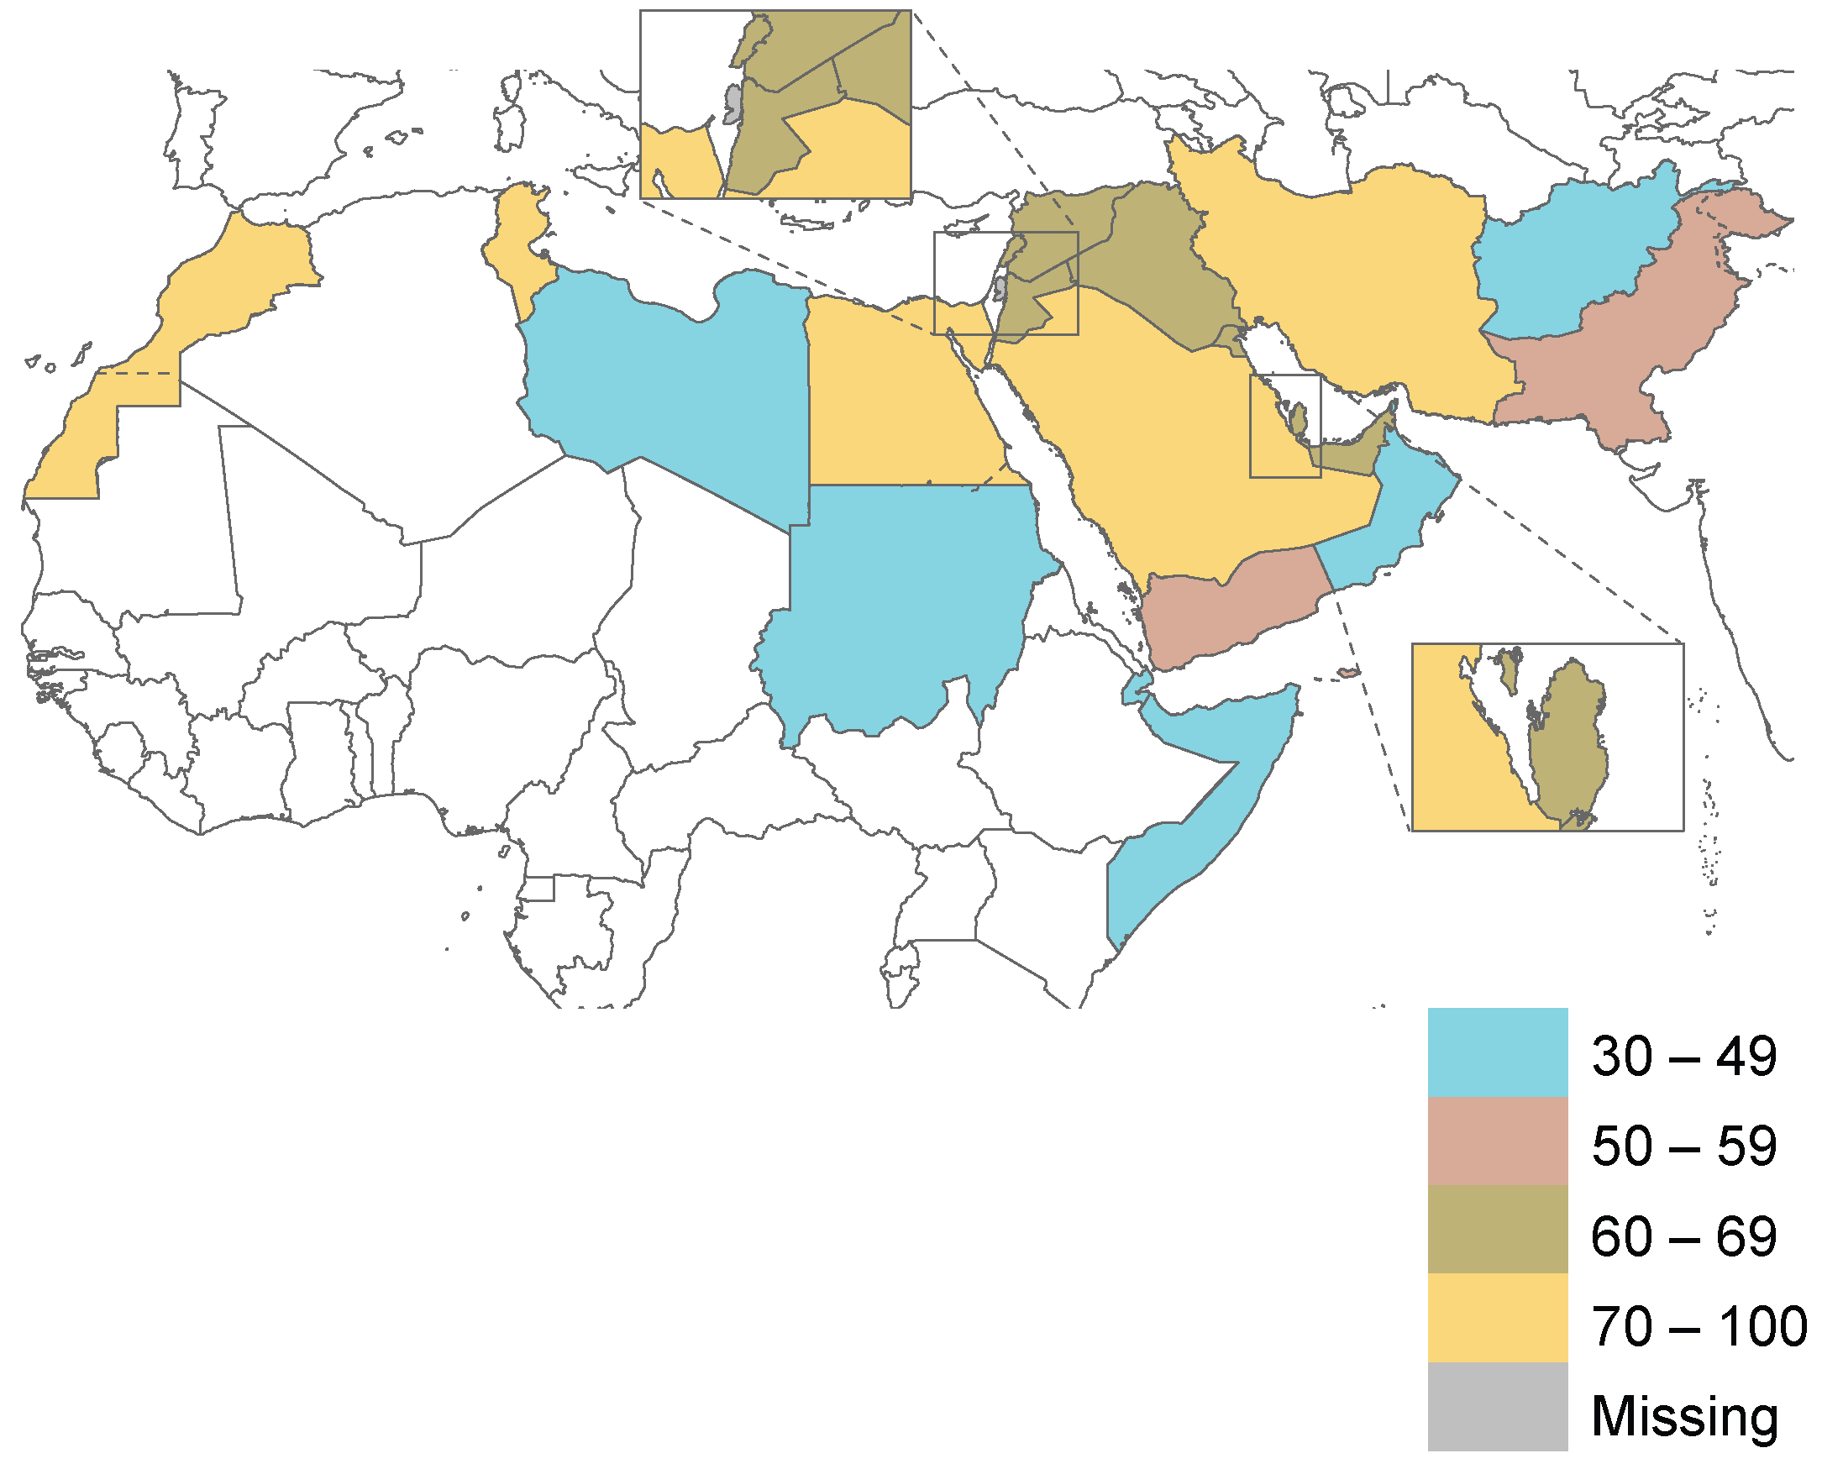
Demand for family planning satisfied with modern contraceptives in EMR countries (%)* ¹³
*Among women in reproductive age (15-49 years)

Slide 20
REGIONAL INITIATIVE THE SOCIAL MARKETING CONTRACEPTION PROJECT IN EGYPT
The Family of the Future (FOF) Project was implemented by an NGO from 1979-1991, with financial support from USAID.¹⁴ It first focused operations in the greater Cairo area and then expanded to other urban areas in Egypt.
Objectives:
To increase awareness and demand for family planning services through contraceptive social marketing, particularly among people, including young people, with lower socioeconomic status in urban settings in Egypt
To establish and maintain a reliable supply of family planning commodities in pharmacies
Approach:
Intensive media-based advertising and personal promotion to build support for the use of family planning and to educate the general public about contraceptive options
Subsidized prices for contraceptive methods, as compared to commercial prices
Outcomes: (According to an audit report covering 1979-1981)
Condom sales increased 260%, foaming tablet sales increased more than 320%
IUD sales increased nearly 330%, driven largely by the introduction of the Copper 7 IUD (which accounted for 35% of this growth)
Couple years of protection (CYP) provided by all contraceptive methods increased from 45,533 in 1979 to 190,831 in 1981, an increase of over 300%.
.
Notes:
Social marketing in family planning programs makes contraceptive products accessible and affordable through private-sector outlets, such as pharmacies and shops, while using commercial marketing techniques to achieve specific behavioral goals. Social marketers combine product, price, place (distribution), and promotion—often referred to as the “4Ps” or the “marketing mix”—to maximize use of specific health products among targeted population groups.
https://www.fphighimpactpractices.org/briefs/social-marketing/#:~:text=Social%20marketing%20in%20family%20planning,to%20achieve%20specific%20behavioral%20goals.
Egypt site of first CSM marketing audit. Soc Mark Update. 1982;2(4):1-3. PMID: 12279587

Slide 21
Opportunities for the Region
The Global Strategy for Women’s, Children’s, and Adolescents’ Health, 2016–2030 ¹⁵
In 2016, WHO led the development of this Global Strategy, which provides an ideal opportunity to expand the availability and accessibility of contraceptive information, counselling, and provision for adolescents. Immediately after the launching of the global strategy, EMRO supported countries to develop their own plans in line with the strategy, taking into account future trends in contraceptive method use.
Accelerated Action for the Health of Adolescents (AA-HA)¹⁶
In 2017, WHO published global guidance for the countries on how to asses adolescent health needs, including with regard to contraception, and recommends evidence-based interventions for responding to these needs. Member States in the Region passed a resolution in 2017 to support national strategic planning for adolescent health, and many countries have since initiated the process of developing their plans accordingly .
Regional Implementation Framework for Newborn, Child, and Adolescent Health, 2019-2023 ¹⁷
The endorsement of this regional framework represents an excellent opportunity to advance adolescents health agenda in general and particularly SRH including family planning. Its strategic priorities include strengthening the integration of health programmes, multisectoral coordination and partnerships for the promotion of healthier newborns, children, and adolescents.

Slide 22
Regional considerations for the delivery of interventions related to adolescent contraception ¹⁶
To prevent child marriage, legal protection for adolescent girls and young women should be provided through law and policy frameworks. Alongside this, programmes to eliminate gender discrimination should also be prioritized.
To address broad, cross-cutting determinants of adolescent health, programmes should be implemented with other relevant sectors. For example, the health and education sectors should work together to influence knowledge, attitudes, and behaviors of adolescents related to sexual and reproductive health.
To address stigma related to adolescent sexuality and address myths and misconceptions about contraception, community engagement e.g., with parents and religious leaders should be a central component of programmes.
To improve the accessibility and acceptability of contraceptive services for adolescents, countries should consider expanding the availability of adolescent-friendly health services, integrating contraceptive services with primary health care services,¹⁸ and using mobile outreach services to meet adolescents where they are.¹⁹
To ensure adolescents in humanitarian crisis contexts, have access to contraceptive services and other priority interventions including for gender-based violence, STIs and HIV, and maternal and newborn care, the Minimum Initial Service Package (MISP) for Reproductive Health in Crisis Situations should be implemented.²⁰
To expand the availability of data on ASRH and the meaningfully engagement of young people in the implementation and accountability of the Sustainable Development Goals, countries should consider establishing youth-led data-collection mechanisms that disaggregate data by age and other important characteristics

Slide 23
Impact of COVID-19 on contraceptive services
( effects on demand, supply & access)
Effects on contraceptive supply: COVID-19 has affected supply by disrupting the manufacture of key pharmaceutical components of contraceptive methods and/or the manufacturing of the methods themselves (e.g., condoms), and by delaying transportation of contraceptive commodities.²¹
Effects on contraception demand: Increased demand for contraception has been observed over the period of pandemic, due to the consequences of lockdowns and movement restrictions.²¹
Closure and/or diversion of services: Equipment and staff involved in provision of sexual and reproductive health services have been diverted in some places to fulfill other needs, and many clinics that were considered non-essential were closed.²²
Estimated impact: 10% global decline in use of reversible contraceptives leads to:²²
48,558,000 additional women with unmet need for modern contraceptives
15,401,000 additional unintended pregnancies.
Notes:
Reductions in the availability of essential SRH and MNH services will result in many thousands of maternal and newborn deaths due to millions of additional unintended pregnancies, unsafe abortions and complicated deliveries without access to essential and emergency care. Even a 10% reduction in these services could result in an estimated 15 million unintended pregnancies, 3.3 million unsafe abortions and 29 000 additional maternal deaths during the next 12 months.

Slide 24
Disruption of FP services during
the COVID-19 pandemic ²³
Notes:
Country dashboard of monitoring the effect COVID-19 on rMNCAH

Slide 25
THANK YOU

Slide 26
References
Das Shrestha B, Ali M, Mahaini R, Gholbzouri K. A review of family planning policies and services in WHO Eastern Mediterranean Region Member States. East Mediterr Health J. 2019 Feb 1;25(02):127-33. http://dx.doi.org/10.26719/emhj.18.023
WHO observatory database. Maternal, newborn, child and adolescent health and ageing Data portal: Proportion of women aged 20-24 years who were married or in a union before age 18 (SDG 5.3.1). World Health Organization; c2021. Available from: https://www.who.int/data/maternal-newborn-child-adolescent-ageing/indicator-explorer-new/mca/proportion-of-women-aged-20-24-years-who-were-married-or-in-a-union-before-age-18
WHO Eastern Mediterranean Health Observatory. Adolescent fertility rate (per 1000 girls aged 15-19 years). World Health Organization; c2019. Available from: https://rho.emro.who.int/ThemeViz/TermID/129
Reproductive, Maternal, New born, Child and Adolescent Health Policy Survey, 2019 (Unpublished report)
WHO. Sexual, reproductive, maternal, newborn, child and adolescent health policy survey, 2018–2019: report. World Health Organization; 2020. Chapter 8, Child health; p. 55-81. Available from: https://www.who.int/docs/default-source/mca-documents/policy-survey-reports/srmncah-policysurvey2018-fullreport-pt-4.pdf?sfvrsn=8a0f7e70_2
UNFPA Arab States. Child marriage. UNFPA; 2020 May. Available from: https://arabstates.unfpa.org/en/topics/child-marriage-5
UNFPA. State of World Population 2012: By Choice, Not By Chance: Family Planning, Human Rights and Development. United Nations Population Fund; 2021. 128 p. Available from: https://www.unfpa.org/publications/state-world-population-2012
Chandra-Mouli V, McCarraher DR, Phillips SJ, Williamson NE, Hainsworth G. Contraception for adolescents in low and middle income countries: needs, barriers, and access. Reproductive Health. 2014 Jan 2;11(1):1. http://dx.doi.org/10.1186/1742-4755-11-1

Slide 27
References
WHO Regional Office for the Eastern Mediterranean. Regional Director Annual reports – 2015: Emergency preparedness and response. World Health Organization; c2021. Available from: http://www.emro.who.int/annual-report/2015/emergency-preparedness-and-response.html
Jennings L, George AS, Jacobs T, Blanchet K, Singh NS. A forgotten group during humanitarian crises: a systematic review of sexual and reproductive health interventions for young people including adolescents in humanitarian settings. Conflict and Health. 2019 Nov 27;13(1):57. http://dx.doi.org/10.1186/s13031-019-0240-y
WHO. Maternal, newborn, child and adolescent health and ageing Data portal: Legal age for married adolescents to provide consent for emergency contraception without spousal consent. World Health Organization; c2021. Available from: https://www.who.int/data/maternal-newborn-child-adolescent-ageing/national-policies/mca/legal-age-for-married-adolescents-to-provide-consent-for-emergency-contraception-without-spousal-consent?themeId=d3a363d9-7031-4d91-9681-936d58c0a0bd
WHO Eastern Mediterranean Health Observatory. Adolescent fertility rate (per 1000 girls aged 15-19 years). World Health Organization; c2019. Available from: https://rho.emro.who.int/ThemeViz/TermID/129
WHO. Sexual, reproductive, maternal, newborn, child and adolescent health policy survey, 2018–2019: report. World Health Organization; 2020. License: CC BY-NC-SA 3.0 IGO. Available from: https://www.who.int/docs/default-source/mca-documents/policy-survey-reports/srmncah-policysurvey2018-fullreport-pt-1.pdf?sfvrsn=930f5059_2
Egypt site of first CSM marketing audit. Soc Mark Update. 1982;2(4):1-3.
Every Woman Every Child. The global strategy for women’s, children’s and adolescents’ health (2016-2030). Every Woman Every Child; 2015. Available from: https://www.everywomaneverychild.org/wp-content/uploads/2016/11/EWEC_globalstrategyreport_200915_FINAL_WEB.pdf
WHO. Global Accelerated Action for the Health of Adolescents (AA-HA!): guidance to support country implementation. Geneva: World Health Organization; 2017. Licence: CC BY-NC-SA 3.0 IGO. Available from: https://apps.who.int/iris/bitstream/handle/10665/255415/9789241512343-eng.pdf?sequence=1
Regional Committee for the Eastern Mediterranean. Regional implementation framework on ending preventable newborn, child and adolescent deaths and improving health and development: Resolution. WHO Regional Office for the Eastern Mediterranean; 2019 Oct. Available from: https://applications.emro.who.int/docs/RC66-R2-eng.pdf

Slide 28
References
Kabakian-Khasholian T, Quezada-Yamamoto H, Ali A, Sahbani S, Afifi M, Rawaf S, El Rabbat M. Integration of sexual and reproductive health services in the provision of primary health care in the Arab States: status and a way forward. Sex Reprod Health Matters. 2020 Dec;28(2):1773693. http://dx.doi.org/10.1080/26410397.2020.1773693
High-Impact Practices in Family Planning (HIPs). Mobile outreach services: expanding access to a full range of modern contraceptives. Washington, DC: USAID; 2014 May. Available from: http://www.fphighimpactpractices.org/briefs/mobile-outreach-services
UNFPA. Minimum Initial Service Package (MISP) for SRH in crisis situations. UNFPA; 2020 Nov. Available from: https://www.unfpa.org/resources/minimum-initial-service-package-misp-srh-crisis-situations
Purdy C. Opinion: How will COVID-19 affect global access to contraceptives — and what can we do about it? Devex; 2020 Mar 11. Available from: https://www.devex.com/news/opinion-how-will-covid-19-affect-global-access-to-contraceptives-and-what-can-we-do-about-it-96745
Riley T, Sully E, Ahmed Z, Biddlecom A. Estimates of the Potential Impact of the COVID-19 Pandemic on Sexual and Reproductive Health In Low- and Middle-Income Countries. Int Perspect Sex Reprod Health. 2020 Apr 16;46:73-6. http://dx.doi.org/10.1363/46e9020
Country dashboard of monitoring the effect COVID-19 on SRMNCAH (Unpublished data)

