Slide 1
VIOLENCE AGAINST WOMEN & GIRLS: PREVENTION, SUPPORT & CARE
Geneva 2021
Dr Venkatraman Chandra-Mouli
Dr Avni Amin
Ms Marina Plesons

Slide 2
DEFINITIONS
Gender-based violence (GBV): Violence directed towards a woman, because she is a woman, or violence that affects women disproportionately.
Violence against women: Any act of gender-based violence that results in, or is likely to result in physical, sexual or psychological harm or suffering to women.
Intimate partner violence: Behaviour by a current or former intimate partner that causes physical, sexual or psychological harm.
Sexual violence: Any sexual act, attempt to obtain a sexual act, or other act directed against a person’s sexuality using coercion, by any person regardless of their relationship to the victim.
Notes:
This slide sets out key definitions.

Slide 3
RATIONALE 1/2
Gender-based violence against adolescents is an important problem: Among ever-partnered girls aged 15-19, the lifetime prevalence of intimate partner violence is 29%.[1] The prevalence of child sexual abuse worldwide is estimated to be approximately 18% for girls and 8% for boys.[2]
Gender-based violence against adolescents has major health & social consequences: It increases girls’ risk of unintended pregnancies, induced abortion (often unsafe), the acquisition of HIV and STIs in some settings, adverse mental health outcomes, & is a risk factor for unhealthy behaviour during adolescence & adulthood.[1,3,4]
Notes:
This is the first of two slides that set out the rationale for investment and action in this area.

Slide 4
RATIONALE 2/2
Gender-based violence prevention, support & care programmes have been shown to be effective: Parenting support programmes, school-based dating violence prevention programmes, & community based interventions to build equitable gender norms & attitudes in boys & girls have been shown to be effective.[5] Effective programmes incorporate multisectoral & multilevel action, foster intersectoral coordination, use longer term investments, repeat exposure to ideas in different settings over time, place gender power interplay at the core of the content, & respond to those who experience violence with empathy & in a timely manner.[6,7]
However, laws & policies, prevention strategies & their implementation, & access to high quality care & support services need attention: There is much that needs to be done.
Notes:
This is the second of two slides that set out the rationale for investment and action in this area.

Slide 5
HUMAN RIGHTS OBLIGATIONS
States are obliged to prevent and address violence against women and girls, providing them with support and care.
States are obliged to immediately pursue all appropriate means of eliminating gender-based violence.
Notes:
This slide sets out the human rights rationale for investment and action in this area.

Slide 6
KEY CONCEPTS TO CONSIDER
Where GBV prevention & response services exist, they are often implemented on a pilot basis & not scaled up; further, they are piecemeal and not integrated into existing platforms. Further intersectoral coordination is weak: Support and care for adolescent girls who experience IPV & sexual violence need to be integrated into sexual & reproductive health, HIV, mental health and adolescent health programmes & services.[6]
Many health care providers are not prepared to deal with GBV, including on the reporting of sexual abuse: Training & ongoing support to health care providers are imperative to ensure that care is child-and adolescent centered, age appropriate, responsive to needs of adolescents & takes into account their evolving capacity in decision-making about involving parents and other caregivers.[6,8,9]
Adolescents often do not seek GBV prevention, support and care services: Raising public awareness on the signs, symptoms & health consequences of IPV & sexual abuse, & on the need, and overcoming stigma is key to changing the situation.[10]
Notes:
This slide points to three key concepts to consider.

Slide 7
WHO GUIDELINES
Responding to children and adolescents who have been sexually abused: WHO clinical guidelines (2017).
Responding to intimate partner violence and sexual violence against women: WHO clinical and policy guidelines (2013).
WHO guidelines on preventing early pregnancy and poor reproductive outcomes among adolescents in developing countries (2011).
WHO guidelines for the health sector response to child maltreatment (2019).
Consolidated guideline on sexual and reproductive health and rights of women with HIV (2017).

Slide 8
COMPLEMENTARY DOCUMENTS TO WHO’s GUIDELINES
Global plan of action: health systems address violence against women and girls (WHO, 2017).
RESPECT women: preventing violence against women, framework and implementation package (WHO, 2019).
INSPIRE: seven strategies for ending violence against children (WHO, 2016).
Global guidance on addressing school-related gender-based violence (UNESCO, 2016).
Sixteen ideas for addressing violence against women in the context of the HIV epidemic: a programming tool (WHO, 2013).
What works to prevent partner violence? An evidence overview. (London School of Hygiene and Tropical Medicine; 2011).
School-based violence prevention: a practical handbook (WHO, 2019).
COVID-19 and violence against women: What the health sector/system can do (WHO, 2020).
Addressing violence against children, women and older people during the covid-19 pandemic: Key actions (WHO, 2020).
Infographics on COVID-19 and violence against women (WHO, 2020).

Slide 9
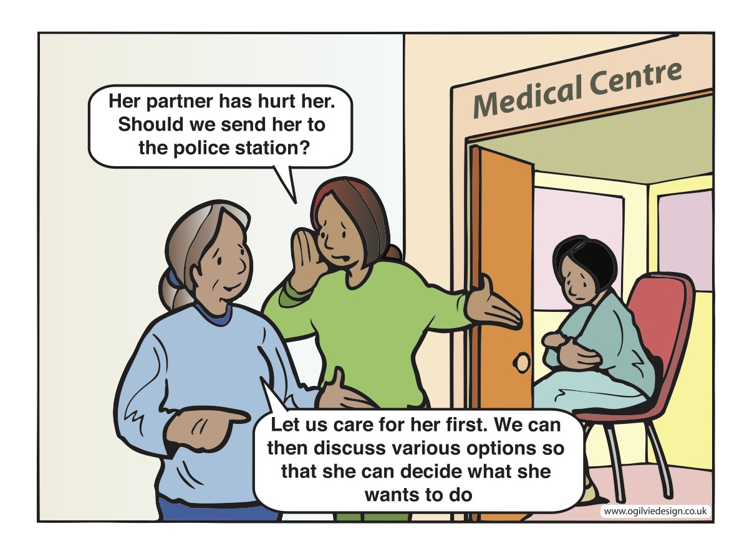
Notes:
Health workers need training and support to respond to adolescent girls and young women who have experienced gender-based violence.

Slide 10
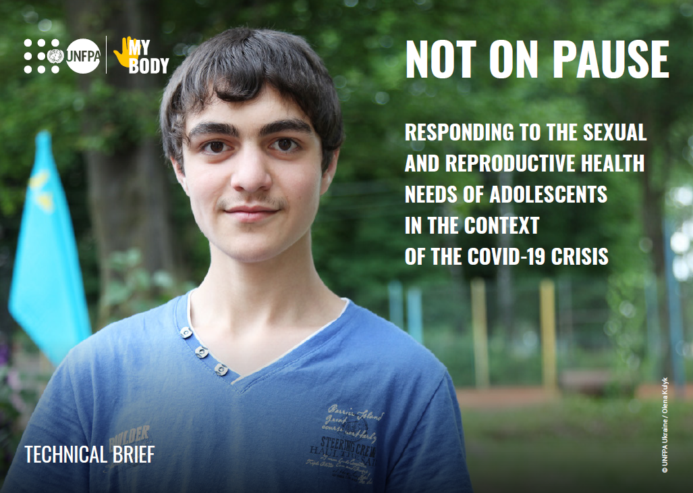
Specific measures for delivery of services in the context of
COVID-19
Inform adolescents where and how to get care, where access is possible, through mass media and digital media.
Sensitize and alert health-care providers, community workers and support networks to the potential for increases in sexual and gender-based violence and ensure they are aware of adolescents’ specific vulnerabilities (e.g. limited ability to report abuse).
Strengthen screening and enhance care and support, including mental health and psychological support for adolescents.
Ensure the availability of post-rape care services including emergency contraception, HIV post-exposure prophylaxis, and testing and treatment for STIs for adolescents.
Identify safe houses, shelters or social service referrals for adolescents at risk of violence in or around their homes.
Establish help lines or enhance existing help lines for adolescents to seek help if needed.

Slide 11
Considerations for resumption of normal services in the context of COVID-19
Inform adolescents that they can seek care if they have experienced sexual and gender-based violence and were unable to do so during periods of confinement.
Where possible, promote the institutionalization of good practices in improving accessibility and quality that were put in place during the period of closures and disruption.

Slide 12
References
Global and regional estimates of violence against women: prevalence and health effects of intimate partner violence and non-partner violence. Geneva: World Health Organization; 2013.
Stoltenborgh M, van IJzendoorn MH, Euser EM, Bakermans-Kranenburg MJ. A global perspective on child sexual abuse: meta-analysis of prevalence around the world. Child Maltreat. 2011;16(2):79–101.
Sumner S, Mercy J, Saul J, Motsa-Nzuza N, Kwesigabo G, Buluma R, et al. Prevalence of sexual violence against children and social services utilization: seven countries, 2007–2013. Morb Mortal Wkly Rep. 2015;64(21):565–569.
Maniglio R. The impact of child sexual abuse on health: a systematic review of reviews. Clin Psychol Rev. 2009;29(7):647–657.
Lundgren R, Amin A. Addressing intimate partner violence and sexual violence among adolescents: emerging evidence of effectiveness. J Adolesc Health. 2015;56(1):S42–S50.
Global plan of action: health systems address violence against women and girls. Geneva: World Health Organization; 2016.
Arango DJ, Morton M, Gennari F, Kiplesund S, Ellsberg M. Interventions to prevent or reduce violence against women and girls: a systematic review of reviews. Washington, DC: World Bank Group; 2014.
Responding to children and adolescents who have been sexually abused: WHO clinical guidelines. Geneva: World Health Organization; 2017.
Responding to intimate partner violence and sexual violence against women: WHO clinical and policy guidelines. Geneva: World Health Organization; 2013.
Namy S, Carlson C, O’Hara K, Nakuti J, Bukuluki P, Lwanyaaga J, et al. Towards a feminist understanding of intersecting violence against women and children in the family. Soc Sci Med. 2017;184(Suppl. C):40–48.

Slide 13
Violence against women and girls: prevention, support and care
A Regional Perspective
“There is never any excuse for violence. We abhor all violence, of all forms, at all times”
Dr Tedros Adhanom, WHO Director-General
Notes:
Welcome everybody to module 7 on Violence against women and girls: prevention, support and care. I want to express my thanks and gratitude to HQ colleagues, thank you for sharing the global data and information. My name is Anna Rita Ronzoni. I am the GBV technical officer at WHO regional office for the Eastern Mediterranean from the Department of Healthier Population, Violence and injuries prevention & Disability Unit, and I will accompany you in this session on the Eastern Mediterranean regional perspective on Violence against women and girls: in terms of prevention, support and care.

Slide 14
Key facts about VAWGs from the Region - 1
The Eastern Mediterranean Region has the second highest prevalence of VAWGs globally, with an estimated 37% of ever-partnered women who have experienced physical and/or sexual intimate partner violence at some point in their lives. (1) Adolescent girls, young women, women belonging to ethnic and other minorities, and women with disabilities face a higher risk of different forms of violence. (2)
Proportion of ever-partnered women and girls aged 15 years and older subjected to physical, sexual, or psychological violence by a current or former intimate partner in the previous 12 months, by form of violence and by age (SDG indicator 5.2.1) (3-7):
  52% in Afghanistan (2015)
  29% in Palestine (2019)
  26% in Jordan (2017)
  25% in Pakistan (2018)
  24% in Egypt (2015)
In Afghanistan, almost 90% of women have experienced one form of domestic violence, 52% have experienced physical violence, and 17% have experienced sexual violence. (8)
In Somalia, 35% of women reported lifetime experiences of physical or sexual IPV and 16% reported lifetime experience of physical or sexual non-partner violence (NPV) since the age of 15 year. (9)

Slide 15
Key facts about VAWGs from the Region - 2
Policy Situation
The EMR has the lowest proportion of countries (53%) with national multi-sectoral plans of action for violence against women globally. (10)
However, of the 16 countries that responded to a RMNCAH policy survey in the Region, 81% cited adolescents as a specific group for defined interventions for gender-based violence. (11)
Likewise, 88% have a law to punish perpetrators of coerced sex involving adolescent girls. (11)

Slide 16
Regional challenges - 1
High rates of child and forced marriages: Women and girls who are married as children are more likely to experience Gender-Based Violence (GBV). Therefore, there is a need to strengthen work with traditional institutions, community and religious leaders, and government actors to systematically address this issue. (12)
Underreporting: Due to social stigma, women and girls hesitate to report incidents and believe that “nothing could be done”. They are commonly afraid of further violence from perpetrators, and do not trust services due to fear confidentiality breech. (13)
Attitudes and social and cultural norms: Social norms that blame the women for violence they experience (e.g., because she was out alone after dark, she was not modestly dressed, she is working outside the home), along with gender discrimination and stigma, prioritize protecting family honor over the safety and wellbeing of the survivor and encourage institutional and social acceptance of GBV as normal. (13,14)

Slide 17
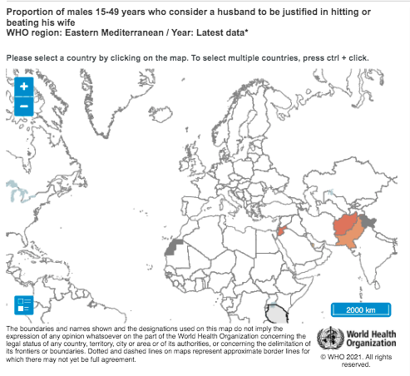
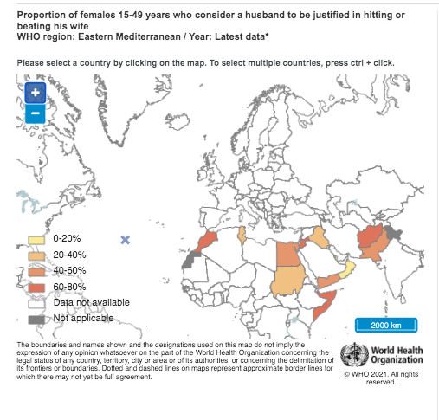
Attitudes towards Gender-Based Violence (15,16)
Proportion of males 15-49 years who consider a husband to be justified in hitting or beating his wife
Proportion of females 15-49 years who consider a husband justified in hitting or beating his wife
AFG: 78 (2015), JOR: 63 (2018), PAK: 51 (2018),
MOR: 64 (2004), EGY: 46 (2014), SUD: 35 (2014),
YEM: 49 (2013) IRAQ: 31(2018), TUN: 26 (2012), OMAN: 9.6 (2014), Lebanon: 22 (2009)
AFG:70 (2015), JOR: 64 (2018), PAK: 58 (2018), QAT: 22 (2012)

Slide 18
Regional challenges - 2
Lack of information: There is limited information available to the public regarding the consequences of GBV and the availability of potential legal and social support services for the survivors. (14)
Low availibility of services: Women and girls who experience GBV are likely to seek Family planning or maternal health services. Therefore, the health sector is one of the key entry points for ensuring survivors get the care and support they need. Unfortunately, these services are often not available. For example, a recent survey showed that only 10% of facilities in Afghanistan are well prepared to address GBV, and that only a quarter of the 280 health facilities surveyed in 7 provinces had private examination rooms and only 2% of facilities had a protocol in place for GBV care. (17)
Numerous humanitarian settings: One in five refugees or displaced women in complex humanitarian settings has experienced sexual violence. (18) Meanwhile, care services for women and girls survivors of violence remains one of the least implemented parts of the Minimum Initial Services Package (MISP).
Notes:
One systematic review found that approximately one in five refugees or displaced women in complex humanitarian settings experienced sexual violence, though this is likely an underestimation of the true prevalence given the many barriers to survivors’ disclosure of GBV.

Slide 19
REGIONAL INITIATIVE 1
Violence against women awareness campaign in Afghanistan (19)
Time period: 2016 and early 2017
Implemented by: Public Legal Awareness Unit of the Afghan Ministry of Justice and two NGOs (Women for Afghan Women and Voice of Women Organization), with support from the International Development Law Organization (IDLO).
Setting: The campaign was rolled out across nine provinces (Badakhshan, Balkh, Bamyan, Herat, Jowzjan, Kabul, Kunduz, Nangarhar and Samangan), including some that posed significant security challenges, reaching 5000 people.
Aim: The campaign aimed to educate participants on all forms of gender-based violence, including domestic violence, forced and underage marriage, rape, forced prostitution, beating, harassment and humiliation.

Slide 20
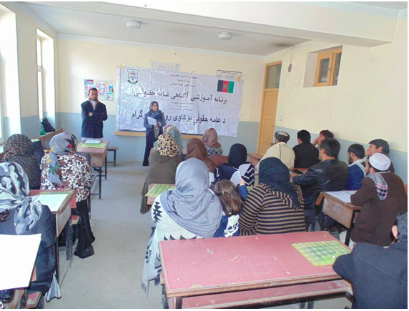
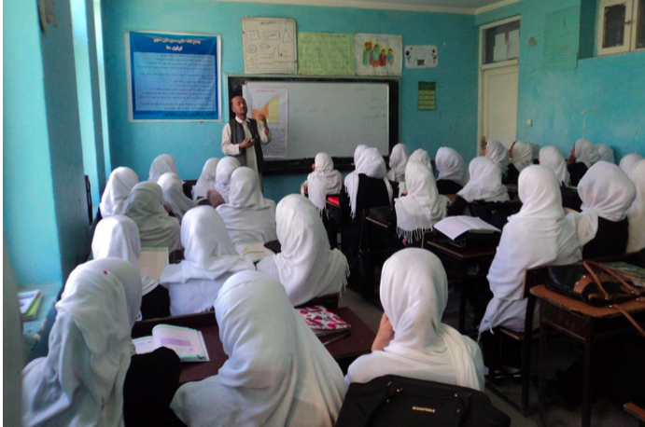
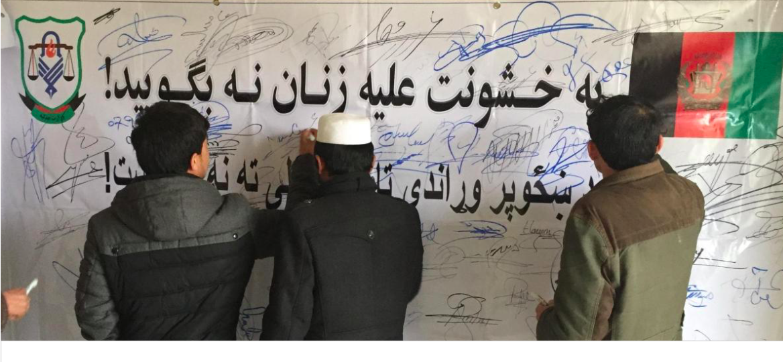
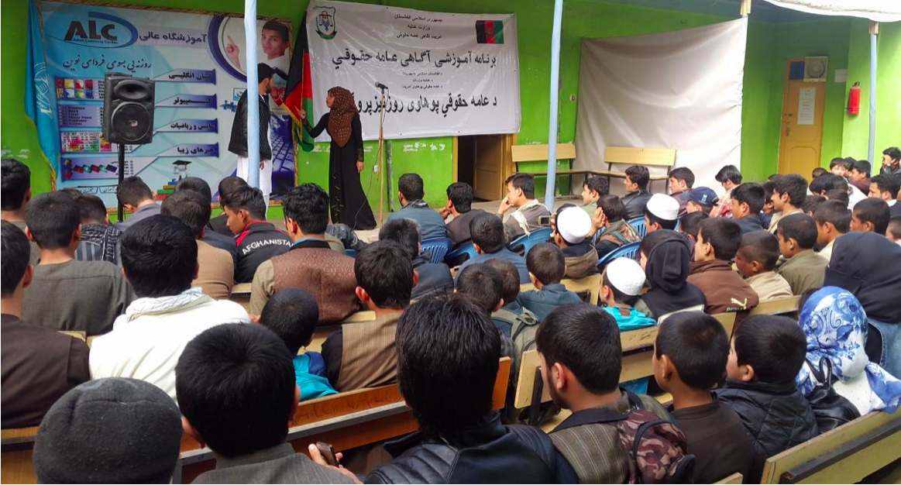
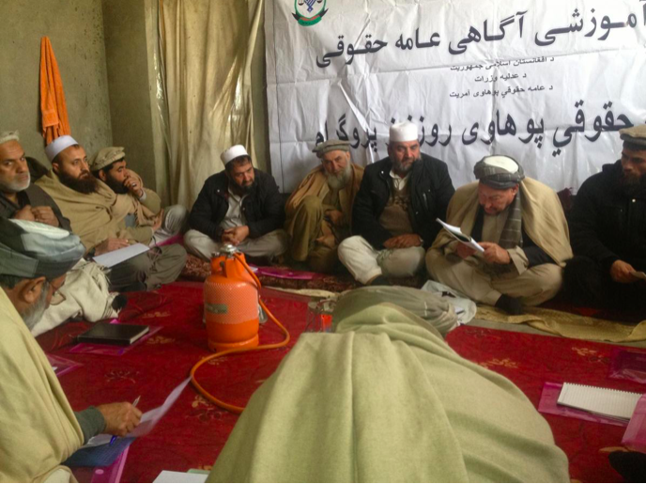
REGIONAL INITIATIVE 1, cont.
Violence against women awareness campaign in Afghanistan (19)
(1) By signing a symbolic pledge banner, students affirmed their commitment to say ‘NO’ to violence against women.
(2) Public awareness of citizens’ rights was an important part of the initiative.
(3) High school teachers were empowered to raise awareness locally within their schools.
(6) Community leaders (Mullah and Tribal elders) were familiarized with constitutional and religious legal frameworks to ensure their decisions are fair and consider the rights of all parties.
(4) Local ownership helped ensure the sustainability and success of the campaign.
(5) Live drama performances engaged young audiences on an emotional level.

Slide 21
REGIONAL INITIATIVE 2
Prevention and response to violence against women and girls in the Region in the time of COVID-19 (20)
Surveys conducted by the Health Clusters (April-May 2020) to measure health service utilization by GBV survivors during COVID-19 in Afghanistan, Iraq, and Somalia showed a 45% percent increase in GBV.
The survey’s findings highlighted an increase not only in domestic violence, but also of sexual violence against girls, along with a concerning upsurge in female genital mutilation (FGM).
Initiatives have thus been undertaken at the country level to address the continuity of life-saving services and to establish referral linkages in order to connect survivors and reach out to women and girls in need of support.
Notes:
The health impacts of violence, particularly intimate partner/domestic violence, on women and their children are significant. Violence against women can result in injuries and serious physical, mental, sexual and reproductive health problems.
The role that the health system can play to prevent and respond to GBV is key, including in health emergencies. Surveys conducted by the Health Clusters in Afghanistan, Iraq and Somalia, between April and May 2020, to measure health service utilization by GBV survivors during COVID-19, showed a 45% percent increase in GBV. This included disclosures of intimate partner violence, sexual exploitation and abuse, harassment, and other forms of GBV than prior to the COVID-19 outbreak.
Health services can still support GBV survivors by ensuring the continuity of life-saving services and establishing referral linkages in order to connect survivors with other available services.

Slide 22
REGIONAL INITIATIVE 2, cont.
Prevention and response to violence against women and girls in the Region in the time of COVID-19 (20)
In Afghanistan, a guidance note was developed for women's protection centres operating during the COVID-19 pandemic, in partnership with UN Women. Management support was provided, as needed.
In Iraq and Lebanon, guidance was produced for both remote and face-to-face health services for women who may have been subjected to violence, and for updated referral pathways for each governorate. Online training was conducted on GBV and COVID-19 for frontline workers from the Ministry of Interior and the Ministry of Defense. Additionally, remote case management was put in place, with the aim of establishing safe, strong and flexible communication lines with survivors living in confinement with their aggressors.
In Pakistan, GBV-specialized telemedicine support and health services were implemented in collaboration with the Institute of Psychiatry in Baluchistan. Additionally, the capacity of health providers in the country’s high risk/burden provinces was built to support them to integrate GBV response into their services during the COVID-19 pandemic.

Slide 23
Key messages
GBV, and specifically violence perpetrated against women and girls which is largely driven by deep-rooted gender discrimination, is a significant threat to adolescent health and well-being in the Region.
Health services are critical for mitigating the health impacts of such violence, particularly to prevent HIV, unwanted pregnancy, STIs, and adverse mental health outcomes.
Health services for women and girls survivors remain inadequate in many countries in the Region, with severe consequences for the health of women and girls.
WHO is intensifying efforts to ensure that violence against women and girls is better prioritized by the health sector in emergencies and that health partners are equipped with the technical knowledge needed to respond.
WHO encourages donors, UN agencies, and NGOs to step up efforts to integrate services for women and girls survivors as a core part of their health responses in emergencies, including for COVID-19.

Slide 24
References
WHO Regional Office for the Eastern Mediterranean. WHO to release Arabic version of package on health system response to violence against women and girls. World Health Organization; c2021. Available from: http://www.emro.who.int/media/news/who-to-release-arabic-version-of-package-on-health-system-response-to-violence-against-women-and-girls.html
WHO. Respect women: preventing violence against women. World Health Organization; 2019.
Central Statistics Organization (CSO); Ministry of Public Health (MoPH); ICF. Afghanistan Demographic and Health Survey (AfDHS) 2015. Kabul (Afghanistan): Central Statistics Organization; 2017. Available from: https://dhsprogram.com/pubs/pdf/FR323/FR323.pdf
Ministry of Health and Population(Egypt); El-Zanaty and Associates; ICF International. Egypt Health Issues Survey (EHIS) 2015. Cairo (Egypt): Ministry of Health and Population; 2015. Jointly published by ICF International. Available from: https://dhsprogram.com/pubs/pdf/FR313/FR313.pdf.
Department of Statistics (DOS); ICF. Jordan Population and Family and Health Survey 2017-18. Amman (Jordan): DOS; 2019. Jointly published by ICF. Available from: https://dhsprogram.com/pubs/pdf/FR346/FR346.pdf.
Palestinian Central Bureau of Statistics. Preliminary results of the violence survey in the Palestinian Society 2019. Ramallah (Palestine): Palestinian Central Bureau of Statistics; 2019. Available from: http://www.pcbs.gov.ps/Downloads/book2480.pdf.
National Institute of Population Studies - NIPS (Pakistan); ICF. Pakistan Demographic and Health Survey 2017-18. Islamabad (Pakistan): NIPS; 2019. Jointly published by ICF. Available from: https://dhsprogram.com/publications/publication-fr354-dhs-final-reports.cfm

Slide 25
References
Nijhowne D, Oates L. Living with violence: a National Report on domestic abuse in Afghanistan. Washington, DC: Global Rights: Partners for Justice; 2008. Available from: https://drive.google.com/file/d/1CCNTi3VldT0eAHZVGlNmCFrcuaKgFXoQ/view
Wirtz AL, Perrin NA, Desgroppes A, Phipps V, Abdi AA, Ross B, Kaburu F, Kajue I, Kutto E, Taniguchi E, Glass N. Lifetime prevalence, correlates and health consequences of gender-based violence victimisation and perpetration among men and women in Somalia. BMJ Global Health. 2018 Jul 1;3(4):e000773. http://dx.doi.org/10.1136/bmjgh-2018-000773
World Health Organization‎. Sexual, reproductive, maternal, newborn, child and adolescent health: policy survey, 2018-2019: summary report. World Health Organization; 2020. License: CC BY-NC-SA 3.0 IGO. Available from: https://apps.who.int/iris/handle/10665/331847.
Reproductive, Maternal, Newborn, Child, and Adolescent Health Policy Survey East Mediterranean Regional Office (EMR) Report 2019 (unpublished report).
International Organization for Migration. Gender-based violence knowledge, attitudes and practices survey in South Sudan. International Organization for Migration; 2019. Available from: https://publications.iom.int/system/files/pdf/south-sudan-gender-based-kap.pdf
McCleary-Sills J, Namy S, Nyoni J, Rweyemamu D, Salvatory A, Steven E. Stigma, shame and women's limited agency in help-seeking for intimate partner violence. Glob Public Health. 2016;11(1-2):224-35. doi: 10.1080/17441692.2015.1047391. Epub 2015 Jul 8. PMID: 26156577.
Perrin N, Marsh M, Clough A, Desgroppes A, Yope Phanuel C, Abdi A, Kaburu F, Heitmann S, Yamashina M, Ross B, Read-Hamilton S, Turner R, Heise L, Glass N. Social norms and beliefs about gender based violence scale: a measure for use with gender based violence prevention programs in low-resource and humanitarian settings. Conflict and Health. 2019 Mar 8;13(1):6. http://dx.doi.org/10.1186/s13031-019-0189-x

Slide 26
References
WHO. Maternal, newborn, child and adolescent health and ageing data portal: Proportion of males 15-49 years who consider a husband to be justified in hitting or beating his wife. WHO; c2021. Available from: https://www.who.int/data/maternal-newborn-child-adolescent-ageing/indicator-explorer-new/mca/proportion-of-males-15-49-years-who-consider-a-husband-to-be-justified-in-hitting-or-beating-his-wife
WHO. Maternal, newborn, child and adolescent health and ageing data portal: Proportion of females 15-49 years who consider a husband to be justified in hitting or beating his wife. WHO; c2021. Available from: https://www.who.int/data/maternal-newborn-child-adolescent-ageing/indicator-explorer-new/mca/proportion-of-females-15-49-years-who-consider-a-husband-to-be-justified-in-hitting-or-beating-his-wife
WHO Regional Office for the Eastern Mediterranean. WHO project improves health care sector’s response to gender-based violence in Afghanistan. WHO; c2021. Available from: http://www.emro.who.int/afg/afghanistan-news/who-project-improves-health-care-sectors-response-to-gender-based-violence-in-afghanistan.html
Vu A, Adam A, Wirtz A, Pham K, Rubenstein L, Glass N, Beyrer C, Singh S. The Prevalence of Sexual Violence among Female Refugees in Complex Humanitarian Emergencies: a Systematic Review and Meta-analysis. PLoS Curr. 2014 Mar 18;6. http://dx.doi.org/10.1371/currents.dis.835f10778fd80ae031aac12d3b533ca7
IDLO. Violence against women awareness campaign in Afghanistan. International Development Law Organization; 2017. Available from: https://www.idlo.int/fr/news/highlights/violence-against-women-awareness-campaign-afghanistan
WHO Regional Office for the Eastern Mediterranean. Violence, injuries and disability: prevention and response to gender-based violence against women and girls in the Eastern Mediterranean Region in the time of COVID-19. WHO; c2021. Available from: http://www.emro.who.int/violence-injuries-disabilities/violence-news/prevention-and-response-to-gender-based-violence-against-women-and-girls-in-the-easter-mediterranean-region-in-the-time-of-covid-19.html

