Slide 1
Family Planning through the lens of global strategies, measurement and human rights Introduction to the Module An Online Evidence-based Course 2021
Moazzam Ali MBBS, PhD, MPH
James Kiarie MBChB, Mmed, MPH
Department of Sexual Reproductive Health and Research

Slide 2
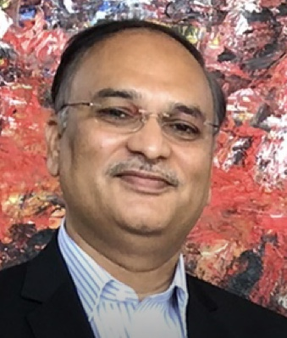
Facilitators
Moazzam Ali is an Epidemiologist at the WHO, Geneva. He is physician by training and has masters and doctorate in public health. He has progressive experience for more than 25 years in managing research for health systems, and teaching health policy and management in low-and-middle income countries. He has managed a wide range of portfolios, including designing and evaluating national health systems, developing a critical mass of researchers and decision-makers for policy and systems research. He is passionate about improving quality of care in family planning and implementing innovative financing modalities in contraception.

Slide 3
Global strategies
Roadmaps to support or guide achievement of desired outcome
Broken down to implementation plans, action plans, guidelines and protocols
Instigate commitment and action, mobilize resources and challenge status quo
Global frameworks
Grouped ideas, rules or beliefs to guide descriptions, discussions and decisions
Facilitate planning, activities, monitoring and reporting
Measurement
What cannot be measured, cannot be improved, managed, reported
What is measured gets done

Slide 4
Human rights
Important issue in contraception covered in several WHO documents

Slide 5
Ensuring human rights in the provision of contraceptive information and services
Priority actions to ensure integration of human rights
Non- discrimination
Availability of contraceptive information and services
Accessibility of contraceptive information and services
Acceptability of contraceptive information and services
Quality of contraceptive information and services
Informed decision-making
Privacy and confidentiality
Participation
Accountability
Elements of quality of care include:
Incorporation of medical standards of care and client feedback
Provision of long-acting reversible contraception (LARC) methods should include insertion and removal services, and counselling on side-effects, in the same locality
Ongoing competency-based training and supervision according to existing WHO guidelines

Slide 6
Module outcome and training objectives
Outcome: Students participate as part of an effective and functional global network for the exchange of knowledge and experiences in family planning.
Training objectives: On completion of the course students should be able to:
Describe global strategies, frameworks and goals that are relevant to family planning programmes
Define basic indicators related to population and family planning and how they are used globally for decision making
Apply human rights principles in describing family planning programmes

Slide 7
Targeted health professionals
Different
levels of knowledge and education
Professions: Doctors, nurses, midwives, managers, social workers
Geographic areas especially lower middle- and lower-income countries
Involved in service
Provision
Management and leadership
Policy formulation
Advocacy

Slide 8
Content
Based on WHO recommendations and enhanced by field experience.
Global strategies and measurement in family planning
The place of family planning in global health frameworks, strategies and goals such as UHC, SDG, RH Strategy and UNSG Strategy
Family planning use and its impact
Indicators used to measure the status of family planning provision and use such as Contraceptive Prevalence and Unmet need for FP
Human rights in family planning
Special populations in family planning
Concepts of reproductive rights in family planning
Gender issues and relations in family planning
Notes:
8

Slide 9
Teaching methods and assessment and duration
Content and Method | Duration
Power point presentations | 3 hours
Videos and reading materials illustrating key concepts | 2 hours
MCQ tests | 1 hour
Total | 6 hours
Assessment based on completion of the content, scores in MCQ tests

Slide 10
Important concepts
Family planning/Contraception: Is an essential intervention to promoting the well-being and autonomy of women, their families and their communities by empowering women to chose if and when to become pregnant
Methods of contraception: Oral contraceptive pills, implants, injectables, patches, vaginal rings, Intra uterine devices, condoms, male and female sterilization, lactational amenorrhea methods, withdrawal and fertility awareness-based methods.
Differ in effectiveness in preventing unintended pregnancy. This is measured by the number of pregnancies per 100 women using the method per year.
Methods classified by their effectiveness as commonly used into: Very effective, Effective, Moderately effective and Less effective.

Slide 11
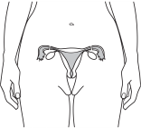
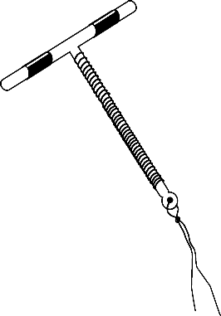
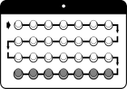
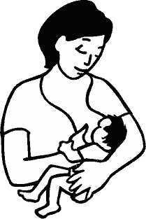
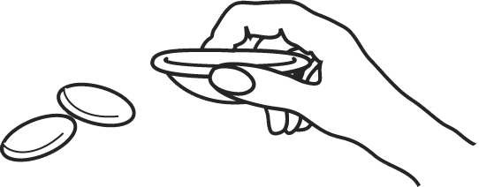
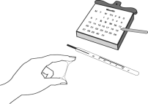
Most effective
Very effective < 1per 100 women)
How to make your method
more effective
Sterilisation
for women
Vasectomy
One-time procedures; nothing to do or remember
Implants
IUD
Effective (1-9 per 100 women)
Need repeat injections every 1, 2 or 3 months
Injectables
Must take a pill each day
Pills
Moderately effective (10-19 per 100 women)
Must follow LAM instructions
LAM
Male condoms
Must use every time you have sex; requires partner’s cooperation
Must use every time you have sex
Diaphragm
Less effective (20 or more per 100 women)
Must use every time you have sex; requires partner’s cooperation
Female condoms
Fertility Awareness-Based Methods
(selected)
Must abstain or use condoms on fertile days; requires partner’s cooperation
Least effective
Spermicides
Must use every time you have sex
Notes:
11

Slide 12
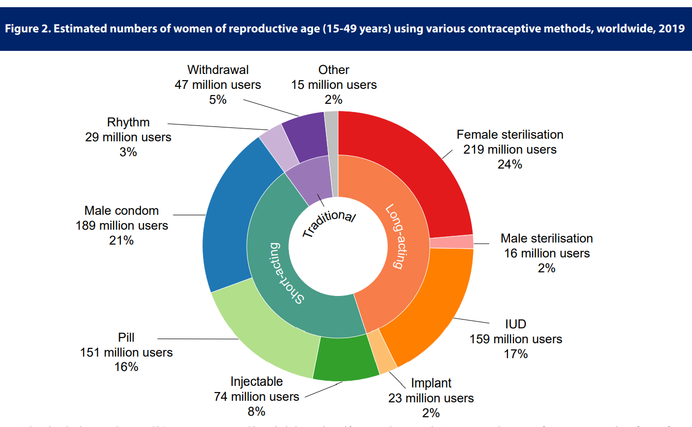
Methods used globally
Contraceptive use by method. United Nations, Department of Economic and Social affairs, 2019.
https://www.un.org/en/development/desa/population/publications/pdf/family/ContraceptiveUseByMethodDataBooklet2019.pdf

Slide 13
Conclusion
Introductory module
Looks at global big picture issues
Important to have grasp of the general before diving to specifics
Assessments will be drawn from the presentations, readings and videos

Slide 14
Readings and videos
Read the WHO factsheet on contraception https://www.who.int/news-room/fact-sheets/detail/family-planning-contraception
Watch the video on WHO and the development of contraceptive methods https://www.youtube.com/watch?v=jHb69wklWN4
Watch video on Human rights and contraception https://www.youtube.com/watch?v=4ubJzsYeJTI&t=513s

