Slide 1
Family Planning through the lens of global strategies, measurement and human rights
Family Planning Global Strategies, Frameworks and Initiatives
Session 2
An Online Evidence-based Course 2021
James Kiarie MBChB, Mmed, MPH
Department of Sexual Reproductive Health and Research

Slide 2
Outline
Strategies: Roadmaps to support or guide achievement of desired outcome
WHO Reproductive health strategy 2004
The Global Strategy for Women’s, Children’s and Adolescents’ Health (2016-2030)
Declaration of Astana on Primary Health care (PHC) 2018
Political Declaration on Universal Health Coverage 2019
Frameworks: Grouped ideas, rules or beliefs to guide descriptions, discussions and decisions
Sustainable Development Goals
International Conference on Population and Development Program of action 1994 and 2019
Initiatives: means or ways to translates goals and visions into practice
FP2030 partnership

Slide 3
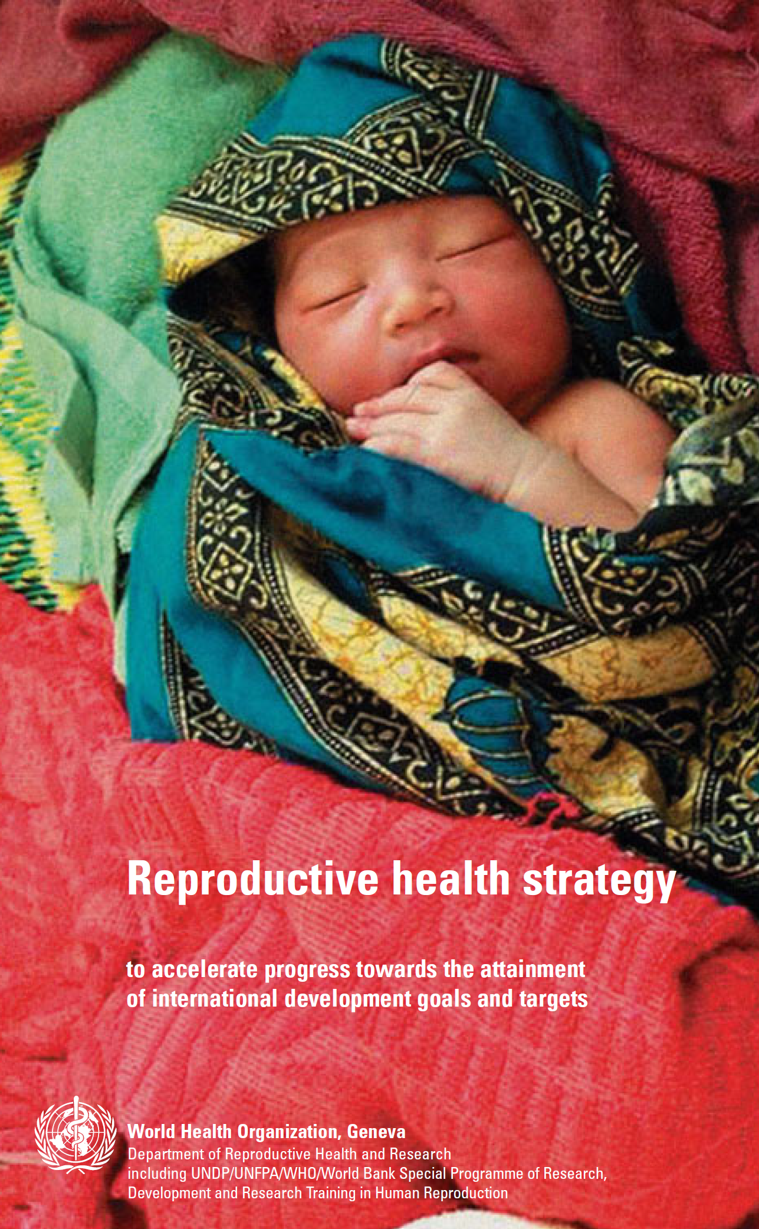
WHO RH Strategy
Presented at the 57th World Health assembly May 2004
5 core aspects of reproductive and sexual health:
  improving antenatal, perinatal, postpartum and newborn care
  providing high-quality services for family planning, including infertility services
  eliminating unsafe abortion
  combating sexually transmitted infections including HIV, reproductive tract infections, cervical cancer and other gynaecological morbidities;
  promoting sexual health
Key Action areas for countries
  strengthening health systems capacity
  improving information for priority setting
  mobilizing political will
  creating supportive legislative and regulatory frameworks, and strengthening monitoring
  evaluation and accountability
Handout 1

Slide 4
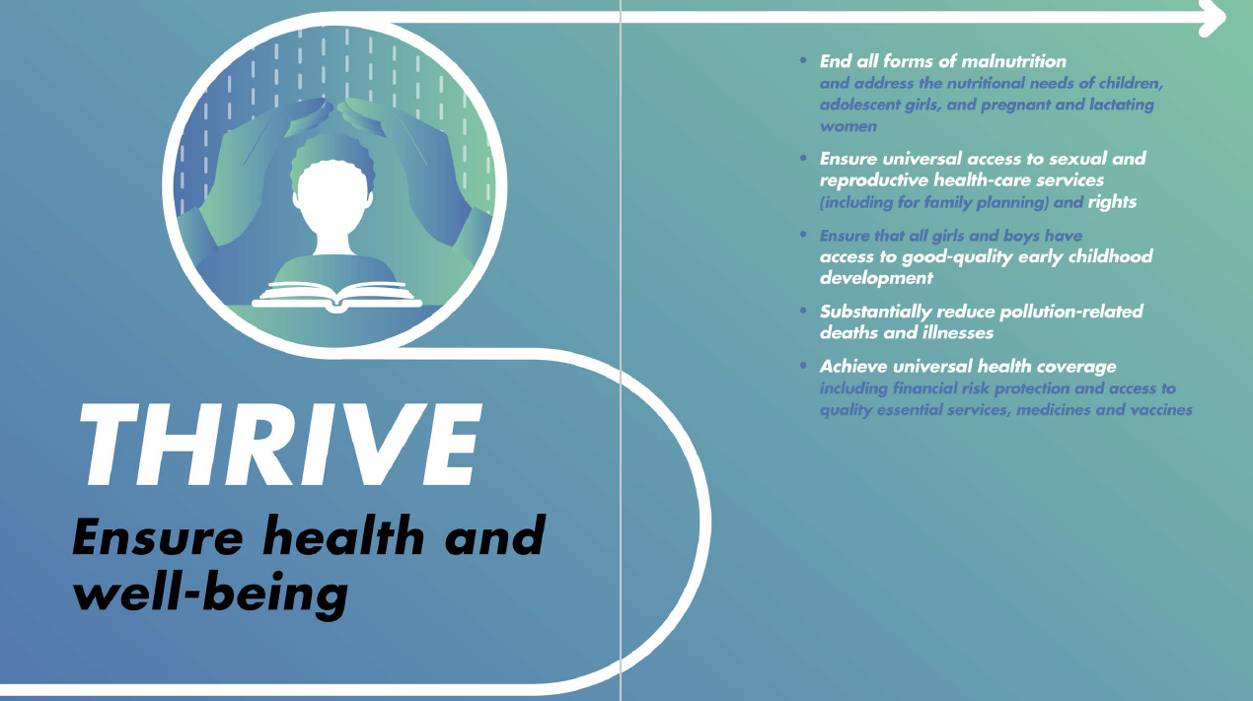
The Global Strategy for Women’s, Children’s and Adolescents’ Health (2016-2030)
Vision: By 2030, a world in which every woman, child and adolescent in every setting realizes their rights to physical and mental health and well-being, has social and economic opportunities, and is able to participate fully in shaping sustainable and prosperous societies.
Objectives
  Survive
  Thrive
  Transform
Targets: same as SDGs
Family planning is under the Thrive Objective
Handout 2

Slide 5
Primary Health Care (PHC)
Vision
  Governments and societies that prioritize, promote and protect people’s health and well-being, at both population and individual levels, through strong health systems.
  Primary health care and health services that are high quality, safe, comprehensive, integrated, accessible, available and affordable for everyone and everywhere, provided with compassion, respect and dignity by health professionals who are well-trained, skilled, motivated and committed.
  Enabling and health-conducive environments in which individuals and communities are empowered and engaged in maintaining and enhancing their health and well-being.
  Partners and stakeholders aligned in providing effective support to national health policies, strategies and plans.
Handout 3
Commitments
1. Make bold political choices for health across all sectors
2. Build sustainable primary health care
3. PHC success driven by Knowledge and capacity-building, Human resources for health, Technology and Financing
4. Empower individuals and communities
5. Align stakeholder support to national policies, strategies and plans

Slide 6
Political Declaration on Universal Health Coverage (UHC) 2019
Ensure universal access to sexual and reproductive health and reproductive rights in accordance with the Programme of Action of the International Conference on Population and Development and the Beijing Platform for Action, including universal access to sexual and reproductive health-care services, including for family planning, information and education, and the integration of reproductive health into national strategies and programmes, and recognizing that the human rights of women include their right to have control over and decide freely and responsibly on all matters related to their sexuality, including sexual and reproductive health, free of coercion, discrimination and violence, as a contribution to the achievement of gender equality and the empowerment of women and the realization of their human rights.
Handout 4

Slide 7
International Conference on Population and Development (ICPD)
Handout 5
ICPD 25 Nairobi 2019
Intensify efforts for the full, effective and accelerated implementation and funding of the ICPD Programme of Action
Achieve universal access to sexual and reproductive health and rights as a part of universal health coverage (UHC) by committing to strive for: Zero unmet need for family planning information and services, and universal availability of quality, accessible, affordable and safe modern contraceptives.
Address sexual and gender-based violence and harmful practices, in particular child, early and forced marriages and female genital mutilation.
Draw on demographic diversity to drive economic growth and achieve sustainable development.
Uphold the right to sexual and reproductive health services in humanitarian and fragile contexts.

Slide 8
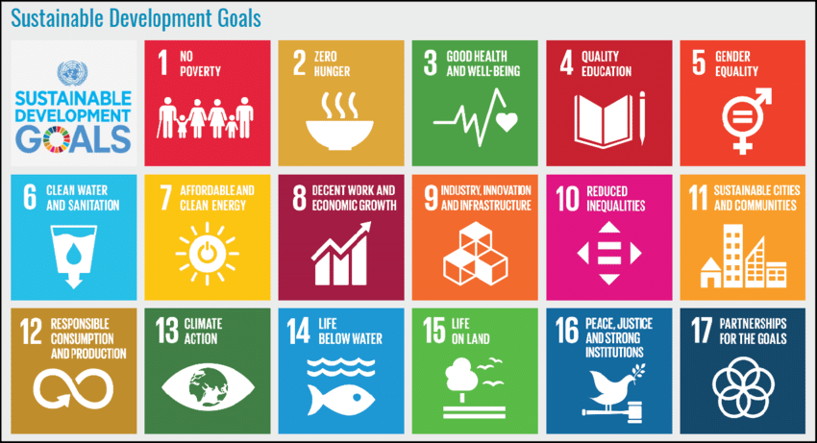
Sustainable Development Goals (SDGs):
FP specified in 3 and 5 but contributes to all
Health includes FP
Gender Equality includes FP
https://sdgs.un.org/goals

Slide 9
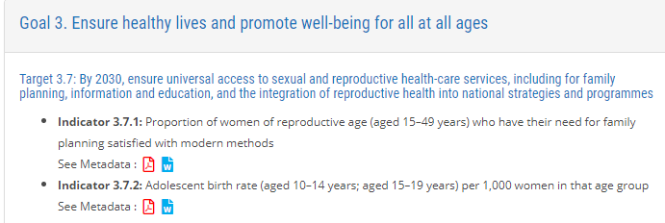
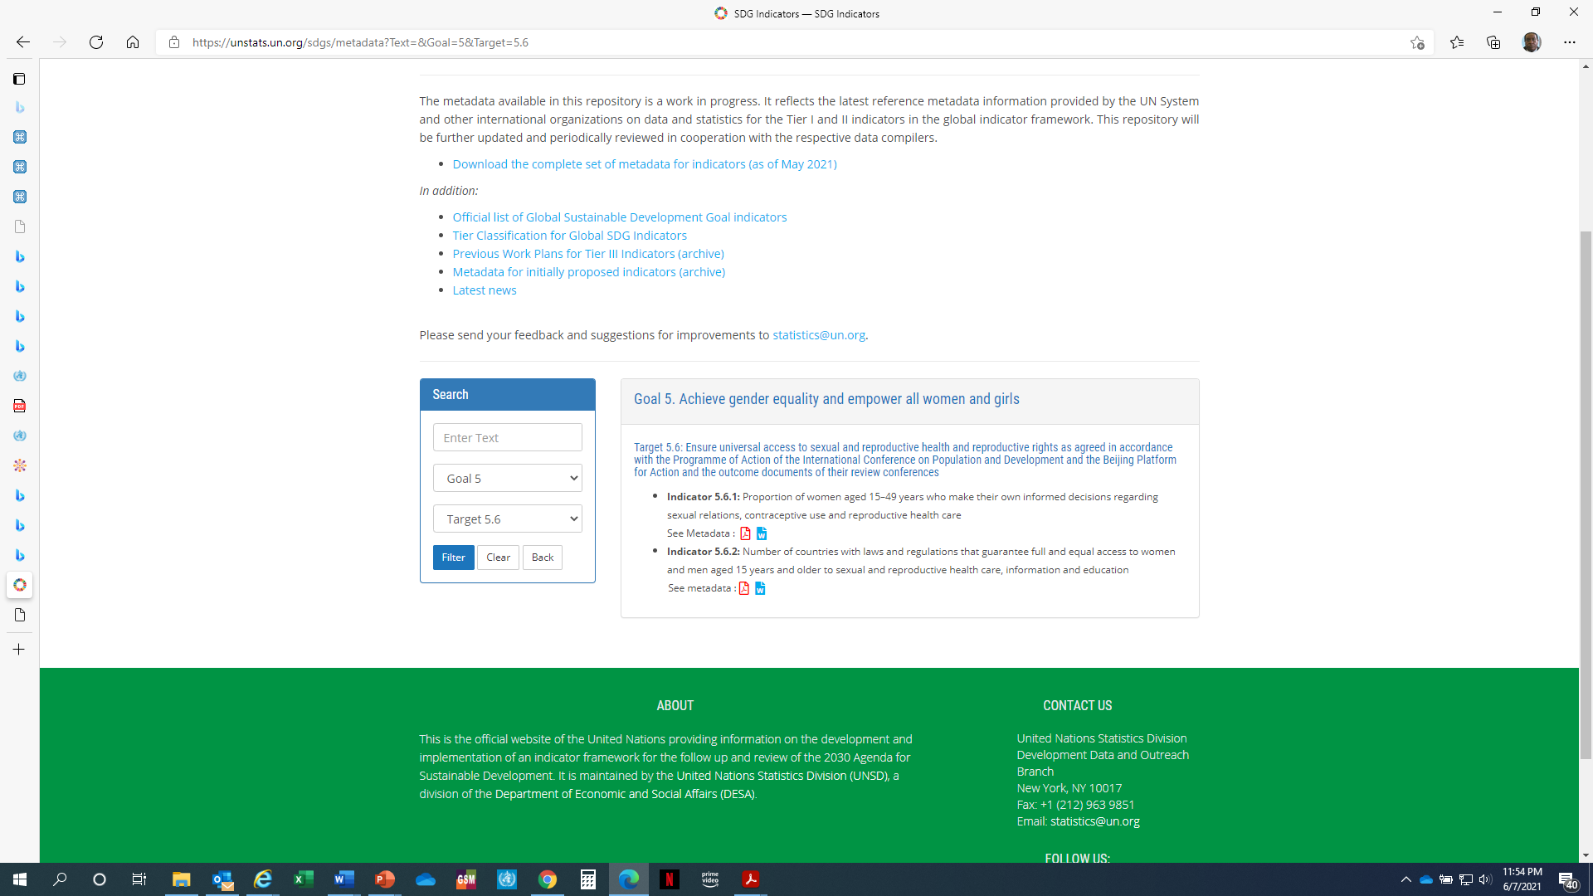
Sustainable Development Goals 3 and 5

Slide 10
Family Planning 2030 Initiative
Follow up on FP2020
Vision: A future where women and girls everywhere have the freedom and ability to lead healthy lives, make their own informed decisions about using contraception and having children, and participate as equals in society and its development.
Change: Voluntary modern contraceptive use by everyone who wants it, achieved through individuals’ informed choice and agency, responsive and sustainable systems providing a range of contraceptives, and a supportive policy environment.
https://familyplanning2020.org/Building2030

Slide 11
Financing of Family Planning as a global agenda
Despite efforts by country governments, donors and individuals are responsible for nearly half (49%) of the costs of reproductive, maternal, neonatal, and children’s health (1).
Household expenditures dwarf the contributions of both domestic and international funding sources.
Future efforts to reduce unmet need for FP must consider consumers’ out-of-pocket costs, programmatic cost-effectiveness, and sources of funding.
sustained fundraising, pooling, and strategic purchasing in critical to scale up delivery systems for contraceptive methods.
http://apps.who.int/iris/bitstream/handle/10665/255863/WHO-RHR-18.26-eng.pdf?ua=1

Slide 12
Conclusion
Global FP efforts well grounded in strategies, Frameworks and initiatives
Though they vary in detail principles in these documents are very consistent
Challenges with reaching consensus on language between member states common in SRH
Family planning in global strategies, frameworks and initiatives grounded on strong evidence on FP
  Health and non benefits
  Cost effectiveness
  Central role in meeting other SDGs
  As a basic human right

Slide 13
Readings and videos
Read
  WHO Fact Sheet on Universal health coverage (UHC) https://www.who.int/news-room/fact-sheets/detail/universal-health-coverage-(uhc)
Watch
  Nairobi Summit on ICPD25 Highlights
  https://youtu.be/6Yn9e1Eqc5A
If you have questions discuss with your coach and submit any that you would like discussed in the webinar.

Slide 14

Thank you
Follow us on Twitter @HRPresearch
Website who.int/reproductivehealth

