Slide 1
Family Planning through the lens of global strategies, measurement and human rights
Family Planning Indicators
Session 3
An Online Evidence-based Course 2021
James Kiarie MBChB, Mmed, MPH
Department of Sexual Reproductive Health and Research

Slide 2
Health indicators
Term “indicator” derived from the Latin “indicare”, meaning to announce, point out or indicate.
Health indicators are quantifiable characteristics of a population used as supporting evidence for describing the health of a population¹
Ideal health indicators:
  Valid: It must measure what it is supposed to measure
  Reliable: Same result if measured by different people
  Sensitive: They should show variations in different situations
  Specific: Changes must occur only in the situation concerned
  Practical/feasible: Data for the indicator readily available
1 Health indicator. Wikipedia, 2021. https://en.wikipedia.org/wiki/Health_indicator#:~:text=Health%20indicators%20are%20quantifiable%20characteristics%20of%20a%20population,evidence%20for%20describing%20the%20health%20of%20a%20population.

Slide 3
Family planning indicators
The family Planning Reproductive Health Data base lists 90 indicators including covering different aspects such as source of supply, method type, integration with other services, counseling and information, continuation and discontinuation, fertility, pregnancy spacing and timing¹
FP included in 3 SDG indicators
  Indicator 3.7.1: Demand satisfied with modern methods
  Indicator 5.6.2: Number of countries with laws and regulations that guarantee full and equal access to women and men aged 15 years and older to sexual and reproductive health care, information and education
  Indicator 5.6.1: Women’s ability to make their own informed decisions about their sexual and reproductive health
FP2020’s 18 Core Indicators based on a results chain measuring
Enabling environment for FP
Process of delivering services
Output of services
Expected outcomes
Impact of contraceptive use
1 Measure Evaluation: Family Planning and Reproductive Health Indicators Database. https://www.data4impactproject.org/prh-family-planning-and-reproductive-health-indicators-database/

Slide 4
At what level do family planning indicators measure
Individual interpersonal
Health system and community
Enabling environment
CONTRACEPTIVE USE
FERTILITY
MATERNAL AND CHILD HEALTH
FP SUPPLIES
EQUITY
ACCESS
SERVICE PROVISION
DEMAND
POLICIES,
FINANCING
PROGRAMS

Slide 5
Common enabling environment indicators
Domestic government family planning expenditures
Donor expenditures on family planning
Laws and regulations that guarantee full access to family planning services
Evidence that preservice and/or in service curricula includes postpartum postpartum family planning

Slide 6
Common health system / community indicators
Stock outs: Percentage of facilities stocked out, by method offered, on the day of assessment.
Method availability: Percentage of primary SDPs that have at least 3 modern methods of contraception available on day of assessment.
CYP: Couple-Years of Protection.
Method Information index: An index measuring the extent to which women were given specific information when they received family planning services.
Unmet need: Percentage of women with an unmet need for modern methods of contraception.
Number or percent of service delivery points which offer a range of appropriate contraceptive options for postpartum women.
Percent of postpartum women with unmet need for contraception.

Slide 7
Common individual level indicators
mCPR: Modern contraceptive prevalence rate Percentage of women using a modern method of contraception.
Demand Satisfied: Percentage of women whose demand is satisfied with a modern method of contraception.
Discontinuation & Method Switching: 12-month contraceptive discontinuation and switching rate.
Method Mix: Percentage of women using each modern method of contraception.
Unintended Pregnancies: Number of unintended pregnancies.
Number or percent of maternal and child health services clients who received counseling about LAM.

Slide 8
Sources of data
Population surveys such as the Demographic Health survey (DHS), PMA2020 surveys, Reproductive Health Survey (RHS), Multiple Indicator Cluster Surveys (MICS) and other nationally representative surveys
Service Provision Assessment (SPA) Surveys
Service statistics
Logistic reports
Financial tracking such as the WHO Commission on Information and Accountability and the UNFPA-NIDI FP resource flows survey

Slide 9
Understanding specific FP indicators
CPR
Demand Satisfied
Unmet need

Slide 10
Contraceptive prevalence rate
The percentage of women who are using (or whose partner is using) a contraceptive method at a particular point in time.
Numerator can include:
  All methods
  Modern methods
The denominator used can be:
  All reproductive age (15-49 years) women
  All women in union (married)
Can be disaggregated by wealth quintile, age, urban/rural, ethnicity

Slide 11
Unmet need
The percentage of fecund women of reproductive age who want no more children or to postpone having the next child but are not using a contraceptive method.
Women using a traditional method are assumed to have an unmet need for modern contraception.
Women who are pregnant or less than six months postpartum who did not intend to become pregnant at the time they conceived and were not using a contraceptive method are assumed to have an unmet need for modern contraception.
Though the concept seems straightforward, the calculation is extraordinarily complex. In DHS, its calculation is based on answers to 15 questions

Slide 12
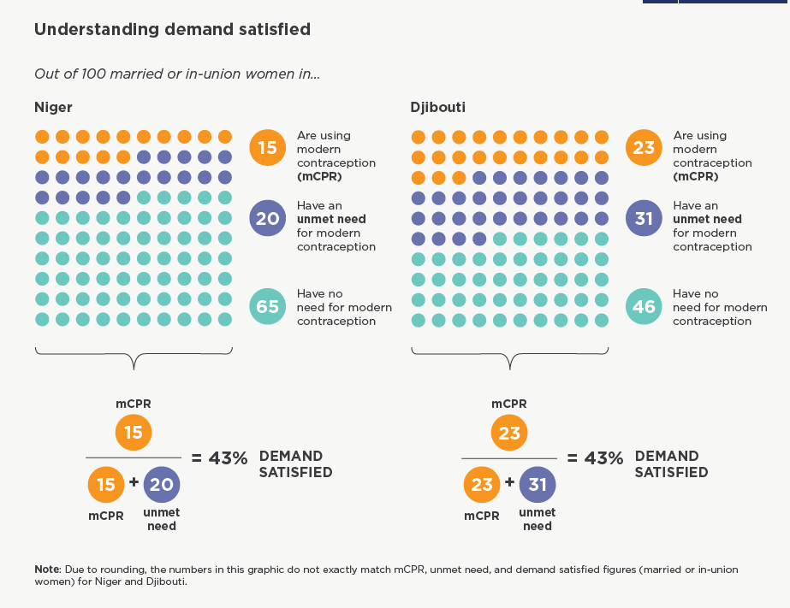
Demand satisfied
The percentage of fecund women of reproductive age who want no more children or to postpone having the next child, and are currently using a contraceptive method
Related to CPR and Unmet need

Slide 13
Using FP indicators in decision making
The S Curve
Contraceptive prevalence and fertility
The demand curve

Slide 14
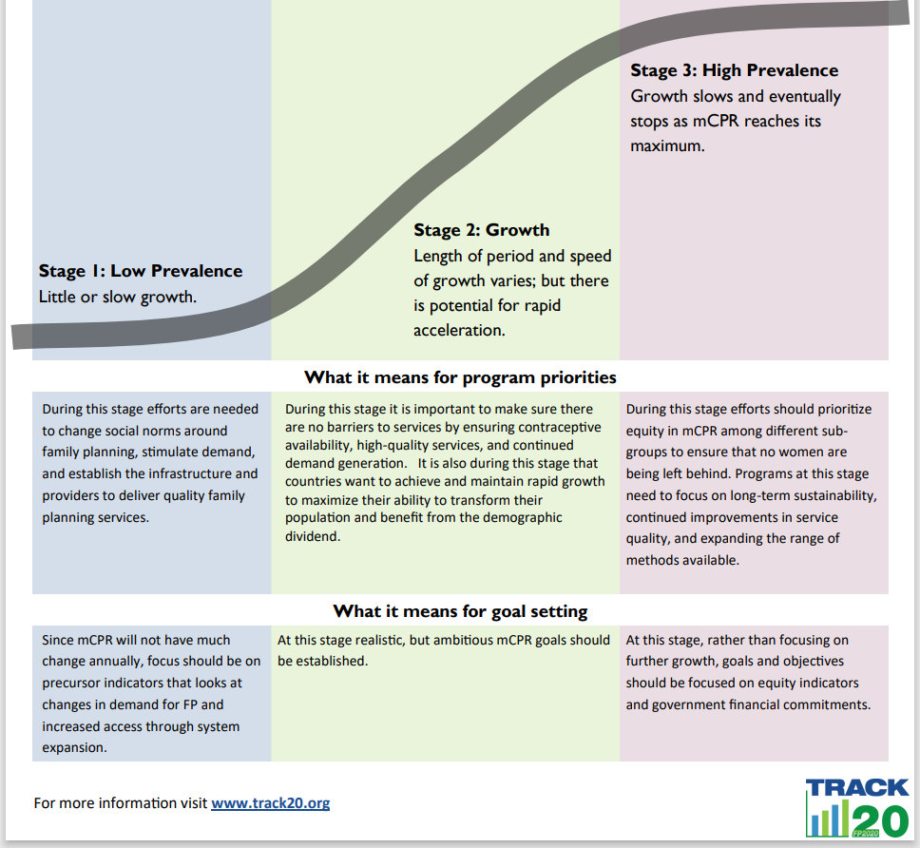
The S Curve
Historical data shows us that modern contraceptive prevalence (mCPR) grows in an S-shaped pattern. Understanding this concept can assist in:
Identifying program priorities
Setting realistic targets for growth and contraceptive prevalence goals
Maximizing the potential of obtaining the demographic dividend

Slide 15
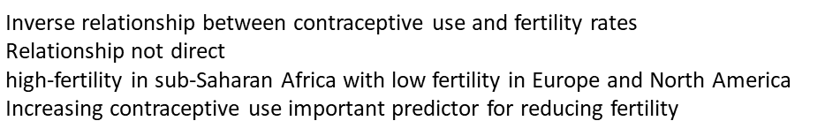
Contraceptive prevalence and fertility
B
D
C
A
B
A
B
C
D

Slide 16
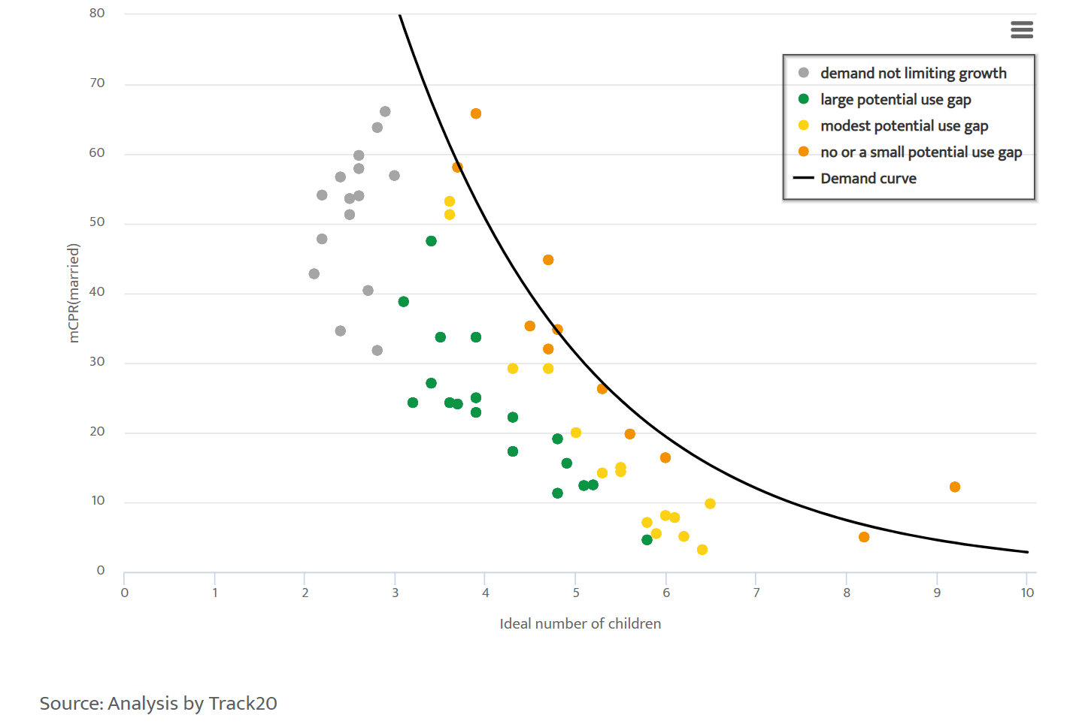
The demand curve
Kenya
Nepal
Cambodia
http://www.track20.org/pages/data_analysis/publications/special_topics/demand_curve.php
Niger
Chad
The curve represents the likely maximum mCPR that could be reached in a country given their level of demand.
Where gap is small or modest (orange or yellow dot), growth in mCPR may be limited without further changes in demand. Need to prioritize interventions that address underlying social norms orset realistic expectations about future growth.
Where the gap is large (green dot), likely room for further mCPR growth from investments to improve and expand family planning service delivery. Demand less likely to be a constraint.
Concept is not applicable where mean ideal number of children is low (grey dot).

Slide 17
Conclusions
Family planning indicators are important health indicators
The indicators vary widely globally and even within countries
Measurement of FP indicators is complex and uses various data sources
FP indicators have important applications for policy and management planning

Slide 18
Readings and videos
Read the Family Planning and the 2030 Agenda for Sustainable Development Data Booklet https://www.un.org/en/development/desa/population/publications/pdf/family/familyPlanning_DataBooklet_2019.pdf
Listen to the FP2030 Data Webinar: Advancing the Family Planning Measurement Agenda from 11.30 minutes to 30.20 minutes.
https://www.youtube.com/watch?v=TSuRyETYB_c
If you have questions discuss with your coach and submit any that you would like discussed in the webinar.

Slide 19

Thank you
Follow us on Twitter @HRPresearch
Website who.int/reproductivehealth

