Slide 1

Contraceptive methods
Part 1 - Combined hormonal contraceptives
"Family Planning”: An Online Evidence-based Course 2021
Raqibat Idris, MBBS, DO, MPH
Geneva Foundation for Medical Education and Research

Slide 2
Outline and objectives
Description of the method
Mechanism of action
Effectiveness
Benefits and side effects
Eligibility criteria
Interventions for associated effects

Slide 3
Methods
Combined hormonal contraceptives
Combined oral contraceptives (COCs)
Combined injectable contraceptives (CICs)
Combined contraceptive patch
Combined contraceptive vaginal ring (CVR)

Slide 4
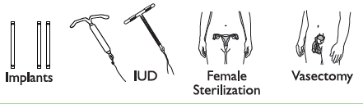

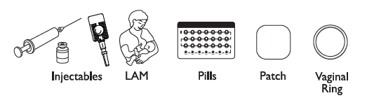


Comparing Effectiveness of Family Planning Methods
More effective
Less than 1 pregnancy per
100 women in one year
How to make your
method more effective
Implants, IUD, female sterilization:
After procedure, little or nothing to do or remember
Vasectomy: Use another method for first
3 months
Injectables: Get repeat injections on time
Lactational Amenorrhea Method (for 6 months): Breastfeed often, day and night
Pills: Take a pill each day
Patch, ring: Keep in place, change on time
Male condoms, diaphragm: Use correctly every time you have sex
Fertility awareness methods: Abstain or use condoms on fertile days. Standard Days Method and Two-Day Method may be easier to use.
Female condoms, withdrawal, spermicides: Use correctly every time you have sex
Less effective
About 30 pregnancies per
100 women in one year
Family Planning: A Global Handbook for Providers (3rd Edition, 2018)
Notes:
Methods of contraception have different mechanisms of action and effectiveness in preventing unintended pregnancy. Effectiveness of methods is measured by the number of pregnancies per 100 women using the method per year.

Slide 5
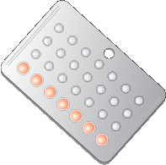
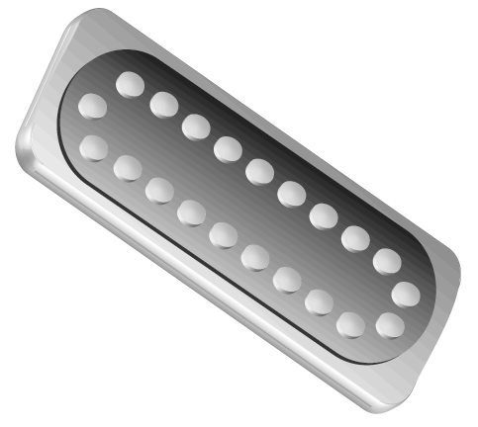
Combined oral contraceptive pills (COCS)

Slide 6
What are COCs? Traits and types
COCs are pills that contain low doses of 2 hormones, a progestin and an
estrogen like the natural hormones progesterone and estrogen in
a woman’s body. They are also called “the Pill,” low-dose combined pills, OCPs, and OCs.
Traits and types
Content | Combination of two hormones: estrogen and progestin
Phasic | Monophasic, biphasic, triphasic
Dose | Low-dose: 30-35 µg of estrogen (common), 20 µg or less (rare in most places)
Pills per pack | 21: all active pills (7-day break between packs)
 | 28: 21 active + 7 inactive pills (no break between packs)
Family Planning: A Global Handbook for Providers (3rd Edition, 2018)
Table adapted from Training Resource Package for Family Planning: https://www.fptraining.org/
Notes:
• COCs can differ in hormone content, dosage, and number of pills per pack. All combined oral contraceptive pills contain ethinyl estradiol, which is a synthetic estrogen, and one of the various types of progestin. The most common type of combined pill is monophasic, in which the hormone content is constant in all 21 active pills.
• COCs are also available as biphasic and triphasic pills, in which the ratio of estrogen to progestin varies among the active pills two or three times during the cycle. There are no clinically significant differences in effectiveness or safety between multiphasic and monophasic pills.
• Both the type and the amount of hormone contained in each formulation of pill are related to its potential for side effects. The low-dose pills used today generally contain 30 to 35 micrograms (µg) of ethinyl estradiol and have a much lower potential for side effects than older high-dose pills containing 50 µg of estrogen (commonly used until the late 1970s and now used primarily for emergency contraception). Some types of low-dose pills contain as little as 20 µg of estrogen, but they are rare in most places.
• COCs are packaged with either 21 or 28 pills per pack. The 21-pill pack contains only active pills and requires women to take a seven-day break between packs. The 28-pill pack contains 21 active pills and seven inactive or hormone-free pills. These inactive pills are included to minimize the risk of women forgetting to start a new pack of pills on time after a seven-day break. The seven-day period, during which no active pills are taken, is called the “hormone-free interval.” Most women have their menstrual bleeding during this hormone-free interval.
Source: Training Resource Package for Family Planning: https://www.fptraining.org/

Slide 7
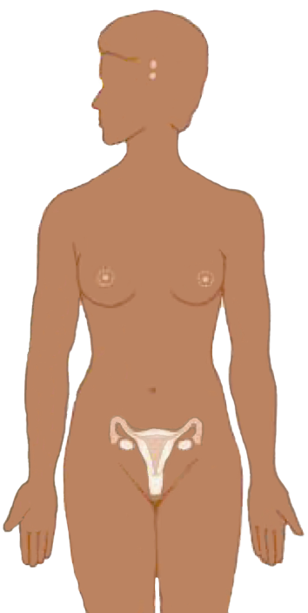
COCs: Mechanism of action
Suppresses
hormones
responsible for
ovulation
Thickens
cervical mucus to block sperm
COCs have no effect on an existing pregnancy.
Adapted from Training Resource Package for Family Planning: https://www.fptraining.org/
Notes:
Illustration credit: Salim Khalaf/FHI

Slide 8
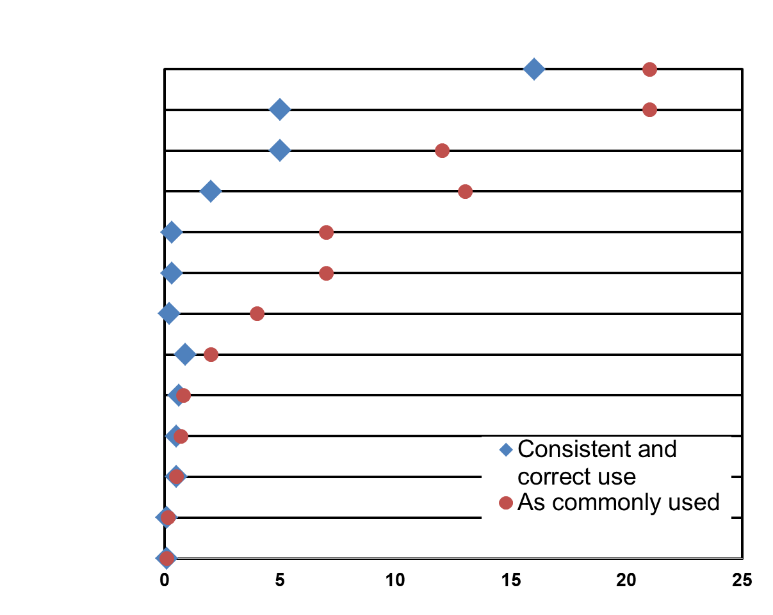
Combined oral contraceptives (COCs):
Effectiveness
Spermicides
Female Condoms
Standard Days Method
Male Condoms
Progestin-only Pills
COCs
Progestin-only Injectables
LAM (6 months)
Copper-IUD
LNG-IUD
Tubal Ligation
Vasectomy
Implants
First-Year Pregnancy Rate per 100 Women
Adapted from Training Resource Package for Family Planning: https://www.fptraining.org/
Notes:
Combined oral contraceptives are very effective when taken correctly and consistently. This chart compares the pregnancy rates for COCs with the rates for other contraceptive methods. The blue diamonds show pregnancy rates for correct and consistent use, reflecting how often a contraceptive fails when it is used both correctly and consistently. The red circles show pregnancy rates for common use, reflecting how often a contraceptive fails in real-life situations, when it may not always be used correctly and consistently.
In the case of COCs, there is a substantial difference between pregnancy rates for correct and consistent use and common use. As the chart shows, the pregnancy rate is less than 1 percent for correct and consistent COC use, but about 9 percent as COCs are commonly used.
Correct and consistent use for users of COCs means taking one pill every day, starting a new pack of pills on time, and following instructions for missed pills.

Slide 9
COCs: Characteristics
Most women can safely use the pill
Safe and more than 99% effective if used correctly
Can be stopped at any time
No delay in return to fertility
Are controlled by the woman
Do not interfere with sex
Have health benefits
Less effective when not used correctly (91%)
Require taking a pill every day
Do not provide protection from STIs/HIV
Have side effects
Have some health risks (rare)
Adapted from Training Resource Package for Family Planning: https://www.fptraining.org/

Slide 10
COCs: Health benefits
Menstrual
Decreased amount of flow and fewer days of bleeding; no bleeding (less common)
Regular, predictable menstrual cycles
Reduced pain and cramps during menses
Reduced pain at time of ovulation
Others
Protection from Risks of pregnancy, ovarian cancer and endometrial cancer and symptomatic PID
Reduced risk of ovarian cysts and iron-deficiency anemia
Decreased symptoms of endometriosis (pelvic pain, irregular bleeding)
Decreased symptoms of polycystic ovarian syndrome (irregular bleeding, acne, excess hair on face or body)
Adapted from Training Resource Package for Family Planning: https://www.fptraining.org/
Notes:
About 90 percent of women taking COCs experience regular monthly cycles: their menses predictably come during the hormone-free interval. COCs reduce the pain and cramps that commonly occur during menses or in mid-cycle at the time of ovulation. They can also relieve the symptoms of dysmenorrheal (painful menses) and are often prescribed for treatment of this condition.
Other Health Benefits
There is lingering concern that COCs may cause cancer. In fact, COCs protect women against ovarian and endometrial cancer. Many studies have demonstrated that COC users have less than half the risk of developing these cancers compared to non-users.
It has also been observed that among women who take COCs, there are fewer symptomatic cases of pelvic inflammatory disease (PID). It is not clear if COCs prevent PID or make PID symptoms less severe.
COCs offer other health benefits as well. Because COCs inhibit ovulation, they have been shown to reduce the risk of functional ovarian cysts.* It was found that the amount of bleeding in women who use COCs is reduced by 50 percent on average, which helps to reduce risk of iron-deficiency anemia. Additionally, the inactive pills in some brands contain iron, which may further reduce the risk of anemia.
COCs inhibit the growth of endometrial tissue, so they are very effective in reducing symptoms of endometriosis, a condition in which endometrial tissue is found outside the uterus, leading to pelvic pain.
COCs are also known to decrease symptoms of polycystic ovarian syndrome, such as irregular bleeding, acne, and excess hair on face and body.

Slide 11
No overall increase in breast cancer risk for COC users
Analysis of a large number of studies:
No overall increase in breast cancer risk among women who had ever used COCs
Current use and use within past 10 years: very slight increase in risk
  May be due to early diagnosis or accelerated growth of pre-existing tumors
More recent study:
No increase in breast cancer risk regardless of age, estrogen dose, ethnicity, or family history of breast cancer
Adapted from Training Resource Package for Family Planning: https://www.fptraining.org/

Slide 12
Relative risk for breast cancer among COC users and non-users
Relative Risk Log Scale
10
Increased Risk
1.0
1.24
[1.15–1.33]
1.16
[1.08–1.23]
1.07
[1.02–1.13]
1.01
[0.96–1.05]
1
No Effect
Protective Effect
[95% Confidence Interval]
0.1
Non-users
Current COC users
1–4 yrs after stopping
5–9 yrs after stopping
10+ yrs after stopping
Adapted from Training Resource Package for Family Planning: https://www.fptraining.org/
Notes:
This chart depicts the findings of the reanalyzed data from 54 independent studies conducted in 25 countries. It shows the relationship of the relative risks for breast cancer among non-users, current users, and past COC users. Non-users have a relative risk of 1.0 because there is no effect on breast cancer due to COC use. Relative risk values with confidence intervals above 1.0 indicate an increased risk, while values below 1.0 indicate a decrease in risk or a protective effect. Notice that the increased risk, while still small, is highest in current users and gradually decreases with time after discontinuation, reaching 1.01 in women who discontinued COCs 10 or more years ago. While the relative risk value for women 10 years after stopping is 1.01, the confidence interval includes 1.0, which means that this small relative risk is not statistically significant.
The study also found that this pattern of risk among COC users remains the same even if women have additional risks of breast cancer, such as women from specific ethnic groups, with certain reproductive histories, or with a family history of breast cancer.

Slide 13
Protective effect of COC use on ovarian and endometrial cancer
Lifetime risk of acquiring ovarian or endometrial cancer after 8+ years of COC use
Number per 100 women
100
10
Reduces
risk by more than 50%
Protection develops after 12 months of use and is present for at least 15 years
Ovarian Cancer
Endometrial Cancer
Non COC users
Non COC users
8
COC users
COC users
6
4
3.1
2
1.7
1.2
0.7
0.6
0.7
0.6
0.4
Source: Petitti and Porterfield, 1992; CASH Study 1987.
0.2
0.3
0.2
0.1
0
United States
Costa Rica
China
Adapted from Training Resource Package for Family Planning: https://www.fptraining.org/
Notes:
One area of confusion is the relationship between COCs and cancer. As shown in this chart, COCs protect women against ovarian and endometrial cancer. Many studies have demonstrated that users have less than half the risk of developing these cancers compared to non-users. The protective effect develops after 12 months of COC use and lasts at least 15 years after a woman discontinues taking the pills.
This chart demonstrates the protective effect using modeled data from selected countries. It is estimated that, in the United States, eight or more years of COC use reduces the lifetime risk of acquiring ovarian cancer from 1.7 per 100 women to 0.7. In both Costa Rica and China, COC use would cause the lifetime risk of ovarian cancer to drop from 0.6 to 0.2 per 100 women. The lifetime risk of endometrial cancer among women using COCs drops from 3.1 to 1.2 per 100 in the United States, from 0.7 to 0.3 per 100 women in Costa Rica, and from 0.4 to 0.1 per 100 in China.

Slide 14
COCs and cervical cancer
Cervical cancer is caused by certain types of human papillomavirus (HPV).
Some increase in risk among women with HPV and others who use COCs more than 5 years.
  Risk of cervical cancer goes back to baseline after 10 years of non-use
Cervical cancer rates in women of reproductive age are low. Risk of cervical cancer at this age group is low compared to mortality and morbidities associated with pregnancy.
COC users should follow the same cervical cancer screening schedule as other women.
Adapted from Training Resource Package for Family Planning: https://www.fptraining.org/

Slide 15
COCs: Risk of blood clots is limited
COCs may slightly increase risk of blood clots:
  Stroke
  Heart attack
Risk is concentrated among women who have additional risk factors, such as:
  Hypertension
  Diabetes
  Smoking
  Deep vein thrombosis
  Pulmonary embolism
Stop COCs immediately if a blood clot develops.
Adapted from Training Resource Package for Family Planning: https://www.fptraining.org/
Notes:
The estrogen component of the combined pill may slightly increase the risk of blood clots in veins or arteries, including stroke, myocardial infarction (heart attack), deep vein thrombosis (DVT), and pulmonary embolism (PE).
However, because the estrogen component of the pill has been progressively reduced over the past few decades, the risk of blood clots with current low-dose COCs—containing 35 µg or less of estrogen—is much smaller than with older, high-dose COCs. COCs containing third generation progestins, such as gestodene and desogestrel, have also been associated with somewhat higher risk of blood clots, but this risk is still significantly smaller than the risk of blood clots during pregnancy.
It is important to put the increased risk for blood clots in perspective. Stroke, heart attack, deep vein thrombosis, and pulmonary embolism are extremely rare in women of reproductive age—especially younger women. Therefore, a small increase in risk due to COC use will result in a very small number of additional cases.
The risk of blood clots is higher in reproductive-age women who have other risk factors such as hypertension, diabetes, or smoking. The number of heart attacks is higher in older COC users who smoke or have high blood pressure compared to healthy COC users. This is why it is important to screen for existing risk factors prior to starting COCs.
In the rare event that a blood clot develops, COCs must be discontinued immediately. Later in this presentation, we will discuss specific symptoms that may accompany blood clots.

Slide 16
COC users and risk of blood clots
Estimates of venous thromboembolism per 100,000 woman-years
 | Incidence | Relative Risk
Young women in the general population | 4–5 | 1
Low-dose COCs | 12–20 | 3–4
High-dose COCs | 24–50 | 6–10
Pregnant women | 48–60 | 12
Pregnancy presents a higher risk of blood clots
than do COCs.
Adapted from Training Resource Package for Family Planning: https://www.fptraining.org/
Notes:
This chart compares the risk of blood clots among women using modern, low-dose COCs, women using older, high-dose formulations, and pregnant women.
Notice that the baseline incidence of blood clots in young women who are not using COCs is four to five cases per 100,000 over a period of one year. For women taking high-dose COCs (with 50 µg or more of estrogen) the incidence of blood clots is 24 to 50 cases per 100,000 women. The incidence drops to 12 to 20 cases among women who take low-dose COCs (with less than 50 µg estrogen).
Note that the risk of blood clots among women taking either high- or low-dose COCs is still significantly less than that of pregnant women.

Slide 17
COC users and risk of heart attack
Estimated number of heart attacks per million woman-years
Characteristic | Age 20-24 | Age 30-34 | Age 40-44
Healthy non-COC user | 0.14 | 1.7 | 21.3
Healthy COC user | 0.34 | 4.2 | 53.2
COC user who smokes | 1.6 | 20.4 | 255
COC user with ↑ BP | 2.0 | 25.5 | 319
Adapted from Training Resource Package for Family Planning: https://www.fptraining.org/
Notes:
This chart compares the estimated number of heart attacks among healthy women who do not use COCs, healthy women who use COCs, and COC users with additional risk factors for heart disease. Notice that among non-smoking, healthy women ages 40–44, the estimated number of heart attacks for non-COC users is 21 and for COC users is 53 per one million woman-years. However, the number of estimated heart attacks among COC users who smoke or have high blood pressure increases dramatically to 255 and 319, respectively.
This is why it is important to screen clients for existing risk factors before they initiate COC use.

Slide 18
COC side effects
Nausea (upset stomach)- most common
Changes in bleeding patterns (lighter, irregular, infrequent or no monthly bleeding)
Mood changes or headaches
Tender breasts
Dizziness
Slight weight gain or loss
Many women do not have any side-effects. Side-effects often go away after a few months and are not harmful.
Adapted from Training Resource Package for Family Planning: https://www.fptraining.org/

Slide 19
Who can use COCS
Category 1 and 2 examples:
WHO Category | Conditions (selected examples)
Category 1 | menarche to 39 yrs; nulliparous; endometriosis; endometrial or ovarian cancer; uterine fibroids; family history of breast cancer; varicose veins; irregular, heavy, or prolonged bleeding; anemia; STI/PID; hepatitis (chronic/carrier)
Category 2 | ≥40 yrs; breastfeeding ≥6 months postpartum; superficial venous thrombosis; dyslipidaemias without other cardiovascular risk factors; uncomplicated diabetes; cervical cancer; unexplained vaginal bleeding; undiagnosed breast mass
Adapted from Training Resource Package for Family Planning: https://www.fptraining.org/
Notes:
Category 1: For women with these conditions or characteristics, the method presents no risk and can be used without restrictions.
Category 2: For women with these conditions or characteristics, the benefits of using the method generally outweigh the theoretical or proven risks. Women with Category 2 conditions generally can use the method, but careful follow-up may be required.

Slide 20
Who should generally not use COCs
Category 3 Examples:
WHO Category | Conditions (selected examples)
Category 3 | Postpartum: Breastfeeding between 6 weeks and 6 months Non-breastfeeding and less than 3 weeks if no additional risk factors for deep vein blood clots (VTE) Non-breastfeeding 3-6 weeks with additional risk of VTE
 | Vascular conditions: Hypertension (history of or BP 140-159/90–99) Migraine without aura (older than 35 yrs)
 | Gastrointestinal conditions: Symptomatic gall bladder disease (current and medically-treated)
 | Drug interactions: Use of seizure medications or rifampicin or rifabutin
Adapted from Training Resource Package for Family Planning: https://www.fptraining.org/
Notes:
Category 3: For women with these conditions or characteristics, the theoretical or proven risks of using the method usually outweigh the benefits. Women with Category 3 conditions generally should not use the method. However, if no better options for contraception are available or acceptable, the provider may judge that the method is appropriate, depending on the severity of the condition. In such cases, ongoing access to clinical services and careful follow-up will be required.

Slide 21
Who should not use COCs
Category 4 Examples:
WHO Category | Conditions (selected examples)
Category 4 | Breastfeeding: <6 weeks postpartum
 | Non-Breastfeeding: <3 weeks with risk factors for VTE
 | Smoking: ≥15 cigarettes/day and ≥ 35 yrs old
 | Vascular conditions: Hypertension (≥160/≥100) Migraines with aura Ischemic heart disease or stroke Diabetes with vascular complications Deep venous thrombosis (history or acute) Pulmonary embolism (history or acute)
 | Liver conditions: Acute hepatitis Severe liver disease and most liver tumors
 | Breast cancer: current or within 5 yrs
Adapted from Training Resource Package for Family Planning: https://www.fptraining.org/
Notes:
Category 4: For women with these conditions or characteristics, the method presents an unacceptable health risk and should not be used.
In some cases, a particular condition or characteristic is assigned to one category for initiation and another for continuation of the method. In other words, the category may depend on whether a woman with the condition wishes to initiate the contraceptive method or was already using that method when she developed the condition.

Slide 22
COC use by women with HIV
WHO Eligibility Criteria
Condition | Category
HIV-infected | 1
AIDS | 1
ARV therapy (which does not contain ritonavir) | 2
Ritonavir/ ritonavir-boosted PIs (as part of ARV regimen) | 3
Women with HIV or AIDS can use without restrictions
Women on ARVs can use COCs safely
Should not be used by women who take medications for seizures or rifampacin or rifabutin for tuberculosis (may reduce effectiveness of COCs)
Using low-dose COCs is appropriate
Condom use should be encouraged in addition to COCs
Adapted from Training Resource Package for Family Planning: https://www.fptraining.org/
Notes:
Women with HIV who may or may not have AIDS can use COCs without any restrictions—category 1.
According to WHO, women with AIDS who are on antiretroviral (ARV) therapy generally can use COCs.
Women who are taking medicines for seizures (such as barbiturates, carbamazepine, lamotrigine, oxcarbazepine, phenytoin, primidone, topiramate) or medication for tuberculosis such as rifampicin, or rifabutin should not take COCs. These medications can make COCs less effective.
A sensible approach may be to use condoms consistently as a backup method of contraception while taking low-dose COCs.
Regardless of the method chosen, counseling on condom use should be an integral part of contraceptive counseling for women with HIV.

Slide 23
COC use by postpartum women
WHO Eligibility Criteria
Condition | Category
Non-breastfeeding <3 weeks | 3
Breastfeeding <6 weeks | 4
Breastfeeding >6 weeks and < 6 months | 3
Breastfeeding ≥6 months | 2
Non-breastfeeding women should not initiate COCs before 3 weeks postpartum (3-6 weeks postpartum with VTE risk factors)
Breastfeeding women
  Should not use COCs before
  6 weeks postpartum
  Should not use COCs from
  6 weeks to 6 months postpartum unless no other method is available
  Can generally initiate COCs at
  6 months postpartum
Adapted from Training Resource Package for Family Planning: https://www.fptraining.org/

Slide 24
When to start COCs - 1
Anytime you are reasonably certain the woman is not pregnant
Pregnancy can be ruled out if the woman meets one of the following criteria:
  Started monthly bleeding within the past 7 days
  Is breastfeeding fully, has no menses and baby is less than 6 months old
  Has abstained from intercourse since last menses or delivery
  Had a baby in the past 4 weeks
  Had a miscarriage or an abortion in the past 7 days
  Is using a reliable contraceptive method consistently and correctly
If none of the above apply, pregnancy can be ruled out by pregnancy test, pelvic exam, or waiting until next menses
Adapted from Training Resource Package for Family Planning: https://www.fptraining.org/
Notes:
A woman can start taking COCs anytime a provider is reasonably certain that she is not pregnant.
A provider can be reasonably certain that a woman is not pregnant if any of these situations apply:
Her monthly bleeding started within the past seven days.
The woman is fully breastfeeding, has no menses, and her baby is less than six months old.
She has abstained from intercourse since her last menses or since delivery.
She had a baby in the past four weeks.
She had a miscarriage or an abortion in the past seven days.
She has been using a reliable contraceptive method consistently and correctly.
If none of these situations apply, a provider can conduct a urine pregnancy test or a bimanual pelvic exam if appropriate to determine if the woman is pregnant.
If no other means to rule out pregnancy are available, a provider can ask a woman to come back at the time of her next menses and to use a backup contraceptive method in the meantime.
Providers may give a pack of COCs to the client with instructions to begin using them when her menses starts. This is known as advance provision.

Slide 25
When to start COCs - 2
If starting during the first 5 days of the menstrual cycle, no backup method needed
After day 5 of her cycle, rule out pregnancy and use backup method for the next 7 days
Postpartum
  Not breastfeeding: May start 3 to 6 weeks after giving birth, depending on presence of risk factors for blood clots
  Breastfeeding: May start 6 months after giving birth
Adapted from Training Resource Package for Family Planning: https://www.fptraining.org/
Notes:
If a woman initiates COC use during the first five days after the onset of her menstrual period, it is not necessary to use a backup method, such as condoms.
Because it takes time for COCs to become fully effective, starting use during the first five days allows the hormones to fully inhibit follicular development in the ovaries and prevent ovulation, ensuring that there is virtually no danger of pregnancy.
If a woman starts COCs after the fifth day of her menstrual cycle it is necessary to rule out pregnancy. She should also use a backup method for seven days as there is a chance she may ovulate before COCs become fully effective.
You can be reasonably certain a woman is not pregnant if she is starting within seven days after the start of her menses. If it is more than seven days, you should ask the other pregnancy-related questions on the checklist to rule out pregnancy.
A woman who is not breastfeeding may begin COCs three weeks after delivery, when the increased risk of blood clots associated with pregnancy subsides. This interval is extended to 6 weeks after delivery for women with additional risk factors for blood clots.
If a non-breastfeeding woman wishes to initiate COCs after four weeks postpartum, it is necessary to first rule out pregnancy.
If fully or nearly fully breastfeeding, a woman may begin COCs at six months postpartum.
COCs may be provided in advance so that a breastfeeding woman can initiate the method when it is appropriate for her situation.

Slide 26
When to start COCs - 3
After miscarriage or abortion
  Immediately, if within 7 days after first- or second-trimester miscarriage or abortion, no backup method needed
  If more than 7 days after, rule out pregnancy, use backup method for
  7 days
Switching from hormonal method
  May start immediately, no backup method needed (with injectables, initiate within reinjection window)
Switching from non-hormonal method
  If starting within 5 days of start of menstrual cycle, no backup method needed
  If starting after day 5 of cycle, use backup method for 7 days
After using emergency contraceptive pills
  Initiate immediately after taking progestin-only ECPs, use backup method for 7 days
  After taking ulipristal acetate (UPA) ECPs she can start or restart COCs on the 6th day after taking UPA EPs
Adapted from Training Resource Package for Family Planning: https://www.fptraining.org/
Family Planning: A Global Handbook for Providers (3rd Edition, 2018)
Notes:
• A woman can start COCs immediately or within the first seven days after a first- or second-trimester miscarriage or abortion without the need for a backup method. However, if she wishes to start COCs more than seven days after a miscarriage or abortion, rule out pregnancy and instruct the woman to use a backup method, such as condoms, for seven days. (Family Planning: A Global Handbook for Providers (3rd Edition, 2018))
• When switching from hormonal methods, COCs can be started immediately with no need for a backup method.
• If the woman is switching from injectables to COCs, she can initiate anytime during the reinjection window.
• When switching from nonhormonal methods, COCs can be started during the first five days of the menstrual cycle with no need for a backup method. After day five of the menstrual cycle, instruct the woman to use a backup method for the next seven days.
• If the woman is switching from an IUD to COCs after day five of her cycle, the IUD can be left in place as backup method for the next seven days or until her next menses. If an IUD user has had intercourse since her last menses, it is particularly important to keep the IUD in place for at least seven days after starting COCs.
• If a woman has taken progestin-only emergency contraceptive pills, she can start or re-start COCs immediately after she takes the ECPs. No need to wait for her next monthly bleeding. If she does not start immediately, but returns for COCs, she can start at any time she is reasonably certain she is not pregnant. If a woman has taken ulipristal acetate (UPA) ECPs she can start or re-start COCs on the 6th day after taking UPA ECPs. All women will need to use a backup method for the first 7 days after taking pills. (Training Resource Package for Family Planning: https://www.fptraining.org/).

Slide 27
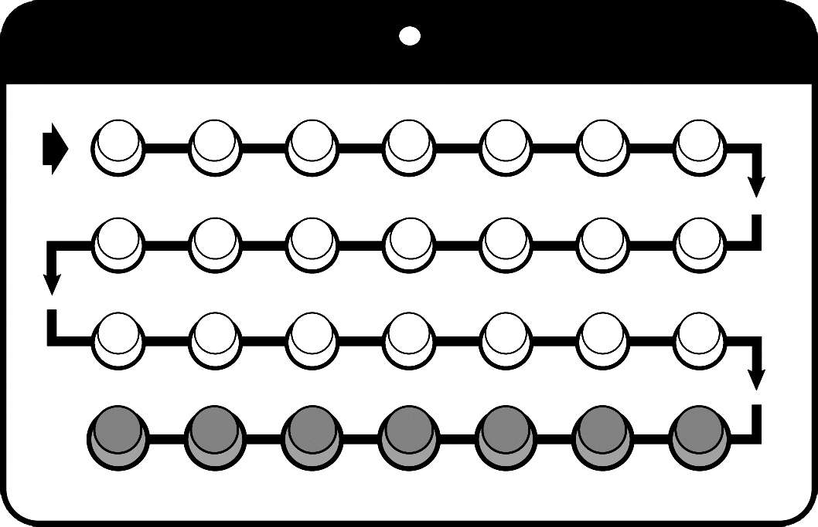
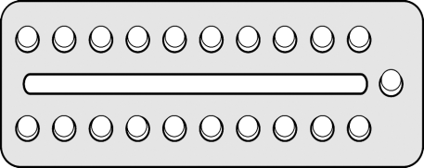
How to take COCs
Take one pill each day, by mouth.
If you use the 28-pill pack:
No waiting between packs.
Once you have finished all the pills in the pack, start new pack on the next day.
If you use the 21-pill pack:
7 days of no pills
Once you have finished all the pills in the pack, wait 7 days before starting new pack. For example: If you finish the old pack on Saturday, take the first pill of the new pack on the following Sunday.
28-pill pack
21-pill pack
21-pill pack
Waiting too long between packs greatly increases risk of pregnancy.
Adapted from Training Resource Package for Family Planning: https://www.fptraining.org/
Notes:
After a woman starts taking COCs, she should take one pill each day until the pack is empty. Failing to take the pill daily increases the risk of pregnancy.
Women using the 21-pill pack take a seven-day break from pill taking each month. The 28-pill pack users take seven inactive pills during the hormone-free interval and do not take a break between pill packs.

Slide 28






COCs: Missed pills instructions
Miss 1 or 2 active pills in a row or start a pack 1 or 2 days late:
Always take a pill as soon as possible.
Continue to take one pill every day.
No need for additional protection.
Miss 3 or more active pills in a row or start a pack 3 or more days late:
Take a pill as soon as possible, continue taking 1 pill each day, and use condoms or avoid sex for next 7 days. If she had sex in the past 5 days, she can consider ECPs.
AND
OR
If these pills missed in week 3, ALSO skip the inactive pills in a 28-pill pack and start a new pack
If the inactive pills are missed, throw away the missed pills and continue taking pills 1 each day
week 3
Adapted from Training Resource Package for Family Planning: https://www.fptraining.org/
Family Planning: A Global Handbook for Providers (3rd Edition, 2018)

Slide 29
COCs: Correcting rumors and misconceptions
COCs:
Do not build up in a woman’s body. Women do not need a “rest” from taking COCs.
Must be taken every day, whether or not a woman has sex that day.
Do not make women infertile.
Do not cause birth defects or multiple births.
Do not change women’s sexual behavior.
Do not collect in the stomach. Instead, the pill dissolves each day.
Do not disrupt an existing pregnancy.
Adapted from Training Resource Package for Family Planning: https://www.fptraining.org/

Slide 30
Management of COC side effects
Counseling and reassurance are key.
Problem | Action/Management
Ordinary headaches | Reassure client: usually diminish over time; take painkillers | If side effects persist and are unacceptable to client: if possible, switch pill formulations or switch to another method.
Nausea and vomiting | Take pills with food or at bedtime
Breast tenderness | Recommend supportive bra; suggest pain reliever
Adapted from Training Resource Package for Family Planning: https://www.fptraining.org/
Notes:
Thorough counseling at the time COCs are provided often reduces the anxiety some women may feel when they experience side effects. If side effects do occur and are bothersome to the client, the first step of management is to address the client’s concerns through follow-up counseling.
If a client experiences ordinary headaches that are not migraines, tell the client that ordinary headaches do not indicate any dangerous conditions and usually diminish over time. She can use standard doses of painkillers such as aspirin, ibuprofen, paracetamol, or other pain relievers to relieve symptoms. For women who experience headaches during the hormone-free week, consider extended or continuous use of COCs.
Although ordinary headaches are a common side effect of COC use, headaches that get worse or occur more often during COC use should be evaluated. While women younger than 35 who have migraine headaches without an aura can initiate COCs, a woman who develops migraine headaches, with or without aura, or whose migraine headaches become worse while using COCs should stop using them. The provider should help her choose a method without estrogen.
Taking pills on a full stomach or at bedtime may help prevent nausea and vomiting. If a woman experiences vomiting or diarrhea within two hours of taking COCs, she should take another pill from her pack as soon as possible and then continue taking pills as usual. If vomiting or diarrhea continues for longer than two days, she should continue daily COC use and start using a backup method, which she should continue using until seven days after the vomiting and diarrhea have resolved.
For breast tenderness, recommend the client wear a supportive bra. She may also try pain relievers.
If side effects persist and are unacceptable to the client, health care providers may recommend switching to a different pill formulation or to another contraceptive method.

Slide 31
Management of COC side effects:
Bleeding changes
Problem | Action/Management
Irregular bleeding | Reassure client: reinforce correct pill taking and review missed pill instructions; ask about other drugs that may interact with COCs; administer short course of non-steroidal anti-inflammatory drugs | If side effects persist and are unacceptable to client: if possible, switch pill formulations or offer another method.
Amenorrhea | Reassure client: no medical treatment necessary.
Adapted from Training Resource Package for Family Planning: https://www.fptraining.org/
Notes:
Use slides to present the following:
If a client complains about irregular or breakthrough bleeding, the provider should first make sure the client is taking the pills correctly, without missing pills. The provider should also ask whether the client is taking any drugs that may interact with COCs, such as rifampicin or rifabutin, which make COCs less effective. If none of these situations applies, providers can explain that COCs make the uterine lining thinner, and it may start shedding early, resulting in this type of bleeding. The provider can assure a woman that this bleeding does not mean that anything is wrong and usually diminishes with time. Suggest that she take pills at the same time each day—this may help to reduce irregular bleeding.
If the irregular bleeding is unacceptable to the client, the provider may want to consider giving her ibuprofen, up to 800 mg three times per day for five days, or an equivalent amount of another non-steroidal anti-inflammatory drug other than aspirin.
If the woman is experiencing unexplained, heavy, or prolonged vaginal bleeding that may suggest a serious medical condition not related to the method, she should be referred for evaluation as soon as possible.
Amenorrhea may simply be a sign that the pills are working effectively. Reassure the client that it does not indicate a health problem and no medical treatment is necessary. If the client develops amenorrhea while using pills incorrectly or after using COCs for only a short time, the provider should determine if the client is pregnant.
Sometimes side effects may diminish or disappear if the client switches to another formulation of COCs. A provider may prescribe a different pill brand if available.
If side effects persist and are unacceptable to the client, the provider should help her to choose another contraceptive method.

Slide 32
When to return: Warning signs of rare COC complications
Severe, constant pain in belly, chest, or legs
Very bad headaches
A bright spot in your vision before bad headaches
Yellow skin or eyes
Advise to stop taking COCs, use a backup method, and see a health care provider.
Adapted from Training Resource Package for Family Planning: https://www.fptraining.org/
Notes:
On very rare occasions, women who use COCs can develop serious complications, usually due to thrombosis or thromboembolism—a blood clot that may form in the blood vessels of the heart, brain, leg, or abdomen. Warning signs of such complications include severe abdominal pain; severe chest pain or shortness of breath; severe headache with dizziness, weakness, numbness, or eye problems, such as temporary vision loss or blurred vision; and severe pain in the calf or thigh.
If a woman taking COCs experiences any of these symptoms, she should stop taking pills, begin using a backup method, and see a health care provider immediately.

Slide 33
Problems that may require stopping COCs or switching to another method - 1
Problem | Action
Unexplained vaginal bleeding | Refer or evaluate by history and pelvic exam Diagnose and treat as appropriate If an STI or PID is diagnosed, the client may continue using COCs during treatment
Migraines | If the client develops migraines with or without aura, or her migraine headaches worsen, stop COC use Help the client choose a method without estrogen
Circumstances that keep her from walking for one week or more | Tell the client she should: Tell her doctors she is using COCs Stop taking COCs and use a backup method Restart COCs 2 weeks after she can move about
Adapted from Training Resource Package for Family Planning: https://www.fptraining.org/
Notes:
There are some serious health conditions that may require a client to stop using COCs.
If a client experiences unexplained, heavy, or prolonged bleeding that is suggestive of a medical condition not related to the method, refer the client or evaluate by taking her medical history and doing a pelvic examination. Diagnose and treat as appropriate. The client can continue using COCs while her condition is being evaluated. If the bleeding is caused by an STI or PID, the client can continue using COCs during treatment. Although women younger than 35 who have migraine headaches without aura can initiate COCs, a woman of any age who develops migraine headaches, with or without aura, or whose migraine headaches become worse while using COCs should stop using them. The provider should help this client choose a method without estrogen. If a client is having major surgery, or her leg is in a cast, or for other reasons she will be unable to move about for one week or more, she should tell her doctors that she is using COCs, stop taking COCs and use a backup method during this period, and resume using COCs two weeks after she can move about again.

Slide 34
Problems that may require stopping COCS or switching to another method - 2
Problem | Action
Starting treatment with anti- convulsants or rifampicin, rifabutin, or ritonavir | These drugs make COCs less effective; COCs may make lamotrigine less effective. Advise the client to consider other contraceptive methods (except progestin-only pills).
Blood clots, heart or liver disease, stroke, or breast cancer | Tell the client to stop COC use Give the client a backup method to use Refer for diagnosis and care
Suspected pregnancy | Assess for pregnancy If confirmed, tell the client to stop taking COCs There are no known risks to a fetus conceived while a woman is taking COCs
Adapted from Training Resource Package for Family Planning: https://www.fptraining.org/
Notes:
If a client is starting long-term treatment with anticonvulsants or the antibiotics rifampicin and rifabutin, advise her to switch to another method, other than progestin-only pills, because these medications make COCs less effective.
Anticonvulsants include barbiturates, carbamazepine, oxcarbazepine, phenytoin, primidone, topiramate, and lamotrigine.
In addition, combined hormonal methods, including COCs, may make lamotrigine less effective. If a woman will be using these medications short-term, she can use a backup method along with COCs for greater protection from pregnancy.
If a woman develops health conditions such as blood clots in the deep veins of the legs or lungs, heart disease due to blocked or narrowed arteries, severe liver disease, vascular damage due to diabetes, or breast cancer, tell the client to stop taking COCs.
Give the woman a backup method to use until her condition is evaluated.
Refer her for diagnosis and care if she is not already under care.
Finally, if you suspect a woman is pregnant, assess for pregnancy and tell her to stop using COCs if pregnancy is confirmed. Reassure her that there are no known risks to a fetus conceived while a woman is using COCs.

Slide 35
COCs: Summary
Safe for almost all women
Effective if used consistently and correctly
Fertility returns without a delay
Screening and counseling are essential
Adapted from Training Resource Package for Family Planning: https://www.fptraining.org/
Notes:
Photo credits: © 1995 Lamia Jaroudi/CCP, Courtesy of Photoshare; © 2009 Nguyen Quoc Phong, Courtesy of Photoshare
Combined oral contraceptives have characteristics that make them a desirable family planning method for many women.
They are safe for almost all women.
They are effective if used consistently and correctly.
Fertility returns without a delay after stopping pills.
Appropriate screening and counseling plays an important role in the provision of oral contraceptives. Providers can use a simple screening tool to determine medical eligibility. Counselors must ensure that clients are aware of potential side effects, understand how to take the pill, know what to do when pills are missed, and can identify situations that require the attention of a provider. Family planning programs that offer COCs benefit their clients by increasing their contraceptive options.

Slide 36
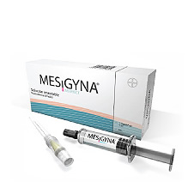
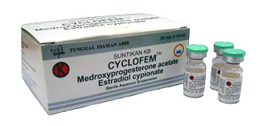
Combined injectable contraceptives (monthly injectables)

Slide 37
What are monthly injectables?
Monthly injectables or combined injectable contraceptives contain 2 hormones, a progestin and an estrogen, like the natural hormones progesterone and estrogen in a woman’s body.
(Combined oral contraceptives also contain these 2 types of hormones.)
They are also called combined injectable contraceptives, CICs, the injection.
They are available as:
  Medroxyprogesterone acetate (MPA) 25mg + estradiol cypionate
  Cyclofem, Ciclofemina, Ciclofem, Cyclo-Provera, Lunella, Lunelle, Novafem, Feminena
  Norethisterone enanthate (NET-EN) 50 mg + estradiol valerate
  Mesigyna, Norigynon
Family Planning: A Global Handbook for Providers (3rd Edition, 2018)

Slide 38
Monthly injectables: Mechanism of action and effectiveness
Mechanism of action
Like COCs, monthly injectables work primarily by preventing the release of eggs from the ovaries (ovulation).
Effectiveness
As commonly used, about 3 pregnancies per 100 women using monthly injectables over the first year. This means that 97 of every 100 women using injectables will not become pregnant.
Less than 1 pregnancy per 100 women using monthly injectables over the first year (5 per 10,000 women), when women receive their injections on time.
Family Planning: A Global Handbook for Providers (3rd Edition, 2018)

Slide 39
Characteristics of monthly injectables
COCs:
Do not require daily action by the user
Can be used privately
Injections can be stopped at any time
Good for spacing births
Slightly delayed return to fertility (An average of about 5 months, one month longer than with most other methods)
No protection against sexually transmitted infections or HIV
Family Planning: A Global Handbook for Providers (3rd Edition, 2018)

Slide 40
Monthly injectables: Differences from progestin-only injectables
Compared to progestin-only injectables DMPA or NET-EN, monthly injectables:
Contain estrogen as well progestins, that is, combined methods.
Contain less progestin
More regular bleeding, fewer bleeding disturbances.
Require a monthly injection, whereas NET-EN is injected every 2 months and DMPA, every 3 months..
Family Planning: A Global Handbook for Providers (3rd Edition, 2018)

Slide 41
Monthly injectables: Side effects
Changes in bleeding patterns
  Lighter bleeding, fewer days of bleeding
  Irregular bleeding
  Infrequent bleeding
  Prolonged bleeding
  Amenorrhea (no monthly bleed)
Weight gain
Headaches
Dizziness
Breast tenderness
Bleeding changes are normal and not harmful.
Family Planning: A Global Handbook for Providers (3rd Edition, 2018)

Slide 42
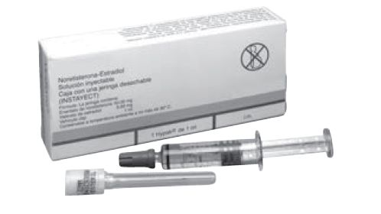
Monthly injectables: Health risks and benefits
Safe and suitable for nearly all women
Long-term studies are limited
Benefits and risks similar to those of COCs
  Less effect on blood pressure, blood clotting, lipid metabolism, and liver function
Family Planning: A Global Handbook for Providers (3rd Edition, 2018)
Notes:
Monthly injectables (also called combined injectable contraceptives) are similar to combined oral contraceptives (COCs). There are few long-term studies done on monthly injectables, but researchers assume that most of the findings about COCs also apply to monthly injectables. Monthly injectables, however, do not pass through the liver first because they are not taken by mouth like COCs. Short-term studies have shown that monthly injectables have less effect than COCs on blood pressure, blood clotting, the breakdown of fatty substances (lipid metabolism), and liver function. Long-term studies of the health risks and benefits of monthly injectables are underway.

Slide 43
Who can and cannot use monthly injectables
Nearly all women can use monthly injectables safely and effectively, including women who:
Have or have not had children
Are married or are not married
Are of any age, including adolescents and women over 40 years old
Have just had an abortion or miscarriage
Smoke any number of cigarettes daily and are under 35 years old
Smoke fewer than 15 cigarettes daily and are over 35 years old
Have anemia now or had anemia in the past
Have varicose veins
Are living with HIV, whether or not on antiretroviral therapy
Family Planning: A Global Handbook for Providers (3rd Edition, 2018)

Slide 44
When to start monthly injectables - 1
A woman can start injectables any time she wants if it is reasonably certain she is not pregnant (use the Pregnancy Checklist). There is no need for pregnancy test, any blood tests, other routine laboratory tests, pelvic examination, cervical screening or breast examination.
Having monthly bleeding:
Within 7 days after the start of monthly bleeding, it can be assumed she is not pregnant. Start injection and no need for a backup method.
If after 7 days after the start of her monthly bleeding, rule out pregnancy before giving injection, use a backup method for 7 days.
Family Planning: A Global Handbook for Providers (3rd Edition, 2018)

Slide 45
When to start monthly injectables - 2
Postpartum:
  If breastfeeding fully or nearly fully: wait 6 months
  If breastfeeding partially: wait 6 weeks
  If not breastfeeding: anytime within 4 weeks after delivery on days 21- 28 (if additional risk for VTE, wait until 6 weeks), no need for backup (after 4 weeks, rule out pregnancy and use backup methods for 7 days).
After miscarriage or abortion: anytime within 7 days
(after day 7 rule out pregnancy and use a backup method for 7 days).
When switching from another method: start immediately if reasonably certain she is not pregnant. No need for a backup method. If switching from another injectable, give the new injectable when the repeat injection would have been given.
Family Planning: A Global Handbook for Providers (3rd Edition, 2018)

Slide 46
When to start monthly injectables - 3
After taking emergency contraceptive pills (ECPs):
Progestin-only or combined ECPs:
  Start or restart injectables on same day as taking the ECPs or anytime after ruling out pregnancy. Use a backup method for 7 days after the injection.
After taking ulipristal acetate (UPA) ECPs:
  Start or restart injectables on the 6th day after taking UPA-ECPs or anytime after the 6th day after ruling out pregnancy. Use a back up method from the day of taking UPA-ECPs until 7 days after the injection.
Family Planning: A Global Handbook for Providers (3rd Edition, 2018)

Slide 47
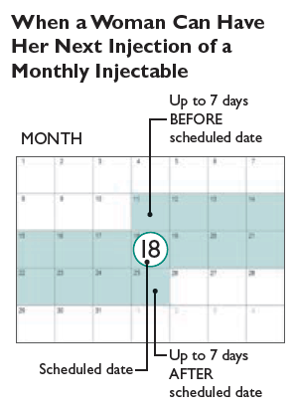
Monthly injectables: Managing late injections
Less than 7 days late for a repeat injection:
Give next injection. No need for tests, evaluation, or a backup method.
More than 7 days:
Give next injection if she has not had sex 7 days after the injection was due or she has used a backup method or taken ECPs if she had. Use a backup method for 7 days after the injection.
If not, rule out pregnancy before giving the next injection.
Family Planning: A Global Handbook for Providers (3rd Edition, 2018)

Slide 48
Monthly injectables: Correcting misconceptions
Monthly injectables:
Can stop monthly bleeding, but this is not harmful; blood does not build up inside the woman
Do not make women infertile
Do not cause early menopause
Do not cause birth defects or multiple births
Do not cause itching
Do not change women's sexual behaviour
Family Planning: A Global Handbook for Providers (3rd Edition, 2018)

Slide 49
Monthly injectables: Management of side effects
Problem | Action/Management
Irregular bleeding | Reassure her that many women using monthly injectables experience irregular bleeding. It is not harmful and usually becomes less or stops after the first few months of use. For modest short-term relief, suggest 800 mg ibuprofen 3 times daily after meals for 5 days, or other nonsteroidal anti-inflammatory drug (NSAID), beginning when irregular bleeding starts.
Heavy or prolonged bleeding | Reassure; suggest NSAID beginning when heavy bleeding. To help prevent anemia, suggest iron tablets and tell her eating of foods containing iron.
No monthly bleeding | Reassure, this not harmful. It is similar to not having monthly bleeding during pregnancy. She is not pregnant or infertile. Blood is not building up inside her.
Family Planning: A Global Handbook for Providers (3rd Edition, 2018)
Notes:
Foods containing iron include meat and poultry (especially beef and chicken liver), fish, green leafy vegetables, and legumes (beans, bean curd, lentils, and peas).

Slide 50
Monthly injectables: Management of side effects
Problem | Action/Management
Weight gain | Review diet and counsel as needed.
Ordinary headaches (nonmigrainous) | Reassure and suggest pain relievers; evaluate headaches that worsened after starting injectables.
Breast tenderness | Recommend that she wear a supportive bra (including during strenuous activity and sleep). Try hot or cold compresses. Suggest aspirin (325–650 mg), ibuprofen (200–400 mg), paracetamol (325–1000 mg), or other pain reliever. Consider locally available remedies.
Dizziness | Consider locally available remedies.
Family Planning: A Global Handbook for Providers (3rd Edition, 2018)

Slide 51
Monthly injectables: New problems that may require switching methods
Problem | Action/Management
Unexplained vaginal bleeding (that suggests a medical condition not related to the method) | Refer or evaluate by history and pelvic examination. Diagnose and treat as appropriate. She can continue using monthly injectables while her condition is being evaluated. If bleeding is caused by sexually transmitted infection or pelvic inflammatory disease, she can continue using monthly injectables during treatment.
Migraine headaches | Regardless of her age, a woman who develops migraine headaches, with or without aura, or whose migraine headaches become worse while using monthly injectables, should stop using injectables. Help her choose a method without estrogen.
Starting treatment with lamotrigine | Combined hormonal methods, including monthly injectables, can make lamotrigine less effective. Unless she can use a different medication for seizures than lamotrigine, help her choose a method without estrogen.
Family Planning: A Global Handbook for Providers (3rd Edition, 2018)

Slide 52
Monthly injectables: New problems that may require switching methods
Problem | Action/Management
Circumstances that will keep her from walking for one week or more | If she will be unable to move about for several weeks, she should: – Tell her doctors that she is using monthly injectables. – Stop injections one month before scheduled surgery, if possible, and use a backup method during this period. – Restart monthly injectables 2 weeks after she can move about again.
Certain serious health conditions including suspected heart or liver disease | Do not give the next injection. Give her a backup method to use until the condition is evaluated. Refer for diagnosis and care if not already under care.
Suspected pregnancy | Assess for pregnancy. Stop injections if pregnancy is confirmed. There are no known risks to a fetus conceived while a woman is using injectables
Family Planning: A Global Handbook for Providers (3rd Edition, 2018)
Notes:
Circumstances that will keep her from walking for one week or more:
If she is having major surgery, or her leg is in a cast, or for other reasons
she will be unable to move about for several weeks.
Certain serious health conditions: suspected heart or liver disease,
high blood pressure (systolic pressure of 140 mm Hg or higher or diastolic
pressure of 90 mm Hg or higher), blood clots in deep veins of legs or lungs,
stroke, breast cancer, or damage to arteries, vision, kidneys, or nervous
system caused by diabetes.

Slide 53
Monthly injectables: summary
Safe for almost all women
Effective if used consistently and correctly - Coming back every 4 weeks is important for greatest effectiveness.
Injection can be as much as 7 days early or late.
Screening and counseling are essential
Family Planning: A Global Handbook for Providers (3rd Edition, 2018)

Slide 54
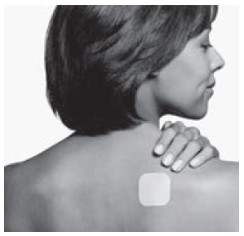
Combined patch

Slide 55
What is the combined patch?
A small, thin, square of flexible plastic worn on the body.
Continuously releases 2 hormones, a progestin and an estrogen which are like the natural hormones progesterone and estrogen in a woman’s body, directly through the skin into the bloodstream.
Also called Ortho Evra and Evra.
Family Planning: A Global Handbook for Providers (3rd Edition, 2018)

Slide 56
Combined patch: Mechanism of action
Works primarily by preventing the release of eggs from the ovaries (ovulation).
The woman puts on a new patch every week for 3 weeks, then no patch for the fourth week. During this fourth week the woman will have monthly bleeding.
No delay in return of fertility after patch use is stopped.
Does not provide protection against sexually transmitted infections.
Family Planning: A Global Handbook for Providers (3rd Edition, 2018)

Slide 57
Combined patch: Effectiveness
As commonly used, about 7 pregnancies per 100 women using the combined patch over the first year. That is, 93 of every 100 women using the combined patch will not become pregnant.
When no mistakes are made with use of the patch, less than 1 pregnancy per 100 women using a patch over the first year (3 per 1,000 women).
Pregnancy rates may be slightly higher among women weighing 90 kg or more.
Family Planning: A Global Handbook for Providers (3rd Edition, 2018)

Slide 58
Combined patch: Side effects
Skin irritation or rash where the patch is applied
Changes in bleeding patterns:
  – Lighter bleeding and fewer days of bleeding
  – Irregular bleeding
  – Prolonged bleeding
  – No monthly bleeding
Headaches
Nausea
Vomiting
Breast tenderness and pain
Abdominal pain
Flu symptoms/upper respiratory infection
Irritation, redness, or inflammation of the vagina (vaginitis)
Family Planning: A Global Handbook for Providers (3rd Edition, 2018)

Slide 59
Combined patch: Known health benefits and health risks
Long-term studies of the patch are limited, but researchers expect that its health benefits and risks are like those of combined oral contraceptives.
Family Planning: A Global Handbook for Providers (3rd Edition, 2018)

Slide 60
Combined patch: Who can start and when to start
Medical eligibility criteria guidelines for when to start and helping continuing users for the combined patch are the same as for combined oral contraceptives and the combined vaginal ring.
Family Planning: A Global Handbook for Providers (3rd Edition, 2018)

Slide 61
Combined patch: Late replacement or removal, or patch comes off - 1
Forgot to apply a new patch after the 7-day patch-free interval or late changing patch at the end of week 1 or 2:
Apply a new patch as soon as possible and keep the same patch-change day.
If late by only 1 or 2 days (48 hours or less), there is no need for a backup method.
If more than 2 days late (more than 48 hours), use a backup method for the first 7 days of patch use. The new patch will begin a new 4-week patch cycle, and this day of the week will become the new patch-change day.
If more than 2 days late and unprotected sex occurred in the past 5 days, consider taking emergency contraceptive pills.
Family Planning: A Global Handbook for Providers (3rd Edition, 2018)

Slide 62
Combined patch: Late replacement or removal, or patch comes off - 2
Late taking off the patch at the end of week 3:
Remove the patch.
Start the next cycle on the usual patch-change day.
No need for a backup method..
The patch came off and was off for less than 2 days (48 hours or less):
Apply a new patch as soon as possible. (The same patch can be re-used if it was off less than 24 hours.)
No need for a backup method.
Keep the same patch change day.
Family Planning: A Global Handbook for Providers (3rd Edition, 2018)

Slide 63
Combined patch: Late replacement or removal, or patch comes off - 3
The patch came off and was off for more than 2 days (more than 48 hours):
Apply a new patch as soon as possible, use a backup method for the next 7 days and keep the same patch-change day.
If during week 3, skip the patch-free week and start a new patch immediately after week 3. If a new patch cannot be started immediately, use a backup method and keep using it through the first 7 days of patch use.
If during week one and unprotected sex occurred in the past 5 days, consider taking emergency contraceptive pills.
Family Planning: A Global Handbook for Providers (3rd Edition, 2018)

Slide 64
Combined patch: summary
Health benefits and risks are like those of combined oral contraceptives.
Replace each patch on time for greatest effectiveness.
No delay in return of fertility after patch use is stopped.
Screening and counseling are essential
Family Planning: A Global Handbook for Providers (3rd Edition, 2018)

Slide 65
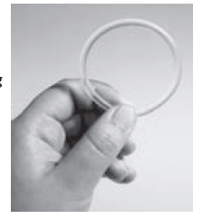
Combined vaginal ring

Slide 66
What is the combined vaginal ring?
A flexible ring that a woman places in her vagina.
Continuously releases 2 hormones, a progestin and an estrogen which are like the natural hormones progesterone and estrogen in a woman’s body, from inside the ring.
Hormones are absorbed through the wall of the vagina directly into the bloodstream.
Also called NuvaRing
Family Planning: A Global Handbook for Providers (3rd Edition, 2018)

Slide 67
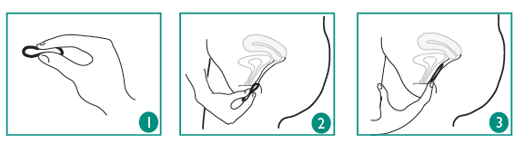
Combined vaginal ring: Mechanism of action
Works primarily by preventing the release of eggs from the ovaries (ovulation).
The woman leaves the ring in her vagina for 3 weeks, then removes it for the fourth week. During this fourth week the woman will have monthly bleeding.
No delay in the return of fertility after ring use is stopped.
No protection against sexually transmitted infections.
Family Planning: A Global Handbook for Providers (3rd Edition, 2018)

Slide 68
Combined vaginal ring: Effectiveness
Depends on the user. Risk of pregnancy is greatest when a woman is late to start a new ring.
As commonly used, about 7 pregnancies per 100 women using the combined vaginal ring over the first year. That is, 93 of every 100 women using the combined vaginal ring will not become pregnant.
When no mistakes are made with use of the combined vaginal ring, less than 1 pregnancy per 100 women using the combined vaginal ring over the first year (3 per 1,000 women).
Family Planning: A Global Handbook for Providers (3rd Edition, 2018)

Slide 69
Combined vaginal ring: Side effects
Changes in bleeding patterns, including:
  – Lighter bleeding and fewer days of bleeding
  – Irregular bleeding
  – Infrequent bleeding
  – Prolonged bleeding
  – No monthly bleeding
Headaches
Irritation, redness, or inflammation of the vagina (vaginitis)
White vaginal discharge
Family Planning: A Global Handbook for Providers (3rd Edition, 2018)

Slide 70
Combined vaginal ring: Known health benefits and health risks
Long-term studies of the vaginal ring are limited.
Researchers expect that its health benefits and risks are like those of combined oral contraceptives.
Evidence to date has not shown adverse effects.
Family Planning: A Global Handbook for Providers (3rd Edition, 2018)

Slide 71
Combined vaginal ring: Who can start and when to start
Medical eligibility criteria, guidelines for when to start, and helping continuing users for the combined ring are the same as for combined oral contraceptives and the combined patch.
Family Planning: A Global Handbook for Providers (3rd Edition, 2018)

Slide 72
Combined vaginal ring: Late replacement or removal - 1
Left ring out for 48 hours or less during weeks 1 through 3:
  Put the ring back in as soon as possible, no need for a backup method.
Left ring out for more than 48 hours during weeks 1 or 2:
  Put the ring back in as soon as possible and use a backup method for the next 7 days.
  If the ring was left out for more than 48 hours in the first week and unprotected sex occurred in the previous 5 days, consider taking emergency contraceptive pills.
Left ring out for more than 48 hours during week 3:
  Put the ring back in as soon as possible and use a backup method for the next 7 days.
  Start a new ring at the end of the third week and skip the ring-free week. If unable to start the new ring at the end of the third week, use a backup method and keep using it through the first 7 days after starting a new ring.
Family Planning: A Global Handbook for Providers (3rd Edition, 2018)

Slide 73
Combined vaginal ring: Late replacement or removal - 2
Forgot to insert a new ring at beginning of the cycle:
  Insert a new ring as soon as possible. If late by only 1 or 2 days (48 hours or less), that is, the ring is left out no longer than 9 days in a row, no need for a backup method. Keep the same ring removal day.
  If the new ring is inserted more than 2 days (more than 48 hours) late, that is, the ring is left out 10 days or more in a row, use a backup method for the first 7 days of ring use.
  If unprotected sex occurred in the past 5 days, consider taking emergency contraceptive pills.
Kept ring in longer than 3 weeks:
  If the same ring is used for up to 28 days (4 weeks), no backup method is needed. She can take a ring-free week or start a new ring immediately.
  If the same ring is used for 28 to 35 days (more than 4 weeks but less than 5 weeks), insert a new ring and skip the ring-free week. No backup method is needed.
Family Planning: A Global Handbook for Providers (3rd Edition, 2018)

Slide 74
Combined vaginal ring: summary
Health benefits and risks are like those of combined oral contraceptives.
Start each new ring on time for greatest effectiveness.
No delay in return of fertility after patch use is stopped.
Screening and counseling are essential
Family Planning: A Global Handbook for Providers (3rd Edition, 2018)

Slide 75
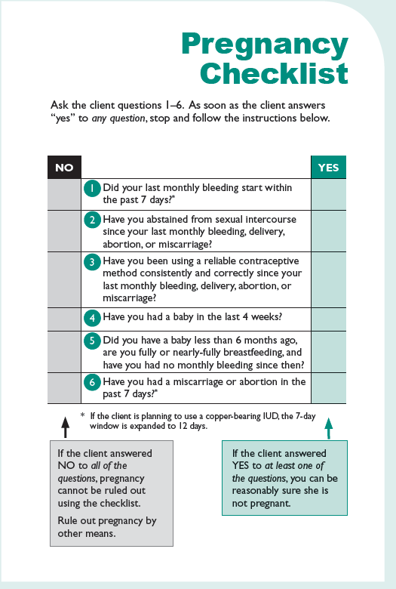
Family Planning: A Global Handbook for Providers (3rd Edition, 2018)

Slide 76
Acknowledgement
This training presentation was adapted from the following resources:
Training Resource Package for Family Planning
https://www.fptraining.org/
World Health Organization Department of Reproductive Health and Research (WHO/RHR) and Johns Hopkins Bloomberg School of Public Health/Center for Communication Programs (CCP), Knowledge for Health Project. Family Planning: A Global Handbook for Providers (2018 update). Baltimore and Geneva: CCP and WHO; 2018. Available from: https://www.fphandbook.org/

Slide 77
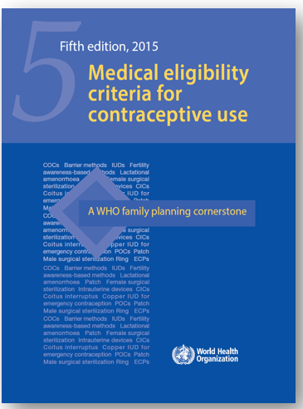
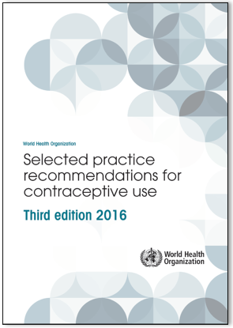
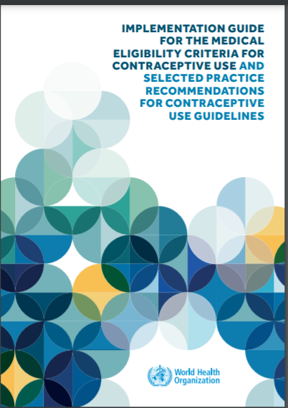
Additional resources
WHO Selected Practice Recommendations for Contraceptive Use (3rd edition 2016). WHO, 2016. Available from: http://www.who.int/reproductivehealth/publications/family_planning/SPR-3/en/
Implementation Guide for the Medical Eligibility Criteria and Selected Practice Recommendations for Contraceptive Use Guidelines. WHO, 2018. Available from: http://apps.who.int/iris/bitstream/handle/10665/272758/9789241513579-eng.pdf?ua=1
WHO Medical Eligibility Criteria (MEC) for Contraceptive Use, Fifth edition. WHO, 2015. Available from: http://www.who.int/reproductivehealth/publications/family_planning/MEC-5/en/
For all the latest publications on family planning visit: https://www.who.int/reproductivehealth/publications/family_planning/en/

