Slide 1

Contraceptive methods - Part 4
"Family Planning”: An Online Evidence-based Course 2021
Raqibat Idris, MBBS, DO, MPH
Geneva Foundation for Medical Education and Research

Slide 2
Outline and objectives
Description of the method
Mechanism of action
Effectiveness
Eligibility criteria
Benefits and side effects
Interventions for associated effects

Slide 3
Methods
1. Permanent methods
    Male sterilization (Vasectomy)
    Female sterilization (tubal ligation)
  2. Emergency contraception (EC) or postcoital contraception
    Emergency contraceptive pills (ECPs)
    Copper-bearing IUDs (Cu-IUD) for EC
  3. Lactational amenorrhea method
  4. Fertility awareness methods
    Standard Days Method (SDM)
    Others
5. Withdrawal

Slide 4
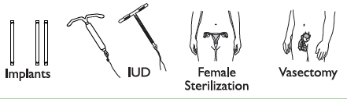

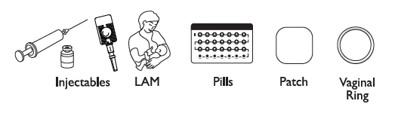
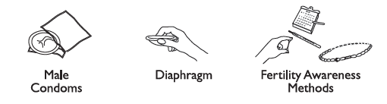
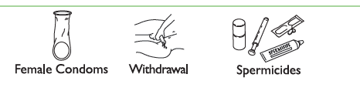
Comparing Effectiveness of Family Planning Methods
More effective
Less than 1 pregnancy per
100 women in one year
How to make your
method more effective
Implants, IUD, female sterilization:
After procedure, little or nothing to do or remember
Vasectomy: Use another method for first
3 months
Injectables: Get repeat injections on time
Lactational Amenorrhea Method (for 6 months): Breastfeed often, day and night
Pills: Take a pill each day
Patch, ring: Keep in place, change on time
Male condoms, diaphragm: Use correctly every time you have sex
Fertility awareness methods: Abstain or use condoms on fertile days. Standard Days Method and Two-Day Method may be easier to use.
Female condoms, withdrawal, spermicides: Use correctly every time you have sex
Less effective
About 30 pregnancies per
100 women in one year
Family Planning: A Global Handbook for Providers (3rd Edition, 2018)
Notes:
Methods of contraception have different mechanisms of action and effectiveness in preventing unintended pregnancy. Effectiveness of methods is measured by the number of pregnancies per 100 women using the method per year.

Slide 5
Vasectomy
(Male Sterilization)

Slide 6
What Is Vasectomy?
A permanent method of contraception for men who do not want any more children
A safe, simple, and short surgical procedure
Also referred to as male sterilization or male surgical contraception
Procedure requires a trained health care provider
Two techniques for performing vasectomy
  Conventional or incisional vasectomy
  No-scalpel vasectomy (NSV)
Adapted from Training Resource Package for Family Planning: https://www.fptraining.org/
Notes:
Vasectomy is a permanent method of contraception for men who do not want to have any more children. The method involves a safe, simple, and short surgical procedure performed on the scrotum. Through a puncture on the scrotum, the provider locates each of the tubes that carry the sperm—also called the vas deferens—and divides and blocks it by tying it closed. The blockage may also be achieved by applying heat or an electric current, also known as cautery.
Because the procedure is permanent, it cannot be reversed.
The procedure requires a trained provider and should be done in the right settings within a health facility or clinic or other settings with the necessary equipment and supplies, to ensure quality of care.
Two types of approaches have been described, the conventional surgical approach to vasectomy and no-scalpel vasectomy (NSV). Both approaches are quick, effective, and safe, Conventional vasectomy requires a use of scalpel to access the vas; the incision is therefore wider when compared to the no-scalpel vasectomy approach, in which the surgeon uses two special instruments to access the vas. There is also less hemorrhaging and other related complications with NSV than with conventional vasectomy. Conventional vasectomy is no longer the recommended technique for vasectomy.

Slide 7
Relative effectiveness of vasectomy to other FP methods
Method | No. of unintended pregnancies among 1,000 women in 1st year of typical use
No method | 850
Withdrawal | 220
Female condom | 210
Male condom | 180
Pill | 90
Patch | 90
Injectable | 60
IUD (Copper T 380A/LNG-IUS) | 8/2
Female sterilization | 5
Vasectomy | 1.5
Implant | 0.5
Source: Trussell, J. 2011. Contraceptive failure in the United States. Contraception 83(5):397–404.
Adapted from Training Resource Package for Family Planning: https://www.fptraining.org/
Notes:
The slide shows the number of women who would get pregnant if 1,000 women used a method for one year. So, if 1,000 fertile women who were having sex, but not using any protection from pregnancy, 850 of them would become pregnant.
Note that vasectomy is not fully effective for three months after the procedure.
Where men cannot have semen analysis three months after the procedure to see if the semen still contains sperms, women’s pregnancy rates are about 2–3 per 1,000 women over the first year after their partners have had a vasectomy. Where men are able to have their semen examined after vasectomy, less than 1 pregnancy per 1,000 women occurs over the first year after vasectomy (approximately 2 per 1,000).
On this slide, if the same 1,000 women were using male sterilization, 1.5 would become pregnant.
As part of good counseling, it is important to inform clients about how effective each method is.

Slide 8
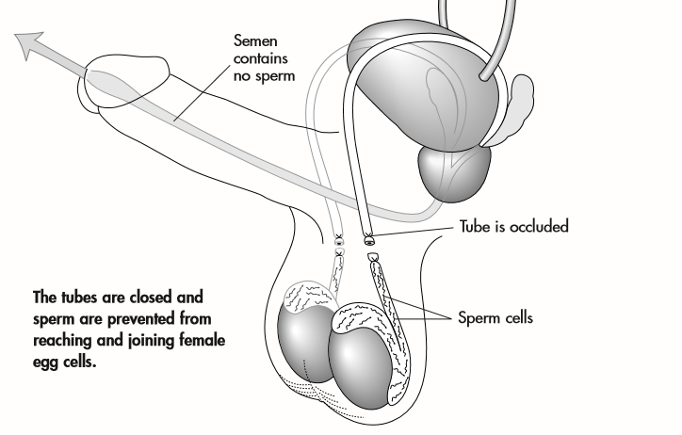
Vasectomy: Method of action
Engrenderhealth NSV Training Curriculum 2007
Adapted from Training Resource Package for Family Planning: https://www.fptraining.org/
Notes:
The method works by closing off each vas deferens, thus blocking the flow of sperm into the semen. The semen continues to be ejaculated, but it cannot cause pregnancy because it contains no sperm.
The onset of the contraceptive effect is not immediate, however. It takes up to three months for the sperm that are within the vas deferens above the blocked section to be ejaculated.

Slide 9
Characteristics of vasectomy
The method must be offered by a provider and involves a simple surgical procedure.
The procedure is much simpler than female sterilization.
No user action is required.
The procedure can be performed at any time the man makes an informed and voluntary decision.
After the procedure, there may be discomfort or some pain during recovery.
It may require semen analysis to measure effectiveness.
It is not reversible. (Where such reversal services are offered, it is expensive, and success is not always guaranteed.)
Adapted from Training Resource Package for Family Planning: https://www.fptraining.org/
Notes:
Other characteristics are
Male sterilization is one of the most effective FP methods. The method carries a small risk of failure. This risk of failure remains the same beyond the first year after vasectomy.
The method is also not effective in the first three months after the procedure. Men should use the condom or have their spouse use another effective FP method to avoid pregnancy during this period.
Some of the reasons for failure include not following instructions to use another method in the first three months, a mistake made by the provider, or the cut ends of the vas growing back together.
Male sterilization is safe and convenient, and it has fewer side effects and complications than many of the methods used by women.
This method does not offer any protection against STIs or HIV.

Slide 10
Health benefits, non-health benefits and risks of vasectomy
Is a cost-effective, one-off event, with no need for resupply
Does not interfere with sex
May enhance enjoyment and frequency of sex
Allows man to play significant role in FP
Is a safe procedure
Carries a small risk of failure
Carries risk associated with pain management drugs and surgical procedure
Adapted from Training Resource Package for Family Planning: https://www.fptraining.org/
Notes:
Display Slide
Explain:
Some of the non-health benefits of male sterilization are that it is cost-effective, as it is a one-off event to have the procedure, and there is no need to go back to the clinic for resupply.
The method does not interfere with sex.
The method may enhance enjoyment and frequency of sex in some couples.
This method allows the man to play a significant role in FP.
The method is very safe but carries a small risk of failure
As a surgical procedure that is done under some form of anesthesia to manage pain, vasectomy carries a small risk associated with pain management drugs and the surgical procedure.

Slide 11
Possible side effects and complications of vasectomy
Headaches and mild dizziness
Nausea
Fever
Pain
Injury to other structures
Hemorrhage
Hematoma
Surgical site/wound infection
Abscess formation
Sperm granuloma
Anti-sperm antibodies
Regret
Failure
Adapted from Training Resource Package for Family Planning: https://www.fptraining.org/
Notes:
Male sterilization per se does not have side effects, but the pain management drugs and the surgical procedure may cause the following:
Headaches and mild dizziness
Nausea
Fever
Pain
Complication are uncommon or very rare and include
Injury to other structures of the spermatic cord
Hemorrhage and formation of a hematoma
Wound infection, which may lead to formation of a localized abscess
In the long term, development of sperm granulomas
Development of antisperm antibodies
Regrets if the client’s decision was not a well-considered one
The method carries a small risk of failure.

Slide 12
Physiological changes after vasectomy
Sexual and reproductive physiology remains unaffected except for desired change in fertility.
  Erection is not affected.
  Ejaculation is not affected.
  Sexual drive is not affected.
  Sperm production is not affected.
  Sperm count in the ejaculate semen is drastically reduced by three months afterward.
  Serum antisperm antibodies rises.
  There are no long-term negative health effects.
Adapted from Training Resource Package for Family Planning: https://www.fptraining.org/
Notes:
After vasectomy, the male sexual and reproductive physiology remains unaffected, aside from the desired change in fertility.
The nerves involved in erection are not disrupted during vasectomy. Seminal fluid, which forms the largest part of ejaculatory fluid, continues to be produced. As a result, the client will not notice any reduction in the amount of ejaculatory fluid.
Sperm production continues, even though the sperm’s passage through the reproductive system has been blocked. These sperm are absorbed into the tissue and tubes of the epididymis. Sometimes sperm blockage causes pressure to build up in the epididymis and its tubes, causing these structures to distend and, in time, rupture. Such ruptures are usually asymptomatic and not problematic. The sperm granulomas that can form at the site of the rupture do not usually require treatment. These may be felt as small nodules in the scrotum.
Sexual drive, which is a physiological process, also is not affected by vasectomy.
Vasectomy causes a breakdown in the blood-testes barrier, which leads to increased levels of sperm antigen and antisperm antibodies in the serum of most men who have had a vasectomy. Factors influencing the development of antisperm antibodies in vasectomized men are unknown. Studies have shown no association of these antibodies with problems in humans.
Over the years, some concerns have been raised about possible negative health consequences of vasectomy. However, large, well-designed studies have consistently shown no adverse effects of vasectomy on the risks of heart disease, testicular or prostate cancer, immune system disorders, and a host of other conditions. Men requesting the procedure can thus be reassured that no substantial long-term health risks are associated with the procedure.

Slide 13
MEC categories for male sterilization (vasectomy)
Who can have vasectomy?
Most men can have a vasectomy.
But they may need to wait if:
  They have problems with their genitals, such as infections, swellings or lumps, or injuries in the penis or scrotum.
  They have other serious health conditions or infections (e.g., diarrhea).
Category | Description | When Clinical Judgement is Available
A=Accept | There is no medical reason to deny the client a vasectomy. | Use the method.
C=Caution | The procedure can normally be conducted in routine settings, but with extra preparations and precautions. | May have some risks, but advantages outweigh any risks.
D=Delay | Delay the procedure until the condition is evaluated or corrected. | The theoretical or proven risks may outweigh benefits of the procedure if the condition is not corrected.
S=Special | The procedure should be undertaken in settings with an experienced surgeon, staff, and equipment for anesthesia and other back-up support. | Theoretical or proven risks may outweigh the benefits of the procedure if it is not performed in settings that have the capacity to manage complicated cases.
Adapted from Training Resource Package for Family Planning: https://www.fptraining.org/
Notes:
Vasectomy is a safe procedure; with proper counseling and informed consent, any man can have a vasectomy safely.
This includes men who have no children or few children, those who are not married, young men, men who do not have permission from their wife or spousal consent, those at risk of STIs, or those who are infected with HIV, regardless of whether they are receiving antiretroviral drugs.
No medical condition would be an absolute contraindication for vasectomy.
There are however some conditions or circumstances when certain precautions need to be addressed or when the provider needs to delay a procedure to allow time for further evaluation of the condition or treatment of the client.
In a few instances, the client’s health condition may necessitate that the procedure be performed by a highly skilled surgeon and in other clinical settings with additional equipment and supplies (to support provision of general anesthesia or other kinds of support that the client may need because of his condition).
In all instances, careful counseling is important to ensure that the man will not regret his decision to have the vasectomy
The four categories listed earlier are meant to assist the provider in determining when and where the client can have the vasectomy procedure performed safely, depending on the outcomes of an evaluation of his health condition.
The rationale for assigning different conditions to specific categories is based on evidence where theoretical and proven risks are compared to advantages and benefits to the client if sterilization is performed as the contraceptive method of choice. The procedure should, however, be performed in the right setting, to ensure infection prevention and the availability of all necessary equipment and supplies, as recommended by national and institutional service provision guidelines.
For Category A (Accept), the advantages and benefits of vasectomy outweigh the theoretical and proven risks associated with the vasectomy procedure on the client with the particular condition. There is therefore no reason to restrict the client’s eligibility for vasectomy. The method can thus be provided to all clients who have been counseled and who have opted for vasectomy.
In Category C (Caution), the conditions classified here have elevated theoretical or proven risks although the advantages and benefits of the vasectomy still outweigh such risks. Certain precautionary measures or extra preparations and precautions are recommended to minimize any such risk. Client with such conditions can have the procedure performed in routine settings, but with extra precautions and preparations.
In Category D (Delay), the conditions may elevate theoretical or proven risks to the client if the vasectomy procedure is performed. It is therefore recommended that the procedure be delayed to allow for time for the condition to be further evaluated and corrected. At this point, the client can then have the procedure since the advantages and benefits of vasectomy far outweigh the risks after the condition is resolved.
As for Category S (Special), the few conditions that fall in this category pose an increased theoretical or proven risk if the vasectomy procedure is performed in routine settings. The risks of complications are minimized if the procedure is performed by an experienced surgeon and staff in clinical settings with the required equipment for anesthesia and other back-up support.
It is important to note that under most circumstances, the female sterilization procedure carries higher risks than vasectomy, which is a simpler procedure.

Slide 14
Eligibility criteria for vasectomy
WHO Category | Conditions (Selected Examples)
A=Accept | Sickle cell disease, mild hypertension, clients at risk of HIV or STIs
C=Caution | Young men, varicocele, hydrocele, previous surgery, depressive mental disorders, diabetes
D=Delay | Systemic infections such as diarrhea, local infection of the penis or scrotum (balanitis), scrotal skin infection or ulcers, STIs, elephantiasis, intrascrotal mass
S=Special | Undescended testis or cryptorchidism, inguinal hernia, coagulation disorders
Adapted from Training Resource Package for Family Planning: https://www.fptraining.org/
Notes:
Category A includes conditions such as sickle cell disease, other chronic ailments (such as mild hypertension), and clients at risk of HIV or other STIs.
Category C includes young men who are unmarried or who have no or few living children, clients with mental disorders (including those with depressive disorders); all of these clients require careful counseling so they understand the permanence of vasectomy. Other conditions in this category include clients with a varicocele or hydrocele (unilateral or bilateral) and clients with diabetes.
A varicocele is an abnormal engorgement of the veins/ blood vessels from the spermatic cord and structures within the scrotum.
A hydrocele is an abnormal accumulation of fluid in a sac within the scrotum.
Category D conditions include any systemic infections, including diarrhea, local infections of the penis and scrotum such as balanitis (an inflammation commonly caused by infections of parts of the penis), scrotal skin infections or ulcers, and STIs, all of which are likely to increase the risks of wound infection and therefore compromise postoperative recovery. Other conditions or chronic infections that may need delays include elephantiasis and intra scrotal mass(es) that may require further evaluation.
Category S includes conditions such as coagulation disorders, which may necessitate special preparation of the client before surgery to ensure that the procedure does not put him at risk. Inguinal hernia is another condition that may also be managed by skilled surgeons when they perform a vasectomy, since the vas is also accessible through the inguinal incision. However, unless the hernia is bilateral, the other vas will still need to be accessed and ligated. In cryptorchidism or undescended testis, again the skills of an experienced surgeon may be required to access the vas and where appropriate manage the undescended testis.

Slide 15
Vasectomy use by men with HIV
Men with asymptomatic or mild HIV clinical disease or severe, advanced HIV disease on antiretroviral drugs can SAFELY have vasectomy. (Special arrangements are needed for advanced clinical disease.)
Patients need to be aware that vasectomy does not protect against HIV infections or STIs.
Promote consistent condom use to prevent transmission of infections.
No one should be coerced or pressured to accept vasectomy, whether or not they are seropositive.
Adapted from Training Resource Package for Family Planning: https://www.fptraining.org/
Notes:
According the WHO’s Medical Eligibility Criteria for Contraceptive Use, clients who are asymptomatic or who have a mild form of HIV clinical disease, according to WHO’s classification of HIV/AIDS disease (whether they are receiving antiretroviral drugs or not) can have the vasectomy procedure in routine settings. WHO’s classification of mild forms of AIDS (also known as clinical stage 2) includes patients confirmed with HIV infection who have symptoms such as weight loss of more than 10%, recurrent infections of the respiratory system, recurrent oral lesions, fungal infections of the nails, herpes zoster infections, and skin lesions. Patients should however be counseled that vasectomy does not protect them against HIV or other STIs and that they should continue consistent use of the male or female condom to prevent infections.
Patients with advanced or severe forms of HIV clinical disease who are receiving antiretroviral drugs can also safely have a vasectomy, but special arrangements should be in place for this category of clients.
It should be emphasized that clients with HIV clinical disease, as with all other seronegative male clients, should not be coerced or pressured to accept vasectomy.

Slide 16
Timing of the vasectomy procedure
When can a client have a vasectomy?
The procedure can be performed at any time if:
  The client has made the request and is prepared.
  No medical conditions warrant delay of the vasectomy.
  The client has made an informed and voluntary decision (provided written informed consent).
  The provider is prepared and ready, with the right equipment and supplies to perform the procedure.
If any of the above conditions are not met, there can be a delay.
The client may need to be referred if he has a condition that needs special attention.
Adapted from Training Resource Package for Family Planning: https://www.fptraining.org/
Notes:
The vasectomy procedure can be performed at any time if :
The client has made the request and is prepared for the procedure
There is no medical condition(s) that would require referral, delay or special precautions,
There is evidence that the client has made an informed and voluntary decision including a written informed consent
The skilled provider is ready to provide quality vasectomy services.
Clients may need to wait if:
They have problems with the genitals such as infections, swellings, injuries, lumps or ulcers in the penis or scrotum.
The have systemic infections such as diarrhea
Clients with serious conditions such as coagulative disorders, inguinal hernia, unilateral undescended testis, large varicocele or hydrocele, should be referred for further evaluation and management by experienced surgeons in facilities with equipment and supplies for general anesthesia and other support

Slide 17
Correcting rumors and misunderstandings about vasectomy
In rare instances, vasectomy may cause testicular cancer. (False)
The volume of ejaculate from vasectomized men is always significantly lower than that of nonvasectomized men. (False)
Vasectomy causes vascular problems for men, especially those who have chronic hypertension. (False)
Vasectomy is not castration. (True)
Vasectomy does not interfere with manhood or sexuality in any way. (True)
It is easier to perform female sterilization on a female client than to perform a vasectomy on a man. (False)
Vasectomy makes men obese and weak. (False)
Adapted from Training Resource Package for Family Planning: https://www.fptraining.org/

Slide 18
Vasectomy: Summary
With proper counseling and informed consent, any man can have a vasectomy safely
Involves a safe, simple surgical procedure
Is permanent and convenient
3-month delay in taking effect
The man takes responsibility for contraception; takes burden off the woman
Does not affect male sexual performance
Does not prevent transmission of sexually transmitted infections, including HIV
Family Planning: A Global Handbook for Providers (3rd Edition, 2018)

Slide 19
Tubal Ligation
(Female Sterilization)

Slide 20
What is female sterilization?
Female sterilization is a family planning method that provides permanent contraception to women and couples who want to limit births or do not want any more children.
The two surgical approaches most often used are minilaparotomy and laparoscopy.
Female sterilization is also referred to as “tubal occlusion,” “tubal sterilization,” “tubal ligation,” “surgical contraception,” “voluntary surgical contraception,” “tubectomy,” “bi-tubal occlusion,” “minilap,” or simply “the operation.”
Adapted from Training Resource Package for Family Planning: https://www.fptraining.org/
Notes:
Female sterilization is a family planning method that provides permanent contraception to women and couples who want to limit births or do not want any more children.
It requires surgery; the two surgical approaches that are most commonly used are:
Minilaparotomy: This procedure involves making a small incision in the abdomen. The fallopian tubes are then brought to the incision and are cut or blocked.
Laparoscopy: This procedure requires insertion of a special instrument called a “laparoscope” (a long, thin tube with a lens and a source of light) into the abdomen through a small incision. The laparoscope enables the surgeon to visualize and block or cut the fallopian tubes in the abdomen.
Female sterilization is also sometimes referred to as tubal sterilization, tubal ligation, surgical contraception, tubectomy, bi-tubal occlusion, minilap, or simply the operation. The term tubal occlusion is currently the preferred terminology.

Slide 21
Relative effectiveness of female sterilization to other family planning methods
Method | No. of unintended pregnancies among 1,000 women in 1st year of typical use
No method use | 850
Withdrawal | 220
Female condom | 210
Male condom | 180
Pill | 90
Injectable | 60
IUD | 8 / 2 (Cu-T/LNG-IUS)
Female sterilization | 5
Vasectomy | 1.5
Implant | 0.5
Source: Trussell, J. 2011. Contraceptive failure in the United States. Contraception 83:397–404.
Adapted from Training Resource Package for Family Planning: https://www.fptraining.org/
Notes:
The slide shows the number of women who would get pregnant if 1,000 women used each particular method for one year. So, if 1,000 fertile women were having sex but not using any protection from pregnancy, it is estimated that 850 of them would become pregnant by the end of one year.
In contrast, if the same 1,000 women were using female sterilization, five would become pregnant by the end of one year. This means that 995 women of every 1,000 women relying on this method would not become pregnant by the end of the first year.
There is a small risk of pregnancy after the first year of use until the woman reaches menopause. Over 10 years of use, for example, about 18–19 pregnancies per 1,000 women have been reported for female sterilization.
The effectiveness of female sterilization also varies slightly with the tubal occlusion method or technique. One of the most effective methods of tubal occlusion is the modified Pomeroy method or technique.
As part of good counseling, it is important to inform clients about how effective each method is and the small chance of method failure with each.

Slide 22
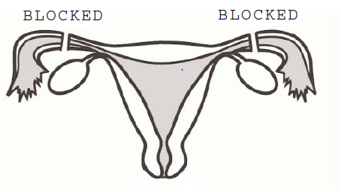
How does female sterilization work?
A segment of the fallopian tube is removed, and then the tube is tied or blocked.
Sperm are blocked from fertilizing the ovum
ovary
Fallopian tube
Fallopian tube
Uterus
Source: Adapted from: Roy Jacobstein and John Pile, Global Technical Brief -Female Sterilization: The Most Popular
Method of Modern Contraception, Engenderhealth and JHUCCP 2004
Adapted from Training Resource Package for Family Planning: https://www.fptraining.org/
Notes:
In female sterilization, contraception is achieved by blocking the fallopian tubes, thus preventing the sperm from reaching and fertilizing the ova.

Slide 23
Female sterilization: Health benefits
Protects against risks of pregnancy and childbirth
Lower risks of ectopic pregnancy
May lower risks of developing ovarian cancers
Adapted from Training Resource Package for Family Planning: https://www.fptraining.org/
Notes:
In addition to the benefit of preventing unwanted pregnancy and therefore preventing the risks associated with pregnancy, female sterilization use has some significant noncontraceptive health benefits. Female sterilization is known to reduce the risk of ectopic pregnancy, because of its effectiveness in preventing pregnancy overall.
In the United States, for example, the ectopic pregnancy rate among female sterilization users is only six per 10,000, compared with 65 per 10,000 among women using no contraception.
However, on the rare occasion when female sterilization fails and the woman becomes pregnant, one-third of those pregnancies will be ectopic.
Female sterilization has also been shown to help protect against ovarian cancer.

Slide 24
Female sterilization: Timing of procedure and surgical approaches
Timing of the procedure
Interval Procedure is performed at any time unrelated to a pregnancy or six weeks or more after the last delivery or abortion.
Postabortion Procedure is performed within the first week following a nonseptic spontaneous or induced abortion.
Postpartum Procedure is performed within the first week after a vaginal delivery or while a cesarean section is being performed.
Approaches
Surgical | Nonsurgical
Laparotomy Minilaparotomy procedure After delivery of baby and Placenta during C/S | Transcervical
Laparoscopic procedure
Adapted from Training Resource Package for Family Planning: https://www.fptraining.org/
Notes:
Female sterilization procedures may also be categorized according to the timing of the procedure in in relation to a recent pregnancy. The three main timings of the procedure are interval, postpartum, and postabortion.
An interval sterilization is when the procedure is performed at any time unrelated to a pregnancy or six weeks or more after the last delivery or abortion, when the uterus is normal in size and located in the pelvis.
Postpartum sterilization is when the procedure is performed within the first week after a vaginal delivery or while a cesarean section is being performed.
Postabortion sterilization may also be performed within the first week following a nonseptic spontaneous or induced abortion.
Female sterilization may also be performed through surgical and nonsurgical approaches.
The most commonly used methods are the surgical methods.
There are two main surgical approaches, through laparotomy and with the use of a laparoscope.
Laparotomy may be performed as a minilaparotomy—that is, through a vey small incision—or following a cesarean section, after delivery of the baby and placenta and closure of the uterine incision, but before closure of the abdominal incision.
Minilaparotomy is the preferred approach for female sterilization in low-resource settings.
The laparoscopic technique involves the use of a laparoscope to visualize and occlude the fallopian tubes. This approach is safer and can be performed in less time than minilaparotomy; however, it can only be performed by highly skilled providers using sophisticated equipment.
The only nonsurgical method of female sterilization is a trans-cervical approach using a special instrument, the hysteroscope. The hysteroscope is introduced through the cervix and an occlusive device (called Essure, which is approved by the U.S. Food and Drug Administration) is introduced into each fallopian tube. The tubes then become occluded over a period of a few months (up to three months); during this waiting period, the client needs to use other effective reversible contraceptive methods to avoid pregnancy.
This approach is costly, requires a high level of skill, and is still under evaluation.

Slide 25
Female sterilization: Side effects and complications
Complications of female sterilization are rare.
Immediate side effects of minilaparotomy are transient and include nausea, vomiting, and minor abdominal discomfort.
Complications may be:
  Surgical
    Injuries to other viscera
    Bleeding or hemorrhage/
    hematoma formation
    Infection
    Small risk of failure leading to
    pregnancy (ectopic or intrauterine)
  Anesthesia-related
    Respiratory depression
    Drug overdose
Long-term effects are rare:
  Risk of ectopic pregnancy
  Potential for regret
Adapted from Training Resource Package for Family Planning: https://www.fptraining.org/

Slide 26
Who can have female sterilization?
Female sterilization is safe for all women.
With proper counseling and informed consent, any woman can safely have a female sterilization procedure, including women who:
  Are not married
  Have no children or few children
  Do not have spousal permission
  Are young
  Just gave birth (within the last seven days)
  Are breastfeeding
  Are infected with HIV, whether or not they are receiving antiretroviral therapy
But they may need to wait if they:
Gave birth 1–6 weeks ago
May be pregnant
Have an infection or other problem
Have some other serious health condition
Adapted from Training Resource Package for Family Planning: https://www.fptraining.org/
Notes:
The client may need to wait if she:
Gave birth 1–6 weeks ago—The sterilization procedure can be done at any time except between seven days to six weeks after delivery.
May be pregnant—The sterilization procedure can only be done at any time that the provider can be reasonably sure the client is not pregnant.
Has an infection or other problem(s) in the genitals—The sterilization procedure should be delayed until the condition or conditions are fully treated.
Has some other serious health conditions—A serious health problem may require a delay in performing steruilization, to allow time for more evaluation of the condition, for further management of the condition, or for specialized care.

Slide 27
Female sterilization: Medical eligibility criteria
Categories
A—Accept There is no medical reason to deny sterilization to a
person with this condition.
C—Caution The procedure is normally conducted in a routine
setting, but with extra preparation and precautions.
D—Delay Postpone the female sterilization procedure. These conditions must be treated and resolved before female
sterilization can be performed.
S—Special The procedure should be undertaken in a setting
with an experienced surgeon and staff, equipment
needed to provide general anesthesia, and other back- up medical support. For these conditions, the capacity to decide on the most appropriate procedure and anesthesia regimen is also needed. Give the client another method to use until the procedure can be performed.
Adapted from Training Resource Package for Family Planning: https://www.fptraining.org/
Notes:
Categories that are recommended for use to determine client eligibility for male and female sterilization are different from those used for nearly all other contraceptive methods (except the natural methods).

Slide 28
Female sterilization use by postpartum and postabortion clients
Condition | Category A=Accept; D=Delay; C=Caution; S=Special | Clarification/ Evidence
Postpartum 1-7 days | A
Postpartum 7–42 days | D
Postpartum >42 days | A | Manage as interval client
Postpartum with other medical condition (e.g., severe anemia, sepsis, severe hypertension) | D
Postabortion (uncomplicated) 1–7 days | A
Postabortion (complicated, with severe anemia, sepsis, genital trauma) | D | Increased risk of complications
Postabortion (complicated, with uterine perforation) | S | May include perforation of other viscera and increased risk of complications
Adapted from Training Resource Package for Family Planning: https://www.fptraining.org/
Notes:
Postpartum and postabortion clients can also use sterilization; however, these are stressful situations, and clients need to make a well-considered decision. Such clients are prone to regret later if the decision is rushed.
Postpartum clients can have the procedure between delivery and the seventh day following delivery.
After the first seven days following childbirth, it is advisable to delay and perform the procedure after 42 days. The client may be advised to choose a back-up method to use as they wait for the sterilization procedure.
After 42 days postpartum, the client should be managed as an interval client—that is, the procedure should be planned for whenever the client feels she can have it, preferably in the proliferative phase of the menstrual cycle.
A postabortion client or a client who has had a miscarriage can also have the procedure within the first week after the abortion.
The procedure should be delayed if the client has other severe medical conditions, such as sepsis, anemia, genial trauma, etc.

Slide 29
Female sterilization: Use by interval clients
Sterilization can be performed:
  At any time, if the provider is certain that the client is not pregnant and that no other medical condition is present.
  Preferably in the first half, or proliferative phase, of the menstrual cycle.
  However, providers should exercise caution if the client is young, to avoid regret in the future.
Adapted from Training Resource Package for Family Planning: https://www.fptraining.org/
Notes:
Interval clients can use sterilization at any time they choose, as long as the trained provider can be reasonably certain that the client is not pregnant.
The procedure should be performed in the first half of the menstrual cycle (the proliferative phase) if a client who is sexually active has not been using a highly effective method of contraception. If the procedure is performed after ovulation, there is a chance that the client may have conceived just before the procedure.
The health care provider should make especially sure that young clients, have been counseled about the permanence of the procedure and the availability of other highly effective long-acting methods. Providers must ensure that such clients make informed and thoughtful choices. According to WHO’s MEC, young age is one of the strongest predictors of regret following sterilization.

Slide 30
Female sterilization use by clients with HIV
Sterilization does not protect against STIs
Condition | Category A=Accept; D=Delay; C=Caution; S=Special | Clarification/Evidence
High risk of HIV | A | No routine screening needed.
HIV infected (asymptomatic or mild HIV clinical disease—WHO stages 1 or 2) | A | No routine screening needed.
Severe or advanced HIV clinical disease (WHO stages 3 or 4) | S | Condition may require delay of procedure to manage AIDS-related illness.
Adapted from Training Resource Package for Family Planning: https://www.fptraining.org/
Notes:
Clients at risk of HIV infection and those infected and asymptomatic or taking antiretroviral drugs can safely use female sterilization.
Special arrangements are needed to perform female sterilization on a woman with severe or advanced HIV clinical disease.
While female sterilization offers highly effective protection from pregnancy, it does not guard against transmission of HIV and other STIs.
Clients should be counseled and urged to use condoms in addition to female sterilization.
Consistent and correct use will prevent transmission of HIV and other STIs
No woman or couple should be coerced or pressured into adopting female sterilization, including women living with HIV.

Slide 31
Female sterilization: Correcting myths and misunderstandings
Female sterilization does not:
Make a woman weak
Cause lasting pain in the back, uterus, or abdomen
Remove a woman’s uterus or lead to a need to have it removed, or turn the womb inside out
Cause a hormonal imbalance
Cause heavier bleeding
Produce changes in weight, appetite, or appearance
Change sexual behavior or sex drive
Adapted from Training Resource Package for Family Planning: https://www.fptraining.org/

Slide 32
Female sterilization: Summary
Permanent method
Involves a physical examination and surgery.
The procedure is done by a specifically trained provider
No long-term side effects
Does not prevent transmission of sexually transmitted infections, including HIV
Family Planning: A Global Handbook for Providers (3rd Edition, 2018)

Slide 33
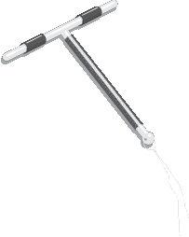
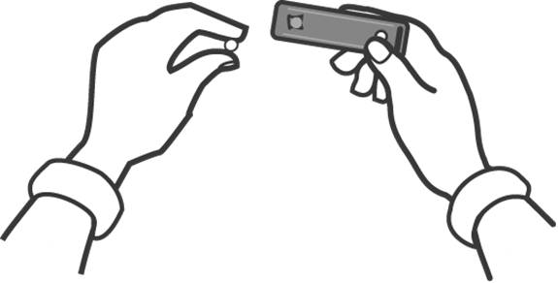
Emergency contraception
Copper T 380A

Slide 34
What is emergency contraception?
Contraceptive methods that are used to prevent pregnancy after sexual intercourse.
Recommended for use within 5 days but their effectiveness increases when used as early as possible after the act of intercourse.
Can prevent up to over 95% of pregnancies when taken within 5 days after intercourse.

Slide 35
Methods of emergency contraception
Emergency contraceptive pills (ECPs)
  Dedicated ECP Products
    ECPs containing ulipristal acetate (UPA)
    ECPs containing levonorgestrel (LNG)
  Progestin-only pills with levonorgestrel or norgestrel
  Combined oral contraceptive pills (COCs) with estrogen and a progestin- levonorgestrel, norgestrel, or norethindrone (also called norethisterone)
Copper-bearing intrauterine devices
Family Planning: A Global Handbook for Providers (3rd Edition, 2018)

Slide 36
Indications for emergency contraception - 1
Emergency contraception can be used in the following situations following sexual intercourse:
When no contraceptive has been used.
Sexual assault when the woman was not protected by an effective contraceptive method.
When there is concern of possible contraceptive failure, from improper or incorrect use.
A woman may be given advance supplies of ECPs to ensure their availability when needed and they can be used as soon as possible after unprotected intercourse.

Slide 37
Indications for emergency contraception - 2
Improper or incorrect use of contraceptives include:
  Condom breakage, slippage, or incorrect use
  3 or more consecutively missed combined oral contraceptive pills
  More than 3 hours late from the usual time of intake of the progestogen-only pill (minipill), or more than 27 hours after the previous pill
  More than 12 hours late from the usual time of intake of the desogestrel-containing pill (0.75 mg) or more than 36 hours after the previous pill
  More than 2 weeks late for the norethisterone enanthate (NET-EN) progestogen-only injection
  More than 4 weeks late for the depot-medroxyprogesterone acetate (DMPA) progestogen-only injection
  More than 7 days late for the combined injectable contraceptive (CIC)
  Dislodgment, breakage, tearing, or early removal of a diaphragm or cervical cap
  Failed withdrawal (e.g. ejaculation in the vagina or on external genitalia)
  Failure of a spermicide tablet or film to melt before intercourse
  Miscalculation of the abstinence period, or failure to abstain or use a barrier method on the fertile days of the cycle when using fertility awareness based methods
  Expulsion of an intrauterine contraceptive device (IUD) or hormonal contraceptive implant

Slide 38
Emergency contraceptive pills (ECPs)
Also called “morning after” pills or postcoital contraceptives.
Types of ECPs
Dedicated ECP Products
  ECPs containing ulipristal acetate (UPA)
  ECPs containing levonorgestrel (LNG)
Progestin-only pills with levonorgestrel or norgestrel
Combined oral contraceptive pills (COCs) with estrogen and a progestin- levonorgestrel, norgestrel, or norethindrone (norethisterone). They are taken as a split dose. This regimen is known as the Yuzpe method.
Family Planning: A Global Handbook for Providers (3rd Edition, 2018)
Notes:
ECPs provide An important back-up in cases of unprotected intercourse, rape or contraceptive accidents such as forgotten pills or condoms.
Training Resource Package for Family Planning: https://www.fptraining.org/

Slide 39
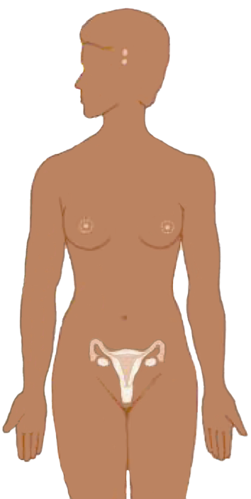
ECPs: Mechanism of action
ECPs interfere
with the process
of ovulation (prevent or delay the release of eggs from the ovaries )
ECPs do not inhibit implantation of a fertilized egg.
ECPs do not cause abortion of an existing pregnancy
do not
Adapted from Training Resource Package for Family Planning: https://www.fptraining.org/
Notes:
Illustration credit: Salim Khalaf/FHI
Research studies have shown that LNG ECPs prevent or delay ovulation. If they are taken before ovulation, LNG ECPs inhibit the pre-ovulatory luteinizing hormone (LH) surge, which impedes follicular development and/or the release of the egg itself.
ECPs do not inhibit implantation of a fertilized egg
ECPs do not cause an abortion of an existing pregnancy. If ECPs are taken after a pregnancy is established, they will not work.

Slide 40
ECPs: Mechanism of action
Fertilization
EC pills have no effect
after fertilization,
do not cause abortion
EC pills work
before fertilization
Last Day of Menstruation
Ovulation Starts
Implantation
First Day of Cycle
Positive Pregnancy Test
Day
1
Adapted from Training Resource Package for Family Planning: https://www.fptraining.org/
Notes:
Effectiveness for an individual woman depends on where she is in her menstrual cycle. An important factor is when ECPs are given within a woman’s menstrual cycle and whether or not fertilization has occurred. This slide shows that LNG ECPs work before fertilization has occurred, but not after. This also helps us understand why LNG ECPs do not cause an abortion. They do not work once fertilization has occurred.

Slide 41
Effectiveness of ECPs
If 100 women each had sex once during the 2nd or 3rd week of the menstrual cycle without using contraception, 8 would likely become pregnant.
If all 100 women used uliprital acetate ECPs, less than one would likely become pregnant.
If all 100 women used progestin (LNG)-only ECPs, one would likely become pregnant.
Effectiveness depends on where a woman is in her menstrual cycle, when she had unprotected sex and when she used ECPs.
Some types of ECP such as ulipristal acetate (UPA) or mifepristone are more effective than LNG-only ECPs and some (regular contraceptives- the Yuzpe regimen) less effective.
Effectiveness may be affected by use of certain medications.
Evidence suggests that ECPs may be less effective in women with higher weight and/or BMI. UPA seems to be more effective in these women than LNG.
Adapted from Training Resource Package for Family Planning: https://www.fptraining.org/
Notes:
The effectiveness of ECPs depends on the type of ECP used and when they are taken. It takes about 6 days after ovulation for a fertilized egg to begin to implant. Pregnancy is established after implantation has been achieved. Therefore, intervention within 72 hours or up to 5 days cannot result in abortion. Treatment should begin as soon as possible after unprotected sex because the efficacy declines with time. LNG ECPs appear to be effective for at least 4 days after sex and potentially up to 5 days (although the label for LNG ECPs says that it is effective for up to 72 hours, or 3 days, it was written before evidence showed that it might work for longer).
Some, but not all studies have found that LNG ECPs may be more effective the sooner they are taken after sex.
No specific data are available about interactions of ECPs with other drugs. However, it is reasonable to assume that drug interactions with LNG ECPs may be similar to those with regular contraceptive pills. Efficacy could be affected by rifampicin, griseofulvin, Saint John’s wort, certain anticonvulsant drugs and certain antiretroviral drugs such as ritonavir.

Slide 42
Medical eligibility criteria (MEC) for ECPs
No medical precautions or contraindications; all women are medically eligible to use ECPs including women who cannot use hormonal contraceptives as regular methods because they are used for a short term.
When taken frequently and repeatedly, ECPs may be harmful for women who have MEC category 2, 3 or 4 conditions for combined hormonal contraception or Progestin-only contraceptives.
Family Planning: A Global Handbook for Providers (3rd Edition, 2018)
Notes:
According to the World Health Organization (WHO) there are no contraindications for ECPs because the amount of hormone is too small to have a clinically significant impact and the duration of use is very short. In addition, these ECPs do not contain estrogen, which is associated with some contraindications, particularly over long-term use. The WHO states that ECPs have no clinically significant impact on conditions such as cardiovascular disease, angina, acute focal migraine, or severe liver disease.
There are no health conditions that would prevent from giving ECPs. No pregnancy test or physical examination is needed before giving ECPs. ECPs should not be taken if a woman is pregnant because they will not work.
The use of certain drugs such as rifampicin, griseofulvin, Saint John’s Wort, certain anticonvulsant drugs and certain antiretroviral drugs (ritonavir) may affect the effectiveness of ECPs.
Training Resource Package for Family Planning: https://www.fptraining.org/

Slide 43
ECP screening flow chart
1. Did you have unprotected sex in the last 120 hours (5 days)?
ECPs are not right for you. If your last menses was over 4 weeks ago, see a health care provider to determine next steps.
No
Yes
Yes
2. Are you pregnant?
Don’t know
Yes
3. Was your last menses was over 4 weeks ago?
No
Recommend ECPs. If your next period does not come within 7 days of when you would normally expect it, see a health care provider to determine pregnancy status.
No
Don’t know
No
4. Do you want to prevent pregnancy?
Yes
Adapted from Training Resource Package for Family Planning: https://www.fptraining.org/

Slide 44
Safety of ECPs
ECPs have no known serious complications.
ECPs do not cause abortion.
They are safe for use by all women including adolescents.
ECPs are not harmful if taken by a woman who is already pregnant.
ECPs have been widely used in various formulations for over 30 years.
Adapted from Training Resource Package for Family Planning: https://www.fptraining.org/
Notes:
ECPs are extraordinarily safe. No deaths or serious complications have ever been linked to any ECP regimen. ECPs do not appear to be harmful if accidentally taken once a woman is already pregnant.
While estrogens contained in many contraceptive pills are associated with some (very low) of stroke and venous thromboembolism, especially in women over 35 who smoke, no such risks are associated with LNG ECPs because they do not contain estrogen. Research shows no association with increased risk of cancer. LNGs do not increase the risk of ectopic pregnancy. The use of ECPs have no effect on future fertility. LNG ECPs do not harm a developing fetus if they are mistakenly taken early in pregnancy and do not interrupt an established pregnancy. No risk of serious harm for moderate repeat use of ECPs appears to exist, and repeated use of ECPs is safer than pregnancy. The safety of ECPs does not change with age; therefore, they carry no added risks for those younger than 17 years.

Slide 45
Advantages of ECPs
ECPs can be taken when needed. The woman does not need to visit a health care provider prior to taking ECPs.
There is no need to do tests and examinations or procedures before taking ECPs. However, if the woman misses her last menses, she should have a pregnancy test before taking ECPs with UPA.
Women have a second chance to prevent unwanted pregnancies.
Pregnancies can be avoided in cases of unconsented sex or where the woman was not allowed to use contraception.
Use is controlled by the woman.
The need for abortion due to nonuse or failure of contraception is less.
The woman can keep supplies of ECPs ready for use if the need arises.
Provide an opportunity for women to start using an ongoing family planning method.
Family Planning: A Global Handbook for Providers (3rd Edition, 2018)

Slide 46
ECP regimens
Pill Type and Hormone | Formulation | Pills to Take
 |  | At First | 12 Hours Later
Dedicated ECP Products
Progestin-only | 1.5 mg LNG (levonorgestrel) | 1 | 0
 | 0.75 mg LNG | 2 | 0
Ulipristal acetate | 30 mg ulipristal acetate | 1 | 0
Oral Contraceptive Pills Used for Emergency Contraception
Combined (estrogen-progestin) oral contraceptives | 0.02 mg EE (ethinyl estradiol) + 0.1 mg LNG | 5 | 5
 | 0.03 mg EE + 0.15 mg LNG | 4 | 4
 | 0.03 mg EE + 0.125 mg LNG | 4 | 4
 | 0.05 mg EE + 0.25 mg LNG | 2 | 2
 | 0.03 mg EE + 0.3 mg norgestrel | 4 | 4
 | 0.05 mg EE + 0.5 mg norgestrel | 2 | 2
Progestin-only pills | 0.03 mg LNG | 50 | 0
 | 0.0375 mg LNG | 40 | 0
 | 0.075 mg norgestrel | 40 | 0
Family Planning: A Global Handbook for Providers (3rd Edition, 2018)
Notes:
Mifepristone, 10-25 mg in a single dose can also be used but is not widely available.
Source: Training Resource Package for Family Planning: https://www.fptraining.org/

Slide 47
Timing of ECPs
Anytime up to 5 days (120 hours) after an unprotected sex.
ECPs protect from pregnancy from sexual intercourse that took place in the preceding 5 days.
To better prevent pregnancy, ECPs should be taken as soon as possible after unprotected sex.
There is no delay in return of fertility.
They do not prevent pregnancy if the sexual intercourse happens more than 24 hours after taking ECPs.
Family Planning: A Global Handbook for Providers (3rd Edition, 2018)

Slide 48
Side effects of ECPs
Side effects of ECPs are uncommon, mild, and in general will resolve without further medications. ECPs with progestin-only or with UPA are much less likely to cause nausea and vomiting compared with ECPs containing estrogen and progestin (COCs).
In the first several days
there may be:
Nausea
Abdominal pain
Fatigue
Headaches
Breast tenderness
Dizziness
Vomiting
Other side effects are:
Changes in bleeding patterns:
  slight irregular vaginal bleeding for 1 to 2 days after taking ECPs
  early or delayed monthly bleeding
Family Planning: A Global Handbook for Providers (3rd Edition, 2018)
Notes:
LNG ECPs are well tolerated and leave the body within a few days. Some women experience mild and short-term side effects. Although side effects may be medically minor, they may be troublesome to some women.
Altered vaginal bleeding patterns- Most women have their next menstrual period within 7 days of the usual time they would normally expect it following the use of ECPs. Menstruation has been reported to occur an average of 1 day earlier than expected following the LNG regimen.
Nausea and vomiting- Nausea, rarely accompanied by vomiting, occurs in less than 20% of women. These symptoms are uncommon enough that prophylactic administration of an antiemetic drug is not needed. If vomiting occurs within 2 hours after taking an ECP dose, some experts recommend a repeat ECP dose can be given vaginally. The other side effects (headache, abdominal pain, breast tenderness, dizziness, fatigue) usually do not occur for more than a few days after treatment and generally resolve within 24 hours.
Source: Training Resource Package for Family Planning: https://www.fptraining.org/

Slide 49
Managing side effects of ECPs - 1
Nausea
Routine use of anti-nausea medications is not recommended.
For nausea occurring with previous ECP use or with the first dose of a 2 dose regimen, anti-nausea medication like 25-50 mg meclizine hydrochloride (Agyrax, Anitvert, Bonine, Postafene) can be taken 30 minutes to one hour before using ECPs.
Vomiting
If vomiting occurs within 2 hours of taking progestin-only or combined ECPs, the dose should be repeated.
If vomiting occurs within 3 hours of taking ulipristal acetate ECPs, the dose should be repeated. Anti-nausea medication can be used with this repeat dose as described above.
If vomiting continues, repeat dose of progestin-only or combined ECPs can be used by placing the pills high in the vagina.
If vomiting occurs more than 2 hours after taking progestin-only or combined ECPs, or more than 3 hours after taking UPA-ECPs, there is no need to repeat the dose.
Family Planning: A Global Handbook for Providers (3rd Edition, 2018)

Slide 50
Managing side effects of ECPs – 2
Irregular vaginal bleeding
Reassure that it is not a sign of illness or pregnancy.
It usually resolves without treatment.
Early or delayed monthly bleeding
Reassure that it is not a sign of illness or pregnancy.
Assess for pregnancy if the monthly bleeding is late by more than 7 days after the use of ECPs.
Reassure that there are no known risks to the fetus if ECPs do not prevent pregnancy.
Family Planning: A Global Handbook for Providers (3rd Edition, 2018)

Slide 51
Addressing common concerns, rumors and misconceptions about ECPs
The availability of ECPs does not increase risky sexual behavior
ECPs do not prevent implantation
ECPs do not cause abortions
ECPs do not cause deformed babies
ECPs are not dangerous
Adapted from Training Resource Package for Family Planning: https://www.fptraining.org/

Slide 52
Transition from ECPs to regular contraception - 1
Method | When to start or restart
 | Following progestin-only or combined ECPs | Following ulipristal (UPA) ECPs
Hormonal methods (combined oral contraceptives, progestin-only pills, progestin-only injectables, monthly injectables, implants, combined patch, combined vaginal ring) | Can start or restart immediately. There is no need to wait for next monthly bleeding. If she is a continuing user of oral contraceptive pills, she should resume use as before. It is not necessary to start a new pack. Patch users should start with a new patch. Ring users should follow the procedure for late replacement or removal of vaginal ring. All women should abstain from sex or use a backup method (abstinence, male and female condoms, spermicides, and withdrawal) for the first 7 days of using the regular method. If the woman does not start immediately but returns for a method later, she can start any method at any time after pregnancy has been ruled out. | Start or restart any method containing progestin on the 6th day. There is no need to wait for the next monthly bleeding. Earlier start for methods containing progestin is not recommended because both LNG and UPA interact. The presence of both drugs in the body may reduce their effectiveness. If the woman wishes to use oral contraceptive pill, vaginal ring, or patch, give her a supply with instructions to start on the 6th day after using UPA-ECPs. If she has chosen to use injectables or implants, give a follow-up appointment for the method on the 6th day of use of UPA-ECPs or as soon as possible after. All women should use a backup method from the time they take UPA-ECPs until 7 days of starting a hormonal method (2 days for progestin-only pills). If the woman returns later than the 6th day to start a method, she may start any method at any time after ruling our pregnancy.
Family Planning: A Global Handbook for Providers (3rd Edition, 2018)

Slide 53
Transition from ECPs to regular contraception - 2
Method | When to start or restart
 | Following progestin-only or combined ECPs | Following ulipristal (UPA) ECPs
Levonorgestrel intrauterine device (LNG-IUD) | LNG-IUD can be inserted at any time if it is confirmed that the woman is not pregnant. Use backup methods for the first 7 days after LNG-IUD insertion. | LNG-IUD can be inserted on the 6th day after ruling out pregnancy. Give an appointment to have it inserted on the 6th day after taking UPA-ECPs or the earliest possible time thereafter. Use backup methods from the time of using UPA-ECPs until 7 days after the insertion of LNG-IUD. If the woman returns after the 6th day, LNG-IUD can be inserted at any time if it can be ascertained that she is not pregnant.
Copper-bearing intrauterine device | Can be inserted on the same day after taking ECPs. No need for a backup method. If the woman returns at a later date, she can have it inserted at any time if it can be established that she is not pregnant.
Female sterilization | The sterilization procedure can be done within 7 days after the start of her next monthly bleeding or any other time after ruling out pregnancy. Supply backup method for her to use until the procedure can be done.
Male and female condoms, spermicides, diaphragms, cervical caps, withdrawal | Immediately
Fertility awareness methods | Standard Days Method: With the start of her next monthly bleeding. Symptoms-based methods: Once normal secretions have returned. Supply backup method to use until she can start the method of her choice.
Family Planning: A Global Handbook for Providers (3rd Edition, 2018)

Slide 54
ECPs follow up and referral for clients
If the client reports no menses within 4 weeks of ECP use, she may be pregnant.
Invite client to tell her story, including the number of sex partners. If her story suggests STI exposure, refer for treatment. Discuss use of condoms if appropriate.
If at risk for STIs, discuss dual protection from pregnancy AND from STIs/HIV/AIDS
If story suggests coercion or violence, provide more help if possible.
Can start another method right away. If client chooses no regular method now, offer ECPs and male or female condoms with instructions for use.
Contraceptive use should never be made a condition for ECP use.
Women who use ECPs as a main method of contraception or for any other reason should be counselled on the appropriateness, effectiveness and the correct usage of more regular contraceptive methods.
Adapted from Training Resource Package for Family Planning: https://www.fptraining.org/
Notes:
Following ECP use, clients will need continuing protection against pregnancy and may need protection against STIs and possibly sexual abuse.
• If the client reports no menses within 4 weeks of ECP use, she may be pregnant. It is normal for a woman’s menses to begin a few days earlier or later than usual after taking
ECPs. If a woman does not have a period within 4 weeks, discuss her next options.
• A client should be encouraged to return if he/she has concerns or problems.
• Assessing STI risk and referring the client for diagnosis and/or treatment is a critical part of EC services. If at risk for STIs, discuss dual protection from pregnancy and from STIs/HIV/AIDS
• Women who have been forced to have sex or have been sexually assaulted and/or raped may seek advice or services. Seeking health services may be a stressful experience after the trauma of a sexual assault. Be supportive and sensitive to the emotional turmoil that women in this situation may be experiencing. Women who have been sexually assaulted are also in need of diagnosis and possible treatment for STIs and should be offered referral for a comprehensive evaluation and possible prophylactic STI treatment.

Slide 55
Copper-bearing intrauterine devices (IUDs) emergency contraception
Particularly beneficial to women who want to use a highly effective, long-acting and reversible contraceptive method.
Timing:
As an emergency contraceptive method, copper-bearing IUD should be inserted within 5 days of unprotected intercourse.
If the time of ovulation can be estimated, the IUD can be inserted up to 5 days after ovulation. This may be more than 5 days after unprotected sex.
Family Planning: A Global Handbook for Providers (3rd Edition, 2018)

Slide 56
Copper-bearing intrauterine devices (IUDs) emergency contraception: Mechanism of action
Copper-bearing intrauterine devices (IUDs)
Cause a chemical change in sperm and egg before they meet to prevent fertilization and thus, pregnancy.
Emergency contraception DOES NOT interrupt an established pregnancy and DOES NOT harm a developing embryo.

Slide 57
Effectiveness of copper-bearing IUDs emergency contraception
Copper-bearing IUDs are the most effective form of emergency contraception available.
The effectiveness of copper-bearing IUDs in preventing pregnancy is > 99% when inserted within 5 days of unprotected intercourse.

Slide 58
Safety of copper-bearing IUDs emergency contraception
Copper-bearing IUD is a safe method of emergency contraception.
The occurrence of Pelvic Inflammatory Disease (PID) may be < 2 cases per 1000 users.
Risks of expulsion or perforation are low.

Slide 59
Emergency contraception: Medical eligibility criteria for copper-bearing IUDs - 1
Eligibility criteria for the general use of a copper IUD apply to its use as an emergency contraceptive method.
IUD insertion may further increase the risk of PID among women at increased risk of sexually transmitted infections (STIs), though this risk may be low. The risk of STIs varies depending on the behaviour of the individual and prevalence of STI in the local setting. In general, women at increased risk of STI can use IUD.
Situations when a copper IUD should not be used as emergency contraception are listed in the next slide.

Slide 60
Emergency contraception: Medical eligibility criteria for copper-bearing IUDs - 2
Copper IUDs should not be used as emergency contraception in the following situations:
In women with MEC category 3 or 4 conditions for copper IUD. This includes women with ongoing PID, puerperal sepsis, unexplained vaginal bleeding, cervical cancer, or severe thrombocytopenia.
In women who are victims of sexual assault due to a high risk of STIs like chlamydia and gonorrhea.
In women who are already pregnant.
In women with very high risks of STIs. Appropriate testing and treatment should be done first before inserting IUD in this category of women.

Slide 61
Transition from copper-bearing IUDs emergency contraception to regular contraception
There is no need for additional contraceptive protection if a copper IUD is used for emergency contraception.
Copper-bearing IUD can be continued as an ongoing method of contraception or the woman may change to another contraceptive method of her choice.

Slide 62
Emergency contraception: Summary
The only currently available contraceptive method that prevents pregnancy after sexual intercourse and before implantation.
Can be used by any woman or girl of reproductive age
No absolute medical contraindications- eligibility criteria for general use of a copper IUD apply when they are used for emergency contraception
The sooner they are used, the more effective they appear to be.
Do not affect an existing pregnancy if used when a woman is already pregnant.
Provide an opportunity for women to start using an ongoing family planning method.

Slide 63
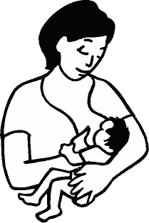
Lactational Amenorrhea Method (LAM)
LAM
Notes:
The Lactational Amenorrhea Method (LAM) is a highly effective, temporary family planning method for breastfeeding women. LAM provides natural protection against pregnancy for up to six months after birth while the woman continues breastfeeding. It encourages the timely transition to other modern methods of contraception.

Slide 64
LAM
What is LAM?
LAM is:
A family planning method based on breastfeeding. Provides contraception for the mother and best feeding for the baby.
Can be effective for up to 6 months after childbirth, as long as monthly bleeding has not returned and the woman is fully or nearly fully breastfeeding.
A “gateway” to other modern methods of contraception.
Requires breastfeeding often, day and night. Almost all of the baby’s feedings should be breast milk.
Adapted from Training Resource Package for Family Planning: https://www.fptraining.org/
Notes:
LAM is not just “breastfeeding.” It is a family planning method based on the hormonal suppression of ovulation caused by breastfeeding.
LAM is one more method that is available to expand the local method mix and meet more contraceptive needs.

Slide 65
LAM: Mechanism of action
Baby’s suckling stimulates the nipple
Nipple stimulation triggers signals to mother’s brain
Signals disrupt hormone production
Disruption of hormones suppresses ovulation
No egg, no pregnancy
Adapted from Training Resource Package for Family Planning: https://www.fptraining.org/
Notes:
LAM prevents pregnancy by interfering with the release of hormones that allow ovulation. Suckling stimulates production of a hormone that tells the brain not to release the hormone necessary for ovulation. Regular and frequent nipple stimulation is necessary to ensure a continuous stimulation of the brain/hypothalamus.
Frequent and intense breastfeeding prevents ovulation through the following sequence of events:
The baby’s sucking stimulates the nipple. The baby squeezes and rubs the nipple with his/her gums and palate; this causes a pressure or “mechanical stimulation” of the nipple.
This stimulation of the nipple sends a neural signal to the mother’s brain—specifically her pituitary, which produces and secretes hormones related to many bodily processes, including ovulation.
This signal to the mother’s brain disrupts the production of hormones that would normally stimulate the ovary.
In response to the suckling stimuli, there is an increased production of prolactin, which inhibits the secretion of GnRH (gonadotropin-releasing hormone) by the hypothalamus. Prolactin controls the rate of milk production but it is not considered to play a major role in suppressing ovarian function.
Disruptions in the release of GnRH, in turn, disrupt the pituitary’s production and release of hormones directly responsible for ovulation: follicle-stimulating hormone (FSH) and luteinizing hormone.
Thus, ovulation is prevented. Disruption in release of FSH impedes the normal maturation of the egg by the ovary; disruptions in the release of LH impede the release of a mature egg by the ovary.

Slide 66
LAM
Three LAM criteria
If breastfeeding now, can use LAM if:
 Baby is less than 6 months old
AND
The baby is fully or nearly fully breastfeeding and is fed often day and night
AND
Menstrual periods have not come back
Adapted from Training Resource Package for Family Planning: https://www.fptraining.org/
Notes:
The three LAM criteria are:
The woman’s menstrual bleeding has not returned; AND
The baby is fully or nearly fully breastfeeding and is fed often day and night; AND
The baby is less than six months old.
LAM will not be effective if any one of the three criteria is not met. LAM is not just “breastfeeding.” While any breastfeeding may decrease fertility, LAM cannot be used as an effective method of contraception unless the other two criteria are also met.

Slide 67
How to use LAM
Can start LAM as soon as baby is born.
Breastfeed often day and night. Daytime feeding no more than 4 hours apart. Night-time feeding no more than 6 hours apart.
Start another method at the right time, BEFORE the LAM criteria no longer apply.
Start giving baby other foods when he/she is 6 months old but continue to breastfeed.
Adapted from Training Resource Package for Family Planning: https://www.fptraining.org/

Slide 68
LAM effectiveness
Spermicides
Female condom
Standard Days Method
Male condom
Oral contraceptives
DMPA
LAM
IUD (TCu-380A)
Rate during perfect use
Female sterilization
Rate during typical use
Implants
0
5
10
15
20
25
30
Percentage of women pregnant in first year of use, but note LAM only used for 6 months
Source: CCP and WHO, 2018.
Adapted from Training Resource Package for Family Planning: https://www.fptraining.org/
Notes:
LAM is very effective when used correctly. This chart compares the pregnancy rates for LAM with the rates for other contraceptive methods. The red rectangles show pregnancy rates for correct and consistent use, reflecting how often a contraceptive fails when it is used both correctly and consistently. The blue rectangles show pregnancy rates for typical use, reflecting how often a contraceptive fails in real-life situations, when it may not always be used correctly and consistently.
In the case of LAM, there is little difference between pregnancy rates for correct and consistent use and typical use.

Slide 69
LAM: Characteristics
Advantages
Safe, natural and no side effects
Requires no supplies or procedures
Health benefits for mother and baby
Can be used immediately after childbirth
A temporary method
Facilitates modern contraceptive use by previous non-users
Is provided and controlled by the woman
Supports and builds on global infant-feeding recommendation to exclusively breastfeed for six months
Limitations
No STI/HIV protection
Is only a temporary method
Not a good method for women who have to be away from their babies for long periods of time
Adapted from Training Resource Package for Family Planning: https://www.fptraining.org/
Notes:
69

Slide 70
LAM eligibility criteria
The woman’s menstrual bleeding has not returned;
AND
She fully or nearly fully breastfeeds her baby; AND
The baby is less than six months old.
Adapted from Training Resource Package for Family Planning: https://www.fptraining.org/

Slide 71
Importance of LAM Criteria -1
The woman’s menstrual bleeding has not returned (“amenorrhea”)
Menstrual bleeding signals return of fertility—the woman can become pregnant again.
Remember: bleeding before
two months postpartum is
NOT considered menstruation.
Adapted from Training Resource Package for Family Planning: https://www.fptraining.org/
Notes:
1. The woman’s menstrual bleeding has not returned (“amenorrhea”).
Bleeding within two months postpartum is not considered menstruation. It is considered lochial discharge and would not disqualify a woman from using LAM.
However, any bleeding after two months postpartum should be considered the return of menses and thus the client should start using another modern method immediately.
If any bleeding (after two months) is considered menstrual bleeding: it can increase the effectiveness of LAM because this reduces or eliminates the probability that a true but scanty menstruation will be ignored.
Some women experience a bleeding episode before ovulation returns (pre-ovulatory bleeding). This is a sign that the endometrium was hormonally stimulated by the ovary without ovulation occurring. However, the woman has no way of knowing whether or not ovulation took place, so such a bleeding episode must be considered a sign of the return of fertility.

Slide 72
Importance of LAM Criteria - 2, 3
2. She fully or nearly fully breastfeeds her baby
3. The baby is less than six months old.
If baby receives food or liquids other than breast milk:
The baby becomes full and will not want the breast as often
Infrequent suckling will cause the mother to produce less and her fertility to return
She can become pregnant again.
Six months is a biologically appropriate cut-off point to start supplemental foods.
Breastfeeding should continue beyond LAM and until baby is two years old.
Adapted from Training Resource Package for Family Planning: https://www.fptraining.org/
Notes:
She fully/or nearly fully breastfeeds her baby.
Fully breastfeeding or exclusive breastfeeding means the infant receives no other liquid or food in addition to breast milk. It means no milk substitutes, pap, herbal tea—all are considered food/liquids.
Nearly fully breastfeeding means that the infant receives some liquid or food in addition to breast milk, but the majority of feedings (more than three fourths of all feeds) are breast milk. Breastfeeding should be “on demand” (not scheduled). (Babies who are fully or exclusively breastfed tend to breastfeed more frequently than every four hours.)
The baby should go no longer than four hours during the day and six hours during the night between feeds.
Mechanical or hand pumping does NOT appropriately stimulate the nipples.
Breastfeeding should begin as soon as possible after birth (preferably within the first hour); it can even begin before the placenta is expelled. Breastfeeding includes feeding of colostrum. Colostrum is important to the newborn for immunity and to help “clean” its intestines.
It is important that the woman continues to fully or nearly fully breastfeed so that she doesn’t ovulate and her menses does not return.
The baby is less than six months old.
Up until six months of age, breast milk is the best and only nutrition needed by the baby. This is supported by evidence and recommended by WHO. When the baby turns six months old, s/he should begin receiving supplemental foods, so suckling will decrease and the mother’s fertility will return.

Slide 73
Who Can Start LAM
Category 1:
LAM is safe for all women.
WHO Category | Conditions
Category 1 | All conditions listed in MEC fall into category 1 for LAM
Adapted from Training Resource Package for Family Planning: https://www.fptraining.org/
Notes:
For LAM, all the conditions that are presented in the MEC are considered category 1. Therefore, LAM as a contraceptive method is a safe choice for most women and can be used without restrictions by women with the LAM category 1 conditions. In certain situations, however, the provider would need to consider whether or not breastfeeding as a method of infant feeding is recommended with certain conditions or with the drugs used to treat certain conditions.

Slide 74
LAM: Return of fertility and risk of pregnancy
  In women not breastfeeding, ovulation will occur at 45 days postpartum on average; may occur as early as 21 days.
  Breastfeeding women not practicing LAM are likely to ovulate before return of menses.
  Between 5% and 10% of women conceive within the first year postpartum.
Adapted from Training Resource Package for Family Planning: https://www.fptraining.org/
Notes:
74
Why is early initiation of LAM or another contraceptive critical if the couple does not want to become pregnant again right away?
Because fertility can return soon after birth.
If not breastfeeding, ovulation will occur on average at 45 days; and it may occur as early as 21 days postpartum.
The breastfeeding woman who is not practicing LAM is likely to ovulate before return of menses.
Between 5% and 10% of women conceive within the first year postpartum.

Slide 75
Transition to another method: An essential component of LAM
  LAM can be a bridge to other modern methods of contraception.
  LAM provides the couple time to decide on another modern method to use after LAM.
  When LAM counseling is initiated, the provider should discuss transition from LAM to another contraceptive method with the client:
    Another method should be started as soon as any one of three LAM criteria is not met.
    Transition method should be selected before this occurs.
Adapted from Training Resource Package for Family Planning: https://www.fptraining.org/
Notes:
By the time any one of the three LAM criteria is no longer met, the woman/couple should be using another modern method of family planning if they do not want to become pregnant.
Therefore, counseling to support effective transition to another modern method must begin before the woman starts using LAM, such as when LAM counseling is initiated.
The woman who is using LAM needs to know that she may become pregnant even when she is breastfeeding:
If she has had any vaginal bleeding after two months postpartum,
If she is no longer breastfeeding fully or nearly fully, or
If the baby is six months of age or older.
A woman can ovulate, and therefore become pregnant, even before her menses return. The woman who meets all three LAM criteria, however, can transition to another family planning method with confidence that she is not pregnant
A woman transitioning from LAM should be encouraged to continue breastfeeding her baby even after she begins using another method of contraception, as appropriate. Continued breastfeeding should be kept in mind when choosing the next method.

Slide 76
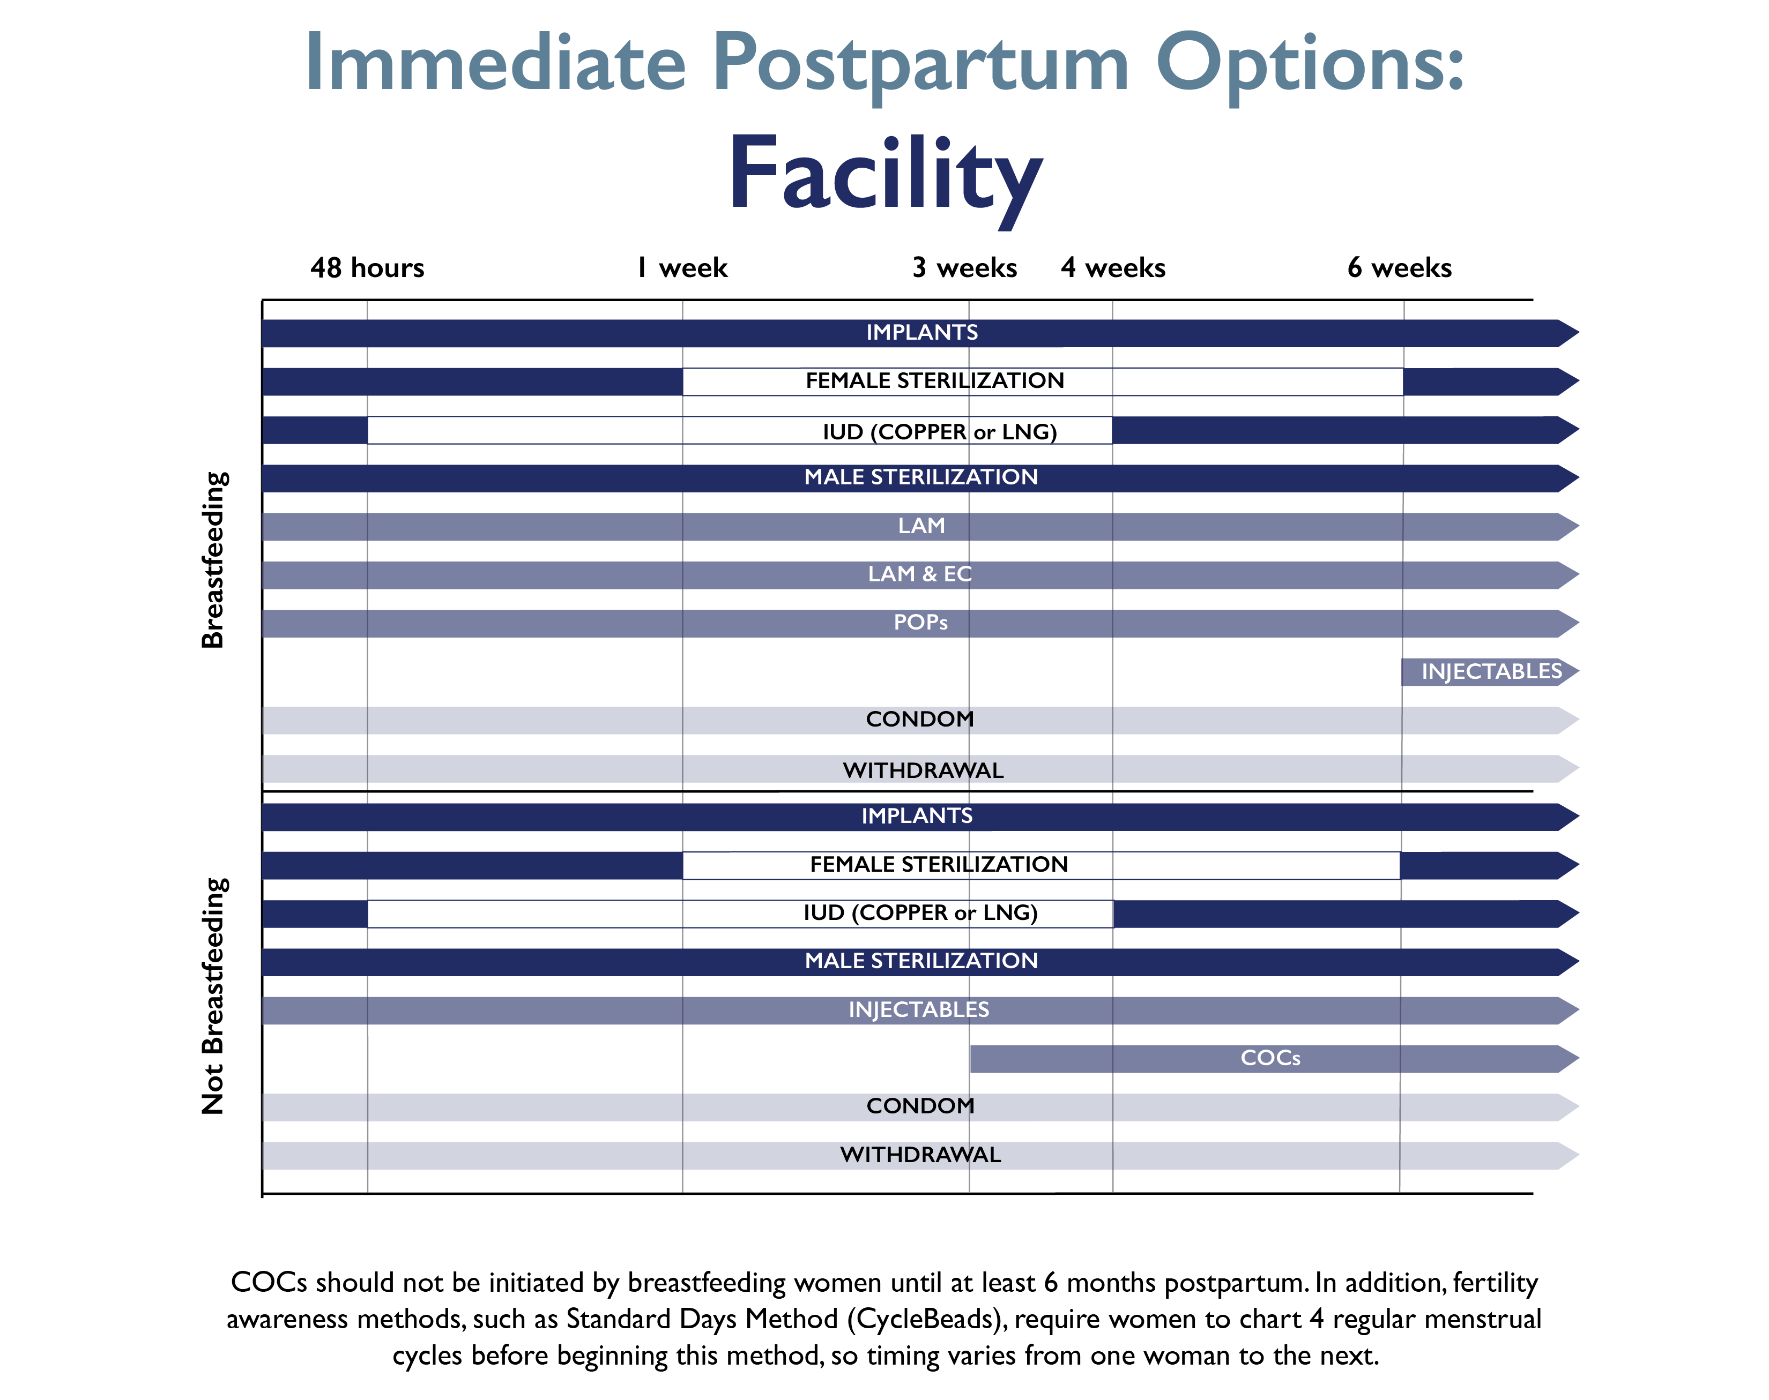
Adapted from Training Resource Package for Family Planning: https://www.fptraining.org/
Notes:
Source MCHIP via K4 Health 2015 https://www.k4health.org/sites/default/files/ppfp_options_facility_graph-02_0.png

Slide 77
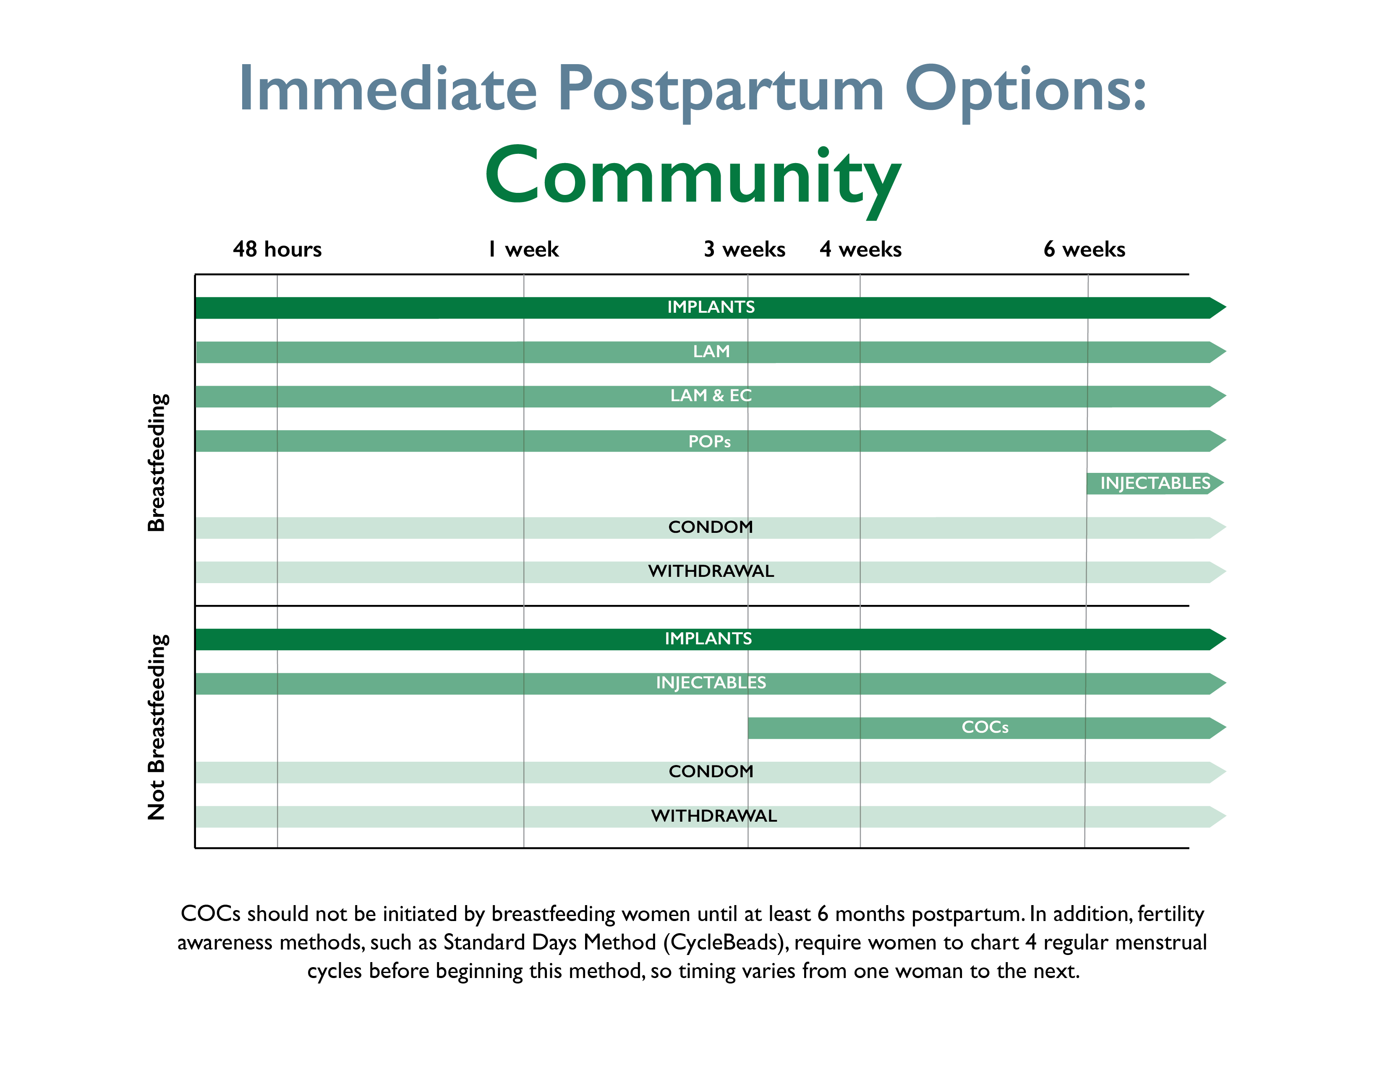
Adapted from Training Resource Package for Family Planning: https://www.fptraining.org/
Notes:
Source MCHIP via K4 Health 2015 https://www.k4health.org/sites/default/files/ppfp_options_community_graph-01_0.png

Slide 78
Opportunities to provide LAM counseling
Antenatal clinic
  Child health (well-baby) clinic
  Postpartum ward
  Postpartum clinic
  Family planning clinic
  Labor ward (during early labor or following birth)
  Community health visits
Adapted from Training Resource Package for Family Planning: https://www.fptraining.org/
Notes:
All pregnant or postpartum women should be informed about LAM and offered the opportunity to use it as a highly effective, temporary method of contraception.
Opportunities to inform women about LAM and counsel them on its use include antenatal clinics; immediate postpartum wards; well-baby, nutrition and immunization visits; postpartum clinics; family planning clinics; labor wards (during early labor or after birth); and community health visits.
The immediate postpartum visit is especially important to the successful implementation of LAM. This may occur at home or in a clinic, hospital or other health care setting.
Likewise, a later postpartum visit at the time of transition (i.e., when a woman no longer meets all three LAM criteria or wants to begin using another method) is essential to facilitate the successful transition to another modern method of contraception.

Slide 79
Health benefits breastfeeding
Mother
  Stimulates uterine contractions in early postpartum period
  Promotes involution (return of uterus to pre-pregnancy state)
  Leads to less anemia because of less iron depletion (due to amenorrhea)
  Strengthens mother–baby bonding
Baby
  Adapts to needs of growing infant
  Promotes optimal brain development
  Provides passive immunity and protects from infections
  Provides some protection against allergies
Adapted from Training Resource Package for Family Planning: https://www.fptraining.org/
Notes:
There are a number of benefits to breastfeeding, which is one of the three LAM criteria.
In early postpartum, breastfeeding stimulates uterine contractions.
It promotes involution (return of the uterus to its pre-pregnancy state).
Also, there is less anemia because there is less iron depletion due to absence of menses.
In addition, breastfeeding strengthens mother-baby bonding.
There are also many health benefits to the baby.
Breast milk adapts to needs of growing infant. As the infant grows and sucks more, more breast milk is produced.
Breast milk promotes optimal brain development and it provides passive immunity and protects from infections. Certain antibodies in breast milk provide immunity to many infections.
Researchers have also found that breast milk provides some protection against allergies. Bottle-fed babies are at higher risk for allergies.
Also, breastfeeding decreases risk of Sudden Infant Death Syndrome (SIDS).

Slide 80
Limitations of LAM
  Offers only temporary contraceptive protection (up to six months).
  Is not usually appropriate if mother will be separated from baby for periods of time.
  HIV-positive mothers may worry about HIV transmission through breastfeeding.
Adapted from Training Resource Package for Family Planning: https://www.fptraining.org/

Slide 81
LAM: correcting rumors and misunderstandings
There are many misconceptions about LAM that need to be addressed, including:
  LAM is not effective – FALSE It ss highly effective when a woman meets all 3 LAM criteria
  Women who work away from home cannot use LAM - FALSE
  Women with HIV cannot use LAM - FALSE
  Concerns that if used for 6 months the woman will run out of milk - FALSE
  Fat/thin women cannot use LAM - FALSE
  Special foods are needed by women - FALSE
  Babies need more than just breastmilk in their first six months - FALSE
Adapted from Training Resource Package for Family Planning: https://www.fptraining.org/

Slide 82
LAM and HIV - 1
Every woman should be supported in her infant-feeding decision and in her contraceptive choice.
Breastfeeding will not make HIV worse.
Early and exclusive breastfeeding is the best way to promote the child’s survival, including for women with HIV.
Giving ART to an HIV-infected mother or an HIV-exposed infant significantly reduces the risk of HIV transmission through breastfeeding
Mothers living with HIV and their infants should receive appropriate ART and exclusively breastfeed their infants for the first 6 months of life, then introduce appropriate complementary foods and continue breastfeeding for at least 12 months and up to 24 months or more while being fully supported to keep taking ART.
Adapted from Training Resource Package for Family Planning: https://www.fptraining.org/
Notes:
HIV-positive women may use LAM. All women should be encouraged to breastfeed.
Replacement feeding should not be encouraged, it is rarely:
(A) acceptable (i.e., in some cultures bottle feeding is not accepted);
(F) feasible (i.e., is not appropriate because the woman does not have the resources to prepare and give replacement feeding);
(A) affordable (i.e., some families cannot afford to pay the high price of formula/replacement feeding);
(S) sustainable (i.e., some people who can afford and prepare formula now may not be able to a month from now); and
(S) safe (i.e., contaminated water or unclean feeding equipment may be the only thing available in some settings)
should be encouraged to fully or nearly fully breastfeed their infants for six months. You may have heard this referred to as “AFASS” in PMTCT programs.
After six months, breastfeeding should continue in addition to supplementary feeds until AFASS criteria are met. The HIV-positive infant should also continue to breastfeed until AFASS criteria are met.

Slide 83
LAM and HIV - 2
Breastfeeding should then only stop once a nutritionally adequate and safe diet without breast milk can be provided.
When HIV-infected mothers decide to stop breastfeeding (at any time) they should do so gradually within one month.
  A mother with HIV who chooses to breastfeed or use LAM should:
  Receive care and treatment for herself to minimize the risk of transmission to the infant and keep herself healthy.
  Use condoms consistently.
  If she experiences cracked nipples or other breast problems, instruct her to feed from unaffected breast (and express and discard milk from affected breast).
  Seek immediate care for baby with thrush or other lesions in mouth.
Adapted from Training Resource Package for Family Planning: https://www.fptraining.org/
Notes:
*Note: the last two bullets are pretty much true for ALL mothers, although they are particularly relevant for HIV+ mothers. The woman who is HIV-positive should be on ARV therapy if clinically eligible. ARVs taken by the mother greatly reduce the likelihood of transmission of the virus through breast milk.
The woman who is HIV positive should continue to use condoms consistently as LAM does not protect against sexually transmitted infections.
HIV is more likely to be transmitted to the baby if the nipples are cracked or bleeding.
HIV is more likely to be transmitted through lesions in the baby’s mouth than through a healthy oral mucosa.
Breast problems in the mother or problems in the mouth of the baby may encourage transmission of the virus from mother to baby.

Slide 84
LAM: Summary
Over 98% effective as long as all three criteria are met:
  No menses
  Breastfeeding only
  Baby less than 6 months
Can be a bridge to other modern methods of family planning
Provides important health benefits to the mother and child
Natural and no side effects
Adapted from Training Resource Package for Family Planning: https://www.fptraining.org/

Slide 85

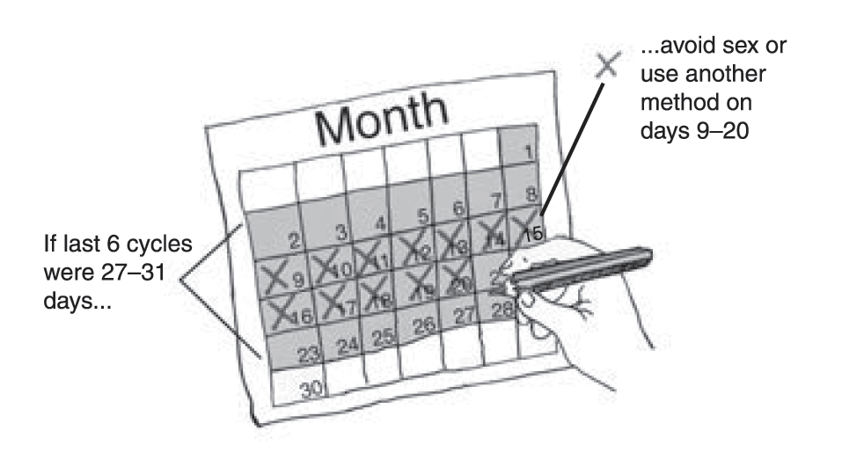
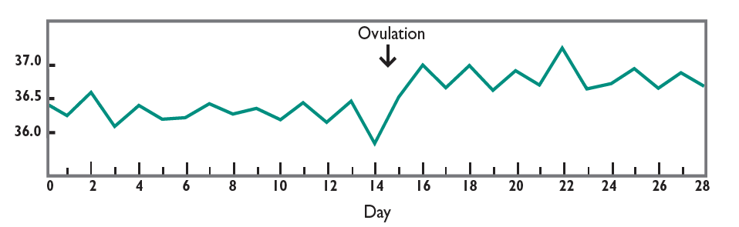
Fertility awareness methods

Slide 86
What are fertility awareness methods?
“Fertility awareness” means that a woman knows how to tell when the fertile time of her menstrual cycle starts and ends. (The fertile time is when she can become pregnant.)
Sometimes called periodic abstinence or natural family planning.
A woman can use several ways, alone or in combination, to tell when her fertile time begins and ends.
Calendar-based methods
Standard Days Method
Symptoms-based methods:
TwoDay Method
Ovulation method
Symptothermal method
Family Planning: A Global Handbook for Providers (3rd Edition, 2018)

Slide 87
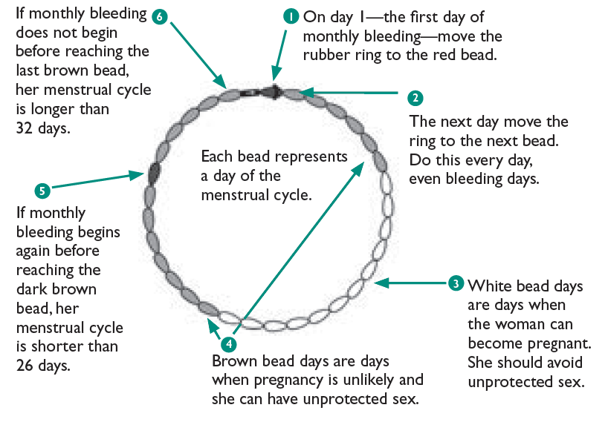
How do fertility awareness methods work? - 1
Calendar-based methods:
Involve keeping track of days of the menstrual cycle to identify the start and end of the fertile time.
Example:
Standard Days Method avoids unprotected vaginal sex on days 8 through 19 of the menstrual cycle, and calendar rhythm method. This will be discussed in further details.
Use memory aids
Family Planning: A Global Handbook for Providers (3rd Edition, 2018)

Slide 88
How do fertility awareness methods work? - 2
Symptoms-based methods:
Depend on observing signs of fertility.
– Cervical secretions:
When a woman sees or feels cervical secretions, she may be fertile. She may feel just a little vaginal wetness.
– Basal body temperature (BBT):
A woman’s resting body temperature goes up slightly after the release of an egg (ovulation). She is not likely to become pregnant from 3 days after this temperature rise through the start of her next monthly bleeding. Her temperature stays higher until the beginning of her next monthly bleeding.
Examples: TwoDay Method, BBT method, ovulation method (also known as Billings method or cervical mucus method), and symptothermal method.
Take body
temperature daily
Family Planning: A Global Handbook for Providers (3rd Edition, 2018)

Slide 89
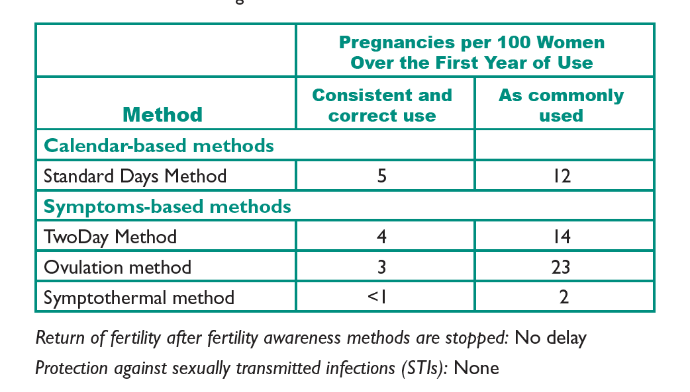
Fertility awareness methods: Types and effectiveness
Family Planning: A Global Handbook for Providers (3rd Edition, 2018)

Slide 90
Advantages of fertility awareness methods
No side effects
No known health risks
Do not require procedures and usually do not require supplies
Help protect against risks of pregnancy
Help women learn about their bodies and fertility
Allow some couples to adhere to their religious or cultural norms about contraception
Can be used to identify fertile days by both women who want to become pregnant and women who want to avoid pregnancy
Can be safely used by women who are living with HIV or are on antiretroviral (ARV) therapy
Family Planning: A Global Handbook for Providers (3rd Edition, 2018)
Notes:
Women who are living with HIV or are on antiretroviral (ARV) therapy can safely use fertility awareness methods. They should be urged to use condoms along with fertility awareness methods. Used consistently and correctly, condoms help prevent transmission of HIV and other STIs.

Slide 91
Fertility awareness methods: Correcting misunderstandings
Fertility awareness methods:
Can be effective if used consistently and correctly.
Do not require literacy or advanced education.
Do not harm men who abstain from sex.
Do not work when a couple is mistaken about when the fertile time occurs, such as thinking it occurs during monthly bleeding.
Family Planning: A Global Handbook for Providers (3rd Edition, 2018)

Slide 92
Standard Days Method (SDM)
Notes:
Family Planning Training Resource Package - Standard Days Method

Slide 93
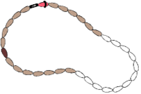
What is the Standard Days Method
The Standard Days Method® (SDM) is a simple fertility awareness-based method of family planning based on a woman's menstrual cycle.
Fertility Awareness is the knowledge of the days in a woman’s menstrual cycle when she is likely to become pregnant (fertile days) by observing fertility signs such as cervical secretions and basal body temperature or monitoring cycle days.
Adapted from Training Resource Package for Family Planning: https://www.fptraining.org/
Notes:
The Standard Days Method® (SDM) is a fertility awareness method of contraception. “Fertility Awareness” means that a woman knows how to tell when the fertile time of her menstrual cycle begins and ends.
Couples using SDM identify the woman’s fertile time using CycleBeads® or a paper-based version of SDM.
The SDM identifies days 8 through 19 as the fertile days of the cycle for most women—those who have menstrual cycles between 26 and 32 days long. To prevent pregnancy couples use barrier methods or abstain from intercourse during those fertile days. Women using SDM can consider cyclebeads® to keep track of their fertility.
Link to multiple versions of the instructions for SDM in several languages.
http://irh.org/?s=cyclebeads+instructions&search_type=resource&country=

Slide 94
Standard Days Method characteristics
Identifies days 8 to19 of the menstrual cycle as fertile days
Is appropriate for women with menstrual cycles between 26 and 32 days long (women who have their periods about once a month fit within this range. If a woman has a cycle outside this range more than once in a given year she should use a different family planning method.)
Helps a couple avoid unplanned pregnancy by knowing which days they should not have unprotected sex
Helps a couple plan a pregnancy by knowing which days they should have sex
Does not protect against STIs/HIV
Adapted from Training Resource Package for Family Planning: https://www.fptraining.org/
Notes:
SDM identifies days 8 – 19 of the menstrual cycle as the fertile days, when there is a significant probability of pregnancy. On all the other days of the cycle, pregnancy is unlikely. The method works best for women who have cycles between 26 and 32 days long.
Therefore, to use the SDM to prevent pregnancy, couples avoid unprotected sex from day 8 through day 19 of each cycle. On all the other cycle days, they can have unprotected sex.
To plan pregnancy, the Standard Days Method can help a couple identify the days to have sex. While this is not sufficient for all couples, it can be an important first step.
The method is based on a formula that accounts for natural variations in the length of the menstrual cycle and the occurrence of ovulation within the cycle (26 to 32 days). A set of color-coded set beads, called CycleBeads®, help users track their menstrual cycle and the days they are likely to become pregnant. A paper version of the SDM can also be used in place of the beads.

Slide 95
SDM: Perfect and typical use effectiveness
Spermicides
Female condom
Standard Days Method
Male condom
Oral contraceptives
DMPA
IUD (TCu-380A)
Rate during perfect use
Female sterilization
Rate during typical use
Implants
0
5
10
15
20
25
30
Percentage of women pregnant in first year of use
Source: CCP and WHO, 2007; updated 2008.
Adapted from Training Resource Package for Family Planning: https://www.fptraining.org/
Notes:
The table shows that when a couple uses SDM perfectly 5 out of 100 will get pregnant within the first year. Another way to say it is that SDM is 95% effective when used perfectly. With typical use, 12 out of 100 will get pregnant (88% effective). With SDM the risk of pregnancy is greatest when couples have sex on the fertile days without using condoms.

Slide 96
Efficacy study of SDM
Multi-site prospective study
Services provided in existing programs
Clients were followed monthly for 13 cycles
Couples used the method correctly in 97% of cycles
478 women in the study, 43 got pregnant
With correct use, the failure rate is 4.8
With typical use the failure rate is 12.0
Adapted from Training Resource Package for Family Planning: https://www.fptraining.org/
Notes:
Source: Training Resource Package for Family Planning: https://www.fptraining.org/
An international multi-center study was conducted. The Standard Days Method was provided to clients of public and private sector family planning programs.
Health personnel were trained to offer the Standard Days Method to their clients.
Clients who were interested in using the method were screened according to specific criteria.
They were taught how to use the method.
They were followed every month for a little over one year, to collect data about their menstrual regularity, their use of the method, their satisfaction with the method, whether they had gotten pregnant, etc.
Results of the efficacy trial were published in Contraception.
References:
Arevalo M, Jennings V, Sinai I. Efficacy of a new method of family planning: the Standard Days Method. Contraception. 2002;65:333-338.

Slide 97
How does SDM prevent pregnancy?
Women are fertile between day 8 and day 19 of their menstrual cycle.
SDM helps couples identify days 8 to19 of the cycle as fertile days by using CycleBeads® or a paper-based version of CycleBeads® .
Couples avoid unprotected sex, either by abstaining from sex or using a condom.
Adapted from Training Resource Package for Family Planning: https://www.fptraining.org/
Notes:
Women are fertile between day 8 and day 19 of their menstrual cycle SDM helps couples identify days 8 to19 of the cycle as fertile days. Couples can identify these days by using CycleBeads® which are a color-coded string of beads that represent the days of the cycle and help the woman track her cycle days, know which days she is fertile, and monitor her cycle lengths. Couples can use a paper-based version of the CycleBeads® if CycleBeads® not available.
• SDM is appropriate for women with menstrual cycles between 26 and 32 days long (women who have their periods about once a month fit within this range)
• SDM helps a couple avoid unplanned pregnancy by knowing which days they should not have unprotected sex
•SDM helps a couple plan a pregnancy by knowing which days they should have sex

Slide 98
Standard Days Method is based on:
The probability of pregnancy relative to ovulation.
Viable sperm – up to 5 days
Viable egg – up to 24 hours
Timing of ovulation.
Menstrual Cycle mid-point ± 3 days
Adapted from Training Resource Package for Family Planning: https://www.fptraining.org/
Notes:
With regards to the probability of pregnancy from intercourse on days relative to ovulation, ultrasound and hormonal studies have found that these are 6 days during the menstrual cycle when it is possible for a woman to become pregnant.
Data on the probability of pregnancy on different days around ovulation indicates that:
There is approximately a 4% probability of pregnancy from intercourse 5 days before ovulation.
This increases to 15%, 4 days before ovulation.
The highest probability of pregnancy – between 25 and 28% -- is on the 2 days before ovulation.
On the day of ovulation, there is an 8-10% probability.
Fertility then decreases – with a 0% probability of pregnancy by the day after ovulation.
These probabilities are due to the limited viable life span of the sperm after ejaculation (not more than 5 days) and to the very limited viable life span of the egg following ovulation (less than 24 hours).
Together these result in an actual fertile window of no more than 6 days during the woman’s cycle. On all the other days, the woman cannot become pregnant.
Putting this in practical terms, if a woman has sex on Saturday and ovulates the following Wednesday, she has a 10 – 12% chance of getting pregnant that cycle. But if she has sex on Saturday and doesn’t ovulate until the following Friday, she has a basically zero % chance of pregnancy.
But how do we know the moment ovulation occurs, and thus know the exact fertile window?
Again, consider probabilities. Data on when during the cycle ovulation occurs indicates that in the great majority of cycles, ovulation occurs very close to the middle of the cycle.
In approximately 30% of cycles, ovulation occurs at the mid point (for example, on or very close to day 14 in a 28 day cycle, or day 15 in a 30 day cycle).
In approximately 60% of cycles, ovulation occurs within 1 day before or after mid cycle.
And in approximately 78% of cycles, ovulation occurs within 2 days before or after the midpoint.
By 4 days before or after midpoint, 95% of ovulations have occurred.

Slide 99
Determining the fertile window
Ovulation
5 days (sperm life)
12 to 24 hours
(ovum life)
Day 8
Day 19
Adapted from Training Resource Package for Family Planning: https://www.fptraining.org/
Notes:
How cycle days 8 through 19 were selected as the fertile window for the Standard Days Method:
Researchers applied various formulae to over 7500 cycles in an existing data set from the World Health Organization, and looked at the probability of pregnancy on different days around ovulation (from up to 5 days before ovulation…until 24 hours after ovulation taking into consideration the viability (sperm life) of sperm and egg during this time, and they also looked at the probability of ovulation on different days of the cycle (usually occurring close to the middle of the cycle, give or take a day or two.)
As a result they determined that for cycles between 26 to 32 days, a fertile window of cycle days 8 through 19 (shown here in green in the lower graph) provided maximum coverage for efficacy while minimizing the number of days for avoiding unprotected intercourse.

Slide 100

CycleBeads
The Standard Days Method (SDM) is used with CycleBeads®, a color-coded string of beads to help a woman:
  Track her cycle days
  Know when she is fertile
  Monitor her cycle length
Adapted from Training Resource Package for Family Planning: https://www.fptraining.org/
Notes:
What are CycleBeads?
CycleBeads represent the menstrual cycle
There are 32 beads, each representing a day of the cycle
The red bead represents the first day of menstruation – which also is the first day of the cycle
The brown beads represent when pregnancy is very unlikely
The white beads represent fertile days when a woman can get pregnant
A moveable rubber ring is used to mark each day
The cylinder, with an arrow, indicates the direction in which the ring should be moved
The darker brown bead helps you know if your period came on time.
Many people also find that CycleBeads are an important factor in gaining the man’s support to use the method. It is very visual – he can literally see when the woman is on a fertile day. It also has served to facilitate communication of the couple regarding how to handle the fertile phase, whether using condoms or abstinence.

Slide 101
How CycleBeads work
What the video: http://www.youtube.com/watch?v=YDOB2fSoJNI
1
If you have not started your period by the day after you put the ring on the last brown bread, contact your provider.
On the day you start your
period, move the
ring to the RED bead.
Also, mark this date
on your calendar
Every morning move the ring to the next bead.
Move the ring even on days when you’re having your monthly bleeding
If you start your period before you put the ring on the darker brown bead, contact your provider.
Keep moving the ring one bead every day. When you start your next period, move the ring directly to the red bead and begin again.
2
On BROWN bead
days you can have intercourse with very low probability of pregnancy.
On WHITE bead days you can get pregnant.
Avoid unprotected intercourse to prevent a pregnancy.
Adapted from Training Resource Package for Family Planning: https://www.fptraining.org/
Notes:
How to use CycleBeads
To use CycleBeads you put this ring (indicate ring) on the red bead the day you get your period.
Then each day after that you move the ring forward, one bead per day, in the direction of the arrow. Move the ring even on days when you’re having your menstrual bleeding (or monthly bleeding).
When the ring is on the red bead or a brown bead, you are on a day when it is very unlikely to get pregnant if you have unprotected sex.. When the ring is on a white bead, you are on a day when pregnancy is very likely. To prevent pregnancy use condoms or do not have sex on these white-bead days. Most women will get their periods somewhere in this area (indicate days between dark brown bead and last bead) and when they do they move the ring forward to the red bead and start the process over. Because this method works best for women with cycles between 26 and 32 days long, there is a darker bead to let you know if you have a shorter cycle (indicate darker bead). If you get your period before reaching this dark brown bead, your cycle is shorter than 26 days and this may not be as effective for you. There are also 32 beads here so if you don’t get your period by the day after the ring is put on the last bead, your cycles may be longer than 32 days and again, this method may not be as effective for you. The medical recommendation is that if you have a cycle outside this range more than once in a given year that you use a different family planning method. To help you know if you have moved the ring daily, always mark the first day of your period on a calendar. That way, if you ever forget if you have moved the ring, you can check your calendar to see when your period came. Starting with the first bead, count how many days have passed since your period started and place the ring on the bead for today.

Slide 102
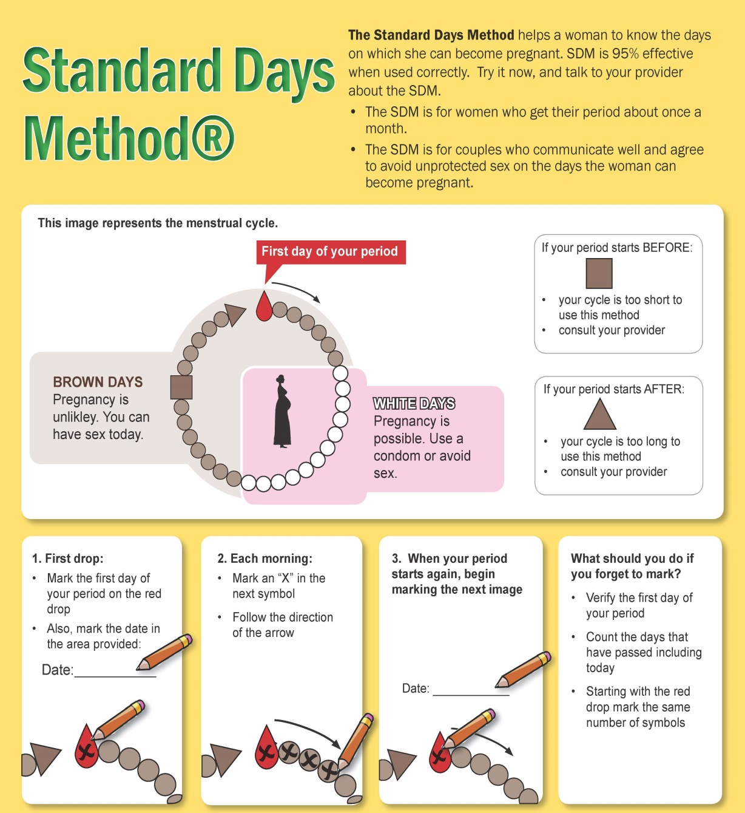
The paper version of SDM
Adapted from Training Resource Package for Family Planning: https://www.fptraining.org/
Notes:
The paper version of SDM can be used when CycleBeads® are not available. It is used in a similar way and the drawing looks like the CycleBeads®.
The beads on the paper represent the menstrual cycle:
There are 32 beads on the paper, each representing a day of the cycle
The red “bead symbol” on the circle of beads represents the first day of the menstrual cycle.
The white “bead symbols” show the days when a woman might get pregnant and should abstain from sex or use a condom.
The brown “bead symbols” show the days when pregnancy is unlikely and the couple can have sex.
The woman should put a red dot or circle on the first day of her period and record the date.
Each morning she should put an “x” on the next symbol, following the arrow.
When her period starts again, she should start over on a new page.
How to use the paper-based version of SDM
To use SDM the woman should mark the red bead symbol the day she gets her period.
Then each day after that she marks one new bead symbol, in the direction of the arrow. She should mark the symbol even on days when she is having her menstrual bleeding.
When she marks a red or brown bead symbol, she is on a day when it is very unlikely to get pregnant if she has unprotected sex.
When she marks a white bead symbol, she is on a day when pregnancy is very likely. To prevent pregnancy, she should use condoms or should not have sex on these white-bead symbol days. Most women will get their periods somewhere in this area and when they do they mark red bead symbol and start the process over. Because this method works best for women with cycles between 26 and 32 days long, there is a square bead symbol to let the woman know if she has a shorter cycle. If she gets her period before reaching this square bead symbol, her cycle is shorter than 26 days and this may not be as effective for her. There are also 32 bead symbols here so if she does not get her period by the day after she marks the last bead symbol, her cycles may be longer than 32 days and again, this method may not be as effective for her. The medical recommendation is that women with a cycle outside this range more than once in a given year should use a different family planning method. To help her know if she has moved the ring daily, she should always put the date on the first day of her period on. That way, if she ever forgets if she has moved the ring, she can check her calendar to see when her period came.

Slide 103
Why some women like SDM
Has no side effects
Does not require procedures and usually do not require supplies
Helps women learn about their bodies and fertility
Allows some couples to adhere to their religious or cultural norms about contraception
Can be used to identify fertile days by both women who want to become pregnant and women who want to avoid pregnancy
Adapted from Training Resource Package for Family Planning: https://www.fptraining.org/

Slide 104
Conditions relating to Fertility Awareness Methods
WHO Category
Conditions
A= Accept
Vaginal discharge
Diseases that elevate body temperature
C= Caution
Age: post menarche or perimenopause
Taking drugs that affect cycle regularity*
D=Delay
Breastfeeding< 6 weeks postpartum
Breastfeeding > 6 weeks postpartum
Postpartum not breastfeeding
Postabortion
*Delay until drug’s effect has been determined, then use caution
Adapted from Training Resource Package for Family Planning: https://www.fptraining.org/
Notes:
All women can use SDM. No medical conditions prevent the use of SDM but some conditions can make it harder to use SDM effectively. See next slide.

Slide 105
Who should delay or use caution in beginning SDM
Circumstances that can affect cycle length and regularity are recent pregnancy or recent use of a hormonal method of contraception
Postpartum/breastfeeding | Wait for 4 consecutive periods Start after 2 most recent periods are about a month apart
3-month Injection, pill, patch, implant, IUD | Wait 90 days after last injection Start after 3 most recent periods are about a month apart
Emergency Contraceptive Pills, miscarriage or abortion | If cycles before pregnancy were 26 to 32 days long Start on first day of next period
Adapted from Training Resource Package for Family Planning: https://www.fptraining.org/
Notes:
In the following situations use caution with SDM:
Menstrual cycles have just started or have become less frequent or stopped due to older age: Menstrual cycle irregularities are common in young women in the first several years after their first monthly bleeding and in older women who are approaching menopause. Identifying the fertile time may be difficult.
In the following situations delay starting calendar-based methods:
Recently gave birth or is breastfeeding: Delay until she has had at least 3 menstrual cycles and her cycles are regular again. For several months after regular cycles have returned, use with caution.
Recently had an abortion or miscarriage: Delay until the start of her next monthly bleeding.
In the following situations delay or use caution with SDM:
Taking any mood-altering drugs such as anti-anxiety therapies (except benzodiazepines), antidepressants (selective serotonin reuptake inhibitors [SSRIs], tricyclic, or tetracyclic), long-term use of certain antibiotics, or long-term use of any nonsteroidal antiinflammatory drug (such as aspirin, ibuprofen, or paracetamol). These drugs may delay ovulation.
Women who are infected with HIV, have AIDS, or are on antiretroviral (ARV) therapy can safely use SDM Urge these women to use condoms while practicing SDM. Used consistently and correctly, condoms help prevent transmission of HIV and other STIs. Condoms also provide extra contraceptive protection for women on ARV therapy.

Slide 106
When is SDM most successful?
SDM is most successful at preventing pregnancy when:
Women have regular menstrual cycles (26 to 32 days long)
Couples are motivated to avoid intercourse or use condoms during fertile days
**SDM does not protect against STIs or HIV/AIDS. Use condoms (for men and women) every time you have sex, to help protect yourself from these diseases.
Adapted from Training Resource Package for Family Planning: https://www.fptraining.org/
Notes:
The World Health Organization, in its publication “Medical Eligibility for Contraceptive Use”, states that the SDM, like other fertility awareness-based methods, poses no adverse risk to women who choose to use it. In general, this method can be provided without concern for health effects to people who choose It. There are no medical conditions that become worse because of SDM. But the SDM is intended for women who meet certain criteria:
The majority of her cycles should be between 26 and 32 days. Women who get their periods about once a month fall within this range.
She and her partner should be able to avoid unprotected sex, i.e. use condoms or not have sex, on days 8 to 19 of her cycle. The collaboration of the man is extremely important for the successful use of the method. He needs to understand and accept that on days 8-19 of each cycle, they will need to use a condom or not have intercourse. If the man (or the woman) cannot avoid unprotected intercourse during the fertile days, they should be encouraged to use another method.
If either member of the couple is exposed to the risk of sexually transmitted infections, the Standard Days Method, as well as most other methods of family planning, will not protect against these infections. Condoms are the only method that provides protection from these infections.

Slide 107
When to start SDM
User: | Start:
User knows the first day of her last period. | Start today
User does not remember the first day of her last period | Start the first day of the next period
Postpartum or breastfeeding. | Wait until you have had 4 periods since baby was born. Start after last two periods have been about a month apart
3-month injection user. | Wait until 90-day protection ends, and last three periods have been about a month apart
Hormonal method user (the pill, 1-month injection, or implant) | After discontinuing method, start SDM if her last three periods have been about a month apart
Had a miscarriage or abortion in the past month OR used emergency contraception. | Start on the first day of her next period
Adapted from Training Resource Package for Family Planning: https://www.fptraining.org/
Notes:
Women who know when their last period started can use the SDM right away. They simply count on the calendar to see which day of their cycle they are on and put the ring on the corresponding bead.
Women who do not remember that date can begin the SDM when their next period starts. While she waits for her period to start, she should use condoms or another back-up method.

Slide 108
Withdrawal

Slide 109
What is withdrawal?
Just before ejaculation, the man withdraws his penis from his partner’s vagina and ejaculates outside the vagina, keeping his semen away from her external genitalia.
Also known as coitus interruptus and “pulling out.”
Works by keeping sperm out of the woman’s body.
No side effects, health benefits and health risks.
Can be used at any time and by all men.
May be especially appropriate for couples who:
  – have no other method available at the time
  – are waiting to start another method
  – have sex infrequently
  – have objections to using other methods
Family Planning: A Global Handbook for Providers (3rd Edition, 2018)

Slide 110
Effectiveness of withdrawal
Depends on the user.
One of the least effective methods, as commonly used.
As commonly used, about 20 pregnancies per 100 women whose partners use withdrawal over the first year. This means that 80 of every 100 women whose partners use withdrawal will not become pregnant.
When used correctly with every act of sex, about 4 pregnancies per 100 women whose partners use withdrawal over the first year.
No delay in return of fertility.
No protection against sexually
transmitted infections.
Effectiveness depends on the willingness and ability of the couple to use withdrawal with every act of intercourse.
Family Planning: A Global Handbook for Providers (3rd Edition, 2018)

Slide 111
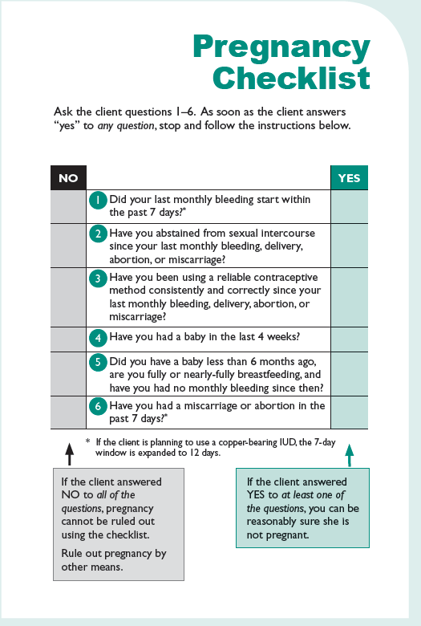
Family Planning: A Global Handbook for Providers (3rd Edition, 2018)

Slide 112
Acknowledgement
This training presentation was adapted from the following resources:
Training Resource Package for Family Planning
https://www.fptraining.org/
World Health Organization Department of Reproductive Health and Research (WHO/RHR) and Johns Hopkins Bloomberg School of Public Health/Center for Communication Programs (CCP), Knowledge for Health Project. Family Planning: A Global Handbook for Providers (2018 update). Baltimore and Geneva: CCP and WHO; 2018. Available from: https://www.fphandbook.org/
World Health Organization. Emergency contraception: Key facts [Internet]. WHO; 2018 Feb 02 [cited 2018 Oct 27]. Available from: http://www.who.int/en/news-room/fact-sheets/detail/emergency-contraception

Slide 113
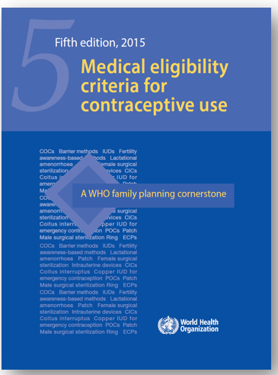
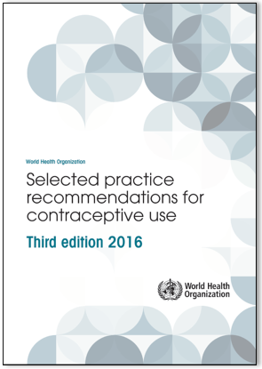
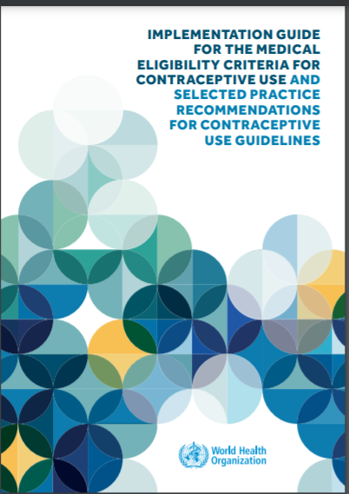
Additional resources
WHO Selected Practice Recommendations for Contraceptive Use (3rd edition 2016). WHO, 2016. Available from: http://www.who.int/reproductivehealth/publications/family_planning/SPR-3/en/
Implementation Guide for the Medical Eligibility Criteria and Selected Practice Recommendations for Contraceptive Use Guidelines. WHO, 2018. Available from: http://apps.who.int/iris/bitstream/handle/10665/272758/9789241513579-eng.pdf?ua=1
WHO Medical Eligibility Criteria (MEC) for Contraceptive Use, Fifth edition. WHO, 2015. Available from: http://www.who.int/reproductivehealth/publications/family_planning/MEC-5/en/
For all the latest publications on family planning visit: https://www.who.int/reproductivehealth/publications/family_planning/en/

