Slide 1
WHO family planning guidelines
Family Planning - A global handbook for providers
An Online Evidence-based Course 2021
Rita Kabra MBBS, MPH
Department of Sexual Reproductive health

Slide 2
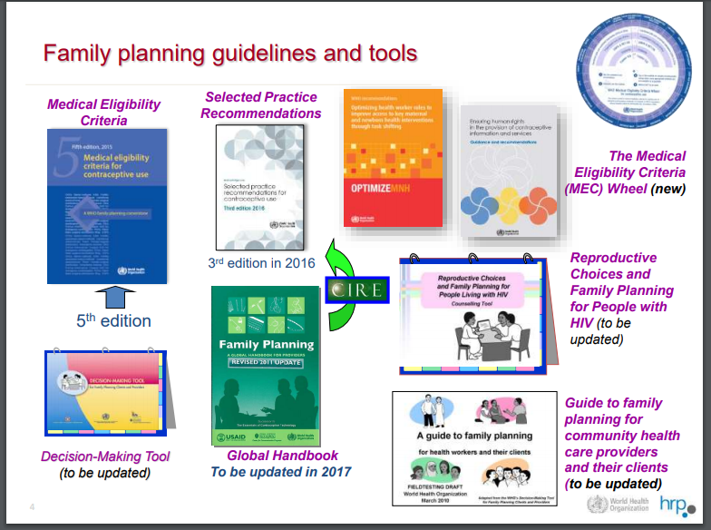
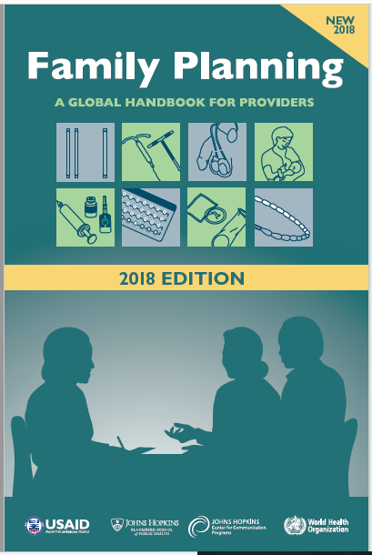
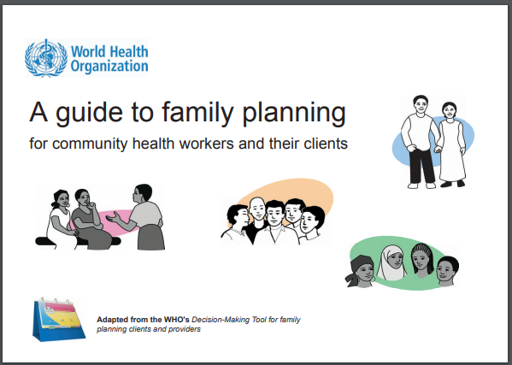

Slide 3
Family Planning – A Global Handbook for Providers
The handbook offers technical information to help health care providers deliver FP methods appropriately and effectively.
It incorporates and reflects the Medical eligibility criteria and the Selected Practice recommendations as well as other WHO guidance.
Intended audience - Health Care providers.
Managers, supervisors and policy makers may find this book helpful and can use it. It can be used for training and supervision.
This is the third edition of the handbook.
Always use the latest edition- as recommendations are updated.
Manual that translates scientific evidence into practical guidance – Launched in 2007, new edition in 2018.

Slide 4
What’s New in This Edition?
New family planning recommendations from WHO:
Women who are breastfeeding can start progestin only pills or implants at any time postpartum; New Selected Practice Recommendations on the levonorgestrel implant Levoplant (Sino-Implant (II)), subcutaneous DMPA, the combined patch, the combined vaginal ring, and ulipristal acetate for emergency contraception; When to start a family planning method after taking emergency contraceptive pills.
New coverage in this edition:
Human rights: Family Planning Providers’ Contribution; “How Can a Partner Help?”; Giving the Injection with Subcutaneous DMPA in Uniject (Sayana Press); Teaching Clients to Self-Inject; Progesterone-releasing vaginal ring; Clients with disabilities; Safer Conception for HIV Serodiscordant Couples; “LIVES”—5 steps for helping women subjected to violence; Counseling About Effectiveness; Task-Sharing: WHO Recommendations; Considering Progestin-Only Injectables Where HIV Risk Is High: Counseling Tips; Ruling Out Pregnancy.
Expanded or updated coverage:
Instructions on implant insertion; Levonorgestrel IUD; Prenatal care; Infant feeding for women with HIV; Infertility; Effectiveness of family planning methods; Medical Eligibility Criteria for Contraceptive Use.

Slide 5
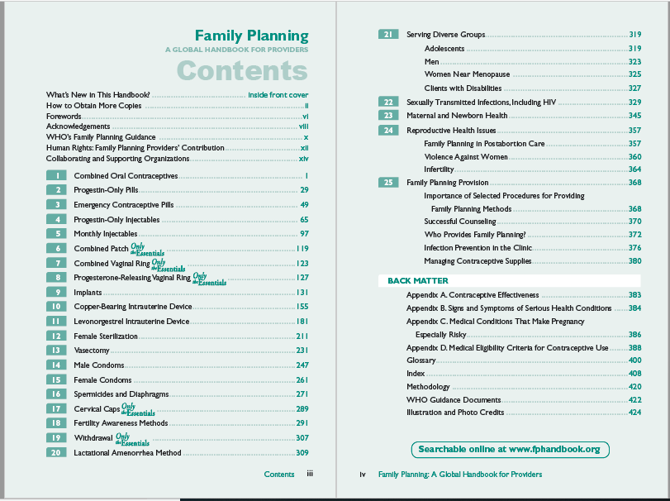
Contents: Method Chapters

Slide 6
Each Chapter Contains
Key points for Providers & Clients
- Helps the client decide about the method
Side effects, health benefits, and risks of the method
Who can and cannot use the method
  - Medical eligibility criteria
How to provide the method e.g., when to start, what to expect when the client use the method, etc.
Follow up users of the method
Questions and answers specific to the method

Slide 7
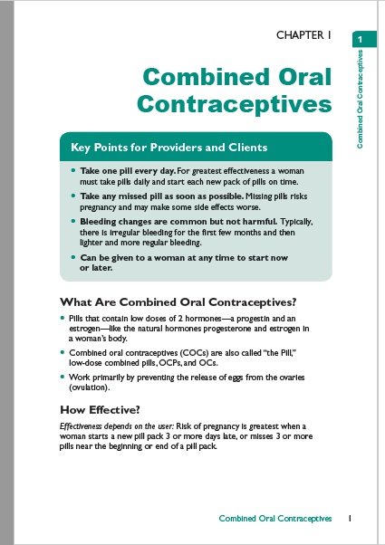
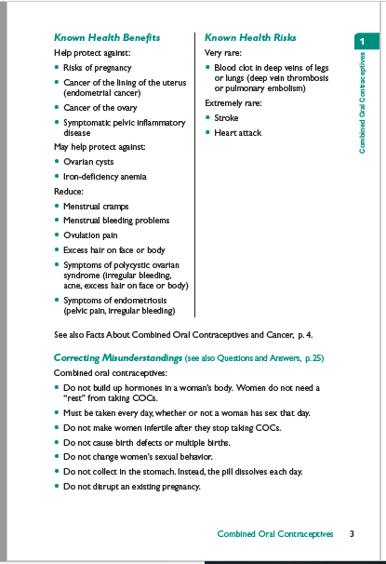

Slide 8
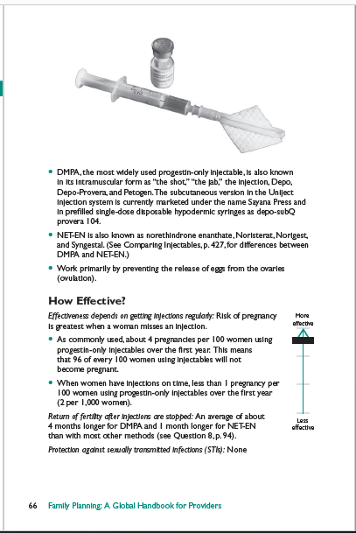
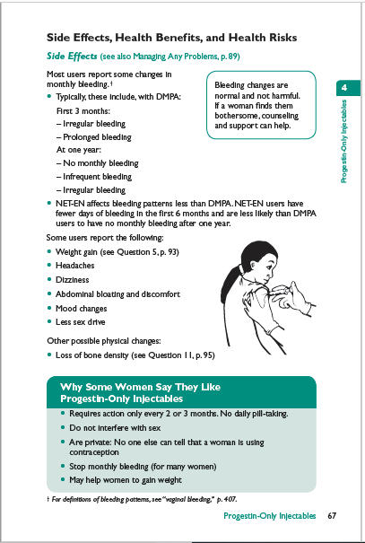

Slide 9
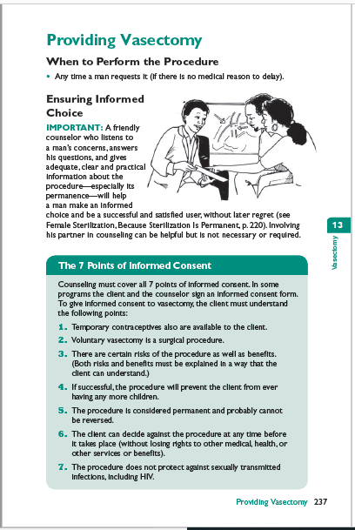
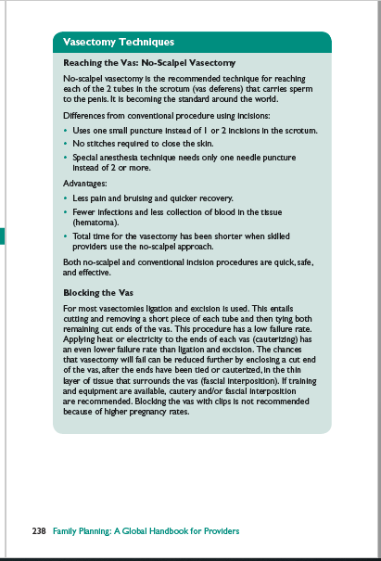

Slide 10
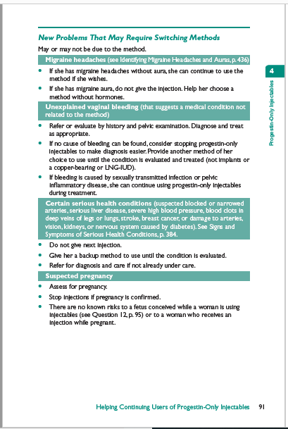
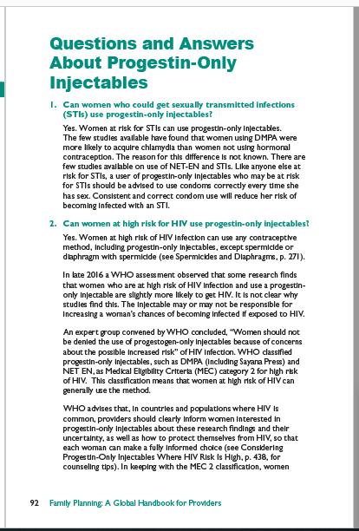

Slide 11
Useful Website Links:
WHO RHR – Family planning
  http://www.who.int/en/news-room/fact-sheets/detail/family-planning-contraception
WHO Family planning guidelines
  http://www.who.int/reproductivehealth/topics/family_planning/en/

Slide 12


Thank you
For more information,
Follow us on Twitter @HRPresearch
Website who.int/reproductivehealth/en

