Slide 1
Selected practice recommendations for contraceptive use (SPR)
Petrus Steyn
Scientist, WHO/ SRH/ CFC

Slide 2
Background
Quality contraceptive services depend upon numerous practices, including :
  maximizing the effectiveness of contraceptive methods
  managing side effects
  addressing problems associated with incorrect method use
  providing appropriate follow-up
  determining when exams and tests should be done

Slide 3
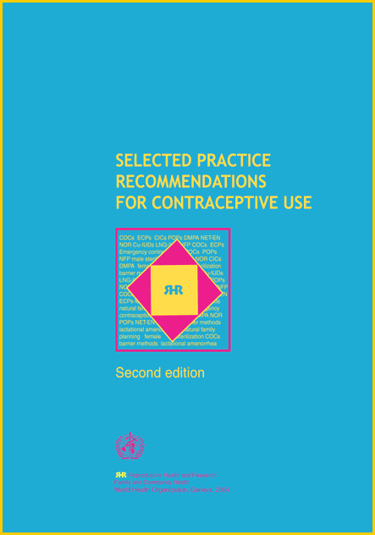
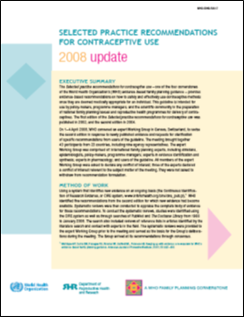
Selected practice recommendations for contraceptive use (SPR)
Initiation/continuation of methods
Incorrect use of methods
Problems during use
Programmatic issues

Slide 4
Contraceptive methods, SPR 2nd edition
Combined oral contraceptive pills (COCs)
Combined injectable contraceptive (CIC)
Progestogen-only pills (POPs)
Progestogen-only injectables (POIs)– DMPA and NET-EN
Implants (Norplant, Jadelle, Implanon)
Levonorgestrel-releasing IUD
Copper-bearing IUD
Emergency contraceptive pills (ECPs)
Standard Days Method
Vasectomy

Slide 5
Method-specific recommendations
COCs, ECPs, POPs
  initiation/continuation, incorrect use, problems during use, bleeding irregularities, programmatic issues (exams & tests, number of pill packs, follow-up)
Injectables
  initiation/continuation, bleeding irregularities, programmatic issues (exams & tests, follow-up)
Implants
  initiation/continuation, bleeding irregularities, programmatic issues (exams & tests, follow-up)
IUDs
  initiation/continuation, bleeding irregularities, PID, pregnancy diagnosis during use, programmatic issues (exams & tests, follow-up)

Slide 6
Initiation and continuation: example
Instructions are offered for the following situations:
  regular menstrual cycles
  amenorrhea
  postpartum (breastfeeding or not breastfeeding)
    recommendations are linked with the MEC
  post abortion
  switching from another hormonal method
  switching from a non-hormonal method
  switch from a IUD

Slide 7
Incorrect use
If a woman has forgotten to take her COC or POP
Instructions for women who have forgotten to take:
  1 or 2 active pills
  3 or more active pills
Instructions for when a woman has started to take her pills:
  1-2 days late
  3 days or more
Instructions available if she has forgotten using:
  pills containing 20 µg EE
  pills containing 30 – 35 µg EE

Slide 8
Classification for differentiating applicability of various exams and tests
Class A: essential and mandatory
Class B: contributes substantially to safe and effective use, risk of not performing exam or text should be balanced against the benefits of making the method available
Class C: does not contribute to safe and effective use

Slide 9
Exams and tests
Situation | COC | CIC | POP | POI | Implants | IUD
Breast exam | c | c | c | c | c | c
Pelvic/genital exam | c | c | c | c | c | a
Cervical cancer screen | c | c | c | c | c | c
Routine lab tests | c | c | c | c | c | c
Haemoglobin | c | c | c | c | c | b
STI risk assessment | c | c | c | c | c | a
HIV/STI screening | c | c | c | c | c | b
Blood pressure | † | † | † | † | † | c
† It is desirable to have blood pressure measured prior to the use of these methods

Slide 10
Ruling out pregnancy
The provider can be reasonably certain that a woman is not pregnant if she has no symptoms or signs of pregnancy and meets the following criteria:
♦ has not had intercourse since last normal menses
♦ has been correctly and consistently using a reliable method of contraception
♦ is within the first 7 days after normal menses
♦ is within 4 weeks postpartum for non-lactating women
♦ is within the first 7 days postabortion or miscarriage
♦ is fully or nearly fully breastfeeding, amenorrhoeic, and less than 6 months postpartum.

Slide 11
Updated guidance
In 2014, WHO’s guideline development group convened to revise the 2nd edition of the SPR (and the 2008 Update)
Key highlights of the revision
  Five contraceptive methods added
  New recommendations for the initiation of regular contraceptive methods, following the use of ECPs

Slide 12
Contraceptive methods in the 3rd edition
Combined oral contraceptives (COC)
Combined injectable contraceptives (CIC)
Progestogen-only pill (POP)
Patch
Combined vaginal ring
Progestogen-only injectables – DMPA & NET-EN
Subcutaneously administered DMPA (DMPA-SC)
Implants (Norplant, Jadelle, Implanon)
Sino-Implant (II)
Copper-bearing IUD
LNG-releasing IUD
Emergency contraceptive pills (COC and LNG based)
Ulipristal acetate (an ECP)
Standard Days Method
Vasectomy

Slide 13
New recommendations for 3rd edition
The patch
  same recommendations as COCs
  exception: Instructions for missed or delayed patch-taking
The combined vaginal ring
  same recommendations as COCs
  exception: Instructions for missed or delayed ring use
DMPA-SC
  same recommendations as DMPA
Sino-Implant (II)
  same recommendations as other implants
ulipristal acetate (an ECP)
  same recommendations as other ECPs
  exception: Instructions for initiating regular contraception after UPA use

Slide 14
Initiating regular contraception after ECP use
After use of the copper-bearing IUD
  no other contraceptive protection is needed.
After ECPs containing LNG or combined estrogen-progestogen pills
  A woman may resume a method immediately
    If she does not start immediately, she can start COCs, CICs, POI, POP, patch, ring, implants at any time if is reasonably certain she is not pregnant.
    If she does not start immediately, she can have an IUD (either LNG or copper) inserted, if reasonably certain she is not pregnant. If she is amenorrhoeic, she can have the IUD (either LNG or copper) inserted if it can be determined that she is not pregnant.

Slide 15
Initiating regular contraception after ECP use
Need for additional contraception for LNG & COC ECP
  The woman is advised to abstain from sexual intercourse or use barrier contraception for 2 days for POPs and 7 days, as well as early pregnancy testing if warranted (e.g., no withdrawal bleed occurs within 3 weeks)
UPA
  She can start CHC or progestogen-containing methods on the 6th day after taking UPA
  An IUD can be inserted immediately, or she returns at a later date, it can be inserted if it is determined she is not pregnant
  Need for additional contraception: continue to abstain from sexual intercourse or use barrier contraception for 2 days for POPs and 7 days for other hormonal methods.

Slide 16
Other new features
User-friendly presentation of information
  By contraceptive method, not by question
  Most effective methods presented first
  Topics listed sequentially according clinical relevance
    method initiation, exams/tests, management of problems, follow-up
We will make an effort to produce French and Spanish versions as soon as possible

Slide 17
Thank you – stay in contact with us !
http://www.who.int/topics/family_planning/

