Slide 1
New methods added to the MEC, 5th Edition
Petrus Steyn
WHO/ SRH/ CFC
Notes:
Original slides Monica Dragoman. Thank you very much for the opportunity to present to you a review of some select WHO evidence-based guidelines for contraceptive use.
As our time is short, I will provide only a brief overview of the recommendations speaking to adolescents’ eligibility for select contraceptive methods in the Medical Eligibility Criteria for Contraceptive Use.

Slide 2
Methods of contraception included in
MEC, 4th Edition
Combined oral contraceptives
Combined hormonal contraceptives (1 month injectables, patch, vaginal ring)
Progestogen-only contraceptives
(pills, implants, 2-3 month injectables)
Emergency contraceptive pills
IUDs (copper bearing and levonorgestrel)
Emergency IUD
Barrier methods (condoms, spermicides
& diaphragm)
Fertility awareness-based methods
Lactational amenorrhoea (LAM)
Coitus Interruptus
Sterilization (male and female)
Notes:
As a reminder, the evidence-based recommendations contained within the MEC do not indicate a “best” method that should be used given a particular medical context; rather, review of the recommendations allows for consideration of multiple methods that could be used safely by people with certain health conditions (e.g. hypertension) or characteristics (e.g. age).
Further, the MEC does not offer recommendations about which specific product or brand (e.g. particular COC formulation) to use after selection of a particular contraceptive method.
Ultimately, decision-making regarding contraceptive methods usually requires the need to make trade-offs among the advantages and disadvantages of different methods, and these vary according to individual circumstances, perceptions and interpretations. In addition to medical eligibility, factors to consider when choosing a particular contraceptive method include the characteristics of the potential user, the baseline risk of disease, the adverse effects profile of different products, cost, availability and patient preferences.
Evidence shows that the respect, protection and fulfilment of human rights contribute to positive health outcomes. The provision of contraceptive information and services that respect individual privacy, confidentiality and informed choice, along with a wide range of safe contraceptive methods, increase people’s satisfaction and continued use of contraception.
Methods covered by the previous edition of the MEC guidance included all hormonal contraceptives, intrauterine devices, barrier methods, fertility awareness-based methods, coitus interruptus, lactational amenorrhoea method, male and female sterilization, and emergency contraception.

Slide 3
New methods added to MEC 5th edition
Subcutaneously-administered depot medroxyprogesterone acetate(DMPA-SC)
Sino implant (II)
Ulipristal acetate (UPA)
Progesterone-releasing vaginal ring (PVR)
Notes:
Four methods were prioritized for inclusion in the new, fifth edition of the MEC based on their global relevance and availability:
These methods include:
Depot medroxyprogesterone acetate Sub-Q
Sino implant (II)
Ulipristal acetate
Progesterone vaginal ring
Briefly, I will review these methods with you and any new recommendations resulting from their inclusion in the MEC.

Slide 4
Subcutaneously - administered Depot medroxyprogesterone Acetate (DMPA-SC)

Slide 5
DMPA-SC
Depot medroxyprogesterone acetate delivered subcutaneously (DMPA SC) at dose of 104 mg/0.65 mL
Important service delivery implications:
- Self-administration feasible and acceptable to both adolescents and adults
Notes:
The progestin-only injectable contraceptive, depot medroxyprogesterone (DMPA), has traditionally been formulated as a crystalline suspension delivered intramuscularly at a dose of 150 mg/mL every 3 months.
A new, lower dose formulation of depot medroxyprogesterone allows for subcutaneous delivery; this formulation was developed as a 16% weight/volume solution resulting in a final dose of 104 mg/0.65 mL that cannot be achieved solely by diluting the original DMPA suspension.
The package labelling recommends injection at the abdomen and anterior thigh, but evidence suggests that administration in the upper arm may also offer sufficient contraceptive protection and be acceptable to women.
Absorption of medroxyprogesterone acetate is immediate following injection and achieves concentrations sufficient for contraceptive protection within 24 hours.
This method may offer some important service delivery advantages over DMPA-IM.
Studies demonstrate that self-administration of DMPA-SC is feasible and acceptable among both adolescent and adult women and is associated with similar continuation and satisfaction rates.

Slide 6
DMPA-SC: Summary of Evidence
Obesity (8 studies)
  Contraceptive efficacy, weight change and other adverse events similar across BMI groups
Age (3 studies)
  Declines in BMD, no differences in weight change or bleeding patterns by age group
Endometriosis (2 studies)
  Declines in BMD, few serious adverse events
HIV (1 study)
  No difference in serious adverse events (SC vs. IM)
Among healthy women (3 studies), evidence suggests DMPA-SC may be similar to DMPA-IM
Notes:
We conducted a systematic review of the published evidence on the safety of DMPA-SC for women of reproductive age according to the medical conditions and characteristics specified by WHO in the MEC.
Additionally, we looked for evidence comparing adverse effects among all users of IM and SC formulations, including healthy women. Because the MEC currently includes recommendations for DMPA-IM, we were interested in whether the safety profiles of the two formulations are similar enough that existing recommendations might apply to this newer formulation.
A randomized trial evaluating changes in bone mineral density (BMD) among adult DMPA-SC and IM users demonstrated no differences at two years of follow-up (1). Limited evidence from three Phase 3 contraceptive trials reported no consistent differences in weight change or bleeding patterns according to age; adolescents aged < 18 years were not included in any studies (1-3). Two prospective, non-comparative studies demonstrated that women with endometriosis treated with DMPA-SC for six months experienced minimal weight gain and decreases in BMD; serious adverse events were rare and DMPA-SC improved pain symptoms associated with the condition (4, 5). A randomized cross-over study reported that women living with HIV tolerated injection of DMPA-SC and that experiences of serious adverse events were rare and occurred at similar rates as in users of DMPA-IM (6). Evidence from three Phase 3 contraceptive trials and four reports from a small prospective cohort study reported similar contraceptive efficacy, weight change, bleeding patterns and other adverse effects, including variations in a number of biomarkers, among obese and non-obese DMPA-SC users (1, 3, 7-12).
DMPA-IM and DMPA-SC appear to be therapeutically equivalent; the two formulations demonstrate similar pharmacokinetics, effects on serum estradiol levels and high contraceptive efficacy (1). In addition, similar effects on weight change, bleeding patterns and experience of other adverse effects have been reported among healthy reproductive age users (1, 3, 13).
----------------------------------------------------------------------------------------------------------------------------------------------------------------------------------
Notes:
The bulk of the data for the review is derived from Phase 3 trials that recruited women from multiple sites around the world which support some generalizability of the findings; however, they also had high dropout rates, more than 20%, over time. We also included a number of small studies with limited exposure to DMPA reporting on a variety of surrogate markers. It is not clear that these are appropriate endpoints to measure the true effect of DMPA-SC on clinically relevant outcomes.

Slide 7
DMPA-SC
No change in existing MEC recommendations for DMPA warranted with inclusion of DMPA-SC as a new method.
Notes:
Based on a review of the evidence, the Guideline Development Group determined that no change to the existing recommendations for DMPA was warranted with inclusion of DMPA-SC as a new method.

Slide 8
Sino-implant (II)

Slide 9
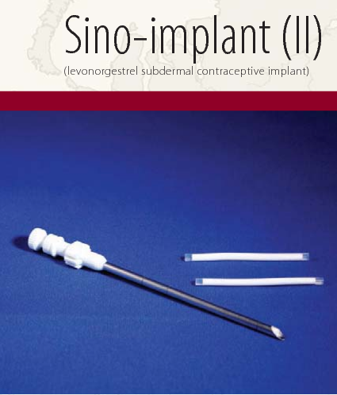
Background: Sino-implant (II)
2-rod, 150 mg LNG implant manufactured in China
Currently used by millions of women worldwide (mostly Indonesia & China)
Notes:
2-rod LNG implant manufactured in China (also known as Femplant® or Zarin®)
MEC currently has recommendations for Jadelle® (also a 2-rod, 150 mg LNG implant)

Slide 10
SI (II) Efficacy
Systematic review of RCTs with > 15000 users found:
  Year 1 pregnancy rates ranged from 0-0.1%
  Cumulative pregnancy rates through year 4 from 0.9-1.06%
Post-marketing surveillance in Madagascar, Kenya and Pakistan indicates high efficacy and satisfaction with method
Source: Steiner MJ et al. Sino-implant (II)--a levonorgestrel-releasing two-rod implant: systematic review of the randomized controlled trials. Contraception. 2010;81(3):197-201.

Slide 11
SI (II) Efficacy
Systematic review of RCTs with > 15000 users found:
  Year 1 pregnancy rates ranged from 0-0.1%
  Cumulative pregnancy rates through year 4 from 0.9-1.06%
Post-marketing surveillance in Madagascar, Kenya and Pakistan indicates high efficacy and satisfaction with method
Source: Steiner MJ et al. Sino-implant (II)--a levonorgestrel-releasing two-rod implant: systematic review of the randomized controlled trials. Contraception. 2010;81(3):197-201.

Slide 12
Ulipristal acetate

Slide 13
Ulipristal Acetate (UPA)
Selective progesterone receptor modulator
Single dose 30mg effective up to 120 hours
Delays ovulation
Approved in EU in 2009, US in 2010
Currently registered in 72 countries
Notes:
Ulipristal acetate is a selective progesterone receptor modulator
Available since 2009 in the European Union and since 2010 in the US, it is now registered in over 72 countries
It is given as a single dose of 30mg and is effective up to 120 hours in delaying ovulation, It has been shown to delay before the onset of the LH surge or after onset but before the LH peak
Currently registered in 72 countries:
15 in Africa
6 in Asia
9 CIS (Commonwealth independent states-- ex Soviet Union countries like Armenia, Belarus, Georgia, Kazakhstan, etc.)
4 in Latin America
2 in Middle East

Slide 14
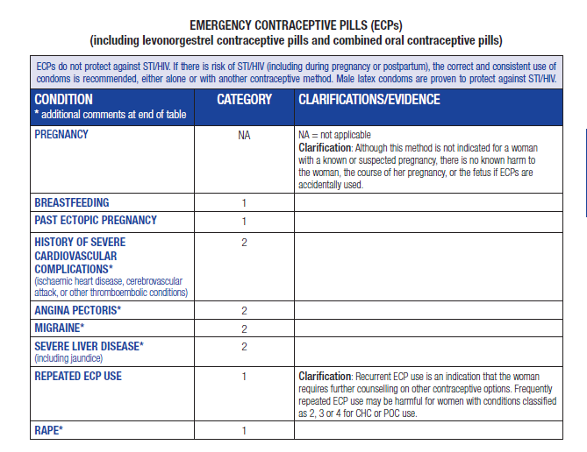
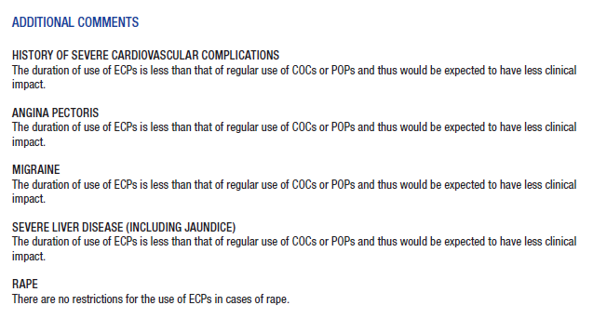
MEC, 4th Edition
ECP
Recommendations
Notes:
In addition to considering the safety evidence specific to ulipristal acetate, the GDG decided to more holistically review the spectrum of conditions included in the MEC as well as whether or not to continue to refer to ECPs generally (lumping recommendations for COCs, LNG and UPA together) or assign category numbers for each formulation by condition.
As a reminder, the fourth edition MEC recommendations for emergency contraceptive pills were for levonorgestrel pills and combined oral contraceptive pills. Conditions include the following: Pregnancy, breastfeeding, past ectopic, history of severe cardiovascular complications, angina, severe liver disease, repeated ECP use and rape.

Slide 15
Evidence Retrieval
1197 articles
4 LNG studies
2 studies: Breastfeeding women
2 studies: Pregnant women
11 Studies: UPA, LNG or Yuzpe
7 studies: Healthy women and pregnancy outcomes
5 studies: Healthy women and adverse events
1 LNG PK study: Breastfeeding women
Direct Evidence
Indirect Evidence
Additional information:
Side effect studies (31)
Six prospective studies of peri-coital LNG
Case reports (23)
LNG and UPA label
Notes:
As part of this process, a systematic review was undertaken to determine whether women with certain characteristics or medical conditions who use levonorgestrel (LNG), ulipristal acetate (UPA) or combined oral contraceptive (COC) regimens for emergency contraception (ECPs) are at increased risk for adverse events compared with non-users.
Limited evidence was identified. No studies were identified that examined COC- ECP use among women with medical conditions. Indirect evidence speaking to safety outcomes in healthy women was used for extrapolation. For LNG ECPs,
Of 1197 articles identified, fifteen articles met inclusion criteria. Given the paucity of information,
Four direct studies examined LNG-ECP use among pregnant or breastfeeding women (2-5). No studies were identified that examined UPA- or COC-ECP use among women with medical conditions or characteristics. One cohort study and one randomized controlled trial analysed outcomes among breastfeeding women (3-4), and two cohort studies analysed outcomes among breastfeeding women (2, 5). Poor pregnancy outcomes appear rare among pregnant women who used ECPs at conception or early in pregnancy. Breastfeeding outcomes do not seem to differ between women exposed to LNG and those unexposed. One pharmacokinetic study demonstrates that LNG does pass to breast-milk but is found in minimal quantities (6).
A small pharmacokinetic study found that concomitant efavirenz use decreased LNG levels in women taking LNG-ECP (0.75 mg) by 56% compared with LNG-ECP alone (7).
There was also limited evidence from one study suggesting that obese women with BMI ≥ 30 kg/m² experience an increased risk of pregnancy after use of LNG compared with women with BMI < 25 kg/m² (8). Evidence from two studies suggests that obese women may also experience an increased risk of pregnancy after use of UPA compared with non-obese women, though this increase was not significant in one of the studies (8, 9).

Slide 16
NEW ECP Recommendations
Condition | COC | LNG | UPA
Pregnancy | NA | NA | NA
Breastfeeding | 1 | 1 | 2
Past ectopic pregnancy | 1 | 1 | 1
Obesity | 1 | 1 | 1
History of severe cardiovascular disease | 2 | 2 | 2
Migraine | 2 | 2 | 2
Severe liver disease (including jaundice) | 2 | 2 | 2
CYP3A4 inducers | 1 | 1 | 1
Repeated emergency contraceptive pill use | 1 | 1 | 1
Rape | 1 | 1 | 1
COC= combined oral contraceptives; LNG = levonorgestrel; UPA = ulipristal acetate;
NA = not applicable
Notes:
Walk through changes to recommendations!
After considering the evidence, the Guideline Development Group agreed to add ulipristal acetate (UPA) was added as a new method to the MEC
There is one recommendation for which UPA is assigned a different category than COC and LNG-containing ECPs.
While women who are breastfeeding can use COCs or LNG regimens for emergency contraception without restriction, women who are breastfeeding generally can use UPA. Breastfeeding is not recommended for one week after taking UPA since it is excreted in breast-milk. Breast-milk should be expressed and discarded during that time (1).
The duration of use of ECPs is less than the duration of regular use of COCs or POPs and thus would be expected to have less clinical impact for women with history of severe cardiovascular complications, migraine or severe liver disease (including jaundice). There are no restrictions for the use of ECPs in cases of rape.
The Guideline Development Group (GDG) decided to remove the condition “angina pectoris” from the MEC recommendations for ECPs. This condition does not appear elsewhere in the MEC and there was no evidence suggesting safety concerns for ECP use among women with angina pectoris.
The GDG decided to change the term “history of severe cardiovascular complications” to “history of severe cardiovascular disease” to be more consistent with terminology used elsewhere in the MEC.
According to labelling information, rifampicin markedly decreases UPA levels by 90% or more, which may decrease its efficacy (1). Theoretical concerns, therefore, extend to use of other CYP3A4 inducers as well as LNG and COCs, which have similar metabolic pathways to UPA.

Slide 17
ECPs and Breastfeeding
Condition | COC | LNG | UPA
Breastfeeding | 1 | 1 | 2
Clarification: Breastfeeding is not recommended for 1 week after taking UPA since it is excreted in breast-milk. Breast-milk should be expressed and discarded during that time.

Slide 18
ECPs and Obesity
Condition | COC | LNG | UPA
Obesity | 1 | 1 | 1
Clarification: ECPs may be less effective among women with BMI ≥ 30 kg/m² than among women with BMI < 25 kg/m². Despite this, there are no safety concerns.
Evidence: There is limited evidence from one study that suggests obese women with BMI ≥ 30 kg/m² experience an increased risk of pregnancy after use of LNG compared with women with BMI < 25 kg/m². Two studies suggest obese women may also experience an increased risk of pregnancy after use of UPA compared with non-obese women, though this increase was not significant in one study.

Slide 19
ECPs and CYP3A4 INDUCERS
Condition | COC | LNG | UPA
CYP3A4 INDUCERS (E.g. rifampicin, phenytoin, phenobarbital, carbamazepine, efavirenz, fosphenytoin, nevirapine, oxcarbazepine, primidone, rifabutin, st john’s wort/hypericum perforatum) | 1 | 1 | 1
Clarification: Strong CYP3A4 inducers may reduce the effectiveness of ECPs.
Evidence: According to labelling information, rifampicin markedly decreases UPA levels by 90% or more which may decrease its efficacy. Theoretical concerns therefore extend to use of other CYP3A4 inducers as well as to COC and LNG ECPs, which have similar metabolic pathways to UPA. A small pharmacokinetic study found that concomitant efavirenz use decreased LNG levels in women taking LNG ECP (0.75 mg) by 56% compared with LNG ECP alone.

Slide 20
Progesterone-releasing vaginal ring (PVR)

Slide 21
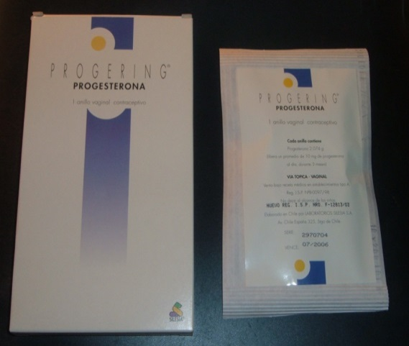
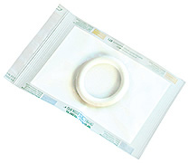
Progesterone- Releasing Vaginal Ring (PVR)
Matrix design
Diameter 58 mm/ Cross-section 8.4 mm
Delivers 10mg/day over 3 months
Serum levels of 10-20 nmol/L [~7ng/ml]
Specifically designed for breastfeeding
Registered in 9 Latin American countries - Acceptability studies underway in Africa
Notes:
The progesterone-releasing vaginal ring (PVR) is a contraceptive method for women who are actively breastfeeding at least four times a day. It consists of a flexible ring that releases 10 µg/day of progesterone. During use, average plasma concentrations of 20 nmol/L are achieved, which are similar to those detected in the average luteal phase in normal fertile women. The PVR is worn continuously for three-month periods (approximately 90 days) and can be initiated at six weeks after childbirth. Use of the PVR during breastfeeding requires replacing the used ring with a new ring at three-month intervals (± two weeks). The mechanism of contraceptive action of the PVR is through the inhibition of ovulation (1, 2).

Slide 22
NEW Recommendations for PVR
Condition | Category
Pregnancy | NA
Clarification: Use of PVRs is not required. There is no known harm to the woman, the course of her pregnancy, or the fetus if PVRs are accidentally used during pregnancy.

Slide 23
NEW Recommendations for PVR
Condition | Category
Breastfeeding > 4 weeks | 1
Clarification: The woman must be actively breastfeeding (i.e. at least 4 breastfeeding episodes per day) during PVR use to maintain efficacy.
Evidence: No differences were observed between various measures of breastfeeding performance among PVR users compared with users of non-hormonal or progestogen-only (synthetic progesterone) contraceptives during 12 months of observation. No statistically significant differences in infant weight gain were observed among PVR users compared with women using a non-hormonal or progestogen-only contraceptives, and similar patterns of infant weight gain were observed in another study that compared PVR and IUD users. One study reported no significant difference in infant health.

