Slide 1
The WHO postpartum family planning compendium
Petrus Steyn
Scientist, WHO/ SRH/ CFC

Slide 2
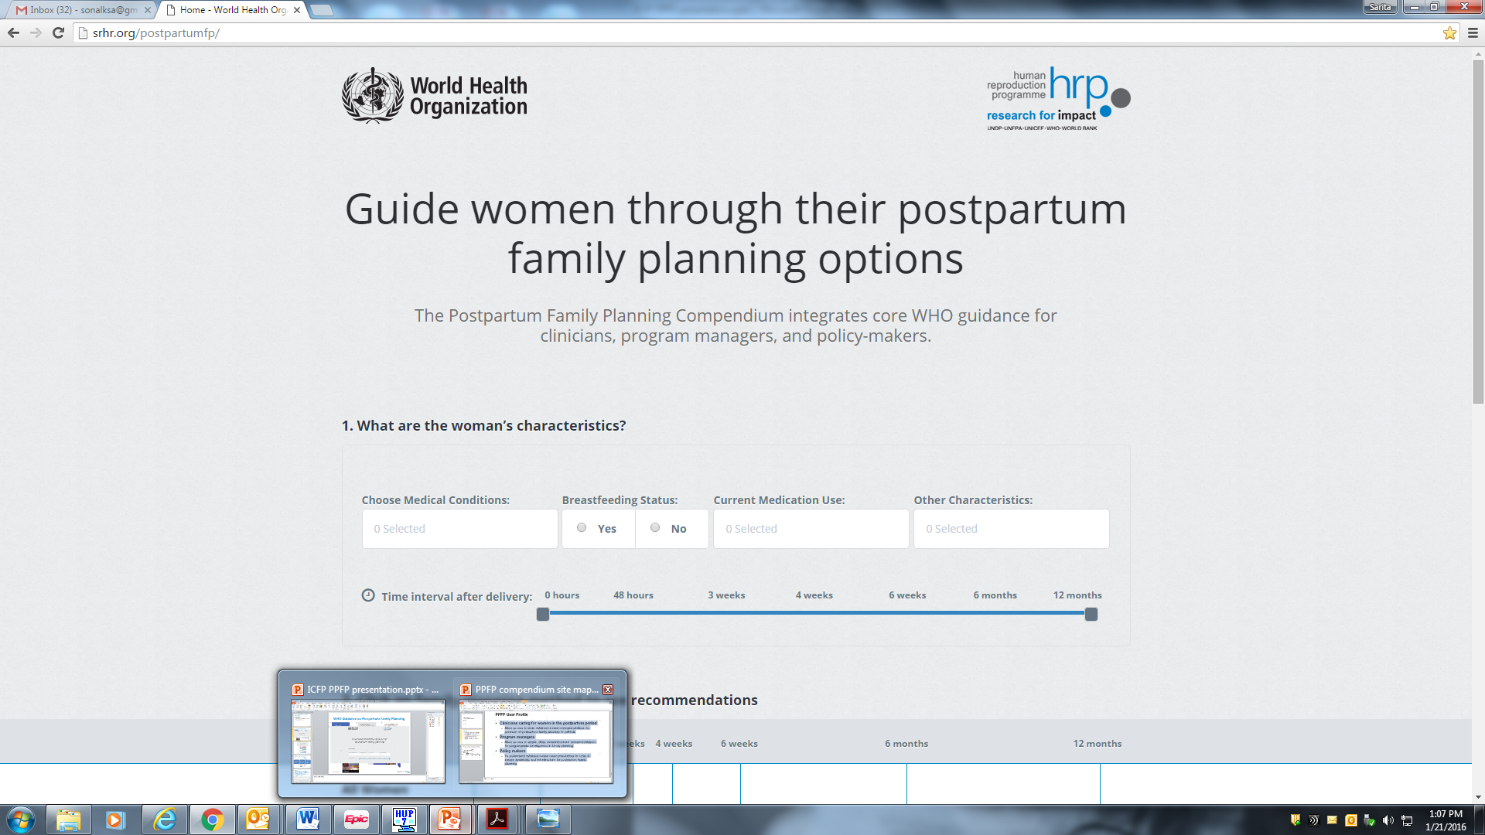



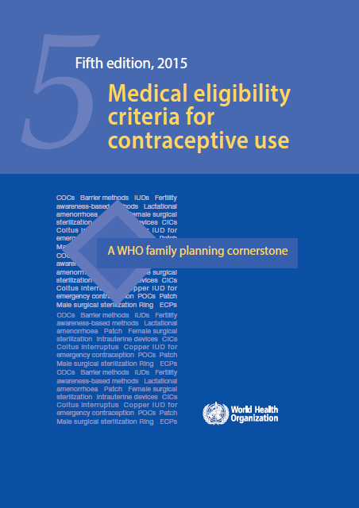

WHO Guidance on Postpartum Family Planning
srhr.org/postpartumFP

Slide 3
Case study
The WHO Postpartum Family Planning Compendium

Slide 4
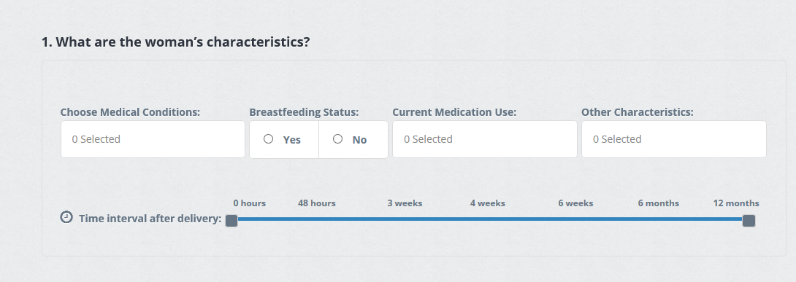
CASE STUDY
Yesterday, a 32-year-old woman delivered a healthy baby 38 weeks gestation at the local hospital. She is breastfeeding. She has a history of hypertension and smokes. She is interested in the contraceptive implant.
Is she eligible for the contraceptive implant prior to her discharge from the hospital?

Slide 5
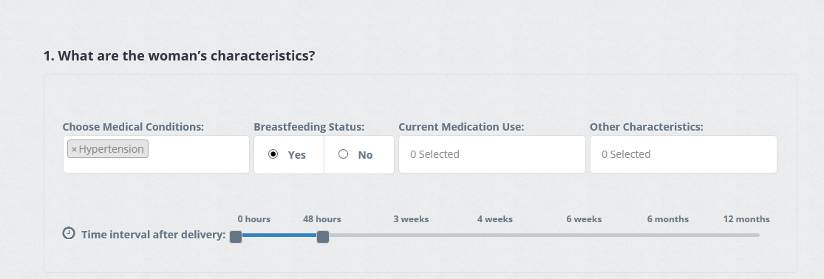
CASE STUDY
Yesterday, a 32-year-old woman delivered a healthy baby 38 weeks gestation at the local hospital. She is breastfeeding. She has a history of hypertension. She is interested in the contraceptive implant.
Is she eligible for the contraceptive implant prior to her discharge from the hospital?

Slide 6
CASE STUDY
Yesterday, a 32-year-old woman delivered a healthy baby 38 weeks gestation at the local hospital. She is breastfeeding. She has a history of hypertension. She is interested in the contraceptive implant.
Is she eligible for the contraceptive implant prior to her discharge from the hospital?

Slide 7
CASE STUDY
Yesterday, a 32-year-old woman delivered a healthy baby 38 weeks gestation at the local hospital. She is breastfeeding. She has a history of hypertension. She is interested in the contraceptive implant.
Is she eligible for the contraceptive implant prior to her discharge from the hospital?

Slide 8
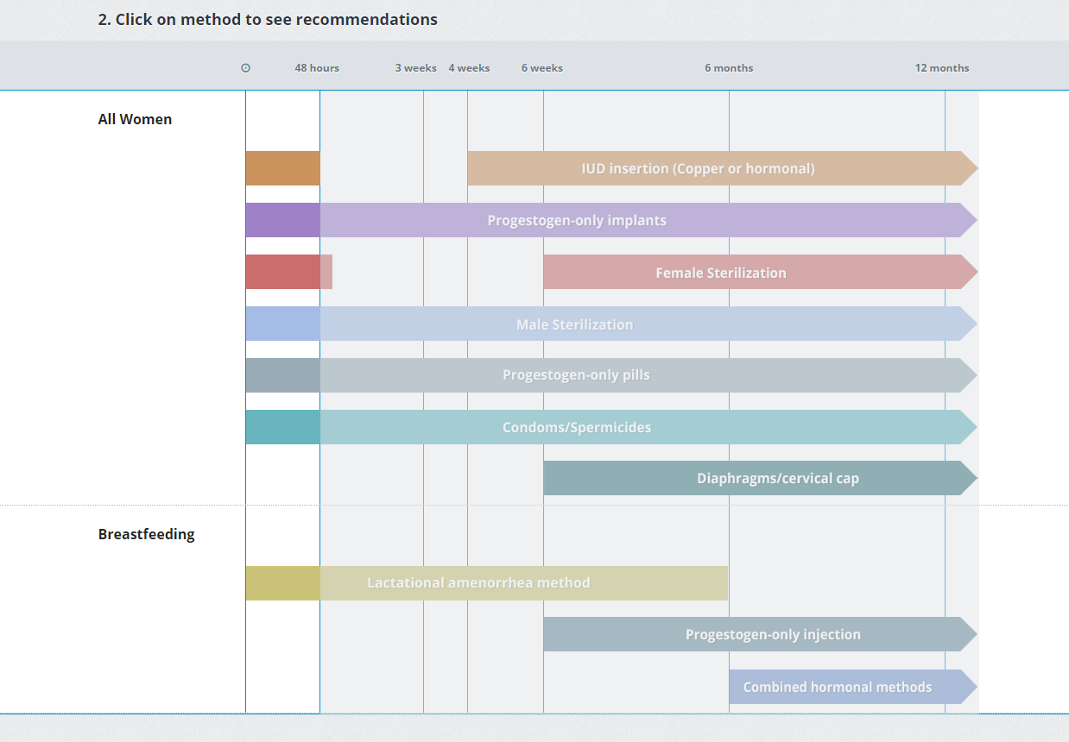
CASE STUDY
Yesterday, a 32-year-old woman delivered a healthy baby 38 weeks gestation at the local hospital. She is breastfeeding. She has a history of hypertension. She is interested in the contraceptive implant.
Is she eligible for the contraceptive implant prior to her discharge from the hospital?

Slide 10
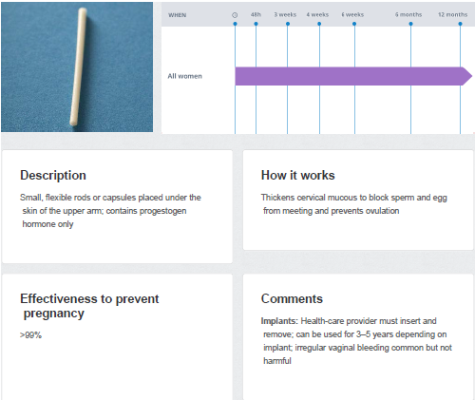
Contraceptive implant, within 48 hours postpartum

Slide 11
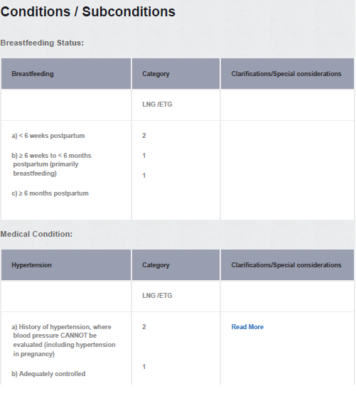
Contraceptive implant, within 48 hours postpartum

Slide 12
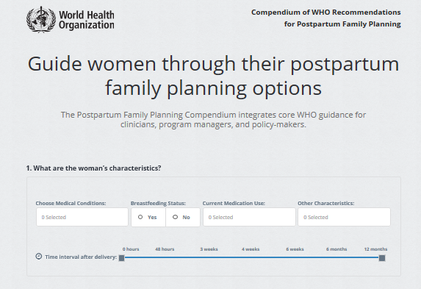
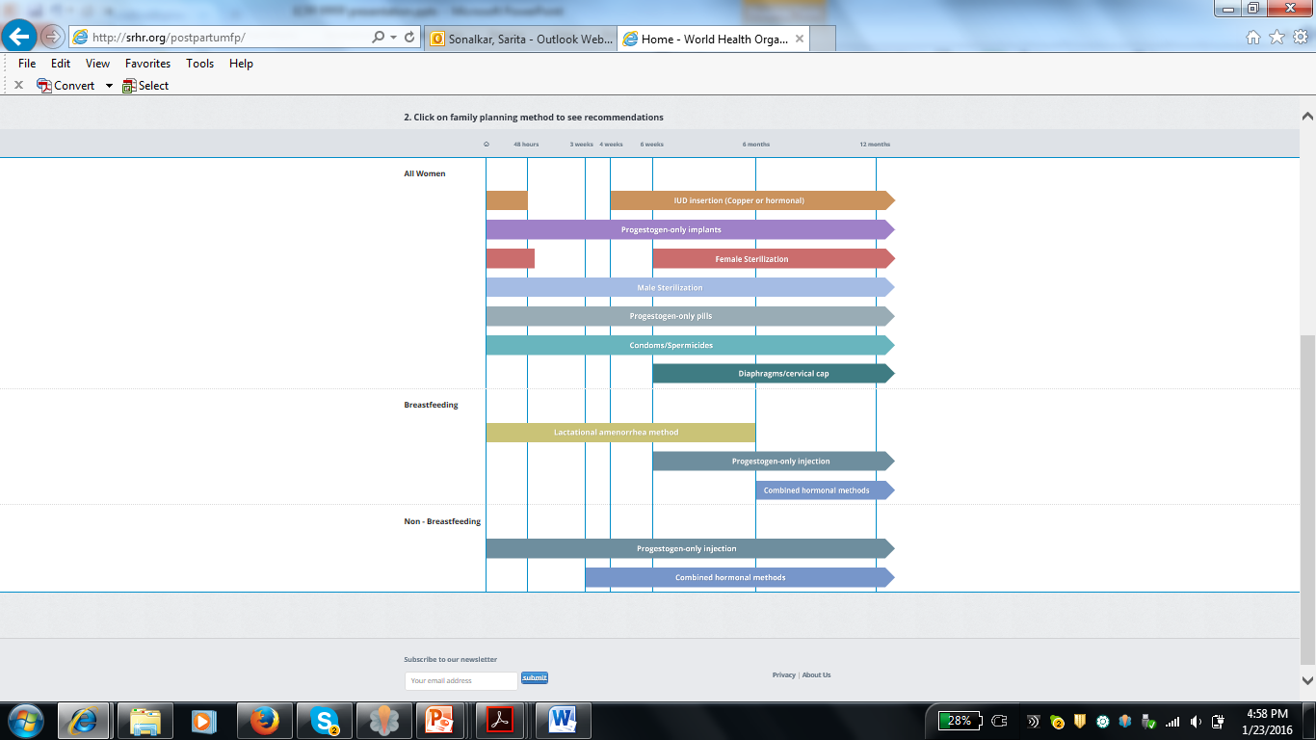

Slide 13
Postpartum family planning guidance at your fingertips: Place a bookmark!
srhr.org/postpartumfp

Slide 14
Follow us on Twitter @HRPresearch
Visit our website who.int/reproductivehealth

