Slide 1
Family planning counselling An introduction
Training course in family planning 2021
Rita Kabra MBBS, MPH
Contraception and Fertility Care Unit
Department of Sexual and Reproductive Health

Slide 2
By the end of this session, you should be able to:
  Communicate information on benefits/ importance of counselling on birth spacing / family planning method use
  Demonstrate effective communication and counselling skills
  Describe existing evidence & gaps on counselling strategies

Slide 3
Key Facts about family planning/contraception
Globally, many women and couples want to postpone or avoid pregnancy.
More women or their partners are using contraceptive methods today than ever before.
YET
An estimated 218 million women of reproductive age, mostly in low and middle-income countries, have an unmet need for modern contraceptive methods.
Around 9% of women (1 in 10 women of reproductive age) who want to avoid or postpone pregnancy are not using any form of contraception/ have an unmet need for family planning.
Improving the quality of contraceptive counseling is one strategy to prevent unintended pregnancy.
https://www.guttmacher.org/sites/default/files/factsheet/adding-it-up-investing-in-sexual-reproductive-health.pdf
Notes:
Guttmacher Institute. Adding it up - investing in sexual and reproductive health in low- and middle-income countries. Fact sheet, 2020. Available:

Slide 4
Unmet need for contraception
Definition
Women with unmet need are those who are fecund and sexually active but are not using any method of contraception, and report not wanting any more children or wanting to delay the next child.
The concept of unmet need points to the gap between women's reproductive intentions and their contraceptive behavior.
Unmet need is especially high among groups such as:
  Adolescents
  Migrants
  Urban slum dwellers
  Refugees
  Women in the postpartum period

Slide 5
Meeting the unmet need for contraception
Meeting the unmet need for contraception across the reproductive cycle in low- and middle-income countries and offering all pregnant women and their newborns the standard care would result in reductions of:
  unintended pregnancies by 68%
  unsafe abortions by 72%
  maternal deaths by 62%
  neonatal deaths by 69%.*
  Recommended by the World Health Organization (WHO)
* Adding it up: investing in sexual and reproductive health. New York, NY: Guttmacher Institute, 2020.
Notes:
Sully E,
Biddlecom A,
Darroch J
. Adding it up: investing in sexual and reproductive health. New York, NY: Guttmacher Institute, 2020.
Google Scholar

Slide 6
Reasons for unmet need for modern FP/C
Limited choice of methods
Limited access to contraception, particularly among young people, poorer segments of populations, or unmarried people
Quality of available services
Gender-based barriers
Users and provider's bias
Poor counselling - fear or experience of side-effects; cultural or religious opposition

Slide 7
Benefits of family planning & birth spacing (1)
Empowers people and enhance education - Delaying having children can give people the opportunity to complete education or further studies.
Prevents adolescent pregnancy - Younger women (adolescents) can delay pregnancy until their bodies are mature and they are ready in terms of their life course.
Spacing births allows the mother to recover physically and emotionally before she gets pregnant again, and faces the demands of pregnancy, birth and breastfeeding.
Waiting to become pregnant at least 24 months after birth can lead to health benefits for the mother and baby.

Slide 8
Benefits of family planning & birth spacing (2)
STIs including HIV/AIDS can be prevented with correct and consistent use of condoms.
Older women (over 35) can prevent unwanted pregnancies that are often risky for their health and can lead to complications for both mothers and infants.
Prevents unplanned pregnancy, abortion and pregnancy-related health risks of women.
Limiting the number of children in a family means more resources for each child and more time for the parents to dedicate to each child.
Family planning helps to decide if, when and how many children you choose to have (timing of pregnancies and birth spacing)

Slide 9
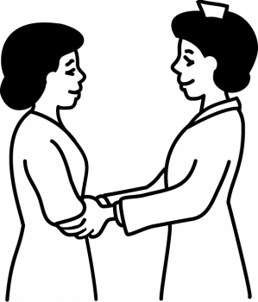
Counselling
Counseling refers to a process of interaction, a two-way communication, between a skilled provider, bounded by a code of ethics and practice, and client/s.
It aims to create awareness of and to facilitate or confirm informed and voluntary sexual and reproductive health decision-making by the client.
It requires empathy, genuineness and the absence of any moral or personal judgment.

Slide 10
Why counselling for family planning
The role of family planning counselling is to support a woman and her partner in choosing the method of FP that best suits them and to support them in solving any problems that may arise with the selected method.
  Spacing
  Limiting
  Switching methods – address discontinuation rates

Slide 11
Contraceptive counselling: definition
Contraceptive counseling is defined as the exchange of information on contraceptive methods based on an assessment of the client’s needs, preferences and lifestyle to support decision-making as per the client’s intentions.
This includes the selection, discontinuation or switching of a contraceptive method.
The key principles are based on coercion-free and informed choice; neutral, understandable and evidence-based information; collaborative and confidential decision-making process; ensuring respectful care, dignity and choice.
Source: Ali M, Tran NT. Defining counseling in contraceptive information and services: what it entails. services: what it entails. Accepted for publication in June 2021. BMJ Sexual and Reproductive Health

Slide 12
  Effective communication & counselling skills

Slide 13
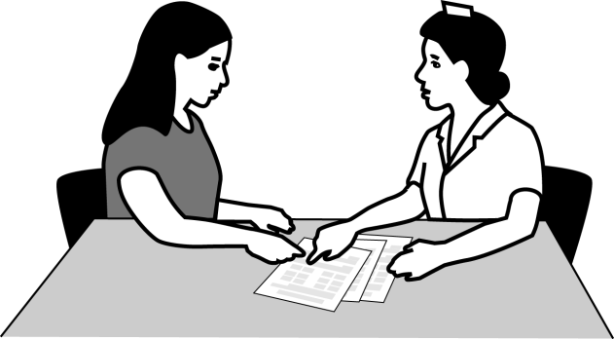

Elements of good counselling
Focus on the woman's needs and knowledge
Assess the context of the problem with the woman
Actively listen and learn from her
Engage in interactive discussion
Utilize skilled ways of asking questions
Explore situations and beliefs
Do not be judgmental
Build trust
Explore options together
Facilitate problem-solving
Make a plan of action together
Encourage and reinforce actions
Evaluate together your plan of action

Slide 15
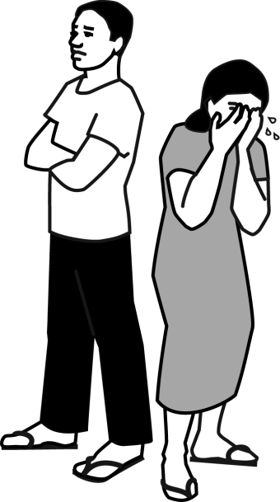
Counselling is Not …
Solving a client’s problems
Telling a client what to do or making decisions for client
Judging, blaming, or lecturing a client
Interrogating a client
Imposing your beliefs
Pressuring a client to use a specific method
Lying to or misleading a client
Notes:
A Training Resource Package for Family Planning, Counseling—CHW, Presentation, 7/2011
15

Slide 16
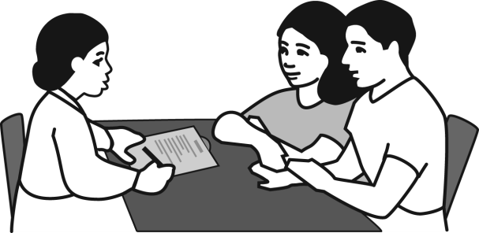
Counselling
Beliefs and attitudes
Be aware of your beliefs and attitudes
Clients may not return if they feel judged or pushed
Remain neutral and nonjudgmental
Respect the rights of your clients
Practice helps
Notes:
A Training Resource Package for Family Planning, Counseling—CHW, Presentation, 7/2011
16

Slide 18
Models of family planning counselling
There are various models of family planning counselling -
GATHER model (Greet the client, Ask about situation and needs, Tell about different methods and options, Help clients choose, Explain how to use a method, Return).
REDI model (Rapport-building, Exploration, Decision-making, and Implementing the decision).

Slide 19
Communication and counselling skills
Success of FP counselling depends on ability to establish and maintain a good connection:
  Builds trust
  Helps client relax
  Helps client communicate openly
Good communication and counselling skills are keys for maintaining good connection throughout the counseling session.
Notes:
The success and effectiveness of the counseling session depend on your ability to establish and keep a good, warm connection with the client, so that you build trust with the client and help them to relax, which helps them to communicate openly with you. What are some things that you do when greeting a client to establish a good connection? <allow participants to respond; affirm or build upon their responses to make the following points> Yes, you greet them using a warm tone of voice, use eye contact if appropriate, call them by name, and ensure that they are seated comfortably.
What are some things that you do to maintain this connection? <allow participants to respond; affirm correct responses>
All of the communication and counseling skills that you have learned up to this point will help you to establish and maintain a good connection.
As we begin to learn and practice each stage of the counseling process, it is good to keep in mind the importance of using these and other skills to maintain a good connection with your client throughout the counseling session.
We have a Competency Based Skills Checklist for Counseling that will remind you of the tasks and skills needed for establishing and maintaining a good connection that you can use on the job. <display the job aid and distribute it to participants> Let’s look at this now.
References:
1. Knebel E. The use of manual job aids by health care providers: What do we know? Issue Paper Volume 1. Baltimore, MD: Quality Assurance Project, 2000.
2. Tumlinson K; Hubacher D; Wesson J; Lasway C. Measuring the usefulness of family planning job aids following distribution at training workshops. Journal of Biosocial Science, 2010. Sep;42(5):695-8.
Reference:
1.Johnson SL, Kim YM, Church K. Towards client-centered counseling: Development and testing of the WHO decision-making tool. Patient education and counseling, 2010. 81:355-361.

Slide 20
Stages of FP counselling
1
Establish rapport and assess client’s needs and concerns
2
Provide information to address client’s needs and concerns
3
Help client make an informed decision or address a problem
4
Help carry out client’s decision
Notes:
A Training Resource Package for Family Planning, Counseling—CHW, Presentation, 7/2011
20

Slide 21
Assess client’s needs and concerns
1
Greet client appropriately
Ensure privacy, confidentiality, and client comfort
Ask about reason for visit
Ask about partner(s), home life, family, health, sexual behavior, HIV status
Ask about plans to have children, desire for FP
Explore STI risk and what client does to avoid STI’s
Notes:
A Training Resource Package for Family Planning, Counseling—CHW, Presentation, 7/2011
21

Slide 22
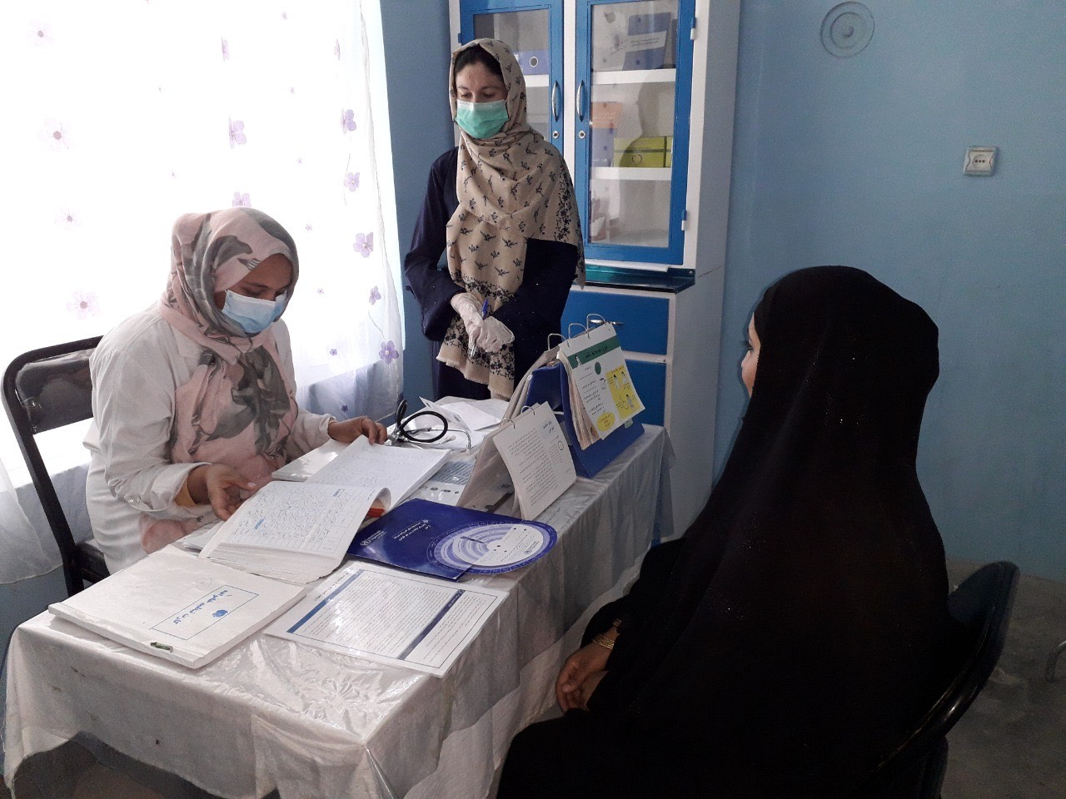
Questions about the client
Ideal family size
Home life
Partner(s)
Health
Sexual behavior
HIV status
Notes:
The purpose of this exercise is for participants have fun while generating a list of questions they can use in the first stage of FP counseling.
Show slide with the categories of information to be gathered from clients. Remind participants that, at the start of a session with a new client, they need to gather information from the client about the client’s ideal family size, partners, home life, health, sexual behavior, and HIV status.
Ask the trainee’s to form small groups of no more than three to four trainees (Depending on the total number of participants, this may be three to five small groups.) Make sure each group has a blank piece of paper, pens or pencils and a place to write. Assign one or two categories from the flip chart to each group, so that all categories are covered and no two groups have the same category. Tell the groups to discuss and agree on what questions they would use to gather information about their assigned category. Tell them that each group will have just two minutes to discuss and write their questions and that they should create mostly open-ended questions, as appropriate. Tell them to write their assigned category or categories at the top of their blank sheet of paper, then signal the groups to begin.
At the end of the two minutes, tell the groups to stop writing. Instruct them to fold their papers into paper airplanes, demonstrating how to do this, if necessary. Tell each group to “fly” the airplane to the group next to them. After each group receives an airplane, they should unfold it carefully and examine the questions listed on this new sheet of paper. Give them about one or two minutes to add any questions to those on the list, or to suggest new ways to ask a question that is already listed. At the end of this time, instruct them to refold the papers into an airplane and “fly” it back to the group it received it from. Ask one representative from each group to read their list of questions aloud to the rest of the participants. Give feedback on the questions; write some of the best questions as examples on flip chart paper, and ask the group to suggest ways to improve other questions.

Slide 23
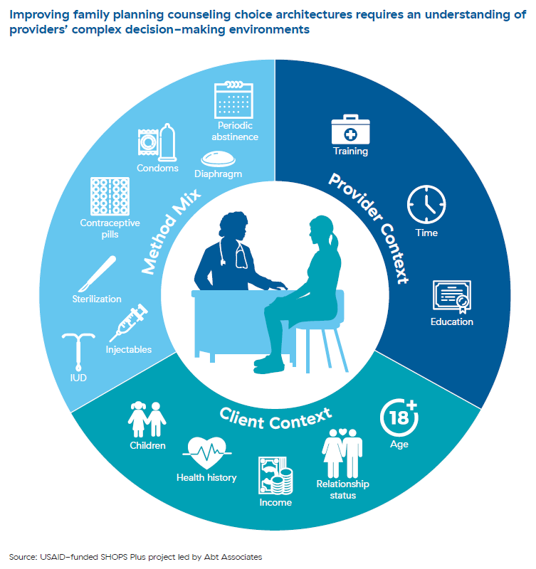
Provide information to address client’s needs and concerns
2
Inform client when needs or concerns are beyond health worker capability
Advise on how to prevent STIs
Advise on how to have a healthy pregnancy (if client wants to become pregnant)
Notes:
A Training Resource Package for Family Planning, Counseling—CHW, Presentation, 7/2011
23

Slide 24
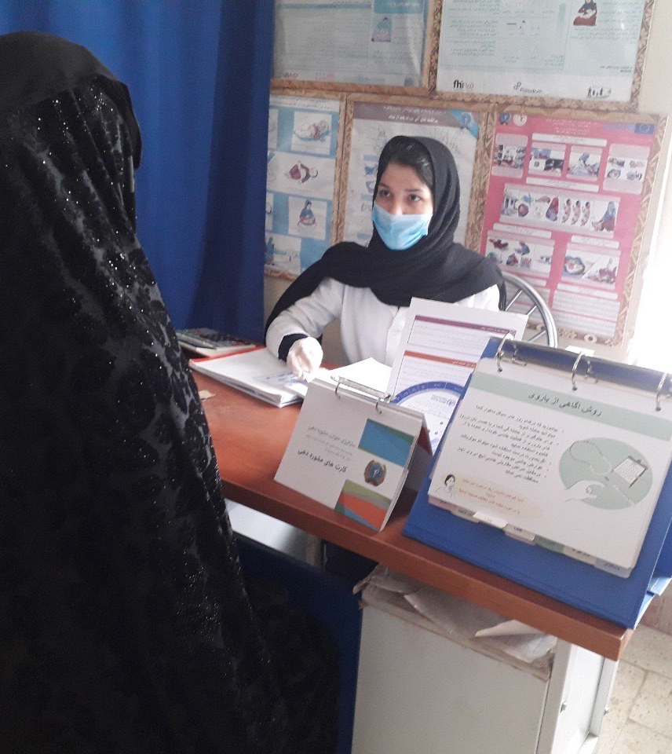
Provide information and options (continued)
2
Explain benefits of FP and healthy spacing
If client wants FP, help client identify methods suited to her needs
Give information on methods of interest
Respond to other client questions or concerns
Notes:
A Training Resource Package for Family Planning, Counseling—CHW, Presentation, 7/2011
24

Slide 25
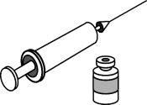
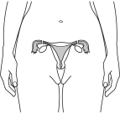

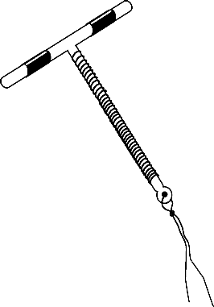



How clients choose methods
Effectiveness
How long client wants protection from pregnancy
Ease of use
Health benefits and possible side effects
Safety
Notes:
A Training Resource Package for Family Planning, Counseling—CHW, Presentation, 7/2011
25

Slide 26
3
Help client make informed decision
Ask client if she or he has any questions about methods you discussed
Ask client to choose a method
Use pregnancy checklist or method screening checklist to determine if client can use method
Agree on decision or plan in partnership with client
Notes:
A Training Resource Package for Family Planning, Counseling—CHW, Presentation, 7/2011
26

Slide 27

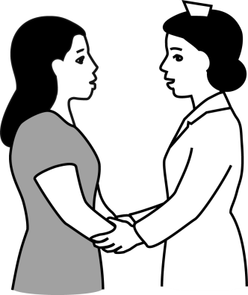
What is informed choice?
All family planning clients have right to informed choice:
Opportunity to freely choose among options
Complete, accurate information about all appropriate, available options
Notes:
A Training Resource Package for Family Planning, Counseling—CHW, Presentation, 7/2011
27

Slide 28
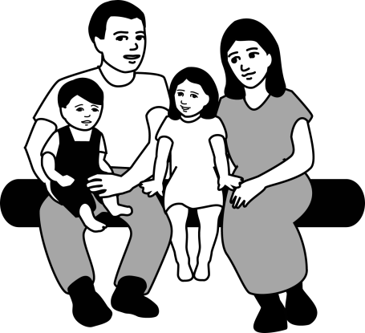
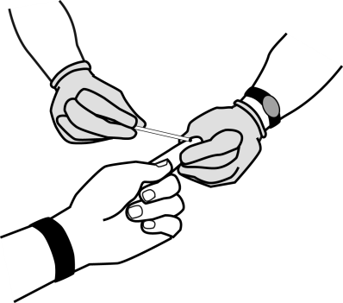
Right to freely choose
Whether to:
Have children, and how many to have
Use FP or not
Be tested for STIs/ HIV
Use condoms
Have one or more sexual partners
Talk with partner about condoms or FP
Reveal their HIV status
Notes:
A Training Resource Package for Family Planning, Counseling—CHW, Presentation, 7/2011
28

Slide 29
Help carry out client’s decision
4
Role-play or rehearse negotiation skills
Give FP method and condoms, if needed
Explain/ demonstrate correct use
Ask client to explain/ demonstrate, reinforce understanding or correct demonstration
Remind client about side effects, reasons to return
Arrange follow-up, resupply, or referral, as needed
Notes:
A Training Resource Package for Family Planning, Counseling—CHW, Presentation, 7/2011
29

Slide 30
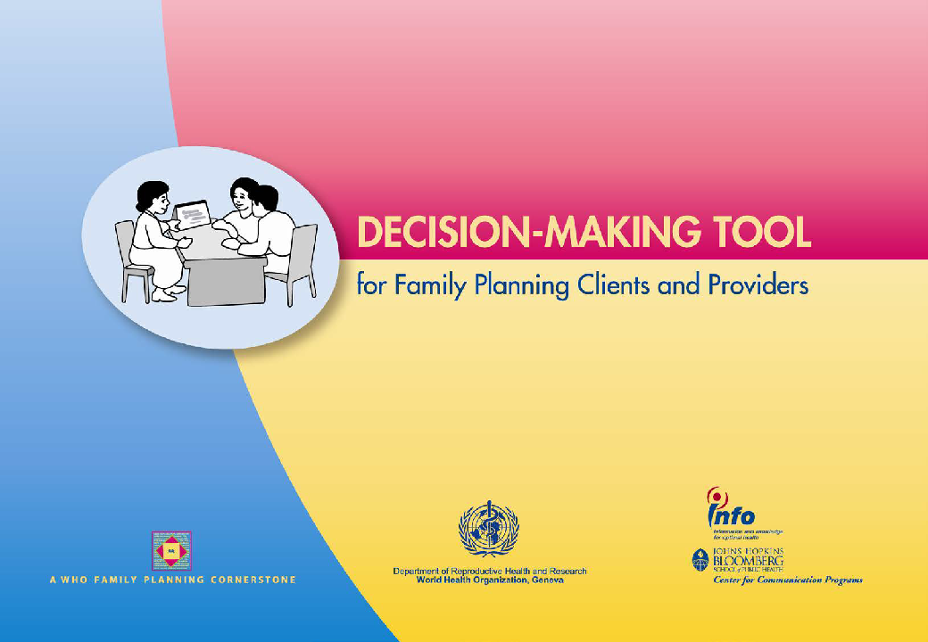
Counselling tool
Decision Making Tool (DMT) for Family Planning Clients and Providers – clinic based counseling tool.
Organized into tabs for easy access to sections on specific methods and topics.
Also with versions for HIV clinic settings and for community health workers.
Notes:
A Training Resource Package for Family Planning, Counseling—CHW, Presentation, 7/2011
30

Slide 31

Counselling diverse groups

Slide 32
Counselling clients with different needs
Different client’s have different needs
  Women who want to delay pregnancy- adolescents vs. adults
  Postabortion or postpartum women vs. interval
  Male Vs. female
  Special needs (physical or mental disability, HIV, Violent relationships

Slide 33
Counselling needs of adolescents
Young people deserve nonjudgmental and respectful care
Show them that you enjoy working with them
Use terms that suit young people
Try to make sure that a young woman's choices are her own
Speak without expressing judgment
Take time to fully address questions, fears, and misinformation
Notes:
Young people deserve nonjudgmental and respectful care no matter how young they are. Criticism or unwelcoming attitudes will keep young people away from the care they need. Family planning counseling and services do not encourage young people to have sex. Instead, they help young people protect their health.
To serve the needs of adolescents, you can:
Show young people that you enjoy working with them.
Use terms that suit young people. Avoid such terms as "family planning," which may not make sense to unmarried adolescents.
Try to make sure that a young woman's choices are her own and are not pressured by her partner or her family. In particular, if she is being pressured to have sex, help a young woman think about what she can say and do to resist and reduce that pressure. Practice skills to negotiate condom use.
Speak without expressing judgment (for example, say "You can" rather than "You should"). Do not criticize even if you do not approve of what the young person is saying or doing. Help young clients make decisions that are in their best interest.
Take time to fully address questions, fears, and misinformation about sex, sexually transmitted infections (STIs), and contraceptives. Many young people want reassurance that the changes in their bodies and their feelings are normal.
Young people can safely use any contraceptive method. Young women are often less tolerant of side effects than older women. With counseling, however, they will know what to expect and may be less likely to stop using their methods.

Slide 34
Counselling needs after an abortion
  Explain that fertility returns quickly and discuss FP options. Support woman & her partner in choosing a method that meets their needs:
  If a woman has no post-abortion complications or infection, she can safely use any FP method, and can start all methods immediately post-abortion (except for the natural calendar method, when she should wait for 3 months).
  If an infection is present or suspected, advise her to avoid intercourse until the infection is ruled out or fully treated. Delay female sterilization and IUD insertion until an infection is fully treated but offer other methods to use in the meantime.
  For IUD insertion or female sterilization after a second trimester abortion, the provider may need special training because of the changed uterine size and the position of the fallopian tubes.
  If a woman thinks she could be at risk of getting STI/HIV, she should use a condom in all sexual relations.
  Explain emergency contraception & offer emergency contraceptive pills to take home in case they may need them.

Slide 35
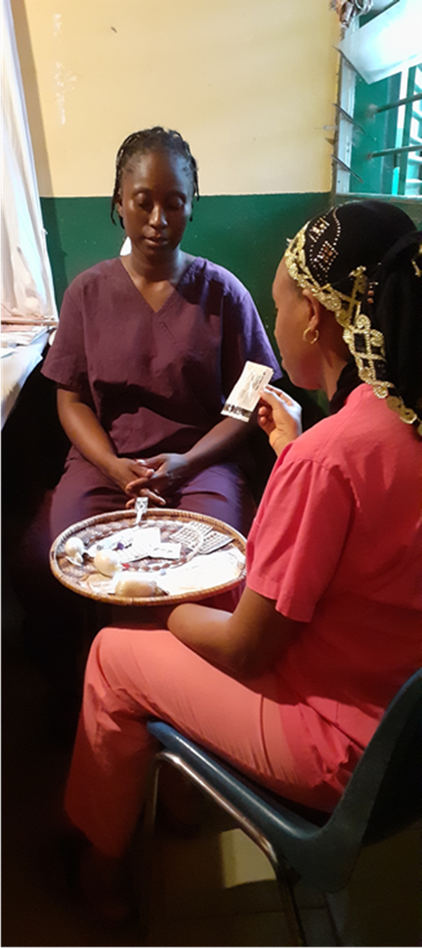
Counselling needs of postpartum woman
A woman can become pregnant within several weeks after birth if she has sexual relations and if she is not breastfeeding exclusively.
It is important that as a health worker you discuss the importance of family planning and birth spacing, and help couples in choosing the contraceptive method that is right for them.

Slide 36
Counselling post partum woman (1)
Begin discussing FP during pregnancy, particularly during the third trimester, after birth and in the immediate postpartum period.
Several methods of FP can be started immediately after birth, but others may need to be delayed if the woman is breastfeeding.
If the woman wants female sterilization or an Intrauterine Device (IUD) inserted immediately after childbirth, she should inform her birth attendant and plan to give birth in a health facility.

Slide 37
Counselling post partum woman (2)
Advise women about the benefits of using breastfeeding as a FP choice, known as the Lactational Amenorrhoea Method (LAM). LAM provides protection when the following three requirements are met:
  the woman is exclusively breastfeeding a baby, day and night
  during the first six months after birth and
  her menstrual periods have not returned.
REMINDER Exclusive breastfeeding means that the baby is not given any other food or drink, not even water. She or he is only given breast milk. Once the baby reaches six months, or receives complementary foods or the mothers' periods have returned, she should use another family planning method. Before this time she needs to start thinking about what method she will use after LAM.

Slide 38
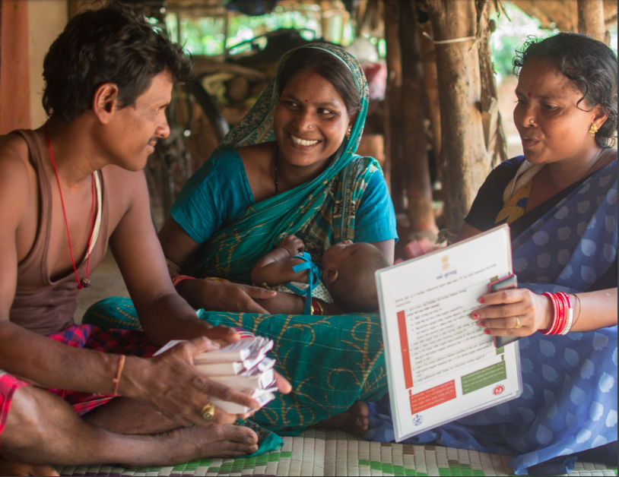
Counselling needs of men
Encourage men to make decisions about sexual and reproductive health jointly with their partners.
Encourage women to bring their partners to see clinical providers for joint counseling, decision-making, and care.
Coach men and women on how to talk with their partners about family planning and STIs.
Suggest women clients that they tell their partners about health services for men. Give them informational materials to take home, if available.
Correct men’s misperceptions and give them information to inform their decisions and opinions.
Source: Essential considerations for engaging men and boys for improved FP outcomes. USAID. 2018
Notes:
For family planning counselors, men are important for two reasons. The first reason is the influence that men have on women. Some men care about their partner's reproductive health and support them. Others stand in their way or make decisions for them. Men's attitudes can determine whether women can practice healthy behaviors. In some situations, such as needing to avoid HIV infection or getting help quickly in a medical emergency, a man's actions can determine whether a woman lives or dies.
Men are also important as clients. Men use major family planning methods—male condoms and vasectomy. Men also have their own sexual and reproductive health needs and concerns—such as concerns about sexually transmitted infections (STIs)—which deserve the attention of health care providers.
Meeting the needs of male clients:
Coach men and women on how to talk with their partners about family planning and STIs.
Encourage men to make decisions about sexual and reproductive health jointly with their partners.
Encourage women to bring their partners to see clinical providers for joint counseling, decision-making, and care.
Suggest to female clients that they tell their partners about health services for men. Give female clients informational materials to take home, if available.
Correct men’s misperceptions and give them information to inform their decisions and opinions. Topics important to men include:
Family planning methods for men and for women, including safety and effectiveness
STIs including HIV/AIDS—how they are and are not transmitted and where to go for testing and treatment
The benefits of waiting until the youngest child is two years old before a woman becomes pregnant again
Male and female sexual and reproductive anatomy and function
Where to learn about safe pregnancy and childbirth

Slide 39
Evidence on counselling

Slide 40
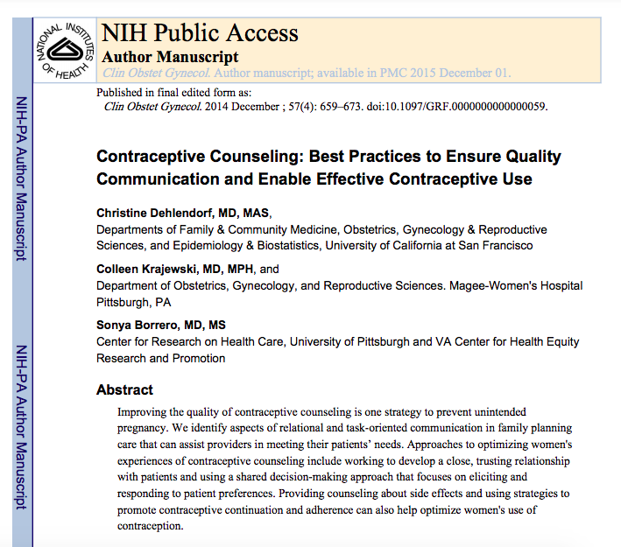
Contraceptive counselling: best practices to ensure quality communication and enable effective contraceptive use
Effective contraceptive counselling can help individuals choose a method that meets their needs and preferences, manage any side effects, and continue using their preferred method or switch to an alternative one.

Slide 41
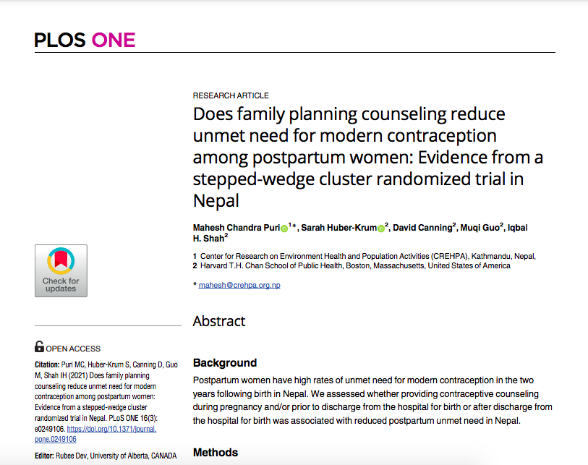
Does family planning counselling reduce unmet need for modern contraception among postpartum women
Counselling women either before or after discharge reduces unmet need for postpartum contraception but counseling in both periods is most effective.

Slide 42
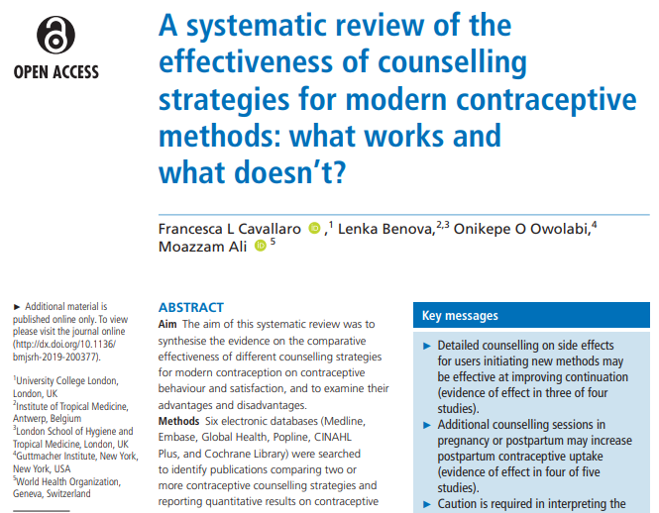
Effectiveness of counselling strategies
A systematic review on the evidence on the comparative effectiveness of different contraceptive counselling strategies found that contraceptive counselling has the potential to improve the effective use of modern contraception and reduce unmet need.
High-quality evidence was lacking, and no clear consensus exists on how best to deliver contraceptive counselling to meet the contraceptive needs of women and improve client satisfaction.

Slide 43
Evidence gap on counselling
Selected evidence gaps on counselling:
  Women’s experiences with and expectations of counselling in a variety of global settings.
  How best to deliver counselling services.
  What are the core elements of high-quality of contraceptive counselling?
  What are the minimum skills and competencies for contraceptive counsellors?
  What should be in a comprehensive package of best practices for FP counselling for different populations (e.g., young people)?

Slide 44
Additional reading
Adolescents and family planning: what the evidence shows. ICRW; 2014.
Ali M, Tran NT, Kabra R, Kiare J. Strengthening contraceptive counselling: gaps in knowledge and implementation research. http://dx.doi.org/10.1136/bmjsrh-2021-201104
Compendium of WHO recommendations for postpartum family planning. WHO; 2016.
Family planning: a global handbook for providers, 2018 edition. WHO; 2018.
Global consensus statement for expanding contraceptive choice for adolescents and youth to include long-acting reversible contraception. FP2020; 2017.
Medical eligibility criteria wheel for contraceptive use. WHO; 2015.
Reducing early and unintended pregnancies among adolescents: evidence brief. WHO; 2017.
Self-administration of injectable contraception: information note. WHO; 2020.
Task sharing to improve access to family planning/contraception: summary brief. WHO; 2017.

Slide 45
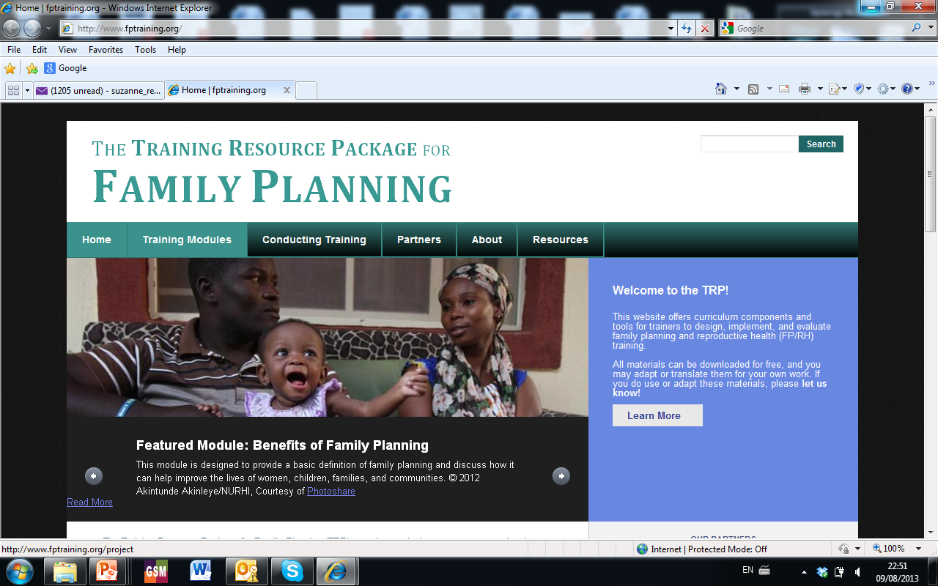
https://www.fptraining.org/projects/family-planning-counseling

Slide 46
Follow us on Twitter @HRPresearch
Visit our website who.int/reproductivehealth

