Slide 1

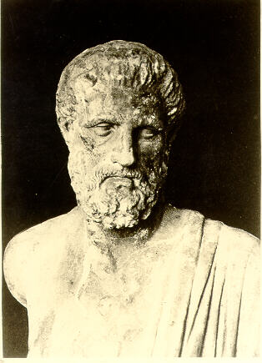

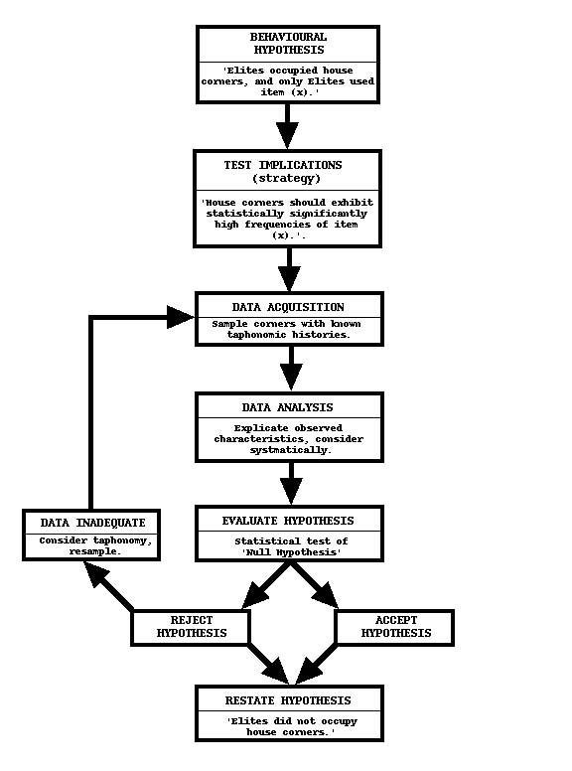


Introduction to study designs
Moazzam Ali MBBS, PhD, MPH
Department of Reproductive Health and Research
World Health Organization
Geneva, Switzerland
Training course in research methodology and research protocol development
GFMER, Geneva 2021
Notes:
1
Slide 1

Slide 2
Today's presentation
Definition of epidemiology, brief history and classical studies
Uses of epidemiology
The evidence pyramid
Introduction to research study designs
Prospective versus retrospective
Observational versus experimental
  Cohort, Case control, RCT, Cross- sectional, Meta-analysis, Ecological

Slide 3
Brief introduction to Epidemiology
Epidemiology is derived from a Greek word Epi meaning on or upon, Demos meaning people and Logos meaning the study of.
Epidemiology pertains to the study of the distribution, dynamics, and determinants of disease. (DDD)
Determinants
It includes all those factors that influence the distribution.
Primary: Causative agent of the disease or disorder. (Virus, parasite)
Secondary: Multitude of factors that influence the disease. (SES, Environment influencing causation of respiratory infections)

Slide 4
Brief introduction to Epidemiology
History
  Plagues, Cholera, pneumonia, influenza.
Hippocrates (340-400 B.C) “ No disease is sent by devils or demons, but is the result of natural cause”.

Slide 5

Epidemiology: Hippocrates (340 BC)
“Whoever wishes to investigate medicine properly should proceed thus; When he comes into a strange city, he ought to consider its situation, how it lies to the wind and sun, and consider the waters the people use. For if he knows these things well, he cannot miss knowing the diseases peculiar to the place”.

Slide 6
Classical studies
Scurvy disease (1747)
Cholera in London and its relationship to water supply location for different households (Snow, 1854)
Nuclear bombs at Hiroshima and Nagasaki- studies of radiation effects among bombs survivors
Severe air pollution in London led to a epidemic of deaths from heart and lung diseases (1952)
Minamata disease- consumption of fish contaminated with methyl mercury
Itai-Itai disease- consumption of rice contaminated with cadmium
Legionnaires disease- infectious disease spread through ventilation system

Slide 7

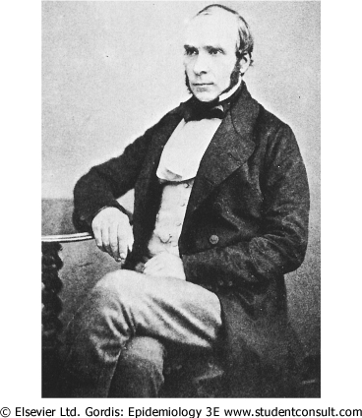
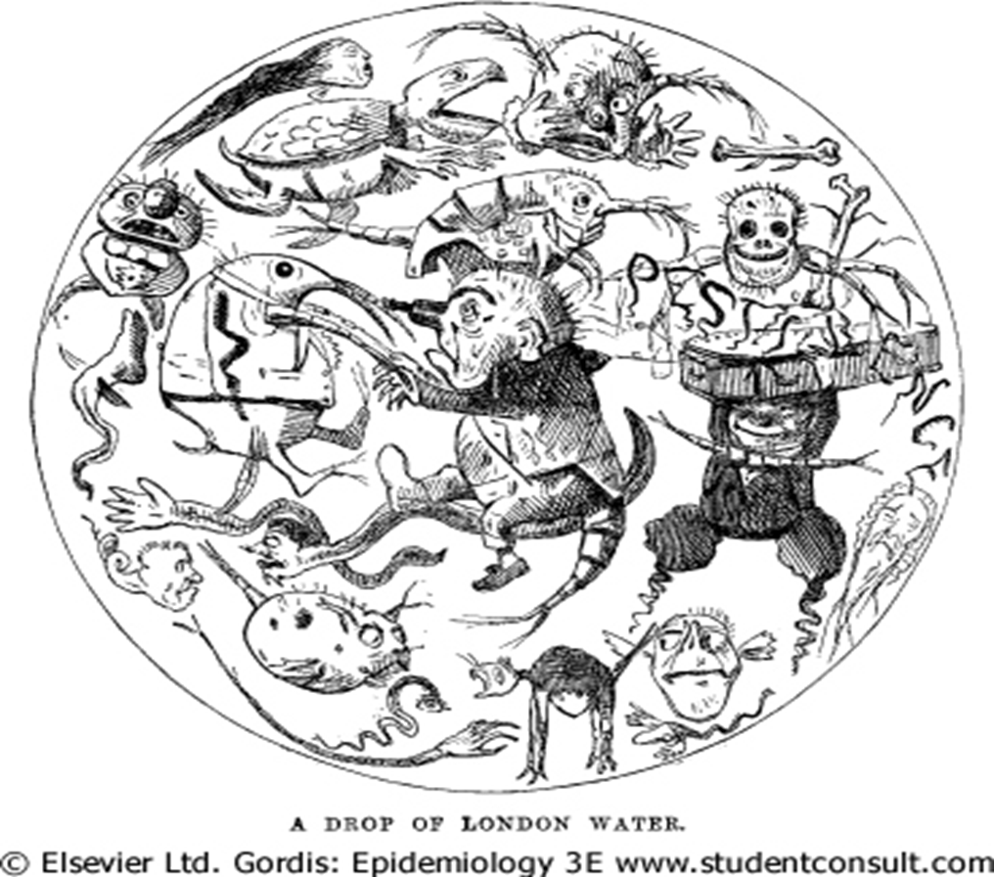

Slide 8
Deaths from Cholera per 10,000 Houses by source of water supply, London (Snow,1854)
Water supply | Number of houses | Cholera deaths | Deaths per 10,000 houses
Southwark & Vauxhall Co. | 40,046 | 1263 | 315
Lambeth Co. | 26,107 | 98 | 38
Other districts in London | 256,423 | 1422 | 56

Slide 9
The Evidence Pyramid
Systematic
Meta Analysis
RCT
Cohort Studies
Case-Control studies
Case series
Case reports
Ideas, editorials, Opinions
Invitro research
Evidence

Slide 10
Epidemiological studies
Observational studies
Experimental studies
Population based
Individual based
Randomized
control trial
Descriptive
Analytic
Case report
/series
Analytic
Quasi experimental trial
Ecological study
Cross-sectional
Cohort
Case control

Slide 11
Study Types
Study type: on the basis of intervention
Study type: on the basis of design
Study type: on the basis of time

Slide 12
Study types: on the basis of intervention
It divides the studies into two categories
Observational studies (no intervention)
Experimental studies / Interventional studies

Slide 13
On the basis of intervention: Observational studies
They are further divided into;
Descriptive
Descriptive is further sub divided into
1. Institutional surveys
2. Community surveys (Cross sectional surveys)
Analytic
Analytic is further sub divided into
1. Cohort
2. Case control

Slide 14
On the basis of intervention: Experimental studies
They are analytic type
It is further sub classified into
1. Randomized control trials
2. Community trials (community mass education program,
smoking prevention program in schools, dietary
intervention at family level)

Slide 15
Study types: on the basis of design
Another way is on the basis of design
• Qualitative study (Time, place, person)
• Quantitative study

Slide 16
Qualitative study
Qualitative field research usually focuses on:
Meanings = (culture, language, norms)
Practices = (various kinds of behavior)
Episodes = (divorce, crime illness)
Encounters = (2 people meeting and interacting)
Roles = (positions people occupy. Ethnic groups)
Relationships = (kinds of behaviors appropriate to pairs or sets of roles: mother-son, lovers, friends)
Groups => relationships = (work groups, teams)
Settlements = (small communities, villages, ghettoes, neighborhoods)

Slide 17
Study types: on the basis of design
Designs include:
Descriptive research
Ecological study
Ethnography
Evaluation research
Experimental research
Historical research
Phenomenology
Quasi experimental research
Randomized control trials
(The above list is in alphabetical order only)

Slide 18
Study types: on the basis of time
Before discussing the various study designs, defining a few terms is helpful. The definitions are intentionally left fairly basic.
Retrospective - Any design that looks at data that have already been gathered (e.g. CCS)
Prospective - Any design that collects data on groups of subjects over time, according to a carefully written protocol, beginning at time zero; this design yields data that enable comparisons of groups. (In ancient Rome, a cohort was a group of foot soldiers.)
Cross-sectional - A design that collects data from a variety of subjects (e.g., patients) at a given point in time

Slide 19
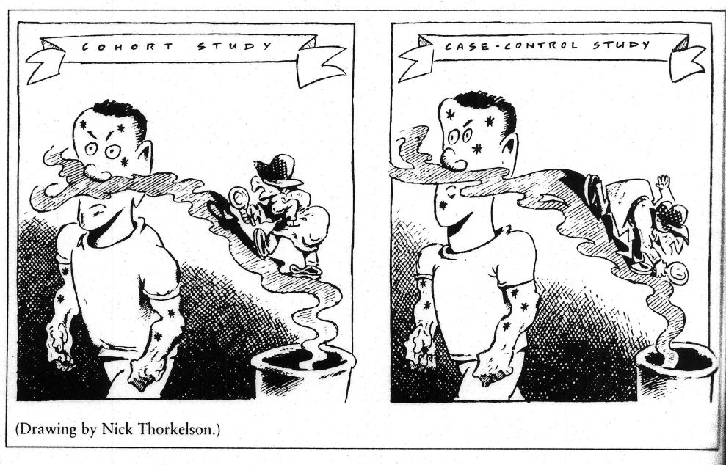

Slide 20
Cohort study: forward in time
Identify and select study population
Classify study population according to exposure status ad other risk factors
Follow cohort members over time to determine health outcome occurrence by exposure status sub-groups
Advantage:
  Establish causality
  Can determine incidence rates and risk
  Can be efficient for studying rare exposures (Nuclear bomb, radiation for enlarged thymus, Chernobyl nuclear accident, Minamata, toxic chemical (methyl isocyanides) from industry such as Bhopal, India)
Disadvantages
  Inefficient, as must follow many subjects (Long period of time)
  Expensive
  Rare exposure, need large sample size
  Results are not available for a long time
  Bias due to attrition and loss to follow up

Slide 21
Design of a Cohort study
Time
No-disease
Exposed
Disease
Population
People
without
the disease
(healthy people)
Un-exposed
No-disease
Disease
Follow-up period

Slide 22
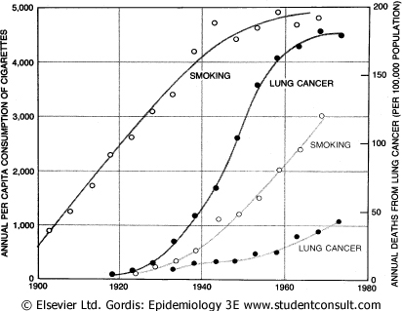

Slide 23
Case-control study: back in time
In studies of disease etiology, for example, researchers begin by selecting a group of patients (the cases) with a particular disease.
Assess prior exposure status and other risk factors for cases and controls
Examples
  Lung cancer and exposure to Radon
  Lung cancer and indoor air pollution in China
  Leukemia in individuals exposed to radioactive fallout from nuclear testing in USA
Advantages
  Inexpensive and efficient (specially for rare diseases)
  Useful for studying diseases with long latencies
Disadvantages
  Difficult to select appropriate comparison group
  Potential bias in measuring exposure (recall bias due to disease)

Slide 24
Design of a Case - Control study
Time
Inquiry
Exposed
Cases
(People
with
the disease)
Un-exposed
Population
Controls
(People
without
the disease)
Exposed
Un-exposed

Slide 25
Main difference between both designs
Case control: The study begins with diseased (cases) and non-diseased (control) people
Cohort study: The study begins with exposed (healthy) and non-exposed (healthy) people

Slide 26
Cross Sectional / Prevalence study
It is also called snap-shot study, as it captures a moment in time.
Choose sampling frame for selecting study participants
Measure exposure and health outcome status of the study participants
  Health outcome are based on prevalence, not incidence
Limitation
  Cannot prove cause-effect relationship

Slide 27
Meta-analysis (contd…)
Meta-analysis also can be defined as a systematic method that uses statistical analyses for combining data from independent studies to obtain a numerical estimate of the overall effect of a particular intervention or variable on a defined outcome.
This study design attempts to overcome much of the subjectivity of the narrative literature review. According to Thacker, the steps are as follows:
  Define the problem and criteria for admission of studies
  Locate research studies
  Classify and code study characteristics
  Quantitatively measure study characteristics on a common scale
  Analyze, interpret, and report the results
  E.g. streptokinase use in myocardial infraction (MI)

Slide 28
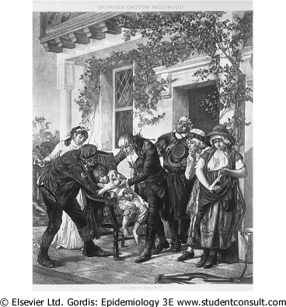
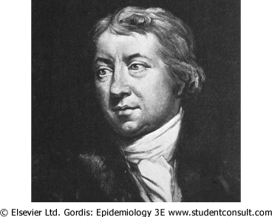
Randomized Clinical Trials

Slide 29
Randomized Clinical Trials
Population
Potential
Participants
Selection criteria
Non-
Participants
Improved
Invite
Participants
Non-
Participants
Obtain information
about them
Not
improved
Participants
Randomization
Improved
Controls
Treatment
Not
improved

Slide 30
Randomized clinical trials (contd…)
RCT has become the accepted standard for evaluating therapeutic efficacy.
Randomized trials are performed in a prospective fashion to allow as much control of variables as possible.
The outstanding feature of such trials is the use of randomization to help prevent bias in the assignment of subjects to specific intervention groups.
If randomization is carried out properly, differences in outcome that are observed among treatment groups tends to result from treatment effects and not from inherent differences among the groups.

Slide 31
Randomized clinical trials
RCTs are often difficult to conduct. Many clinicians and patients are reluctant to accept randomization, especially if one of the proposed interventions is particularly desirable or undesirable.
This may be an ethical consideration.
Furthermore, large numbers of patients may be required if the disease prevalence is low.
This may necessitate the involvement of multiple institutions, which may increase its complexity and cost.
E.g.:
  Breast cancer and Tamoxifen
  Hypertension monitoring and policy

Slide 32
Ecological study
Unit of analysis is group or population, rather than individuals (schools, factories, nations)
Compare aggregate measure of health outcome with aggregate measure of exposure
Generally based on existing data
Advantages
  Can be done quickly and inexpensively
  May be able to identify associations by examining greater range in exposure
Disadvantages
  Ecological fallacy: Cannot link exposure with disease in individuals
  Difficult to control confounding factors

Slide 33
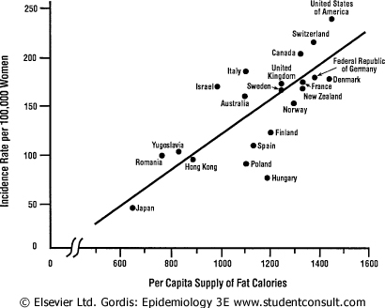
Breast cancer and fat intake

Slide 34
Research question and study type
(Reference: Leon Gordis)
State of the knowledge of the problem | Type of research questions | Type of study
Knowing that a problem exists but knowing little about its characteristics or possible causes | What is the nature/ magnitude of the problem? Who is affected? How do the affected people behave? What do we know think or believe about the problem and its causes? | Exploratory studies or Descriptive studies Descriptive case studies Cross sectional surveys

Slide 35
Research question and study type
State of the knowledge of the problem | Type of research questions | Type of study
Suspecting that certain factors contribute to the problem | Are certain factors indeed associated with the problem? (e.g. is low fiber diet related to carcinoma of large intestine?) | Analytical studies: Cross sectional comparative studies Case-control studies Cohort studies

Slide 36
Research question and study type
State of the knowledge of the problem | Type of research questions | Type of study
Having established that certain factors are associated with the problem: desiring to establish the extent to which a particular factor causes or contributes to the problem. | What is the cause of the problem? Will the removal of particular factor prevent or reduce the problem? (e.g., stopping smoking, providing safe water etc.) | Cohort studies Experimental or quasi experimental studies

Slide 37
Research question and study type
State of the knowledge of the problem | Type of research questions | Type of study
Having sufficient knowledge about causes to develop and assess an intervention that would prevent, control or solve the problem | What is the effect of a particular intervention/strategy? (e.g., treating with a particular drug, being exposed to a certain type of health education) Which of the two alternate strategies give better results? Which strategy is most cost-effective? | Experimental or Quasi-experimental studies

Slide 38
Thank you

