Slide 1

Ethical issues in sexual and reproductive health research
Dr Raqibat Idris, MBBS, DO, MPH
Geneva Foundation for Medical Education and Research
Training course in research methodology and
research protocol development
Geneva 2021

Slide 2
Learning objectives
Definitions
Principles of research ethics
The development of contemporary research ethics
The informed consent process
Protection of research participants
Special issues

Slide 3

Acknowledgement
  This presentation was adapted mainly from the Research Ethics Training Curriculum (RETC) developed by Family Health International (FHI 360)
  https://www.fhi360.org/resource/research-ethics-training-curriculum-retc-second-edition
The lotus flower represents purity and perfection in many culture. FHI 360 used this image to “symbolize the fundamental ethical elements” and “challenges the research community to aspire to a pure and perfect research design – the foundation on which ethical research is developed and implemented”.

Slide 4
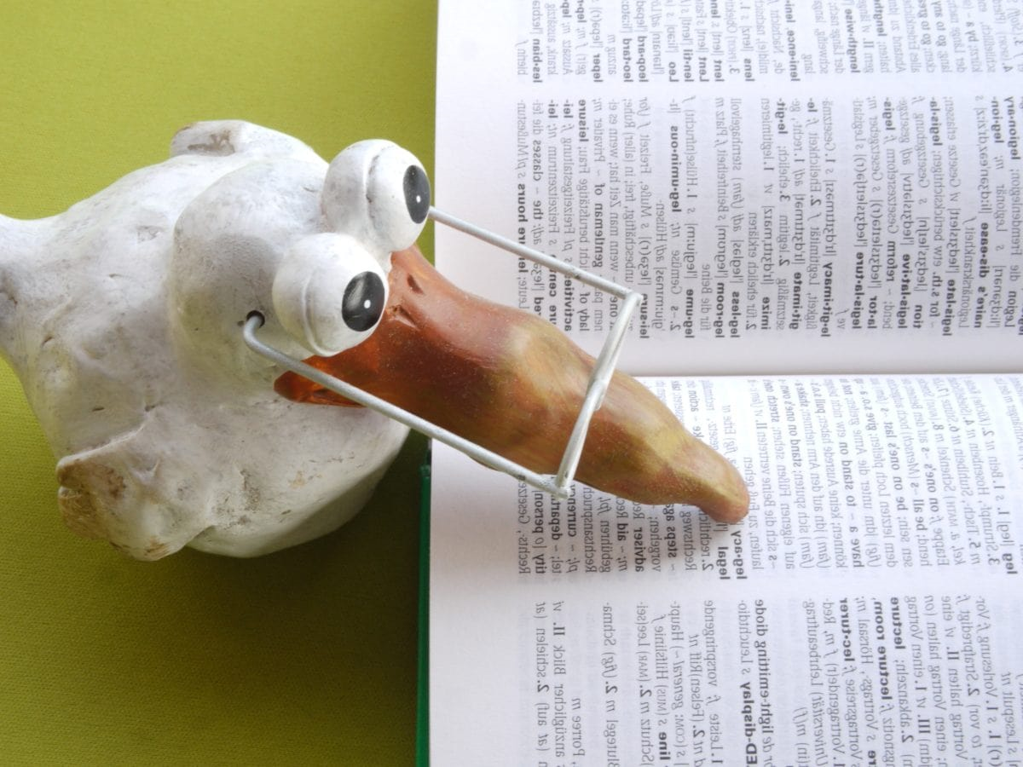
Definitions
Research
“A systematic investigation, including research development, testing and evaluation, designed to develop or contribute to generalizable knowledge.”

Slide 5

Definitions cont’d.
Human subject
“A living individual about whom an investigator (whether professional or student) conducting research:
  Obtains information or biospecimens through intervention or interaction with the individual, and, uses studies, or analyzes the information or biospecimens; or
  Obtains, uses, studies, analyzes, or generates identifiable private information or identifiable biospecimens.”

Slide 6
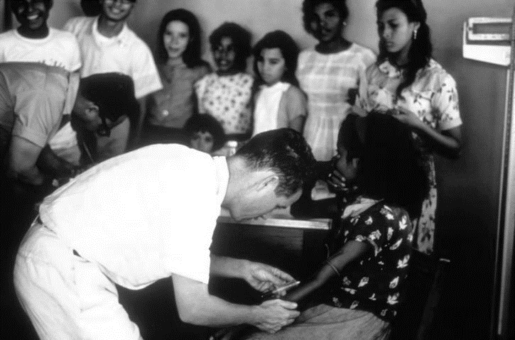
Definitions cont’d.
Intervention
  Physical procedures by which investigators collect information or biospecimens and manipulations of the subjects or the subjects’ environment for the purpose of the research.
Interaction
  Communication and interpersonal contact between investigators and research participants (verbally, in writing, or electronically), to obtain information about them for the research.

Slide 7

Definitions cont’d.
Private information
  Information about behavior that occurs in a context in which an individual can reasonably expect that no observation or recording is taking place
  Information that has been provided for specific purposes by an individual and which the individual can reasonably expect will not be made public
Human research
  Data from living individuals
  Biological material from living individuals
  Interaction or intervention with a living individual
  Use of a non-FDA approved, drug, device or biological

Slide 8

Fundamental principles of human research ethics
Human research ethics rest on three fundamental principles that are considered the foundation of all regulations or guidelines governing research ethics:
  Respect for persons
  Beneficence
  Justice
These principles are considered universal, transcending geographic, cultural, economic, legal, and political boundaries.
Although these principles are universal, the availability of the resources needed to maintain them is not universal.

Slide 9

Respect for persons
(and community)
Respect for persons recognizes the right and capacity of all individuals to make their own choices and decisions. It refers to respect for the:
  Autonomy and self-determination
  Freedom, and capacity to decide, make choices
  Dignity of the people and the individual
  Respect for the community and local culture

Slide 10

Beneficence
The principle of beneficence
refers to “No harm” or “non-maleficence”
  Holds the researcher responsible for the participant’s physical, mental, and social well-being throughout participation in the study
  Risks reduced to a minimum
  Benefits to the participant must be weighed against potential risks of participating
  Benefits for the communities where the research is conducted

Slide 11

Justice
The principle of justice forbids placing one group of people at risk solely for the benefit of another.
  The researchers and sponsors have the obligation to:
  Distribute the risk and benefits in an equitable manner for both potential participants and communities
  Equitable recruitment of research participants
  Special protection for vulnerable groups
  Protection of underprivileged communities

Slide 12




Vulnerable research participants
Vulnerability is “substantial incapacity to protect one’s own interests owing to such impediments as lack of capability to give informed consent, lack of alternative means of obtaining medical care or other expensive necessities, or being a junior or subordinate member of a hierarchical group.” (The Council for International Organizations of Medical Sciences (CIOMS))
Vulnerable groups include: pregnant women or fetuses, neonates, children, prisoners and participants who may be vulnerable due to their cultural, social, or economic characteristics.

Slide 13
Principles of research ethics: summary
All codes and regulations advocate three fundamental principles:
  Respect for persons
  Beneficence
  Justice
These principles apply not only to the person, but also to the community at large
Vulnerable research participants require special protections

Slide 14

The development of contemporary research ethics
Guidelines, codes, and regulations created to guide the conduct of research involving human participants
Development driven by historical events, in response to the increasing globalization of research and in an attempt to provide answers to new problems and challenges created by a dynamic research environment
Each reflects the principles of respect for persons, beneficence, and justice

Slide 15
Guidelines, codes, and regulations
The Nuremberg Code
The Declaration of Helsinki
The Belmont Report
The Common Rule
Council for International Organizations of Medical Science (CIOMS) Guidelines
International Conference on Harmonization (ICH)

Slide 16

The Nuremberg Code
A 10-point statement guiding physicians in the conduct of research on human participants which came into existence at the end of World War II
It requires that “the voluntary informed consent of the human subject is absolutely essential”:
  Capacity to consent
  Freedom from coercion
  Comprehension of the risks and benefits involved
The minimization of risk and harm
A favorable risk/benefit ratio
Qualified researchers using appropriate research designs
Freedom for the participant to withdraw at any time

Slide 17

The Declaration of Helsinki
Created by the World Medical Association (WMA) in 1964.
The well-being of the participant should take precedence over the interests of science and society
Consent should be in writing
Use caution if participant is in dependent relationship with researcher
Limited use of placebo (use only “where no current proven intervention exists or where, for compelling and scientifically sound methodological reasons, the use of placebo is necessary and participants will not be subject to any serious risk”)
Greater access to benefit

Slide 18

The Belmont Report
The national commission for the protection of human subjects of biomedical and behavioral research was established in 1974 in response to the Tuskegee study, which took place in the southern united states from 1932 to 1972.
In 1978, the commission submitted its report: The Belmont report: ethical principles and guidelines for the protection of human subjects of research.
The report sets forth the fundamental ethical principles underlying the acceptable conduct of research involving human participants: Respect for persons, beneficence, and justice

Slide 19

The U.S. Code of Federal Regulations (also called the Common Rule)
In 1991, the federal policy (referred to as the Common Rule) was adopted by 16 federal agencies that conduct, support, or otherwise regulate human participant research in the United States. Institutions conducting research that is funded by the U.S. government nationally or internationally must agree to abide by the Common Rule.
The Common Rule requires:
Prior ethics committee approval
Written informed consent and documentation
Equitable recruitment of research participants
Special protection for vulnerable groups
Continuing review of approved research

Slide 20
Council for International Organizations of Medical Science (CIOMS) Guidelines
In 1982, CIOMS issued the Proposed International Ethical Guidelines for Biomedical Research Involving Human Subjects. The guidelines were revised in 1993 and 2002.
The current guidelines are 21 and are based on the three principles of research ethics. Topics include:
  Informed consent
  Research in developing countries
  Protection of vulnerable populations
  Role of ethics committees
  Community participation
  Obligations of the sponsor, the researcher, and the host country
Nuremberg
Helsinki
CIOMS
The CIOMS Guidelines are designed to be used in developing national policies on the ethics of biomedical research.

Slide 21

International Conference on Harmonization (ICH)
In 1990, representatives of the regulatory agencies and industry associations of the United States, Japan, and Europe met and formed ICH.
In 1996, the ICH finalized the Guidelines for Good Clinical Practice (GCP). The GCP Guidelines provide standards for ethical and scientific quality for developing, conducting, and recording clinical trials in the pharmaceutical industry:
  Standardize drug development and approval process
  Protocol development standards
  Review by ethics committee
  Researcher responsibilities
  Sponsor responsibilities
  Informed consent of the participants

Slide 22
Other reports and guidelines
National Bioethics Advisory Committee (NBAC) in 2001 (now disbanded) – Ethical and Policy issues in international Research: Clinical Trials in Developing Countries.
Nuffield Council on Bioethics – UK based: Reported on ethical issues in international research in its 2002 publication, The Ethics of Research Related to Healthcare in Developing Countries.
HIV Prevention Trials Network (HPTN): Ethics Guidance for Research developed in 2003 for HIV prevention researchers – Emphasizes mutual accountability among peers and the thoughtful translation of ethical considerations into action.

Slide 23

National regulations and guidelines
Many countries have national regulations on
the conduct of human research.
Yet, many countries still lack or are developing formal regulations.
Existing international recommendations, such as the Declaration of Helsinki or the CIOMS International Ethical Guidelines, are important references, but they are not a substitute for national or local regulations.
Does your country have established guidelines for the conduct of research? Does your local institution?

Slide 24
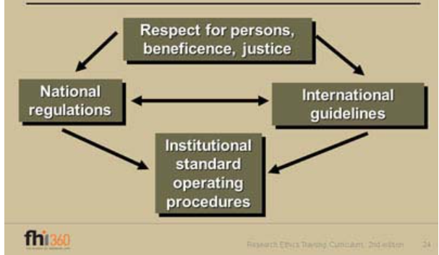
From fundamental ethical principles to local guidelines
The three fundamental principles of human research ethics – respect for persons, beneficence, and justice – are commonly embodied in national regulations or international guidelines.
These regulations and guidelines need to be adapted or transformed into institutional standard operating procedures (SOPs) to be used at the local level to guide the planning, review, approval, and conduct of human research.
The process allows the application of fundamental principles within the context of local laws and cultural and economic circumstances.

Slide 25

The informed consent process
Designed to empower the potential participant to make a voluntary informed decision, free of coercion, on whether to participate or not in a research study.
Research Ethics Committees (RECs) have the responsibility to assure that the informed consent process is appropriate for vulnerable individuals or groups.

Slide 26
What is informed consent?
The CIOMS International Ethical Guidelines define informed consent as consent given by a competent individual who:
  Has received the necessary information
  Has adequately understood the information
  After considering the information, has arrived at a decision without having been subjected to coercion, undue influence or inducement, or intimidation
Informed consent is a process that requires the participation of numerous people, including researchers, RECs, and community representatives.
It is an obligation to obtain appropriate informed consent from participants in a research study before participation is initiated.

Slide 27

Informed consent as a process
Informed consent is a communication process between the research team and the participant
It starts before the research is initiated and continues throughout the study
The potential participant must understand the information provided and be empowered by it to make a voluntary decision about whether or not to participate in the study.
The type, extent, and method of the proposed informed consent process require the review and approval of an appropriate REC.
BEFORE STUDY
AFTER STUDY

Slide 28

Informed consent – before study initiation
Knowledge of the local culture and resources available – conditions of local health services, languages, social norms, and conditions special to the type of participants
Community participation
Identification of risks and benefits, before and after the study
Pilot testing
Knowledge of the local REC requirements

Slide 29

Informed consent – study initiation
At this stage of the process:
Information is presented
Participants decides
It is important who presents the information:
  should be by individuals with communication or counselling skills
  the researcher may not be the best option
  some guidelines may require the presence of a witness
Support materials are helpful – illustrations, videos
Understanding is assessed – correct any problem with understanding

Slide 30

Informed consent – during the study
Reinforce key points
Communicate new information – change in risk/benefit ratio should be to the participants and the responsible RECs.
  May require re-consent from all of the participants
Address rumors – may cause undue concern to the participants if they arise

Slide 31
Information in informed consent
Necessary versus excessive information –
“Adequate information” defined as “the amount of information necessary to the individual to make a reasoned decision about whether to participate in the research”
Long forms versus short forms
Common Rule and CIOMS Guidelines are valuable resources - Common Rule categorizes necessary information into eight basic elements and CIOMS Guidelines propose 26 elements, most of which provide additional guidance on the Common Rule elements.
Not only what, but how, when, and by whom
Participants understanding assessment necessary

Slide 32
Development of informed consent materials
Use local language
Write for appropriate reading level
Illustrate with appropriate concepts and images
Perform a translation and back-translation
Pilot test for appropriateness - involves a person who knows the materials and uses them with someone who is very similar to the individuals to be recruited for the study. Based on results from this test, the materials may need to be revised to make them more understandable.
Informed consent is an educational and communication process. The research team may find individuals with experience in these fields very helpful.

Slide 33

Community representation and the informed consent process
To provide culturally appropriate guidance
Community and participants’ perspectives – in selecting the type and sufficiency of information that the potential participant may actually need or expect and how it may best be presented
Possible vigilance of the process – to assure that informed consent is conducted in accordance with the approved process

Slide 34
Essential elements of informed consent
Research description
Risks
Benefits
Alternatives
Confidentiality
Compensation
Contacts
Voluntary participation

Slide 35
Essential elements of informed consent: Research description
Description of the research and participant’s participation, including identification of experimental procedures
    Research study
    The purpose or objectives of the research
    Anticipated duration of study, number of participants and study sites
    Expected responsibilities of participants
    Procedures involved
    Explanation of placebo and randomization
    Names of the research sponsors and members of the REC that reviewed and approved the research

Slide 36

Essential elements of informed consent: Risks
Description of reasonably
foreseeable risks
  Anticipated or foreseeable risk
  Physical, social (stigma, discrimination, loss of respect, or public ridicule), & psychological
  Culturally appropriate – what is considered a risk or side effect, and whether it is severe, differs from culture to culture
  Decision on the amount of information on possible risks, and how it is presented to be made by the researchers and the REC
  If any new risks are identified during the research, the informed consent must be revised and all of the participating individuals must be notified promptly

Slide 37

Essential elements of informed consent: Benefits
Description of expected
benefits
  Reasonably expected
  No exaggeration – should not be coercive
  Benefits available once research is ended
  Anticipated benefits to the community participating in the research - CIOMS Guidelines say to include “the expected benefits of the research to the community or to society at large, or contributions to scientific knowledge”

Slide 38

Essential elements of informed consent: Alternatives
Potentially advantageous
alternatives to participation
  Alternative procedures or treatment
  Advantage and disadvantages
  Availability
  The informed consent form must describe treatment alternatives that are available or may be made available—including other options to participating in the research
  For some studies, the only alternative may be not to participate

Slide 39

Essential elements of informed consent: Confidentiality
Explanation of confidentiality “an agreement between the participant and the investigator about how the participant’s data will be handled and to whom it will be disclosed”
  Degree of confidentiality
  Indicate persons or organizations who may have access to the information
  Special cultural circumstances – when public knowledge of participation is potentially damaging
  Anticipated future use of the information or tissue samples collected during the study

Slide 40

Essential elements of informed consent: Compensation
Explanation of compensation
for injuries
  Available compensation in case of injury
  Treatment available and cost
  Fair payment for time, travel or inconvenience – should be reasonable, based on local costs, and commensurate with the extent of participation
  Not coercive
Compensation should not be so high as to unduly influence a potential participant’s decision to participate in the study.

Slide 41

Essential elements of informed consent: Contacts
Whom to contact about the research and participants’ rights
  Contact for research - related questions or side effects, injuries, or complications: Usually a
  member of the research team
  Contact for concerns about rights as a
  participant: A member of the REC would be appropriate
Contact information should be realistic and economically viable and culturally appropriate
As much as possible, contact persons should be available at all times

Slide 42

Essential elements of informed consent: Voluntary participation
Explanation that participation is voluntary
  Absolutely voluntary
  Right to discontinue at any time
  No penalty for refusal
In the informed consent form, it is necessary to state that participation is absolutely voluntary. This element of the informed consent should explicitly indicate that refusal to participate in the research or the desire to withdraw from the study at any time will not result in any penalties or loss of benefits to which the participant is otherwise entitled, including health care.

Slide 43
Documentation of informed consent
Part of informed consent process
Usually in writing An important step in the process of informed consent is the signing, or other type of evidence, that documents the consent. All guidelines encourage written documentation as much as possible.
May not always be necessary
Ethics Committee review and approval The need for documentation will vary according to the specifics and the setting of the research. Low-risk survey research may not require the participant’s signature, and in some locations, participants may be uncomfortable signing forms. The REC responsible for the study determines and approves the method of documenting, or not documenting, informed consent.

Slide 44

Waiver of informed consent
Minimal risk – Research should involve no more than minimal risk to the participant
Rights and welfare of participants protected – waiver will not adversely affect the rights and welfare of the participants
Research not possible without a waiver
Appropriate information provided – the participants will receive additional pertinent information after their participation ends
All requests should be submitted to the REC when the protocol is submitted for review.

Slide 45

Protection of research participants
Research may be monitored by:
Research Ethics Committee
Data and Safety Monitoring Boards (DSMBs)
Other stakeholders
  Sponsor or monitor
  Regulatory agencies
  Institutional regulatory and compliance offices
  Public interest groups

Slide 46

Research Ethics Committees (RECs)
Names of committees vary by location – The World Health Organization uses the terminologies Ethics Committees (ECs) or Research Ethics Committees (RECs)
REC is required by ethical and regulatory guidelines
To work effectively and consistently, the REC must develop standard operating procedures (SOPs) that defines its functions and to guide its reviews. SOPs should include the:
  Authority under which the committee is established
  Criteria for selecting members
  Processes followed by the REC
REC must work effectively with research staff
REC requires adequate resources

Slide 47



Role of the Research Ethics Committees
Review and approval of research study:
Primary responsibility of EC is to review research to ensure the protection of human participants through the application of the three principles of research ethics.

Slide 48

Role of the Research Ethics Committees
Beyond the initial review and approval of a research study:
  Conduct regular review of ongoing research
  Review all modifications and amendments to approved research – protocol and informed consent documents, recruitment materials, data collection instruments, and clinical investigator brochures
  Monitor active research studies for compliance
  Investigate problems that could impact the safety of participants
  Investigate allegations of research misconduct and possible violations of the rights of research participants
  When problems are discovered, report them as required by local SOPs and regulations

Slide 49
Research Ethics Committees: Criteria for review and approval
At a minimum, the REC should address six core issues:
1. Scientific design and conduct of the study
  Appropriateness of research design?
  Qualified researchers?
2. Recruitment of research participants
  Appropriate recruitment methods?
  Safeguards for vulnerable populations?
3. Community considerations
  Benefits to community?
  Consultation with community?

Slide 50

Research Ethics Committees: Criteria for review and approval (cont’d)
4. Care and protection of research participants
  During and after the research?
  Monitoring the research?
5. Informed consent
  Complete information?
  Written documentation?
6. Confidentiality issues
  Adequate protection?
  Risk of breach?
The REC should grant approval only when all of these questions have been answered.

Slide 51

Data and Safety Monitoring Boards (DSMB)
A DSMB is a committee that is created to review the data from randomized clinical trials to determine whether it is safe for the study to continue.
Must be independent with no potential conflicts of interest
Chosen for their technical experts
Review safety data and compare study arms
Authority to “break the blind”
Rules for stopping the research
Complementary to the mission of the REC

Slide 52

Protecting research participants: Other stakeholders
In addition to the oversight of RECs and DSMBs, ongoing research may be subject to monitoring from several different groups who want to ensure that the research is being conducted correctly. They are:
  Sponsor or monitor
  Regulatory agencies
  Institutional regulatory and compliance offices
  Public interest groups
Unofficial oversight: High-profile research studies may attract the attention of the media and public interest groups that are organized on behalf of selected communities (e.g., people living with HIV/AIDS, women at increased risk for breast cancer, etc.)

Slide 53

Responsibilities of sponsors and researchers
Sponsors and researchers share many responsibilities throughout the research process, primarily:
  Protect the safety and well-being of research participants
  Design ethical research that addresses a local research need
  Ensure proper ethical review and approval of the research
  Conduct the research according to the highest ethical standards
  Apply and share the knowledge gained by the research

Slide 54

Sponsor’s responsibilities
Select only qualified researchers
Provide necessary support to implement the research properly - methodologically sound protocols, operational procedures, training
Require the review and approval of a properly established REC
Promote research integrity - monitor study sites, manage potential conflicts of interest, training
Ensure the appropriate management of serious adverse events (SAEs) – in some settings
In international research,
    Comply with all local ethical, regulatory and legal requirements
    Ensure the local relevance of the research
    Ensure the availability and access to health care services necessary for the safe conduct of the research
    Assist in capacity building
    Post-trial responsibilities – make the products of the research available to the participants and the host community

Slide 55

Researcher’s responsibilities
Protection of research participants:
Develop scientifically and technically appropriate research protocols
Ensure appropriate informed consent
Protect the confidentiality of the participants as stipulated in the informed consent
Conduct research according to protocol
Conduct the research with integrity
Comply with REC requirements
  Report adverse experiences, protocol violations, participant complaints
• Post-study
  Protect the long-term interests of participants- e.g., facilitate access to the study product

Slide 56

Researcher’s responsibilities cont’d.
In addition to clinical and scientific skills, researchers should possess the following human qualities:
Integrity
Respect
Compassion
Professionalism
Courtesy
Sensitivity

Slide 57
Researcher’s responsibilities: Summary
Research with human participants is a privilege, not a right, and is given to the researcher by the society.
The protection of the well-being of the research participant is the primary responsibility of the researcher.
Protecting the participant is more important than the pursuit of new knowledge, the benefit to science that may result from the research, and personal or professional research interests.

Slide 58
Special issues
Conflict of interest
Pregnant and breastfeeding women as research participants
Adolescents as research participants

Slide 59

Special issues: Conflict of interest
“When there is a substantial risk that secondary interests of one or more stakeholders in research unduly influence their judgment and thereby compromise or undermine the primary goal of research.”
  Competitive environment for academic researchers
  Increasing commercialization of research
  Conflicts of interest can influence the choice of research questions and methods, recruitment and retention of participants, interpretation and publication of data, and the ethical review of research
  Managing conflicts of interests safeguards the scientific integrity of research and protects the rights and interests of study participants

Slide 60
Special issues: Conflict of interest cont’d.
Types of conflict of interest:
Researchers – academic, financial,
Research institutions (universities, research centres, or pharmaceutical companies) – reputational, financial
Research ethics committees – dual role (research and REC member), financial
General rule:
  “A potential serious conflict of interest exists when there is a significant possibility that the actions of an investigator resulting from professional, academic, or financial interests will result in biased study results or cause harm or wrong to participants”.

Slide 61

Management of conflict of interest
To identify, mitigate, eliminate, or otherwise manage conflicts of interest is a shared responsibility by all stakeholders with the research institutions playing a critical role.
  Education of researchers and research
  ethics committees.
  Disclosure of interests to research
  ethics committees
  Disclosure of interests to participants
  Mitigation of conflicts
  Policies and measures for managing conflicts of interest must be transparent and actively communicated to those affected.

Slide 62

Special issues: Pregnant and breastfeeding women as research participants
Distinctive physiologies and health needs
In pregnant women, initiate research only after careful consideration of the best available relevant data
Permission of another person MUST not replace the requirement of individual informed consent by the pregnant or breastfeeding woman

Slide 63
Special issues: Pregnant and breastfeeding women as research participants cont’d.
For research interventions or procedures that have the potential to benefit either pregnant or breastfeeding women or their fetus or infant:
  risks must be minimized and outweighed by the prospect of potential individual benefit
For research interventions or procedures that have no potential individual benefits for pregnant and breastfeeding women:
  the risks must be minimized and no more than minimal
  the purpose of the research must be to obtain knowledge relevant to the particular health needs of pregnant or breastfeeding women or their fetuses or infants

Slide 64
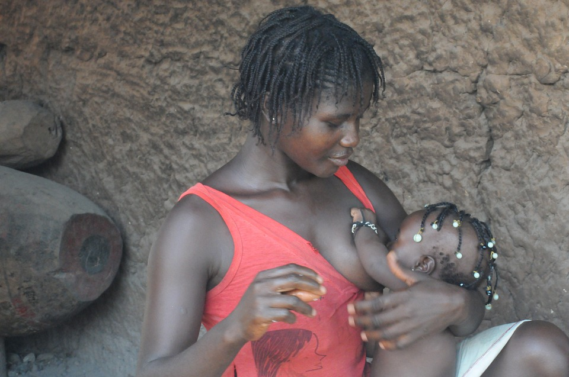
Special issues: Pregnant and breastfeeding women as research participants cont’d.
REC may permit a minor increase above minimal risk in compelling situations when research cannot be conducted in non-pregnant or nonbreastfeeding women
Short-term and long‐term follow-up of the fetus and the child – depending upon the study intervention and its potential risks
General rule:
  “Health-related research involving pregnant women that has the potential for harm to the fetus should be conducted only in settings where women can be guaranteed access to a safe, timely and legal abortion in the event that participation in the research makes the pregnancy unwanted.”

Slide 65

Special issues: Adolescents as research participants
Before undertaking research involving
children and adolescents, the researcher
and the research ethics committee must ensure that:
  A parent or a legally authorized representative of the child or adolescent has given permission.
  The agreement (assent) of the child or adolescent has been obtained in keeping with the child’s or adolescent’s capacity, after having been provided with adequate information about the research tailored to the child’s or adolescent’s level of maturity.
  If children reach the legal age of maturity during the research, their consent to continued participation should be obtained.
  In general, the refusal of a child or adolescent to participate or continue in the research must be respected, unless, in exceptional circumstances, research participation is considered the best medical option for a child or adolescent.

Slide 66

Special issues: Adolescents as research participants cont’d.
Researcher and REC must ensure that:
Potential individual benefits and risks have been
assessed
For research interventions or procedures that have the potential to benefit children or adolescents:
  the risks must be minimized and outweighed by the prospect of potential individual benefit

Slide 67

Special issues: Adolescents as research participants cont’d.
Researcher and REC must ensure that:
For research interventions or procedures that have no potential individual benefits for participants:
  the interventions and procedures should be studied in adults first, when these interventions and procedures target conditions that affect adults as well as children and adolescents, unless the necessary data cannot be obtained without participation of children or adolescents
  the risks must be minimized and no more than minimal
When the social value of the studies with such research interventions and procedures is compelling, and these studies cannot be conducted in adults, REC may permit a minor increase above minimal risk.

Slide 68

Special issues: Adolescents as research participants cont’d.
Assent
  Children and adolescents who are legally
  minors cannot give legally valid informed consent, but can give assent
  To give assent means that the child or adolescent is meaningfully engaged in the research discussion in accordance with his or her capacities
  Assent is a process and not merely the absence of dissent
  The researcher must involve the child or adolescent in the actual decision-making process and use age-appropriate information

Slide 69

Special issues: Adolescents as research participants cont’d.
Deliberate objection
  An expression of disapproval or refusal of
  a proposed procedure
  Children and adolescents who are too immature to give assent
Permission of a parent or legally authorized representative
  The researcher must obtain the permission of at least one parent or guardian in writing, consistent with applicable laws and regulations

Slide 70

Special issues: Adolescents as research participants cont’d.
Waiver of parental permission
  In certain circumstances, research ethics
  committees may waive parental permission – permission of a parent is not feasible or is undesirable, “emancipated” or “mature” minors
  Special protections must be in place to ensure that the best interests of the children or adolescents are being served – involvement of independent child advocates, a relative, trusted friend, or family physician (chosen by the child) who is not involved in the research project to represent the child
Observation of the study by a parent or guardian
  To a reasonable extent and without violating the privacy of other study participants

Slide 71
Resource for case studies
Casebook on ethical issues in international health research. WHO; 2009. Available from: https://apps.who.int/iris/handle/10665/44118 (in English, Arabic, Chinese and Russia)
  The casebook contains 63 case studies, each raising an important and difficult ethical issue connected with planning, reviewing, or conducting health-related research. The purpose of the book is to encourage thoughtful analysis of these issues by researchers and members of research ethics committees, particularly those involved with studies that are conducted or sponsored internationally.

Slide 72
Thank you

Slide 73
Other online training resources in research ethics
Globethics.net (a global network of teachers and institutions with the vision to embed ethics in higher education) https://www.globethics.net/
Government of Canada: Panel on Research Ethics https://ethics.gc.ca/eng/education_tutorial-didacticiel.html (available in English and French)
The Fogarty International Center https://www.fic.nih.gov/ResearchTopics/Bioethics/Pages/teachers-students.aspx
Training and Resources in Research Ethics Evaluation (TRREE) - on-line training programme on the ethics and regulation of health research involving human participants https://elearning.trree.org/ (available in several languages)

Slide 74
References
Guidance on ethical considerations in planning and reviewing research studies on sexual and reproductive health in adolescents. Geneva: World Health Organization; 2018. Licence: CC BY-NC-SA 3.0 IGO. Available from: https://www.who.int/reproductivehealth/publications/adolescence/ethical-considerations-srh-research-in-adolescents/en/
Human Research Protection Training: what is human subjects research (Lesson 2-)? Office for Human Research Protections (OHRP); 2021. Available from: https://www.hhs.gov/ohrp/education-and-outreach/online-education/human-research-protection-training/index.html
International Ethical Guidelines for Health-related Research Involving Humans, Fourth Edition. Geneva. Council for International Organizations of Medical Sciences (CIOMS); 2016. https://cdn-auth-cms.who.int/media/docs/default-source/ethics/international-ethical-guidelines-for-health-related-research-involving-humans.pdf?sfvrsn=f62ee074_0
Research Ethics Training Curriculum (RETC), Second Edition. FHI 360; 2011. Available from: https://www.fhi360.org/resource/research-ethics-training-curriculum-retc-second-edition
Responsible conduct of research with humans (RCRH). University of California Regents; c2006. Available from: https://ori.hhs.gov/education/products/ucla/chapter2/page00b.htm

