Slide 1


Scientific writing
Jane Hirst
Associate Professor and UKRI Future Leaders Fellow
Nuffield Department of Women's & Reproductive Health, University of Oxford
Consultant Obstetrician, Oxford University Hospitals NHS Foundation Trust
Honorary Senior Research Fellow,The George Institute for Global Health, UK

Slide 2

Open access pdf:
http://www.foldtan.ro/files/Scientific_writing.pdf
BMJ Publications 2002

Slide 3
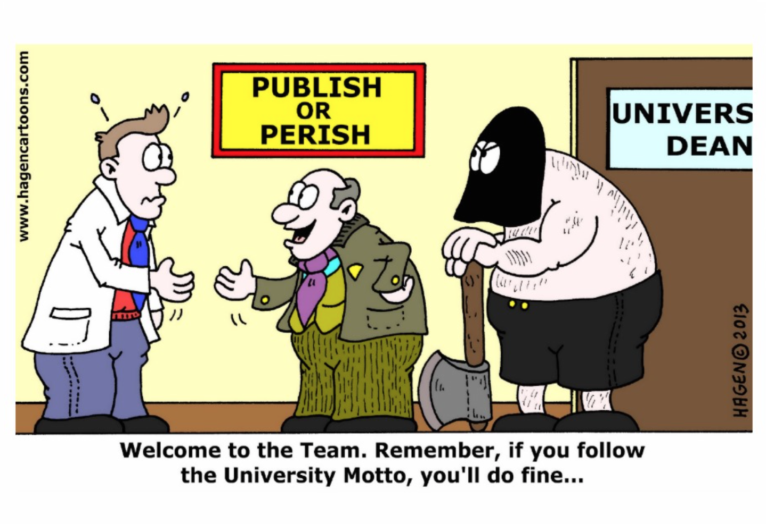

Slide 4
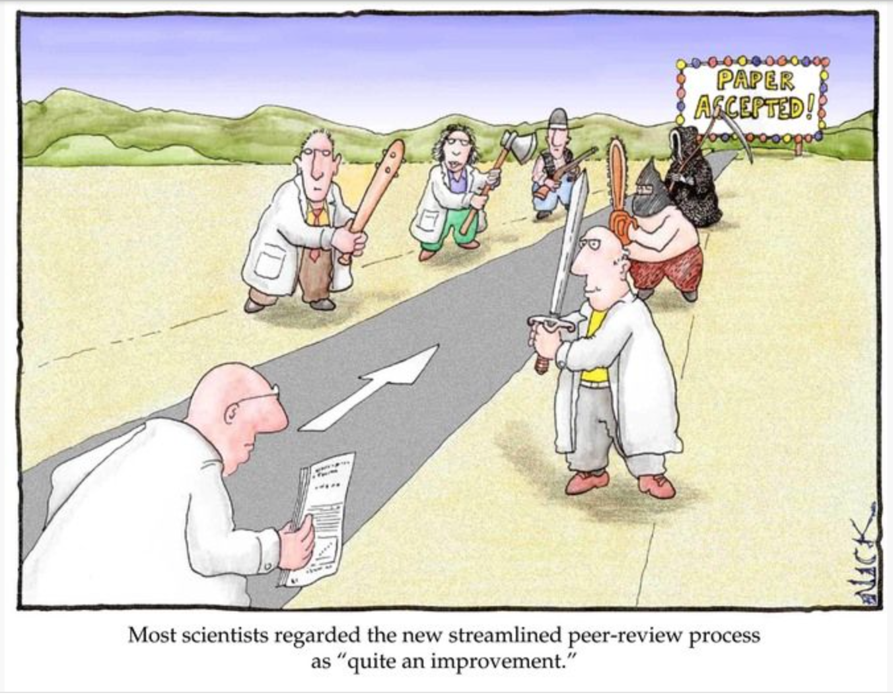

Slide 5

Scientific writing
A precise way to explain what you did, what you found, and why it matters

Slide 6
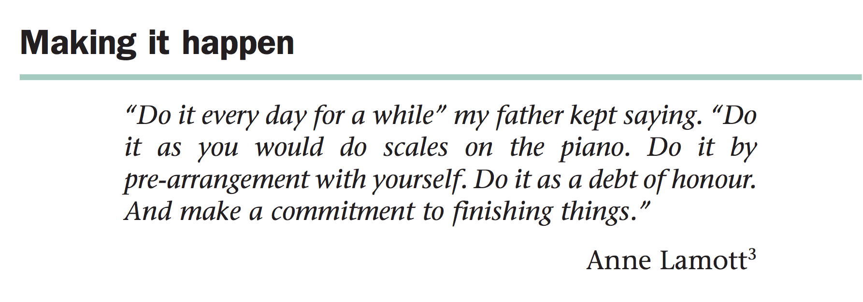
Peat, Scientific Writing, 2002 BMJ Publications

Slide 7
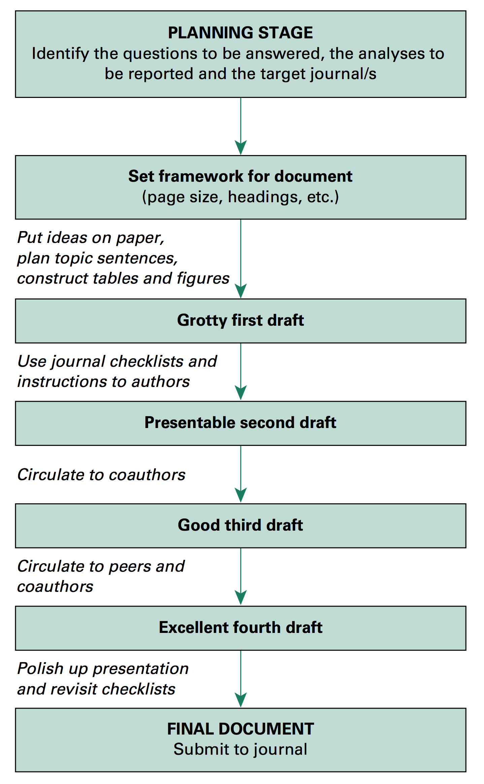
Peat et al 2002

Slide 8
Deciding on a journal
Where were the articles you cited published?
What journals do you read?
Who are your target audience?
Use an online tool like JANE http://www.biosemantics.org/jane/
Check the Journal’s website for information
Send an exploratory e-mail to the editors
Look out for calls for articles on your topic
Check impact factors
Notes:
Demonstrate Jane tool using a real abstract (TBC).
Journals usually publish a mission statement: who there audience is, what they publish and what they don’t publish.

Slide 9
Journal Impact
Impact factor: A measure of the frequency with which the ‘average article’ in a journal has been cited in a particular year
Helps evaluate a journal’s relative importance, especially compared to others in the same field
Impact factor >5 considered very good
Other measures: SJR scientific journal rankings
Notes:
Note limitations of Impact Factor:
Comparisons across disciplines may not be fair
Favours journals with that publish reviews
May reflect the large impact of a relatively small proportion of a journal’s output
Penalises Open Access journals that are less selective in what they publish (high impact articles “diluted”)
Other “impact” metrics are available

Slide 10
Choosing where to submit
‘Very High impact’ general medicine journals
e.g. Lancet, British Medical Journal, New England Journal of Medicine, JAMA etc….
  Wide readership
  High impact
  Great for CV
  Often very quick to reject
  Only accept a tiny minority of papers
  Laborious process of review, revision and publication.
Notes:
BMJ publishes 7% of the 7,000 to 8,000 articles they receive annually.
Example of what we mean by specialist paper: e.g. communicable disease case report, a methodology paper, a paper with relevance to a specific population group, e.g. geriatric public health

Slide 11
Choosing where to submit
Specialist journals
e.g. Journal of Public Health, Journal of Epidemiology and Community Health, BJOG
  More likely to reach an interested audience
  Tend to accept a greater proportion of papers
  Lower impact than general medical journals
  Less likely to attract media coverage
  Laborious process of review, revision and publication

Slide 12
Choosing where to submit
Open Access journals, e.g. PLOS Medicine, BMC Public Health, BMJ Open
  Papers can be published within weeks not months
  Some OA journals accept all papers, so long as they are methodologically sound
  Full paper available to everyone
  Many have high fees to cover costs
  Variable quality and impact
  Beware of “predatory journals”

Slide 13
Predatory journals
Unsolicited emails “greetings” etc
Names often sound similar to reputable journals, e.g. Journal of AIDS and Clinical Research
However checking out their website can be telling!
Acquired Immune Deficiency Syndrome (AIDS) is a disease caused due to HIV virus that affects the human immune system tremendously eventually leading to death. HIV is considered as one of the fatal cause of death in the present times.

Slide 14
Peat et al 2002

Slide 15
Instructions to authors
International Council of Medical Journal Editors (ICMJE) uniform requirements
Clear and concise instructions on how to prepare a manuscript adopted by over 500 journals
Make sure your paper conforms exactly to the journals specifications
Most papers can be shortened!

Slide 16
Standardised reporting guidelines
CONSORT: reporting of randomised controlled trials
  Comprehensive checklist
  Model flow diagram designed to track patients through the four stages of a trial: enrolment, intervention allocation, follow-up, analysis
MOOSE: Meta-analysis of observational studies in epidemiology
  How background and search strategies, methods, results and conclusions should be presented
QUOROM: Quality of reporting of meta-analyses
PRISMA: Reporting of Systematic Reviews and meta analyses
STARD: Studies designed to assess diagnostic tests

Slide 17
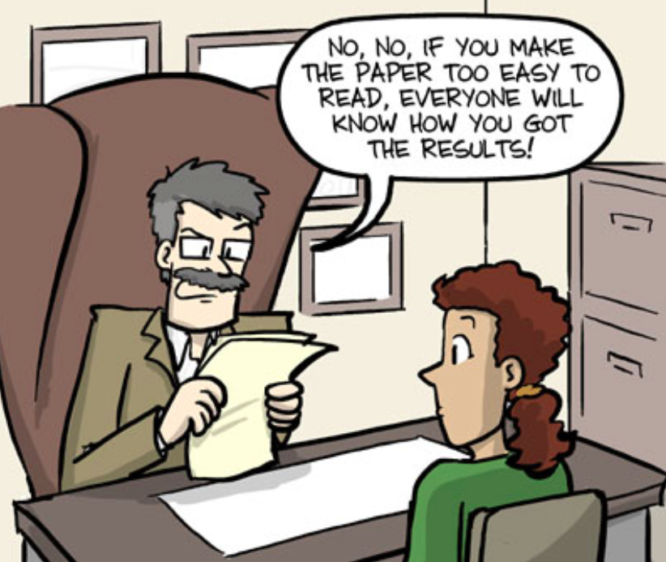
Writing Styles…..

Slide 18
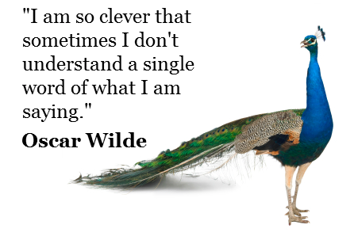

Slide 19
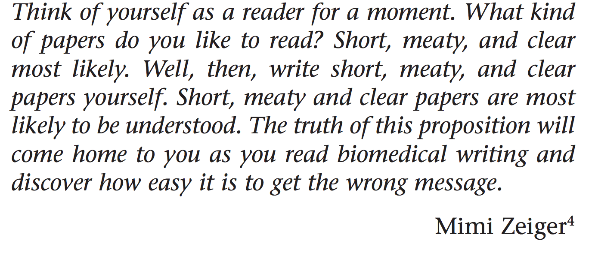
Writing your paper…..

Slide 20
Tips for high quality academic writing
Try to avoid the passive voice, e.g move away from “this was done” to “ we did this”
Avoid unnecessary adjectives, e.g. “we demonstrated a very large effect ….”
Remove the verb “ To be” where possible: e.g. “Evidence suggests….” rather than “ There is evidence to suggest…”
Keep paragraphs short
Remove unnecessary words
Guyat 2006, J Clin Epi, 59: 900-906

Slide 21
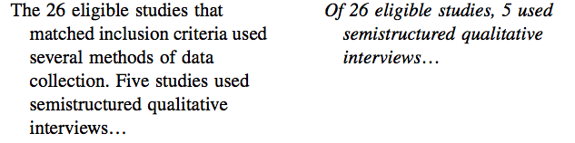

Slide 22
The abstract
Only convey the most interesting and important parts of your work
Most journals require you structure the abstract
Limit to 250 words (MEDLINE limit)
Results are supported by data and p values
Interpretation of findings is clearly stated in the conclusion

Slide 23
Start with the subheadings
Introduction
Methods
Results
Conclusions

Slide 24
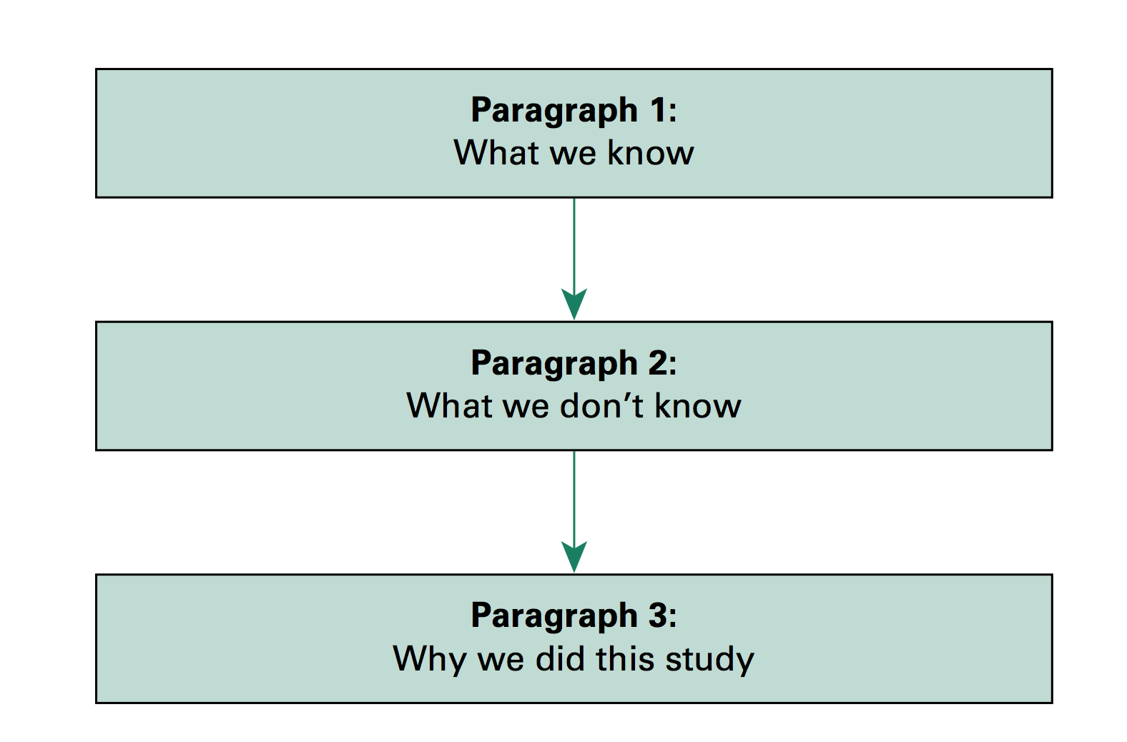
The introduction

Slide 25
Introduction
Draw the reader in
Decide on the level of background information needed; do not just repeat the obvious first line you have read in every paper
Be clear about what the problem you are addressing is and how your study proposes to answer this

Slide 26
Methods
Describe how you obtained your results in a way that others could replicate them (use CONSORT, STROBE or similar structure)
Study design
Participants
Sample size calculation
Define exposures and outcomes
Statistical analysis
Ethical approval

Slide 27
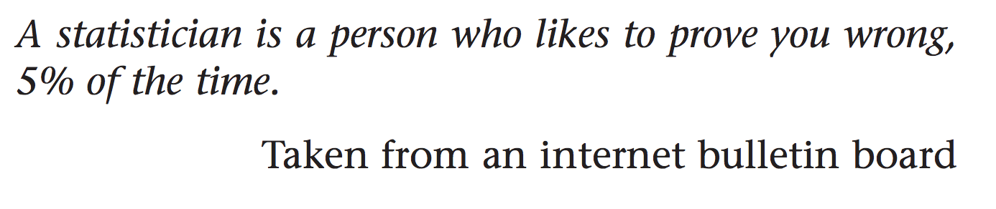

Slide 28
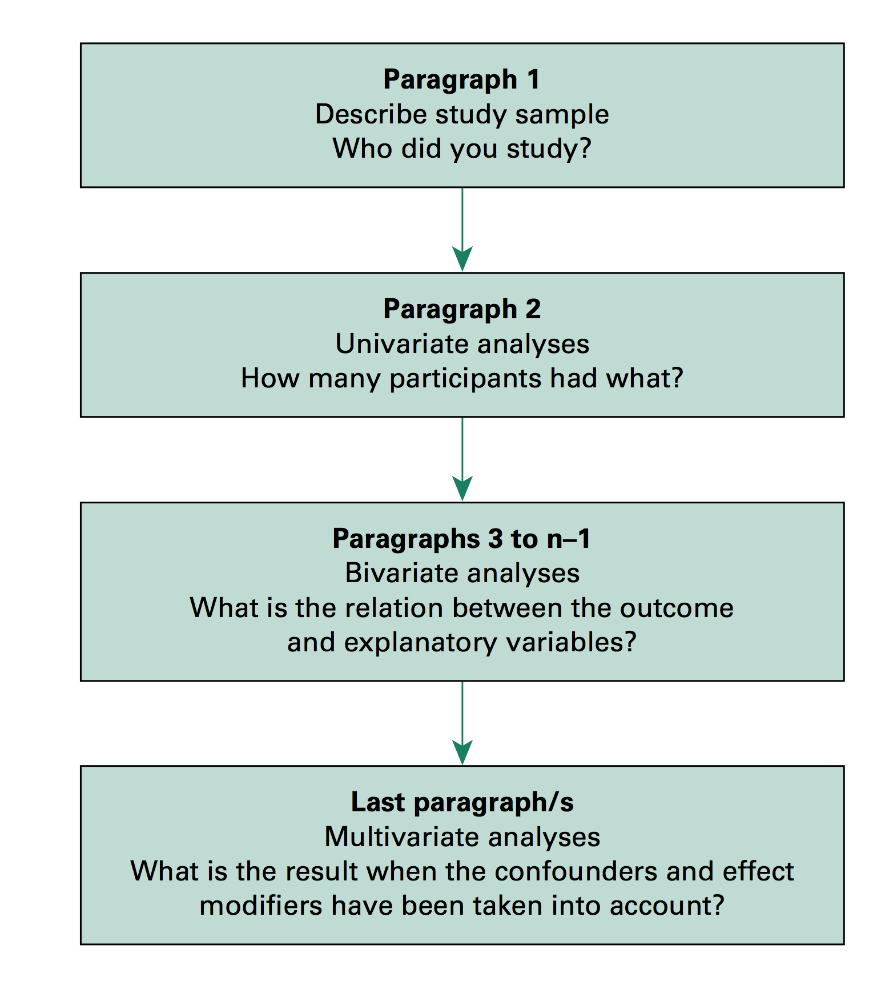
Results

Slide 29
Results
Be consistent with units and decimal places
Don’t just repeat what is in the tables: guide the reader systematically through the results highlighting important observations
Avoid ‘data dredging’: be aware of multiple comparisons and interpretation of significance
Always use a table for baseline characteristics and a flow diagram to describe participant selection and flow through the study
Present results in an objective and dispassionate way
  e.g: Not: “there was an extremely high incidence of disease in the study population”
  Better: “The incidence of disease was higher than has been measured previously”

Slide 30
Results
Never state there was a difference between the two groups if p > 0.05
A point estimate (e.g. odds ratio, relative risk etc) with confidence intervals is better as it gives an estimate of precision
Avoid confusing statements:
“The active group had a larger change from baseline than the control group, although the difference did not reach statistical significance”

Slide 31
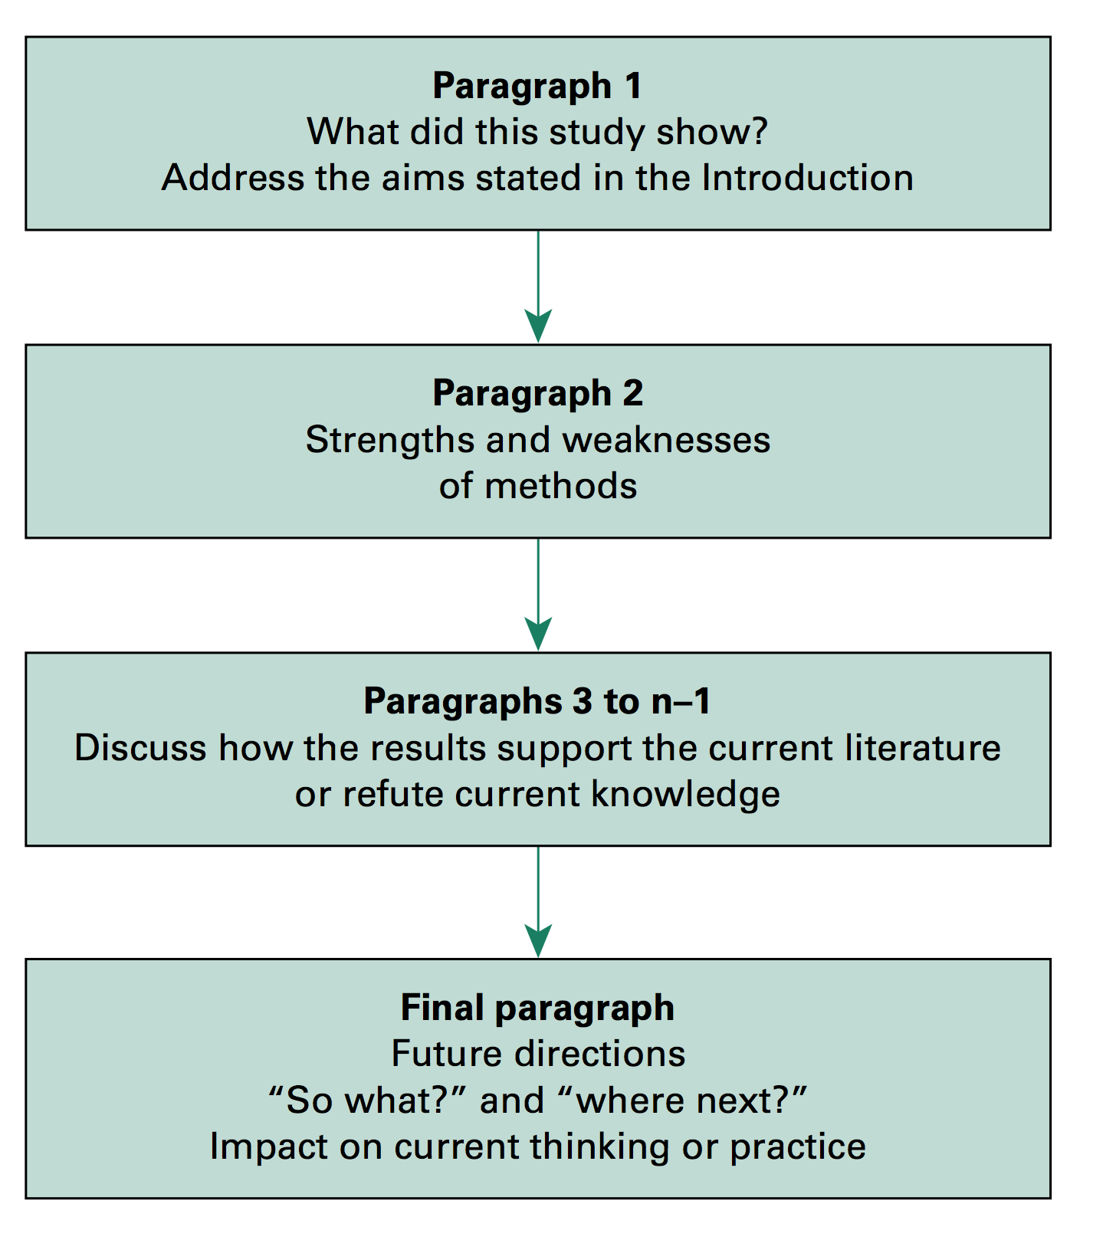
Discussion

Slide 32
Discussion
Good phrases to begin:
  “The results from this study showed that…
  “Our results indicate that….
  “The purpose of this study was to…and we…etc
Be bold, explain precisely what you have found and explain how it will add to current knowledge or change healthcare
Second paragraph address the strengths and limitations
Third paragraph should put the research in context of what is already known in the field

Slide 33
Conclusion
Try to avoid concluding that “further research is needed”
Think about how your research could change the way medicine is practiced and what this could mean for patients and health systems.
A good paper has answers the question it set out to study and has a clear message of how this adds to what is known

Slide 34
Co-author etiquette
If it’s your paper, you should be the first author
Often the main supervisor or principal investigator is last
Link those positions in between to relative contributions made following ICMR guidance for authorship
Shared 1st authorship is becoming more common
Notes:
Note choice of second and second to last is also important.

Slide 35

Submission and Peer review

Slide 36
Responses from editor:
Rejection, no reason or feedback given
Rejection after peer review
Opportunity to respond to reviewer comments and resubmit
Unconditional acceptance (also known as pigs flying…)

Slide 37
Responding to reviewer comments
Make sure you read the comments very carefully
Learn to accept criticism and learn from the experience
Try to remain dispassionate and objective
Respond to each point individually, with line number references to the changes you have subsequently made in your manuscript

Slide 38

Finding the right journal for your work

Slide 39
Conclusion
Scientific writing is a skill that we all have to learn
A structured approach and being clear about your main message is the key
Always use simple and non- emotive language, however keep your writing interesting and emphasise the bigger picture
Every one gets rejected
Keep trying!

