Slide 1






International technical guidance on sexuality education
Revised edition
MEETING
DATE
An evidence-informed approach
The Guidance at a glance

Slide 2

What is Comprehensive Sexuality Education (CSE?)
Revised edition
The Guidance at a glance
An evidence-informed approach
A curriculum-based process of teaching and learning about the cognitive, emotional, physical and social aspects of sexuality.
It aims to equips children and young people knowledge, skills, attitudes and values that will empower them to:
realize their health, well-being and dignity;
develop respectful social and sexual relationships;
consider how their choices affect their own wellbeing and that of others; and,
understand and ensure the protection of their rights throughout their lives.
What is CSE?
Why do young people need & want CSE?
What does the evidence say about CSE?
Why have technical Guidance on CSE?
What is the ITGSE?
Who is the Guidance for?
What’s new in the Guidance?
What’s in the revised Guidance?
Why use the Guidance?
Notes:
Please note that :
National policies and curricula may use different terms to refer to CSE. These include: prevention education, relationship and sexuality education, family-life education, HIV education, lifeskills education, healthy life styles and basic life safety.

Slide 3










What is Comprehensive Sexuality Education (CSE?)
Revised edition
The Guidance at a glance
An evidence-informed approach
CSE is education delivered in formal and non-formal settings that is:
Scientifically accurate
Based on a human rights approach
Incremental
Based on gender equality
Age and developmentally appropriate
Culturally relevant and context appropriate
Curriculum based
Transformative
Comprehensive
Able to develop life skills needed to support healthy choices
What is CSE?
Why do young people need & want CSE?
What does the evidence say about CSE?
Why have technical Guidance on CSE?
What is the ITGSE?
Who is the Guidance for?
What’s new in the Guidance?
What’s in the revised Guidance?
Why use the Guidance?
Notes:
Scientifically accurate: the content of CSE is based on facts and evidence related to SRH, sexuality and behaviours.
Incremental: CSE is a continuing educational process that starts at an early age, and where new information builds upon previous learning, using a spiral-curriculum approach.
Age and developmentally appropriate: the content of CSE is responsive to the changing needs and capabilities of the child and the young person as they grow. Based on the age and development of learners, CSE addresses developmentally relevant topics when it is most timely for their health and well-being. It accommodates developmental diversity; adapts content when cognitive and emotional development is delayed; and is presented when the internalization of SRH and relationship-related messages is most likely.
Curriculum based: CSE is included within a written curriculum that guides educators’ efforts to support students’ learning. The curriculum – which can be delivered in either in-school or out-of-school settings – includes key teaching objectives; the development of learning objectives; the presentation of concepts; and the delivery of clear key messages in a structured way.
Comprehensive: CSE provides opportunities to acquire comprehensive, accurate, evidence-informed and age-appropriate information on sexuality. It addresses sexual and reproductive health issues, including, but not limited to: sexual and reproductive anatomy and physiology; puberty and menstruation; reproduction, modern contraception, pregnancy and childbirth; and STIs, including HIV and AIDS. CSE covers the full range of topics that are important for all learners to know, including those that may be challenging in some social and cultural contexts. It supports learners’ empowerment by improving their analytical, communication and other life skills for health and well-being in relation to: sexuality, human rights, a healthy and respectful family life and interpersonal relationships, personal and shared values, cultural and social norms, gender equality, non-discrimination (including on the basis of sex, gender, sexual orientation and gender identity), sexual behaviour, violence and gender-based violence (GBV), consent and bodily integrity, sexual abuse and harmful practices such as child, early and forced marriage (CEFM) and female genital mutilation/ cutting (FGM/C). ‘Comprehensive’ also refers to the breadth and depth of topics and to content that is consistently delivered to learners over time, throughout their education, rather than a one-off lesson or intervention.
Based on a human rights approach: CSE builds on and promotes an understanding of universal human rights – including the rights of children and young people – and the rights of all persons to health, education, information equality and non-discrimination. Using a human rights-based approach within CSE also involves raising awareness among young people, encouraging them to recognize their own rights, acknowledge and respect the rights of others, and advocate for those whose rights are violated. Providing young people with equal access to CSE respects their right to the highest attainable standard of health, including safe,
responsible and respectful sexual choices free of coercion and violence, as well as their right to access the information that young people need for effective self-care.
Based on gender equality: the gender perspective is mainstreamed throughout CSE curricula and is integral to the effective delivery of CSE programmes. CSE addresses the different ways that gender norms can influence inequality, and how these inequalities can affect the overall health and well-being of children and young people, while also impacting efforts to prevent issues such as HIV, STIs, early and unintended pregnancies, and gender-based violence. CSE contributes to gender equality by building awareness of the centrality and diversity of gender in people’s lives; examining gender norms shaped by cultural, social and biological
differences and similarities; and by encouraging the creation of respectful and equitable relationships based on empathy and understanding.
Culturally relevant and context appropriate: CSE fosters respect and responsibility within relationships, supporting learners as they examine, understand and challenge the ways in which cultural structures, norms and behaviours affect people’s choices and relationships within a specific setting.
Transformative: CSE contributes to the formation of a fair and compassionate society by empowering individuals and communities, promoting critical thinking skills and strengthening young people’s citizenship. It provides learners with opportunities to explore and nurture positive values and attitudes towards SRH; and to develop self-esteem and respect for human rights and gender equality. Additionally, CSE empowers young people to take responsibility for their own decisions and behaviours, and the ways in which they may affect others. It builds the skills and attitudes that enable young people to treat others with respect, acceptance, tolerance and empathy, regardless of their ethnicity, race, social, economic or immigration status, religion, disability, sexual orientation, gender identity or expression, or sex characteristics.
Able to develop life skills needed to support healthy choices: this includes the ability to reflect and make informed decisions, communicate and negotiate effectively and demonstrate assertiveness. These skills can help children and young people form respectful and healthy relationships with family members, peers, friends and romantic or sexual partners.

Slide 4
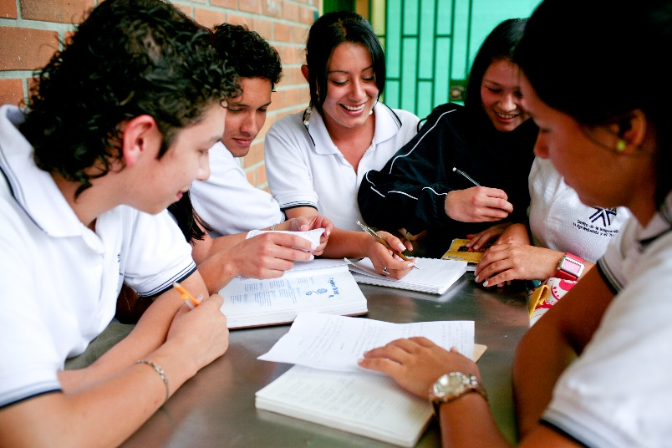

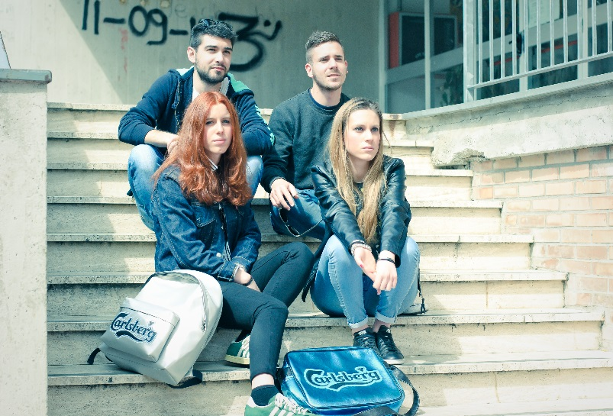
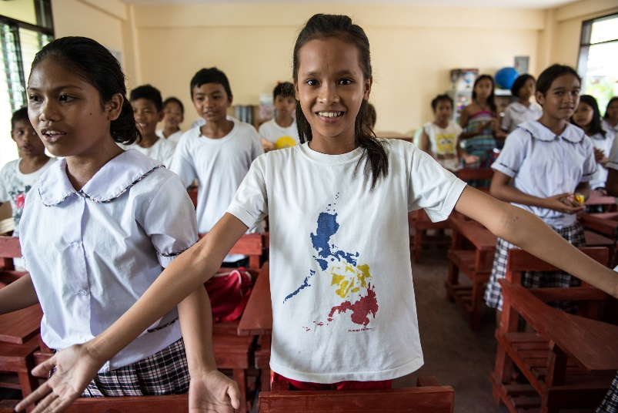
Revised edition
The Guidance at a glance
An evidence-informed approach
Why do young people need and want CSE?
In some parts of the world, two out of three girls reported having no idea of what was happening to them when they began menstruating.
Pregnancy and childbirth complications are the second cause of death among 15 to 19 year olds with approximately 70,000 adolescents affected annually.
Child, early and forced marriage is a risk factor – approximately 90 per cent of births to teenage mothers in developing countries occurs within marriage.
Every year, an estimated 246 million children are subject to some form of gender-based violence (GBV), including mistreatment, bullying, psychological abuse and sexual harassment, in or on the way to school.
Around 120 million girls worldwide (slightly more than 1 in 10) have experienced forced intercourse or other forced sexual acts or any other form of intimate partner violence at some point in their lives.
Globally, only 34 per cent of young people can demonstrate accurate knowledge about HIV prevention and transmission.
What is CSE?
Why do young people need & want CSE?
What does the evidence say about CSE?
Why have technical Guidance on CSE?
What is the ITGSE?
Who is the Guidance for?
What’s new in the Guidance?
What’s in the revised Guidance?
Why use the Guidance?

Slide 5
Revised edition
The Guidance at a glance
An evidence-informed approach
Why do young people need and want CSE?
Key sexual and reproductive health (SRH) issues that affect young people that can be addressed through CSE
Other key SRH issues that affect young people that can be addressed through CSE
Puberty
The influence of ICT on sexual behaviour
Poor mental/emotional health
Pregnancy
Alcohol, tobacco and drugs
Access to modern contraception
Subgroups of children and young people have specific SRH needs and other issues that can be addressed through CSE
Abortion (safe and unsafe)
Young people living with HIV (YPLHIV)
Violence, including gender-based violence
Young people living in poverty
HIV and AIDS
Young people with disabilities
LGBTI young people
Sexually transmitted infections (STIs)
Young people affected by humanitarian crisis
What is CSE?
Why do young people need & want CSE?
What does the evidence say about CSE?
Why have technical Guidance on CSE?
What is the ITGSE?
Who is the Guidance for?
What’s new in the Guidance?
What’s in the revised Guidance?
Why use the Guidance?
Notes:
Too many young people receive confusing and conflicting information about relationships and sex as they make the transition from childhood to adulthood. This has led to an increasing demand from young people for reliable information which prepares them for a safe, productive and fulfilling life.
CSE responds to this demand, empowering young people to make informed decisions about relationships and sexuality and helping them navigate a world where gender-based violence, gender inequality, early and unintended pregnancies, HIV and other sexually transmitted infections (STIs) still pose serious risks to their health and well-being.

Slide 6




Why do young people need and want CSE?
Revised edition
The Guidance at a glance
An evidence-informed approach
…because CSE:
Prepares them for a safe, productive, fulfilling life in a world where gender-based violence, gender inequality, early and unintended pregnancies, HIV and other sexually transmitted infections (STIs) still pose serious risks to their health and well-being.
Presents sexuality with a positive approach, emphasizing values such as respect, acceptance, tolerance, non-discrimination, equality, empathy, responsibility and reciprocity.
Provides age-appropriate and phased education about human rights, gender equality, relationships, reproduction, sexual behaviors risks and prevention of ill health.
What is CSE?
Why do young people need & want CSE?
What does the evidence say about CSE?
Why have technical Guidance on CSE?
What is the ITGSE?
Who is the Guidance for?
What’s new in the Guidance?
What’s in the revised Guidance?
Why use the Guidance?

Slide 7

What does the evidence say about CSE?
Revised edition
The Guidance at a glance
An evidence-informed approach
Comprehensive sexuality education has positive effects, including young people’s knowledge and improving their attitudes related to sexual and reproductive health and behaviour.
Sexuality education does not increase sexual activity, sexual risk-taking behaviour or STI/HIV infection rates
Abstinence-only programmes are not effective in delaying sexual initiation, reducing frequency of sex, or reducing number of sexual partners
What is CSE?
Why do young people need & want CSE?
What does the evidence say about CSE?
Why have technical Guidance on CSE?
What is the ITGSE?
Who is the Guidance for?
What’s new in the Guidance?
What’s in the revised Guidance?
Why use the Guidance?
Notes:
There is significant evidence on the positive impact of sexuality education on sexual behaviour and health. The main conclusions presented here are taken from two evidence review processes commissioned by UNESCO in 2008 and 2016. Overall, the evidence base for the effectiveness of school-based sexuality education continues to grow and strengthen, with many reviews reporting positive results on a range of outcomes The evidence emphasizes that:

Slide 8
What does the evidence say about CSE?
Revised edition
The Guidance at a glance
An evidence-informed approach
Gender-focused programmes are substantially more effective than ‘gender-blind’ programmes in achieving health outcomes, reducing unintended pregnancy or STIs.
Programmes that are comprehensive and delivered fully as intended are more likely to have the desired positive impact on young people’s health outcomes
Sexuality education is most impactful when school-based programmes are complemented with non-discriminatory, youth-friendly services and parental engagement
What is CSE?
Why do young people need & want CSE?
What does the evidence say about CSE?
Why have technical Guidance on CSE?
What is the ITGSE?
Who is the Guidance for?
What’s new in the Guidance?
What’s in the revised Guidance?
Why use the Guidance?

Slide 9




Why have technical guidance on CSE?
Revised edition
The Guidance at a glance
An evidence-informed approach
Enable national authorities to design comprehensive and relevant curricula and programmes.
Support all stakeholders with recommendations on how to equip young people with knowledge and skills to make responsible choices for their lives
Address misconceptions and concerns around CSE using empirical evidence and a human rights-based approach.
What is CSE?
Why do young people need & want CSE?
What does the evidence say about CSE?
Why have technical Guidance on CSE?
What is the ITGSE?
Who is the Guidance for?
What’s new in the Guidance?
What’s in the revised Guidance?
Why use the Guidance?
Notes:
4. There are common misconceptions and concerns that are sometimes raised when CSE programmes are initially proposed. A clear understanding of these questions and accurate responses are important, as education and health ministry staff, school principals and teachers may be unsure of the need for the education or health sector to provide CSE, or may be reluctant to provide CSE because they lack the confidence and skills to do so. To support Ministries of education and their partners in developing and delivering CSE, the UN has developed International Technical Guidance on Sexuality Education.

Slide 10


Common concerns or misconceptions
Revised edition
The Guidance at a glance
An evidence-informed approach
Response
Concerns
Response
CSE leads to early sexual initiation
CSE does not lead to early initiation or more sex, it leads to delayed initiation and more responsible sexual behaviour
Evidence shows that children benefit from scientifically accurate, non-judgmental and age- and developmentally-appropriate information through formal schooling.
CSE deprives children of their ‘innocence’
CSE goes against our culture or religion
CSE programmes should build support among the custodians of culture in order to adapt content to the local cultural context, while also addressing negative social norms and harmful practices that are not in line with human rights
Parents will object to sexuality education being taught in schools
CSE programmes are meant to work in partnership with and engage parents
What is CSE?
Why do young people need & want CSE?
What does the evidence say about CSE?
Why have technical Guidance on CSE?
What is the ITGSE?
Who is the Guidance for?
What’s new in the Guidance?
What’s in the revised Guidance?
Why use the Guidance?
Notes:
-Research from around the world clearly indicates that sexuality education rarely, if ever, leads to early sexual initiation. Research has shown that CSE has either no direct impact
on the age of sexual initiation, or that it actually leads to later and more responsible sexual behaviour.
-Evidence illustrates that children and young people benefit from receiving appropriate information that is scientifically accurate, non-judgmental and age- and developmentally appropriate, in a carefully planned process from the beginning of formal schooling. In the absence of CSE, children and young people can be vulnerable to conflicting and sometimes even damaging messages from their peers, the media or other sources. Good quality sexuality education provides complete and correct information with an emphasis on positive values and relationships. Sexuality education is about more than sex – it includes information about the body, puberty, relationships, life skills, etc.
-The Guidance stresses the need to engage and build support among the custodians of culture in a given community, in order to adapt the content to the local cultural context. Key
stakeholders, including religious leaders, can assist programme developers and providers to engage with the key values central to the relevant religions and cultures, as people’s
religious beliefs will inform what they do with the knowledge they possess. The Guidance also highlights the need to reflect on and address negative social norms and harmful
practices that are not in line with human rights or that increase vulnerability and risk, especially for girls and young women or other marginalized populations.
-Parents play a primary role in shaping key aspects of their children's sexual identity and their sexual and social relationships. Parents’ objections to CSE programmes in school are often based on fear and lack of information about CSE and its impact, as they want to be sure that messages about sexuality and SRH are rooted in the family’s values system. CSE programmes are not meant to take over the role of parents, but rather are meant to work in partnership with parents, and involve and support them.
-Most parents are among the strongest supporters of quality sexuality education programmes in schools. Many parents value external support to help them approach and
discuss ‘sex issues’ with their children, ways to react to difficult situations (e.g. when a child watches porn on the Internet or is bullied on social media) and how to access and provide
accurate information.

Slide 11
Revised edition
The Guidance at a glance
An evidence-informed approach
Common concerns or misconceptions
Response
Concerns
Response
Teaching CSE is too difficult for teachers
Most teachers have the skills or can be trained in CSE as included in national curricula
CSE is already covered in other subjects (biology, life-skills or civics education)
Effective CSE covers a comprehensive set of topics, attitudinal and skills-based learning outcomes which may not necessarily be included in other subjects
Young people already know everything about sex and sexuality through the Internet and social media
Online media doesn’t necessarily provide age-appropriate, evidence-based facts. CSE offers them a healthy space for discussion.
CSE is a means of recruiting young people towards alternative lifestyles
The main principle of CSE is that everyone, regardless of lifestyle, has the right to accurate information and services related to their health and well-being
What is CSE?
Why do young people need & want CSE?
What does the evidence say about CSE?
Why have technical Guidance on CSE?
What is the ITGSE?
Who is the Guidance for?
What’s new in the Guidance?
What’s in the revised Guidance?
Why use the Guidance?
Notes:
-Teaching and talking about sexuality can be challenging in social and cultural contexts where there are negative and contradictory messages about sex, gender and sexuality. At
the same time, most teachers and educators have the skills to build rapport with learners, to actively listen and help identify needs and concerns and to provide information. Teachers
can be trained in CSE content through participatory methodologies and are not expected to be experts on sexuality. This training can be included as part of the curriculum of teacher
training institutes (pre-service) or as in-service teacher training.
-Using the Guidance provides an opportunity to evaluate and strengthen the curriculum, teaching practice and the evidence, based on the dynamic and rapidly changing field of CSE,
and to ensure that schools fully cover a comprehensive set of topics and learning objectives, even if the learning is distributed across a range of school subjects. In addition, effective
CSE includes a number of attitudinal and skills-based learning outcomes which may not necessarily be included in other subjects.
The Internet and social media can be excellent ways for young people to access information and answers to their questions about sexuality. Young people often use online media
(including social media) because they are unable to quickly and conveniently access information elsewhere. However, online media doesn’t necessarily provide age-appropriate,
evidence-based facts and can in fact provide biased and distorted messages. It is difficult for young people to distinguish between accurate and inaccurate information. While
online media can offer a lot of information, it does not offer the space for young people to discuss, reflect and debate the issues, nor to develop the relevant skills. CSE offers a forum
for young people to understand and make sense of the images, practices, norms and sexual scripts that they observe via social media and pornography. It provides an opportunity to
learn about the aspects of sexuality that are absent from pornography, such as emotional intimacy, negotiating consent and discussing modern contraception. CSE can also support
young people to safely navigate the Internet and social media and can help them identify correct and fact-based information.
-The main principle of quality CSE is that everyone has the right to accurate information and services in order to achieve the highest standard of health and well-being, without
making judgement on sexual behaviour, sexual orientation, gender identity or health status. CSE takes a rights-based approach that is also focused on gender, and
acknowledges that people express themselves differently in all societies, sometimes not conforming to gender or social norms, including on the issue of sexual behaviour and sexual
orientation or gender identity. It does not endorse or campaign for any particular lifestyle other than promoting health and well-being for all.

Slide 12
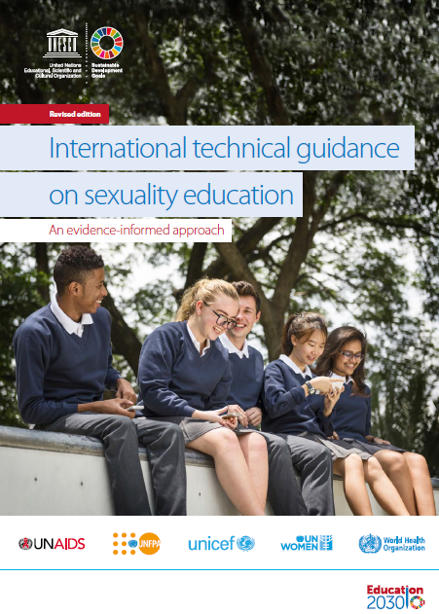



What is the International Technical Guidance on Sexuality Education?
Revised edition
The Guidance at a glance
An evidence-informed approach
Identifies the characteristics of effective CSE programmes
Recommends essential topics and learning objectives that should be covered in CSE curricula for learners aged 5 to 18+ years
Outlines approaches for planning, delivering and monitoring CSE programmes
The Guidance is voluntary and non-mandatory, based on current evidence and international best practice, and recognizes the diversity of national contexts in which sexuality education is taking place.
It was developed by UNESCO with UNAIDS, UNFPA, UNICEF, UN Women and WHO as a revised edition, based firmly on the original document published in 2009.
What is CSE?
Why do young people need & want CSE?
What does the evidence say about CSE?
Why have a technical Guidance on CSE?
What is the ITGSE?
Who is the Guidance for?
What’s new in the Guidance?
What’s in the revised Guidance?
Why use the Guidance?
Notes:
The International technical guidance on sexuality education is a technical tool that presents the evidence base and rationale for delivering CSE to young people in order to achieve global Sustainable Development Goals. The Guidance identifies the characteristics of effective comprehensive sexuality education programmes; recommends essential topics and learning objectives that should be covered in CSE curricula for all learners; and, outlines approaches for planning, delivering and
monitoring CSE programmes.
Its purpose is to support curriculum developers and programme managers to create and adapt CSE curricula that is appropriate to their context, along with effective implementation and monitoring measures. It is also a resource for advocacy in favour of young people's health and well-being. The Guidance was developed through a consultative process aimed at ensuring quality, acceptability and ownership, with inputs from practitioners and experts, including young people, from different regions around the world.

Slide 13





Who is the Guidance for?
Revised edition
The Guidance at a glance
An evidence-informed approach
Health and other relevant authorities
Governments and ministries (education, health, gender equality among others)
Non-governmental organizations
Youth workers and young people can also use the document as an advocacy tool
What is CSE?
Why do young people need & want CSE?
What does the evidence say about CSE?
Why have a technical Guidance on CSE?
What is the ITGSE?
Who is the Guidance for?
What’s new in the Guidance?
What’s in the revised Guidance?
Why use the Guidance?
Notes:
The Guidance is for practitioners involved in the design, delivery and evaluation of sexuality education programmes both in and out of school, including:
(SLIDE ABOVE)

Slide 14







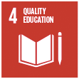
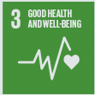
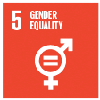
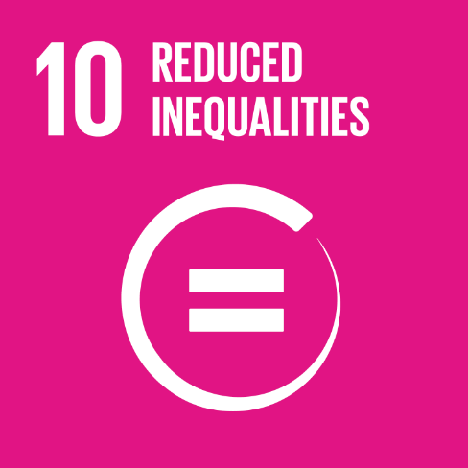

What’s new in the Guidance?
Revised edition
The Guidance at a glance
An evidence-informed approach
The latest evidence and lessons learned from implementing CSE programmes across diverse education settings.
Presents sexuality with a positive approach
Recognizes that CSE goes beyond educating about reproduction, risks and disease
Key concepts, topics and learning objectives that have been enhanced and expanded
Reaffirms the position of CSE within a framework of human rights and gender equality
A deeper understanding of the relevance of CSE to young people’s healthy development and overall well-being
Reflects the contribution of CSE to the realization of multiple Sustainable Development Goals, including
What is CSE?
Why do young people need & want CSE?
What does the evidence say about CSE?
Why have a technical Guidance on CSE?
What is the ITGSE?
Who is the Guidance for?
What’s new in the Guidance?
What’s in the revised Guidance?
Why use the Guidance?
Notes:
This revised edition builds on the original document published in 2009. It has been reviewed and updated to apply the latest evidence and lessons learned from implementing sexuality education programmes across diverse education settings. The key concepts, topics and learning objectives of the Guidance have been enhanced and expanded to reflect a deeper understanding of the relevance of CSE to young people’s healthy development and overall well-being.
The revised Guidance presents sexuality with a positive approach, recognizing that CSE goes beyond educating about reproduction, risks and disease. It reaffirms the position of sexuality education within a framework of human rights and gender equality, and reflects the contribution of sexuality education to the realization of multiple Sustainable Development Goals, notably Goal 3 on good health and well-being for all, Goal 4 on quality education for all, and Goal 5 to achieve gender equality

Slide 15
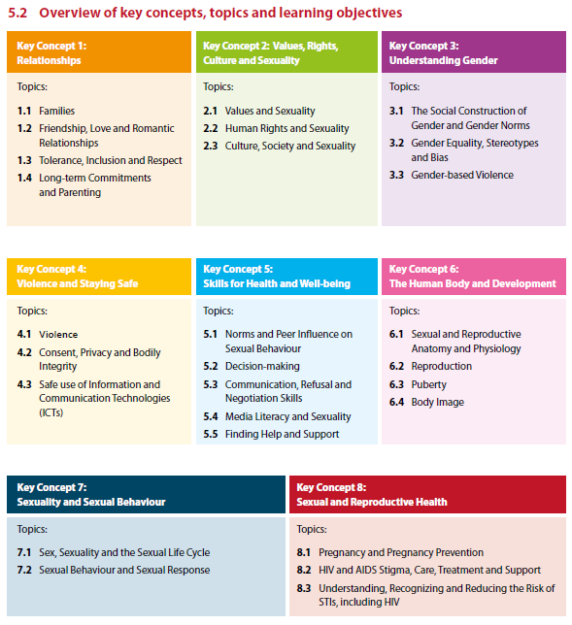
What’s in the revised Guidance?
Revised edition
The Guidance at a glance
An evidence-informed approach
A comprehensive set of key concepts, topics and illustrative learning objectives to guide the development of locally-adapted curricula
Learning objectives that are age –appropriate and logically sequenced to become increasingly complex with age and developmental ability across four age groups (5-8 years; 9-12 years; 12-15 years and 15-18+ years)
8 key concepts taught simultaneously and focused on 3 domains of learning: knowledge, attitudes and skills
What is CSE?
Why do young people need & want CSE?
What does the evidence say about CSE?
Why have a technical Guidance on CSE?
What is the ITGSE?
Who is the Guidance for?
What’s new in the Guidance?
What’s in the revised Guidance?
Why use the Guidance?

Slide 16
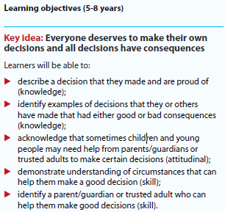
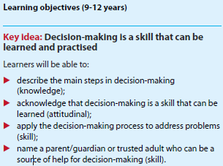
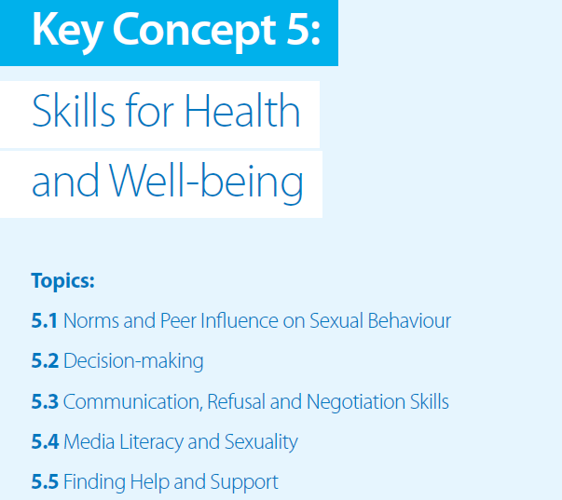
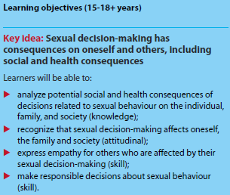
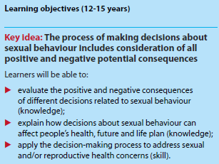
What’s in the revised Guidance?
Revised edition
The Guidance at a glance
An evidence-informed approach
Example of a key concept, topics and learning objectives
What is CSE?
Why do young people need & want CSE?
What does the evidence say about CSE?
Why have a technical Guidance on CSE?
What is the ITGSE?
Who is the Guidance for?
What’s new in the Guidance?
What’s in the revised Guidance?
Why use the Guidance?
Notes:
Here is one example of a key concept that demonstrates the spiral curriculum approach across age groups and covering the 3 domains of learning: knowledge, skills and attitudes

Slide 17
What’s in the revised Guidance?
Revised edition
The Guidance at a glance
An evidence-informed approach
Building support and planning for the implementation of CSE programmes
Building support through:
CSE programme implementation through:
Use evidence that demonstrates young people's existing needs within the national/local context
Use existing international, regional and local frameworks and international agreements that support CSE
Share arguments on the importance of the social and emotional well-being of children and young people
National level
Community level
School level
What is CSE?
Why do young people need & want CSE?
What does the evidence say about CSE?
Why have a technical Guidance on CSE?
What is the ITGSE?
Who is the Guidance for?
What’s new in the Guidance?
What’s in the revised Guidance?
Why use the Guidance?
Notes:
In addition to the revised and expanded Key concepts, topics and learning objectives, the revised guidance also includes other updated content, including recommendations for uilding support and planning for the implementation of CSE programmes
BUILDING SUPPORT THROUGH:
Despite the clear and pressing need for effective CSE, it remains unavailable in many countries throughout the world. There are many reasons for this, including perceived or anticipated resistance to CSE programmes, resulting from misunderstandings about the nature, purpose and effects of sexuality education. It is important to address this resistance, real or perceived, in order to include CSE on the agenda.
The following points can help establish a clear rationale for the introduction and national roll out of CSE:
(SLIDE ABOVE)
---------------
CSE PROGRAMME IMPLEMENTATION THROUGH:
National and regional level
Local education ministries
National policy
Community level
Diverse groups of stakeholders in the community, including faith-based organizations and nongovernmental organizations (NGOs)
Parents
Media and other gatekeepers
Health providers
School level
Role of school authority and management
Role of health providers and other non-teaching staff operating within the school setting
Role of students in school

Slide 18
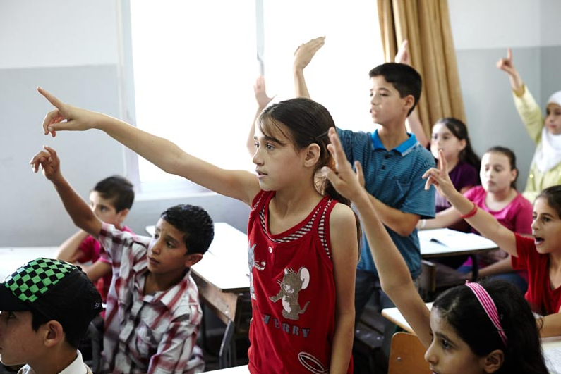
What’s in the revised Guidance?
Revised edition
The Guidance at a glance
An evidence-informed approach
Delivering effective CSE programmes
Developing effective curriculum (preparatory phase and content development)
Designing and implementing CSE programmes (stand-alone or integrate)
Monitoring and evaluation of CSE programmes
Scaling-up CSE programmes
What is CSE?
Why do young people need & want CSE?
What does the evidence say about CSE?
Why have a technical Guidance on CSE?
What is the ITGSE?
Who is the Guidance for?
What’s new in the Guidance?
What’s in the revised Guidance?
Why use the Guidance?
Notes:
…And evidence-based recommendations on delivering effective CSE national programmes
1. DEVELOPPING EFFECTIVE CURRICULUM (preparatory phase and content development):
Preparatory phase
1. Involve experts on human sexuality, behaviour change and related pedagogical theory.
2. Involve young people, parents/family members and other community stakeholders.
3. Assess the social, SRH needs and behaviours of children and young people targeted by the programme, based on their
evolving capacities.
4. Assess the resources (human, time and financial) available to develop and implement the curricula.
Content development
5. Focus on clear goals, outcomes and key learnings to determine the content, approach and activities.
6. Cover topics in a logical sequence.
7. Design activities that are context-oriented and promote critical thinking.
8. Address consent and life skills.
9. Provide scientifically accurate information about HIV and AIDS and other STIs, pregnancy prevention, early and unintended
pregnancy and the effectiveness and availability of different methods of protection.
10. Address how biological experiences, gender and cultural norms affect the way children and young people experience and
navigate their sexuality and their SRH in general.
11. Address specific risk and protective factors that affect particular sexual behaviours.
12. Address how to manage specific situations that might lead to HIV infection, other STIs, unwanted or unprotected sexual
intercourse or violence.
13. Address individual attitudes and peer norms concerning condoms and the full range of contraceptives.
14. Provide information about what services are available to address the health needs of children and young people, especially
their SRH needs.
2. DESIGNING AND IMPLEMENTING CSE PROGRAMMES (stand-alone or integrate)
Decide whether to use a stand-alone or integrated programme
Include multiple, sequential sessions over several years
Pilot test the CSE curriculum
Employ participatory teaching methods that actively involve children and young people and help them internalize and integrate information
Select capable and motivated educators to implement the curriculum in schools and non-formal settings
Provide educators with sensitization, values clarification, quality pre- and on-the-job training and continuous professional development opportunities
Ensure confidentiality, privacy and a safe environment for all children and young people
Implement multicomponent initiatives
Assess the appropriateness of using digital media as a delivery mechanism
Maintain quality when replicating a CSE programme
3. MONITORING AND EVALUATION OF CSE PROGRAMMES
Assess the programme and obtain ongoing feedback from schools, communities, educators and learners about how the programme is achieving its outcomes
Integrate one or more key indicators in national education monitoring systems to ensure systematic measurement of the delivery of sexuality education
Evaluate the outcomes and impact of the programme
SCALING-UP CSE PROGRAMMES
1. Choose an intervention/approach that can be scaled up within existing systems.
2. Clarify the aims of scaling up and the roles of different players, and ensure local/national ownership/lead role.
3. Understand perceived need and fit within existing governmental systems and policies.
4. Obtain and disseminate data on the effectiveness of pilot programmes before scaling up.
5. Document and evaluate the impact of changes made to interventions on programme effectiveness.
6. Recognize the role of leadership.
7. Plan for sustainability and ensure the availability of resources for scaling up or plan for fundraising.
8. Plan for the long-term (not donor funding cycles) and anticipate changes and setbacks.
9. Anticipate the need for changes in the ‘resource team’ leading the scaling up process over time.
10. Adapt the scaling up strategy with changes in the political environment; take advantage of ‘policy windows’ when
they occur.

Slide 19
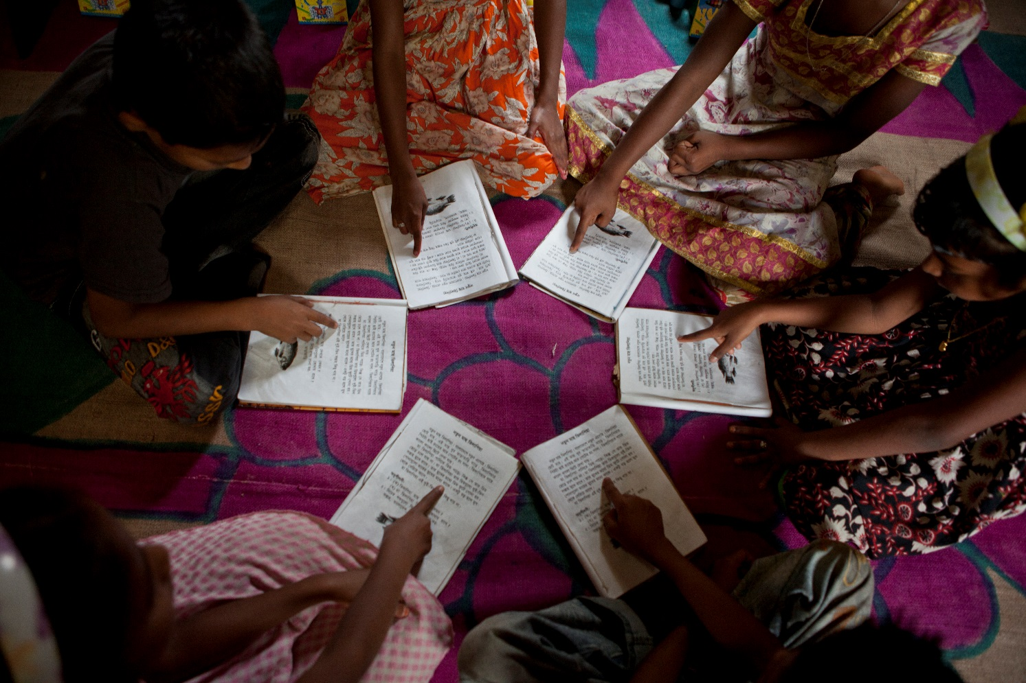
The ITGSE revision process
Revised edition
The Guidance at a glance
An evidence-informed approach
This revised edition
is based on a new review of evidence, together with a review of curricula and curricula frameworks, both commissioned by UNESCO in 2016;
was developed with input from a CSE Advisory group comprised of technical experts from across the globe, working in the fields of education, health, youth development, human rights and gender equality;
involved broad consultation, including: through an online survey of user perspectives on the original Guidance; targeted focus group discussions at country level; and, a global stakeholder consultation meeting in 2016.
What is CSE?
Why do young people need & want CSE?
What does the evidence say about CSE?
Why have a technical Guidance on CSE?
What is the ITGSE?
Who is the Guidance for?
What’s new in the Guidance?
What’s in the revised Guidance?
Why use the Guidance?
Notes:
This revised publication is based on a new review of evidence, together with a review of curricula and curricula frameworks, both commissioned by UNESCO in 2016. The new evidence review was conducted by Professor Paul Montgomery and
Wendy Knerr of University of Oxford Centre for Evidence- Based Intervention, UK (referenced as UNESCO 2016b) in this Guidance. The review of curricula and curricular frameworks was carried out by Advocates for Youth, USA (referenced as
UNESCO 2017c).
UNESCO also convened an advisory group in order to oversee and guide the revisions of this volume. The Comprehensive Sexuality Education Advisory Group comprised technical experts from across the globe, working in the fields of education, health, youth development, human rights and gender equality. It included researchers, ministry of education officials, young people, NGO programme implementers and development partners. In order to gather input from multiple stakeholders, and to assess the use and usefulness of the original Guidance among its intended audience, the revision process also involved an online survey of user perspectives on the original Guidance; targeted focus group discussions at country level; and a global stakeholder consultation meeting. This revised version is therefore based on wideranging expert inputs, including the voices of young people, and an understanding of existing best practices

Slide 20
Why use the Guidance?
Revised edition
The Guidance at a glance
An evidence-informed approach
The Guidance will enable users to:
gain a clear understanding of CSE, the need for CSE and the desired positive outcomes of CSE;
clarify misunderstanding and address misconceptions as to the purpose and nature of CSE;
share evidence and research-based recommendations to guide policy-makers, educators and curriculum developers in designing good quality CSE programmes;
develop relevant, evidence-informed, age- and developmentally-appropriate CSE curricula, teaching and learning materials and programmes that are culturally responsive;
build support for CSE at community and school levels;
increase awareness, through CSE, about relevant sexual and reproductive health issues that impact children and young people.
What is CSE?
Why do young people need & want CSE?
What does the evidence say about CSE?
Why have a technical Guidance on CSE?
What is the ITGSE?
Who is the Guidance for?
What’s new in the Guidance?
What’s in the revised Guidance?
Why use the Guidance?

Slide 21
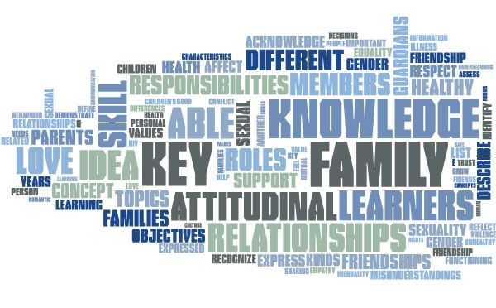
Revised edition
The Guidance at a glance
An evidence-informed approach
Thank you
Learn more: www.unesco.org/education
@UNESCO
en.unesco.org/themes/education-21st-century
What is CSE?
Why do young people need & want CSE?
What does the evidence say about CSE?
Why have a technical Guidance on CSE?
What is the ITGSE?
Who is the Guidance for?
What’s new in the Guidance?
What’s in the revised Guidance?
Why use the Guidance?

Slide 22

Revised edition
The Guidance at a glance
An evidence-informed approach
Questions?
What is CSE?
Why do young people need & want CSE?
What does the evidence say about CSE?
Why have a technical Guidance on CSE?
What is the ITGSE?
Who is the Guidance for?
What’s new in the Guidance?
What’s in the revised Guidance?
Why use the Guidance?

