Slide 1
CONTRACEPTION COUNSELLING AND PROVISION
Geneva 2022
Dr Venkatraman Chandra-Mouli
Notes:
This module addresses the provision of contraceptive counselling and services.

Slide 2
DEFINITION
Contraception is the intentional prevention of pregnancy by artificial or natural means.
It enables people to attain their desired number of children, & to determine the spacing of their pregnancies by delaying or preventing child bearing.
Contraceptive methods are designated by duration & context of use (permanent, long acting, short-term or emergency) & by mode of operation (hormonal, non-hormonal, barrier or fertility awareness-based).
Notes:
This slide carries a definition of contraception.

Slide 3
RATIONALE – 1/2
Early pregnancies, both intended or unintended, among adolescents are an important problem: An estimated 21 million girls aged 15-19 years become pregnant.¹ An estimated 12 million girls aged 15-19 years and 2.5 million girls under age 16 in LMICs give birth every year. ^{1,2} Approximately half of pregnancies to girls aged 15–19 years in developing regions are unintended.¹
Early pregnancies among adolescents have major health and social consequences: Pregnancy & childbirth complications are the leading cause of deaths among girls aged 15-19 years globally.³ Girls aged 10-19 face higher risks of eclampsia, puerperal endometritis and systemic infections than women aged 20-24.⁴ An estimated 5.7 million girls aged 15-19 have an abortion, the majority of which are unsafe.¹ Babies born to mothers under 20 years of age face higher risks of low birth weight, preterm delivery and severe neonatal conditions.⁴
Notes:
References:
Guttmacher Institute. Fact sheet: Adding it up: Investing in adolescents’ sexual and reproductive health in low- and middle-income countries. New York: Guttmacher Institute; 2019.
Neal S, Matthews Z, Frost M, Fogstad H, Camacho AV, Laski L. Childbearing in adolescents aged 12–15 years in low resource countries: a neglected issue – new estimates from demographic and household surveys in 42 countries. Acta Obstet Gynecol Scand. 2012;91(9):1114–1118.
WHO. Adolescents: Health Risks and Solutions. Geneva: WHO; 2018. Available from: www.who.int/news-room/fact-sheets/detail/adolescents-health-risks-and-solutions
Ganchimeg T, Ota E, Morisaki N, Laopaiboon M, Lumbiganon P, Zhang J, et al. Pregnancy and childbirth outcomes among adolescent mothers: a World Health Organization multicountry study. BJOG. 2014;121(Suppl. 1):40–48.

Slide 4
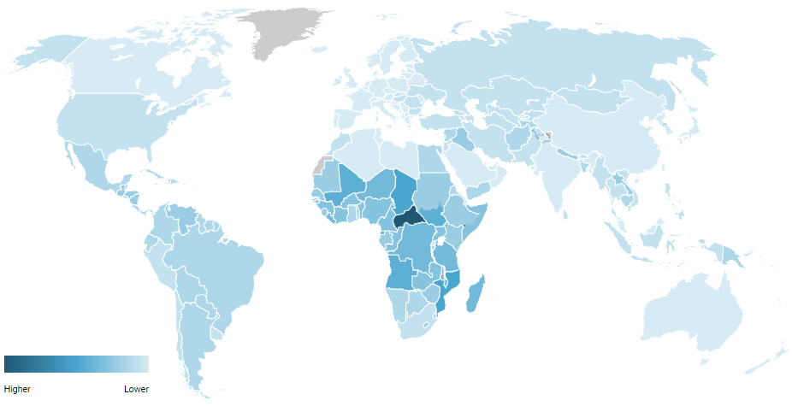
Adolescent birth rate per 1,000 women aged 15-19 years
Central and Southern Asia | 26.2
Eastern and South-Eastern Asia | 20.4
Latin America and the Caribbean | 63.0
Northern Africa and Western Asia | 40.5
Sub-Saharan Africa | 104.4
Reference 2
Reference 1
Notes:
References:
UNFPA. World Population Dashboard: Adolescent birth rate. New York: UNFPA; 2020. Available from: https://www.unfpa.org/data/world-population-dashboard
UNPD. Adolescent birth rate per 1,000 women aged 15-19 between 2010-2017. New York: UN Population Division (no date). Available from: https://www.un.org/development/desa/pd/node/3282

Slide 5
RATIONALE – 2/2
Promotion of contraceptive use to address early pregnancies among adolescents has been shown to be effective: When correctly & consistently used, contraceptives can prevent unintended pregnancies & thereby reduce maternal & newborn mortality & morbidity. Male & female condoms can protect against both unintended pregnancies & HIV/STI.
Laws & policies, & the provision of good-quality services need attention: 14 million girls aged 15-19 years have an unmet need for modern contraception.¹ Contraceptive use in sexually active adolescents is lower than in other age groups because of lack of knowledge, knowledge gaps and misconceptions, difficulties in being able to obtain contraceptive services/commodities, & difficulties in wanting to/being able to use them correctly & consistently.
Notes:
References:
Guttmacher Institute. Fact sheet: Adding it up: Investing in adolescents’ sexual and reproductive health in low- and middle-income countries. New York: Guttmacher Institute; 2019.

Slide 6
HUMAN RIGHTS OBLIGATIONS
States are obliged under human rights law to provide contraceptive information & services to adolescents, & to adopt legal & policy measure to ensure their access to affordable, safe and effective contraception.
Contraceptive information & services should be free, confidential, adolescent-responsive and non-discriminatory; barriers such as third party authorization requirements should be removed.
Adolescents should have easy access to the full range of contraceptive; such access must not be hampered by marital status or providers’ conscientious objections.
Notes:
This slide lists the human rights obligations of countries in relation to contraception.

Slide 7
KEY CONCEPTS TO CONSIDER -1/2
Laws & policies prevent the provision of contraception based on age or marital status in many countries: Critical to adolescent-friendly service provision are laws & policies that support their access to contraception regardless of age or marital status, & without third-party authorization/notification.
Many adolescents have misconceptions about contraception or do not know where & how to obtain contraceptive information & services: CSE is an effective way to reach & inform adolescents about contraception. It should be complemented by reaching out to parents, teachers & other gatekeepers.
Notes:
This is the first of two slides that set out key concepts to consider in planning and implementing programmes.

Slide 8
KEY CONCEPTS TO CONSIDER – 2/2
Contraceptive services & health-care providers are often not adolescent friendly: There is a need to overcome health-care provider biases and misconceptions regarding contraceptive use by adolescents.
The contraceptive needs of adolescents are diverse & evolving: Complementary strategies must be used to respond to the differing needs & preferences of adolescents. Additionally, programmes must address the needs of special population of adolescents (e.g., those with disabilities, migrants and refugees).
Notes:
This slide continues with key concepts to consider in planning and implementing programmes.

Slide 9
WHO GUIDELINES
WHO guidelines on preventing early pregnancy & poor reproductive outcomes among adolescents in developing countries (2011)
Medical eligibility criteria for contraceptive use, 5th edition (2015)
Selected practice recommendations for contraceptive use (2016)
Ensuring human rights in the provision of contraceptive information & services: guidance & recommendations (2014)
WHO consolidated guideline on self-care interventions for health: sexual and reproductive health and rights (2019)
Consolidated guideline on sexual & reproductive health & rights of women living with HIV (2017)
Guidance statement: hormonal contraceptive eligibility for women at high risk of HIV (2017)
WHO recommendations on health promotion interventions for maternal & newborn health (2015)
Responding to children & adolescents who have been sexually abused: WHO clinical guidelines (2017)
Responding to intimate partner violence & sexual violence against women: WHO clinical and policy guidelines (2013)
Notes:
This slide lists the array of WHO guidelines which address contraception in adolescents – either exclusively or as part of a broader treatment of the subject. All these guidelines are available online.

Slide 10
COMPLEMENTARY GUIDELINES TO WHO’s GUIDELINES
Medical eligibility criteria application for contraceptive use (WHO, 2019)
Medical eligibility criteria wheel for contraceptive use (WHO, 2015)
Family planning: a global handbook for providers, 2018 edition (WHO, 2018)
Information note on self-administration of injectable contraception (WHO, 2020)
Training resource package for family planning (WHO, 2021)
Task sharing to improve access to family planning/contraception: summary brief (WHO, 2017)
Compendium of WHO recommendations for postpartum family planning (WHO, 2016)
Reducing early and unintended pregnancies among adolescents: evidence brief (WHO, 2017)
Adolescents and family planning: what the evidence shows (ICRW, 2014)
High-impact Practices (HIPS) in family planning: Adolescent-friendly contraceptive services - mainstreaming adolescent-friendly elements into existing contraceptive services (USAID, 2015)
Youth contraceptive use: effective interventions- a reference guide (PRB, 2017)
Global consensus statement for expanding contraceptive choice for adolescents and youth to include long-acting reversible contraception (FP 2020, 2017).

Slide 11
Impact of COVID-19 on family planning
COVID-19 is impacting family planning provision and demand. UNFPA projections indicate the following:
Clinical staff occupied with the COVID-19 response may not have time to provide services, or may lack personal protective equipment to provide services safely
Health facilities in many places are closing or limiting services
Women are refraining from visiting health facilities due to fears about COVID-19 exposure or due to movement restrictions
Supply chain disruptions are limiting availability of contraceptives in many places, and stock-outs of many contraceptive methods are anticipated within the next 6 months in more than a dozen lowest income countries
Product shortages and lack of access to trained providers or clinics mean that women may be unable to use their preferred method of contraception, may instead use a less effective short-term method, or may discontinue contraceptive use entirely
Notes:
Reference:
UNFPA. Impact of the COVID-19 Pandemic on Family Planning and Ending Gender-based Violence, Female Genital Mutilation and Child Marriage. April 2020. https://www.unfpa.org/sites/default/files/resource-pdf/COVID-19_impact_brief_for_UNFPA_24_April_2020_1.pdf

Slide 12
UNFPA projections for contraceptive disruptions due to COVID-19
Some 47 million women in 114 low- and middle-income countries are projected to be unable to use modern contraceptives if the average lockdown, or COVID-19-related disruption, continues for 6 months with major disruptions to services
For every 3 months the lockdown continues, assuming high levels of disruption, up to 2 million additional women may be unable to use modern contraceptives
If the lockdown continues for 6 months and there are major service disruptions due to COVID-19, an additional 7 million unintended pregnancies are expected to occur
Notes:
Reference:
UNFPA. Impact of the COVID-19 Pandemic on Family Planning and Ending Gender-based Violence, Female Genital Mutilation and Child Marriage. April 2020. https://www.unfpa.org/sites/default/files/resource-pdf/COVID-19_impact_brief_for_UNFPA_24_April_2020_1.pdf

Slide 13
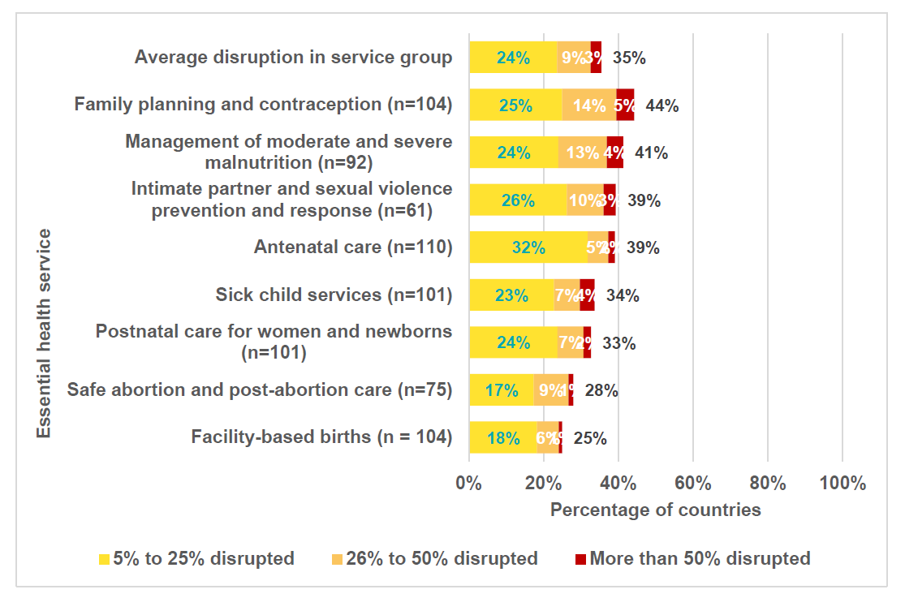
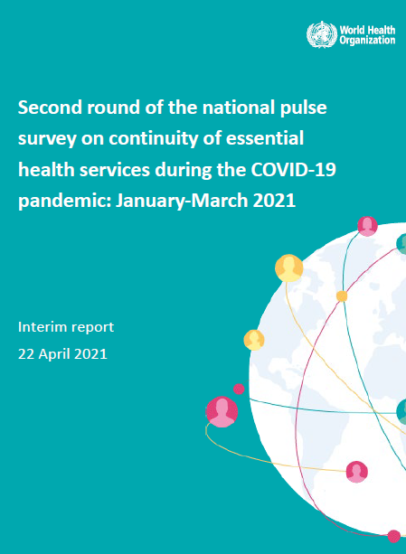
Evidence on the impact of COVID-19 on contraception
PULSE SURVEY: Round 2
On average, 35% of countries reported disruptions across RMNCAH and nutrition services. The most frequently disrupted services were family planning and contraception services.
Notes:
Reference:
World Health Organization. Second round of the national pulse survey on continuity of essential health services during the COVID-19 pandemic: interim report, 22 April 2021. World Health Organization; 2021.

Slide 14
Specific measures for delivery of services in the context of COVID-19 – 1/2
Inform adolescents where and how to access contraceptive counselling and services, including changes, if any, to service delivery times, location, etc. during the COVID-19 response.
In health facilities, ensure that adolescents have access to the full range of contraceptive methods, including condoms and emergency contraception.
Ensure that forecasting for commodities and procurement planning are taking adolescents’ needs into account, and adjust for potential alterations in method choice.
In case the preferred method is not available, support the adolescent to identify an alternative method that meets his/her needs and preferences.
Consider waiving restrictions (if restrictions exist), such as those based on age, marital status or parental/spousal consent, and providing services free of charge within the relevant legal jurisdiction and in line with international guidelines.
Notes:
This slide continues with key concepts to consider in planning and implementing programmes.

Slide 15
Specific measures for delivery of services in the context of COVID-19 – 2/2
Consider providing multi-month supplies with clear information about the method and how to access referral care for adverse reactions.
Counselling and services should continue to be provided discreetly and confidentially to adolescents, especially if someone else accompanies the adolescent to the consultation’.
Consider establishing alternative delivery modalities for contraceptives that are more accessible to adolescents (such as through pharmacies, shops or community-based delivery).
Consider setting up hotlines for adolescents providing information and advice on contraception self-use, side effects, method choice and other questions on SRHR.
Notes:
This slide continues with key concepts to consider in planning and implementing programmes.

Slide 16
Considerations for resumption of normal services in the context of COVID-19
Enable adolescents who had to pause contraceptive use or change methods, because their preferred method was unavailable, to return to it.
Where possible, promote the institutionalization of good practices in improving accessibility and quality that were put in place during the period of closures and disruption.
Notes:
This slide continues with key concepts to consider in planning and implementing programmes.

Slide 17
Notes:
Health workers in many places do not provide contraceptives to adolescents before they have children, falsely believing that this can contribute to infertility.

Slide 18
CONTRACEPTION , COUNSELLING AND
PROVISION
A REGIONAL PERSPECTIVE
Access to contraceptives for adolescents has been shown to promote autonomy and decision-making abilities, improve partner communication, and empower young women to lead healthy and productive lives (UNFPA, 2013).

Slide 19
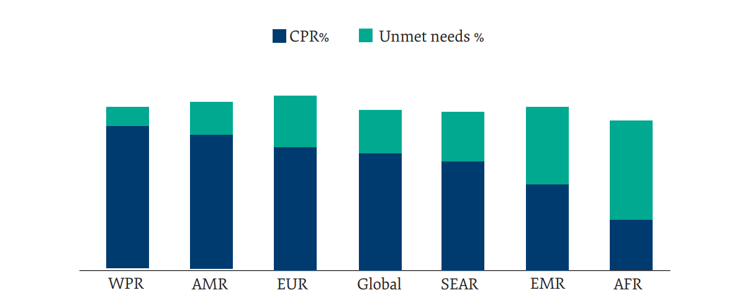
Key facts from the Region
Key Indicators
The EMR has the second lowest contraceptive prevalence rate (CPR) (48%) and the second highest unmet need for family planning (FP) globally, after the African Region.¹
Ten Member States have an unmet need for FP exceeding 20%.
Nine Member States (Afghanistan, Djibouti, Oman, Pakistan, Qatar, Saudi Arabia, Somalia, Sudan and Yemen) have a lower CPR than the regional average.¹
Much of the unmet need for FP in the Region is among married women and girls. This is compounded by the high rate of early marriages.²
Notes:
References:
Das Shrestha B, Ali M, Mahaini R, Gholbzouri K. A review of family planning policies and services in WHO Eastern Mediterranean Region Member States. East Mediterr Health J. 2019 Feb 1;25(02):127-33. http://dx.doi.org/10.26719/emhj.18.023
WHO observatory database. Maternal, newborn, child and adolescent health and ageing Data portal: Proportion of women aged 20-24 years who were married or in a union before age 18 (SDG 5.3.1). World Health Organization; c2021. Available from: https://www.who.int/data/maternal-newborn-child-adolescent-ageing/indicator-explorer-new/mca/proportion-of-women-aged-20-24-years-who-were-married-or-in-a-union-before-age-18

Slide 20
Key facts from the Region
Policy and programmatic situation in the Region
Three countries in the Region have a national policy/guideline on contraception that prohibits access to adolescents on the basis of age.¹
Only 7 out of 16 surveyed countries in the Region have contraception policies that require the disaggregation of data for the adolescent age group.¹
The Region has the lowest proportion of countries that include adolescent health in pre-service training for clinicians, nurses, and community health workers (33%).²
Notes:
References:
Reproductive, Maternal, New born, Child and Adolescent Health Policy Survey, 2019 (Unpublished report).
WHO. Sexual, reproductive, maternal, newborn, child and adolescent health policy survey, 2018–2019: report. World Health Organization; 2020. Chapter 8, Child health; p. 55-81. Available from: https://www.who.int/docs/default-source/mca-documents/policy-survey-reports/srmncah-policysurvey2018-fullreport-pt-4.pdf?sfvrsn=8a0f7e70_2

Slide 21
Regional challenges in provision of contraceptive services
Sociocultural challenges
High rate of early marriages: As noted on slide 2, much of the unmet need for FP in the Region is among married women and girls.
Sociocultural barriers: Social norms and myths and misconceptions about contraception are important barriers to the provision of contraceptive services in the Region.
Humanitarian crises: Interruption of health services for adolescents, including the provision of contraceptive services, increases the risk of unintended pregnancies, STIs, and unsafe abortions.¹
Policy and programmatic challenges
Laws and policies regarding provision of contraception: Legal and policy restrictions related to age, marital status, parental/spousal consent, and provider authorization exist in many countries in the Region. For example, in Morocco there is a legal age for married adolescent to provide consent for emergency contraception without spousal consent.²
Access to and quality of services: Lack of infrastructure, supply shortages, provider biases and lack of competencies, and cost of contraceptive methods impede access to contraceptive services for adolescents in the Region.^{3,4}
Lack of data: There is an important lack of age-disaggregated data on knowledge, attitudes and practices related to contraception, due to the sensitive nature of these issues in the Region. This impedes programme planning, monitoring, and evaluation.
Notes:
References:
Jennings L, George AS, Jacobs T, Blanchet K, Singh NS. A forgotten group during humanitarian crises: a systematic review of sexual and reproductive health interventions for young people including adolescents in humanitarian settings. Conflict and Health. 2019 Nov 27;13(1):57. http://dx.doi.org/10.1186/s13031-019-0240-y
WHO. Maternal, newborn, child and adolescent health and ageing Data portal: Legal age for married adolescents to provide consent for emergency contraception without spousal consent. World Health Organization; c2021. Available from: https://www.who.int/data/maternal-newborn-child-adolescent-ageing/national-policies/mca/legal-age-for-married-adolescents-to-provide-consent-for-emergency-contraception-without-spousal-consent?themeId=d3a363d9-7031-4d91-9681-936d58c0a0bd
UNFPA. State of World Population 2012: By Choice, Not By Chance: Family Planning, Human Rights and Development. United Nations Population Fund; 2021. 128 p. Available from: https://www.unfpa.org/publications/state-world-population-2012
Chandra-Mouli V, McCarraher DR, Phillips SJ, Williamson NE, Hainsworth G. Contraception for adolescents in low and middle income countries: needs, barriers, and access. Reproductive Health. 2014 Jan 2;11(1):1. http://dx.doi.org/10.1186/1742-4755-11-1

Slide 22
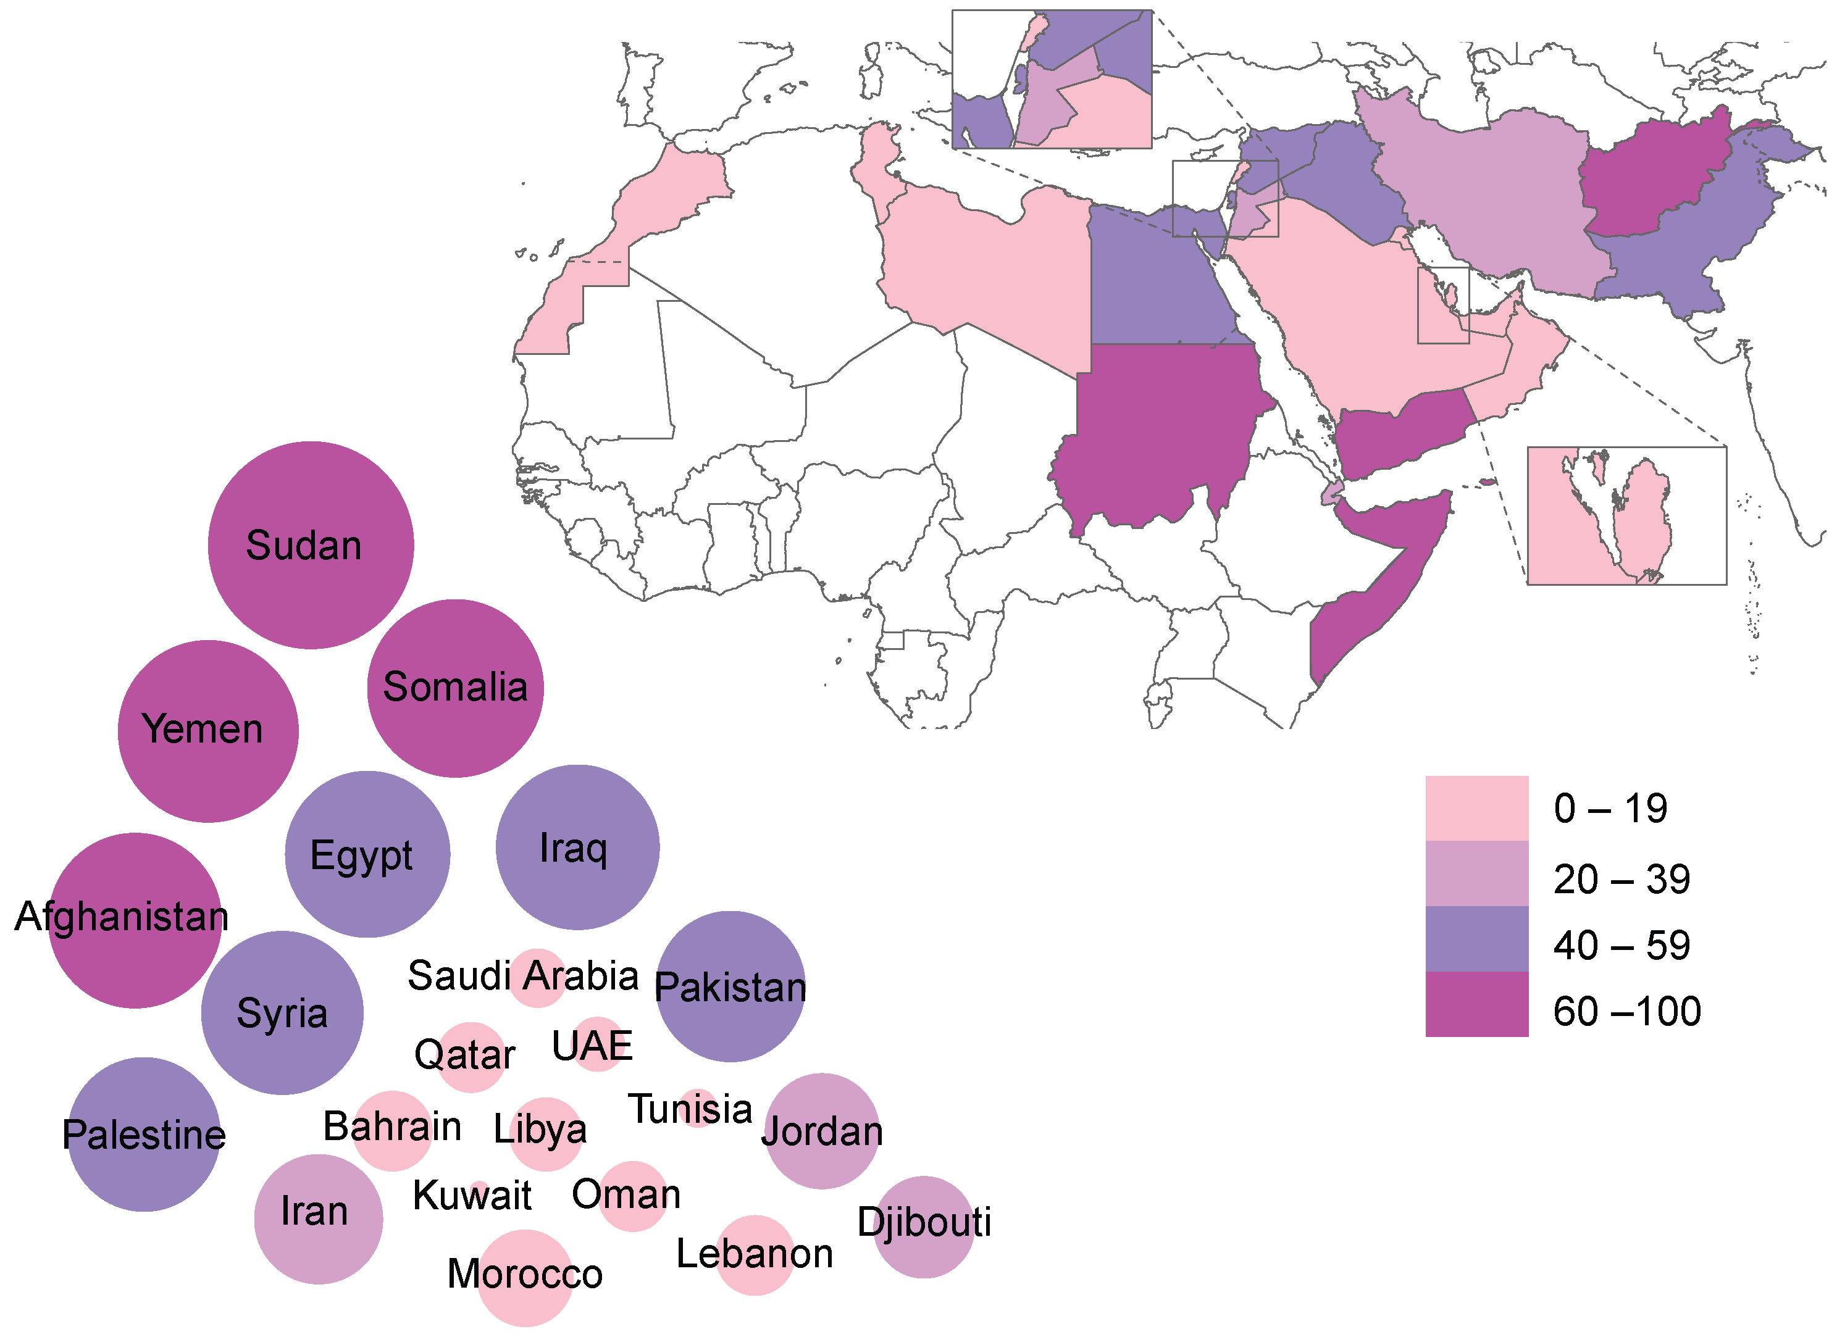
Adolescent (15-19 years) fertility rate (per 1000 girls)
Notes:
Reference:
WHO Eastern Mediterranean Health Observatory. Adolescent fertility rate (per 1000 girls aged 15-19 years). World Health Organization; c2019. Available from: https://rho.emro.who.int/ThemeViz/TermID/129

Slide 23
Demand for family planning satisfied by modern methods among 15–19-year-olds in select EMR countries
From DHS statcompiler: https://www.statcompiler.com/en/
Notes:
While some countries experienced progress from the 90’s like Yemen and Morocco, progress has stalled or reversed in others
Reference:
DHS statcompiler: https://www.statcompiler.com/en/

Slide 24
What do adolescents know and think about contraception?
Lebanese university students ¹
A self-administered Arabic survey was distributed on campuses to 3,384 university students
Measured knowledge of contraceptives; knowledge of menstrual cycle; contraceptive use and failure; and knowledge about STIs
All males knew about the condom, but 2.8% of females had never heard of it
Three-quarters of males had heard about the intrauterine device (IUD) in comparison with 88.6% of females
Around 73% of males and 21.8% of females ever had a sexual relationship
Of those, around two-thirds of males and a quarter of females had used contraception
Rural areas in Egypt ²
Household survey of 729 married adolescent girls in 23 villages
Only 6% of married adolescent girls were using a modern contraceptive method; 10.6% had ever used a modern contraceptive method
None had ever used a modern contraceptive method before their first delivery
The most common methods were short acting (oral contraceptive pills [COCs, 64.9%] and contraceptive injections [16.9%]), while only 9% used a long-acting reversible contraceptive (LARC) method.
34% and 54.3% of participants believed that using contraception would reduce a woman’s fertility and that women should not delay their first pregnancy
Notes:
References:
Barbour B, Salameh P. Knowledge and practice of university students in Lebanon regarding contraception. East Mediterr Health J Rev Sante Mediterr Orient Al-Majallah Al-Sihhiyah Li-Sharq Al-Mutawassit. 2009 Apr;15(2):387–99.
Aziz MM, Elgibaly O, Mohammed HM. Family planning perspectives and practices of married adolescent girls in rural Upper Egypt. Eur J Contracept Reprod Health Care. 2021 May 4;26(3):214–20.

Slide 25
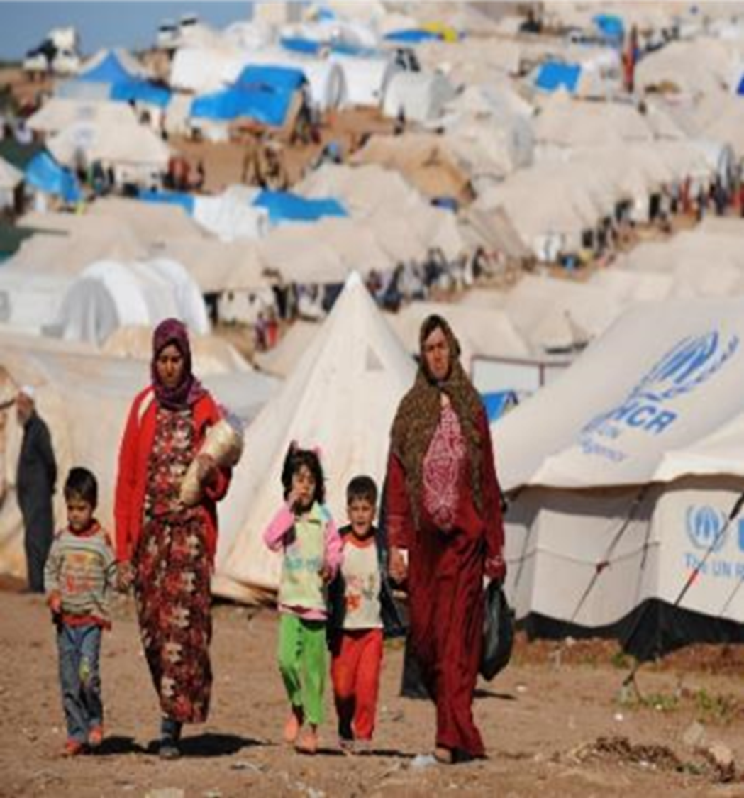
Contraception in humanitarian settings
Women in humanitarian situations may find themselves at much greater risk of an unintended pregnancy.
The Minimum Initial Services Package (MISP) for sexual and reproductive health (SRH) is the global standard for SRH response in acute emergencies.
It is a coordinated set of activities designed to address priority reproductive health needs in the early days and weeks of an emergency.
One of the six objectives of MISP is prevention of unintended pregnancy which includes the following priority activities:
Ensuring availability of a range of long-acting, reversible and short-acting contraceptive methods (including condoms and emergency contraception) at primary health care facilities to meet demand
Providing information, including existing information, education, and communications materials, and contraceptive counseling
Ensuring the community is aware of the availability of contraceptives for women, adolescents, and men
Safe abortion care to the full extent of the law is included as a standalone “other priority activity.”
Notes:
References:
WHO. Delivering contraceptive services in humanitarian settings. 2018. Available from: https://www.who.int/reproductivehealth/publications/humanitarian-settings-contraception/en/
Inter-agency working group on Reproductive Health in Crises. Minimum Initial Service Package (MISP) Advocacy Sheet. Available from: https://iawg.net/resources/minimum-initial-service-package-advocacy-sheet#:~:text=The%20MISP%20for%20SRH%20is,throughout%20protracted%20crises%20and%20recovery.

Slide 26
Contraception in humanitarian settings: Assessment of gaps and recommendations from a landscaping assessment
“In the contraceptive programming survey, across all regions, 41 percent of programs reported that contraceptive services were available and accessible for unmarried adolescent girls most of the time or always, but 41 percent also reported that they were never or only sometimes available. Regional variations emerged, with only 13 percent of respondents in the Middle East and North Africa reporting contraceptive services to be available and accessible to unmarried adolescent girls most of the time or always, as compared to 68 percent of respondents in Sub-Saharan Africa."
Notes:
Reference:
Women’s Refugee Commission. Contraceptive Services in Humanitarian Settings and in the Humanitarian-Development Nexus: Summary of Gaps and Recommendations from a State-of-the-Field Landscaping Assessment. 2021. Available from: www.womensrefugeecommission.org/wp-content/uploads/2021/03/Contraceptive-Services-in-Humanitarian-Settings-Summary-Gaps-Recommendations-Final.pdf

Slide 27
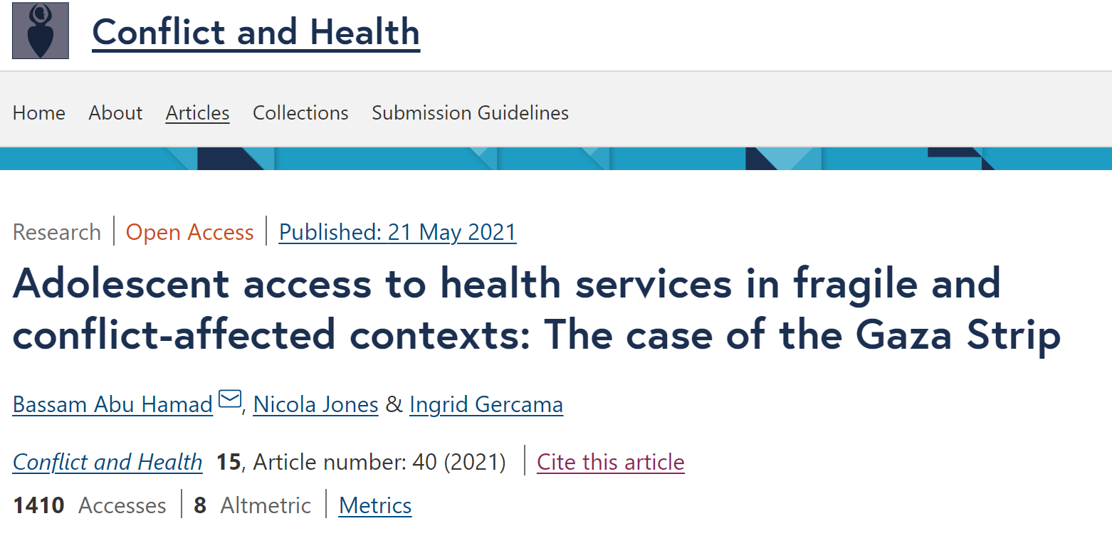
Contraceptives and protracted conflict: The case of Gaza
Study as part of the multi-country Gender and Adolescence: Global Evidence (GAGE) longitudinal research program.
40% of the population of Palestine are refugees and 66% in Gaza.
Of married girls aged 15–19 in Gaza, 84% were not using contraception, compared to 62% of married women aged 20–24.
Contraceptive use is delayed until after 4th or 5th child and after having at least one boy – son preference.
Limited access to information on family planning methods and weak counselling.
Nearly 30% of girls in Gaza are pregnant before the age of 18 and half become mothers before the age of 20.
Of those aged 15–17, 40% had not heard about sexually transmitted infections (STIs) and 20% had not heard of HIV.
Source: Abu Hamad B, Jones N, Gercama I. Adolescent access to health services in fragile and conflict-affected contexts: The case of the Gaza Strip. Confl Health. 2021 May 21;15(1):40.
Notes:
Reference:
Abu Hamad B, Jones N, Gercama I. Adolescent access to health services in fragile and conflict-affected contexts: The case of the Gaza Strip. Confl Health. 2021 May 21;15(1):40.

Slide 28
Contraceptives and protracted conflict: The case of Gaza
Deeply entrenched gender norms that prioritize girls’ virginity and family honor prevent girls and women from seeking SRH services other than those related to pregnancy care.
“Participants noted that parents often do not allow unmarried girls to visit a gynecologist because they are concerned that any invasive procedure might break the hymen. One girl explained:
Fathers will prevent girls from visiting a doctor no matter how severe the condition because they believe there is a chance that her virginity will be ruined, and as a result she will not get married. (FGD with 15–19-year-old girls, Shajaia)”
According to GAGE data, 85% of married adolescent girls in Gaza had been pregnant and only one-third (32%) reported ever using a family planning method.
Notes:
Reference:
Abu Hamad B, Jones N, Gercama I. Adolescent access to health services in fragile and conflict-affected contexts: The case of the Gaza Strip. Confl Health. 2021 May 21;15(1):40.

Slide 29
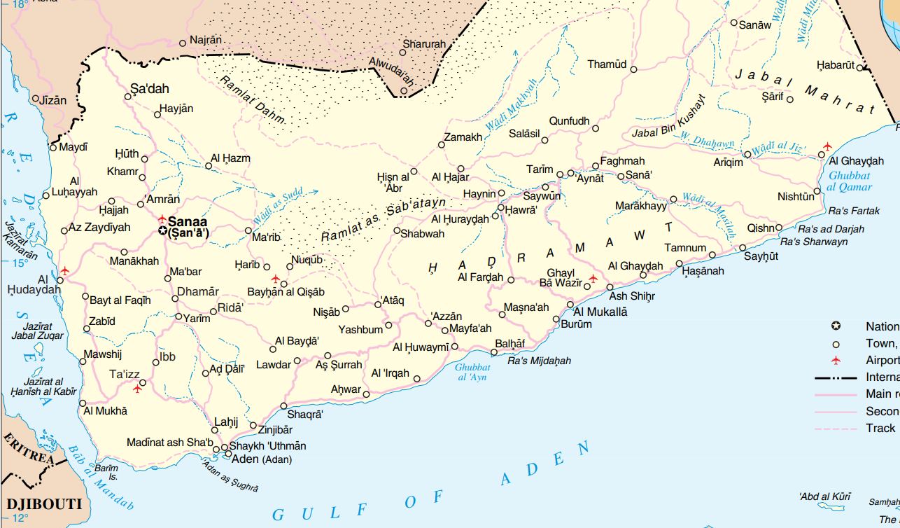
Contraceptives in humanitarian settings: the case of Yemen
Yemen’s ongoing war has been described as the world’s ‘worst humanitarian crisis’.
The current conflict, now in its sixth year, has resulted in a complex humanitarian emergency that includes seemingly intractable power struggles, widespread conflict-induced displacement, a slow onset crisis in food security and malnutrition, and one of the largest cholera outbreaks in recent history – among other health and protection challenges.
Notes:
Reference:
Tappis H, Elaraby S, Elnakib S, AlShawafi NAA, BaSaleem H, Al-Gawfi IAS, Othman F, Shafique F, Al-Kubati E, Rafique N, Spiegel P. Reproductive, maternal, newborn and child health service delivery during conflict in Yemen: a case study. Conflict and Health. 2020 May 27;14(1):30. http://dx.doi.org/10.1186/s13031-020-00269-x

Slide 30
Supply-side barriers to RH services
Demand-side barriers to RH services
Only 51% of health facilities were fully functioning. Only 20% of health facilities provide maternal and child health services due to the conflict.
Staff shortages: suspension of salaries of 1.5 million state employees including health workers
Insecurity
Rampant destruction of infrastructure
Long and recurrent electricity cuts
Lack of running water
Lack of equipment and supplies: no gloves, no cotton, not sterilization equipment, no stethoscopes
Pre-existing disapproval of family planning accentuated by the war.
Some participants suspect that contraception is part of a Western agenda
Low pre-existing awareness of family planning
Notes:
Reference:
Tappis H, Elaraby S, Elnakib S, AlShawafi NAA, BaSaleem H, Al-Gawfi IAS, Othman F, Shafique F, Al-Kubati E, Rafique N, Spiegel P. Reproductive, maternal, newborn and child health service delivery during conflict in Yemen: a case study. Conflict and Health. 2020 May 27;14(1):30. http://dx.doi.org/10.1186/s13031-020-00269-x

Slide 31
Political and organizational barriers
Outbreak response viewed as more pressing and prioritized over RH services (unprecedented cholera epidemic – the largest in history).
Extended stockouts and delayed procurements of contraception for over a year.
In Taiz, family planning methods were reported to have been absent from the market for months and in Aden oral contraception has been unavailable for almost two years.
Deliberately blocked by MoPHP authorities in Sana’a.
“[Family planning] is weakly provided due to the lack of supplies. We only provide oral contraceptive pills. Implants haven't been provided since more than two years. IUD and other family planning tools are also weakly provided due to the lack of supplies, and the difficulty of sending them to the directorate and transferring them to health centers.” -MoPHP official, Taiz
Notes:
Reference:
Tappis H, Elaraby S, Elnakib S, AlShawafi NAA, BaSaleem H, Al-Gawfi IAS, Othman F, Shafique F, Al-Kubati E, Rafique N, Spiegel P. Reproductive, maternal, newborn and child health service delivery during conflict in Yemen: a case study. Conflict and Health. 2020 May 27;14(1):30. http://dx.doi.org/10.1186/s13031-020-00269-x

Slide 32
Evidence on the impact of COVID-19 on contraception
Evidence from GAGE: ²
In Jordan, GAGE data shows that access to contraceptives was impeded in the initial months of COVID-19, and adolescent pregnancies increased. Almost all married adolescents in the qualitative sample were pregnant at some point in the last year, which was not the case in previous years
‘I used to take contraceptives 6 months ago to not get pregnant. Now I know I need another injection and I should have taken it 10 days ago, but I couldn’t. I asked my husband, but he doesn’t have money for it now’. – Jordan
Notes:
References:
Country dashboard of monitoring the effect COVID-19 on rMNCAH.
Jones N, Guglielmi G, Małachowska A, Abu Hamad B, Yadete W. with Abu Hamad S, Abu Hamra E, Alam F, Alheiwidi S, Alabbadi T, Al-Redaisy N, Amaireh W, Amdeselassie T, Banioweda K, Diab R, Gebeyehu Y, Gezahegne K, Iyasu A, Qandeel A, Sultan M, Tilahun K, Workneh F. ‘Some got married, others don’t want to attend school as they are involved in income-generation’: Adolescent experiences following covid-19 lockdowns in low- and middle-income countries. Report. London: Gender and Adolescence: Global Evidence; 2021.

Slide 33
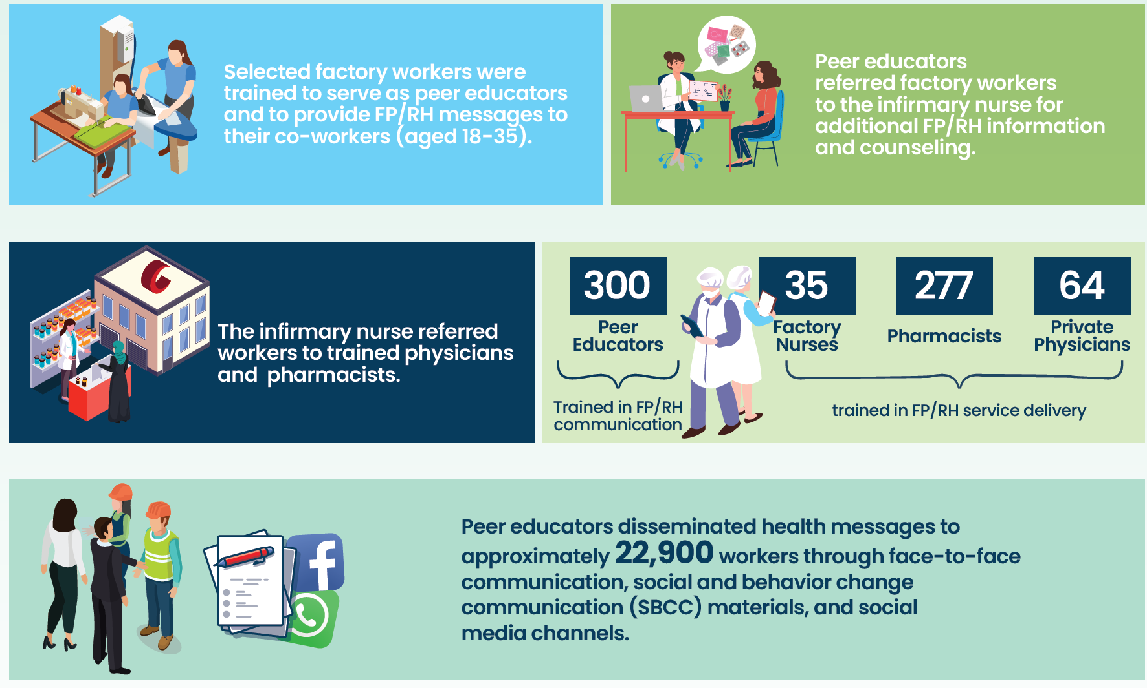
REGIONAL INITIATIVE The Evidence Project: Workers’ Health Education Programs in Egypt
Population Council’s Evidence Project implemented an intervention aimed at increasing FP service demand among young people (aged 18–35) in Port Said and urban Souhag
Rationale
Between 2008 and 2014, Egypt’s fertility rate increased from 3.0 births per woman aged 15–49 to 3.5, and unmet need for family planning (FP) increased from 10% to 12% among young people.
.
Notes:
Reference:
Population Council. Two Implementation Models of Workers’ Health Education Programs in Egypt: What works? What doesn’t work? 2020

Slide 34
Opportunities for the Region
The Global Strategy for Women’s, Children’s, and Adolescents’ Health, 2016–2030 ¹
In 2016, WHO led the development of this Global Strategy, which provides an ideal opportunity to expand the availability and accessibility of contraceptive information, counselling, and provision for adolescents. Immediately after the launching of the global strategy, EMRO supported countries to develop their own plans in line with the strategy, taking into account future trends in contraceptive method use.
Accelerated Action for the Health of Adolescents (AA-HA) ²
In 2017, WHO published global guidance for the countries on how to asses adolescent health needs, including with regard to contraception, and recommends evidence-based interventions for responding to these needs. Member States in the Region passed a resolution in 2017 to support national strategic planning for adolescent health, and many countries have since initiated the process of developing their plans accordingly .
Regional Implementation Framework for Newborn, Child, and Adolescent Health, 2019-2023 ³
The endorsement of this regional framework represents an excellent opportunity to advance adolescents health agenda in general and particularly SRH including family planning. Its strategic priorities include strengthening the integration of health programmes, multisectoral coordination and partnerships for the promotion of healthier newborns, children, and adolescents.
Notes:
References:
Every Woman Every Child. The global strategy for women’s, children’s and adolescents’ health (2016-2030). Every Woman Every Child; 2015. Available from: https://www.everywomaneverychild.org/wp-content/uploads/2016/11/EWEC_globalstrategyreport_200915_FINAL_WEB.pdf
WHO. Global Accelerated Action for the Health of Adolescents (AA-HA!): guidance to support country implementation. Geneva: World Health Organization; 2017. Licence: CC BY-NC-SA 3.0 IGO. Available from: https://apps.who.int/iris/bitstream/handle/10665/255415/9789241512343-eng.pdf?sequence=1
Regional Committee for the Eastern Mediterranean. Regional implementation framework on ending preventable newborn, child and adolescent deaths and improving health and development: Resolution. WHO Regional Office for the Eastern Mediterranean; 2019 Oct. Available from: https://applications.emro.who.int/docs/RC66-R2-eng.pdf

Slide 35
Regional considerations for the delivery of interventions related to adolescent contraception ¹
To prevent child marriage, legal protection for adolescent girls and young women should be provided through law and policy frameworks. Alongside this, programmes to eliminate gender discrimination should also be prioritized.
To address broad, cross-cutting determinants of adolescent health, programmes should be implemented with other relevant sectors. For example, the health and education sectors should work together to influence knowledge, attitudes, and behaviors of adolescents related to sexual and reproductive health.
To address stigma related to adolescent sexuality and address myths and misconceptions about contraception, community engagement e.g., with parents and religious leaders should be a central component of programmes.
To improve the accessibility and acceptability of contraceptive services for adolescents, countries should consider expanding the availability of adolescent-friendly health services, integrating contraceptive services with primary health care services,² and using mobile outreach services to meet adolescents where they are.³
To ensure adolescents in humanitarian crisis contexts, have access to contraceptive services and other priority interventions including for gender-based violence, STIs and HIV, and maternal and newborn care, the Minimum Initial Service Package (MISP) for Reproductive Health in Crisis Situations should be implemented.⁴
To expand the availability of data on ASRH and the meaningfully engagement of young people in the implementation and accountability of the Sustainable Development Goals, countries should consider establishing youth-led data-collection mechanisms that disaggregate data by age and other important characteristics.
Notes:
References:
WHO. Global Accelerated Action for the Health of Adolescents (AA-HA!): guidance to support country implementation. Geneva: World Health Organization; 2017. Licence: CC BY-NC-SA 3.0 IGO. Available from: https://apps.who.int/iris/bitstream/handle/10665/255415/9789241512343-eng.pdf?sequence=1
Kabakian-Khasholian T, Quezada-Yamamoto H, Ali A, Sahbani S, Afifi M, Rawaf S, El Rabbat M. Integration of sexual and reproductive health services in the provision of primary health care in the Arab States: status and a way forward. Sex Reprod Health Matters. 2020 Dec;28(2):1773693. http://dx.doi.org/10.1080/26410397.2020.1773693
High-Impact Practices in Family Planning (HIPs). Mobile outreach services: expanding access to a full range of modern contraceptives. Washington, DC: USAID; 2014 May. Available from: http://www.fphighimpactpractices.org/briefs/mobile-outreach-services
UNFPA. Minimum Initial Service Package (MISP) for SRH in crisis situations. UNFPA; 2020 Nov. Available from: https://www.unfpa.org/resources/minimum-initial-service-package-misp-srh-crisis-situations

Slide 36
THANK YOU

