Slide 1
HARMFUL TRADITIONAL PRACTICES PREVENTION
2022

Slide 2
DEFINITIONS
Traditional cultural practices: They reflect values & beliefs held by members of a community for periods often spanning generations. Some are beneficial, some have neither benefits nor harms, and some are harmful to a specific group e.g. Female Genital Mutilation & child marriage.
Female genital mutilation (FGM): Any procedure that involves the partial or total removal of external genitalia or other injury to the female genital organs for non-medical reasons.
Child marriage: Formal marriage or informal union before the age of 18 years.
Notes:
This slide contains key definitions.

Slide 3
RATIONALE 1/2
Harmful traditional practices among adolescents are an important problem:
Over 200 million girls & women are estimated to be living with the effects of FGM which is predominantly performed on girls under the age of 18 years.
Every year, about 12 million girls are married before the age of 18.
Harmful traditional practices among adolescents can have serious health & social consequences:
FGM has no known health benefits,. It can cause immediate health consequences - hemorrhage, shock, infections & death & can cause long-term health & social consequences such as post-traumatic stress disorder & menstrual health problems. Women with type III FGM have an increased likelihood of experiencing problems during child birth. Babies born to children with FGM are at increased risk of neonatal complications.
Child marriage often leads to early childbearing in young girls which is associated with an increased risk of pregnancy-related mortality & morbidity and of increased risk of mortality and morbidity in babies born to a adolescent mothers. Child marriage is also associated with an increased risk of intimate partner violence. Finally, it has a negative effect on educational attainment.
Notes:
This is the first of two slides which set out the rationale for investment in this area.

Slide 4
RATIONALE 2/2
Prevention of harmful traditional practice interventions has been shown to be effective: There is a growing evidence base of effective approaches as well as those which are promising but have not been shown to be effective.
Laws & policies, & prevention strategies and their implementation need attention: Laws and policies forbidding the practices are in place in many countries, but that has not stopped the practices from continuing. Efforts must be stepped up to communicate the laws & policies & to support their application without exception. These efforts must be combined with efforts to mobilize families & community, & to empower girls, & to provide those who have experienced FGM & child marriage with the health, social and legal services they need.
Notes:
This is the second of two slides which set out the rationale.

Slide 5
HUMAN RIGHTS OBLIGATIONS
Human rights standards call for a holistic approach to the prevention & elimination of harmful practices.
States must adopt legislative measures to prohibit these practices, including providing for adequate sanctions, combined with other legal & policy measures, including social measures. These measures must include attention to the root causes of harmful practices, capacity building at all levels, & protective measures for women & children who have been victims of harmful practices.
Notes:
This slide outlines the human rights obligations of states.

Slide 6
KEY CONCEPTS TO CONSIDER
FGM and child marriage are longstanding, deep-seated traditional practices that cannot be reversed by briefly implemented single-component interventions: Efforts to prevent FGM and CM require long term & multi-level interventions.
Leaders, including health care providers, may themselves support FGM or CM: All stakeholders need to be involved in contributing to efforts to prevent FGM & CM.
Many adolescents who have undergone FGM or have been married before 18 do not have access to care & support: In addition, girls & women may delay seeking care because they are embarrassed or ashamed.
Notes:
This slide lists three key concepts to consider in moving ahead.

Slide 7
WHO GUIDELINES
WHO guidelines on the management of health complications from female genital mutilation (2016).
  The guideline is relevant for, but not specific to adolescents. It provides recommendations for the management of health complications of FGM.
WHO guidelines on preventing early pregnancy and poor reproductive outcomes among adolescents in developing countries (2011).
  The guidelines in specific to adolescents.
  It sets our recommendations for actions at three levels, as follows. At the policy level, encourage political leaders, planers and community leaders to formulate and enforce laws that prohibit marriage of girls before the age of 18;. At the community level, influence family and community norms to delay marriage of girls until age of 18 years and increase educational opportunities for girls through formal and non-formal channels;. At the individual level, empower girls in combination with intervention to influence family and community norms.
Notes:
This slide lists two WHO guidelines which address FGM and child marriage.

Slide 8
COMPLEMENTARY DOCUMENTS TO WHO’s GUIDELINES
FGM
Care of girls and women living with female genital mutilation: a clinical handbook (WHO, 2018).
Global strategy to stop health-care providers from performing female genital mutilation (WHO, 2010).
Interagency statement on eliminating female genital mutilation (WHO, 2008).
COVID-19 disrupting SDG 5.3 – female genital mutilation (UNFPA, 2020)
Child marriage
COVID-19 and child, early and forced marriage: An agenda for action (GirlNotBrides, April 2020)
Adapting to COVID-19 (UNICEF, UNFPA, September 2020)
Addressing child marriage in humanitarian settings (UNICEF, UNFPA, February 2021)
Notes:
This slide lists a selection of complementary documents which could be useful.

Slide 9
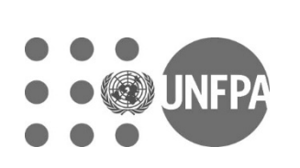
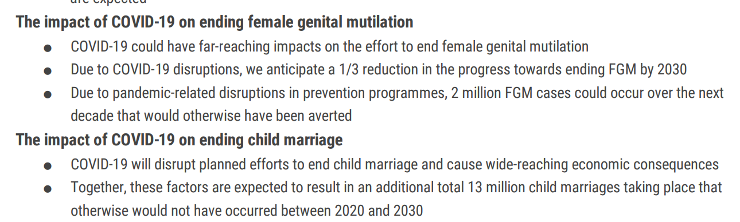
The impact of COVID-19 on child marriage and FGM
Source: UNFPA. Impact of the COVID-19 Pandemic on Family Planning and Ending Gender-based Violence, Female Genital Mutilation and Child Marriage. UNFPA; 2020 Apr. https://www.unfpa.org/sites/default/files/resource-pdf/COVID-19_impact_brief_for_UNFPA_24_April_2020_1.pdf

Slide 10
Recommendations on:
Mitigating the immediate & long term impacts
Health, including SRH
Education
Gender-based violence & protection of children
Economic impacts
Impact on political & civil rights

Slide 12
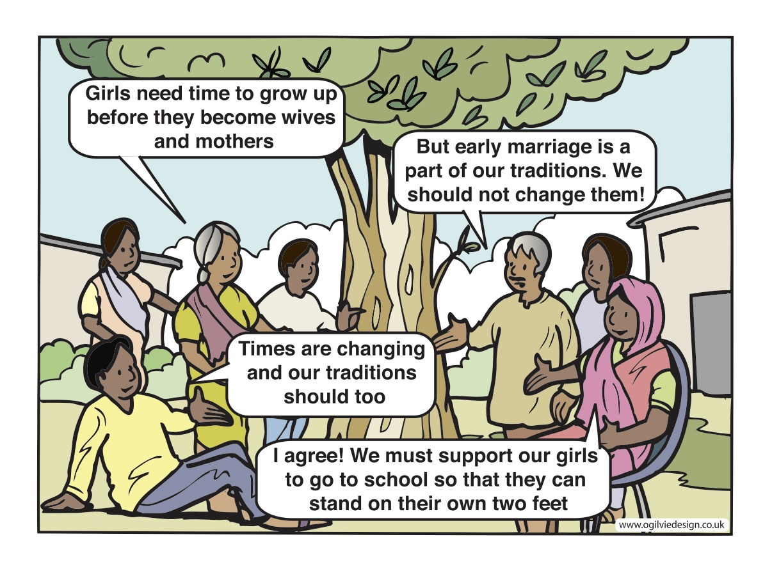
Notes:
Both education and employment opportunities, and community dialogue are needed to bring about norm change.

Slide 13
HARMFUL TRADITIONAL PRACTICES AND PREVENTION
A Regional Perspective
Article 25 of the Universal Declaration of Human Rights states that “everyone has the right to a standard of living adequate for health and well-being,” and this statement has been used to argue that FGM violates the right to health and bodily integrity.

Slide 14
Child marriage
Number of women first married or in union before age 18 in Middle East and North African Region (MENA) is 35 million. (1)
Legal protections are weakest in the Middle East and North Africa where three in four girls (73.3%) between 10 and 17 years of age do not have legal protection against child marriage as compared to South Asia (47.7%). (2)

Slide 15
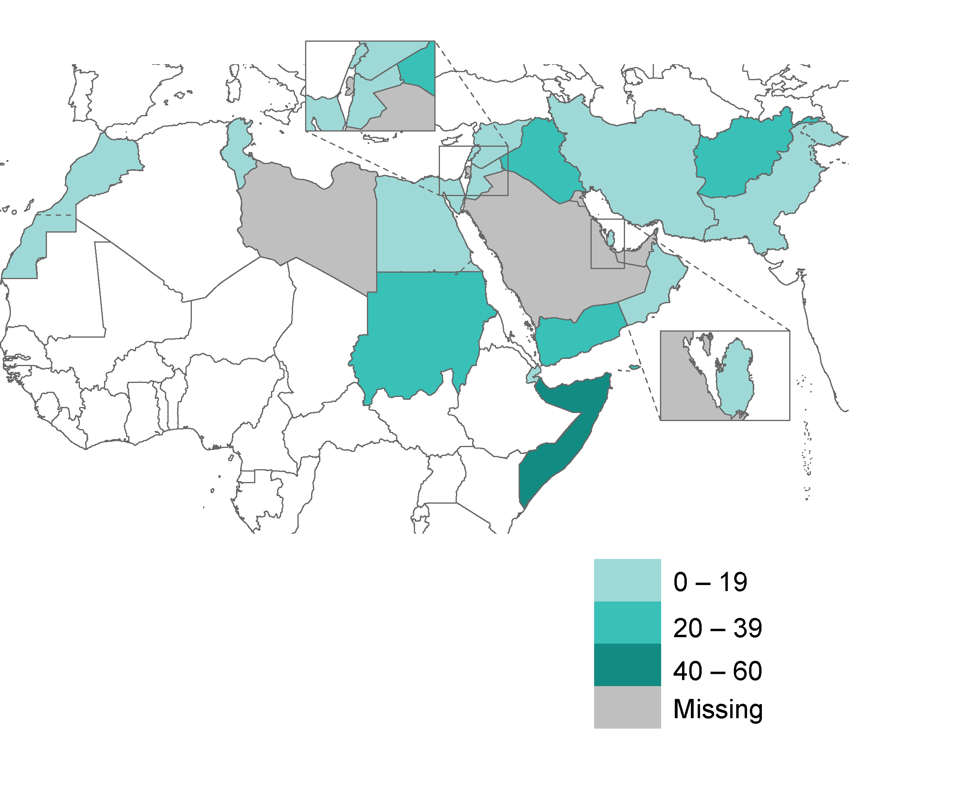
Proportion of women aged 20-24 years who were married or in union before the age of 18 in EMR (SDG, 5.3.1) (3)
Notes:
The proportion of women aged 20-24 years who were married or in union before the age of 18 in EMR (SDG, 5.3.1) (3)
Somalia: 43.2%
Sudan: 34%
Yemen: 31%
Afghanistan: 28.3%
Iraq: 28%
Pakistan: 18.3%
Egypt: 17.4%
Iran: 16.7%
Morocco: 13.7%
Syria: 13.3
Jordon: 9.0%
Lebanon: 6%
Djibouti: 5.3
Qatar: 4.2%
Oman: 4%
Tunisia: 1%

Slide 16
Trends in child marriage over time
Source: DHS statcompiler: https://www.statcompiler.com/en/

Slide 17
Regional drivers
Drivers of child marriage are complex, diverse and contextual; they are the outcomes of the interplay between the macro-social forces and the local traditions and cultural experiences.
Girls’ voice & agency: Restricted social and spatial mobility outside of the household is a significant factor driving child marriage, contributing to limited access to education, economic opportunities, and health services, as well as vulnerability to gender-based violence, and limited access to justice. (4)
Lack of legal protection against child marriage: Most countries in the Region have ratified international conventions, including CRC* & CEDAW** which set the minimum age of marriage at 18, however, exceptions to key provisions of these conventions allow child marriage to remain legal in certain circumstances in most countries. (4)
Family honour: Many societies in the Region highly value girls’ sexuality and their virginity as a marker of family honour. Families will marry off their daughters early to legitimize a relationship and avoid the stigma of premarital sex. (5)
Economic reasons: Child marriage is viewed by many families as a way to shift the financial burden of girls onto a male suitor and his family and as a means to ensure financial security. Maintaining kinship and securing inheritance are other major drivers. (6)
Local cultural traditions: In many societies in the region, child marriage is a deeply rooted tradition. It is also claimed by some to be dictated by religious teachings although there is significant variation in opinions about the religious stance on child marriage, with many in agreement that there is religious and scriptural support against child marriage. (7)
* CRC: Convention on the Rights of the Child
** CEDAW: Convention on the Elimination of All Forms of Discrimination Against Women
Notes:
CEDAW: Convention on the Elimination of All Forms of Discrimination against Women
CRC: Convention on the Rights of the Child

Slide 18
Regional challenges
Lack of legal protection against child marriage.
Lack of understanding that puberty is an ongoing process of physical, mental and emotional development and lack of awareness on the impact of child marriage mortality and morbidity on girls and their children.
Availability of service: Lack of services for girls at risk of child marriage and for those already married. Both Sudan and Yemen called for a critical need in funding to provide effective prevention and response services. (4)
Lack of evidence: Most common need articulated by stakeholders related to evidence generation, and for better coordination amongst different groups conducting research and programming related to child marriage. (4)
Weak reporting: There is lack of efficient reporting system and response to child marriages and weak birth registration.
Humanitarian setting: Displacement can increase girls’ vulnerability to child marriage. Families see child marriage as a way to cope with greater economic hardship and to protect girls from increased violence. (8)

Slide 19
Child marriage in humanitarian settings
There is concern that existence of multiple conflicts in the region may increase rates of child marriage.
A systematic review evaluating the impact of conflict on adolescent transitions, including first marriage found mixed evidence:
  In some settings, conflict led to a postponement of marriage among adolescents.
  In others, loss of educational opportunities, security concerns and poverty prompted families to earlier marriages. (9)
A study conducted among Syrian refugees in Jordan demonstrated that while 12.0% of registered marriages in pre-war Syria involved a girl under the age of 18, 18.4% involved children in 2012, 25.0% in 2013 and 31.7% in the first quarter of 2014. (10)

Slide 20
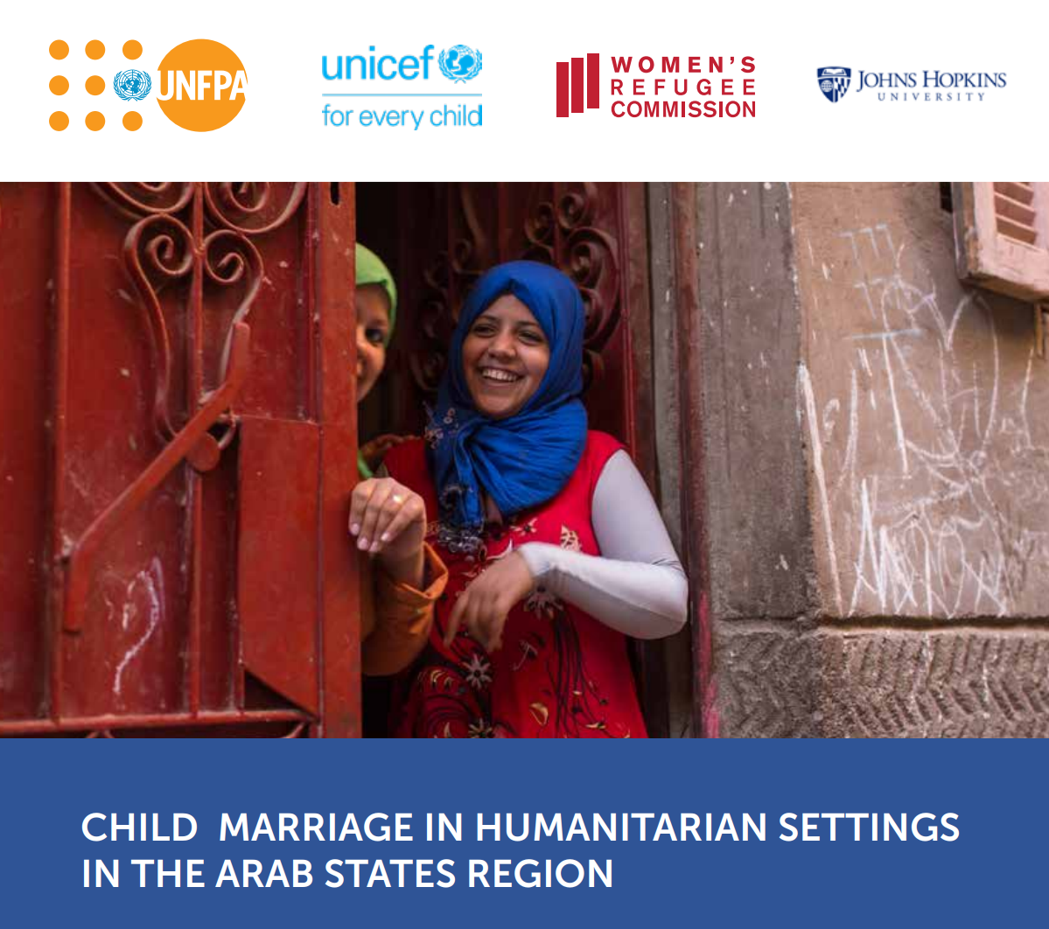
Child marriage in humanitarian settings in Arab states
Impact of humanitarian crisis on child marriage is found to vary based on context.
Child marriage was more widely practiced among displaced populations in Yemen compared to non-displaced, and among younger cohorts of girls compared to older women – indicating an impact of the Yemen crisis on child marriage rates.
In Egypt, displacement acted both as a risk factor and moderator for child marriage.
  Many refugees were facing difficulties regularizing their residence which prevented them from enrolling children in school and thus marrying them off.
  Shifts in family structure and roles, such as reduced grandparent involvement and decrease in cousin marriages, led to changes in traditional marriage practices.
  Interactions with host populations that were perceived as more liberal relaxed social rules that curtailed girls’ mobility and educational attainment. (7,11,12)

Slide 21
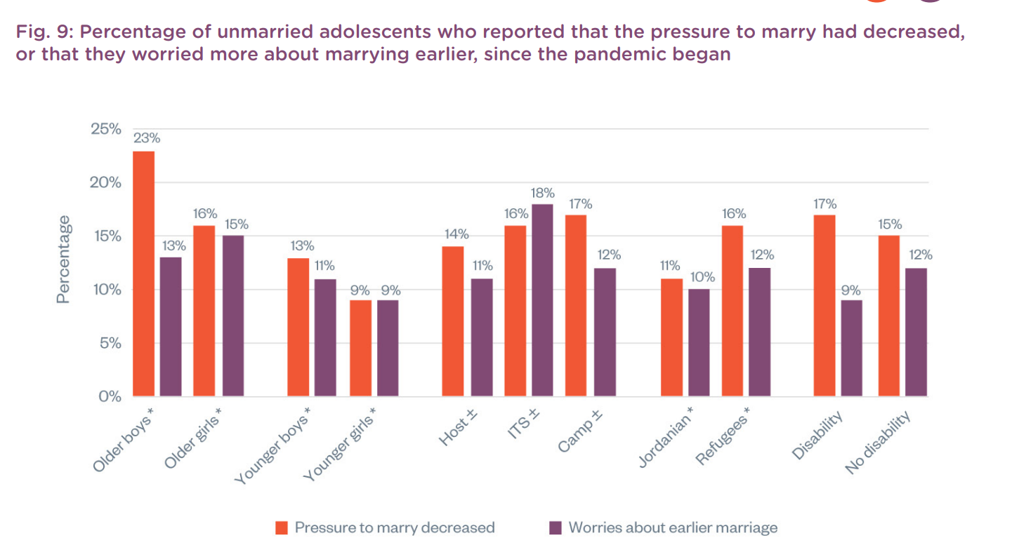
Impact of COVID-19 on child marriage: Evidence from Jordan
In Jordan, 15% of older girls are worried that covid-19 will expedite their marriage, but 16% think pressure to get married decreased
“I can’t save money to marry and I can’t save money to be able to rent a house when I get married. During these conditions, it is difficult to get engaged, to pay money for dowry, to get married and to buy the furniture of the house also.” – Syrian refugee boy (13)
Source: Abu Hamad B, et al. Living with the Covid-19 pandemic: adolescent experiences in Jordan. Report. London: Gender and Adolescence: Global Evidence; 2021 Aug.

Slide 22
Impact of COVID-19 on child marriage: Evidence from Lebanon
As was the case in Jordan, in Lebanon, impact of the pandemic on child marriage among Palestine refugees was mixed:
  On the one hand, the pandemic has caused greater poverty, which decreased pressures for marriage.
    ‘‘Now that everything is expensive, there will be no grooms as the boys will not be able to afford marriage.’
  On the other hand, many families are marrying off girls to men residing in other countries so that they can escape Lebanon and the impact of the pandemic and economic crisis.
    ‘Many girls agree to marry men living abroad even if they do not know them …. Most girls prefer migrating outside Lebanon because there is security abroad.’ (14)

Slide 23
End Child Marriage initiative in YEMEN
UNFPA-UNICEF Global Programme to End Child Marriage in YEMEN (15)
It is implemented since 2016 in 12 high burden countries for child marriage including in Yemen (home to 4 million child brides of which 1.4 million are married before age 15).
Phase I (2016-2019) & Phase II (2020-2023).
Achievements:
Significant achievements during Phase I in improving access to education and healthcare services for adolescent girls, in educating parents and communities on the consequences of child marriage and in generating data on what works to address child marriage and related issues such as gender-based violence.
Deepened partnerships with the government to accelerate action to end child marriage and to provide data and evidence with advocacy to promote policy change and legal reform at various levels.

Slide 24
End Child Marriage initiative in YEMEN (15)
Achievements cont.:
19,750 Adolescent girls participated in at least one programme intervention (since 2016). | 273 Girls were supported in 2019 to enroll and continue with their education.
61,509 Individuals from the community were engaged in dialogues promoting gender equality. | 10,102 Adolescent girls utilized health or protection services.

Slide 25
The Punjab Female School Stipend Program (16)
Cash transfers, conditional or unconditional, are a type of intervention that incentivizes families to make investments in the human capital of their children.
Conditional cash transfers have certain conditions attached to them, such as retaining girls in school or other behavioral conditions.
The Punjabi program aimed to increase girls’ retention in school and decrease gender inequalities
Each female student was given a quarterly stipend of approximately PKR 600 or 10 USD.
Eligibility was conditional on a minimum school attendance rate of 80 percent, as reported regularly by the school.
As of 2007, the program covered 245,000 beneficiaries.
Findings
Participant girls (between 15 to 19 years of age) tend to delay their marriage by 1.4 years and have 0.3 fewer children.
The program encouraged girls to work less, delay their marriage, and have fewer children.

Slide 26
Regional key facts about female genital mutilation (FGM)
Proportion of women and girls aged 15-49 years who have undergone female genital mutilation/cutting (SDG indicator 5.3.2): (17)
Somalia, Djibouti, Egypt and Sudan have some of the highest rates of FGM in the world.
Country | Year | Total | Q1 | Q2 | Q3 | Q4 | Q5
Djibouti | 2012 | 94 | 97 | 94 | 94 | 93 | 96
Egypt | 2015 | 87 | 94 | 92 | 87 | 70 | 93
Iraq | 2018 | 7 | 1 | 3 | 6 | 22 | 3
Somalia | 2020 | 99 | 99 | 99 | 100 | 99 | 100
Sudan | 2014 | 87 | 88 | 81 | 90 | 92 | 82
Yemen | 2013 | 19 | 26 | 13 | 20 | 14 | 21
Notes:
Levels of FGM among girls aged 0-14 years vary across countries in the region:
Djibouti (43%),
Sudan (30%),
Egypt (14%),
Iraq (1%)
Age at cutting varies across countries in the region; in Yemen it most often occurs in the first week of life, while in Egypt it is most likely to occur in adolescence.
Information collected on FGM about girls under age 15 reflects their current, but not final, FGM status. Some girls who have not been cut may still be at risk once they reach the customary age for cutting. Therefore, the data on prevalence for girls under age 15 is an underestimation of the true extent of the practice. Since age at cutting varies among settings, the amount of underestimation also varies. This should be kept in mind when interpreting all FGM prevalence data for this age group.
(United Nations Children’s Fund. Female Genital Mutilation in the Middle East and North Africa. New York: UNICEF; 2020.)

Slide 27
Drivers of FGM in the Region
Social norms: FGM is a social norm in many countries, especially those with high prevalence of FGM. Failure to conform to FGM/C leads to social exclusion, ostracism, disapproval, rebuke or even violence, in addition to having an affect on a girl’s marriageability. (18)
Perception of FGM:
  Women and girls (15-49 years) who think the practice should continue (EGYPT 54%, Djibouti 48%, Sudan 41%, Yemen 19% and Iraq 3%).
  Men and boys (15-49 years) who think the practice should continue (58% in Egypt and 27% in Sudan). (19)
Gender norm: There is unequal power dynamics and expectations around gender in many countries of the Region with more control on female sexuality by men through FGM. Girls and women are dependent on men. They have little voice in matters that affect their lives, rendering them powerless to challenge harmful practices. (18)
Misperceptions: False beliefs for example that FGM is associated with reduce girls' sexual desires, increases cleanliness and hygiene and increases husband's sexual experience are highly prevalent in countries like Sudan. (20)
Notes:
Less than half of women support the continuation of FGM in most countries in the region.
FGM is highly medicalized in Egypt and Sudan where almost 8 in 10 girls are cut by medical personnel, whereas traditional practitioners are responsible for most cutting in Djibouti, Iraq and Yemen.
(United Nations Children’s Fund. Female Genital Mutilation in the Middle East and North Africa. New York: UNICEF; 2020.)

Slide 28
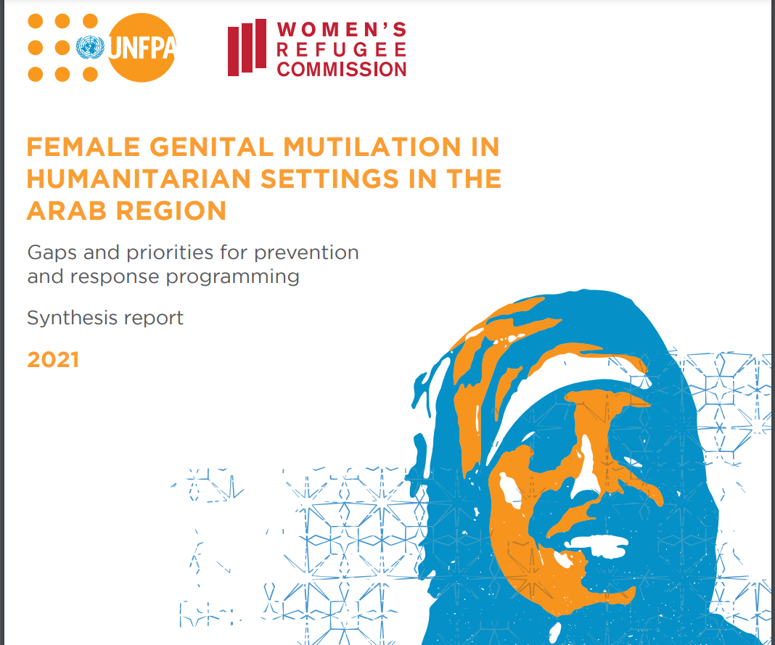
FGM in humanitarian settings
Humanitarian crisis and displacement impact FGM.
There is some evidence of shifts in social norms when communities practicing FGM are displaced into places where FGM is not practiced. (21)
  For example, one study conducted in South Sudan among Sudanese refugees who were displaced in 2011 into South Sudan found that the practice was declining in Doro camp in part due to shifts in social norms that no longer positioned FGM as a prerequisite to marriage. The practice ceased to be a social norm in Doro camp so much that it was no longer done openly out of fear of judgment by other community members. (22)
  In another study, “there was a move away from the extremity of pharaonic circumcision [FGM Type III]” among Somali women in Johannesburg, with women describing that they felt “free from social pressure.” (23)
In other cases, FGM is adopted by the displaced community if they are displaced into a place where FGM is practiced. (24)
Elnakib S, UNFPA ASRO, Metzler J. Female Genital Mutilation in Humanitarian Settings in the Arab Region: Synthesis Report on Gaps and Priorities for Prevention and Response Programming. Cairo and New York: UNFPA and the Women’s Refugee Commission; 2021.

Slide 29
Medicalization of FGM in the Region (25)
Due to increasing level of awareness about the health-related risks of FGM, some parents have turned to medical practitioners to cut their daughters or chose less severe forms of cutting. FGM is highly medicalized in Egypt and Sudan where almost 8 in 10 girls are cut by medical personnel, whereas traditional practitioners are responsible for most cutting in Djibouti, Iraq and Yemen.
A qualitative study looking at the health care providers’ and mothers’ perceptions about the medicalization of FGM in Egypt found that:
For many mothers and healthcare providers, adherence to community customs and traditions was the most important motive to practice FGM/C.
The social construction of girls’ well-being and bodily beauty makes FGM/C a perceived necessity which lays the ground for stigmatization against uncut girls.
The language around FGM/C is being reframed by many healthcare providers as a cosmetic surgery. Such reframing may be one way for providers to overcome the law against FGM/C and market the operation. (25)

Slide 30
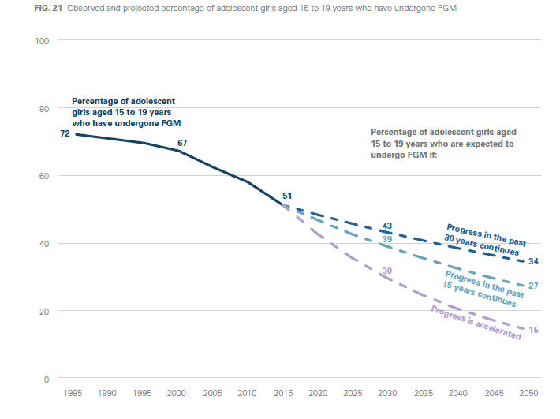
Looking ahead towards elimination of FGM (19)
Even if the progress is accelerated, about one in three adolescent girls will still
experience FGM in 2030
Observed and projected percentage of adolescent girls aged 15 to 19 years who have undergone FGM
Notes:
In order to reach the SDG target 5.3 of eliminating FGM by 2030, the rate of progress would need to be 15 times faster for the region overall.

Slide 31
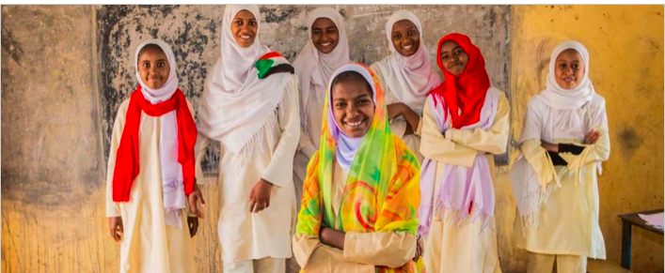
“Saleema” initiative in Sudan (26,27)
Launched in 2008 to promote long-term abandonment of FGM and cutting (FGM) by changing social norms, attitudes, and intentions related to the practice.
Main goal:
Spreading a social norm that modern Sudanese society no longer practices FGM is the long-term goal of Saleema.
Main activities:
  Sufara Saleema Campaign- public pledges to abandon FGM and support the Saleema initiative
  Saleema Colors Campaign- wearing Saleema colours as a sign of support
  Community dialogue- public dialogue on the existence of FGM, its role in society
  Born Saleema Project pledges not to cut newborn daughters immediately after birth
Settings:
Each component of the campaign was conducted in a public setting, including large gatherings (e.g., community dialogue).
These activities collectively aimed to increase public commitment, dialogue, and self and collective efficacy to abandon FGM.
Notes:
“The Saleema Initiative is a Sudanese program supported by the government that receives technical and financial assistance from UNICEF and supports the protection of girls from FGM, particularly in the context of efforts to promote collective community abandonment of the practice. The broad objective is to change the way that people talk about FGM by promoting wide usage of new positive terminology to describe the natural bodies of girls and women. Saleema also aims to stimulate new discussions about FGM at family and community levels–new both with regard to who talks to whom (‘talk pathways’) and the specific issues discussed (‘talk content’).”
“The immediate measureable outcome of the program is to increase social acceptance of uncut girls, as reflected in increased use of the positive term Saleema and in normative beliefs about the acceptability of being uncut.”
“When a social norm such as FGM is in place, families and individuals engage in the practice because they believe that it is expected of them and is prevalent. Creating alternative views is thus a key step in social norm change. When subjective and descriptive norms are in conflict, many people follow descriptive norms, what they perceive the prevalent behavior to be. Even if a norm is considered subjectively important (what should be) if individuals observe non-conformity they will be less likely to follow the norm. Spreading a social norm that modern Sudanese society no longer practices FGM is the long-term goal of Saleema.”
(Evans WD, Donahue C, Snider J, Bedri N, Elhussein TA, Elamin SA. The Saleema initiative in Sudan to abandon female genital mutilation: Outcomes and dose response effects. PLOS ONE. 2019 Mar 12;14(3):e0213380. http://dx.doi.org/10.1371/journal.pone.0213380. p.2-3.)

Slide 32
Monitoring and evaluation of Saleema project (27)
In 2014, in collaboration with the United Nations Children's Fund (UNICEF), the National Council for Child Welfare (NCCW), and local organizations, developed a Saleema Evaluation and Monitoring System (SEAMS) based on data gathered from 2015-2017.
Changes over time in key outcomes:
Most people in your community practice cutting (more than 25% less likely to agree with this statement, p < .001)
Most of my friends practice cutting (more than 35% less likely to agree with this statement, p < .001)
It is appropriate for families in my community to practice cutting (no effect, which is in positive direction but p > .05)
Sudanese society in general considers it appropriate to practice cutting (more than 34% less likely to agree with this statement, p < .001)
In addition, higher practice of Saleema activities, measured through an exogenous measure of campaign event exposure from an independent monitoring system, was associated with reduced pro-FGM social norms.

Slide 33
References
United Nations Children’s Fund. Child marriage: latest trends and future prospects. New York: UNICEF; 2018. Available from: https://data.unicef.org/resources/child-marriage-latest-trends-and-future-prospects/
Wodon Q, Tavares P, Fiala O, Le Nestour A, Wise L. Ending child marriage: legal age for marriage, illegal child marriages, and the need for interventions. London and Washington, DC: Save the Children and The World Bank; 2017. Available from: https://www.globalpartnership.org/content/ending-child-marriage-child-marriage-laws-and-their-limitations
World Health Organization. Maternal, newborn, child and adolescent health and ageing data portal: adolescent - adolescent sexual and reproductive health. WHO; c2022. Available from: https://www.who.int/data/maternal-newborn-child-adolescent-ageing/adolescent-data/adolescent---adolescent-sexual-and-reproductive-health
United Nations Children’s Fund (UNICEF) Middle East and North Africa Regional Office; International Center for Research on Women (IRCW). ‘Child marriage in the Middle East and North Africa. UNICEF; 2017. Available from: https://www.unicef.org/mena/reports/child-marriage-middle-east-and-north-africa
Girls Not Brides. Facts related to child marriages in Egypt. Girls Not Brides; c2002 – 2021. Available from: https://www.girlsnotbrides.org/child-marriage/egypt/
Child Marriage in the Middle East and North Africa – Executive Summary. United Nations Children’s Fund (UNICEF) Middle East and North Africa Regional Office in collaboration with the International Center for Research on Women (IRCW); 2017. Available from: https://www.icrw.org/publications/child-marriage-in-the-middle-east-and-north-africa/
Elnakib S, Hussein SA, Hafez S, Elsallab M, Hunersen K, Metzler J, Robinson WC. Drivers and consequences of child marriage in a context of protracted displacement: a qualitative study among Syrian refugees in Egypt. BMC Public Health. 2021 Apr 7;21(1):674. doi: 10.1186/s12889-021-10718-8. PMID: 33827503; PMCID: PMC8028254.

Slide 34
References
Girls Not Brides. Child marriage in humanitarian settings. Girls Not Brides; 2018. Available from: https://resourcecentre.savethechildren.net/node/13805/pdf/child-marriage-in-humanitarian-settings.pdf
Neal S, Stone N, Ingham R. The impact of armed conflict on adolescent transitions: a systematic review of quantitative research on age of sexual debut, first marriage and first birth in young women under the age of 20 years. BMC Public Health. 2016 Mar 4;16(1):225. http://dx.doi.org/10.1186/s12889-016-2868-5
UNICEF. A study on early marriage in Jordan 2014 [internet]. Jordan: UNICEF; 2014. Available from: https://resourcecentre.savethechildren.net/document/study-early-marriage-jordan-2014/
Elnakib S, El Khoury G, Salameh P, Sacre H, Abirafeh L, Robinson WC, Metzler J. Investigating Incidence, Correlates, and Consequences of Child Marriage Among Syrian Refugees Residing in the South of Lebanon: A Cross-Sectional Study. J Adolesc Health. 2022 Mar;70(3S):S64-S71. doi: 10.1016/j.jadohealth.2021.08.022. PMID: 35184834.
Hunersen K, Attal B, Jeffery A, Metzler J, Alkibsi T, Elnakib S, Robinson WC. Child Marriage in Yemen: A Mixed Methods Study in Ongoing Conflict and Displacement. Journal of Refugee Studies. 2021 Dec 1;34(4):4551-71. http://dx.doi.org/10.1093/jrs/feaa144
Abu Hamad B, Baird S, Jones N, Małachowska A, Oakley E. with Alabbadi T, Alheiwidi S, Amaireh W. Living with the Covid-19 pandemic: adolescent experiences in Jordan. Report. London: Gender and Adolescence: Global Evidence; 2021 Aug. Available from: https://www.gage.odi.org/wp-content/uploads/2021/08/Adolescents-and-the-COVID-19-pandemic-experiences-and-perspectives-from-Jordan%E2%80%99s-host-communities-and-refugee-camps_final.pdf

Slide 35
References
Presler-Marshall E, Abu Hamad B, Youssef S, Jones N, Baird S, Małachowska A. Adolescents in protracted displacement: exploring risks of age- and gender-based violence among Palestine refugees in Jordan, Lebanon and the State of Palestine. Report. London: Gender and Adolescence: Global Evidence; 2021. Available from: https://www.gage.odi.org/publication/adolescents-in-protracted-displacement-exploring-risks-of-age-and-gender-based-violence-among-palestine-refugees-in-jordan-lebanon-and-the-state-of-palestine/
UNFPA-UNICEF Global Programme to End Child Marriage. Phase I Country Profiles (2016-2019). United Nations Population Fund (UNFPA); 2020 Oct. Jointly published by United Nations Children’s Fund (UNICEF). Available from: https://www.unicef.org/documents/unfpa-unicef-global-programme-end-child-marriage-phase-i-country-profiles-2016-2019
Alam A, Baez JE, Del Carpio XV. Does Cash for School Influence Young Women’s Behavior in the Longer Term? Evidence from Pakistan. The World Bank; 2011 May. http://dx.doi.org/10.1596/1813-9450-5669
World Health Organization. Global Health Observatory Data Repository (Eastern Mediterranean Region): Female genital mutilation data by country. World Health Organization; 2018. Available from: https://apps.who.int/gho/data/node.main.FGM?lang=en
UNICEF Innocenti Research Centre. The dynamics of social change towards the abandonment of female genital mutilation/cutting in five African countries. United Nations Children’s Fund (UNICEF); 2010. Available from: https://www.unicef-irc.org/publications/pdf/fgm_insight_eng.pdf
United Nations Children’s Fund. Female Genital Mutilation in the Middle East and North Africa. New York: UNICEF; 2020. Available from: https://data.unicef.org/resources/female-genital-mutilation-in-the-middle-east-and-north-africa/

Slide 36
References
Bedri N, Sherfi H, Rudwan G, Elhadi S, Kabiru C, Amin W. Shifts in FGM/C practice in Sudan: communities’ perspectives and drivers. BMC Women’s Health. 2019 Dec 30;19(1):168. http://dx.doi.org/10.1186/s12905-019-0863-6
Elnakib S, Metzler N. A scoping review of FGM in humanitarian settings: an overlooked phenomenon with lifelong consequences. 2022. Under review.
UNICEF. The humanitarian-development nexus: the future of protection in the elimination of female genital mutilation. UNICEF; 2020. Available from: https://www.unicef.org/media/87311/file/FGM-Humanitarian-Development-Nexus-2020.pdf
Jinnah Z, Lowe L. Circumcising Circumcision: Renegotiating Beliefs and Practices among Somali Women in Johannesburg and Nairobi. Med Anthropol. 2015;34(4):371-88. http://dx.doi.org/10.1080/01459740.2015.1045140
Ryan M, Glennie A, Robertson L, Wilson A-M. The impact of emergency situations on female genital mutilation: 28 Too Many Briefing Paper. 28 Too Many; 2014. Available from: https://www.28toomany.org/static/media/uploads/Training%20Research%20and%20Resources/the_impact_of_emergency_situations_on_fgm.pdf
El-Gibaly O, Aziz M, Abou Hussein S. Health care providers' and mothers' perceptions about the medicalization of female genital mutilation or cutting in Egypt: a cross-sectional qualitative study. BMC Int Health Hum Rights. 2019 Aug 27;19(1):26. doi: 10.1186/s12914-019-0202-x. PMID: 31455345; PMCID: PMC6712689.
UNICEF Sudan. Saleema initiative: the right to a girlhood [Internet]. UNICEF; [cited 2022 March 08]. Available from: https://www.unicef.org/sudan/saleema-initiative
Evans WD, Donahue C, Snider J, Bedri N, Elhussein TA, Elamin SA. The Saleema initiative in Sudan to abandon female genital mutilation: Outcomes and dose response effects. PLOS ONE. 2019 Mar 12;14(3):e0213380. http://dx.doi.org/10.1371/journal.pone.0213380

