Slide 1
HUMAN IMMUNODEFICIENCY VIRUS (HIV)
PREVENTION & CARE
Geneva 2022
Dr Venkatraman Chandra-Mouli

Slide 2
DEFINITIONS
Human immunodeficiency virus (HIV): A virus that targets the immune system & weakens the body’s defense system against infections.
Antiretroviral medicines (ARVs): They are medicines used to treat HIV. They can be used for post-exposure prophylaxis (short term treatment started as soon as possible) & pre-exposure prophylaxis (for people tested negative for HIV but are at high risk of infection).
Antiretroviral therapy: Also known as combination antiretroviral therapy or highly active antiretroviral therapy is the use of a combination of three or more antiretroviral medicines to treat HIV infection. It involves lifelong treatment.

Slide 3
RATIONALE – 1/2
HIV among adolescents is an important problem, especially in sub-Saharan Africa [1,2]: There are 1.7 million adolescents living with HIV worldwide, 88% of whom live in Sub-Saharan Africa. With 170,000 new HIV infections in 2019, adolescents account for about 10% of new adult infections. In Eastern and Southern Africa, about 4/5 new adolescent infections are amongst adolescent girls. This is underpinned by gender inequalities and harmful masculinities, violence, poor access to education & employment.
HIV among adolescents has major health consequences: AIDS-related deaths have declined in 10-14 year olds, largely due to the impact of Prevention in Mother to Child Transmission. AIDS-related deaths in 15-19 year olds have continued to rise because of growing autonomy & its impact on treatment adherence. Compared to children & adults living with HIV, adolescents have higher rates of mortality.
Notes:
This is the first of two slides on the rationale for investment and action in this area.

Slide 4
RATIONALE – 2/2
HIV prevention & management services have been shown to be effective: Packages of effective interventions are available for HIV prevention in adolescents and young people, and for key populations within the age groups. Similar packages of effective interventions are available for treatment & care.
Prevention strategies & their implementation, & access to high quality services need attention: These effective interventions are not reaching the many adolescents who need them.
Notes:
This is the second of the wo slides which sets out the rationale for investment in this area.

Slide 5
HUMAN RIGHTS OBLIGATIONS
States are obliged to ensure adolescents have access to confidential HIV testing & counselling services, & to evidence-based HIV prevention & treatment programmes by health personnel that acknowledge the rights of adolescents to privacy and non-discrimination.
States must ensure that right to health is not undermined as a result of discrimination including because of their HIV status.
Removal of barriers to access such as third-party consent requirements, are also part of states’ obligations.

Slide 6
KEY CONCEPTS TO CONSIDER
Many adolescents do not know how to prevent HIV or where to access HIV preventive services.
Many adolescents, especially those in key populations, do not know their HIV status.
Adolescents find it difficult to reach and obtain HIV prevention and care services.
HIV prevention & care services are often not adolescent friendly.
With regard to diagnosis & post-test counselling, receiving information about potential HIV exposure may be more challenging for adolescents than for adults.
With regard to treatment, frequent clinic visits, time spent waiting for services & having to miss school discourages adolescents’ engagement in care.
With regard to disclosure, this potential loss of social or economic support or loss of a partner may be especially difficult for adolescents, particularly, if the partner is older or has more power in the relationship.

Slide 7
WHO GUIDELINES
Consolidated HIV prevention, testing, treatment and service delivery guidelines (2021).
Consolidated guidelines on HIV testing services (2019).
Consolidated HIV strategic information guidelines (2020).
Consolidated guidelines on HIV prevention, diagnosis, treatment & care for key populations: updated version (2016).
  Preventing HIV through safe voluntary medical male circumcision for adolescent boys and men in generalized HIV epidemics: recommendations and key considerations (2020).
  Guidelines on HIV self-testing & partner notification (2016).
  Updated recommendations on first-line & second-line antiretroviral regimens & post- exposure prophylaxis & recommendations on early infant diagnosis of HIV: interim guidance (2018).
  Guideline on when to start antiretroviral therapy & on pre-exposure prophylaxis for HIV (2015).
  Guidelines on post-exposure prophylaxis for HIV & the use of cotrimoxazole prophylaxis for HIV-related infections among adults, adolescents & children (2014).
  Consolidated guidelines on the use of antiretroviral drugs for treating & preventing HIV infection: recommendations for a public health approach (2016).
  Guidelines for managing advanced HIV disease & rapid initiation of antiretroviral therapy (2017).
  Consolidated guidelines on person-centered HIV patient monitoring & case surveillance (2017).
  Guidelines on the public health response to pretreatment HIV drug resistance (2017).
HIV & adolescents: guidance for HIV testing & counselling & care for adolescents living with HIV: recommendations for a public health approach and considerations for policy-makers and managers (2013).
Integrating collaborative TB & HIV services within a comprehensive package of care for people who inject drugs: consolidated guidelines (2016).
Consolidated guideline on sexual & reproductive health and rights of women living with HIV (2017).
Responding to children and adolescents who have been sexually abused: WHO clinical guidelines (2017).

Slide 8
COMPLEMENTARY DOCUMENTS TO WHO GUIDELINES
Adolescent-friendly health services for adolescents living with HIV: from theory to practice (WHO, 2019)
Adolescent HIV testing, counselling & care: implementation guidance for health providers and planners. (WHO, 2014)
HIV strategic information: accelerating progress on HIV testing and treatment for children and adolescents through improved strategic information (WHO, 2020)
HIV prevention among adolescent girls & young women: putting HIV prevention among adolescent girls & young women on the Fast-Track and engaging men and boys. (UNAIDS, 2016)
Learning session on HIV-affected adolescent mothers and their children in sub-Saharan Africa: meeting report (WHO, 2020)
Key considerations for differentiated antiretroviral therapy delivery for specific populations: children, adolescents, pregnant & breastfeeding women and key populations. (WHO, 2017)
The importance of sexual & reproductive health & rights to prevent HIV in adolescent girls & young women in eastern & southern Africa. (WHO, 2017)
Clinical manual for male circumcision under local anesthesia & HIV prevention services for adolescent boys & men. (WHO, 2018)
WHO implementation tool for pre-exposure prophylaxis of HIV infection. (WHO, 2017)

Slide 9
Adolescents and Young people are at high HIV risk in humanitarian settings
Adolescents and young people, including those from key populations, should have access to tailored and age appropriate and rights-based information and services.
There should be meaningful participation of young people in the design, implementation, monitoring and evaluation of policies and programs. This includes:
Provision of rights-based and gender-transformative comprehensive sexuality education
Access to comprehensive adolescent SRH services, including for HIV, other STIs, and contraception
Ensuring that sufficient and accurate information about reproductive health and rights is provided
Creating peer education and support programs
Providing adolescents with treatment, care, and support
Supporting adolescents living with HIV to make informed decisions about if, when and to whom to disclose their HIV status
Supporting adolescents with treatment adherence and the transition from pediatric to adult services [3]

Slide 10
REFERENCES
UNAIDS AIDSinfo: People living with HIV receiving ART (#) (as of 30 June). UNAIDS; 2020. Available from: https://aidsinfo.unaids.org/
UNICEF. HIV and AIDS in adolescents: Turning the tide against AIDS will require more concentrated focus on adolescents and young people. UNICEF; 2020 Jul. Available from: https://data.unicef.org/topic/adolescents/hiv-aids/
Inter-agency Working Group on Reproductive Health in Crises (IAWG). Inter-Agency Field Manual on Reproductive Health in Humanitarian Settings 2018. IAWG; 2018. Available from: https://iawg.wpengine.com/wp-content/uploads/2019/07/IAFM-English.pdf

Slide 11
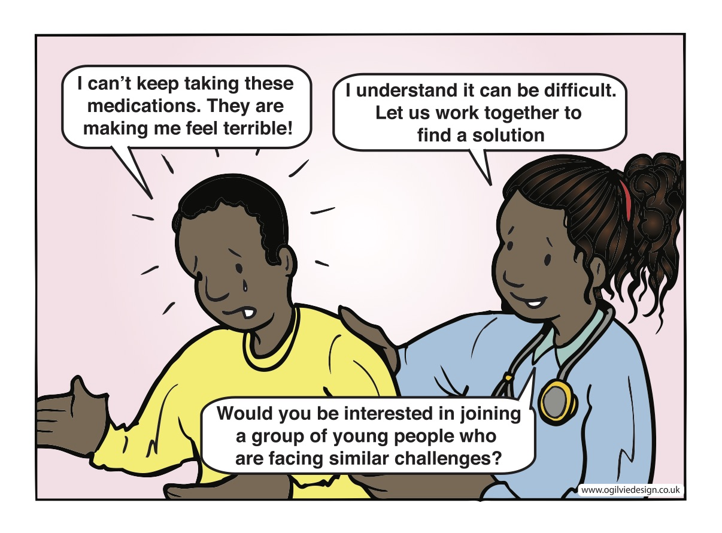
Notes:
Adolescents need support to continue their medication.

Slide 12
HIV PREVENTION & CARE
A Regional Perspective

Slide 13
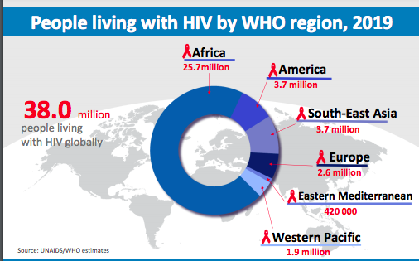
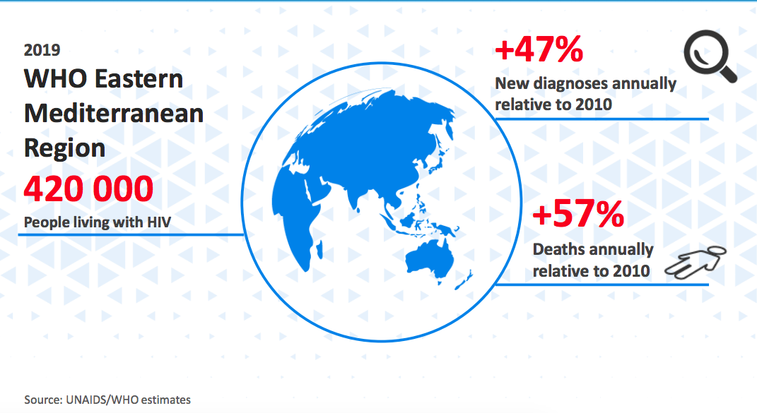
Key facts about HIV from the
Eastern Mediterranean Region
HIV prevalence in the EMR is lowest in the world. An estimated 1.1% (420,000) of adults aged 15–49 years are living with HIV in the EMR, according to 2019 estimates. (1)
Comparison with other Regions
Overview of HIV in EMR
Notes:
It is important to note that the number of new diagnoses and deaths annually have increased substantially since 2010.
Individual country profile for HIV can be accessed from the WHO portal data base: https://cfs.hivci.org/country-factsheet.html

Slide 14
Key facts about HIV from the Region
Despite having the lowest HIV prevalence in the world, the EMR region is one of few regions where the HIV epidemic has not waned and continues to increase; i.e.
  47% new infections by 2020 compared to 2010
  57% increase in AIDS deaths by 2020 compared to 2010
  (2, 3)
The region suffers from poor access to antiretroviral treatment (ART), with only 40% of those needing ART having access –compared to the global level of 73% by 2020 (2, 3)
Notes:
In the Eastern Mediterranean Region:
An estimated 420 000 [370 000–550 000] people were living with HIV in 2020, with 40% diagnosed, and 25% on treatment.
An estimated 110 000 [100 000–110 000] people were on antiretroviral therapy in 2020.
An estimated 41 000 [35 000–60 000] people became newly infected with HIV in 2020
New infections among all ages remained stable at 0.06 [0.05–0.09] out of 1000 uninfected population in 2020.
17 000 [14 000–24 000] deaths were attributed to HIV-related causes in 2020, an increase of around 1.2% from 2019. (2)

Slide 15
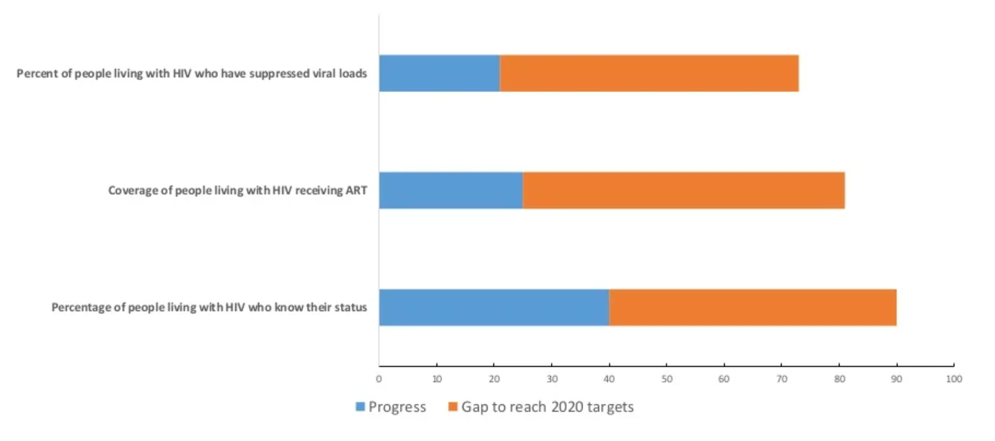
HIV cascade of care in the Region
Source: WHO Regional Office for the Eastern Mediterranean. Regional overview of HIV/AIDS in the Eastern Mediterranean Region, 2020. http://www.emro.who.int/asd/country-activities/
Notes:
Source: WHO Regional Office for the Eastern Mediterranean. Regional overview of HIV/AIDS in the Eastern Mediterranean Region, 2020. Available from: http://www.emro.who.int/asd/country-activities/

Slide 16
Key facts about HIV from the Region
Policy Situation
20/22 countries have adopted WHO HIV Test, Treat, and Retain policy (4)
Although the general population living with HIV (PLHIV) is low, key populations in the Region continue to be disproportionately affected (5)
High rates of infection are found among people who inject drugs in Pakistan (21%), Islamic Republic of Iran (9.3%), Morocco (7.9%), Afghanistan (4.4%), Tunisia (3.9%), and Egypt (2.4%).
HIV prevalence among men who have sex with men (MSM) was estimated at 12.6% in Lebanon, followed by Morocco (5.7%), Sudan (1.4%), and Tunis (1.4%).
HIV prevalence among sex workers was estimated to be 12.9% in Djibouti, followed by Somalia (5.2%), Egypt (2.8%), and Pakistan (3.8%).
Antiretroviral therapy (ART) coverage (5)
By 2020, EMR continued to demonstrate the lowest ART coverage at 25% among PLHIV and 23% for children living with HIV.
ART coverage varies across countries in the Region. For example, high ART coverage is observed in low burden countries such as Morocco (65%), Lebanon (63%), Oman (61%), and most Gulf countries. Meanwhile, high burden countries such as Pakistan (21%), Sudan (22%), and Iran (25%) have lower ART coverage.

Slide 17
Knowledge of HIV among adolescents
Source: DHS statcompiler. https://www.statcompiler.com/en/
Notes:
Source: DHS statcompiler. Available from: https://www.statcompiler.com/en/

Slide 18
Knowledge of HIV prevention among adolescents
Source: DHS statcompiler. https://www.statcompiler.com/en/
Notes:
Source: DHS statcompiler. Available from: https://www.statcompiler.com/en/

Slide 19
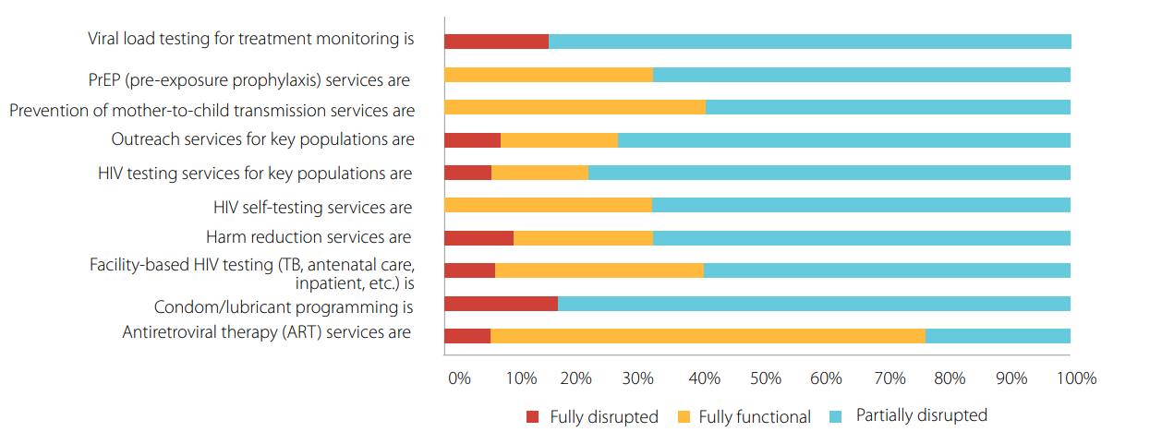
Disruption to HIV services in the Eastern Mediterranean Region
Source: WHO Regional Office for the Eastern Mediterranean. Regional overview of HIV/AIDS in the Eastern Mediterranean Region, 2020. http://www.emro.who.int/asd/country-activities/
Notes:
Source: WHO Regional Office for the Eastern Mediterranean. Regional overview of HIV/AIDS in the Eastern Mediterranean Region, 2020. Available from: http://www.emro.who.int/asd/country-activities/

Slide 20
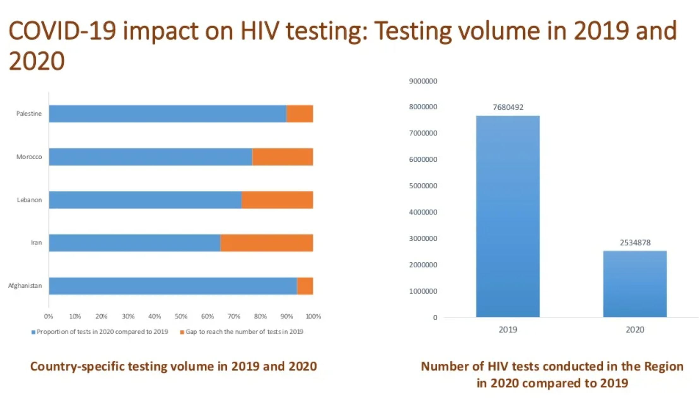
Source: WHO Regional Office for the Eastern Mediterranean. Regional overview of HIV/AIDS in the Eastern Mediterranean Region, 2020. http://www.emro.who.int/asd/country-activities/
Notes:
Source: WHO Regional Office for the Eastern Mediterranean. Regional overview of HIV/AIDS in the Eastern Mediterranean Region, 2020. Available from: http://www.emro.who.int/asd/country-activities/

Slide 21
Regional Challenges
Limited access to services: The majority of PLWHIV in the Region do not have access to HIV testing, and an analysis of the situation showed that the “treatment gap” is mainly due to the “testing gap”. Gender-based discrimination further prevents access to services for many adolescent girls. (5)
Stigma: Stigma related to HIV and to key populations, who are disproportionally affected by HIV is rife in the Region and presents a major obstacle to uptake of HIV services. (5, 6)
Inadequate political commitment: In most low-income countries in the Region, the HIV response is largely dependent on external donor funding. This is a reflection of the limited political commitment and low priority given to HIV in many countries. Further, political developments in the past decade in the Region have not been conducive to de-criminalization and de-stigmatization. (5)
Lack of integration and concerns about confidentiality: The current service delivery models are challenged by a lack of integration and decentralization, which if addressed could serve to improve acceptability of services for HIV and other stigmatized diseases. As a result, key populations and adolescents are often reluctant to use services for fear of their HIV status being exposed to their communities. (5, 6)
Poor surveillance systems: One study found that only four (Morocco, Iran, Djibouti, Pakistan) of the 23 MENA countries assessed had effective HIV surveillance systems to enable them to track their epidemics. (7)
Lack of disaggregated data: There is a lack of age and sex disaggregated data in the routine health management systems is many countries of the Region. Such data is required to know who needs services and how existing services are or are not meeting their needs to inform evidence-based decision-making.
Notes:
HIV test-treat-retain cascade analysis in countries of the Region shows consistently that the treatment gap is mainly the result of a “testing gap”, i.e., a gap between the estimated number of PLHIV and the number of PLHIV who know that they are infected. (However, as stated above, HIV estimates might also not be reliable). (5)
There is concern that HIV estimates are not very accurate in most countries of the Region because:
the UNAIDS estimation methodology is not well adapted to low-prevalence countries
Data on sizes of and HIV prevalence among key populations in many countries are scarce and not always of good quality. However, those data are essential for a meaningful modelling of the HIV epidemics. (7)

Slide 22
REGIONAL INITIATIVE 1
Egyptian Family Planning Association (EFPA)
The EFPA uses outreach as an extension of its clinical services to engage with young people who are most at risk of acquiring HIV (8)
Strategy
Outreach activities through peer educators to extend the reach of health services.
Advocacy to influence policy change that prioritizes the sexual and reproductive health needs of young people within the national health system.
Services
Peer educators conduct outreach sessions with young people less than 18 years of age, primarily at orphanages and government institutions for street children. The peer educators explain the services offered at the clinics, encourage participants to use services as needed, and distribute condoms.
The sessions are offered at a location away from the clinic so that the participants to preserve confidentiality and avoid the stigma associated with seeking HIV services.
Achievements
In 2012, 81 peer-to-peer sessions reached almost 2,300 people, one-third of whom were young men who have sex with men or young people who inject drugs.
Notes:
EGYPTIAN FAMILY PLANNING ASSOCIATION | EGYPT
Serving the needs of key populations: Case examples of innovation and good practice on HIV prevention, diagnosis, treatment and care (WHO, 2017. p. 42)
Each clinic has two male and two female educators aged 18–25 years who are trained in comprehensive sexual and reproductive health education, HIV and other STIs, and communication skills; they are supervised by clinic staff and by an EFPA reproductive health officer and youth officer.
Of the 56 EFPA educators, 30 have been trained to work specifically with young key populations, and some are themselves members of key populations.

Slide 23
REGIONAL INITIATIVE 2
Development of a TEST, TREAT, RETAIN tool (8*, 9)
To improve access to treatment, the WHO Eastern Mediterranean Regional Office (EMRO) developed a tool to assess barriers to HIV testing, care, and treatment in 2014.
Purpose
To guide healthcare providers in using qualitative data to assess the determinants and extent of engagement of PLWHIV along the continuum of diagnosis and care.
To highlight opportunities to improve access to HIV testing, strengthen linkages to care, and support patient retention in lifelong treatment.
Achievements
Six countries (Egypt, Islamic Republic of Iran, Lebanon, Morocco, Pakistan (Punjab), Sudan) carried out the test, treat, retain cascade analysis.
In follow up to this analysis, and with support from WHO EMRO, the countries have:
  Developed testing and treatment acceleration action plans, which are now being implemented.
  Updated their HIV treatment guidelines in line with latest WHO recommendations and adopted them at the national level.
*Page 48 of Serving the needs of key populations: Case examples of innovation and good practice on HIV prevention, diagnosis, treatment and care (WHO, 2017.).
Notes:
It is crucial to address barriers across the prevention, testing and treatment cascade for key populations. WHO Eastern Mediterranean Regional Office developed a tool for countries to assess these barriers and address them.
Five focus countries (Egypt, Islamic Republic of Iran, Morocco, Pakistan/Punjab and Sudan) and Lebanon carried out the test-treat and retain cascade analysis and identified missed opportunities for engaging people living with HIV in the continuum of HIV testing care and treatment. Testing and treatment acceleration action plans to close these gaps were developed and are now being implemented in these countries.

Slide 24
Regional opportunities (10)
Regional strategy for health sector response to HIV, 2016-2021
The WHO Eastern Mediterranean Regional Office, in consultation with stakeholders, developed a regional strategy for the health sector’s response to HIV. This presents an opportunity for the Region to align with the commitments made by the United Nations General Assembly in 2001 and 2006, as well as the strategic directions for the achievement of universal access to HIV prevention, treatment, care and support developed by WHO and UNAIDS:
Maintaining and improving coverage of optimized treatment among PLHIV
Tailoring programming to improve access and uptake of services (prevention, testing, treatment) for key populations
Re-engaging those lost-to-follow-up
Enhancing health information systems
Continuing advocacy and resource mobilization

Slide 25
References
World Health Organization. Latest HIV estimates and updates on HIV policies uptake, November 2020: Global HIV, Hepatitis and STI Programmes. World Health Organization; 2020. Available from: https://www.who.int/docs/default-source/hiv-hq/latest-hiv-estimates-and-updates-on-hiv-policies-uptake-november2020.pdf?sfvrsn=10a0043d_12
Mugisa B, Sabry A, Hutin Y, Hermez J. HIV epidemiology in the WHO Eastern Mediterranean region: a multicountry programme review. The Lancet HIV. 2022 Feb 1;9(2):e112-9. http://dx.doi.org/10.1016/S2352-3018(21)00320-9
UNAIDS DATA 2020. UNAIDS; 2020. Available from: https://www.unaids.org/sites/default/files/media_asset/JC3032_AIDS_Data_book_2021_En.pdf
EMRO HIV and STI prevention and care Department. (Unpublished report). For more details contact mugisab@who.int
WHO EMRO. AIDS and sexually transmitted diseases: HIV in the WHO Eastern Mediterranean Region. World Health Organization; c2021. Available from: http://www.emro.who.int/asd/about/hiv-situation-region.html
Al-Iryani B, Basaleem H, Al-Sakkaf K, Crutzen R, Kok G, van den Borne B. Evaluation of a school-based HIV prevention intervention among Yemeni adolescents. BMC Public Health. 2011 May 7;11(1):279. http://dx.doi.org/10.1186/1471-2458-11-279

Slide 26
References
Bozicevic I, Riedner G, Calleja JMG. HIV surveillance in MENA: recent developments and results. Sexually Transmitted Infections. 2013 Nov;89(Suppl 3):iii11. http://dx.doi.org/10.1136/sextrans-2012-050849
World Health Organization. Serving the needs of key populations: Case examples of innovation and good practice on HIV prevention, diagnosis, treatment and care. Geneva: World Health Organization; 2017. Licence: CC BY-NC-SA 3.0 IGO. p. 42, 48. Available from: https://www.who.int/hiv/pub/populations/key-populations-case-examples/en/
UNAIDS DATA 2020. UNAIDS; 2020. Available from: https://www.unaids.org/sites/default/files/media_asset/JC3032_AIDS_Data_book_2021_En.pdf
WHO Regional Office for the Eastern Mediterranean. Regional strategy for health sector response to HIV 2011–2015. World Health Organization; 2011. Available from: https://applications.emro.who.int/dsaf/emropub_2011_1242.pdf
Individual country profile for HIV can be accessed from the WHO portal data base: https://cfs.hivci.org/country-factsheet.html

