Slide 1
COMPREHENSIVE SEXUALITY EDUCATION (CSE) PROVISION
Notes:
This module addresses Comprehensive Sexuality Education (CSE).

Slide 2
WHAT IS CSE?
CSE is a curriculum-based process of teaching & learning about the cognitive, emotional, physical & social aspects of sexuality.
CSE aims to equip children & adolescents with:
knowledge, skills, attitudes & values that will empower them to realize their health, well-being & dignity,
(ii) develop respectful social & sexual relationships,
(iii) consider how their choices affect their own wellbeing & that of others, &
(iv) understand & ensure the protection of their rights throughout their lives.
Notes:
This slide explains what CSE is and what it aims to achieve.
UNESCO, (2018). International technical guidance on sexuality education. An evidence-informed approach.
Available at: https://www.unfpa.org/sites/default/files/pub-pdf/ITGSE.pdf

Slide 3
Key Concepts to be included in the curricula International Technical Guidance on CSE
Relationships
Values, Rights, Cultures and Sexuality
Understanding Gender
Violence and Staying Safe
Skills for Health and Wellbeing
The Human Body and Development
Sexuality and Sexual Behavior
Sexual and Reproductive Health Topics
Notes:
Key concepts of the International Technical Guidance on Sexuality Education
1. RELATIONSHIPS
1.1 Families
1.2 Friendship, Love and Romantic Relationships
1.3 Tolerance, Inclusion and Respect
1.4 Long-term Commitments and Parenting
2. VALUES, RIGHTS, CULTURES AND SEXUALITY
2.1 Values and Sexuality
2.2 Human Rights and Sexuality
2.3 Culture, Society and Sexuality
3. UNDERSTANDING GENDER
3.1 The Social Construction of Gender and Gender Norms
3.2 Gender Equality, Stereotypes and Bias
3.3 Gender-based Violence
4. VIOLENCE AND STAYING SAFE
4.1 Violence
4.2 Consent, Privacy and Bodily Integrity
4.3 Safe use of Information and Communication Technologies (ICTs)
5. SKILLS FOR HEALTH AND WELLBEING
5.1 Norms and Peer Influence on Sexual Behavior
5.2 Decision-making
5.3 Communication, Refusal and Negotiation Skills
5.4 Media Literacy and Sexuality
5.5 Finding Help and Support
6. THE HUMAN BODY AND DEVELOPMENT
6.1 Sexual and Reproductive Anatomy and Physiology
6.2 Reproduction
6.3 Puberty
6.4 Body Image
7. SEXUALITY AND SEXUAL BEHAVIOR
7.1 Sex, Sexuality and the Sexual Life Cycle
7.2 Sexual Behavior and Sexual Response
8. SEXUAL AND REPRODUCTIVE HEALTH
8.1 Pregnancy and Pregnancy Prevention
8.2 HIV and AIDS Stigma, Care, Treatment and Support
8.3 Understanding, Recognizing and Reducing the Risk of STIs, including HIV

Slide 4
RATIONALE
Adolescents need CSE: Adolescents need knowledge & skills to make well-informed choices about their lives, learn how to avoid & deal with problems, & know where to seek help if necessary.
CSE has been shown to be effective: There is strong evidence for the positive effects of CSE. There is no evidence that CSE increases sexual activity, sexual risk-taking behaviour, or rates of HIV or other STIs.
Access to & provision of good-quality CSE programmes need attention: Many countries that have implemented large-scale CSE programmes struggle with ensuring quality and fidelity. Furthermore, the ability to access CSE is often based on being in school.
Notes:
This slide sets out the rationale for CSE.

Slide 5
HUMAN RIGHTS OBLIGATIONS
CSE is part of the core obligations of states to uphold the right to sexual & reproductive health.
CSE should address self-awareness & knowledge about the body, sexual health & well-being.
All children & adolescents should have access to CSE which should be free, confidential, adolescent-responsive & non-discriminatory.
CSE should be available both online and in person. It should be age-appropriate based on scientific evidence, comprehensive & inclusive.
CSE curricula should be developed with adolescents & be part of the mandatory school curriculum.
Notes:
This slide lists the human rights obligations of signatories of the Convention on the rights of the child in relation to CSE.

Slide 6
KEY CONCEPTS TO CONSIDER
There is deep-seated discomfort about adolescent sexuality which contributes to barriers to the provision of CSE: CSE needs to be placed on national agendas, & strategies put in place to build community support and identify & address reduce resistance.
There is a widespread misconception that the provision of CSE leads to early or risky sexual behaviour: There is strong evidence that CSE does not increase sexual activity, sexual risk-taking behavior or rates of HIV or other STIs. This message must be communicated widely.
Teachers often lack good quality training & support on CSE content & on participatory facilitation/non-judgmental teaching: Teachers and schools must be supported to deliver CSE effectively and to engage parents & families in this.

Slide 7
WHO GUIDELINES
WHO guidelines on preventing early pregnancy and poor reproductive outcomes among adolescents in developing countries (2011)
  With regards to CSE, the guideline recommends Advocacy at community level involving all stakeholders through information provision, sexuality and health education, life skills building, contraceptive counselling and service provision and creation of supportive environments.
  At the individual level, provision of accurate information and education, particularly CSE to increase contraceptive use.
Ensuring human rights in the provision of contraceptive information and services: guidance and recommendations (2014)
  At the individual level, provision of scientifically accurate CSE programmes within and outside of schools that include information on contraceptive use and acquisition.
Consolidated guidelines on HIV prevention, diagnosis, treatment and care for key populations (2016 update)
  Includes the good practice recommendation that sexuality education programmes for adolescents both in and outside of schools, should be scientifically accurate and comprehensive and include information on contraceptives, including and to use and where to get them.
  Promotes CSE as an approach to addressing social norms and stigma concerning sexuality, gender identities and sexual orientation
Notes:
This slide lists the three WHO guidelines which address CSE. All these guidelines are available online.

Slide 8
COMPLEMENTARY PUBLICATIONS TO WHO’s GUIDELINES
1/2
Revised edition: International technical guidance on sexuality education- an evidence-informed approach (UNESCO, 2018).
Standards for sexuality education in Europe: a framework for policy makers, educational and health authorities and specialists (WHO Regional Office for Europe and Federal Centre for Health Education, 2010).
Standards for sexuality education in Europe: guidance for implementation (Federal Centre for Health Education, 2013)
Operational guidance for comprehensive sexuality education: a focus on human rights and gender (UNFPA, 2014).
The evaluation of comprehensive sexuality education programmes: a focus on the gender and empowerment outcomes (UNFPA, 2015).
Notes:
This slide lists some key publications complementary to WHO’s guidelines.

Slide 9
COMPLEMENTARY PUBLICATIONS TO WHO’s GUIDELINES
2/2
Youth-centred digital health interventions: a framework for planning, developing & implementing solutions with & for young people (WHO, 2020)
https://www.who.int/publications/i/item/9789240011717
Switched on: Sexual education in the digital space (UNESCO, 2019)
https://en.unesco.org/sites/default/files/unesco-swtiched_on-technical_brief.pdf
International Technical and Programmatic Guidance for out-of-school CSE (UNFPA, 2020)
https://www.unfpa.org/publications/international-technical-and-programmatic-guidance-out-school-comprehensive-sexuality
Notes:
This slide lists some key publications complementary to WHO’s guidelines.
Youth-centred digital health interventions: a framework for planning, developing and implementing solutions with and for young people
Switched on: Sexual education in the digital space
International Technical and Programmatic Guidance on out-of-school CSE

Slide 10
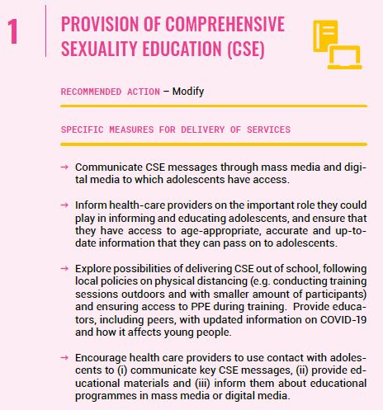

Slide 11
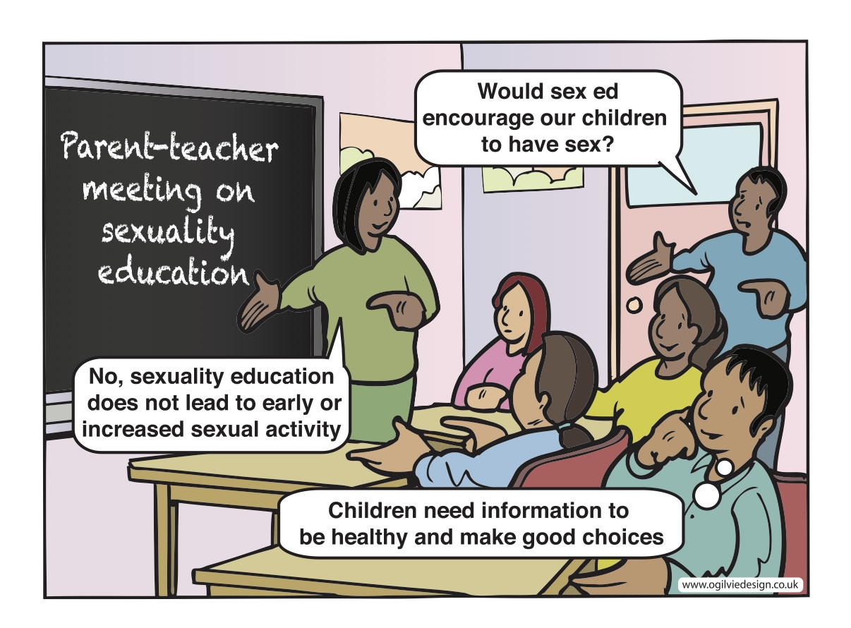
Notes:
There is widespread misconception that providing CSE will encourage adolescents to engage in early and risky sexual behaviour. As a result, the content of CSE is often watered down or more limited than recommended by international guidance.

Slide 12
COMPREHENSIVE SEXUALITY EDUCATION IN THE EASTERN MEDITERRANEAN REGION
MODULE 1
A Regional Perspective

Slide 13
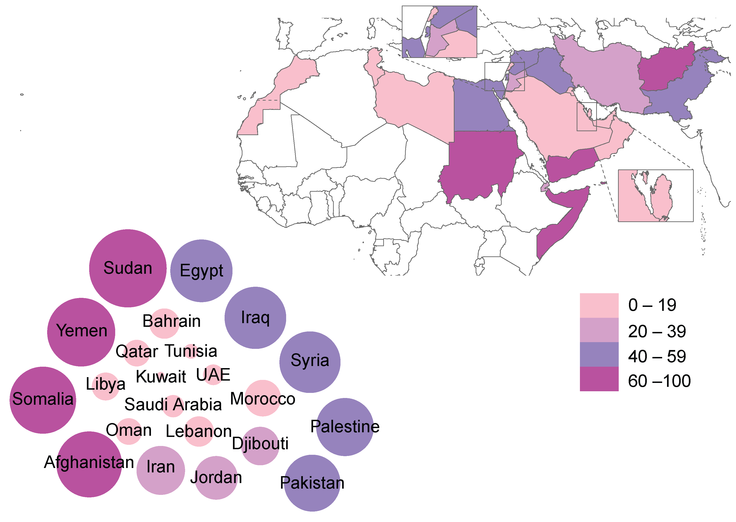
Adolescent fertility rate (per 1000 girls aged 15-19 years) in Eastern Mediterranean Region (EMR)
Notes:
Monitoring health and health system performance in the Eastern Mediterranean Region
https://rho.emro.who.int/sites/default/files/booklets/EMR-HIS-and-core-indicators-2019-final_0.pdf%20

Slide 14
CSE IN THE EMR (KNOWLEDGE AND ATTITUDES)
Knowledge
The data from the Pan Project for Family Health (PAPFAM) in 2013 concluded that there are misconceptions and gaps in knowledge of sexual and reproductive health, affecting the attitudes of young people in countries like Djibouti, Lebanon, Syria and Tunisia.¹
Young people in the region do not know how to protect themselves from sexual and reproductive health risks and illnesses; nor do they have adequate access to reliable sources of information to answer their questions and address their concerns. Schools are ill equipped, and parents are unwilling to provide information on this issue.²
There is poor knowledge of pubertal changes and other reproductive health information among most adolescent girls. Less than 40% of girls in Riyadh knew that key Sexually Transmitted infections (STI) were in fact sexually-transmitted according to a study in 2012.³
A 2021 study conducted on KAP among males in Palestine found that⁴:
  Adolescent boys and girls had low knowledge of contraception methods. Overall percentage level of knowledge about FP methods were as follows; among men 19%; women 26%; boys 7%, girls 16%
  When asked about SRHR, the first reaction of some boys was to say ‘Shame!’
  Qualitative interviews indicated that boys get insufficient information from schools, with teachers often skipping relevant topics; it is more common for adolescents to get unreliable and possibly inaccurate information mostly from the virtual world or from their friends or from the streets.

Slide 15
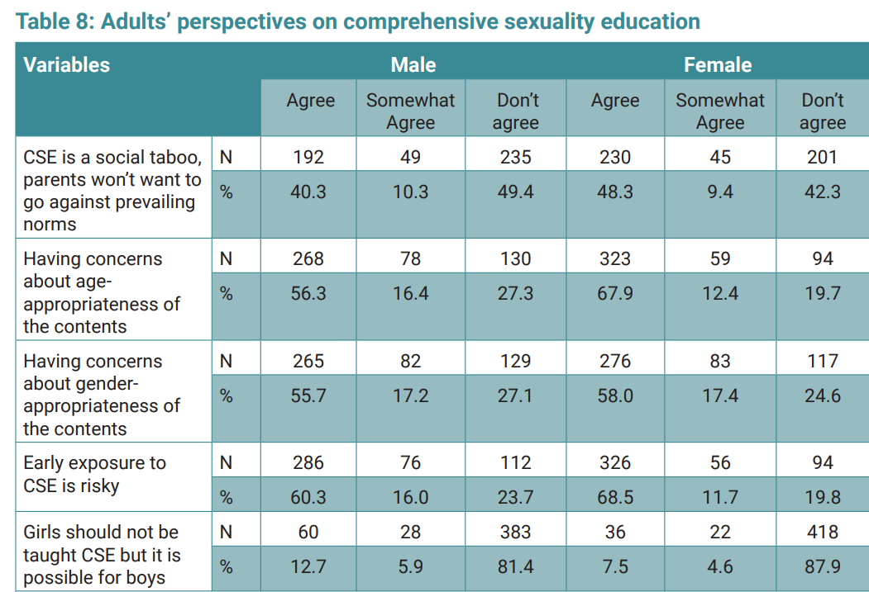
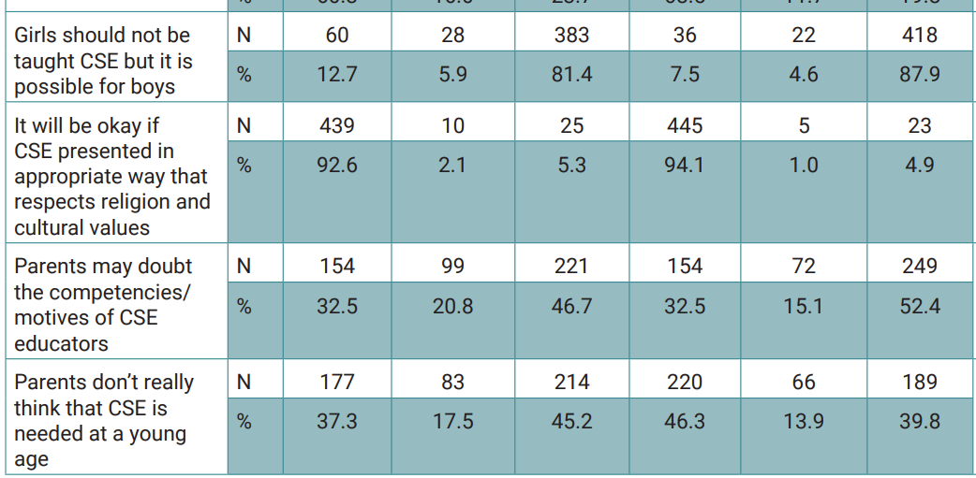
CSE IN THE EMR (KNOWLEDGE AND ATTITUDES)
Attitudes
I. Parents’ attitudes: Surveys in Pakistan and Oman showed that 73% of Omani parents and 76% of Pakistani parents agree to the provision of science-based CSE in schools. Almost all parents (95.8%) agreed that CSE should be provided in accordance with Islamic regulations. Parental support for school-based CSE programmes that do not subvert Islamic values clearly indicates that discussion of sexual and reproductive matters is not taboo but is acknowledged and respected in the Islamic context ^{5,6}
II. Teachers’ attitudes: A survey conducted in Saudi Arabia showed that 61% of young women reported that their teachers displayed negative attitudes when posed questions related to sexual issues.⁷
III. The 2021 study conducted on KAP among males in Palestine found
that^{4:}
almost half of adult respondents agreed or somewhat agreed that comprehensive sexuality education (CSE) is a taboo subject
76% of male adults and 80% of female adults think early exposure to CSE is risky
Around half of parents agreed or somewhat agreed that they may doubt the competencies or motives of CSE educators.

Slide 16
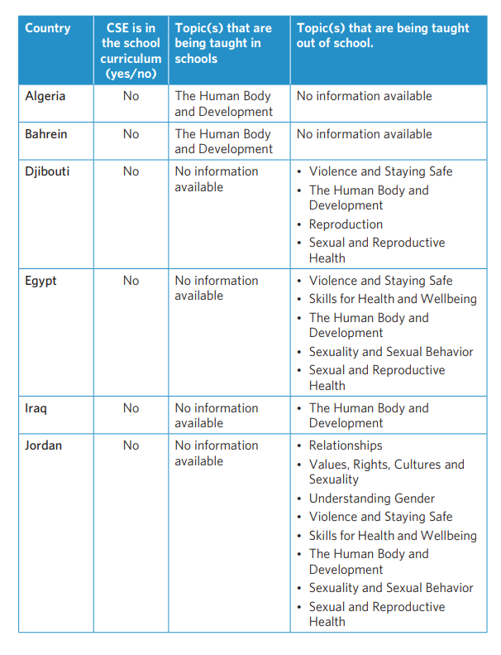
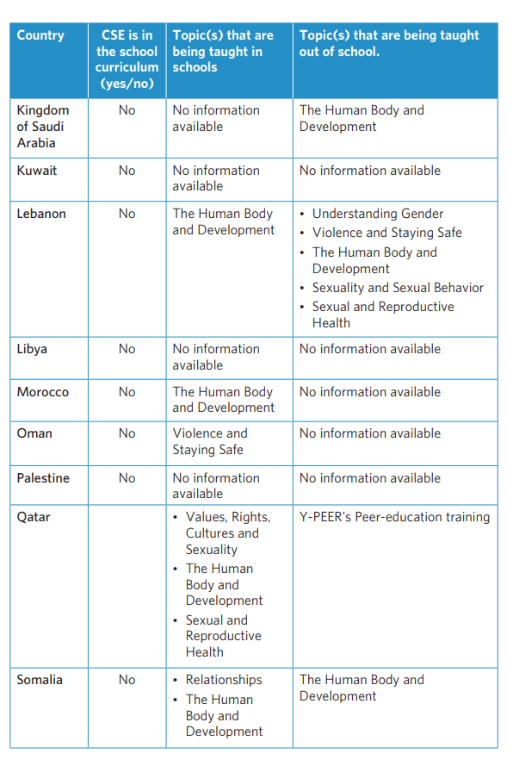
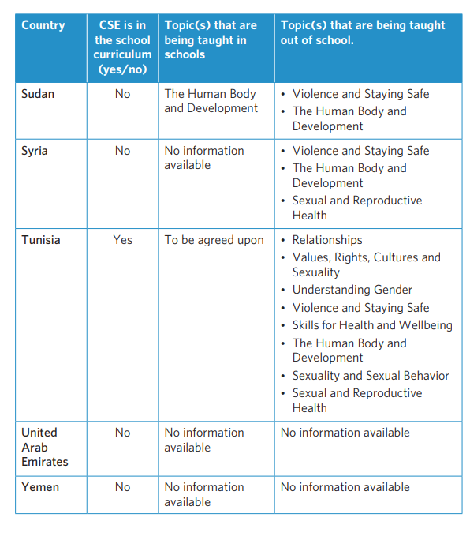
CSE in Arab States
Is CSE provided in school and out-of-school settings?
Source: UNFPA. Navigating Comprehensive Sexuality Education in the Arab Region: A situational analysis. UNFPA; 2020.
Notes:
No data compiled for EMR countries, but there is data compiled on CSE in Arab States by UNFPA

Slide 17


Backed by first national law to combat VAW
Expert Committee established
Developing age and developmentally appropriate teaching & learning resources
Tunisia
Country example - Tunisia
This slide was provided by UNESCO HQ
Notes:
As we are gathered today in the Middle East and North Africa region, let’s start with a regional journey toward CSE. Sexuality education is currently undergoing a major reform in Tunisia, following concerted advocacy from a wide range of stakeholders. Sexuality education is backed by the first national law to combat violence against women, passed in 2017, which mandates education for health and sexuality.
Following a 2017 conference, an Expert Committee was established. This group continued to advocate to the MoE, and started developing a range of teaching and learning resources that are age appropriate and consider the stages of development of the learner for potential future use.

Slide 18

Tunisia
Increased reports of sexual harassment & violence in school = mandatory sexuality education for all learners
Expert group expanded
Plans for scale up in place
Notes:
In 2019, increasing reports of sexual harassment and violence in schools triggered the MoE to step up its efforts to strengthen sexuality education. The ministry released a circular mandating sexuality education for all learners aged 5-18 and appointed a ministry staff member to manage efforts.
Further members joined the expert group, including representatives from the Ministry of Health, the Ministry of Women, Family and Children, education unions, teachers and youth, who worked together to integrate topics and learning objectives, guided by the revised UN ITGSE into the curriculum across several subjects, with recognition of local context. Teaching and learning resources that support the curriculum have also been developed, and adapted for learners with disabilities.
There has been some opposition from parents and religious leaders, for instance, by teachers of Islamic Studies. Representatives of these teachers were invited to join the expert committee and have been part of efforts to revise some of the language.
With two recent changes of government in Tunisia and the onset of the COVID-19 pandemic, implementation has been delayed. However, with the curriculum and training tools ready to go, and a pool of trained master trainers, they move to the finalisation phase as they started with a pilot phase in ten regions: these regions were chosen either on a voluntary basis, that is, the teachers were willing to participate in the project, or because these are regions where the rate of violence is quite high. They are also preparing a plan of action for staff training at a larger scale and planned an evaluation phase at the end of the course to be able to take a decision on the generalisation of this project all around Tunisia.

Slide 19
REGIONAL CHALLENGES TO CSE
Socio-cultural challenges
Myths about the negative impact of sexuality education (SE) to adolescents are prevalent. More resistance about the content of SE programmes than about CSE itself. ‘Cultural silence,’ perceived stigma and embarrassment lead to reluctance in discussing sexual matters in public. ^{8,9}
CSE is perceived as a source of imitating foreign models and a threat to religious obligations. This reduces its social acceptability. The wide inter-generational gap as a consequence of advanced communication technology further reduces confidence of families to trust adolescents seeking information from different sources. ^{8,9}
EMR is facing an unprecedented scale of humanitarian emergencies, in several countries. Disruption of families, health services and social norms during these crises leave adolescents without access to SRH information and services. ¹⁰
Policy and programmatic challenges ¹¹
Lack of coordination between national authorities and NGOs is also a challenge in the many countries and leads to lack of clarity over whose mandate it is to implement CSE.
Failure of effective policy dialogues and reluctance to legal reforms related to adolescent reproductive and sexual rights is responsible for lack of effective implementation of sexual health education programmes.
Lack of monitoring and evaluation of programmes leads to lack of availability of timely, quality data for programmes particularly those designed for the age group of 10- to 14-year-olds.
Financial constraints: Funding for adolescent health in most countries of the EMR is limited, and most programmes depend on external organizations which tend to be short-lived and lack sustainability.

Slide 20
Regional Initiative: the case of Jordan¹²
Online RH elective courses in 7 universities reached 7749 students
Y-PEER + Shababna Youth Network mobilized CSE online learning + initiatives reaching more than 6000 youth/ Youth Role in National COVID-19 awareness raising campaigns
Pilot of MOE CSE module + Online learning reaching 2000 school students
"When I heard my daughter saying she is attending a peer education session on SRHR, I was hesitant and thought the session would open my daughter's eyes and won't be in line with our values and principles. But when I started to listen to the session with her...it really hit me that no one ever spoke to me about reproductive health. The information was not available, and I learned from my personal experience. At the end of the session I thanked the facilitator for the efforts in raising awareness in topics we really don't know much about, or we consider it as a taboo,” Majd Kreishan a mother of one of the participants from Maan.

Slide 21
REGIONAL INITIATIVES- SUCCESSFUL PROGRAMMES
  The Egyptian Family Health Society (EFHS)
  EFHS has implemented one of the largest studies on SRH education projects in EMR in collaboration with the Ministry of Education, providing SRH and life-skills education in preparatory and secondary schools in 22 governorates, at the beginning of the academic year 2010-2011. The project identified large deficiencies in the knowledge of adolescents on SRH. A post-programme evaluation in 2012 showed marked improvement in the level of their knowledge after attending teaching sessions and parents’ willingness for their children to attend such sessions. ¹³
  Aahung – Rutgers: Advancing adolescent’s SRH in PAKISTAN
Through capacity building and information dissemination Aahung aims to improve the quality of SRH services while advocating for an enabling environment. It has been successful in developing culturally informed strategies in response to the SRH needs of the population. Targeted age groups are girls and women aged 12-22 years. Aahung life skills-based education (LSBE) program is a comprehensive curriculum, spanning across the spheres of critical reproductive health information, prevention of abuse and the management skills with which it is necessary to equip children and adolescents as they grow. This curriculum also focused on building core life skills supporting communication, decision making and negotiating. ¹⁴
https://www.aahung.org

Slide 22
CHANGING ATTITUDES TOWARDS CSE IN THE REGION - LESSONS LEARNED
Deep rooted social and cultural barriers within an adolescents’ environments, in order to sensitize and engage influencers for the successful delivery of SRH education to adolescents in the region. ^{12,13}
Engagement of stakeholders ^{15,16}
Engagement of “gate keeper (parents and custodians of culture in the community for example religious leaders) in CSE curriculum development.
Engagement of adolescents: From a developmental perspective, the engagement of adolescents enhances adolescent-adult relationships, develops adolescent leadership skills, motivation and self-esteem, and enables them to develop the competencies and the confidence they need to play an active, positive and pro-social role in society.
Scaling up CSE in schools in collaboration with the health sector
A recent online survey of 2,000 young people (18–30 years) through Love Matters Arabic found that 82% of respondents think CSE programmes should be implemented in schools by social workers (68%) and teachers (14%) (LMA, 2019).¹⁷
Promotion of CSE through the education and health sectors will increase credibility and draw political support in rolling out CSE. WHO recommends that appropriate health sector representatives should be informed about effective CSE and should actively support its implementation at multiple ecological levels (policy, community and school level settings). ¹⁸
Notes:
For Aahung, this process involved ongoing diplomacy and partnership building with school administrators, teachers, and school communities. They began by leveraging key advocates among government officials and civil service organizations to sensitize school decision makers on the utility of LSBE to address young people's health and social needs.

Slide 23
FUTURE PROSPECTS - 1
1: Building On the Existing Opportunities:
  EMR vision of integration of ASRH, 2019
  Initiative taken in 2019 to integrate sexual and reproductive health and rights package in national health policies, programmes and practices in the Eastern Mediterranean Region. This will allow the initiatives at the central/regional level to filter down at the national level of each country.¹⁹
Regional Framework for Joint UN Strategic Action for Young People in the Arab States, Middle Eastern and North African Region (2016-2017) ²⁰
To develop a common two-year framework for young people (10-24 years) in the Arab States and MENA region that will contribute to fulfilling their human rights and enable them to develop their capacities– within a safe and supportive environment. Out of four strategic priorities they recommended Establishing a regional conceptual framework for life- skills education and a regional conceptual framework for comprehensive sexuality education, leading to national frameworks.
Youth Targets for Sustainable Development Goals (SDG’s) 2030
This provides an opportunity to address CSE from both health and development perspective.
    Ensure healthy lives and promote well-being for all at all stages (SDG3)
    Ensure inclusive and equitable quality education and promote lifelong learning opportunities for all (SDG4)
    Achieve gender equality and empower all women and girls (SDG5)
    This offers significant opportunities to build global and national action to achieving adolescent reproductive and sexual health.²¹
Notes:
It was agreed that Integration of SRHR interventions into existing programmes and service delivery packages will improve the accessibility and availability of SRHR services, reduce costs and maximize the use of already limited human resources.

Slide 24
FUTURE PROSPECTS-2
2: Implementing A successful CSE programme;
Implementation CSE programme through adopting evidence-based interventions at the policy, community and school levels ^{12,16, 18}
Enabling Environment
Building block necessary for a successful CSE programme is an enabling environment, which encompasses
Enabling policies
Supportive cultural norms and values
Infrastructure
Collaborative model of CSE
The collaborative model of education and health sector can together facilitate implementation CSE
Providing inputs for the development of evidence-based, age-appropriate and skills-based SRH education in school curricula
Encouraging the development and adaptations of the curriculum to different cultural contexts and use of standards for SRH education
Teacher training and retraining through professional organizations; enhancing positive attitudes towards CSE ²²
Jointly reviewing the accuracy of information and the appropriateness of skills-based training in school curricula
Supporting out-of-school comprehensive sexuality education
Coordinated implementation
Ongoing monitoring and evaluation of the implemented programmes

Slide 25
REFERENCES
1. Abdelwanis Mohamed M. Health Knowledge and Attitudes Among Youth in Selected Arab Countries, with a Specific Focus on Sexual and Reproductive Health: Maha Abdelwanis Mohamed. European Journal of Public Health. 2013 Oct 1;23(ckt123.022). http://dx.doi.org/10.1093/eurpub/ckt123.022
2. Wahba M. Adolescents’ Sexual and Reproductive Health in the Arab World. In: Laher I, ed. Handbook of Healthcare in the Arab World. Cham: Springer International Publishing; 2019:1-25. http://dx.doi.org/10.1007/978-3-319-74365-3_100-1
3. AlQuaiz AM, Kazi A, Al Muneef M. Determinants of sexual health knowledge in adolescent girls in schools of Riyadh-Saudi Arabia: a cross sectional study. BMC Women’s Health. 2013 Apr 15;13(1):19. http://dx.doi.org/10.1186/1472-6874-13-19
4. Nadia Al Bayoumi, Riyad Diab and Bassam Abu Hamad. Knowledge, Attitudes and Practices Among Men in the Gaza Strip Related to Sexual and Reproductive Health and Rights and Child-Rearing. 2021 Oct.
5. Zaabi OA, Heffernan M, Holroyd E, Jackson M. Islamic parents’ attitudes and beliefs towards school-based sexual and reproductive health education programmes in Oman. Sex Education. 2019 Sep 3;19(5):534-50. http://dx.doi.org/10.1080/14681811.2018.1553708
6. Nadeem A, Cheema MK, Zameer S. Perceptions of Muslim parents and teachers towards sex education in Pakistan. Sex Education. 2021 Jan 2;21(1):106-18. http://dx.doi.org/10.1080/14681811.2020.1753032
7. Alquaiz AM, Almuneef MA, Minhas HR. Knowledge, attitudes, and resources of sex education among female adolescents in public and private schools in Central Saudi Arabia. Saudi Med J. 2012 Sep;33(9):1001-9.

Slide 26
REFERENCES
8. Latifnejad Roudsari R, et al. Socio-cultural challenges to sexual health education for female adolescents in Iran. Iran J Reprod Med. 2013 Feb;11(2):101-10. Available from: https://www.ncbi.nlm.nih.gov/pmc/articles/PMC3941358/
9. Askari F, Mirzaiinajmabadi K, Saeedy Rezvani M, Asgharinekah SM. Sexual health education issues (challenges) for adolescent boys in Iran: A qualitative study. J Educ Health Promot. 2020 Feb 28;9. doi: 10.4103/jehp.jehp_462_19
10. UNFPA. Adolescent sexual and reproductive health toolkit for humanitarian settings: A companion to the inter-agency field manual on reproductive health in humanitarian settings. United Nations Population Fund; 2009. Available from: https://www.unfpa.org/sites/default/files/pub-pdf/UNFPA_ASRHtoolkit_english.pdf
11. Keogh SC, et al. Challenges to implementing national comprehensive sexuality education curricula in low- and middle-income countries: Case studies of Ghana, Kenya, Peru and Guatemala. PLOS ONE. 2018 Jul 11;13(7):e0200513. http://dx.doi.org/10.1371/journal.pone.0200513
12. UNFPA Jordan. Promoting Comprehensive Sexuality Education in Jordan from a socio-ecological model. 2021. https://jordan.unfpa.org/en/news/promoting-comprehensive-sexuality-education-jordan-socio-ecological-model
13. Wahba M, Roudi-Fahimi F. The Need for Reproductive Health Education in Schools in Egypt [Policy Brief]. Population Reference Bureau; 2012 Oct 10.
14. Chandra-Mouli V, et al. Building Support for Adolescent Sexuality and Reproductive Health Education and Responding to Resistance in Conservative Contexts: Cases From Pakistan. Glob Health Sci Pract. 2018 21;6(1):128-36. http://dx.doi.org/10.9745/GHSP-D-17-00285
15. Gordon, P. Review of sex, relationships and HIV education in schools. Paris: UNESCO; 2008. 38 p. [cited 2019 Mar 9].
16. UNFPA. International technical guidance on sexuality education: An evidence-informed approach. Paris: UNESCO; 2018.

Slide 27
REFERENCES
17. Love Matters Arabic (LMA). Experiences and views of young people on comprehensive sexuality education in Egypt. [Unpublished] 2019.
18. Global Accelerated Action for the Health of Adolescents (AA-HA!): Guidance to support country implementation. Geneva: World Health Organization; 2017. Licence: CC BY-NC-SA 3.0 IGO.
19. Integrating sexual and reproductive health and rights package in national health policies, programmes and practices in the Eastern Mediterranean Region. East Mediterr Health J. 2019 Oct 1;25(10):763-4. http://dx.doi.org/10.26719/2019.25.10.763
20. United Nations Inter-Agency Technical Task Team on Young People (UN IATTTYP). Regional framework of joint strategic actions for young people 2016 – 2017, in the Arab States and Middle East and North Africa Region. UN IATTTYP; 2015. Available from: https://documents.wfp.org/stellent/groups/public/documents/op_reports/wfp282333.pdf
21. United Nations. World Youth Report: Youth and 2030 agenda for sustainable development goal. United Nations; 2018.
22. O’Brien H, Hendriks J, Burns S. Teacher training organisations and their preparation of the pre-service teacher to deliver comprehensive sexuality education in the school setting: a systematic literature review. Sex Education. 2020 Jul 29;0(0):1-20. http://dx.doi.org/10.1080/14681811.2020.1792874

