Slide 1
SEXUALLY TRANSMITTED INFECTIONS (STIs) PREVENTION & CARE
2022

Slide 2
DEFINITION
Sexually transmitted infections (STIs) are infections caused by bacteria, viruses & parasites transmitted through sexual contact, including vaginal, anal & oral sex. Some STIs are transmitted through skin-to-skin sexual contact or through non-sexual means e.g. from mother to child during pregnancy & childbirth.
There are more than 30 known bacteria, viruses & parasites that cause STIs.

Slide 3
RATIONALE - 1/2
STIs among adolescents are an important problem: In Although there is a lack of data on the incidence or prevalence of STIs in adolescents at the global level, where age-disaggregated surveillance systems exist, a substantial proportion of STI incidence occurs in adolescents.
Adolescent girls have greater biological susceptibility than adult women to some STIs due to the immaturity of the cervical mucosa & increased cervical ectopy: Adolescent girls have a greater biological susceptibility. They are also at greater susceptibility because social norms prevent them from being well prepared to have safe sex & to refuse unsafe (or unwanted) sex. Adolescent boys on the other hand susceptible because they are under pressure to have multiple partners because of stereotypical masculinity norms. Among both boys & girls, specific groups are more susceptible because of their sexual practices.
Notes:
This is the first of two slides that set out the rationale for investing in STI in adolescents.

Slide 4
RATIONALE - 2/2
STIs among adolescents have major health consequences: STIs can immediate effects such as discomfort and pain. They can also have serious consequences beyond the immediate ones including infertility.
Prevention & management services for STIs have been shown to be effective: Proven approaches to prevent STIs, to accurately diagnose them and to cure some STIs and effectively treat others are available.
Design & implementation of prevention strategies & access to & provision of good-quality services need attention: Effective STI prevention & management services are an urgent need for adolescents including scale-up of STI case management and provision of HPV vaccination.
Notes:
This is the second of two slides that sets out the rationale for investing in STI in adolescents.

Slide 5
HUMAN RIGHTS OBLIGATIONS
States have obligations to ensure care & treatment of STIs to adolescents, as part of a package of SRH services.
States are obliged to ensure that STI services are accessible to adolescents, & are free, confidential & nondiscriminatory.
States are also obliged to remove barriers such as third-party consent requirements.
Notes:
This slide outlines government’s human rights obligations in relation to STI.

Slide 6
KEY CONCEPTS TO CONSIDER
Adolescents lack knowledge & understanding about STIs & STI prevention & management services: Adolescents should be informed about STIS when they interact with the health system & through educational outreach. Also HPV vaccination strategies offer opportunity for educational outreach.
STI prevention & management services often do not reach adolescents. If they do, they are often not adolescent friendly: STI prevention strategies need to be tailored to reach & meet the needs of adolescents. Further, efforts are needed to ensure that adolescents know where and how to seek care for STIs, if & when needed. Finally, STI management services must be adolescent friendly.
Notes:
This slide lists key concepts to be considered when strengthening STI prevention and care services to meet the needs of adolescents.

Slide 7
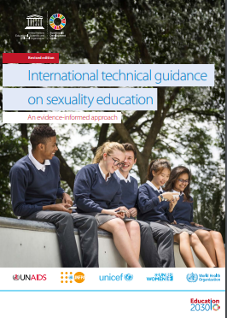
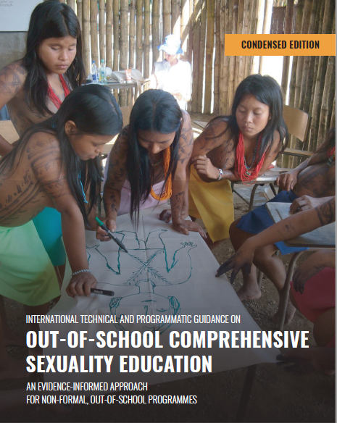
Comprehensive Sexuality Education
Children & adolescents need & have a right to sexuality education.
Sexuality education does not harm children & adolescents.
Well designed & well delivered sexuality education programmes can do them good.
REVISED INTERNATIONAL TECHNICAL GUIDANCE ON CSE
INTERNATIONAL TECHNICAL & PROGRAMMATIC GUIDANCE ON
OUT-OF-SCHOOL CSE

Slide 8
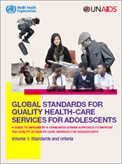
Quality Health Services
Adolescents’ health literacy
Community support
Appropriate package of services
Providers' competencies
Facility characteristics
Equity and non-discrimination
Data and quality improvement
Adolescent- Participation
Equitable
Accessible
Acceptable
Appropriate
Effective

Slide 9
WHO GUIDELINES 1/2
Guidelines on case management
WHO guidelines for the treatment of Treponema pallidum (syphilis) (2016).
WHO guideline on syphilis screening and treatment for pregnant women (2017).
WHO guidelines for the treatment of genital herpes simplex virus (2016).
WHO guidelines for the treatment of Chlamydia trachomatis (2016).
WHO guidelines for the treatment of Neisseria gonorrhoeae (2016).
Guidelines on hepatitis B and C testing (2016).
Guidelines for the prevention, care and treatment of persons with chronic hepatitis B infection (2015).
Guidelines for the screening, care and treatment of persons with chronic hepatitis C infection: updated version (2016).
Strategies and laboratory methods for strengthening surveillance of sexually transmitted infections (WHO, 2012).
Laboratory diagnosis of sexually transmitted infections, including human immunodeficiency virus (WHO, 2013).
Notes:
This slides lists the WHO guidelines that address STIs in adolescents from a case management perspective. They are either specific to adolescents or are relevant to them, while not being specific to them.

Slide 10
WHO GUIDELINES 2/2
Guidelines on public health policy & strategy development
Consolidated guidelines on HIV prevention, diagnosis, treatment and care for key populations: updated version (2016).
Prevention and treatment of HIV and other sexually transmitted infections among men who have sex with men and transgender people: recommendations for a public health approach (2011).
Prevention and treatment of HIV and other sexually transmitted infections for sex workers in low- and-middle- income countries: recommendations for a public health approach (2012).
Consolidated guideline on sexual and reproductive health and rights of women living with HIV (2017).
Comprehensive cervical cancer control: a guideline to essential practice, 2nd edition (2014).
Responding to children and adolescents who have been sexually abused (2017).
Brief sexuality-related communication: recommendations for a public health approach (2015).
Notes:
This slides lists the WHO guidelines that address STIs in adolescents from a public health perspective. They are either specific to adolescents or are relevant to them, while not being specific to them.

Slide 11
COMPLEMENTARY DOCUMENTS TO WHO’s GUIDELINES
Global strategy to accelerate the elimination of cervical cancer as a public health problem (WHO, 2020).
Global health sector strategy on sexually transmitted infections 2016-2021 (WHO, 2016).
World Health Organization. Human papillomavirus vaccines: WHO position paper, Weekly Epidemiology Record, May 2017, 92, 241-268.
World Health Organization. Hepatitis B vaccines. WHO position paper. Weekly Epidemiology Record, July 2017, 92, 369-392.
Guide to introducing HPV vaccine into national immunization programmes. Geneva: World Health Organization; 2016 (142).
Scaling-up HPV vaccine introduction. Geneva: World Health Organization; 2016 (143).
Sexually transmitted diseases: treatment guidelines, 2015. Atlanta, GA: Centers for Disease Control and Prevention; 2015 (144).
HPV vaccine lessons learnt project overview. Seattle, WA: PATH; 2015 (145).

Slide 12
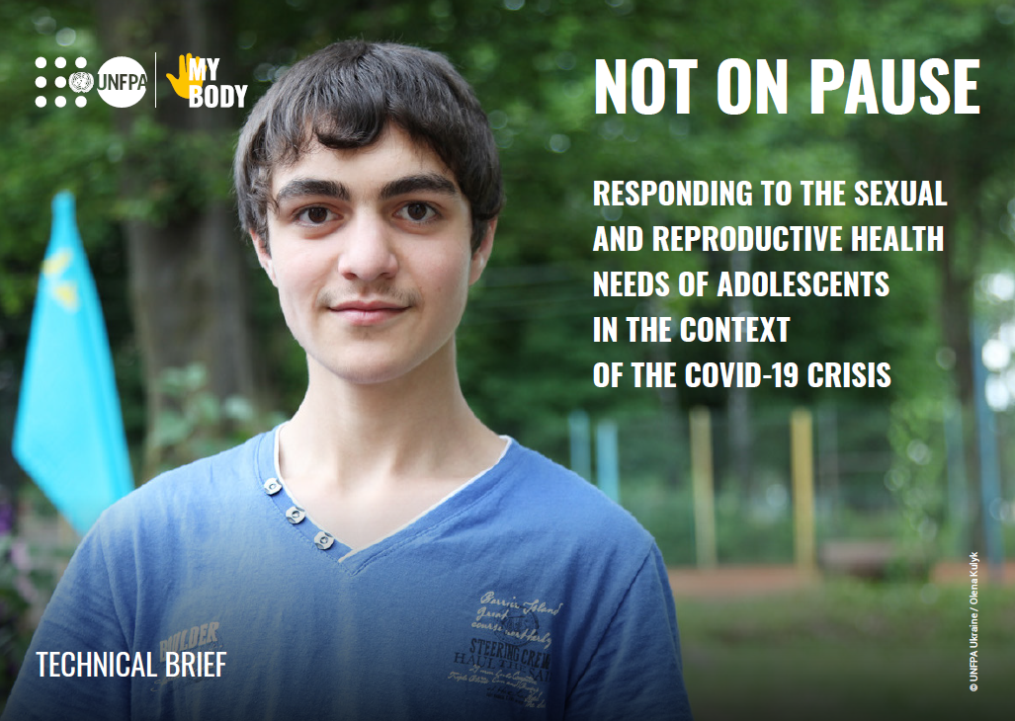
Specific measures for delivery of services in the context of
COVID-19 – 1/2
Inform adolescents where and how to access HIV and other STI testing and care, where access is possible, through mass media and digital media.
In health facilities, ensure the availability of HIV and STI diagnostics and medications are available and that HIV and STI testing and care are provided discreetly and confidentially.
Ensure the availability of condoms and promote their use.
Consider waiving restrictions (if these exist), such as those based on age, marital status or parental/spousal consent, and providing services free of charge.

Slide 13
Specific measures for delivery of services in the context of
COVID-19 – 2/2
Prioritize HIV and other STI testing for adolescents who are at higher risk of infection and those presenting with defined conditions (e.g. screen people with tuberculosis for HIV).
Encourage adolescents presenting for testing and care to refer their sexual partners, and/or offer them the possibility of dispensing treatment to their sexual partners themselves.
Where possible, provide home-based HIV and other STI tests, as well as information about proper self-sampling and where to send samples. Establish clear pathways for further testing.
Where possible, use digital platforms and mobile health strategies (to minimize clinic visits) to provide adolescents with test results, treatment and prevention messaging, while ensuring privacy and confidentiality.

Slide 14
Considerations for resumption of normal services in the context of COVID-19
Run catch-up campaigns for HIV and other STI testing.
Where possible, promote the institutionalization of good practices in improving accessibility and quality that were put in place during the period of closures and disruption.

Slide 15
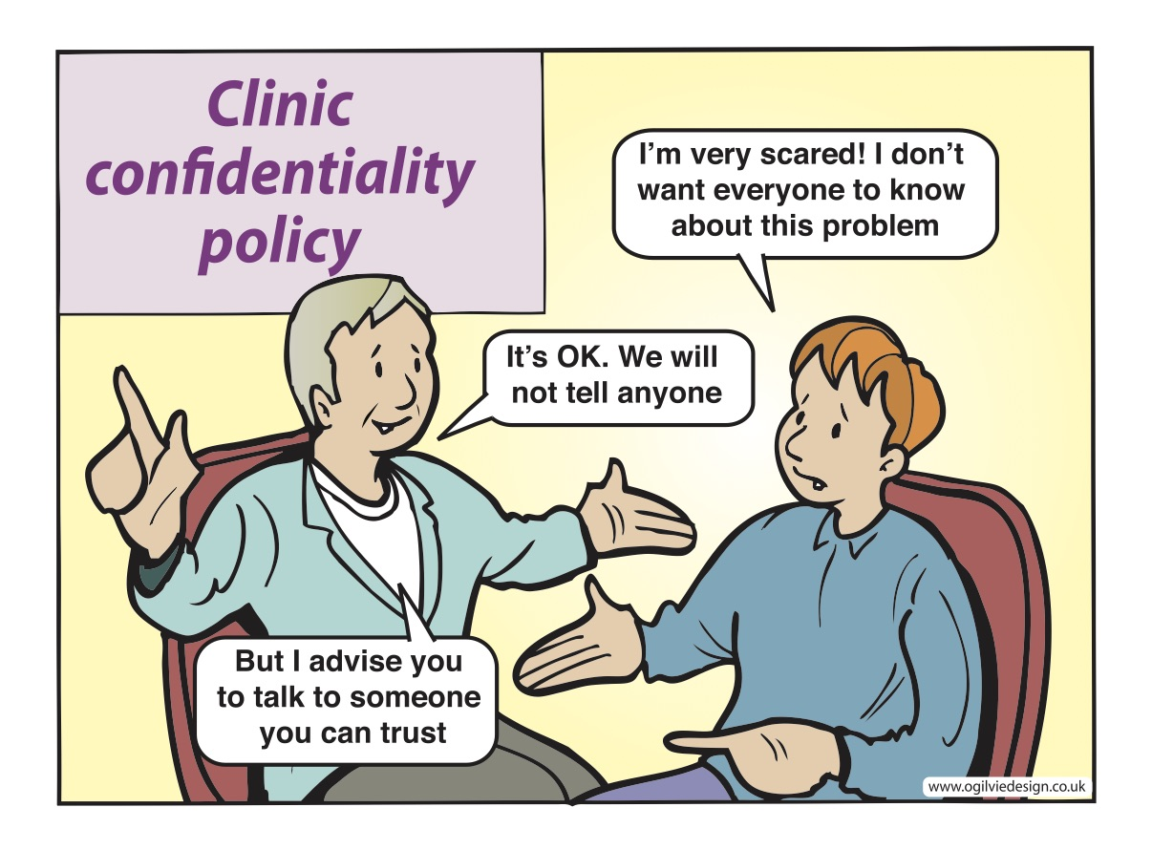
Notes:
Fear of family members, friends and others learning about their STI, prevents many adolescents from seeking care.

Slide 16
Why STIs are an issue in humanitarian settings
In humanitarian settings, the risk of STI (including HIV) transmission may be high due to increased sexual violence, the presence of workers in high mobility jobs (e.g., truck drivers, peacekeepers), transactional sex, alcohol and drug use, lack of information and access to condoms, and high population density in camps.
Ensuring the availability of syndromic diagnosis and treatment of STIs is incorporated into the Minimum Initial Service Package (MISP) under the objective, “prevent the transmission of and reduce morbidity and mortality due to HIV and other STIs.
Guaranteeing the availability of free lubricated male condoms and ensuring provision of female condoms when the population was exposed to them before the crisis are also important components of prevention.
To make treatment available for patients presenting with STI symptoms as part of routine clinical services at the onset of the humanitarian response.
Source: Inter-agency Working Group on Reproductive Health in Crises (IAWG). Inter-Agency Field Manual on Reproductive Health in Humanitarian Settings 2018. IAWG; 2018.
Notes:
Reference:
Inter-agency Working Group on Reproductive Health in Crises (IAWG). Inter-Agency Field Manual on Reproductive Health in Humanitarian Settings 2018. IAWG; 2018. Available from: https://iawg.wpengine.com/wp-content/uploads/2019/07/IAFM-English.pdf

Slide 17
STI PREVENTION AND CURE
A Regional Perspective

Slide 18
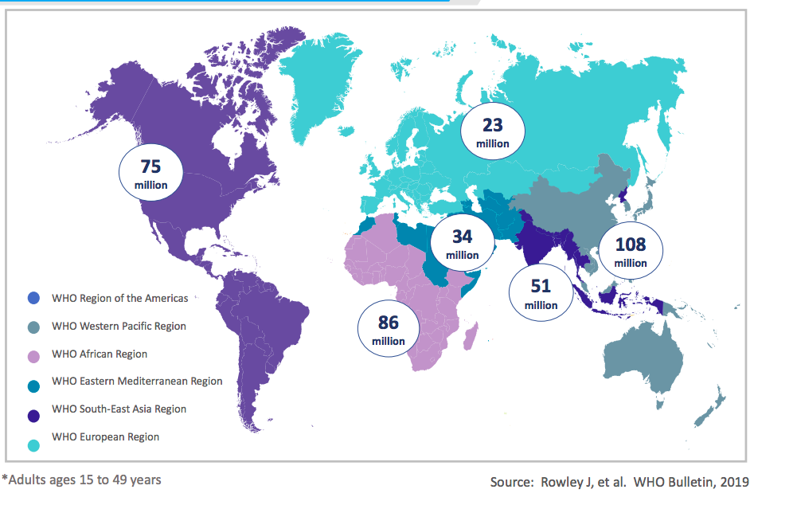
Global and regional situation: STI incidence and prevalence ¹
WHO incident case estimates of four curable STIs (Chlamydia, Gonorrhea, Trichomoniasis, Syphilis) globally and by region, 2016. 34 million new cases were reported in the EMR.
Prevalence (%) estimates of four curable STIs for male (M) and female (F) ages 15 to 49 years in the EMR, 2016.
Chlamydia
M 3%, F 3.8%
N gonorrhea
M 0.6%, F 0.7%
Trichomoniasis
M 0.5%, F 4.7%
Syphillis
M 0.69%,
F 0.73%

Slide 19
Sexual debut and STIs in the region
Serious dearth of population-based data on issues around sexuality among adolescents.
Source: Afghanistan DHS 2015, Egypt DHS 2014, Pakistan DHS 2017, Yemen DHS 2013
Notes:
Source: Afghanistan DHS 2015, Egypt DHS 2014, Pakistan DHS 2017, Yemen DHS 2013
The figure on the left shows that in some places, like Egypt, adolescents have higher incidence of STIs compared to adults whereas in other settings the reverse is true.
The figure on the right shows that a very large proportion of adolescents engage in sexual relations at an early age.

Slide 20
Attitudes towards negotiating safe sex among adolescents
Source: Afghanistan DHS 2015, Egypt DHS 2014, Pakistan DHS 2017, Yemen DHS 2013
Notes:
Adolescents are consistently less likely to believe that women are justified to refuse to have sex with husband if he has sex with other women.
Variation across countries – in Morocco, only 10% of adolescents believe a woman is justified to refuse to have sex with her husband and in Pakistan and Afghanistan only half.

Slide 21
Regional situation: Awareness, knowledge & misperceptions
A survey of people aged 18-25 years in Saudi Arabia in 2008 showed: ²
  56% of women were completely unaware of their sexual health.
  Only 60% knew that condoms do not provide 100% protection from all STIs.
A study in Iran involving men and women engaged to be married showed: ³
  Only 4.5% people knew that a person with STI does not necessarily look ill.
  78% were not aware that painful urination could be a sign of an STI.
  51% were not aware that the presence of sores in the genital area is an STI symptom in both men and women.
A study in Egypt and the United Arab Emirates (UAE) involving university and college students showed: ^{4, 5}
  Only 20% of the participants knew that if one person is infected, sexual partners need to be tested and treated (Egypt).
  Almost 70% believed that they are more likely to be infected when they are menstruating, sharing toilets, using swimming pools as well as physical contact such as hand shaking or hugging (UAE).

Slide 22
Regional situation: Beliefs & attitudes
Negative beliefs and attitudes towards people with STIs and about the provision of SRH education & services are prevalent in the region.
Pakistan study (2013) ⁶
  Women with STI tend to be subjected to more blame and judgment compared to men, and this gender-related discrimination was considered normal.
  More women than men believed that there is no need for sexual education for Muslims, believing that STIs are not an issue among them.
Saudi Arabia study (2008) ²
  Although, 90% believed that their partners had the right to know if they had an STI, 55% said they would ask for a divorce if their partner had an STI.
Iran study (2013) ³
  62% believe that education about STIs and unintended pregnancies does not lead to premarital sex.
  62% males and only 27% of females believe that all young adults should have access to contraceptives including condoms before marriage.

Slide 23
Policy situation for STI prevention & care in the EMR ⁷
According to the Regional Health Policy Survey 2019;
13/16 countries have a national policy/guideline for STI diagnosis, treatment, and counseling.
9/16 countries reported having a national policy/guideline that aligns with the Global Health Sector Strategy on STIs (2016-2021) or latest WHO guidelines.
8/16 countries stated that the national policy on STIs requires the use of a STI surveillance system to monitor the progress to global STI targets.
11/16 countries have a national policy/guideline that aims to reduce N. gonorrhea incidence.
Notes:
Eleven of the responding countries have a national policy/guideline that contributes to the reduction in N. gonorrhea incidence.

Slide 24
Regional Challenges
Slow policy adoption: Discrepancies between policy formulation and its implementation, which may be due lack of resources, infrastructure and finances.
Lack of knowledge: Sexual health is not taught in any formal setting in most countries of the Region leading to poor knowledge of sexual and reproductive health among adolescents. For example, the study in Saudi Arabia showed that the major sources of information on STIs among respondents were internet (87%), books (73%), TV/radio (62%), friends (55%), newspapers/ magazines (50%), and family (37%). ³
Age restrictions: Placing the conventional or widely accepted legal age of consent at 18 years and ambiguous policies prevent access to HIV testing among minors who are sexually active and are at risk of HIV infection. ⁸
Misconceptions among both educated and uneducated populations. For example, a study examining physicians’ knowledge in Saudi Arabia reported that almost half of them identified casual kissing as a mode of HIV transmission. ⁹
Notes:
“Consent is defined as the agreement, expressed either verbally or in writing, to a proposed action or situation. For purposes of medical intervention or research, consent given by a subject for a procedure, course of treatment, or any other health intervention to be performed, must be informed. The subject should receive information about the intervention and must indicate that they understand the possible risks and/or benefits of participation; and, if consent is given, that it has been done so voluntarily without any feeling of coercion. Therefore, informed consent must be given by someone who has the competence to understand the elements of the intervention and the consequences of making the choice to receive the intervention”. (Fox et al., 2013 p. 3)
“The central issue in the debate over minor rights to health interventions is finding the balance between the parental responsibilities toward the adolescent, the immaturity and vulnerability of adolescent children, and his or her right to be emancipated from the decision of the parent. As a result, a patchwork of laws has been produced, making it difficult to make any overriding statements about minor and parental rights regarding medical treatment. This highlights the acknowledged conflict between the rights of the adolescent—under the Convention on the Rights of the Child—and that of the parent or guardian who understands themself to have the legal right to make medical decisions for his or her child. For adolescents, limiting the right of consent to HIV testing to parents or guardians, has serious potential implications. Studies have shown that requiring parental consent to HTC services might in fact reduce adolescent access because of perceived negative reactions from parents/guardians or health-care providers and the fear of HIV-related stigma. It has also been documented that adolescents may opt not to seek care because they want to avoid telling their parents about their health problems and sexual activities”. (Fox et al., 2013 p. 3-4).
Fox K, Ferguson J, Ajose W, Singh J, Marum E, Baggaley R. Adolescent consent to testing: a review of current policies and issues in sub-Saharan Africa. In: HIV and adolescents: Guidance for HIV testing and counselling and care for adolescents living with HIV: Recommendations for a public health approach and considerations for policy-makers and managers. World Health Organization; 2013. ANNEX 15.

Slide 25
Regional Challenges
Socio-cultural factors: Conservative views and social disapproval of sexual health education significantly influence sexual health awareness and safer sex practices.
Low perceived risk: Due to social and cultural factors, STI rates are not commonly reported in many countries, which might contribute to the perception of low risk among many Muslims countries as highlighted in a systematic review looking at the attitudes among Muslim women. ¹⁰
Service providers’ attitude: Negative and judgmental attitude of the care providers towards people attending STIs services. ¹¹
Cost and infrastructure: A study in MENA & North Africa documented that reasons for not using condoms included partners’ refusal, high condom prices, and low perceived risk of infection. ¹² Countries like Afghanistan, Sudan and Yemen and Syria with humanitarian settings have poor infrastructure and significant gaps in provision and access of these services. ¹³
Weak Health Information System: Low reporting of STIs have bearing on disease burden, for example low reporting on HPV and its relationship with cervical cancer.
Notes:
According to the Health Belief Model, low perceived vulnerability is a risk factor as it reduces the individual’s motivation to take protective measures.

Slide 26
Regional best practice initiative
Marsa in Lebanon ¹⁴
Marsa is an NGO in Beirut, which established a holistic sexual health center in 2011 with support from WHO, the Medico and Arabic Foundation for Freedom and Equality (AFE), and the National AIDS Program (NAP).
Aim: To provide SRH services to adolescents, adult women, and socially and/or economically vulnerable groups with a multidisciplinary team in a safe, welcoming, accessible, and friendly environment that is free of judgment and bias.
Services:
Information and education provision
Voluntary counseling & testing for STIs and HIV
Cervical cancer screening
Medical consultation with family doctors and dermatologists, with specialty skills in STI management
Psychosocial counseling and alternative therapies
Promotional outreach campaigns (e.g., on how to use condoms)
Key features of the services:
Provision of a comprehensive package of services
Assurance of a non-judgmental environment with full autonomy and confidentiality for patients
Provision of services by a highly trained and friendly team
Notes:
Through its comprehensive service provision, Marsa aims to equip its beneficiaries with needed sexual health education since it is lacking within the majority of people living in Lebanon. With the knowledge gained at the center, young individuals will be capable of determining the appropriate safer sexual practices that suit their needs; thus, empowering them to become well informed decision makers when it comes to their sexual health. Additionally, what they learn at Marsa will help foster healthy standards of communication with their partners, encouraging better decisions regarding their sexual health, and that of their partners.
Clients at Marsa can also get screened for sexually transmitted infections for free or at a subsidized price by highly skilled medical professionals who have ample experience and are familiar with the social constraints surrounding sexual health in Lebanon and the region. These medical services are complimented by psychosocial and alternative therapies that cater to the emotional well-being of the clientele. An internal and external referral system has been established at the center to provide holistic care to the clients and cater to their every need.
Counseling
Marsa has catered to the psychological and emotional well-being of beneficiaries by providing counseling sessions for subjects falling under the umbrella of sexual health, such as sexual traumas, sexual violence, and various gender and sexuality subject matters. Specialized counseling is also offered for People Living with HIV and other chronic infections to support their adaptation to the newly acquired virus and its implications, to learn that the virus is manageable, and to draw a life map and plan their healthy futures.
Medical consultation
Seven years into its endeavors, Marsa offered medical consultations with family doctors and dermatologists, with specialty skills in sexually transmitted infections management. Clients benefitted from friendly doctors that welcome their intimate details without judgment, stigma or discrimination. Screening for a package of common sexually transmitted infections is available at a subsidized cost in collaboration with a prominent Lebanese hospital.
Marsa sexual health center. Marsa: 7 years young, 2011 – 2017. Marsa sexual health center; [no date]. Available from: https://marsa.me/wp-content/uploads/2019/02/Marsa7YearReport.pdf

Slide 27
Regional opportunities ¹⁵
These are aligned to the WHO’s Global Health Sector Strategy on STIs, and EMR Regional Framework and Action Plan for STI prevention and control, which emphasize the need for an integrated approach to STI prevention and control through securing universal access to sexual and reproductive health-care services and rights.
Increase access and coverage to testing and treatment of STIs.
Where feasible, promote integration of STI services into other programs e.g., HIV and hepatitis.
Adopt the use of the new multiplex technologies for diagnosis e.g., dual testing of HIV and Syphilis.
Promote the use of prevention interventions to high-risk groups.
Resource mobilization for STI programs.
Continued advocacy at policy level.

Slide 28
References
World Health Organization Global adult estimates of chlamydia, gonorrhoea, trichomoniasis and syphilis including maternal and congenital syphilis, 2016. World Health Organization; 2020 Mar. Available from: https://www.who.int/reproductivehealth/topics/rtis/STIs-Estimates.pdf?ua=1
Fageeh WM. Awareness of Sexually Transmitted Diseases among Adolescents in Saudi Arabia. JKAU Med Sci. 2008 Jan 1;15(1):77-90. http://dx.doi.org/10.4197/med.15-1.7
Khajehei M, Ziyadlou S, Ghanizadeh A. Knowledge of and attitudes towards sexual and reproductive health in adults in Shiraz: a need for further education. East Mediterr Health J. 2013 Dec;19(12):982-9. PMID: 24684095.
El Gelany S, Moussa O. Reproductive health awareness among educated young women in Egypt. Int J Gynaecol Obstet. 2013 Jan;120(1):23-6. doi: 10.1016/j.ijgo.2012.07.027. Epub 2012 Oct 23. PMID: 23099050.
Haroun D, El Saleh O, Wood L, Mechli R, Al Marzouqi N, Anouti S. Assessing Knowledge of, and Attitudes to, HIV/AIDS among University Students in the United Arab Emirates. PLoS One. 2016 Feb 25;11(2):e0149920. doi: 10.1371/journal.pone.0149920. PMID: 26913902; PMCID: PMC4767799.
Farid-ul-Hasnain S, Johansson E, Gulzar S, Krantz G. Need for multilevel strategies and enhanced acceptance of contraceptive use in order to combat the spread of HIV/AIDS in a Muslim society: a qualitative study of young adults in urban Karachi, Pakistan. Glob J Health Sci. 2013 May 27;5(5):57-66. doi: 10.5539/gjhs.v5n5p57. PMID: 23985107; PMCID: PMC4776849.
WHO Regional Office for the Eastern Mediterranean. Regional report on reproductive, maternal, newborn, child and adolescent health policy survey 2019. (unpublished report). For more details contact siddeegk@who.int

Slide 29
References
Fox K, Ferguson J, Ajose W, Singh J, Marum E, Baggaley R. Adolescent consent to testing: a review of current policies and issues in sub-Saharan Africa. In: HIV and adolescents: Guidance for HIV testing and counselling and care for adolescents living with HIV: Recommendations for a public health approach and considerations for policy-makers and managers. World Health Organization; 2013. ANNEX 15. Available from: https://www.ncbi.nlm.nih.gov/books/NBK217954/
Mahfouz AA, Alakija W, al-Khozayem AA, al-Erian RA. Knowledge and attitudes towards AIDS among primary health care physicians in the Asir Region, Saudi Arabia. J R Soc Health. 1995 Feb;115(1):23-5. doi: 10.1177/146642409511500108. PMID: 7738977.
Alomair N, Alageel S, Davies N, Bailey JV. Sexually transmitted infection knowledge and attitudes among Muslim women worldwide: a systematic review. Sex Reprod Health Matters. 2020 Dec;28(1):1731296. doi: 10.1080/26410397.2020.1731296. PMID: 32202220.
George P, Lennox Terrion J, Ahmed R. Reproductive health behaviour of Muslim immigrant women in Canada. International Journal of Migration, Health and Social Care. 2014 Jan 1;10(2):88-101. http://dx.doi.org/10.1108/IJMHSC-09-2013-0032
Gökengin D, Doroudi F, Tohme J, Collins B, Madani N. HIV/AIDS: trends in the Middle East and North Africa region. Int J Infect Dis. 2016 Mar;44:66-73. doi: 10.1016/j.ijid.2015.11.008. PMID: 26948920.
Government of Afghanistan (National AIDS Control Program (NACP). Country progress report – Afghanistan: Global AIDS Monitoring 2018. UNAIDS; 2018. Available from: https://www.unaids.org/sites/default/files/country/documents/AFG_2018_countryreport.pdf
Marsa sexual health center. About us. Marsa; c2022. Available from: https://marsa.me/about/
World Health Organization. Global health sector strategy on sexually transmitted infections 2016-2021: toward ending STIs. World Health Organization; 2016. Available from: https://apps.who.int/iris/bitstream/handle/10665/246296/WHO-RHR-16.09-eng.pdf

