Slide 1
Module 1 – Session 4 Family Planning Impact An Online Evidence-based Course 2022
James Kiarie MBChB, Mmed, MPH
Department of Sexual Reproductive Health and Research

Slide 2
Outline
Family planning fertility and population
Reproductive health benefits of family planning
Other health benefits of family planning
Family planning and empowerment of adolescents, youth and women
The health care system and family planning

Slide 3
Family planning fertility and population
Changes in population determined by Fertility, Mortality, and Migration
Population change more rapid and more universal in the past six decades than any other period in human history, but vary widely
Fertility rates have declined to below three births per women in all regions except sub-Saharan Africa
Global population 7.79 Billion (in 2020)
Africa population will double in size between 2010-2050

Slide 4
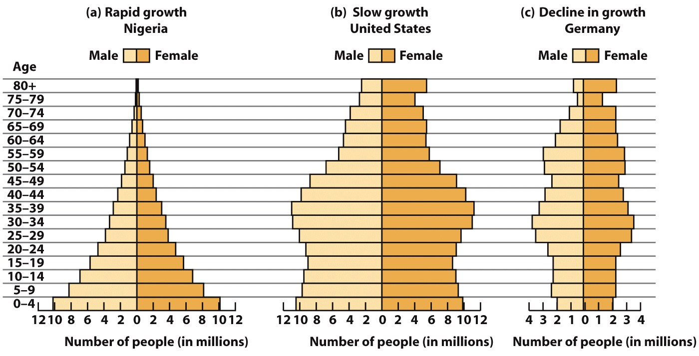
The population pyramid concept
Total fertility rate (TFR): average number of children that would be born to a woman over her lifetime.
Replacement level fertility: average number of children per woman to maintain existing population. Set at 2.1 in a woman's lifetime.

Slide 5
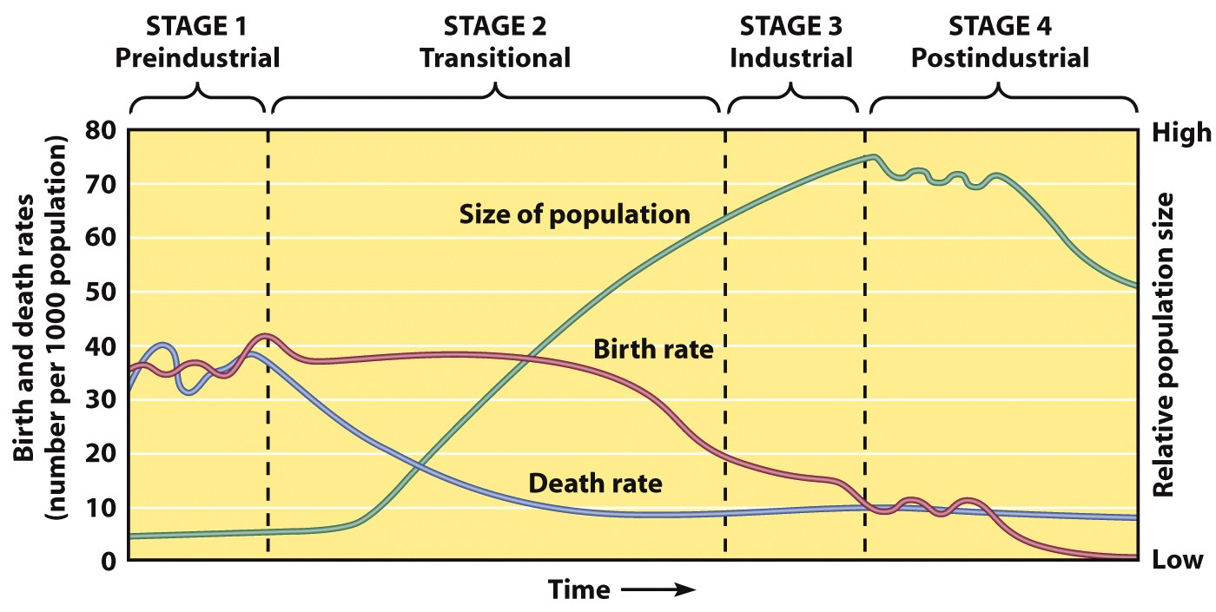
Demographic stages
Birth rates below replacement level, may lead to a shrinking population
High Death and birth rates in balance
Increased lifespan with rapid drop-in death rates while birth rates unchanged
Birth rates fall with access to FP
Slow population
growth
Slow population
growth
Rapid population
growth
Population
decline

Slide 6
Effects of overpopulation and rapid population growth
Shortages of energy and other natural resources (land, water)
Communicable diseases in dense populations
Habitat destruction
Conflict over scarce resources such as land area
Small productive population supporting a large dependent population

Slide 7
Effect of declining fertility and population
Fertility declines associated with:
An increase in women’s education, health, earnings, and participation in paid employment
Better access to health, education and employment for children
These combined effects can lead to large macroeconomic demographic benefits – Demographic Dividends
Prolonged fertility declines with increasing life expectancy can lead to:
Aging population that dependent on few workers
High care health costs

Slide 8
Reproductive health benefits of family planning
Reduced maternal mortality and morbidity due to
Reduced number of births
Prevention of unintended pregnancy that leads to abortion
Prevention of high-risk pregnancies: grand multiparity, teenage pregnancies, older age, repeat operative delivery, pregnancies complicated by medical conditions
Reduced neonatal, infant and child mortality
Increased interpregnancy intervals leading to longer breast feeding and better childcare
Better maternal health leading to reduced risk of still birth and low birthweight

Slide 9
Other health benefits of family planning
Health benefits of combined or contraceptives
Reduced risks of endometrial cancer, Cancer of the ovary, Symptomatic pelvic inflammatory disease
Protection against: Ovarian cysts, Iron-deficiency anemia
Reduced menstrual cramps, Menstrual bleeding problems, Ovulation pain, Excess hair on face or body
Reduced Symptoms of polycystic ovarian syndrome (irregular bleeding, acne, excess hair on face or body) and of endometriosis (pelvic pain, irregular bleeding)
Health benefits of DMPA
Reduced risks of endometrial cancer, Uterine fibroids
Protection against Symptomatic PID, Iron-deficiency anemia
Reduced: Sickle cell crises among women with sickle cell anemia and Symptoms of endometriosis (pelvic pain, irregular bleeding)
Health benefits of implants
Reduced risk of endometrial and cervical cancer
Health benefits of LNG IUD
Protection against Iron-deficiency anemia
Reduced risk of endometrial and cervical
Reduced menstrual cramps, menorrhagia and symptoms of endometriosis
Health benefits of tubal sterilization
Reduced risk of ovarian cancer
Health benefits of condoms
Reduced risks of STIs, including HIV and their complications such as PID, cervical cancer and infertility

Slide 10
Empowerment of adolescents, youth and women
Empowerment – The expansion of people’s ability to make strategic life choices in a context where this ability was previously denied to them.
Positive effect of empowerment on the use of contraceptives is well established. However, the reverse effect, less studied.
Mechanisms of contraception leading to empowerment:
Education and employment opportunities
Sense of control over own body
Control over family size and birth interval

Slide 11
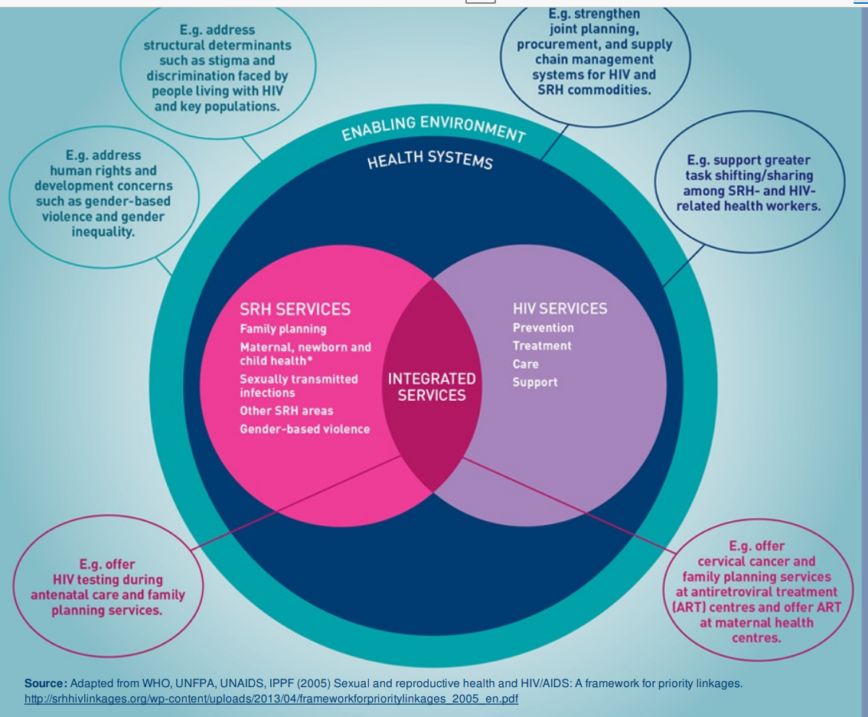
The health care system and family planning
In the health system and services family planning can be strongly linked with:
STI and HIV
Nutrition
Maternal and child health
Chronic disease screening
Social welfare

Slide 12
Conclusion
Family planning has impacts at various levels
Population
Individual health
Individual and group empowerment and agency
Generational health
Based on these¹
Two-thirds reduction in unsafe abortions and maternal deaths in LMICs if contraceptive demand met and quality of pregnancy care
Every dollar spent on contraceptive services beyond the current level would save $3 in the cost of maternal, newborn and abortion care
1 Guttmacher Institute. Adding It Up Investing in Sexual and Reproductive Health in Low- and Middle-Income Countries. Guttmacher Institute, 2019. https://www.guttmacher.org/fact-sheet/investing-sexual-and-reproductive-health-low-and-middle-income-countries

Slide 13
Readings and videos
Read the WHO evidence brief on Accelerating uptake of voluntary, rights-based family planning in developing countries https://apps.who.int/iris/bitstream/handle/10665/255859/WHO-RHR-17.07-eng.pdf?sequence=1&isAllowed=y
Watch the Video on global Population projects by 2050 The World Population in 2050 - YouTube
If you have questions discuss with your coach and submit any that you would like discussed in the webinar.

Slide 14
Thank you
Follow us on Twitter @HRPresearch
Website
https://www.who.int/teams/sexual-and-reproductive-health-and-research-(srh)/

