Slide 1
Module 1 – Session 5
Contraception and human rights: Rights based quality of care and monitoring in contraceptive programmes
An Online Evidence-based Course 2022
Moazzam Ali MD, PhD, MPH
Department of Reproductive Health and Research

Slide 2
Unmet need for contraception
Unintended pregnancy, resulting from unmet need for contraception, threatens the lives and well-being of women and their families globally.
It is critical that commitment to the rights-based approach to family planning is not compromised by the requirement to scale up rapidly.
  - History of coercion
Ensuring access to contraception is fundamental to upholding human rights as well as contributing to improved health outcomes, as recognised in SDG 3.7 for universal access to sexual and reproductive healthcare services.
Despite increases in contraceptive use, an estimated 218 million women had an unmet need for contraception in developing regions (Guttmacher 2020).
Discontinuation rates for method-related reasons are high in these countries and use of modern methods is suboptimal in some groups (e.g., missed pills): there is a need to improve effective coverage among modern method users.
Sully E, Biddlecom A, Darroch JE, et al. Adding It Up: Investing in Sexual and Reproductive Health 2019. New York: Guttmacher Institute, 2020 Jul 28. http://dx.doi.org/10.1363/2020.31637

Slide 3
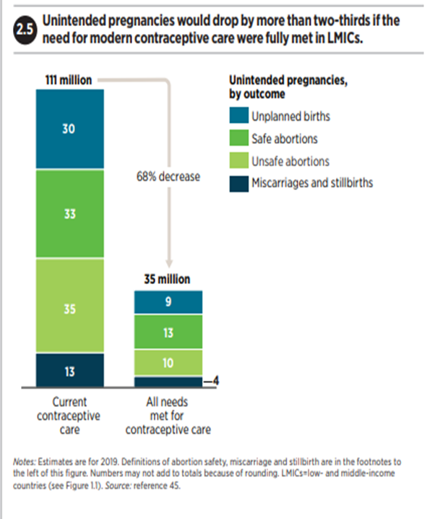
If all unmet need for modern contraception were satisfied..
… in LMIC regions and all pregnant women and their newborns were to receive care at the standards recommended by the World Health Organization, the impacts would be dramatic:
  Unintended pregnancies would drop by 68%
  Unsafe abortions would drop by 72%
  Maternal deaths would drop by 62% from 299,000 to 113,000.
  Providing the recommended maternal and newborn care would also vastly improve newborn health. Newborn deaths would drop by 69%, and new HIV infections among babies six weeks and younger would drop by 88%. (Guttmacher 2020)
Guttmacher Institute. Adding It Up - Investing in Sexual and Reproductive Health in Low- and Middle-Income Countries. Fact Sheet. Guttmacher Institute, 2020 Jul.
https://www.guttmacher.org/sites/default/files/factsheet/adding-it-up-investing-in-sexual-reproductive-health.pdf.

Slide 4
Why is quality of care important?
To improve maternal and child health emphasis in the 1990s and in the past decade
  improve access, and
  availability of medical care
The above-mentioned aspects are “necessary, but not sufficient” – do not guarantee increased utilization of services or improved client satisfaction.
Evidence is emerging that poor quality of care is the most plausible explanation for this reality.

Slide 5
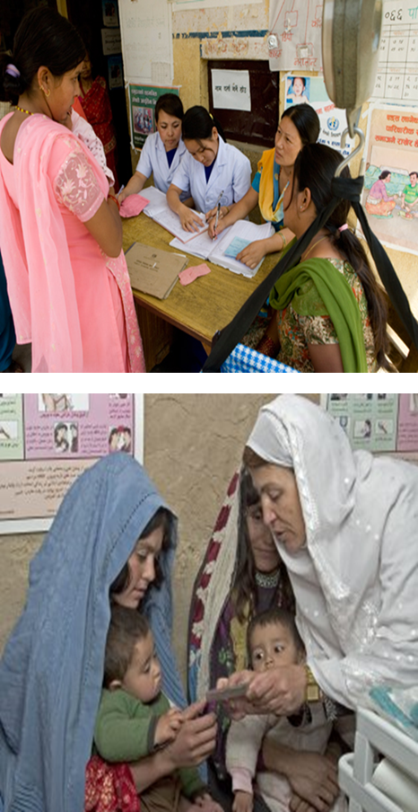
Defining quality of care
Quality of care is a multi-dimensional concept and has significant role in improving health outcomes. It can be defined as:
“clinically effective, safe and a good experience for the patient” (Goodlee 2009)
“the degree to which maternal health services for individuals and populations increase the likelihood of timely and appropriate treatment for the purpose of achieving desired outcomes that are both consistent with current professional knowledge and uphold basic reproductive rights.” (Hulton et al. 2005)
Basic attributes: access to care, effectiveness of care, safety, equitability, acceptability and efficiency.
Godlee F. Effective, safe, and a good patient experience. BMJ. 2009 Oct 22;339:b4346. http://dx.doi.org/10.1136/bmj.b4346
Hulton LA, Matthews Z, Stones RW. A framework for assessing quality of maternal health services and preliminary findings from its application in Urban India (S3RI Applications and Policy Working Papers, A05/03). Southampton, UK: Southampton Statistical Sciences Research Institute, 2005. 37pp. http://eprints.soton.ac.uk/id/eprint/15011

Slide 6



Rationale for good quality
As a right
People have a right to services of good quality
Good quality is an end in itself
As an instrument
May lead to other desirable RH outcomes
As an added bonus

Slide 7
Quality of care: the essentials
A functioning health system
Technical competence of health care providers
User satisfaction with the services received
Accountability mechanism that enables and allows participation, redress and remedies
Notes:
1. A functioning health system must be in place, with a budget, supportive and clear policies and protocols, adequate numbers of physical infrastructures – actual clinics or health centres that are organized to adhere to standards of care – training curricula, supervision, equipment and supplies, information, and a mechanism for referral between services.
2. Technical competence of health care providers who are paid and protected. Technical competence includes not only the carrying out of procedures and giving information related to providing contraceptives, but also the cultivation and use of effective and respectful interpersonal communication and counselling skills.
User satisfaction with the services received.
Accountability mechanism that enables and allows participation, redress and remedies.

Slide 8
Donabedian system model
Process
Structure
Outcome

Slide 9
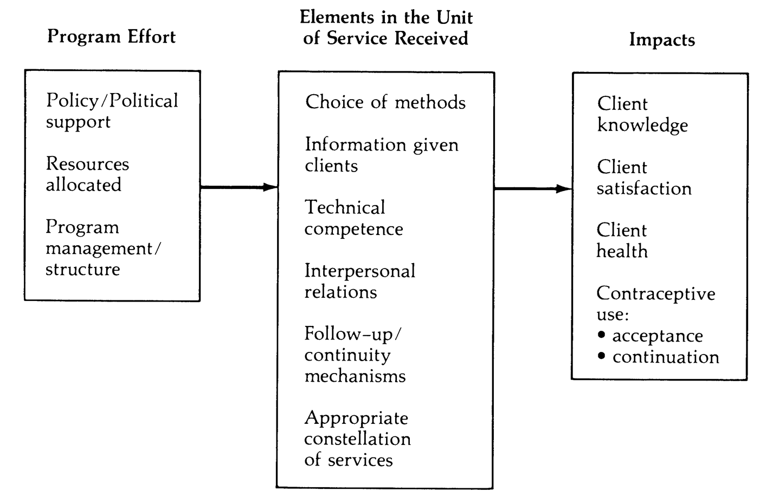
Bruce and Jain framework
Fundamental elements of quality of care. (Bruce 1990)
Bruce J. Fundamental elements of the quality of care: a simple framework. Stud Fam Plann. 1990 Apr;21(2):61-91.

Slide 10
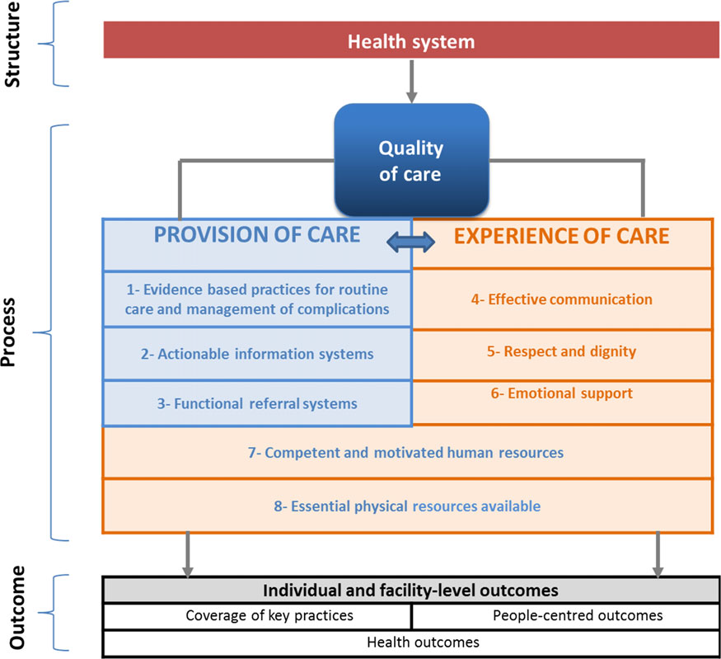
WHO quality of care framework

Slide 11
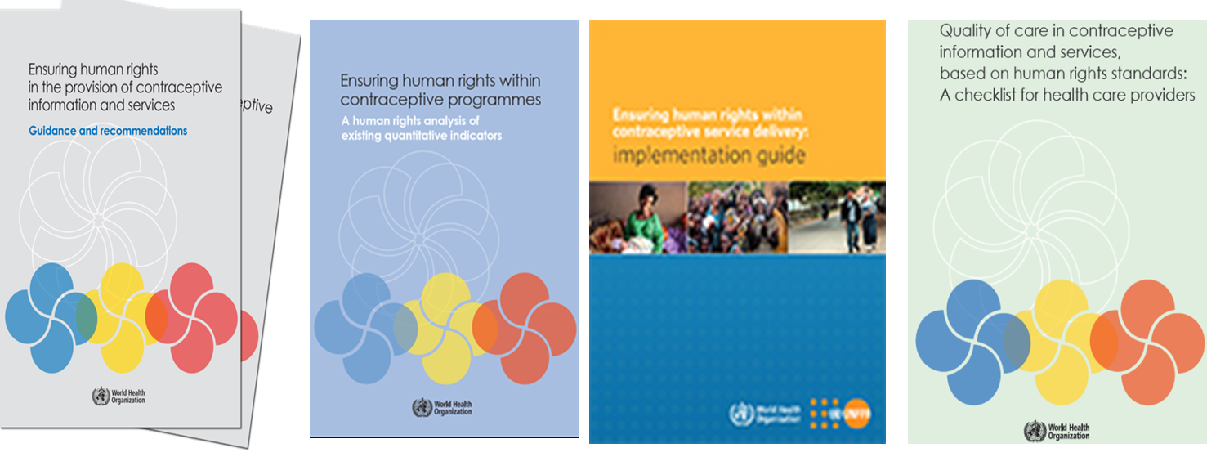

Background of WHO’S work on contraception
WHO’s work on contraception and human rights
  Ensuring human rights in the provision of contraceptive information and services: guidance for programmes
  Ensuring human rights within contraceptive programmes: a human rights analysis of existing quantitative indicators
  UNFPA/WHO Implementation guide for programmes
  Ensuring quality of care in context of rights based approaches

Slide 12
Quality of care based on human rights standards
WHO is developing this body of work:
To ensure women’s agency, autonomy and choice: Women’s right to choose
To accelerate progress towards attainment of international development goals and targets in sexual and reproductive health.
To contribute to reducing unmet need for contraceptive information and services.
To provide practical guidance on how to ensure and implement a rights based approach from a contraceptive programme design and management perspective.
Primary audience
Checklist specifically addressed to health care providers, probably at the primary health care level, who are involved in the direct provision of contraceptive information and services
Web Link: http://apps.who.int/iris/bitstream/10665/254826/1/9789241512091-eng.pdf?ua=1

Slide 13

Ensuring human rights in contraceptive information and services: Organizing principles
Non-discrimination
Availability
Accessibility
Acceptability
Quality
Informed decision making
Privacy and confidentiality
Participation
Accountability
Most commonly used tools for assessing quality in contraceptive service (e.g., DHS surveys or “Quick Inspection of Quality”) do not incorporate an explicit rights perspective.
Notes:
Recommendations were organized around these standards, drawn from international law and health evidence.
Human rights are guaranteed in international and regional treaties, as well as in national constitutions and laws. They include the right to non-discrimination, the right to life, survival and development, the right to the highest attainable standard of health, and the rights to education and to information (9). These rights have been applied by international, regional and national authoritative human rights bodies – such as UN treaty-monitoring bodies, international and regional courts, constitutional and supreme courts – to a wide range of sexual and reproductive health issues, including the accessibility of contraceptive information and services. All rights are interdependent and indivisible.
Choice and qualityt: selfstanding and cross-cutting

Slide 14

Quality of care based on human rights standards
Quality of care in health services is a key aspect of the right to health
Critical element of WHO Guidelines and Implementation Guide
Checklist specifically addressed to health care providers, who are involved in the direct provision of contraceptive information and services

Slide 15
Key elements of framework
1. Respecting users’ privacy and guaranteeing confidentiality
1.1 Autonomous decision-making and confidentiality
1.2 Physical integrity and private spaces for counselling and examination
2. Choice of contraceptives
2.1 Ensuring accurate and unbiased information
2.2 Ensuring non-judgmental and respectful counselling and interactions with users
2.3 Ensuring a range of contraceptive methods
3. Fostering an accessible and acceptable service
4. Involvement of users in improving services
5. Fostering continuity of care and follow-up and ensuring your
own efficacy

Slide 17
Checklist: how to use
Answers to questions: a self assessment checklist for service providers
Analysis: Score of 1-5
Action points. Series of follow up action points geared to steering the provider
Application of findings
  Workshops with service providers
  Workshops with service users
  Possible evaluation tool
Notes:
1. The guide is set up in the form of a check-list of questions addressed to individual service providers. Providers should try to answer each of the questions to the best of their ability. Each question provides a scale from 1-5 for the response, providers should try and identify the score based on their knowledge and present provision in relation to contraceptives at the facility. Scores <3 suggest need for urgent action (based on steps suggested below) where as scores > 3 suggest a good level of facility preparedness to ensure quality with some follow up actions required.
Workshop: . Results of using the check-list can be fruitfully used as a basis for discussion among service providers in the same health centre or clinic, or even – if practical in terms of geographical location – across services. This might entail an informal workshop in which the team of service providers examines the answers to the questions and then discusses the ways in which improvements could be brought across the service as a whole, in a way that is continually supportive of individual providers. Such workshops can also be run on a regular basis, say once every 6 or 12 months.
Users: . Information arising from the checklist could also be used as a basis for an informal workshop with service users. This would require some carefully planning to ensure that an atmosphere of genuine exchange of ideas among equals is fostered
Evaluation: The check-list could be used as an evaluation tool, but only in a process in which the provider and her/his supervisor discuss the contents of the check-list in advance and come to an understanding about what is intended and how improvements can be introduced. But please bear in mind that the main purpose of the check-list is to help improve services. It is not intended, in the first instance, to be used as an evaluation, and never as the basis of a punitive approach.

Slide 18
To summarize:
This work will help strengthen the quality of services in contraceptive programs and provide the national leadership the strategic direction to implementation and scale up
Ultimate goal - stronger policy and health systems’ capacity to provide quality contraceptive services as their contribution to meeting the unmet need for contraception using right based approach

Slide 19
Reading list
Read the WHO facts sheet on Human rights and health
https://www.who.int/news-room/fact-sheets/detail/human-rights-and-health
Other resources
Ensuring human rights in the provision of contraceptive information and services. Guidance and recommendations
https://apps.who.int/iris/bitstream/handle/10665/102539/9789241506748_eng.pdf;jsessionid=8BBF2242D8C16E1BBA24AD33CB7E912F?sequence=1
Ensuring human rights within contraceptive service delivery. Implementation guide
http://apps.who.int/iris/bitstream/handle/10665/158866/9789241549103_eng.pdf?sequence=1
Ensuring human rights within contraceptive programmes. A human rights analysis of existing quantitative indicators
https://apps.who.int/iris/bitstream/handle/10665/126799/9789241507493_eng.pdf?sequence=1
Quality of care in contraceptive information and services, based on human rights standards: a checklist for health care providers
https://apps.who.int/iris/bitstream/handle/10665/254826/9789241512091-eng.pdf?sequence=1&isAllowed=y
If you have questions discuss with your coach and submit any that you would like discussed in the webinar.

Slide 20
Thank you
Follow us on Twitter @HRPresearch
Website
https://www.who.int/teams/sexual-and-reproductive-health-and-research-(srh)/

