Slide 1

Contraceptive methods
Part 2 - Progestogen-only contraceptives
"Family Planning”: An Online Evidence-based Course 2022
Raqibat Idris, MBBS, DO, MPH
Geneva Foundation for Medical Education and Research

Slide 2
Outline and objectives
Description of the method
Mechanism of action
Effectiveness
Eligibility criteria
Benefits and side effects
Interventions for associated effects

Slide 3
Methods
Progestogen-only contraceptives
Progestogen-only pills (POPs)
Progestogen-only injectable contraceptives (POIs)
Progestogen-only implants
Progesterone-Releasing Vaginal Ring

Slide 4
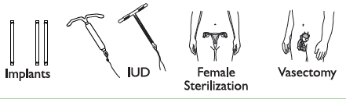

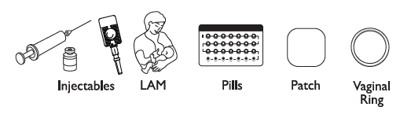
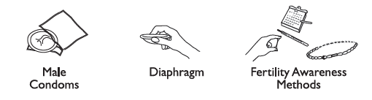

Comparing Effectiveness of Family Planning Methods
More effective
Less than 1 pregnancy per
100 women in one year
How to make your
method more effective
Implants, IUD, female sterilization:
After procedure, little or nothing to do or remember
Vasectomy: Use another method for first
3 months
Injectables: Get repeat injections on time
Lactational Amenorrhea Method (for 6 months): Breastfeed often, day and night
Pills: Take a pill each day
Patch, ring: Keep in place, change on time
Male condoms, diaphragm: Use correctly every time you have sex
Fertility awareness methods: Abstain or use condoms on fertile days. Standard Days Method and Two-Day Method may be easier to use.
Female condoms, withdrawal, spermicides: Use correctly every time you have sex
Less effective
About 30 pregnancies per
100 women in one year
Family Planning: A Global Handbook for Providers (3rd Edition, 2018)
Notes:
Methods of contraception have different mechanisms of action and effectiveness in preventing unintended pregnancy. Effectiveness of methods is measured by the number of pregnancies per 100 women using the method per year.

Slide 5
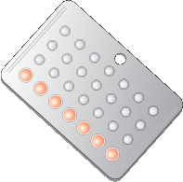
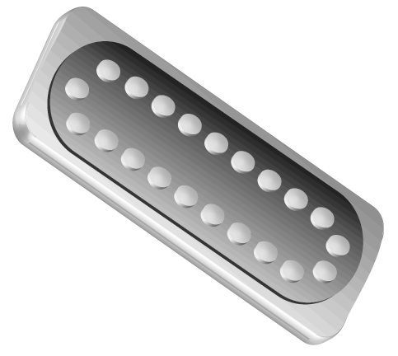
Progestin-only pills
(POPS)

Slide 6
What are POPS? Content and types
POPs are pills that contain very low doses of a progestin like the natural hormone progesterone in a woman’s body. They are also called “minipills” and progestin-only oral contraceptives.
Traits and types
Content | Only one hormone, progestin. Do NOT contain estrogen. Sometimes called the “mini-pill”
Types | Common: norethistrone (norethindrone), levonorgestrel, desogestrel, Less Common: etynodial diacetate, lynestrenol Have similar effectiveness, safety, characteristics, and eligibility criteria
Pills per pack | 28: all active pills 35: all active pills (no break between packs)
Family Planning: A Global Handbook for Providers (3rd Edition, 2018)
Table adapted from Training Resource Package for Family Planning: https://www.fptraining.org/
Notes:
POPs only contain one hormone, progestin. They do not contain estrogen.
There are different types of POPs. There are no clinically significant differences in effectiveness, characteristics, eligibility criteria or safety between these.
POPs are packaged with either 28 or 35 pills per pack.
Both contain all active pills. Every pill contains the same amount of hormone.
There are no hormone free intervals or breaks between packs. A woman starts the next pack of pills the next day after she finishes the current pack.
Source: Training Resource Package for Family Planning

Slide 7
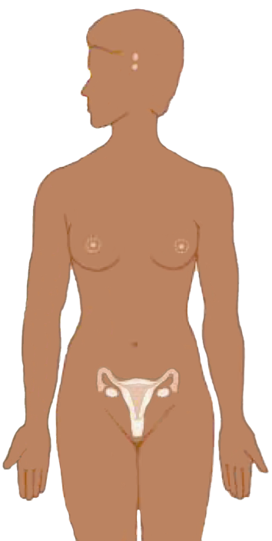
POPs: Mechanism of Action
Suppresses
hormones
responsible for
ovulation
Thickens
cervical mucus to block sperm
POPs have no effect on an existing pregnancy.
Adapted from Training Resource Package for Family Planning: https://www.fptraining.org/
Notes:
Progestin-only injectables prevent pregnancy in two ways:
The primary mechanism of action is to suppress ovulation. Progestin causes the hypothalamus and the pituitary gland to reduce production of the hormones that are necessary for ovulation. Without ovulation, there is no egg to be fertilized.
Progestin also thickens the cervical mucus. The thickened mucus makes it more difficult for sperm to enter the uterine cavity. In the unlikely event that a woman does ovulate, this mucus barrier greatly reduces the chance that the egg will be fertilized.
Other contraceptive methods that work this way are injectables, implants and combined oral contraceptives (COCs).
POPs do not disrupt an existing pregnancy and do not harm a fetus if a woman is accidentally given this method when she is already pregnant. However, if it is determined that a woman who is using POPs is, indeed, pregnant, she should stop receiving injections.
Illustration credit: Salim Khalaf/FHI

Slide 8
Relative effectiveness of POPs compared with other FP methods
Method | # of unintended pregnancies among 1,000 women in 1st year of typical use
No method | 850
Withdrawal | 220
Female condom | 210
Male condom | 180
Pill (COCs and POPs) | 80 (COCs) 70 (POPs alone) 10 (POPs and breastfeeding)
Injectable | 60
IUD (CU-T 380A / LNG-IUS) | 8 / 2
Female sterilization | 5
Vasectomy | 1.5
Implant | 0.5
Source: Trussell J., Contraceptive Failure in the United States, Contraception 83 (2011) 397- 404, Elsevier Inc. with POP+BF addition from Family Planning: A Global Handbook for Providers
Adapted from Training Resource Package for Family Planning: https://www.fptraining.org/
Notes:
In this slide we look at how effective FP methods are as they are commonly used. The slide shows the number of women who would get pregnant if 1,000 women used a method for one year. So, if 1,000 fertile women who were having sex, but not using any protection from pregnancy, 850 of them would become pregnant. But, if the same 1,000 women were using a POP while breastfeeding 10 would become pregnant and if the same 1,000 women were using a POP while not breastfeeding 70 would become pregnant. Ask participants- what if these same women were using an IUD, how many would become pregnant? As part of good counseling, it is important to inform clients about how effective each method is.

Slide 9
POPs: Characteristics
Require taking one pill, every day, with no break between packs, and at the same time every day, especially if not breastfeeding
Very effective when used correctly, especially for breastfeeding women
Safe for breastfeeding women and their babies
Bleeding changes are common but not harmful.
Can be stopped at any time
No delay in return to fertility
Controlled by the woman
Do not interfere with sex
Very few health risks
Do not provide protection from STIs/HIV
Have some potential side effects
Adapted from Training Resource Package for Family Planning: https://www.fptraining.org/
Notes:
People with similar characteristics in similar situations may have very different reasons for making choices about contraceptive methods. When counseling clients it is important to help them consider how these method characteristics fit with their lifestyles and reproductive health goals and desires.

Slide 10
Breastfeeding and POPs
POPs have no effect on:
Onset or duration of lactation
Quantity or quality of breast milk
Health and development of infant
POPs can be taken immediately after delivery by both breastfeeding and non-breastfeeding women.
Adapted from Training Resource Package for Family Planning: https://www.fptraining.org/
Notes:
No impact of POPs on milk quality or quantity, duration of breastfeeding, or infant growth or well-being
No concerns about use POPs for breastfeeding women and their infants
Breastfeeding and non-breastfeeding women may begin POPs any time after delivery. This is a change from previous versions of the MEC, which suggested breastfeeding women wait 6 weeks before starting POPs to allow milk supply to be fully established. New data has shown this is not necessary and women can begin immediately.

Slide 11
POPs vs. COCs: Advantages
All pills the same-no pill color changes or days without pill taking
May be taken by women who cannot use estrogen
May by taken by breastfeeding women
Lower risk of complications such as stroke and blood clots
No impact on quality or quantity of milk for breastfeeding moms
Adapted from Training Resource Package for Family Planning: https://www.fptraining.org/

Slide 12
POPs vs. COCs: Disadvantages
For non-breastfeeding women:
  POPs are not as effective as COCs and other hormonal methods
  More likely to have menstrual bleeding changes (irregular, more frequent, or heavier bleeding) than women on COCs
  More likely to develop ovarian follicles than on COCs, though these usually go away on their own.
Both need to be taken every day, but it is more important to take POPs at exactly the same time each day, especially for non-breastfeeding women.
POPs do not increase the risk of ovarian and endometrial cancers but not reduce the risk. COCs reduce the risk of ovarian and endometrial cancers.
Adapted from Training Resource Package for Family Planning: https://www.fptraining.org/

Slide 13
POP side effects
Common (when not breastfeeding):
  irregular bleeding or spotting (bleeding at unexpected times)
  heavy or prolonged bleeding (twice as much as usual or longer than 8 days)
  no monthly bleeding
Less common:
  nausea
  headache
  tender breasts,
  dizziness
  abdominal pain
Many women do not have any side-effects. Side-effects often go away after a few months and are not harmful.
Adapted from Training Resource Package for Family Planning: https://www.fptraining.org/

Slide 14
POPs are safe for nearly all women
Almost all women can use POPs safely, including women who:
  Are breastfeeding (starting immediately after birth)
  Have or have not had children
  Are not married
  Are of any age, including adolescents and women over 40 years old
  Have just had an abortion, miscarriage, or ectopic pregnancy
  Smoke (no matter their age or the number of cigarettes)
  Have anemia now or had it in the past
  Have varicose veins
  Have an STI or HIV, whether or not they are on antiretroviral therapy
Most health conditions do not affect safe and effective use of POPs
Adapted from Training Resource Package for Family Planning: https://www.fptraining.org/

Slide 15
Who can use POPs
Category 1 and 2 examples:
WHO Category | Conditions (selected examples)
Category 1 | menarche to >45 yrs; nulliparous; breastfeeding ≥6 weeks to ≥6 months postpartum; postpartum non-breastfeeding <21 days; post-abortion (any trimester); smoking (any age or number of cigarettes; obesity; headaches including migraines; varicose veins; cervical cancer; endometriosis; hepatitis; thyroid disease; anemia; sickle cell disease; elevated BP
Category 2 | breastfeeding <6 weeks postpartum; past ectopic pregnancy; migraines with aura; history of DVT/PE; unexplained vaginal bleeding; gall bladder disease; diabetes; elevated BP systolic ≥ 160 or diastolic ≥ 100 mm Hg; some HIV meds
Adapted from Training Resource Package for Family Planning: https://www.fptraining.org/

Slide 16
Who should generally not use POPs
Category 3 and 4 examples:
WHO Category | Conditions (selected examples)
Category 3 | Rheumatic Diseases: Lupus with positive or unknown antiphospholipid antibodies
 | Vascular conditions: Acute DVT/PE
 | Gastrointestinal conditions: Severe cirrhosis Liver tumors
 | Drug interactions: Use of rifampicin, rifabutin, anticonvulsants
Category 4 | Breast cancer: current or within 5 yrs
Adapted from Training Resource Package for Family Planning: https://www.fptraining.org/

Slide 17
POP use by women with HIV
WHO Eligibility Criteria
Condition | Category
At high risk of HIV | 1
Asymptomatic or mild HIV clinical disease | 1
Severe or advanced HIV clinical disease | 1
ARV therapy with NRTIs | 1
ARV therapy with NNRTIs- Etravirine and Rilpivirine) | 1
ARV therapy with NNRTIs- Efavirenz and Nevirapine | 2
ARV therapy with protease inhibitors (PIs) | 2
Women with HIV can use without restrictions
Women on all ARVs can use POPs safely
Condom use should be encouraged in addition to POPs
Adapted from Training Resource Package for Family Planning: https://www.fptraining.org/
Notes:
Women with HIV can use POPs without any restrictions, regardless of how advanced their disease is—category 1.
According to WHO, women with HIV who are on antiretroviral (ARV) therapy can also use POPs, regardless of exact type of ARV therapy. ARV therapy includes a variety of different treatments, but all regimens contain either NNRTI (non-nucleoside reverse transcriptase inhibitors) or PI (protease inhibitor). Research shows that these ARVs interact with progestin in a way that slightly reduces the blood concentration of progestin—but not to a degree that impairs contraceptive effectiveness. For more information, consult the WHO document, Medical Eligibility Criteria for Contraceptive Use.
Regardless of the method chosen, counseling on condom use should be an integral part of contraceptive counseling for women with HIV. Condoms provide both additional protection from pregnancy and protection from STI/HIV transmission between partners.

Slide 18
POP use by postpartum women
WHO Eligibility Criteria
Condition | Category
Non-breastfeeding <21 days | 1
Non-breastfeeding ≥ 21 days
Breastfeeding <6 weeks postpartum | 2
Breastfeeding >6 weeks and < 6 months | 1
Breastfeeding ≥6 months | 1
Breastfeeding and non-breastfeeding women may initiate POPs at any time postpartum
Adapted from Training Resource Package for Family Planning: https://www.fptraining.org/

Slide 19
When to start POPs - 1
Anytime you are reasonably certain the woman is not pregnant.
Pregnancy can be ruled out if the woman meets one of the following criteria:
  Started monthly bleeding within the past 7 days
  Is breastfeeding fully, has no menses and baby is less than 6 months old
  Has abstained from intercourse since last menses or delivery
  Had a baby in the past 4 weeks
  Had a miscarriage or an abortion in the past 7 days
  Is using a reliable contraceptive method consistently and correctly
If none of the above apply, pregnancy can be ruled out by pregnancy test, pelvic exam, or waiting until next menses.
Adapted from Training Resource Package for Family Planning: https://www.fptraining.org/

Slide 20
When to start POPs - 2
Having menstrual cycles:
  If starting during the first 5 days of the menstrual cycle, no backup method needed
  After day 5 of her cycle, rule out pregnancy and abstain from sex or use backup method for the next 2 days
Amenorrhoeic (not having menstrual cycles):
  Initiate at any time after ruling out pregnancy and abstain from sex or use backup method for the next 2 days
Adapted from Training Resource Package for Family Planning: https://www.fptraining.org/
Notes:
For women having menstrual cycles, if she initiates POP use during the first five days after the onset of her menstrual period, it is not necessary to use a backup method, such as condoms.
Because it takes time for POPs to become fully effective, starting use during the first five days allows the hormones to thicken the cervical mucus and inhibit follicular development in the ovaries and prevent ovulation, ensuring that there is virtually no danger of pregnancy.
If a woman starts POPs after the fifth day of her menstrual cycle it is necessary to rule out pregnancy. She should also use a backup method for two days as there is a chance she may ovulate before POPs become fully effective.
Women who are not having menstrual cycles (amenorrhoeic) should also use a backup method for two days as there is a chance she may ovulate before POPs become fully effective.

Slide 21
When to start POPs - 3
Postpartum and breastfeeding:
  <6 weeks postpartum: Can initiate any time postpartum. If she is fully or nearly fully breastfeeding, no backup method needed.
  6 weeks to 6 months postpartum and menstrual cycles have not returned: Can initiate at any time. If she is fully or nearly fully breastfeeding, no backup method is needed.
  More than 6 weeks postpartum and cycles have returned: Follow POP initiation for women having menstrual cycles.
Postpartum and not breastfeeding:
  <21 days postpartum: POPs can be started, no additional backup method needed.
  21 or more days postpartum and menstrual cycles have not returned: Rule out pregnancy and abstain from sex or use a backup method for the next 2 days.
  Menstrual cycles have returned: Follow POP initiation for women having menstrual cycles.
Adapted from Training Resource Package for Family Planning: https://www.fptraining.org/

Slide 22
When to Start POPs - 4
After miscarriage or abortion:
  If within 7 days after miscarriage or abortion, no backup method needed.
  If more than 7 days after, rule out pregnancy, use backup method for
  2 days.
Switching from hormonal method:
  If using method correctly and consistently or she is reasonably sure she is not pregnant, may start immediately, no backup method needed (with injectables, initiate within reinjection window).
Switching from nonhormonal method other than IUD:
  If starting within 5 days of start of menstrual cycle, may start immediately and no backup method needed.
  If starting after day 5 of cycle, rule out pregnancy and use backup method for 2 days.
Adapted from Training Resource Package for Family Planning: https://www.fptraining.org/

Slide 23
When to start POPs - 5
Switching from the IUD (including levonorgestrel-releasing IUD):
Within 5 days after start of menstrual bleeding:
  Initiate POPs, no backup method necessary
More than 5 days since the start of menstrual bleeding:
  Sexually active during this cycle: Recommend client remove IUD at time of next menses and initiate POPs at that time
  Not sexually active in this cycle: Remove IUD, initiate POPs, and abstain from sex or use a backup method for next two days, or initiate POPs and remove IUD at next cycle
Amenorrhoeic:
  Initiate as for other amenorrhoeic women
Adapted from Training Resource Package for Family Planning: https://www.fptraining.org/

Slide 24
POPs: Instructions for missed pills
Late taking a pill?
    Take it as soon as you remember
3 or more hours late taking a pill and are having monthly bleeding regularly:
  Take a missed pill as soon as possible.
  Continue to take one pill every day.
  Use a backup method for next 2 days.
  If client has had sex in last 5 days, can consider emergency contraception (ECP).
3 or more hours late taking a pill and are breastfeeding and monthly bleeding has not returned:
  Take a missed pill as soon as possible.
  Continue to take one pill every day.
  No extra protection necessary.
Severe vomiting or diarrhea
  If she vomits within 2 hours after taking a pill, she should take another pill from her pack as soon as possible and keep taking pills as usual
Adapted from Training Resource Package for Family Planning: https://www.fptraining.org/
Notes:
If the woman is 3 or more hours late taking a pill and is having monthly bleeding regularly:
Take the missed pill as soon as possible, even if it means taking two pills at once
Continue to take one pill every day
Use a backup method for the next 2 days
If the client has had vaginal intercourse in the last 5 days, offer emergency contraception

Slide 25
Correcting rumors and misconceptions about POPs
Breastfeeding women can safely use POPs, no matter how recently she gave birth.
A woman can continue taking POPs even after she stops breastfeeding.
Women of any age can take POPs.
POPs do not cause birth defects or multiple births or disrupt an existing pregnancy.
POPs do not cause cancer.
POPs do not change a woman’s mood or sex drive.
POPs do not cause ectopic pregnancies- they actually reduce the risk of ectopic pregnancy.
Women can get pregnant quickly after stopping POPs.
It is okay to have not to have a period while taking POPs, and does not mean a woman is pregnant.
Adapted from Training Resource Package for Family Planning: https://www.fptraining.org/

Slide 26
Management of POP side effects - 1
Counseling and reassurance are key.
Problem | Action/Management
Ordinary headaches | Reassure client: usually diminish over time; take painkillers | If side effects persist and are unacceptable to client: if possible, switch mini-pill formulations or switch to another method
Nausea and vomiting | Take pills with food or at bedtime
Breast tenderness | Recommend supportive bra; suggest pain reliever; hot/cold compresses; if breastfeeding evaluate for engorgement, blocked ducts and treat
Adapted from Training Resource Package for Family Planning: https://www.fptraining.org/

Slide 27
Management of POP side effects - 2
Counseling and reassurance are key.
Problem | Action/Management
Pain in lower abdomen | Reassure client these are likely ovarian cysts or follicles, which are usually mild and go away on their own. Have client come back in 6 weeks if possible. | If severe pain in lower abdomen persists or is extremely severe, refer for care and diagnosis.
Changes in mood or sex drive | Discuss changes in client’s life that could affect her mood or sex drive, including changes with the relationship with her partner. Support as appropriate. Refer if concerned about major depression or other serious mood changes. Consider locally available remedies.
Adapted from Training Resource Package for Family Planning: https://www.fptraining.org/
Notes:
If the woman is having pain in her lower abdomen, it is usually related to enlarged ovarian follicles or cysts. These are usually mild and resolve on their own. If you can, have the client come back to make sure that the problem is resolving. She does not need to stop POPs. If she is showing signs of an ectopic pregnancy or another serious health condition is suspected, you should refer the patient for further assessment, diagnosis, and care.
For clients presenting with changes in their mood or sex drive, discuss recent changes in her life that could be affecting these things and give her support as appropriate. If you are concerned about serious depression, especially in the first year postpartum, refer the client for care.
If side effects persist and are unacceptable to the client, health care providers may recommend switching to a different pill formulation or to another contraceptive method.

Slide 28
Management of POP side effects:
Bleeding changes - 1
Problem | Action/Management
Irregular bleeding | Reassure client it is not harmful and often stops after first several months: reinforce correct pill taking and review missed pill instructions; ask about other drugs that may interact with POPs; administer short course of non-steroidal anti-inflammatory drugs. | If side effects persist and are unacceptable to client: if possible, switch pill formulations or offer another method.
Amenorrhea | Reassure client. If she has been taking her pills, she is probably not pregnant. Offer or refer her for a pregnancy test if she is still concerned. No medical treatment necessary.
Adapted from Training Resource Package for Family Planning: https://www.fptraining.org/
Notes:
If a client complains about irregular or breakthrough bleeding, the provider should first make sure the client is taking the pills correctly, without missing pills. The provider should also ask whether the client is taking any drugs that may interact with POPs, such as rifampicin or rifabutin, which make POPs less effective. The provider can assure a woman that this bleeding does not mean that anything is wrong and usually diminishes with time. Suggest that she take pills at the same time each day and knows how to make up for missed pills properly—this may help to reduce irregular bleeding.
If the irregular bleeding is unacceptable to the client, the provider may want to consider giving her ibuprofen, up to 800 mg three times per day for five days, or an equivalent amount of another non-steroidal anti-inflammatory drug other than aspirin.
Amenorrhea may simply be a sign that the pills are working effectively. Reassure the client that it does not indicate a health problem and no medical treatment is necessary. If the client develops amenorrhea while using pills incorrectly or after using POPs for only a short time, the provider should determine if the client is pregnant.

Slide 29
Management of POP side effects:
Bleeding changes - 2
Problem | Action/Management
Heavy or prolonged bleeding | Reassure client it is usually not harmful and often becomes less or stops after first several months: administer short course of non-steroidal anti-inflammatory drugs; eat foods rich in iron and/or take iron tablets to prevent anemia. If does not improve or starts after several months of normal bleeding on POPs, or there are additional symptoms, refer for further evaluation. | If side effects persist and are unacceptable to client: if possible, switch pill formulations or offer another method.
Adapted from Training Resource Package for Family Planning: https://www.fptraining.org/
Notes:
Heavy or prolonged vaginal bleeding is bleeding that is twice as much as usual or longer than 8 days. This can happen with POPs and is generally not harmful and usually becomes less or stops after a few months. The client can try the NSAID treatment used for irregular bleeding (above). She should also eat foods rich in iron and/or take iron tablets to prevent anemia. However, if it does not improve or starts after several months of normal or monthly bleeding, or there are additional symptoms, there may suggest a serious medical condition not related to the method, she should be referred for evaluation as soon as possible.
Sometimes side effects may diminish or disappear if the client switches to another formulation of POPs. A provider may prescribe a different pill brand if available.
If side effects persist and are unacceptable to the client, the provider should help her to choose another contraceptive method. Ask that she try the new pills for at least 3 months.

Slide 30
Problems that may require stopping POPs or switching to another method - 1
Problem | Action
Unexplained vaginal bleeding | Refer or evaluate by history and pelvic exam Diagnose and treat as appropriate If an STI or PID is diagnosed, the client may continue using POPs during treatment
Migraines | If the client develops migraines without aura she can continue to use POPs if she wishes. If she has migraine aura, stop POPs. Help the client choose a method without hormones.
Heart disease due to blocked or narrowed arteries or stroke | A woman who has these already can safely start POP. If these conditions develop after she starts using POPs she should stop POPs and choose a method without hormones. Refer for diagnosis and care
Adapted from Training Resource Package for Family Planning: https://www.fptraining.org/
Notes:
There are some serious health problems which may require that a client stop using progestin-only injectables.
Unexplained vaginal bleeding: If a client experiences unexplained vaginal bleeding or heavy or prolonged bleeding that is suggestive of a medical condition not related to the method, she may need to discontinue injectables. Refer the client or evaluate by taking her medical history and doing a pelvic examination. Diagnose and treat as appropriate. If no cause of bleeding can be found, consider stopping POPs to make the diagnosis easier. Provide the client with another contraceptive method of her choice until the condition is evaluated and treated. If the bleeding is caused by a sexually transmitted infection or PID, the client can continue using POPs during treatment.
Migraines: Women with migraine headaches without aura can continue using POPs. Although women who have migraine headaches with an aura can initiate POPs, if a women develops migraines with aura after starting POPs, do not give more POPs. Help her choose a non-hormonal method.
Certain serious health conditions: If a woman develops a serious health condition (suspected blocked or narrowed arteries, serious liver disease, blood clots in the deep veins of the legs or lungs, severe liver disease, stroke, or damage to arteries, vision, kidneys or nervous system cause by diabetes), do not give more POPs. Help her choose a non-hormonal method.
Proceed to next slide for more information on this topic

Slide 31
Problems that may require stopping POPs or Switching to another method - 2
Problem | Action
Suspected blood clots in deep veins of legs or lungs, liver disease, or breast cancer | Tell the client to stop taking POPs Give the client a backup method to use Refer for diagnosis and care
Starting treatment with anti- convulsants or rifampicin or rifabutin. | These drugs make POPs less effective Advise the client to consider other contraceptive methods (long-term) or use a backup method (short-term).
Suspected pregnancy | Assess for pregnancy If confirmed, tell the client to stop taking POPs There are no known risks to a fetus conceived while a woman is taking POPs
Adapted from Training Resource Package for Family Planning: https://www.fptraining.org/
Notes:
If a client is starting long-term treatment with anticonvulsants (include barbiturates, carbamazepine, oxcarbazepine, phenytoin, primidone, topiramate, and lamotrigine) or the antibiotics rifampicin and rifabutin, advise her to switch to another method, other than combined oral contraceptives, because these medications make POPs less effective. If their use is short term, she may consider using a backup method for the duration of treatment.
Finally, if a woman is pregnant, stop POPs. However, there are no known risks to a fetus conceived while a woman is using injectables.

Slide 32
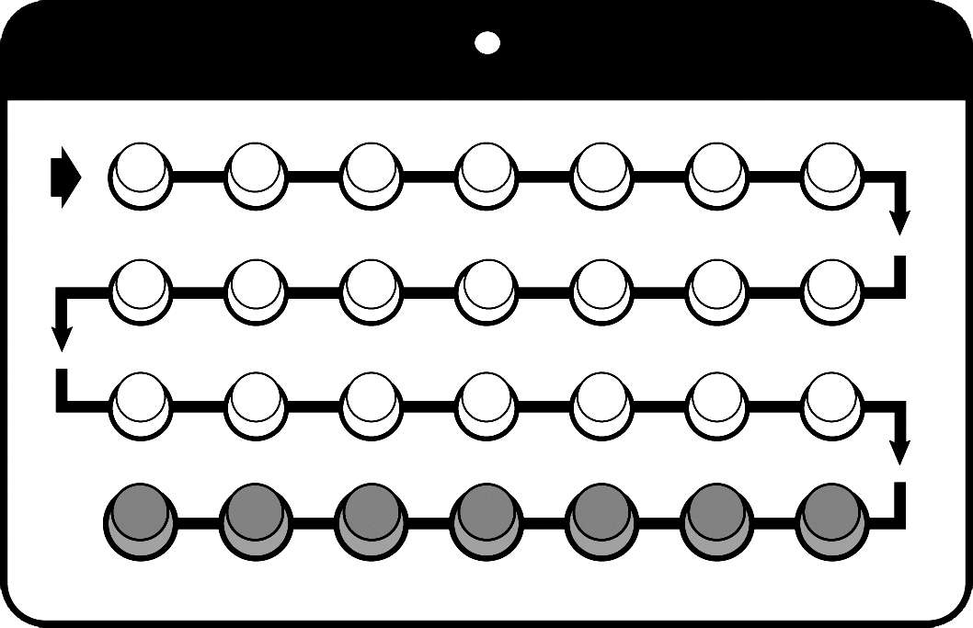
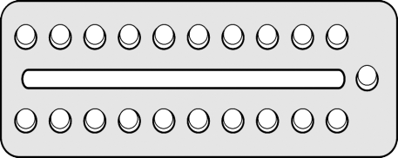
POPs: Summary
Safe for almost all women, including breastfeeding women
Effective if used consistently and correctly
Fertility returns without a delay
Screening and counseling are essential
Adapted from Training Resource Package for Family Planning: https://www.fptraining.org/
Notes:
Progestin-only pills have characteristics that make them a desirable family planning method for many women.
They are safe for almost all women, including breastfeeding women.
They are effective if used consistently and correctly.
Fertility returns without a delay after stopping pills.

Slide 33
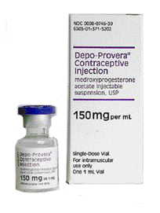
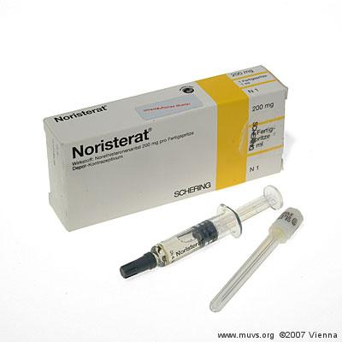
Progestin-only injectable contraceptives
Notes:
Photo credit: FHI (packaging from socially marketed DMPA in Kenya and Uganda)

Slide 34
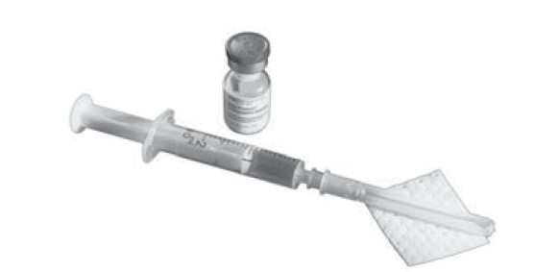
What are progestin-only injectables?
Injectable contraceptives containing a progestin like the natural hormone progesterone
Administered by injection into the muscle (intramuscular injection) or just under the skin (subcutaneous injection).
The hormone is released slowly into the bloodstream.
Different from monthly injectables which contain both estrogen and progestin.
Family Planning: A Global Handbook for Providers (3rd Edition, 2018)

Slide 35
Types of progestin-only injectables
  DMPA (depot medroxyprogesterone acetate)
    Given either into the muscle (DMPA-IM, known as “the shot,” “the jab,” the injection, Depo, Depo-Provera, and Petogen or under the skin (DMPA-SC, under the name Sayana Press and in prefilled single-dose disposable hypodermic syringes as depo-subQ provera 104.)
    Injection every 3 months (13 weeks)
  NET-EN (norethisterone enanthate), also called Noristerat, Norigest, and Syngestal
    Injection every 2 months (8 weeks)
Have similar effectiveness, safety, characteristics and eligibility criteria
Adapted from Training Resource Package for Family Planning: https://www.fptraining.org/
Family Planning: A Global Handbook for Providers (3rd Edition, 2018)
Notes:
Photo credits: News-Leader, ©2005 Springfield, MO; Museum of Contraception and Abortion, ©2007 Vienna
There are two types of progestin-only injectables: DMPA (depot medroxyprogesterone acetate) and NET-EN (has two chemical formulations: norethindrone enanthate and norethisterone enanthate). Each contain a progestin like the natural hormone progesterone in a woman’s body.
DMPA and NET-EN are given as intramuscular injections in one of three sites: the muscles of the upper arm, the muscle of the hip, or in the buttock.
Progestin-only injectables are different from combined injectable contraceptives. Combined injectables contain both a progestin and an estrogen. They are known as CICs or monthly injectables, because injectables are given once a month. This presentation addresses only progestin-only injectables.

Slide 36
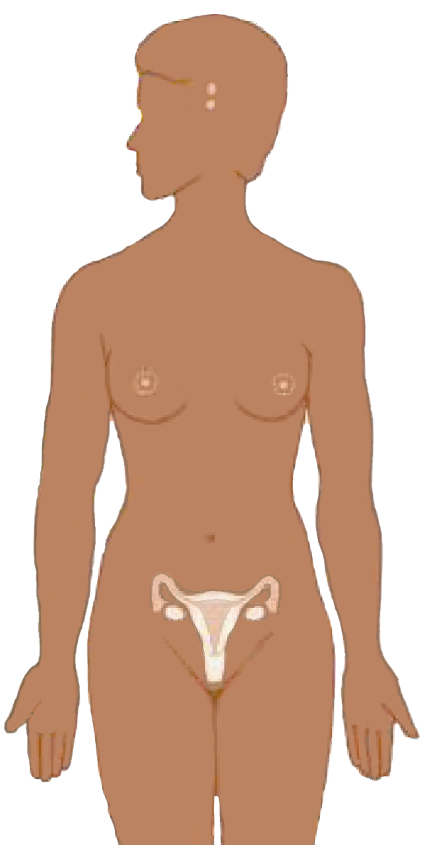
Progestin-only injectables: Mechanism of action
Suppress hormones
responsible for
ovulation
Thicken cervical mucus to block sperm
Note: Do not disrupt existing pregnancy
Adapted from Training Resource Package for Family Planning: https://www.fptraining.org/
Notes:
Progestin-only injectables prevent pregnancy in two ways:
The primary mechanism of action is to suppress ovulation. Progestin causes the hypothalamus and the pituitary gland to reduce production of the hormones that are necessary for ovulation. Without ovulation, there is no egg to be fertilized.
Progestin also thickens the cervical mucus. The thickened mucus makes it more difficult for sperm to enter the uterine cavity. In the unlikely event that a woman does ovulate, this mucus barrier greatly reduces the chance that the egg will be fertilized.
Other contraceptive methods that work this way are implants and combined oral contraceptives (COCs).
Progestin-only injectables do not disrupt an existing pregnancy and do not harm a fetus if a woman is accidentally given this method when she is already pregnant. However, if it is determined that a woman who is using injectables is, indeed, pregnant, she should stop receiving injections.

Slide 37
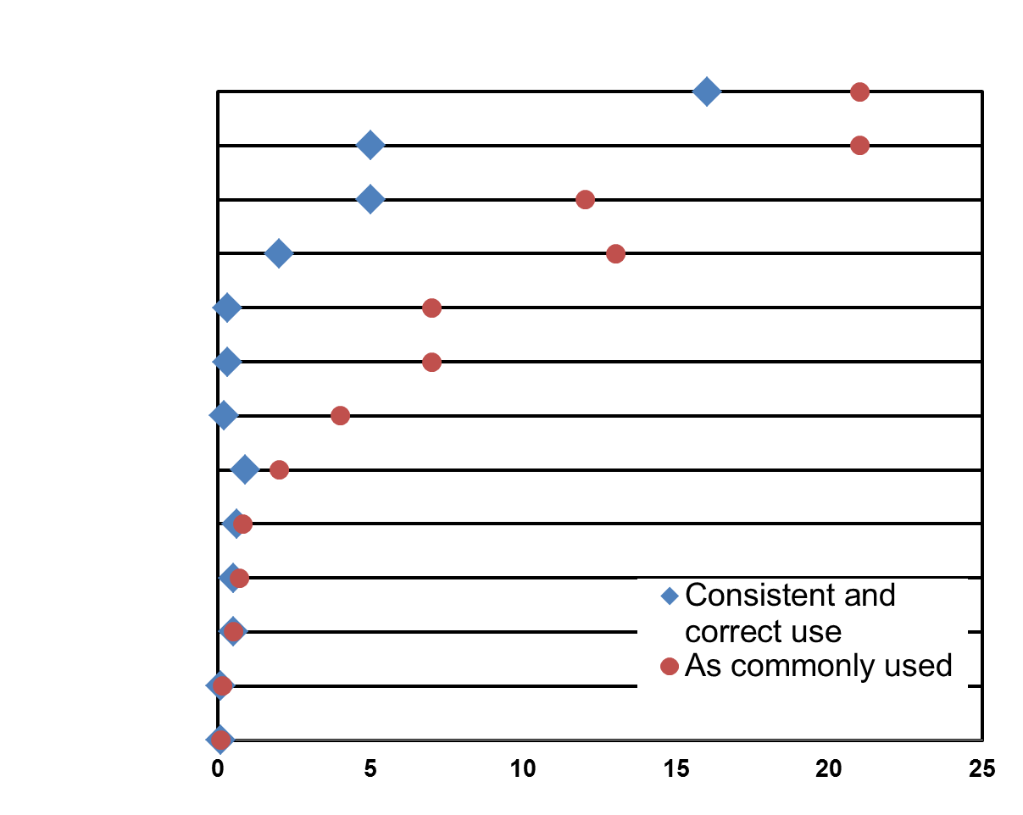
Progestin-only injectables: Effectiveness
Spermicides
Female Condoms
Standard Days Method
Male Condoms
Progestin-only Pills
COCs
Progestin-only Injectables
LAM (6 months)
Copper-IUD
LNG-IUD
Tubal Ligation
Vasectomy
Implants
First-Year Pregnancy Rate per 100 Women
Adapted from Training Resource Package for Family Planning: https://www.fptraining.org/
Notes:
A woman’s chance of becoming pregnant while using progestin-only injectables is quite low. However, their effectiveness depends on the user getting injections regularly. This chart compares the pregnancy rates for women using DMPA with the rates for those using other contraceptive methods. The blue diamonds show pregnancy rates for correct and consistent use. The red circles show pregnancy rates as the method is commonly used, demonstrating how often a contraceptive fails in real-life situations when it may not always be used correctly and consistently.
When women have their injections on time, injectables are 99.8 percent effective, (only two pregnancies per 1,000 women using injectables over the first year). As the chart shows, when it used correctly and consistently—that is, when women always return for their injections on time—DMPA is nearly as effective as the IUD. As commonly used, that is, when women sometimes do not return for injections on time, injectables are 94 percent effective, or about six pregnancies per 100 women using injectables over the first year.
Other reversible contraceptive methods, such as barrier methods, have much larger differences; they may have low pregnancy rates when used correctly and consistently but much higher rates as commonly used.
With progestin-only injectables, all a woman needs to do is to receive her next injection on time. Because the effectiveness of injectables does not depend on daily user compliance, the pregnancy rates for injectables are fairly low, even as commonly used. The only other reversible methods that are more effective as commonly used are intrauterine devices, also known as IUDs, and progestin-only implants.
Reference:
Trussell J. Contraceptive failure in the United States. Contraception 2011;83:397-404.
Source: Training Resource Package for Family Planning: https://www.fptraining.org/

Slide 38
Characteristics of progestin-only injectables
Safe and very effective
Easy to use; requires no daily routine
Long-lasting and reversible
Can be discontinued
without provider’s help
Can be provided outside of clinics
Can be used by breastfeeding women
Use can be private
Does not interfere with sex
Can be used by breastfeeding women
Provide non-contraceptive health benefits
Have side effects
Cause delay in return to fertility
Effectiveness depends on user getting injections regularly
Provide no protection from STIs/HIV
Adapted from Training Resource Package for Family Planning: https://www.fptraining.org/

Slide 39
Progestin-only injectables: Side effects
Possible side effects include:
Prolonged or heavy bleeding irregular bleeding or spotting – most common
Weight gain – common, about 1–2 kg per year
Less common
Headaches
Dizziness
Amenorrhea (no menses)
Abdominal bloating and discomfort
Changes in mood
Less sex drive
Many women experience no side effects but about one third of users discontinue in the first year due to side effects.
Adapted from Training Resource Package for Family Planning: https://www.fptraining.org/
Notes:
Many women experience no side effects, but some users of injectables experience side effects.
The most commonly reported side effects of DMPA and NET-EN are menstrual changes, including prolonged, heavy or irregular bleeding, spotting, and amenorrhea.
In the first three to six months, women using progestin-only injectables commonly experience irregular bleeding or spotting and prolonged bleeding.
After one year, women commonly experience infrequent bleeding, irregular bleeding, and amenorrhea.
Less than 10% of DMPA users have normal cycles in the first year of use (90% of users will have bleeding changes in the first year).
Menstrual bleeding changes for any one client are unpredictable.
About 47 percent of women, nearly half, develop amenorrhea and have no monthly bleedings after one year of DMPA use
DMPA and NET-EN users also commonly report weight gain, although some injectables users report weight loss while others report no change in weight.
Less commonly reported side effects are headaches; dizziness; abdominal bloating and discomfort; mood changes, such as anxiety; and changes in sex drive. It is difficult to determine wither a change in a woman’s mood or reduced sex drive is related to DMPA or NET-EN or to other reasons; there is no evidence that injectables affect a woman’s sexual behavior.
Typically, nine out of ten of injectables users report at least one side effect during the first year of use. In most cases, none of these side effects result in health risks. Nonetheless, some side effects, such as changes in bleeding, may have serious practical and social consequences for women.
About one third of users discontinue in the first year due to side effects.
It is important to reassure clients that side effects are experienced by many women who use injectables and they are not signs of illness.

Slide 40
Comparing DMPA and NET-EN side effects
No significant difference in:
  Proportion of clients who experienced vaginal bleeding/spotting events
  Duration of vaginal bleeding/spotting events at 12 and 24 months
  Changes in body weight
  Changes in blood pressure
  Frequency of discontinuation at 12 months
  Reasons for discontinuation
Occurrence of amenorrhea 21% higher for DMPA
Adapted from Training Resource Package for Family Planning: https://www.fptraining.org/
Notes:
A Cochrane review paper analyzed data from two published clinical trials comparing DMPA and NET-EN in terms of contraceptive effectiveness, reversibility, discontinuation patters, minor effects and major effects. The review found no significant differences between the two methods for the following outcomes:
The proportion of women who experienced vaginal bleeding/spotting events, and the duration of bleeding and spotting events at 12 and 24 months
Changes in body weight: Even after two years there was no difference at all in weight gain between the groups, and the weight change recorded did not exceed 3.5 kg.
Changes in blood pressure: There were no significant differences in BP changes, and the BP changes recorded were very small.
The frequency of discontinuation at 12 months and reasons for discontinuation were also similar for the two methods: Nearly half of both groups discontinued at 12 months. (Note: This rate includes people who discontinued for personal reasons, those lost to follow up, and due to accidental pregnancy, in addition to those who reported that they discontinued due to side effects.) Both groups discontinued at similar rates due to amenorrhea, bleeding problems, and accidental pregnancy. NET-EN users were slightly (four percent) more likely to discontinue for personal reasons.The only statistically significant difference found between the two methods was the likelihood of experiencing amenorrhea. Women on DMPA were 21% more likely to experience amenorrhea at 12 and 24 months than were women on NET-EN.The study noted that, due to this significant difference, if progestin-only injectable contraceptives are the method of choice, then the choice between DMPA and NET-EN in terms of probable menstrual bleeding effects becomes important. DMPA may be recommended to women who would regard potential amenorrhea as an advantage.¹
Reference:
Draper BH, Morroni C, Hoffman M, et al. Depot medroxyprogesterone versus Noresthisterone oenanthate for long-acting progestogenic contraception. Cochrane Database of Systematic Reviews 2006, Issue 3. Art. No.: CK005214. DOI: 10.1002/14651858.CK005214.pub2.
Source: Training Resource Package for Family Planning: https://www.fptraining.org/

Slide 41
Progestin-only injectables: Health benefits
Help protect against:
  Risks of pregnancy
  Endometrial cancer
  Uterine fibroids
May help protect against symptomatic pelvic inflammatory disease (PID) and iron-deficiency anemia
Reduce sickle cell crises in women with sickle cell anemia
Reduce symptoms of endometriosis (pelvic pain, irregular bleeding)
Adapted from Training Resource Package for Family Planning: https://www.fptraining.org/
Notes:
In addition to preventing pregnancy, progestin-only injectables provide a number of health benefits to users including:
They help protect against endometrial cancer and uterine fibroids.
They may help protect against symptomatic pelvic inflammatory disease (PID) and iron-deficiency anemia.
They reduce sickle cell crises in women with sickle cell anemia
They also reduce the symptoms of endometriosis, including pelvic pain, and irregular bleeding.
NET-EN may offer many of the same health benefits as DMPA, but this list of benefits includes only those for which there is available research evidence.

Slide 42
Injectables and risk of breast cancer
No effect on overall risk of breast cancer
Older studies found a somewhat increased risk during first 5 years of use
  May be due to detection bias or accelerated growth of pre-existing tumors
Recent large study found no increased risk in current or past DMPA users regardless of age and duration of use
Little research has been done on NET-EN
Adapted from Training Resource Package for Family Planning: https://www.fptraining.org/
Notes:
Progestin-only injectables have no effect on a client’s overall risk of breast cancer. Older studies had found a somewhat increased risk of breast cancer among current users. But this finding was probably due to detection bias or accelerated growth of pre-existing tumors.
A recent large study found no increased cancer risk in current or past DMPA users regardless of age and duration of use.
No studies were done for NET-EN.

Slide 43
Effect of DMPA on bone density
DMPA users have lower bone density than non-users
Women initiating DMPA use as adults regain most lost bone
Long-term effect in adolescents unknown
  Concerns about reaching peak bone mass
  Long-term studies are needed
  Generally acceptable to use
Adapted from Training Resource Package for Family Planning: https://www.fptraining.org/
Notes:
Most studies have found that DMPA users have lower bone density than non-users, especially women age 21 or younger. A woman’s bones normally reach their maximum density during adolescence, but the use of DMPA during adolescence may affect peak bone mass.
Women who start using DMPA as adults appear to regain most of the lost bone after they stop using DMPA.
However, it is not yet known whether bone loss in adolescents and young women is completely reversible. One study found that adolescent NET-EN users recovered bone mass density after discontinuing. However, long-term studies are needed to determine whether DMPA use increases the risk of fracture, especially in women who begin using DMPA during adolescence. Currently, DMPA use is considered to be generally acceptable for adolescent clients, because preventing risks associated with unwanted pregnancy at a young age outweigh the theoretical risk of fracture later in life.

Slide 44
Infant exposure to DMPA/NET-EN during breastfeeding
DMPA and NET-EN have no effect on:
Onset or duration of lactation
Quantity or quality of breast milk
Health and development of infant
Initiation before 6 weeks postpartum is generally not recommended. (WHO/MEC)
Adapted from Training Resource Package for Family Planning: https://www.fptraining.org/
Notes:
Photo credit: ©1991 Lauren Goodsmith, Courtesy of Photoshare
DMPA and NET-EN have been used extensively by women who are breastfeeding. Because DMPA and NET-EN are partially excreted through breastmilk, a breastfeeding infant swallows a small amount of hormone, which enters the child’s circulatory system. Studies have shown that DMPA has no adverse effects on the onset or duration of lactation; the quantity or quality of breastmilk; or the health and development of nursing infants.

Slide 45
Injectables: Return to fertility
Return to fertility depends on how fast a woman fully metabolizes the injectable
On average, women become pregnant 9–10 months after their last injection of DMPA
Length of time injectable was used makes no difference
Adapted from Training Resource Package for Family Planning: https://www.fptraining.org/
Notes:
Return to fertility for injectables users depends on how long it takes a woman to fully metabolize the DMPA or NET-EN from her last injection. Because women differ in how they metabolize DMPA and NET-EN, there is considerable variability in how long it takes to become pregnant after discontinuation.
In the case of DMPA, on average, women can become pregnant nine to 10 months after their last DMPA injection. Some women may become pregnant as soon as four months after the last injection, but a small percentage may take as long as 18 months. The average time it takes to become pregnant after discontinuing injectables is about four months longer for DMPA users and about one month longer for NET-EN users than for women who use other modern methods. The difference in fertility between former DMPA users and former users of other contraceptives disappears approximately 16 months after discontinuation.
The length of time a woman has used DMPA or NET-EN makes no difference in return to fertility.
Because of the delay in return to fertility, women should be counseled to consider discontinuing DMPA or NET-EN several months before the time they want to conceive.

Slide 46
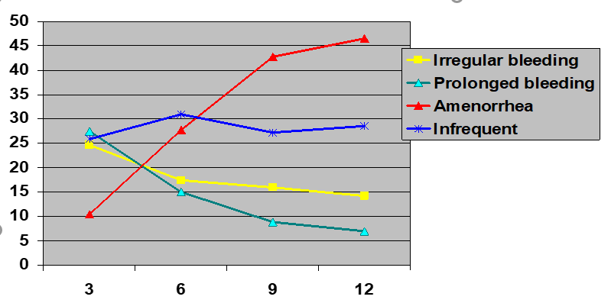
DMPA: Menstrual bleeding changes
Percent of users experiencing bleeding changes
Number of months using DMPA
Adapted from Training Resource Package for Family Planning: https://www.fptraining.org/
Notes:
The most reliable information on bleeding patterns among women using injectables and other hormonal contraceptives comes from a WHO-coordinated multicenter clinical trial in which women kept detailed menstrual diaries. Less than 10% of DMPA users have normal cycles in the first year of use. As indicated on the graph, many DMPA users can expect to have irregular or prolonged bleeding in the first six months and then infrequent bleeding or amenorrhea in the next six months and beyond. About 47% of women are amenorrheic (have no monthly bleeding) after one year of DMPA use and, although not reflected on this graph, about 80% are amenorrheic after two years of DMPA use.¹
The original data from the WHO trial described the percentages of women in the trial who experienced eight types of bleeding changes at three, six, nine, and 12 months of DMPA use. This graph collapses those eight categories of data into four. Data from each of the four categories of prolonged bleeding were added together to form one category of prolonged bleeding. The data on frequent bleeding were added to the data on irregular bleeding and are displayed here as irregular bleeding. The data shown here for amenorrhea and infrequent bleeding are as originally published.
The WHO trial studied effects of DMPA given in three-monthly doses of either 150 mg or 100 mg. The data used in this graph came from the group receiving the150 mg dose.
Reference:
1. WHO Special Programme of Research, Development and Research Training in Human Reproduction: Task Force on Long-Acting Agents for Fertility Regulation (WHO). A multicentered phase III comparative clinical trial of Depot-medroxygrogesterone acetate given three-monthly at doses of 100mg or 150mg: II. The comparison of bleeding patterns. Contraception 1987;35(6):591-607.
Source: Training Resource Package for Family Planning: https://www.fptraining.org/

Slide 47
Who can use DMPA or NET-EN
Category 1 examples:
WHO Category | Conditions (selected examples)
Category 1 | Age 18-45 years; any parity (including nulliparous); smoking (any amount, any age); breastfeeding after 6 weeks postpartum; postabortion; and acute or chronic hepatitis. NET-EN: Obesity of more than 30 kg/m2 body mass index in women younger than 18 ears of age. DMPA: Women who are using certain types of ARVs (non-nucleoside reverse transcriptase inhibitors or ritonavir-boosted protease inhibitors). DMPA: Women using specific anticonvulsants (phenytoin, carbamazepine, barbiturates, primidone topiramate, or oxcarbazepine).
Adapted from Training Resource Package for Family Planning: https://www.fptraining.org/
Notes:
Category 1: For women with these conditions or characteristics, the method presents no risk and can be used without restrictions.

Slide 48
Who Can Use DMPA or NET-EN
Category 2 examples:
WHO Category | Conditions (selected examples)
Category 2 | Age <18 years or >45; mild hypertension (BP <159/99 mmHg); non-vascular diabetes; prolonged or heavy bleeding patterns; and history of DVT. DMPA: Obesity of more than 30 kg/m2 body mass index in women younger than 18 ears of age. NET-EN: Women who are using certain types of ARVs (non-nucleoside reverse transcriptase inhibitors or ritonavir-boosted protease inhibitors). NET-EN: Women using specific anticonvulsants (phenytoin, carbamazepine, barbiturates, primidone topiramate, or oxcarbazepine).
Adapted from Training Resource Package for Family Planning: https://www.fptraining.org/
Notes:
Category 2: For women with these conditions or characteristics, the benefits of using the method generally outweigh the theoretical or proven risks.
Other examples of Category 2 conditions that are not listed on this slide <migraines without an aura; migraines with aura/to initiate use; history of deep venous thrombosis (DVT); known hyperlipidemias; cervical cancer; an undiagnosed breast mass; irregular bleeding patterns; cholestasis related to oral contraceptives>.

Slide 49
Who Should not use DMPA and NET-EN
Category 3 and 4 examples:
WHO Category | Conditions (selected examples)
Category 3 | Breastfeeding before 6 weeks postpartum, severe hypertension (≥160/≥100 mmHg), unexplained vaginal bleeding (before evaluation) acute DVT/PE, complicated diabetes, severe liver disease
Category 4 | Current breast cancer
Adapted from Training Resource Package for Family Planning: https://www.fptraining.org/
Notes:
Although progestin-only injectables are safe for most women, there are some exceptions.
According to the WHO MEC, progestin-only injectables are not generally recommended for women with category 3 conditions. In these situations, the risks of using this method usually outweigh the advantages. Category 3 conditions include:
Acute blood clot in deep veins of legs or lungs, unexplained vaginal bleeding, severe hypertension (≥160/≥100 mmHg),, severe liver disease and most liver tumors, complicated diabetes and breastfeeding before 6 weeks postpartum.
The condition of breastfeeding before 6 weeks postpartum is a special case that merits further consideration. Based on theoretical (i.e. not proven) reasons having to do with the concern that progestogens may negatively affect the neonatal liver or brain, the WHO MEC has classified breastfeeding before 6 weeks postpartum as a category 3. WHO also notes that “in many settings pregnancy morbidity and mortality are high, and access to services is limited. Progestin-only contraceptives may be one of the few types of methods widely available and accessible to breastfeeding women immediately postpartum.” Reflecting this consideration, after careful evaluation of the evidence and their own health systems and settings, some countries have made different classifications. The United States Center for Disease control (CDC) gives the condition of breastfeeding at 0-4 weeks a Category 2 and from 4-6 weeks a Category 1. The United Kingdom’s Royal College of Obstetricians and Gynecologists: Faculty of Sexual and Reproductive Health Care give it a Category 1 from birth onward. This distinction has important programmatic considerations because it would mean that implants could be offered in the immediate postpartum setting to women who wanted to receive them. The materials in this training package reflect the WHO classification, with room for discussion of the various options.
Women with category 4 conditions should not use DMPA and NET-EN. Current breast cancer is the only category 4 condition.

Slide 50
Injectables use by women with HIV and AIDS
WHO Eligibility Criteria
Condition | Category
HIV-infected | 1
AIDS | 1
ARV therapy | 1 or 2
Women with HIV or AIDS can use without restrictions
Injectable dose provides wide margin
of effectiveness
Return for injections
on time if on any type of ARV treatment
Encourage dual method use
Adapted from Training Resource Package for Family Planning: https://www.fptraining.org/
Notes:
According to the WHO MEC, DMPA and NET-EN can be used without restrictions by women whit HIV and women who have AIDS; these are all Category 1 for both DMPA and NET-EN.
ARV therapy includes a variety of different treatments, but all regimens contain either NNRTI (non-nucleoside reverse transcriptase inhibitors) or PI (protease inhibitor). As noted earlier, NNRTIs and ritonavir or ritonavir-boosted PIs are Category 1 for DMPA and Category 2 for NET-EN. Research shows that these ARVs interact with both DMPA and NET-EN in a way that slightly reduces the blood concentration of progestin—but not to a degree that impairs contraceptive effectiveness. For more information, consult the WHO document, Medical Eligibility Criteria for Contraceptive Use.
Providers should encourage all women on ARV therapy to receive their injections by their scheduled reinjection dates to ensure maximum effectiveness.
Women with HIV who choose to use progestin-only injectables should be counseled about dual method use and advised to use condoms in addition to injectables. Condoms provide both additional protection from pregnancy in the event of late reinjection and protection from STI/HIV transmission between partners.

Slide 51
Injectables use by postpartum women
WHO Eligibility Criteria
Characteristic/ Condition | Category
Non-breastfeeding | 1
Breastfeeding <6 weeks | 3
Breastfeeding ≥6 weeks | 1
Non-breastfeeding women can initiate immediately postpartum
Breastfeeding women
  Generally should not use injectables before 6 weeks postpartum
  No restrictions after
  6 weeks postpartum
Adapted from Training Resource Package for Family Planning: https://www.fptraining.org/
Notes:
Non-breastfeeding women can initiate injectables immediately postpartum.

Slide 52
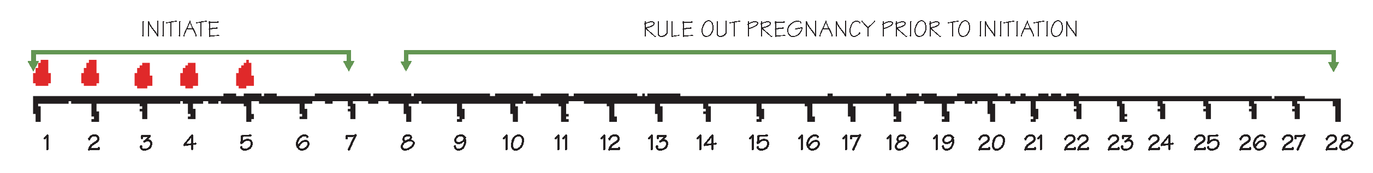
When to start injectables - 1
Anytime – if you are sure woman is not pregnant. May be started without a pelvic exam or routine lab tests, without cervical cancer screening, and without a breast exam.
During the first seven days after your client’s period starts you can assume that she is not pregnant.
You can give an injection now. There is no need for her to abstain or use condoms.
After day eight of her cycle, you must rule out pregnancy before giving an injection.
If she is not pregnant, give the injection and tell her to abstain from sex or use condoms for the next seven days.
Adapted from Training Resource Package for Family Planning: https://www.fptraining.org/
Notes:
Injectables may be initiated without a pelvic exam; without blood tests or routine lab tests; without cervical cancer screening; without a breast exam.
DMPA and NET-EN can be started anytime during the menstrual cycle as long as the provider can be reasonably sure the woman is not pregnant. You can be reasonably certain that a woman is not pregnant if any of these situations apply:
Her menstrual bleeding started within the past seven days.
The woman is fully breastfeeding, has no menses, and her baby is less than six months old.
She has abstained from intercourse since her last menses or since delivery.
She has given birth in the past four weeks.
She had a miscarriage or an abortion in the past seven days.
She has been using a reliable contraceptive method consistently and correctly.

Slide 53
When to start injectables - 2
Postpartum:
  If breastfeeding: wait 6 weeks
  If not breastfeeding: anytime within 4 weeks after delivery (after 4 weeks, rule out pregnancy)
After miscarriage or abortion:
  anytime within 7 days
  (after day 7 rule out pregnancy)
When switching from another method:
  start immediately
Adapted from Training Resource Package for Family Planning: https://www.fptraining.org/
Notes:
If DMPA or NET-EN are initiated during the first seven days of the menstrual cycle—where day one is the first day of bleeding—no backup contraceptive method is necessary. If progestin-only injectables are initiated more than seven days after the start of woman’s monthly bleeding, advise her to use a backup contraceptive method such as condoms for the first seven days following the injection. Ideally, postpartum women who are breastfeeding generally should not start using injectables until six weeks postpartum because of concerns the newborn infants will be exposed to DMPA or NET-EN received in breast milk. This represents the international consensus on the initiation of progestin-only injectables and breastfeeding as reflected in the WHO MEC. Women who are exclusively breastfeeding a baby less than six months old and whose menses have not returned are protected from pregnancy by the lactational amenorrhea method (LAM). Postpartum women who are not breastfeeding may start progestin-only injectables immediately after giving birth. If a woman who is not breastfeeding wants to start using progestin-only injectables more than four weeks after she has given birth, it is necessary to rule out pregnancy before giving the injection. Progestin-only injectables can be initiated immediately following an abortion or miscarriage without need for a backup method. If it is more than seven days after a first- or second-trimester miscarriage or abortion, a woman can start injectables any time it is reasonably certain she is not pregnant. She will need a backup method for the first seven days after the injection. If a woman is switching to injectables from another hormonal method, she can have an injection of DMPA or NET-EN immediately, provided that she has been using the hormonal method consistently and correctly or if it is otherwise reasonably certain she is not pregnant. There is no need for her to wait for her next monthly bleeding. There is no need for her to use a backup method. If she is switching from another injectable, she can have the new injectable when the repeat injection would have been given. No need for a backup method. She can start injectables on the same day that she uses emergency contraceptive pills (ECPs), or, if she prefers, within seven days after the start of her monthly bleeding. She will need a backup method for the first seven days after the injection. She should return if she has signs or symptoms of pregnancy other than not having monthly bleeding.

Slide 54
Injectables: Correcting rumors and misunderstandings
Progestin-only injectables:
Can stop monthly bleeding, but this is not harmful
  Blood is not building up inside the woman
  It is similar to not having menses during pregnancy
  Usually not a sign of pregnancy
Do not cause an abortion/disrupt an existing pregnancy
Do not make women infertile
Adapted from Training Resource Package for Family Planning: https://www.fptraining.org/

Slide 55
Management of side effects of injectables: Bleeding changes - 1
Counseling and reassurance are key.
Problem | Action/Management
Irregular bleeding (spotting or light bleeding at unexpected times that bothers the client) | Reassure client that this is common and not harmful Recommend a 5-day course of mefenamic acid (500 mg 2 times per day after meals) Or 40 mg valdecoxib daily for 5 days, beginning when irregular bleeding starts | If side effects persist and are unacceptable to the client, help her choose another method
Amenorrhea | Reassure client: no medical treatment necessary
Adapted from Training Resource Package for Family Planning: https://www.fptraining.org/

Slide 56
Management of side effects: Bleeding changes - 2
Problem | Action/Management
Heavy or prolonged bleeding (twice as much as usual or longer than 8 days) | Reassure client that this is common, not harmful Recommend 5-day course of mefenamic acid (500 mg 2 times per day after meals); or 40 mg valdecoxib daily for 5 days; or COCs daily for 21 days; beginning when heavy bleeding starts Suggest iron tablets and foods high in iron to prevent anemia Consider underlying conditions if heavy bleeding continues or starts after several months If bleeding becomes a health threat, of if the woman wants, help her choose another method
Adapted from Training Resource Package for Family Planning: https://www.fptraining.org/

Slide 57
Management of other side effects of injectables
Problem | Action/Management
Common headaches, dizziness | Reassure and suggest pain relievers; evaluate headaches that worsened after starting injectables. Dizziness: consider local remedies.
Abdominal bloating/ discomfort | Reassure; suggest local remedies. Refer for care if abdominal pain is severe.
Changes in mood or sex drive | Ask about changes in life that could affect mood or sex drive, including relationship changes. Give support as appropriate. For serious mood changes, refer for care.
Weight gain | Review diet and counsel as needed.
Adapted from Training Resource Package for Family Planning: https://www.fptraining.org/

Slide 58
Problems that may require switching from injectables to another method
Problem | Action/Management
Unexplained vaginal bleeding | Refer or evaluate by history and pelvic exam. If an STI is diagnosed, she can continue using injectables during treatment. If no cause can be found, consider stopping injectables to make diagnosis easier.
Migraines | If client has migraines without aura, she can continue to use injectables. If she has migraine aura, do not give the injection. Help her choose a method without hormones.
Certain serious health conditions | Do not give next injection. Give client backup method to use until condition is evaluated. Refer for diagnosis and treatment..
Adapted from Training Resource Package for Family Planning: https://www.fptraining.org/

Slide 59
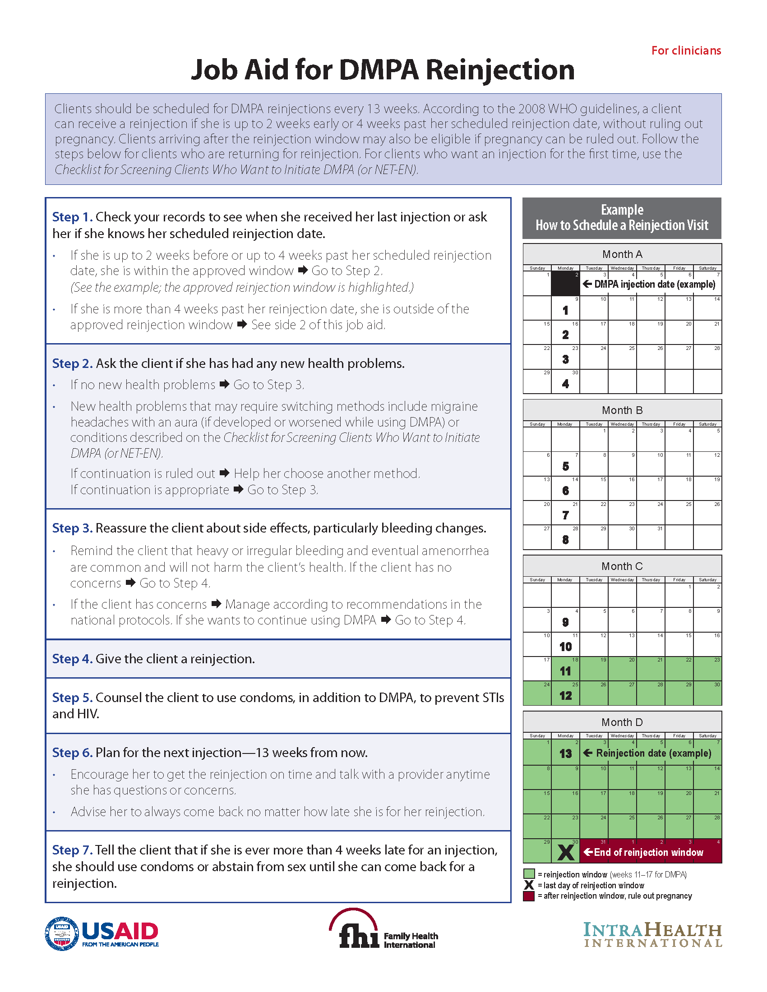
DMPA Injection Schedule
150 mg DMPA
Injection every 13 weeks (or 3 months)
Can be up to 2 weeks early or 4 weeks late
Adapted from Training Resource Package for Family Planning: https://www.fptraining.org/
Notes:
A woman should receive an injection of 150 mg DMPA once every three months or 13 weeks. However, there is a safe window (“grace period”) for repeat injections—that is, how early or late the injection can be given while maintaining effective contraception.
For DMPA, this window is up to two weeks before or four weeks after a scheduled reinjection date.

Slide 60
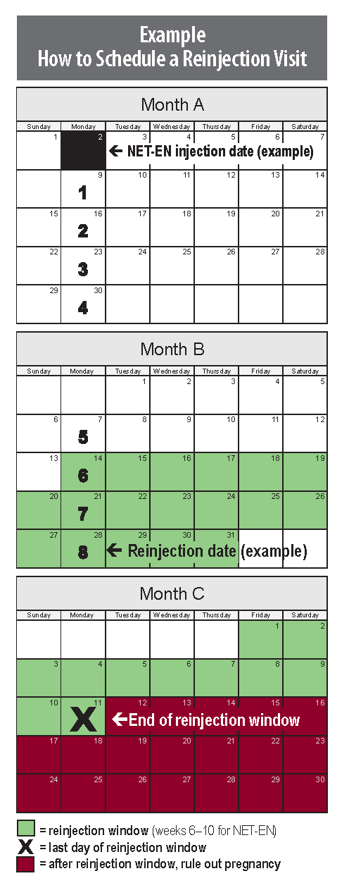
NET-EN Injection Schedule
200mg NET-EN
Injection every 8 weeks (every 2 months)
Can be up to 2 weeks early or 2 weeks late
Adapted from Training Resource Package for Family Planning: https://www.fptraining.org/
Notes:
A woman should receive an injection of 200mg NET-EN once every eight weeks (or two months). However, there is a safe window for repeat injections (“grace period”)—that is, how early or late the injection can be given while maintaining effective contraception.
The safe window for repeat injections for NET-EN is up to two weeks before or two weeks after a scheduled reinjection date

Slide 61
Progestin-only injectables: Managing late injections
Rule out pregnancy using one of following:
  Option 1: Modified pregnancy checklist
  Option 2: Pregnancy test
  Option 3: Bimanual pelvic exam for comparison at follow-up
  Option 4: Abdominal exam
  Assess if returning within reinjection window may remain a problem, if yes, discuss other method options
Adapted from Training Resource Package for Family Planning: https://www.fptraining.org/
Notes:
To rule out pregnancy in this situation, providers have these four options:
Use the modified pregnancy checklist.
Use a pregnancy test.
If a pregnancy test is not available, conduct a bimanual pelvic examination to determine the size of the uterus for comparison at a follow-up visit.
If a pregnancy test or bimanual pelvic examination are not available, do an abdominal examination and give her a backup method to use until her return visit for another abdominal examination in 12 to 14 weeks to see if the uterus could be located through the abdominal wall, or during her next menses, whichever comes first.

Slide 62
Progestin-only injectables: Summary
Safe and highly effective
Easy to use
Most women can use
Bleeding changes may be a concern for some women
Can be provided in both clinical and non-clinical settings
Need appropriate counseling
Adapted from Training Resource Package for Family Planning: https://www.fptraining.org/

Slide 63
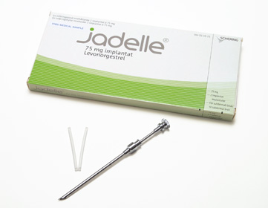

Contraceptive implants
Notes:
Photo credits: © 2006 David Alexander/CCP, Courtesy of Photoshare

Slide 64
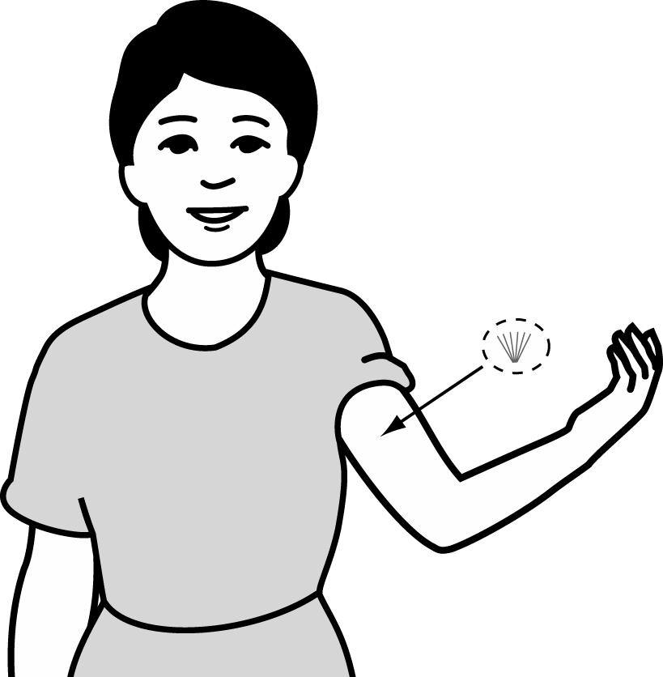

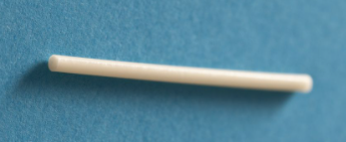
What are implants?
Progestin-filled rods (each about the size of a match stick) that are inserted under the skin
  Jadelle: 2-rod system, effective for 5 years
  Levoplant (Sino-implant (II)): 2-rod system, Labelled for up to 4 years of use.
  Implanon NXT (Nexplanon): 1-rod system, labelled for up to 3 years of use (a recent study shows it may be highly effective for 5 years).
Implants are:
Safe to use
Very effective
Long lasting - 3 to 5 years depending on type
Adapted from Training Resource Package for Family Planning: https://www.fptraining.org/
Family Planning: A Global Handbook for Providers (3rd Edition, 2018)
Notes:
Illustration credits: WHO; Salim Khalaf/FHI

Slide 65
Implants: Mechanism of action
Implants work in two ways:
Suppresses hormones
responsible for
ovulation
Thickens
cervical mucus to block sperm
Implants have no effect on an existing pregnancy.
Adapted from Training Resource Package for Family Planning: https://www.fptraining.org/
Notes:
Illustration credit: Salim Khalaf/FHI
Implants prevent pregnancy in two ways:
They prevent the release of eggs from the ovaries by suppressing the hormones that cause ovulation. When there is no egg, there is nothing for sperm to fertilize.
Implants also cause the cervical mucus to thicken. The thicker mucus acts as a barrier, making it more difficult for sperm to enter the uterine cavity. In the unlikely event that a woman does ovulate, this barrier of mucus greatly reduces the chance that the egg will be fertilized.
Implants do not disrupt an existing pregnancy and have no adverse effect on a woman or a fetus if accidentally inserted in the arm of a woman who is already pregnant.
However, in the rare event that a woman is found to be pregnant with an implant in place, the device should be removed.

Slide 66
Relative effectiveness of implants to other FP methods
Method | # of unintended pregnancies among 1,000 women in 1st year of typical use
No method | 850
Withdrawal | 200
Female condom | 210
Male condom | 130
Pill COCs and POPs | 70
Injectable | 40
IUD (CU-T 380A / LNG-IUS) | 8 / 7
Female sterilization | 5
Vasectomy | 1.5
Implant | 1-6
Source: Trussell J., Contraceptive Failure in the United States, Contraception 83 (2011) 397- 404, Elsevier Inc.
Adapted from Training Resource Package for Family Planning: https://www.fptraining.org/
Notes:
In this slide we look at effective FP methods as they are correctly (not commonly) used. These data are taken from the latest edition (2018) of the global FP Handbook. They indicate the number of women who would be pregnant in the first year of use out of every 100 users of a particular method. As you can see methods vary in their level of effectiveness. Implants are the most effective and as expected, not using a method at all is the least effective.

Slide 67
Implants: Characteristics
Benefits
Very safe and 99.95% effective
Easy to use
Fertility returns without delay when removed
Can be used by breastfeeding women
Offers non contraceptive health benefits
Limitations
Have side effects
Requires a minor procedure to insert and remove
Cannot be initiated and discontinued without a trained provider.
Provide no protection from STIs/HIV
Adapted from Training Resource Package for Family Planning: https://www.fptraining.org/

Slide 68
Implants: Health benefits
Reduced risk of symptomatic pelvic inflammatory disease (PID)
May help protect against iron-deficiency anemia
Reduced risk of ectopic pregnancy
  6 per 100,000 in implant users
  650 per 100,000 in women using no contraception
Adapted from Training Resource Package for Family Planning: https://www.fptraining.org/
Notes:
Non-Contraceptive Health Benefits of Implants
In addition to being an effective way to prevent pregnancy and associated risks, implants offer other health benefits.
Physicians have observed that women who use implants tend to have fewer cases of symptomatic pelvic inflammatory disease, or PID. It is not clear if this is due to actual prevention of PID or whether using implants makes PID symptoms less severe.
Because most implant users experience an overall reduction in the amount of menstrual blood loss, implant use can reduce the likelihood of iron-deficiency anemia.
Because implants are so effective at preventing pregnancy, they dramatically lower a woman’s chances of having an ectopic pregnancy, which is a potentially life-threatening condition.
The risk of ectopic pregnancy is reduced by a factor of more than 100; the rate of ectopic pregnancy among women using implants is 6 per 100,000 women per year compared with 650 per 100,000 women per year among women using no contraceptive method.
In the rare event that implants fail and pregnancy occurs, providers must be aware that an ectopic pregnancy is possible and be prepared to treat this life-threatening condition.

Slide 69
Possible side effects of implants 1
Some users report changes in bleeding patterns:
First several months:
Lighter bleeding and fewer days of bleeding
Prolonged bleeding
Irregular bleeding
Infrequent bleeding
No monthly bleeding
After about one year:
Lighter bleeding and fewer days of bleeding
Irregular bleeding
Infrequent bleeding
No monthly bleeding
*Implanon NXT users are more likely to have infrequent or no monthly bleeding than irregular bleeding.
Adapted from Training Resource Package for Family Planning: https://www.fptraining.org/

Slide 70
Possible side effects of implants - 2
Headaches
Breast tenderness
Lower abdominal pain
Acne (can improve or worsen)
Weight change
Dizziness
Mood changes
Nausea, nervousness
Adapted from Training Resource Package for Family Planning: https://www.fptraining.org/

Slide 71
Complications from implants
Complications from implants are rare and may include:
Infection at insertion site
  If occurs, most likely within the first 2 months
Difficult removal
  Rare if inserted properly and removed by a trained provider
Expulsions
Rare; most occur within first 4 months after insertion.
Found in another place in the body e.g in a blood vessel
Extremely rare: due to improper insertion
Adapted from Training Resource Package for Family Planning: https://www.fptraining.org/
Notes:
Whereas side effects—especially those related to menstruation—are relatively common with progestin-only implants, complications are uncommon or rare. They may include:
Infection at the insertion site is an uncommon complication. If an infection occurs, it will most likely be within the first two months.
Difficulty with removal may occur if insertion was done improperly or if removal is attempted by an untrained provider. However, if implants are properly inserted and removed by a trained provider, difficulty in removing implants is rare.
Expulsion of an implant is a rare complication. If this occurs, it is most likely to happen in the first four months. If no infection is present, a fresh implant may be inserted through a new incision near the other rods or capsules to replace the one that was expelled.

Slide 72
Implants are safe for nearly all women
Almost all women can use implants safely, including women who:
Have or have not had children
Are married or not married
Are of any age including adolescents and women over 40 years old
Are infected with HIV
Are breastfeeding
Have just had an abortion, miscarriage or ectopic pregnancy
Have anemia now or in the past
Have varicose veins
Smoke cigarettes, regardless of woman’s age or number of cigarettes smoked
Most health conditions do not affect safe and effective use of implants.
Many women who cannot use methods that contain estrogen can safely use implants.
Adapted from Training Resource Package for Family Planning: https://www.fptraining.org/

Slide 73
Who can start implants
Category 1 and 2 examples:
Implants are safe for nearly all women.
WHO Category | Conditions (selected examples)
Category 1 | Adolescents, post-abortion, postpartum in non-breastfeeding women, heavy smokers, women being treated for high blood pressure, valvular heart disease, endometriosis, endometrial or ovarian cancer, thyroid disorders, mild liver disease
Category 2 | Breastfeeding <6 weeks postpartum, multiple risk factors for cardiovascular disease, blood pressure ≥160/100, history of blood clots in legs or lungs, diabetes with vascular complications, heavy or prolonged vaginal bleeding patterns
Adapted from Training Resource Package for Family Planning: https://www.fptraining.org/

Slide 74
Who should not start implants
Category 3 and 4
A small number of women may not be able to use implants.
WHO Category | Conditions (selected examples)
Category 3 | Acute blood clots in deep veins of legs or lungs; unexplained vaginal bleeding; history of breast cancer; severe liver disease; most liver tumors; and certain cases of systemic lupus. Continuation only: ischemic heart disease, stroke, migraine with aura.
Category 4 | Current breast cancer
Adapted from Training Resource Package for Family Planning: https://www.fptraining.org/
Notes:
Although progestin-only implants are safe for most women, there are some exceptions.
According to the WHO MEC, progestin-only implants are not generally recommended for women with category 3 conditions. In these situations, the risks of using this method usually outweigh the advantages.
Category 3 conditions include:
Acute blood clot in deep veins of legs or lungs, unexplained vaginal bleeding, history of breast cancer, severe liver disease and most liver tumors, certain cases of systemic lupus.
Women who develop ischemic heart disease, have a stroke, or develop migraine headaches with an aura while using implants should generally not continue using progestin-only implants. Women with category 4 conditions should not use implants.
Current breast cancer is the only category 4 condition.

Slide 75
Implant use by women with HIV
WHO Eligibility Criteria
Condition | Category
Asymptomatic or mild HIV clinical disease | 1
Severe or advanced HIV clinical disease | 1
ARV therapy with NRTIs and integrase inhibitors | 1
ARV therapy with NNRTIs and PIs | 2
Women with HIV or AIDS can use without restrictions
Women on ARV therapy can generally use implants
Counsel that some ARVs, particularly efavirenz, can reduce implant effectiveness somewhat.
Dual method use should be encouraged for women taking Efavirenz
Adapted from Training Resource Package for Family Planning: https://www.fptraining.org/

Slide 76
Implant use by postpartum women
Breastfeeding and non-breastfeeding women can start the use of implants anytime starting immediately postpartum.
WHO Eligibility Criteria
Condition | Category
Non-breastfeeding | 1
Breastfeeding<6 weeks | 2
Breastfeeding≥6 weeks | 1
Adapted from Training Resource Package for Family Planning: https://www.fptraining.org/

Slide 77
When to start implants - 1
Anytime a provider is reasonably certain a woman is not pregnant.
Pregnancy can be ruled out if any of these situations apply:
  Is fully breastfeeding, has no menses, and baby is between 6 weeks and 6 months old
  Abstained from intercourse since last menses or delivery
  Had a baby in the past 4 weeks (if not breastfeeding)
  Started monthly bleeding within the past 7 days
  Had a miscarriage or abortion in the past 7 days
  Is using a reliable contraceptive method consistently and correctly
If none of the above apply, pregnancy can be ruled out by pregnancy test, pelvic exam, or by waiting till next menses.
Adapted from Training Resource Package for Family Planning: https://www.fptraining.org/
Notes:
Pregnancy Tests vs. Pregnancy Checklist:
https://www.fhi360.org/resource/job-aid-how-and-when-use-pregnancy-checklist-and-pregnancy-tests
(Also available on page 439-440 of the Family Planning Global handbook for providers 2018)

Slide 78
When to start implants- 2
First 7 days of menstrual cycle, no backup method needed.
After 7th day of menstrual cycle, rule out pregnancy and use backup method for 7 days.
Postpartum
  Menses has not returned
    Fully breastfeeding and <6 months postpartum OR not breastfeeding and <4 weeks postpartum: Insert anytime, no backup needed
    Fully breastfeeding and >6 months postpartum OR partially breastfeeding OR not breastfeeding and >4 weeks postpartum: Rule out pregnancy and use backup method for 7 days
  Menses has returned (breastfeeding AND non-breastfeeding): As advised for women having menstrual cycles
Adapted from Training Resource Package for Family Planning: https://www.fptraining.org/

Slide 79
When to start implants – 3
Post abortion or miscarriage:
Surgical abortion:
  Immediately; without backup if within 7 days.
  If more than 7 days, rule out pregnancy and use a backup method for 7 days after insertion.
For women undergoing medical abortion:
  Implants can be inserted along with the first pill of the medical abortion regimen.
Switching from a hormonal method: immediately if it was used consistently and correctly
  Injectable users can have implants inserted within the
  reinjection window; without backup
  No need to wait for next menses
Adapted from Training Resource Package for Family Planning: https://www.fptraining.org/

Slide 80
When to start implants - 4
After using emergency contraceptive pills (ECPs):
  Progestin-only or combined ECPs
    Implants can be inserted on same day ECPs taken, use a backup method for first 7 days
  Ulipristal acetate ECPs (UPA-ECPs)
    Interaction between UPA-ECPs and implants that may make one or both less effective
    Implants can be inserted on the 6th day after taking UPA-ECPs
    Use a backup method from the time she takes UPA-ECPs until 7 days after implant inserted
Adapted from Training Resource Package for Family Planning: https://www.fptraining.org/

Slide 81
Implants: Correcting rumors and misunderstandings
Implants stop working once they are removed. Their hormones do not remain in a woman’s body.
They can stop monthly bleeding, but this is not harmful. It is similar to not having monthly bleeding during pregnancy. Blood is not building up inside the woman.
Implants:
  Do not make women infertile
  Do not move to other parts of the body
  Significantly reduce a woman’s risk for ectopic pregnancy
Adapted from Training Resource Package for Family Planning: https://www.fptraining.org/

Slide 82
Management of implant side effects:
Bleeding changes
  Counseling and reassurance are key
Problem | Action/Management
Irregular, heavy or prolonged bleeding | Reassure the client that this is common and not harmful Recommend a 5-day course of ibuprofen (up to 800 mg 3 times per day for 5 days) when bleeding starts If no relief, offer COCs for 3 weeks If bleeding is heavy, iron tablets may prevent anemia | If side effects persist and are unacceptable help client choose another method
Amenorrhea | Reassure client Rule out pregnancy if soon after implant insertion
Adapted from Training Resource Package for Family Planning: https://www.fptraining.org/
Notes:
The best way to reduce the anxiety some women feel when they experience side effects is to provide detailed information about possible side effects before implant insertion. If side effects occur, the first step is to address the client’s concerns through follow-up counseling.
If a client complains about irregular or breakthrough bleeding, the provider should explain that implants make the uterine lining thinner, sometimes causing it to shed earlier than usual, resulting in this type of bleeding. It is also important to reassure the woman that this bleeding does not mean that anything is wrong and remind her that it will likely diminish with time.
If the irregular bleeding is unacceptable to the client, the provider may recommend up to 800 mg of ibuprofen, or an equivalent amount of another non-steroidal anti-inflammatory drug (NSAID) other than aspirin, three times per day for five days. Women who are experiencing irregular bleeding should not take aspirin, since it may increase bleeding, not decrease it.
If an NSAID does not provide relief, the provider can give a low-dose combined oral contraceptive (COC) containing the progestin levonorgestrel for 21 days. An alternative to COCs is to give 50 µg ethinyl estradiol daily for 21 days. If bleeding is prolonged or heavy—twice as long or twice as much as usual—the provider can suggest that the woman take iron tablets to help prevent anemia. If irregular or heavy bleeding continues to bother the client or starts after several months of normal monthly bleeding or amenorrhea, the provider should rule out a possible underlying condition unrelated to method use, such as uterine fibroids, an STI, genital cancer, or pregnancy.
Amenorrhea is another common side effect of implants. Providers can reassure their clients that it does not indicate a health problem and no medical treatment is necessary. This side effect is similar to not having monthly bleeding during pregnancy.
If side effects persist and are unacceptable to the client, the provider should help her choose another contraceptive method.

Slide 83
Management of implant side effects:
Non-menstrual problems
Problem | Action/Management
Common headache | Reassure and suggest painkillers; evaluate headaches that worsened since implant initiation | If side effects persist and are unacceptable to the client, counsel about alternative hormonal or non-hormonal methods
Mild abdominal pain | Reassure; suggest pain- killers; follow-up if needed
Breast tenderness | Recommend a supportive bra, compresses, or painkillers
Weight change | Review healthy eating habits and exercise
Adapted from Training Resource Package for Family Planning: https://www.fptraining.org/

Slide 84
Management of implant side effects:
Problems related to insertion
Problem | Action/Management
Pain after insertion or removal | Check that the bandage or gauze is not too tight; replace bandage; avoid pressing on site Give painkillers for a few days
Infection | Clean the infected area Give oral antibiotics for 7–10 days Remove implants if no improvement
Abscess | Clean, cut open, and drain the abscess Treat the wound Give antibiotics for 7–10 days Remove implants if no improvement
Expulsion or partial expulsion | Expulsion or partial expulsion of the implants often follows an infection Ask the client to return for follow-up care if she notices an implant coming out
Adapted from Training Resource Package for Family Planning: https://www.fptraining.org/

Slide 85
Problems that may require switching from implants to another method - 1
Problem | Action/Management
Unexplained vaginal bleeding | Refer or evaluate by history and pelvic exam If an STI is diagnosed, treat with implants in place If no cause can be found, consider removing implants to make diagnosis easier
Migraines with aura | If the client develops migraines with aura after implants are inserted, the implants should be removed ( category 3) Help client choose a method without hormones
Blood clots, liver or breast cancer | Remove implants Help client choose a method without hormones Treat or refer to a specialist for treatment
Adapted from Training Resource Package for Family Planning: https://www.fptraining.org/
Notes:
There are some serious health conditions that may require a client to stop using implants. These include:
If a client experiences unexplained vaginal bleeding or heavy or prolonged bleeding that is suggestive of a medical condition not related to the method, she might need to discontinue use of implants.
Refer the client or evaluate by taking her medical history and doing a pelvic examination. Diagnose and treat as appropriate.
If no cause of bleeding can be found, consider stopping implants to make the diagnosis easier. Provide the client with another contraceptive method of her choice until the condition is evaluated and treated. The alternative method should be something other than progestin-only injectables or a copper-bearing or hormonal IUD.
If the bleeding is caused by an STI or PID, the client can continue using implants during treatment.
Although women who have migraine headaches with an aura can initiate implants, implants should be removed if a woman develops migraines with aura after implants are inserted. The provider should help her choose a non-hormonal method.
If a woman develops health conditions such as blood clots in the deep veins of the legs or lungs, severe liver disease, or breast cancer, the implants must be removed. Help client choose a method without hormones. Refer to a specialist for treatment

Slide 86
Problems that may require switching from implants to another method - 2
Problem | Action/Management
Heart disease due to blocked or narrowed arteries (ischemic heart disease) | A woman who has one of these conditions can safely start implants. If however the condition develops while she is using implants: Remove the implants or refer for removal Help her choose a method without hormones Refer for diagnosis and care if not already under care
Adapted from Training Resource Package for Family Planning: https://www.fptraining.org/
Notes:
Although women with ischemic heart disease and women who have had a stroke can initiate use of implants, use of implants should be discontinued if these conditions develop or get worse while using implants.
Remove the implants or refer for removal and give the woman a backup method to use until her condition is evaluated. Refer her for diagnosis and care if she is not already receiving treatment.

Slide 87
Implants: Summary
Implants are an option that fulfills an unmet need of contraception for many women
Provides long-term protection
Safe and easy to use
Highly effective and readily reversible
Appropriate for most women, including young and nulliparous
Little is required of the client once the implant is in place
Irregular bleeding patterns may be a problem for some women
Thorough counseling is essential
Adapted from Training Resource Package for Family Planning: https://www.fptraining.org/

Slide 88
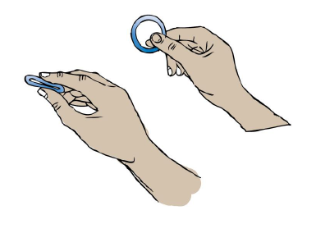
Progesterone vaginal ring (PVR)

Slide 89
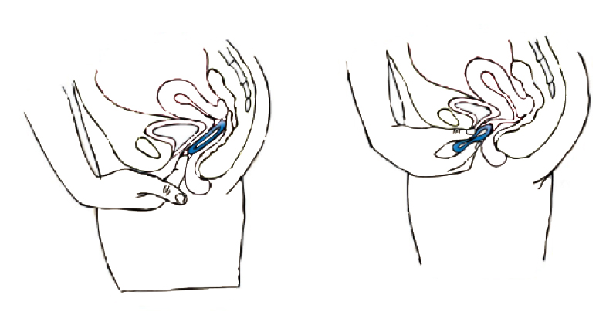
What is the progesterone vaginal ring?
  Contraceptive method for postpartum women who breastfeed at least 4 times per day
Smooth, soft, flexible, silicone ring containing natural progesterone
Easily inserted and removed from the vagina by the woman
Adapted from Training Resource Package for Family Planning: https://www.fptraining.org/
Notes:
The PVR is a contraceptive that has been designed for use by postpartum women who are breastfeeding. Women may be breastfeeding their babies but may not be exclusively or fully breastfeeding. The PVR is suitable for them especially if they breastfeed at least four times a day.
The ring is made of silicone and is soft, smooth and flexible. It has natural progesterone mixed into the silicone. The PVR is a self-use product and hence a woman should be able to insert it into the vagina and remove it herself. The graphic shows where the ring is inserted.

Slide 90
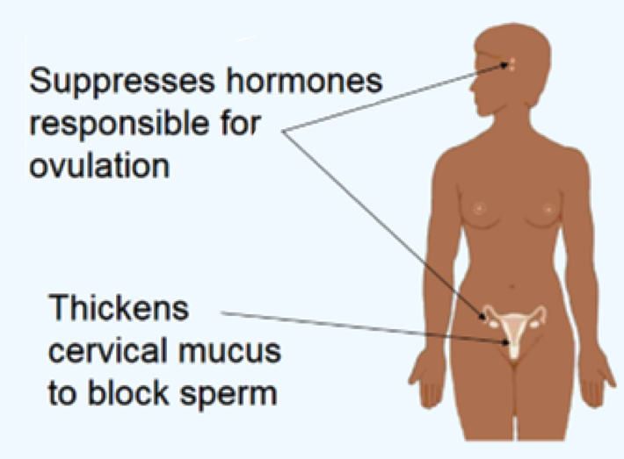
How does PVR work? - 1
The PVR delivers 10mg of progesterone locally in the vagina, which works in two ways:
Adapted from Training Resource Package for Family Planning: https://www.fptraining.org/
Notes:
Illustration credit: Salim Khalaf/FHI
The PVR delivers 10mg of progesterone locally in the vagina and works in two primary ways. The hormone reaches the circulation system via absorption of the vaginal walls. First, like other progestin-based methods, it suppresses hormones that are responsible for ovulation. It prevents the release of eggs from the ovaries and when no egg is released, there is nothing for the sperm to fertilize. Moreover, in breastfeeding women, the hypothalamic-pituitary system is sensitive to the baby’s suckling of the mother’s breast. and progesterone reinforces the prolactin response to suckling. Thus, the combination of suppression of ovulation along with lactational amenorrhea caused by breastfeeding protects a woman against pregnancy.
Second, like other progestin-based methods, the PVR thickens cervical mucus to block sperm. Thicker mucus acts as a barrier making it more difficult for sperm to enter the uterine cavity.

Slide 91
How does PVR work? - 2
Breastfeeding naturally interferes with the hormones that cause ovulation. PVR’s progesterone reinforces this and suppresses ovulation.
Progesterone extends postpartum amenorrhea:
lack of menstruation.
Must continue breastfeeding at least 4 times a day.
Progesterone creates a mucus around the cervix, blocking sperm from reaching egg.
Adapted from Training Resource Package for Family Planning: https://www.fptraining.org/
Notes:
It is because of the effect of suckling that it is important that women breastfeed at least four times a day. Thus, the combination of breastfeeding along with the progesterone in the PVR will protect the mother against a pregnancy.

Slide 92
Relative effectiveness of PVR compared to other methods
Family Planning Method | First Year Pregnancy Rate
No method | 85
Spermicides | 16
Diaphragm with spermicide | 16
Standard Days Method | 5
Male condoms | 2
PVR | 1.5
Female Sterilization | 0.5
Copper IUD | 0.6
Progestin-only pills | 0.3
Progestin-only Injectables | 0.2
Implants | 0.1
Adapted from Training Resource Package for Family Planning: https://www.fptraining.org/

Slide 93
Who can use PVR?
  Women who are 4 weeks after childbirth and whose menses have not returned
  Women who are breastfeeding at least 4 times a day
  Baby is less than 1 year old
  Women who are not pregnant
  No other health conditions
Adapted from Training Resource Package for Family Planning: https://www.fptraining.org/
Notes:
A woman has to be at least four weeks postpartum to begin to use the PVR so as to reduce the risk of thrombosis in the immediate postpartum period. Furthermore, if she is breastfeeding and due to the high frequency of breastfeeding in the first 4 weeks, she is unlikely to need a contraceptive for further protection against a pregnancy. A woman who meets all the following conditions is a good candidate for the PVR.
Any woman who gave birth over four weeks ago and has not begun menstruating.
She has been breastfeeding her baby and intends to breastfeed her baby as long as she is on the PVR. She needs to breastfeed a minimum of four times a day.
The baby is less than a year old. This is important since the PVR works only in the first year postpartum.
She is not currently pregnant.
And she is healthy and does not have any other health conditions which would preclude her from using the PVR.

Slide 94
How to use PVR?
The woman inserts the ring high in her vaginal canal.
Each ring is effective up to 3 months and she should leave it in the vagina for the entire time.
After 3 months, the woman easily removes the ring and inserts a new one.
She can use this method successively up to 1 year (4 rings in 1 year).
The ring can be left in vagina during intercourse or removed for no more than 2 hours.
Adapted from Training Resource Package for Family Planning: https://www.fptraining.org/
Notes:
If there is a gap more than two hours, the effectiveness of the PVR will reduce. Hence, users should be encouraged to keep the PVR inserted at all times and not get in the habit of removal. Keeping it inserted at all times reduces the likelihood of use-related errors such as forgetting to insert on time. If the user forgets to put the PVR within two hours, advise her to use EC or condoms for 24hours after reinsertion or abstain for 24 hours after reinsertion.

Slide 95
PVR: Side effects
Normal Possible Side Effects:
Changes in bleeding patterns:
  Spotting
  Irregular bleeding
  No menstrual bleeding
Mild cramping
Breast tenderness
Rare Possible Side Effects (return to clinic if experience):
Severe pain
Unusual, bad smelling discharge
Genital lesions
Adapted from Training Resource Package for Family Planning: https://www.fptraining.org/

Slide 96
PVR: Health benefits
Reduced number of unintended pregnancies
Improved birth spacing
Increased breastfeeding rates
This leads to better child nutrition and decreasing maternal and newborn mortality rates.
Adapted from Training Resource Package for Family Planning: https://www.fptraining.org/
Notes:
There are health benefits to both the woman and her baby when she uses the PVR.
Since the PVR is a contraceptive, it protects the mother from unintended pregnancy and hence contributes to reductions in unintended pregnancies. It also works to extend birth intervals.
Since the PVR works as long as the woman is breastfeeding, the baby benefits from being nursed. Babies that are breastfed receive the necessary nutrients they need for healthy development. Breastmilk also provides babies with protected from many common ailments such as diarrhea and pneumonia. Thus babies are offered protection against some common causes of infant mortality.
Thus, the use of the PVR benefits both mothers and babies.

Slide 97
PVR: Advantages and disadvantages
Advantages Disadvantages
Safe for mother and baby
98.5% effective
Easy to use
No effect on breastfeeding
Fertility returns without delay when removed
Safe for a woman living with HIV/AIDS, even if she takes antiretroviral medicines
Partner may be able to feel the ring
Only for up to one year
Removal for over two hours reduces efficacy
Provides no protection from sexually transmitted infections, including HIV
Has some side effects
Adapted from Training Resource Package for Family Planning: https://www.fptraining.org/
Notes:
PVR is a safe and effective method. It is safe for both the mother and baby. Use of the PVR does not affect the mother’s ability to breastfeed—it does not alter the volume of milk she produces. Furthermore, since it is a self-use product, the woman can use or not use the PVR as per her preference. It is safe for women who are HIV positive and are taking ARV medicines. Fertility returns once she stops using the PVR.
On the other hand, there are some disadvantages. Since the PVR is a vaginal product, some men may feel the ring during intercourse and if the woman wants to keep her contraceptive use secret, it may not be appropriate. Women who want to use a contraceptive for periods longer than a year will have to switch to a different method after 1 year. It does not protect against HIV and other STIs. Side-effects exist but these are minor.

Slide 98
Who can use the PVR?
Women who can use the PVR are:
Breastfeeding at least 4 times a day
PVR is safe for nearly all women including those who:
Smoke cigarettes
Have anemia now or have had it
in the past
Have varicose veins
Are not married
Are of any age, including adolescents and women over 40 years old
Are infected with HIV (on antiretroviral therapy or not)
Most health conditions do not affect safe and effective use of the PVR.
Many women who cannot use methods that contain estrogen can safely use the PVR.
Adapted from Training Resource Package for Family Planning: https://www.fptraining.org/

Slide 99
Who cannot use the PVR?
Less than 4 weeks postpartum | Ask her to come back when baby is 4 weeks old.
Over 12 weeks postpartum | Ask her to choose a different method.
Breastfeeding less than 4 times a day | Urge her to keep breastfeeding and to return for the PVR when she is breastfeeding at least 4 times a day.
May be pregnant | If in doubt, use pregnancy checklist or perform pregnancy test if available at your facility.
Some other serious health conditions | Currently have genital or urinary tract infection (can start PVR after remedied or treatment started). Pelvic Inflammatory Disease or Salpingitis since delivery. History of: uterine disease (endometrial or cervical), uterine abnormalities, migraine with symptoms, recurrent urinary tract infections, ectopic pregnancy, pelvic surgery, breast cancer, deep venous thrombosis, thromboembolic disorders, incomplete involution of the uterus after birth, pulmonary edema, liver damage or illness, presence of an IUD, STI, sensitivity to silicone.
Women who cannot use the PVR are:
Adapted from Training Resource Package for Family Planning: https://www.fptraining.org/

Slide 100
When to start the PVR?
When a provider is reasonably certain a woman is not pregnant.
  Pregnancy can be ruled out if any of these situations apply:
  Is fully breastfeeding, has no menses, and baby is between 4 weeks and 6 months old
  Abstained from intercourse since last menses or delivery
  Pregnancy checklist from the MEC and FP Handbook indicates she is not pregnant
  Negative pregnancy test if a pregnancy test is available
If the woman is between 4–12 weeks postpartum
Consistently breastfeeding at least 4 times a day
If all the above are true, the woman can start immediately!
Adapted from Training Resource Package for Family Planning: https://www.fptraining.org/

Slide 101
Common rumors and misunderstandings about the PVR
Rumor | Correct
The PVR keeps working after it is removed, and so the woman will have trouble getting pregnant. | The PVR stops working once it is removed. Its hormone do not remain in a woman’s body.
PVR stops monthly bleeding, and blood is building up inside the woman. | The PVR prevents monthly bleeding, but this is not harmful. It is similar to not having monthly bleeding during pregnancy. Blood is not building up inside the woman.
PVR makes a woman infertile. | The PVR does not make women infertile once she stops using it.
PVR moves to other parts of the body. | The PVR does not move to other parts of the body. It will remain in the vagina.
Adapted from Training Resource Package for Family Planning: https://www.fptraining.org/

Slide 102
Management of PVR side effects
Counseling and reassurance are key.
Problem | Action/Management
Spotting or Irregular Bleeding | Reassure the client that this is common and not harmful.
Amenorrhea | Reassure client that this is common and not harmful.
Mild Cramping | Reassure client that this is common and not harmful. Suggest pain medication.
Breast Tenderness | Reassure client that this is common and not harmful. Recommend a supportive bra or compresses.
Adapted from Training Resource Package for Family Planning: https://www.fptraining.org/

Slide 103
Problems that may require switching from PVR to another method
Problem | Action/Management
Unexplained vaginal bleeding | Remove the PVR Refer or evaluate by history and pelvic exam If an STI is diagnosed, treat with PVRs in place If no cause can be found, consider removing PVRs to make diagnosis easier
Migraines | If the client develops migraines with aura after PVRs are inserted, the PVRs should be removed Help client choose a method without hormones
Blood clots, liver or heart disease, stroke, or breast cancer | Remove PVRs Help client choose a method without hormones Treat or refer to a specialist for treatment
Heart disease due to blocked or narrowed arteries (ischemic heart disease) | A woman who has one of these conditions can safely start PVRs. If, however the condition develops while she is using PVRs: Remove the PVRs or refer for removal Help her choose a method without hormones Refer for diagnosis and care if not already under care
Suspected pregnancy | Assess for pregnancy, including ectopic pregnancy Remove the PVRs or refer for removal if she will carry the pregnancy to term There are no known risks to a fetus conceived while a woman has PVRs in place
Adapted from Training Resource Package for Family Planning: https://www.fptraining.org/

Slide 104
PVR: Summary
The PVR:
A new option that fulfills an unmet need for many women
Effective protection from unintended pregnancy when used correctly
Safe for baby and mother
Used by a new mother beginning 4 weeks after birth, if she is
breastfeeding her baby at least 4 times per day and will continue to
do so
Each ring effective for 3 months; replaced up to 3 times
Easy to use—inserted and removed by the woman
Very few side effects, generally mild
Adapted from Training Resource Package for Family Planning: https://www.fptraining.org/

Slide 105
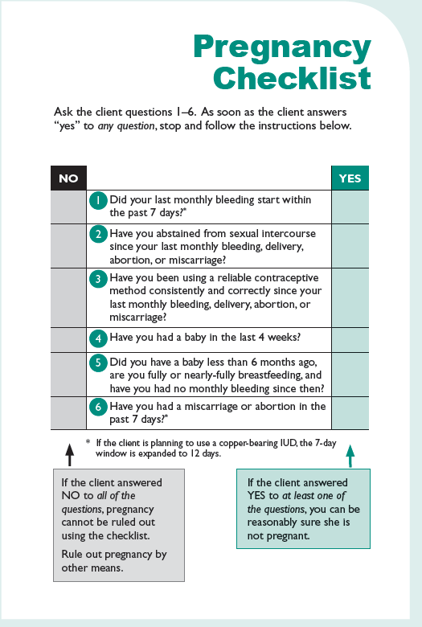
Family Planning: A Global Handbook for Providers (3rd Edition, 2018)

Slide 106
Acknowledgement
This training presentation was adapted from the following resources:
Training Resource Package for Family Planning
https://www.fptraining.org/
World Health Organization Department of Reproductive Health and Research (WHO/RHR) and Johns Hopkins Bloomberg School of Public Health/Center for Communication Programs (CCP), Knowledge for Health Project. Family Planning: A Global Handbook for Providers (2018 update). Baltimore and Geneva: CCP and WHO; 2018. Available from: https://www.fphandbook.org/

Slide 107
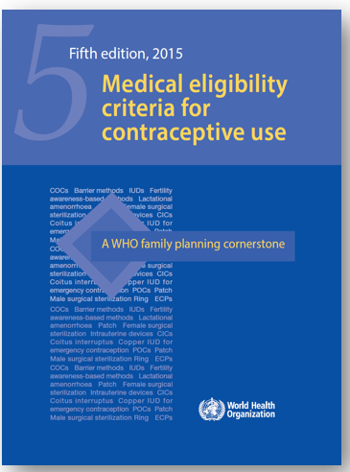
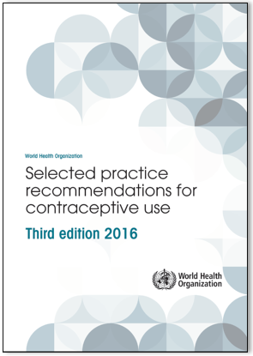
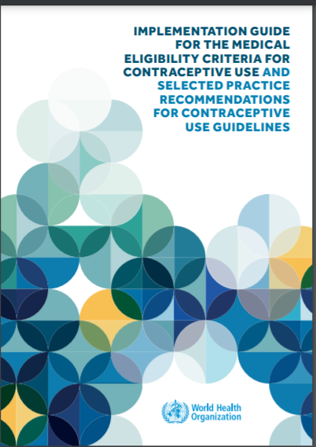
Additional resources
WHO Selected Practice Recommendations for Contraceptive Use (3rd edition 2016). WHO, 2016. Available from: https://www.who.int/publications/i/item/9789241565400
Implementation Guide for the Medical Eligibility Criteria and Selected Practice Recommendations for Contraceptive Use Guidelines. WHO, 2018. Available from: http://apps.who.int/iris/bitstream/handle/10665/272758/9789241513579-eng.pdf?ua=1
WHO Medical Eligibility Criteria (MEC) for Contraceptive Use, Fifth edition. WHO, 2015. Available from: https://www.who.int/publications/i/item/9789241549158
For all the latest publications on contraception visit: https://www.who.int/health-topics/contraception

