Slide 1

Contraceptive methods - Part 3
"Family Planning”: An Online Evidence-based Course 2022
Raqibat Idris, MBBS, DO, MPH
Geneva Foundation for Medical Education and Research

Slide 2
Outline and objectives
Description of the method
Mechanism of action
Effectiveness
Eligibility criteria
Benefits and side effects
Interventions for associated effects

Slide 3
Methods
Intrauterine devices (IUDs)
  Intrauterine device (IUD) levonorgestrel
  Intrauterine device (IUD): copper containing
Barrier methods
  Male condoms
  Female condoms
  Others: Spermicides, Diaphragm, Cervical caps

Slide 4
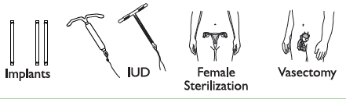

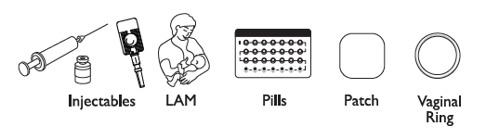


Comparing Effectiveness of Family Planning Methods
More effective
Less than 1 pregnancy per
100 women in one year
How to make your
method more effective
Implants, IUD, female sterilization:
After procedure, little or nothing to do or remember
Vasectomy: Use another method for first
3 months
Injectables: Get repeat injections on time
Lactational Amenorrhea Method (for 6 months): Breastfeed often, day and night
Pills: Take a pill each day
Patch, ring: Keep in place, change on time
Male condoms, diaphragm: Use correctly every time you have sex
Fertility awareness methods: Abstain or use condoms on fertile days. Standard Days Method and Two-Day Method may be easier to use.
Female condoms, withdrawal, spermicides: Use correctly every time you have sex
Less effective
About 30 pregnancies per
100 women in one year
Family Planning: A Global Handbook for Providers (3rd Edition, 2018)
Notes:
Methods of contraception have different mechanisms of action and effectiveness in preventing unintended pregnancy. Effectiveness of methods is measured by the number of pregnancies per 100 women using the method per year.

Slide 5
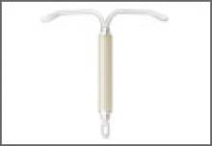
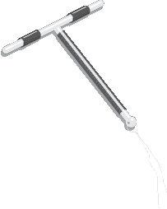
Intrauterine devices (IUDs)
LNG-IUD
Copper T 380A

Slide 6
Levonorgestrel intrauterine devices (LNG-IUDs)
LNG-IUD

Slide 7
What are LNG-IUDs
LNG-IUD
Small plastic devices inserted through the vagina and cervix into the uterus.
Work by releasing small amounts of levonorgestrel hormone into the uterus which prevent the sperm from fertilizing an egg. This is the same hormone used in some implants and oral contraceptive pills.
Very effective in preventing pregnancy.
Long acting and easily reversible. LNG-IUDs can work 3-7 years (depending on type) and can be easily removed by a provider whenever the woman wants.
Return to fertility is not delayed after an LNG-IUD is removed.
Family Planning: A Global Handbook for Providers (3rd Edition, 2018)

Slide 8
LNG-IUDs: Types and brands
May be unbranded or may be marketed under names such as Mirena, Liletta, Avibela, Skyla, Kyleena, and Jaydess.
Though they all work the same way, the type and size of inserter and amount of LNG hormone released by the IUD may be different for different LNG-IUD types.
The size of the LNG-IUD frame and inserter tube for Kyleena, Skyla, and Jaydess are slightly smaller than the Mirena, Avibela, and Liletta.
Adapted from Training Resource Package for Family Planning: https://www.fptraining.org/
Family Planning: A Global Handbook for Providers (3rd Edition, 2018)

Slide 9
Similarities: Copper IUDs vs. LNG-IUDs
Both Copper IUDs and LNG-IUDs:
Are very effective and safe
Are long acting and reversible
Return to fertility is not delayed upon removal
Can be removed anytime the woman wants
Require trained provider to insert and remove
Protect against the risks of pregnancy- uterine and ectopic and may protect against endometrial and cervical cancer.
Can be inserted at any time in the cycle if reasonably sure that woman is not pregnant
Can be inserted post abortion and postpartum if no evidence of complications
Adapted from Training Resource Package for Family Planning: https://www.fptraining.org/

Slide 10
Differences: Copper vs LNG-IUDs
 | Copper IUDs | LNG-IUDs
Appearance | T-shaped plastic device with copper sleeves or wire wrapped around them | T-shaped plastic device with the hormone reservoir in the stem of the T frame
Lasts for: | 10-12 years depending on brand and national guidelines | 3-7 years depending on brand and national guidelines
Effectiveness | Very effective; 6 per 1,000 women using perfectly will become pregnant in the first year. | Very effective; less than 2 per 1,000 women using perfectly will become pregnant in first year.
Hormones | No hormones | Small amounts of the hormone levonorgestrel
Works by | Causes a chemical change that Interferes with sperm motility and prevents sperm and egg from meeting | Thickens cervical mucosa, Interferes with movement of the sperm, so the sperm and the egg do not meet.
Side effects | Changes in bleeding patterns including prolonged and heavy monthly bleeding, more cramps and pain during monthly bleeding. | Changes in bleeding patterns including lighter bleeding, fewer days of bleeding, or no bleeding. Mild systemic side effects such as headaches, breast tenderness.
Additional considerations | May contribute to anemia if woman has low iron stores. May be more easily available and less expensive than LNG-IUDs. Can be used as emergency contraception. | Helps protect against iron-deficiency anemia. Reduces menstrual cramps, heavy monthly bleeding, and pelvic pain and irregular bleeding from uterine fibroids and endometriosis. Not used as Emergency Contraception. Must wait for at least 6 days to insert for after taking UPA emergency contraception to avoid drug interaction.
Adapted from Training Resource Package for Family Planning: https://www.fptraining.org/

Slide 11
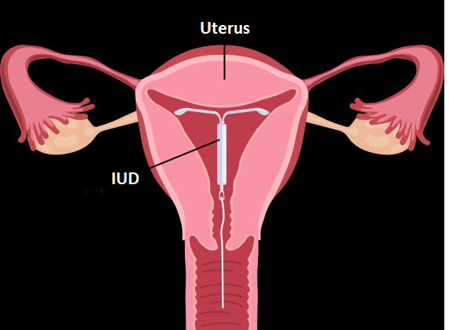
LNG-IUD: Mechanism of action
Prevents fertilization of the egg and sperm by:
Thickening of cervical mucus
Interfering with movement of the sperm
Adapted from Training Resource Package for Family Planning: https://www.fptraining.org/

Slide 12
Relative effectiveness of LNG IUD to other family planning methods
Method | # of unintended pregnancies among 1,000 women in 1st year of typical use
Implant | 1
Male sterilization | 1.5
Female sterilization | 5
LNG IUD | 7
Copper IUD | 8
Lactational amenorrhea | 20
Progestin-only injectables | 40
Progestin-only pills | 70
Combined oral contraceptives | 70
Standard-days method | 120
Male condom | 130
Withdrawal | 200
Female condom | 210
No method | 850
Adapted from Training Resource Package for Family Planning: https://www.fptraining.org/

Slide 13
LNG-IUD: Characteristics
Benefits
Safe and highly effective
Requires no user action once in place.
Private
Long-acting (3-7 years depending on type)
No delay in return to fertility after removal
Has health benefits
No further costs once inserted
Limitations
Trained provider needed to insert and remove
Requires pelvic exam
Possible pain or discomfort during insertion
Have potential side effects
Complications are rare, but may occur
Does not protect against STIs/HIV
Adapted from Training Resource Package for Family Planning: https://www.fptraining.org/

Slide 14
LNG-IUD: Health benefits
Apart from preventing pregnancy and associated health risks, LNG-IUDs are known to:
Reduce menstrual cramps, heavy monthly bleeding, and symptoms of endometriosis (Irregular bleeding and pelvic pain)
Protect against iron-deficiency anemia
Reduce risk of ectopic pregnancy
  Rate in LNG-IUD users is 10 ectopic pregnancies in 10,000 women
  Rate in women using no contraception is 65 ectopic pregnancies in 10,000 women
May help protect against cervical and endometrial cancer
Adapted from Training Resource Package for Family Planning: https://www.fptraining.org/

Slide 15
IUDs Reduce Risk of Ectopic Pregnancy
Ectopic pregnancy rate per 1000 woman-years
Source: Sivin, 1991; Bosco-Levy, 2019.
Adapted from Training Resource Package for Family Planning: https://www.fptraining.org/
Notes:
This slide displays the data from the two different studies estimating risk of ectopic pregnancy for several contraceptive methods, including LNG-IUD, and for women who do not use any contraceptive method. It was shown that in women who are not using contraception, approximately 2% of all pregnancies are ectopic. When pregnancy does occur in an LNG-IUD (or in Copper IUD) user, the risk of it being ectopic is as high as 25-50%. However, because both LNG and Copper IUD are very effective in preventing pregnancy, the overall number of ectopic pregnancies is lower among LNG-IUD and Copper IUD users compared to women who use some other contraceptive methods and dramatically lower compared to women who use no contraception at all.^{1, 2}
A 2019 study compared the safety of the LNG-IUD to Copper IUDs, using ectopic pregnancy rates as one of their outcome measures (showed as the last two columns on this slide). They found no significant difference between ectopic pregnancy rates among LNG-IUD and Copper IUD users – 0.4 per 1000 woman-years for Copper IUD and 0.3 per 1000 woman-years for LNG-IUD. Similarly, another 2015 study (although not presented on this slide) compared the effectiveness of the LNG-IUD and Copper IUD and found the risk of ectopic pregnancy with an LNG-IUD to be 0.02 per 100 woman-years.³
The findings underline both the overall safety and protective effect of LNG-IUDs with regard to ectopic pregnancy. However, it is important to counsel women about the risk of ectopic pregnancy in a very unlikely event LNG-IUD fails, so they can make a fully informed decision. Ectopic pregnancy should always be ruled out in LNG-IUD users presenting with a positive pregnancy test.
Reference:
Sivin I. Alternative estimates of ectopic pregnancy risks during contraception. Am J Obstet Gynecol. 1991;165(6 Pt 1):1900.
Bosco-Levy P, Gouverneur A, Langlade C, Miremont G, Pariente A. Safety of levonorgestrel 52 mg intrauterine system compared to copper intrauterine device: a population-based cohort study. Contraception 2019;99(6): 345-349
Heinemann K, Reed S, Moehner S, Minh TD. Comparative contraceptive effectiveness of levonorgestrel‐releasing and copper intrauterine devices: the European Active Surveillance Study for Intrauterine Devices. Contraception. 2015;91(4):280‐283.
Source: Training Resource Package for Family Planning: https://www.fptraining.org/

Slide 16
LNG-IUD: Possible side-effects
Most common:
Changes in bleeding patterns (lighter, irregular, infrequent or no monthly bleeding
Less common:
Nausea (upset stomach)
Tender breasts
Mood changes or headaches
Slight weight gain
Dizziness
Acne
Side effects are not usually signs of illness and they get better in 3-6 months of insertion.
Adapted from Training Resource Package for Family Planning: https://www.fptraining.org/

Slide 17
Who can use LNG-IUDs
Category 1 and 2 examples:
WHO Category | Conditions (selected examples)
Category 1 | Post abortion 1st trimester, smoking (any number of cigarettes), obesity, varicose veins, heavy or prolonged bleeding (initiation only), cervical ectopy, uterine fibroids without distortion of the uterine cavity, endometriosis, irregular bleeding without heavy bleeding, anemia, hypertension with BP of less than 160/100 mmHg,
Category 2 | Menarche to <20 years, nulliparous, post abortion 2nd trimester, elevated blood pressure of ≥160/≥100 , PID (continuation), vascular disease, diabetes, history of DVT or stroke, migraine with aura (initiation)
Adapted from Training Resource Package for Family Planning: https://www.fptraining.org/

Slide 18
Who should not use LNG-IUDs
Category 3 and 4 examples:
WHO Category | Conditions (selected examples)
Category 3 | Migraine with aura (continuation), severe cirrhosis, high individual risk of STI (initiation), acute DVT/PE, lupus with positive (or unknown) antiphospholipid antibodies
Category 4 | Pregnancy, unexplained vaginal bleeding (initiation prior to evaluation), puerperal sepsis or immediate post-septic abortion, current PID or cervical infection (initiation) Current breast cancer, distorted uterine cavity incompatible with IUD insertion"
Adapted from Training Resource Package for Family Planning: https://www.fptraining.org/

Slide 19
LNG-IUD use by women with HIV Infection
LNG-IUDs are safe for majority of women with HIV, whether or not they are on ARVs
Initiation not recommended if woman has severe or advanced HIV clinical disease
Women at high risk of acquiring HIV can use LNG-IUD without restrictions
Encourage dual method use
WHO Eligibility Criteria
Condition | Category
 | Initiate | Continue
Asymptomatic or mild HIV clinical disease | 2 | 2
Severe or advanced HIV clinical disease | 3 | 2
High risk of HIV | 1 | 1
Adapted from Training Resource Package for Family Planning: https://www.fptraining.org/
Notes:
While the LNG-IUD offers highly effective protection from pregnancy, it does not guard against STI and HIV transmission. As with other methods, providers who counsel sexually active HIV-infected clients about their contraceptive options should always encourage condom use in addition to the LNG-IUD.

Slide 20
LNG-IUD use by postpartum women
WHO Eligibility Criteria
Characteristic/ Condition | Category
<48 hours, non-breastfeeding | 1
<48 hours, breastfeeding | 2
≥48 hours hours to <4 weeks | 3
≥4 weeks | 1
Puerperal sepsis | 4
Women less than
48 hours postpartum
can have LNG-IUD inserted
Women between 48 hours to 4 weeks postpartum generally should not get LNG IUDs
No restrictions starting at 4 weeks postpartum
Women with current puerperal sepsis should not have LNG-IUD inserted
Adapted from Training Resource Package for Family Planning: https://www.fptraining.org/

Slide 21
When to start LNG-IUD - 1
Having menstrual cycles or switching from a non-hormonal method | If menstrual bleeding started in last 7 days, can insert IUD now. No back up needed If menstrual bleeding started more than 7 days ago, can insert IUD now if reasonably certain she is not pregnant. No need to wait for next menstrual period. Need a backup method for the first 7 days after insertion.
Switching from a hormonal method, if she has been using method consistently and correctly or otherwise certain not pregnant. | If menstrual bleeding started in last 7 days, can insert IUD now. No backup method needed. If menstrual bleeding started more than 7 days ago, can insert LNG-IUD now. Need a backup method for the first 7 days after insertion. If switching from an injectable, can have the LNG-IUD inserted when the repeat injection would have been given. No backup method needed.
Adapted from Training Resource Package for Family Planning: https://www.fptraining.org/

Slide 22
When to start LNG-IUD - 2
No monthly bleeding (not related to childbirth or breastfeeding) | Can be inserted any time if reasonably certain that she is not pregnant. Use a backup method for the first 7 days after insertion.
LNG-IUD can be inserted in first 2 days after you give birth, whether or not you are breastfeeding | Can insert within 48 hours after birth (if no postpartum infection). Special training needed. Can be inserted during a cesarean delivery after removal of placenta and before closure of uterus
More than 2 days but less than 4 weeks after giving birth | Between 48 hours and 4 weeks after birth, delay insertion. Offer condoms or another method if she is not fully breastfeeding
Adapted from Training Resource Package for Family Planning: https://www.fptraining.org/

Slide 23
When to start LNG-IUD - 3
If not inserted within 2 days after birth, LNG-IUD can be inserted anytime after 4 weeks postpartum, for fully or nearly fully breastfeeding women | If monthly bleeding has not returned and less than 6 months postpartum, can insert IUD anytime. No backup method needed. If monthly bleeding has not returned and more than 6 months postpartum, can insert IUD anytime if reasonably certain that woman is not pregnant. Use backup method for first 7 days after insertion. If monthly bleeding has returned, can have LNG-IUD inserted as advised for women having menstrual cycles (as discussed earlier)
If not inserted within 2 days after birth, LNG-IUD can be inserted anytime after 4 weeks postpartum, for women who are partially breastfeeding or not breastfeeding | If monthly bleeding has not returned, insert anytime if it can be determined that she is not pregnant. Use backup method for first 7 days after insertion. If monthly bleeding has returned, can have LNG-IUD inserted as advised for women having menstrual cycles (as discussed earlier)
Adapted from Training Resource Package for Family Planning: https://www.fptraining.org/

Slide 24
When to start LNG-IUD - 4
After an abortion or miscarriage. | For medical abortion, LNG-IUD can be inserted at the time of confirmation that abortion is complete or within 7 days. No back up method needed. For surgical abortion, LNG-IUD may be inserted immediately after the procedure or within 7 days. No backup method needed. In case of an infection, delay insertion until the infection is resolved. LNG-IUD insertion after second-trimester abortion or miscarriage requires specific training. If trained provider is not available, delay insertion until at least 4 weeks post-abortion. Provide backup method in the interim.
After taking progestin-only, combined, or ulipristal acetate (UPA) emergency contraceptive pills. | Can be inserted anytime when it can be determined that she is not pregnant. Give her another contraceptive method to use until she can have the LNG-IUD inserted. To avoid drug interaction, wait until 6 days after taking UPA-ECPs to insert LNG-IUD.
Adapted from Training Resource Package for Family Planning: https://www.fptraining.org/

Slide 25
Correcting rumours and misconceptions about LNG-IUDs
Rumor/Misconception | Reality
Cause pain during sex. | Do not cause pain during sex. Occasionally, a man may feel the strings during sex if the strings are cut very short during insertion.
It prevents pregnancy by causing an abortion. | The mechanism of action of the LNG-IUS is preventing the sperm and egg from meeting and thus preventing pregnancy
Absence of bleeding with LNG-IUD means the woman is no longer fertile. | When the LNG IUD is removed, menstrual bleeding will return and fertility is restored without a delay.
Absence of bleeding is unhealthy. It means dirty blood remains in the body | Bleeding is reduced or absent, because the hormone released by LNG-IUD makes uterine lining thin, so it may not produce bleeding. No dirty blood remains in the uterus. Instead, this helps in preventing anemia
Can move through the body including to heart and brain | LNG-IUDs normally stay within the uterus like a seed within a shell. In very rare cases, during the insertion, the IUD can go through the wall of the uterus into the abdominal cavity.
Adapted from Training Resource Package for Family Planning: https://www.fptraining.org/

Slide 26
Correcting rumours and misconceptions about LNG-IUDS
Rumor/Misconception | Reality
Increases risk of ectopic pregnancy | Greatly REDUCES the risk of ectopic pregnancy.
Are only for women who have had children | Can be used by women who have had children and those who have not
Are not safe for adolescents | Can be used by women of any age, including adolescents
An LNG-IUD cannot be inserted immediately postpartum | The LNG-IUD can be inserted by a trained provider immediately after a vaginal delivery(within 10 minutes of delivery of the placenta) or up to 48 hours following vaginal delivery or during a cesarean section.
Increase the risk of getting STIs, including HIV | Do not increase the risk of any STI, including HIV.
Must be inserted during monthly bleeding | Can be an inserted at anytime during menstrual cycle when it is reasonably certain that she is not pregnant.
Adapted from Training Resource Package for Family Planning: https://www.fptraining.org/

Slide 27
Infertility is linked to STIs, not to IUDs
 | IUD use in the past |  | Chlamydia antibodies
 | No | Yes | No | Yes
Infertile women with tubal occlusion | 93.6% | 6.4% | 61.7% | 38.3%
Infertile women without tubal occlusion (controls) | 94% | 6% | 64.6% | 35.4%
Pregnant women (controls) | 93.2% | 6.8% | 77.4% | 22.6%
Source: Hubacher, 2001.
Adapted from Training Resource Package for Family Planning: https://www.fptraining.org/
Notes:
A 2017 systemic review¹ of IUD safety among young women identified no studies that assessed infertility risk among young LNG-IUD users but referred to the evidence from 2001 study on Copper IUD use (shown on this slide).
This case-control study demonstrated that primary infertility (due to tubal occlusion) is associated with a history of chlamydia infection but is not associated with past IUD use. It compared 358 women with primary infertility and tubal occlusion, to 953 women with primary infertility who did not have tubal occlusion and to 584 first-time pregnant women.
Researchers collected information about the women's past use of contraceptives, including copper IUDs, previous sexual relationships, and history of genital tract infections. Each woman's blood was tested for antibodies to chlamydia.
As it shows in this table, the study found that approximately the same number of women in each group had used an IUD in the past, but that more women in the two infertile groups tested positive for chlamydia antibodies.²
Reference:
Jatlaoui T, Halley EMR, Curtis K. The safety of Intrauterine Devices Among Young Women: A Systematic Review. Contraception 2017;95(1):17-39.
Hubacher, D. et al. Use of copper intrauterine devices and the risk of tubal infertility among nulligravid women. New England Journal of Medicine 2001;345(8):561-567.

Slide 28
Complications of LNG IUD
Problem | Risk | Linked to | Reduced through/by
Expulsion | Generally low (about 10 per 100 users over 3 years) | Provider skill; age and parity of woman; timing of insertion | Provider training, supportive supervision
PID | Estimated at approximately 1 in 666 (depending on STI prevalence) | Presence of cervical infections or chlamydia/ gonorrhea at time of insertion | Screening women for risk of STIs prior to insertion
Perforation | Very low, 1 in 1,000 insertions | Provider skills/correct insertion technique; careful pelvic exam to determine size and position of uterus; breastfeeding status and time since delivery | Provider training, supportive supervision
Adapted from Training Resource Package for Family Planning: https://www.fptraining.org/

Slide 29
Expulsion rates of LNG IUD are higher for postpartum insertion
Timing of Insertion | Expulsion Rates
Interval (> 4 weeks after delivery) | 1.8%
Immediate after cesarean delivery | 2.3%
Immediate after vaginal delivery (within 10 minutes) | 27.4%
Between 10 min and 4 weeks postpartum | 36.8%
Source: Averbach et al., 2020
Adapted from Training Resource Package for Family Planning: https://www.fptraining.org/
Notes:
Though an expulsion is not a serious complication, an undetected expulsion puts the woman at risk of pregnancy. Studies have shown that the expulsion rate is generally higher during the postpartum period due to the changes the uterus undergoes as it returns to its normal size.
The systematic review and meta analysis from Source-Averbach et al, 2020 looked at Copper and LNG IUDs expulsion rates during various postpartum intervals and based on different types of delivery (vaginal vs. cesarean). For IUDs placed during the interval time period (defined as more than four weeks after delivery), the risk of complete expulsion was 1.8% among 13 studies. The pooled rate of complete LNG-IUD expulsion was still low when placed after cesarean delivery – 2.3%. Among women with LNG-IUDs placed immediately after vaginal deliveries, the pooled complete expulsion rates was much higher – 27.4%. Expulsion rates were unacceptably high among women with IUD placed between 10 min and 4 weeks postpartum – 36.8%. In this study, no data were provided separately for the first 48 hours postpartum (which is considered less risky in terms of expulsion than the time between 48 hours and 4 weeks after delivery).
MEC guidelines support placement of LNG-IUDs up to 48 hours after birth; however, data on early postpartum placement (>10 min but <48 hours) is limited, as many studies do not differentiate this period from late postpartum (48 hours to 4 weeks). Therefore, when feasible, provision of IUDs immediately postpartum (within 10 minutes after placental delivery) may result in a lower expulsion risk than early postpartum placement and a significantly lower expulsion rate than late postpartum placement.
Clients choosing to have the IUD inserted immediately postpartum should be counseled that the risk of expulsion is greater if the IUD is inserted during this period. The client choosing postpartum insertion should also be counselled on immediate vs late postpartum insertion in order for the client to be able to make an informed choice regarding postpartum insertion.
Reference: Sarah H Averbach , et al. Expulsion of intrauterine devices after postpartum placement by timing of placement, delivery type, and intrauterine device type: a systematic review and meta-analysis. Am J Obstet Gynecol. 2020 Aug;223(2):177-188
Source: Training Resource Package for Family Planning: https://www.fptraining.org/

Slide 30
Signs of possible LNG-IUD complications
Advise client to return immediately in case of:
Signs and symptoms | Possible Cause
Bleeding and severe abdominal cramping within a few days post-insertion | Perforation
Unexplained vaginal bleeding (e.g. after a pattern of bleeding has been established) or pain in every cycle | Partial expulsion, perforation, infection
Fever, chills, unusual/foul-smelling vaginal discharge, low abdominal pain | Infection (PID)
Missing IUD strings, missed period or symptoms of pregnancy | Expulsion, perforation, pregnancy
Adapted from Training Resource Package for Family Planning: https://www.fptraining.org/
Notes:
Bleeding or severe abdominal cramping during the first few days after insertion could indicate that the uterus may have been perforated at a time of the LNG-IUD insertion.
Unexplained vaginal bleeding (e.g. unusual bleeding that occurs after a bleeding pattern has been established) or pain in every cycle could indicate partial expulsion of the LNG-IUD, uterine perforation or infection.
Fever and chills, unusual/foul-smelling vaginal discharge, lower abdominal pain could indicate an infection, such as pelvic inflammatory disease (PID), which is a concern especially during the first month after the LNG-IUD is inserted. This is when PID, although rare, is most likely to develop.
Missed menstrual period (if occurs during the month following LNG-IUD insertion or after a regular bleeding pattern was established) or missing LNG-IUD strings could indicate LNG-IUD expulsion, uterine perforation, or/and pregnancy, either uterine or ectopic.

Slide 31
Managing LNG-IUD side effects or complications:
Changes in bleeding patterns
Counseling and reassurance are key
Problem | Action/Management
Irregular bleeding/ spotting | Reassure client that this is common and not harmful, usually diminishes after few months
No monthly bleeding | Reassure her that many women eventually stop having monthly bleeding when using LNG-IUD and this is not harmful. Blood is not building up inside her. There is no need to lose blood every month.
Heavy or prolonged bleeding | Reassure client that this is common and not harmful, usually diminishes after few months Provide iron tablets
Adapted from Training Resource Package for Family Planning: https://www.fptraining.org/

Slide 32
Managing LNG-IUD side effects or complications: Cramping and mild pain
Counseling and reassurance are key
Problem | Action/Management
Cramping and mild pain | She can expect cramping and pain in first 1–2 days after insertion Suggest ibuprofen/paracetamol, other pain reliever (not aspirin if she also has heavy bleeding) If cramping continues evaluate for other partial expulsion or perforation, or other causes; treat or refer. If cramping is severe but no underlying condition, discuss removing the LNG-IUD and. switching to another method
Adapted from Training Resource Package for Family Planning: https://www.fptraining.org/
Notes:
If a client reports cramping and pain:
Inform her she can expect some cramping and pain for the first day or two after insertion.
Suggest aspirin (325–650 mg), ibuprofen (200–400 mg), paracetamol (325–1000 mg), or other pain reliever. If she also has heavy or prolonged bleeding, aspirin should not be used because it may increase bleeding
If cramping continues beyond the first 2 days, evaluate for partial expulsion or perforation.

Slide 33
Managing LNG-IUD side effects or complications: Severe pain in lower abdomen
Severe pain in lower abdomen is rare. Rule out PID, ectopic pregnancy, ovarian cyst, perforation.
If ectopic pregnancy is suspected:
  Refer immediately.
If PID is suspected:
  Treat with appropriate antibiotics for gonorrhea, chlamydia and anaerobic bacterial infection.
  There is no need to remove the LNG-IUD.
If ovarian cyst or enlarged ovarian follicles suspected:
  Reassure client they usually disappear on their own
  No need to treat unless they grow abnormally large, twist, or burst
  Can continue to use LNG-IUD
  Follow up in 6 weeks to ensure problem resolving
Adapted from Training Resource Package for Family Planning: https://www.fptraining.org/

Slide 34
Managing LNG-IUD side effects or complications: Suspected perforation
If perforation is suspected at a time of insertion, stop procedure immediately, remove all instruments and LNG-IUD if inserted.
Observe vital signs every 5-10 min for an hour; check for signs of bleeding and shock
  If rapid pulse, falling blood pressure, or increased pain: refer
  If stable, observe several more hours and send home
Provide alternative contraception
  Advise to avoid sex for 2 weeks
Follow-up in a week or as needed
Adapted from Training Resource Package for Family Planning: https://www.fptraining.org/
Notes:
If perforation is suspected at the time of insertion or sounding of the uterus, stop the procedure immediately (and remove the LNG-IUD if inserted). Observe the client in the clinic carefully.
For the first hour, keep the woman at bed rest and check her vital signs (blood pressure, pulse, respiration, and temperature every 5 to 10 min)
Check for signs of intraabdominal bleeding, such as low hematocrit or hemoglobin or rebound tenderness on abdominal examination. Observe for several more hours. If she has no signs or symptoms, she can be sent home, but she should avoid sex for 2 weeks. Help her choose another method.
If she has a rapid pulse and falling blood pressure or increasing pain around the uterus, refer her to a higher level of care.
If uterine perforation is suspected, based on clinical symptoms, within 6 weeks or more after insertion, refer the client for evaluation to a clinician experienced at removing such LNG-IUDs.

Slide 35
Managing LNG-IUD side effects or complications: Missing strings
Ask the client:
  Whether and when she saw the LNG-IUD come out
  When did she have her last monthly bleeding
  If she has any symptoms of pregnancy
  If she has used a backup method since she noticed the LNG-IUD come out
Perform pelvic exam, gently probe for strings in cervical canal
If cannot locate strings, consider x-ray (if pregnancy can be ruled out) or ultrasound, or refer. Provide a backup method in meantime in case LNG-IUD came out and the woman did not notice.
Insert another LNG-IUD if expulsion is confirmed and she is not pregnant and still wants to use an LNG-IUD.
Adapted from Training Resource Package for Family Planning: https://www.fptraining.org/

Slide 36
Managing LNG-IUD side effects or complications: Suspected pregnancy
When pregnancy is suspected based of absence of bleeding and/or symptoms of pregnancy:
Assess for pregnancy, including ectopic pregnancy by pregnancy test or other means (e.g. ultrasound).
If the client is pregnant and wishes to continue the pregnancy:
  Explain that an IUD in the uterus during pregnancy increases the risk of preterm delivery or miscarriage often complicated with infection
  If possible, remove the LNG-IUD
If she chooses to keep the LNG-IUD, advise close follow-up for signs of miscarriage (with or without infection).
Adapted from Training Resource Package for Family Planning: https://www.fptraining.org/
Notes:
When pregnancy is suspected based of absence of bleeding and/or symptoms of pregnancy:
Assess for pregnancy, including ectopic pregnancy, by pregnancy test and/or other means (e.g. ultrasound).
Explain that exposure of the fetus to an LNG-IUD does not increase the risk of birth defects. However, an LNG-IUD in the uterus during pregnancy increases the risk of preterm delivery or miscarriage, including infected (septic) miscarriage during the first or second trimester, which can be life-threatening.
If the woman does not want to continue the pregnancy, counsel her according to program guidelines.
If she continues the pregnancy:
Advise her that it is best to remove the IUD
Explain the risks of the pregnancy with an IUD in place. Early removal of the IUD reduces these risks, although the removal procedure itself involves a small risk of miscarriage.
If she agrees to removal and IUD strings are visible, gently remove the IUD or refer for removal
If she chooses to keep the LNG-IUD, explain that she could return at once if she develops any signs of miscarriage (vaginal bleeding, cramping, pain, abnormal vaginal discharge, or fever). A nurse or doctor should follow her pregnancy closely. She should see a nurse or doctor at once if he develops any signs of septic miscarriage.
If the LNG-IUD strings are not visible and cannot be found in the cervical canal, the LNG-IUD cannot be safely retrieved. Refer for ultrasound, if possible, to determine whether the LNG-IUD is still n the uterus. If it is (or if the ultrasound is not available) the LNG-IUD should be left in place, but her pregnancy should be followed closely. She should seek care at once if she develops any signs of septic miscarriage.

Slide 37
LNG-IUDs: Summary
LNG-IUDs:
Are safe, private, highly effective, convenient, reversible, long lasting, cost-effective, easy to use, and appropriate for the majority of women.
Offer important health benefits, including (but not limited to) protection from endometrial and cervical cancers, and reduction of menstrual cramping and bleeding.
Providers can ensure safety by:
Informative counseling
Careful screening
Adherence to infection prevention practices
Proper follow-up
Adapted from Training Resource Package for Family Planning: https://www.fptraining.org/
Notes:
LNG-IUDs have characteristics that make them a desirable family planning method for many women.
They are safe for almost all women.
They are highly effective and easy to use.
Fertility returns without a delay after having LNG-IUD removed
They have important health benefits
Appropriate counseling and screening for medical eligibility play an important role in the provision of LNG-IUDs. Providers can use a simple screening tool to determine medical eligibility. Counselors must ensure that clients are aware of potential side effects, understand how LNG-IUD is inserted placed, and can identify situations that require follow-up. Providers can also ensure safety by adherence to infection prevention practices when inserting LNG-IUDs. Family planning programs that offer LNG-IUDs benefit their clients by increasing their contraceptive options.

Slide 38
Copper-bearing intrauterine devices (IUDS)
Copper T 380A
Notes:
Illustration credit: Salim Khalaf/FHI

Slide 39
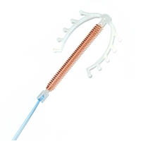
What are Copper IUDs?
Small plastic devices inserted through the vagina and cervix into the uterus.
Requires no user action.
Requires a clinically trained provider to properly insert and remove.
They are:
  very safe so can be used by most women.
  very effective.
  Long acting – up to 12 years – depending on type of device
A woman can soon become pregnant when IUD is taken out.
Copper T-380A
Multiload 375
Adapted from Training Resource Package for Family Planning: https://www.fptraining.org/

Slide 40
Copper IUDs: Types
  Copper IUDs have a small plastic frame
  with copper sleeves or wire around it
  TCu-380A, “Copper T” is most widely
  used copper IUD
  Multiload 375 is another copper IUD
  commonly available in some
  countries
Copper T-380A
Multiload 375
Adapted from Training Resource Package for Family Planning: https://www.fptraining.org/

Slide 41
Copper IUDs: Mechanism of action
Prevents fertilization by:
Impairing the viability of the sperm
Interfering with movement of the sperm
Source: Ortiz, 1996
Adapted from Training Resource Package for Family Planning: https://www.fptraining.org/

Slide 42
Relative effectiveness of Copper IUDs to other methods
Method | # of unintended pregnancies among 1,000 women in 1st year of typical use
No method | 850
Withdrawal | 220
Female condom | 210
Male condom | 180
Pill | 90
Injectable | 60
IUD (Copper/ LNG-IUD) | 8 / 2
Female sterilization | 5
Vasectomy | 1.5
Implant | 0.5
Source: Trussell J., Contraceptive Failure in the United States, Contraception 83 (2011) 397- 404, Elsevier Inc.
Adapted from Training Resource Package for Family Planning: https://www.fptraining.org/

Slide 43
Copper IUDs: Characteristics
Safe and highly effective
Require no user action
Long-acting (up to 12 years)
Rapid return to fertility
No systemic effects
Have health benefits
Trained provider needed to insert and remove
Require pelvic exam
Possible pain or discomfort during insertion
Have potential side effects
Complications are rare, but may occur
Do not protect against STIs/HIV
Adapted from Training Resource Package for Family Planning: https://www.fptraining.org/

Slide 44
Copper IUDs: Health benefits
IUDs are known to:
Prevent risks of pregnancy
Reduce risk of ectopic pregnancy
  Rate in IUD users is 12 in 10,000
  Rate in women using no contraception is
  65 in 10,000
May help protect against cervical and endometrial cancer
Adapted from Training Resource Package for Family Planning: https://www.fptraining.org/

Slide 45
Copper IUDs: Possible side effects
If a woman chooses this method, she may have some side-effects. They are not usually signs of illness.
After insertion:
Some cramps for several days
Some spotting for a few weeks
Other common side-effects:
Longer and heavier periods
Bleeding or spotting between periods
More cramps or pain during periods
May get less after a few months
Adapted from Training Resource Package for Family Planning: https://www.fptraining.org/

Slide 46
Who can use Copper IUDs
Category 1 and 2 examples:
WHO Category | Conditions (selected examples)
Category 1 | ≥20 years, cervical ectopy, uterine fibroids without distortion of the uterine cavity, irregular bleeding without heavy bleeding, breastfeeding, history of or acute DVT/PE
Category 2 | Menarche to <20 years, nulliparous, heavy or prolonged bleeding, severe dysmenorrhea, anemia
Adapted from Training Resource Package for Family Planning: https://www.fptraining.org/

Slide 47
Who should not use Copper IUDs
Category 3 and 4 examples:
WHO Category | Conditions (selected examples)
Category 3 | 48 hours to <4 weeks postpartum, ovarian cancer/if initiating use, high individual risk of STI/ if initiating use
Category 4 | Pregnancy, unexplained vaginal bleeding (prior to evaluation), current PID or cervical infection, endometrial or cervical cancer/if initiating use
Adapted from Training Resource Package for Family Planning: https://www.fptraining.org/

Slide 48
IUD Use by Women with HIV Infection
WHO Eligibility Criteria
Condition | Category
 | Initiate | Continue
Asymptomatic or mild HIV clinical disease | 2 | 2
Severe or advanced HIV clinical disease | 3 | 2
High risk of HIV | 2 | 2
IUDs safe for majority of women with HIV, whether or not they are on ARVs
Initiation not recommended if woman has severe or advanced HIV clinical disease
Encourage dual method use
Adapted from Training Resource Package for Family Planning: https://www.fptraining.org/

Slide 49
IUD use by postpartum women
Women less than 48 hours postpartum can have copper IUD inserted
Women 48 hours to 4 weeks postpartum generally should not initiate IUDs
No restrictions starting at 4 weeks postpartum
Women with current puerperal sepsis should not have IUD inserted
WHO Eligibility Criteria
Characteristic/ Condition | Category
<48 hours | 1
48 hours to <4 weeks | 3
≥4 weeks | 1
Puerperal sepsis | 4
Adapted from Training Resource Package for Family Planning: https://www.fptraining.org/

Slide 50
When to start Copper IUD - 1
IUD can be inserted in first 2 days after birth. | Insertion after childbirth: Can insert within 48 hours after birth. Special training needed. Between 48 hours and 4 weeks after birth, delay insertion. Offer condoms or another method if she is not fully breastfeeding. Can insert after 4 weeks after birth. Must be reasonably certain she is not pregnant. If infection, insert after infection has been treated and cured.
It can be started any day of the menstrual cycle if pregnancy can be ruled out | If menstrual bleeding started in last 12 days, can insert IUD now. If menstrual bleeding started more than 12 days ago, can insert IUD now if reasonably certain she is not pregnant. No need to wait for next menstrual period.
Adapted from Training Resource Package for Family Planning: https://www.fptraining.org/

Slide 51
When to start Copper IUD - 2
IUD can be inserted if fully or nearly fully breastfeeding less than 6 months after giving birth. | An IUD can be inserted anytime from 4 weeks to 6 months after giving birth and menstruation has not returned.
IUD can be inserted after an abortion or miscarriage. | Can be inserted immediately or within 12 days after a first- or second-trimester abortion or miscarriage if no infection is present. No need for a backup method. IUD insertion after second-trimester abortion or miscarriage requires specific training. If not specifically trained, delay insertion until at least 4 weeks after miscarriage or abortion. If infection, insert after infection has been treated and cured.
IUD can be inserted if switching from another method. | Can be inserted immediately, if she has been using the method consistently and correctly or if it is otherwise reasonably certain she is not pregnant.
Adapted from Training Resource Package for Family Planning: https://www.fptraining.org/

Slide 52
Copper IUDS: Correcting rumors and misconceptions
IUDs:
  Rarely lead to PID
  Do not increase risk of STIs, including HIV
  Do not work by causing abortion
  Do not make women infertile
  Do not move to the heart or brain
  Do not cause birth defects
  Do not cause pain for woman or man during sex
  Significantly reduce risk of ectopic pregnancy
Adapted from Training Resource Package for Family Planning: https://www.fptraining.org/

Slide 53
Complications of Copper IUDs - 1
Potential complications of IUDs include puncturing of uterus (perforation), pelvic inflammatory disease (PID), and expulsions.
Biases in early research overstated risks of PID.
Most research since the 1980s has concluded that serious complications are rare with modern IUDs.
Adapted from Training Resource Package for Family Planning: https://www.fptraining.org/

Slide 54
Complications of Copper IUDs - 2
Complication | Risk | Linked to | Reduced through/by
Perforation | Very low, 1 in 1,000 insertions | Skill and experience of provider | Supervised training
PID | Estimated at approximately 1 in 666 (depending on STI prevalence) | Mostly due to presence of cervical infections or chlamydia/ gonorrhea at time of insertion | Screening women for risk of STIs; not inserting in women with current STIs; adherence to infection prevention procedures
Expulsion |  | Provider’s skill; age and parity of woman; time since insertion; timing of insertion
Adapted from Training Resource Package for Family Planning: https://www.fptraining.org/

Slide 55
Signs of possible Copper IUD complications
Advise client to return immediately in case of:
Bleeding and severe abdominal cramping within a few days post-insertion perforation
Irregular bleeding or pain every cycle
partial expulsion, perforation
Fever, unusual vaginal discharge, low abdominal pain infection
Missing IUD strings, missed period expulsion, pregnancy
Adapted from Training Resource Package for Family Planning: https://www.fptraining.org/

Slide 56
Managing Copper IUD side effects or complications: Heavy, prolonged or irregular bleeding
Counseling and reassurance are key
Problem | Action/Management
Heavy or prolonged bleeding | Reassure client that this is common and not harmful, usually diminishes after few months For short-term relief offer 5-day course of tranexamic acid or NSAIDs (not aspirin) Provide iron tablets
Irregular bleeding | Reassure client For short-term relief offer ibuprofen or indomethacin 2 times daily after meals for 5 days
Adapted from Training Resource Package for Family Planning: https://www.fptraining.org/

Slide 57
Managing Copper IUD side effects or complications: Cramping and mild pain
Counseling and reassurance are key
Problem | Action/Management
Cramping and mild pain | She can expect cramping and pain in first 1–2 days after insertion Reassure client that this is common in first 3–6 months, not harmful, usually decreases over time Suggest ibuprofen, other pain reliever (not aspirin if she also has heavy bleeding) If cramping continues and/or occurs outside of menstruation, evaluate for partial expulsion or perforation, treat or refer If cramping is severe but no underlying condition, discuss removing the IUD
Adapted from Training Resource Package for Family Planning: https://www.fptraining.org/

Slide 58
Managing Copper IUD side effects or complications: Severe pain in lower abdomen
Severe pain in lower abdomen is rare:
Rule out PID, ectopic pregnancy or perforation.
If PID is suspected, treat with appropriate antibiotics for gonorrhea, chlamydia and anaerobic bacterial infection. There is no need to remove the IUD.
If ectopic pregnancy is suspected, refer immediately.
Adapted from Training Resource Package for Family Planning: https://www.fptraining.org/

Slide 59
Managing Copper IUD side effects or complications: Suspected perforation
Stop procedure immediately, remove IUD
Observe vital signs every 5-10 min for an hour; check for signs of bleeding
  If rapid pulse, falling blood pressure, or increased pain: refer
  If stable, observe several more hours and send home if no signs or symptoms
Provide alternative contraception
  Advise avoid sex for 2 weeks
Follow-up in a week or as needed
Adapted from Training Resource Package for Family Planning: https://www.fptraining.org/

Slide 60
Managing Copper IUD side effects or complications: Missing strings
Determine risk of pregnancy
Perform pelvic exam, probe for strings in cervical canal
If cannot locate strings, consider X-ray or ultrasound, or refer
Give choice of another contraceptive method
Insert another IUD if expulsion is confirmed and
  Woman is not pregnant
  She still wants to use an IUD
Adapted from Training Resource Package for Family Planning: https://www.fptraining.org/

Slide 61
Managing Copper IUD side effects or complications: Suspected pregnancy
Assess for pregnancy, including ectopic pregnancy
If the client is pregnant and wishes to continue the pregnancy:
  Explain that an IUD in the uterus during pregnancy increases the risk of preterm delivery or miscarriage
  If possible, remove the IUD
  Advise close follow-up for signs of septic miscarriage
Adapted from Training Resource Package for Family Planning: https://www.fptraining.org/

Slide 62
Copper IUDs: Summary
Copper IUDs are:
Safe, highly effective, convenient, reversible, long lasting, cost-effective, easy to use, and appropriate for the majority of women.
Providers can ensure safety by:
Informative counseling
Careful screening
Appropriate infection prevention practices
Proper follow-up
Adapted from Training Resource Package for Family Planning: https://www.fptraining.org/

Slide 63
Barrier methods
Male condoms
Female condoms
Spermicides
Diaphragms
Cervical caps

Slide 64
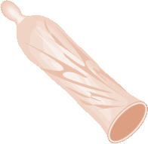
Male condoms
Notes:
Illustration credit: Salim Khalaf/FHI

Slide 65


What are male condoms?
Effective barrier method that can be used for both prevention of pregnancy and protection against HIV and other sexually transmitted infections (STIs).
A sheath that fits over a man’s erect
penis.
Also called rubbers, “raincoats,” “umbrellas,”
skins, prophylactics and preservativos; and
known by many different brand names.
Most made of thin latex rubber.
Variety of sizes, colors, flavors, and
textures are available.
Adapted from Training Resource Package for Family Planning: https://www.fptraining.org/
Family Planning: A Global Handbook for Providers (3rd Edition, 2018)
Notes:
Illustration credit: Salim Khalaf/FHI
Training Resource Package for Family Planning
Male Condom Module: Basic Slide Set I
65

Slide 66
Male condoms: Dual protection
Male (and female) condoms are the only FP methods that provide dual protection:
Protection from pregnancy and
Protection from transmission of HIV and other STIs between partners
Adapted from Training Resource Package for Family Planning: https://www.fptraining.org/
Notes:
Illustration credit: Salim Khalaf/FHI

Slide 67
Relative effectiveness of male condoms compared to other FP methods
Method | # of unintended pregnancies among 1,000 women in 1st year of typical use
No method | 850
Withdrawal | 220
Female condom | 210
Male condom | 180
Pill | 90
Injectable | 60
IUD (CU-T 380A / LNG-IUS) | 8 / 2
Female sterilization | 5
Vasectomy | 1.5
Implant | 0.5
Source: Trussell J., Contraceptive Failure in the United States, Contraception 83 (2011) 397- 404, Elsevier Inc.
Adapted from Training Resource Package for Family Planning: https://www.fptraining.org/
Notes:
Training Resource Package for Family Planning
Male Condom Module: Basic Slide Set I
67

Slide 68
Male condoms: Effectiveness for preventing HIV
Correct and consistent use of condoms significantly reduces the risk of HIV infection in men and women.
When used correctly with every act of sex, condoms prevent 80 to 95 out of 100 HIV infections that would have occurred without condoms.
Adapted from Training Resource Package for Family Planning: https://www.fptraining.org/

Slide 69
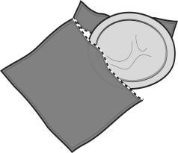
Characteristics of male condoms: Advantages
Safe and easy to use
Widely available
Effective for preventing pregnancy and STIs when used consistently and correctly
No hormonal side effects
Can be used as backup method of contraception
Can help men with premature ejaculation
Do not require provider’s help
Protect women from PID, cervical cancer
Available in a variety of sizes, flavors and textures
Adapted from Training Resource Package for Family Planning: https://www.fptraining.org/
Notes:
Illustration credit: Rita Meyer, from The Decision-Making Tool for Family Planning Clients and Providers

Slide 70
Characteristics of male condoms: Limitations
As commonly used, less effective than many other methods
Require partner communication and cooperation
Require motivation to put on before any physical contact occurs
Latex condoms can be damaged by oil-based lubricants, heat, humidity or light
May reduce sensation
Adapted from Training Resource Package for Family Planning: https://www.fptraining.org/
Notes:
Illustration credit: Rita Meyer, from The Decision-Making Tool for Family Planning Clients and Providers

Slide 71
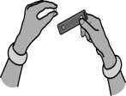

Male condoms: Managing problems - 1
If condom slipped, broke or was not used:
  Offer emergency contraceptive pills
  Ask about practices, behaviors
If difficulty putting on:
  Ask client to demonstrate, correct errors
If difficulty persuading partner to use:
  Discuss ways to talk about condoms with partner
  Suggest combining condoms with another contraceptive method
Adapted from Training Resource Package for Family Planning: https://www.fptraining.org/

Slide 72
Male condoms: Managing problems - 2
Mild irritation or mild allergic reaction to condom -itching, redness, rash and/or swelling
  Suggest trying another brand of condoms
  Suggest lubricant or water on the condom
  If symptoms continue, assess or refer for possible vaginal infection or STI
  If no infection, may have allergy to latex
Adapted from Training Resource Package for Family Planning: https://www.fptraining.org/

Slide 73
Male condoms: Summary
Safe and easy to use
Protect from both pregnancy and STIs/HIV
Female condom can be initiated by woman
Require partner’s cooperation
Adapted from Training Resource Package for Family Planning: https://www.fptraining.org/

Slide 74
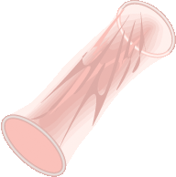
Female condoms
Notes:
Illustration credit: Salim Khalaf/FHI

Slide 75
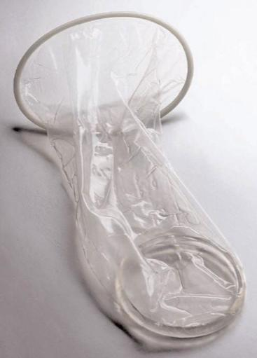
What is the female condom?
Effective barrier method that can be used for both prevention of pregnancy and protection against HIV and other sexually transmitted infections (STIs)
A transparent sheath or lining, that fits loosely inside a woman’s vagina:
  Have flexible rings at both ends
  One ring at the closed end helps to insert the condom
  The ring at the open end holds part of the condom outside the vagina
Made of made of thin, transparent, soft film (latex, polyurethane, and nitrile).
Female Condom 2
Adapted from Training Resource Package for Family Planning: https://www.fptraining.org/
Family Planning: A Global Handbook for Providers (3rd Edition, 2018)
Notes:
Illustration credit: Salim Khalaf/FHI
Training Resource Package for Family Planning
Female Condom Module: Basic Slide Set I
75

Slide 76
Female Condom: How does it work
Work by forming a barrier that keeps sperm out of the vagina, preventing pregnancy.
Also helps to keep infections in semen, on the penis, or in the vagina from infecting the other partner.
Female (and male) condoms are the only FP methods that provide dual protection:
  Protection from pregnancy and protection from transmission of HIV and other STIs between partners
Adapted from Training Resource Package for Family Planning: https://www.fptraining.org/
Family Planning: A Global Handbook for Providers (3rd Edition, 2018)
Notes:
Illustration credit: Salim Khalaf/FHI

Slide 77
Relative effectiveness of female condoms to other FP methods
Method | # of unintended pregnancies among 1,000 women in 1st year of typical use
No method | 850
Withdrawal | 220
Female condom | 210
Male condom | 180
Pill | 90
Injectable | 60
IUD (CU-T 380A / LNG-IUS) | 8 / 2
Female sterilization | 5
Vasectomy | 1.5
Implant | 0.5
Source: Trussell J., Contraceptive Failure in the United States, Contraception 83 (2011) 397- 404, Elsevier Inc.
Adapted from Training Resource Package for Family Planning: https://www.fptraining.org/
Notes:
Training Resource Package for Family Planning
Female Condom Module: Basic Slide Set I
77

Slide 78
Characteristics of female condoms:
What men and women like
What Women Like:
Female-controlled
Soft, moist texture feels more natural than latex male condoms
Offer STI/HIV protection and pregnancy protection
Outer ring provides stimulation
Do not require provider’s help
What Men Like:
Can be inserted in advance
Are not tight or constricting
Do not dull sensation
Can enhance sexual pleasure
Do not have to be removed immediately
Adapted from Training Resource Package for Family Planning: https://www.fptraining.org/
Notes:
Illustration credit: Rita Meyer, from The Decision-Making Tool for Family Planning Clients and Providers

Slide 79
Characteristics of female condoms:
What women and men do not like
Limitations:
May be difficult to insert at first, require practice
Not as effective as some other methods
More expensive than male condoms
Less available than male condoms
Adapted from Training Resource Package for Family Planning: https://www.fptraining.org/

Slide 80
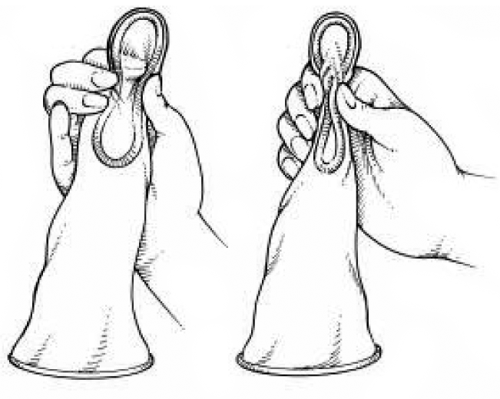


Female condoms: Managing problems - 1
If having trouble inserting: Ask her to demonstrate, suggest practice
If uncomfortable: Reinsert or reposition
If condom squeaks: Use more lubricant
If condoms slips or is not used correctly: Offer emergency contraceptive pills
If difficulty persuading partner:
Discuss ways to negotiate use;
offer other contraceptive options
Adapted from Training Resource Package for Family Planning: https://www.fptraining.org/

Slide 81
Female condoms: Managing problems - 2
Mild irritation in or around the vagina or penis (itching, redness, rash)
  Usually goes away on its own
  Suggest added lubricant inside condom or on penis
  If symptoms persist, assess and treat for possible vaginal infection or STI
Adapted from Training Resource Package for Family Planning: https://www.fptraining.org/

Slide 82
Male and female condoms: Problems that may require switching
Woman is using treatment for vaginal infection
  Some vaginal medication can damage latex
  Switch to plastic male condoms or female condoms, or abstain from sex
Severe allergic reaction to latex condom (extremely rare)
  Stop using latex condoms; treat or refer as appropriate
Adapted from Training Resource Package for Family Planning: https://www.fptraining.org/

Slide 83
Female condom: Summary
Safe and easy to use
Protect from both pregnancy and STIs/HIV
Female condom can be initiated by woman
Require partner’s cooperation
Adapted from Training Resource Package for Family Planning: https://www.fptraining.org/

Slide 84
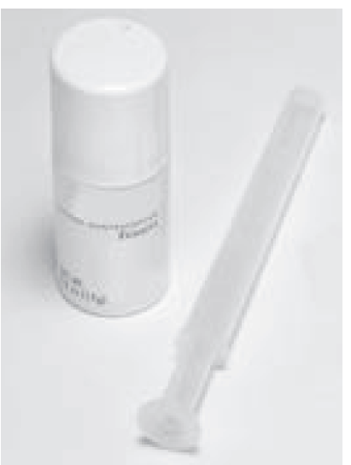
Spermicides

Slide 85
What are spermicides?
Sperm-killing substances inserted deep in the vagina, near the cervix, before sex.
Examples include: Nonoxynol-9 (most widely used), benzalkonium chloride, chlorhexidine, menfegol, octoxynol-9, and sodium docusate.
Available in foaming tablets, melting or foaming suppositories, cans of pressurized foam, melting film, jelly, and cream.
  − Jellies, creams, and foam from cans can be used alone, with a diaphragm, or with condoms.
  − Films, suppositories, foaming tablets, or foaming suppositories can be used alone or with condoms.
Work by causing the membrane of sperm cells to break, killing them or slowing their movement. This keeps sperm from meeting an egg.
Family Planning: A Global Handbook for Providers (3rd Edition, 2018)

Slide 86
How do spermicides work and what do users like?
Mechanism of action
Work by causing the membrane of sperm cells to break, killing them or slowing their movement. This keeps sperm from meeting an egg.
They can be started at anytime the client wants.
Risk of pregnancy is greatest when spermicides are not used with every act of sex.
Why Some Women Say They Like Spermicides
Are controlled by the woman
Have no hormonal side effects
Increase vaginal lubrication
Can be used without seeing a health care provider
Can be inserted ahead of time and so do not interrupt sex
Family Planning: A Global Handbook for Providers (3rd Edition, 2018)

Slide 87
Spermicide: Effectiveness
Depends on the user.
One of the least effective family planning methods.
As commonly used, about 21 pregnancies per 100 women using spermicides over the first year. This means that 79 of every 100 women using spermicides will not become pregnant.
When used correctly with every act of sex, about 16 pregnancies per 100 women using spermicides over the first year.
No delay in return of fertility after spermicides are stopped.
Does not offer protection against sexually transmitted infections (STIs).
Frequent use of nonoxynol-9 may increase risk of HIV infection.
Family Planning: A Global Handbook for Providers (3rd Edition, 2018)

Slide 88
Spermicide: Side effects, health benefits and health risks
Side Effects
Irritation in or around the vagina or penis
Other possible physical changes:
Vaginal lesions
Known Health Risks
Risks of pregnancy
Uncommon:
Urinary tract infection, especially when using spermicides 2 or more times a day
Rare:
Frequent use of nonoxynol-9 may increase risk of HIV infection
Known Health Benefits
Help protect against risks of pregnancy
Family Planning: A Global Handbook for Providers (3rd Edition, 2018)

Slide 89
Spermicide: Correcting misunderstandings
Spermicides:
Do not reduce vaginal secretions or make women bleed during sex.
Do not cause cervical cancer or birth defects.
Do not protect against STIs.
Do not change men’s or women’s sex drive or reduce sexual pleasure for most men.
Do not stop women’s monthly bleeding.
Family Planning: A Global Handbook for Providers (3rd Edition, 2018)

Slide 90
Who can and cannot use spermicide?
All women can safely use spermicides except those who:
Are at high risk for HIV infection
Have HIV infection
Women who are at high risk for HIV infection or who have HIV should use another method.
Family Planning: A Global Handbook for Providers (3rd Edition, 2018)

Slide 91
Spermicide: Summary
One of the least effective family planning methods.
Safe and suitable for nearly all women
Women who are at high risk for HIV infection or who have HIV should use another method.
No delay in return of fertility.
No protection against sexually transmitted infections (STIs).
Family Planning: A Global Handbook for Providers (3rd Edition, 2018)

Slide 92
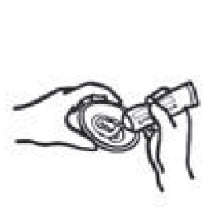
Diaphragms

Slide 93
What is the diaphragm?
A soft latex cup (or plastic / silicone)
that covers the cervix.
The rim contains a firm, flexible spring
that keeps the diaphragm in place.
Used with spermicidal cream, jelly, or foam to improve effectiveness.
Most diaphragms come in different sizes and require fitting by a specifically trained provider. A one-size-fits-all diaphragm is becoming available.
It does not require seeing a provider for fitting.
Family Planning: A Global Handbook for Providers (3rd Edition, 2018)

Slide 94
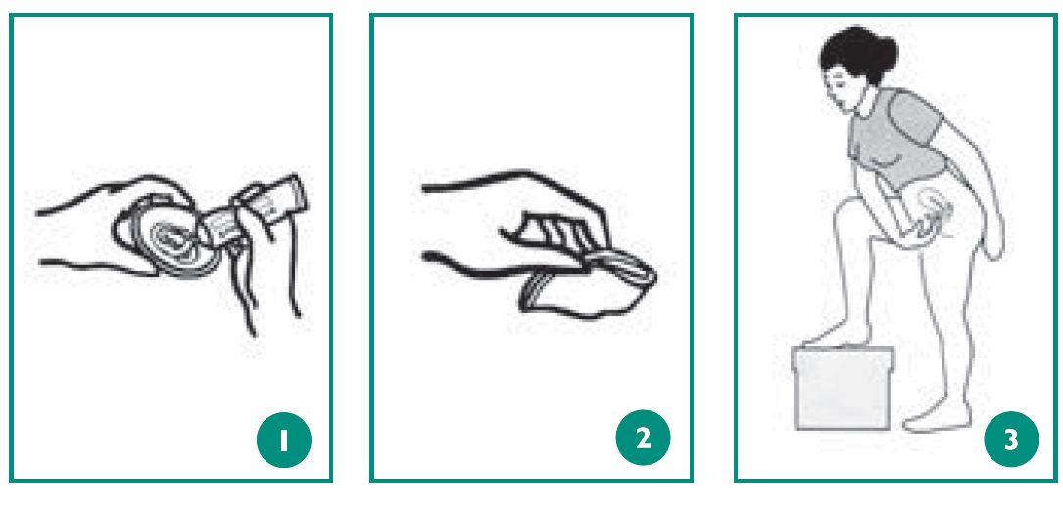
How does the diaphragm work?
Works by blocking sperm from entering the cervix; spermicide kills or disables sperm.
Both keep sperm from meeting an egg.
No delay in return of fertility after use of the diaphragm is stopped.
Does not provide protection against STIs: May provide some protection against certain STIs but should not be relied on for STI prevention.
Family Planning: A Global Handbook for Providers (3rd Edition, 2018)

Slide 95
The diaphragm: Effectiveness
Depends on the user: Risk of pregnancy is greatest when the diaphragm with spermicide is not used with every act of sex.
As commonly used, about 17 pregnancies per 100 women using the diaphragm with spermicide over the first year. This means that 83 of every 100 women using the diaphragm will not become pregnant.
When used correctly with every act of sex, about 16 pregnancies per 100 women using the diaphragm with spermicide over the first year.
Family Planning: A Global Handbook for Providers (3rd Edition, 2018)

Slide 96
The diaphragm: Health benefits
Known Health Benefits:
Help protect against the risks of pregnancy
May help protect against:
Certain STIs (chlamydia, gonorrhea, pelvic inflammatory disease, trichomoniasis)
Cervical precancer and cancer
Some women say they like the diaphragm because it:
Is controlled by the woman
Has no hormonal side effects
Can be inserted ahead of time and so does not interrupt sex
Family Planning: A Global Handbook for Providers (3rd Edition, 2018)

Slide 97
The diaphragm: Side effects and health risks
Side Effects:
Irritation in or around the vagina or penis
Vaginal lesions
Known Health Risks
Common to uncommon:
Urinary tract infection
Uncommon:
Bacterial vaginosis
Candidiasis
Rare:
Frequent use of nonoxynol-9 may increase risk of HIV infection
Extremely rare:
Toxic shock syndrome
Family Planning: A Global Handbook for Providers (3rd Edition, 2018)

Slide 98
Who can and cannot use the diaphragm?
Nearly all women can use the diaphragm safely and effectively.
It can be started at any time.
  If the woman has had a full-term delivery or second trimester spontaneous or induced abortion less than 6 weeks ago, give her a backup method to use, if needed, until 6 weeks have passed.
For a woman switching from another method, suggest that she try the diaphragm for a time while still using her other method so that she can safely gain confidence that she can use the diaphragm correctly.
Family Planning: A Global Handbook for Providers (3rd Edition, 2018)

Slide 99
The diaphragm: Correcting misunderstandings
Diaphragms:
Do not affect the feeling of sex. A few men report feeling the diaphragm during sex, but most do not.
Cannot pass through the cervix. They cannot go into the uterus or otherwise get lost in the woman’s body.
Do not cause cervical cancer.
Family Planning: A Global Handbook for Providers (3rd Edition, 2018)

Slide 100
The diaphragm: Summary
Safe and suitable for nearly all women.
Controlled by the woman.
Effectiveness depends on the user; risk of pregnancy is greatest when the diaphragm with spermicide is not used with every act of sex.
Do not delay the return of fertility.
May provide some protection against certain STIs.
Family Planning: A Global Handbook for Providers (3rd Edition, 2018)

Slide 101
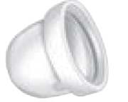
Cervical caps

Slide 102
What is the cervical cap?
A soft, deep, latex or plastic rubber cup that snugly covers the cervix.
It is placed deep in the vagina before sex.
Comes in different sizes; requires fitting by a specifically trained provider.
Used together with spermicide to improve effectiveness.
No delay in return of fertility.
No protection against sexually transmitted infections.
Side effects, health benefits, and health risks are same as for diaphragms.
Family Planning: A Global Handbook for Providers (3rd Edition, 2018)

Slide 103
Effectiveness of the cervical cap
Women who have given birth:
One of the least effective methods, as commonly used.
As commonly used, about 32 pregnancies per 100 women using the cervical cap with spermicide over the first year. This means that 68 of every 100 women using the cervical cap will not become pregnant.
When used correctly with every act of sex, about 26 pregnancies per 100 women using the cervical cap over the first year.
Women who have not given birth: More effective among these group of women.
As commonly used, about 16 pregnancies per 100 women using the cervical cap with spermicide over the first year. This means that 84 of every 100 women using the cervical cap will not become pregnant.
When used correctly with every act of sex, about 9 pregnancies per 100 women using the cervical cap over the first year.
Effectiveness depends on the user. Risk of pregnancy is greatest when the cervical cap with spermicide is not used with every act of sex.
Family Planning: A Global Handbook for Providers (3rd Edition, 2018)

Slide 104
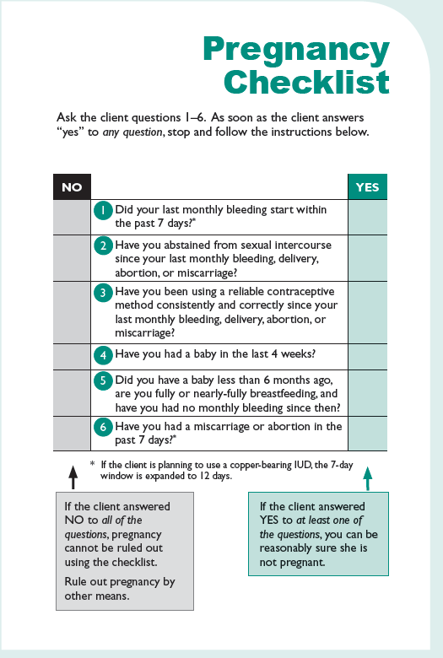
Family Planning: A Global Handbook for Providers (3rd Edition, 2018)

Slide 105
Acknowledgement
This training presentation was adapted from the following resources:
Training Resource Package for Family Planning
https://www.fptraining.org/
World Health Organization Department of Reproductive Health and Research (WHO/RHR) and Johns Hopkins Bloomberg School of Public Health/Center for Communication Programs (CCP), Knowledge for Health Project. Family Planning: A Global Handbook for Providers (2018 update). Baltimore and Geneva: CCP and WHO; 2018. Available from: https://www.fphandbook.org/

Slide 106
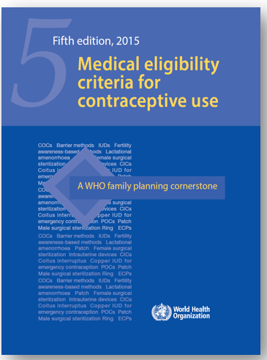
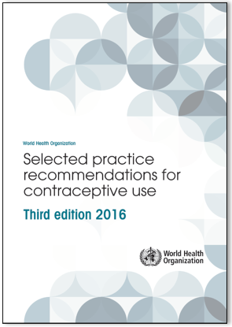

Additional resources
WHO Selected Practice Recommendations for Contraceptive Use (3rd edition 2016). WHO, 2016. Available from: https://www.who.int/publications/i/item/9789241565400
Implementation Guide for the Medical Eligibility Criteria and Selected Practice Recommendations for Contraceptive Use Guidelines. WHO, 2018. Available from: http://apps.who.int/iris/bitstream/handle/10665/272758/9789241513579-eng.pdf?ua=1
WHO Medical Eligibility Criteria (MEC) for Contraceptive Use, Fifth edition. WHO, 2015. Available from: https://www.who.int/publications/i/item/9789241549158
For all the latest publications on contraception visit: https://www.who.int/health-topics/contraception

