Slide 1
WHO
Using the 2015 Medical Eligibility Criteria for contraceptive use and the MEC wheel
Petrus Steyn
Scientist, WHO/ SRH/ CFC

Slide 2
Outline of the presentation
Medical eligibility criteria (MEC) for contraceptive use 5th ed
MEC Wheel

Slide 3

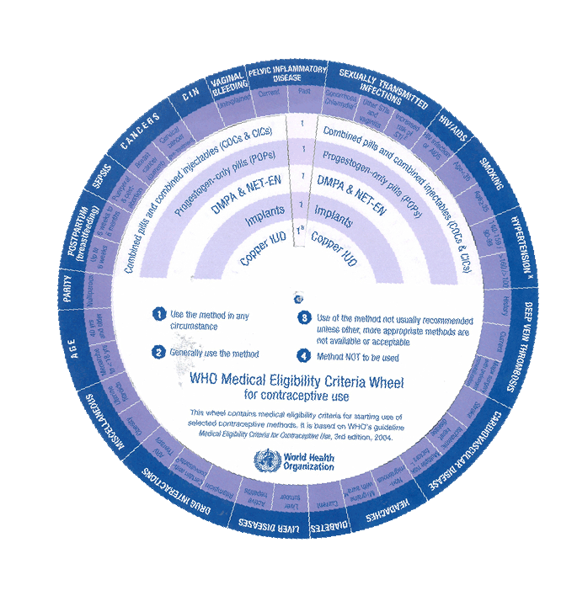
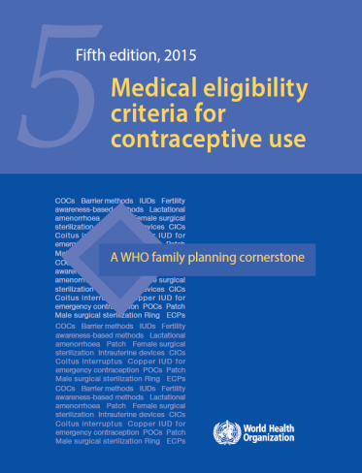
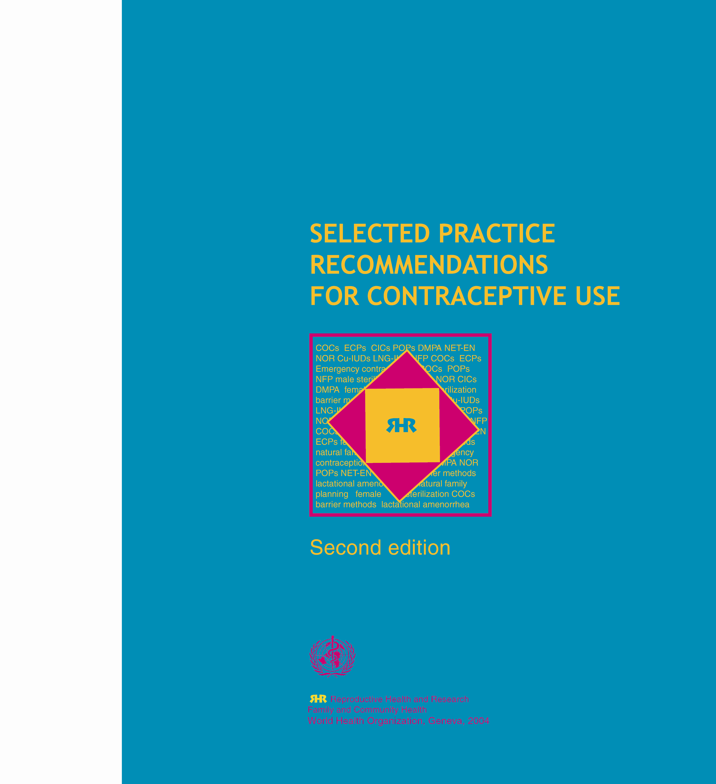


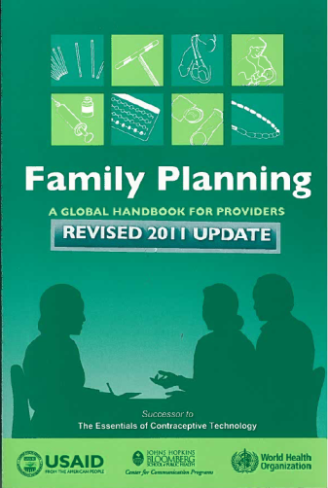


Family planning guidelines and tools: constant updates, constant demand
Medical Eligibility Criteria
Selected Practice Recommendations
The Medical Eligibility Criteria (MEC) Wheel (new)
3rd edition in 2016
Reproductive Choices and Family Planning for People with HIV (to be updated)
5th edition
Guide to family planning for community health care providers and their clients
(to be updated)
Decision-Making Tool
(to be updated)
Global Handbook
To be updated in 2016

Slide 4
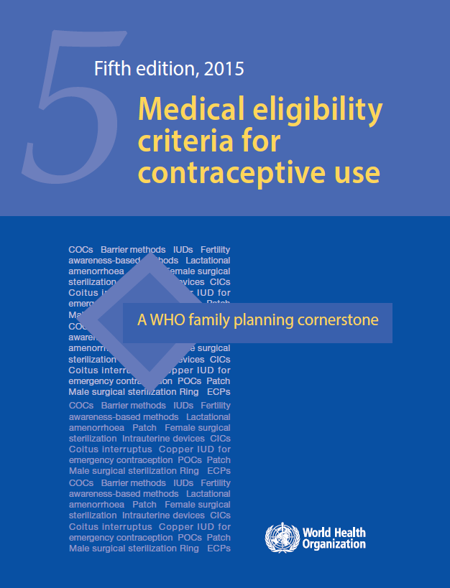
Medical eligibility criteria for contraceptive use (MEC)
Purpose: Who can safely use contraceptive methods?
Offers ≈ 2000 recommendations for 25 methods
  pre-existing medical conditions
  personal characteristics
  certain health problem
Developed through consensus driven process during 3 consultations
  Systematic review of scientific evidence
  Adhered to WHO procedures for guideline development
Previous editions
1996, 2000, 2004, 2009

Slide 5
MEC Categories
  Where warranted, recommendations will differ if a woman is
  starting a method (I = initiation) or
  continuing a method (C = continuation)

Slide 6

Medical eligibility criteria for contraceptive use 5th ed.
Executive summary
(p 5)
Part I – Development (p 13)
Part II – Using the recommendation (p97)
https://www.who.int/publications/i/item/9789241549158
Notes:
Executive summary
Part 1 – Development

Slide 7
Medical eligibility criteria for contraceptive use 5th ed. – Using the recommendations (p 99)
Reproductive and sexual health care as a human right
  Delivery of care in accordance with the client’s human and reproductive rights is fundamental to quality of care.
  This document does not provide recommendations about which specific product or brand to use after selecting a particular type of contraceptive method.
  Instead, it provides guidance for whether women with specific medical conditions or medically relevant physiological or personal characteristics are eligible to use various contraceptive methods.
  Decisions about what methods to use should also take into account clinical judgment and user preferences.
Notes:
Executive summary
Part 1 – Development
Part 2- using the recommendations
The goal of the document is to improve access to, and quality of, family planning services by providing policy-makers, decision-makers and the scientific community with recommendations that can be used for developing or revising national guidelines on the medical eligibility criteria for the use of specific contraceptive methods.
The Programme of Action of the International Conference on Population and Development (ICPD) defines reproductive health as: “a state of complete physical, mental and social well-being, and not merely the absence of disease or infirmity, in all matters relating to the reproductive system and to its functions and processes
These rights rest on the recognition of the basic right of all couples and individuals to decide freely and responsibly the number and spacing and timing of their children and to have the information and means to do so, and the right to attain the highest standard of sexual and reproductive health

Slide 8
Medical eligibility criteria for contraceptive use 5th ed. – Using the recommendations (p 100)
Issues of service quality and access that affect method use and choice
  Clients should be given adequate information to help them make an informed, voluntary choice of a contraceptive method.
  This information should at least include:
    the relative effectiveness of the method;
    correct usage of the method;
    how it works;
    common side-effects;
    health risks and benefits of the method;
    signs and symptoms that would necessitate a return to the clinic;
    information on return to fertility after discontinuing method use; and
    information on STI protection.

Slide 9
Medical eligibility criteria for contraceptive use 5th ed. – Using the recommendations
Issues of service quality and access that affect method use and choice
  Effectiveness of method
  Conditions that expose a woman to increased risk as a result of unintended pregnancy
  Return to fertility
  STIs and contraception: dual protection
How to use this document

Slide 10
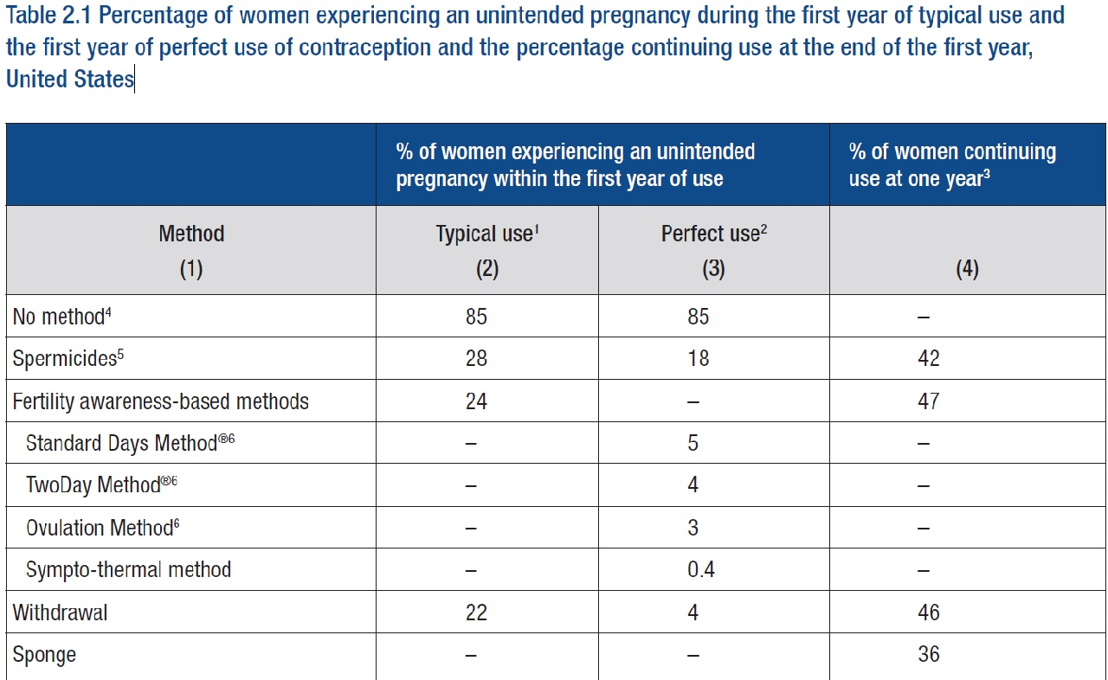
Medical eligibility criteria for contraceptive use 5th ed. – Using the recommendations
Effectiveness of method (p 102)

Slide 11
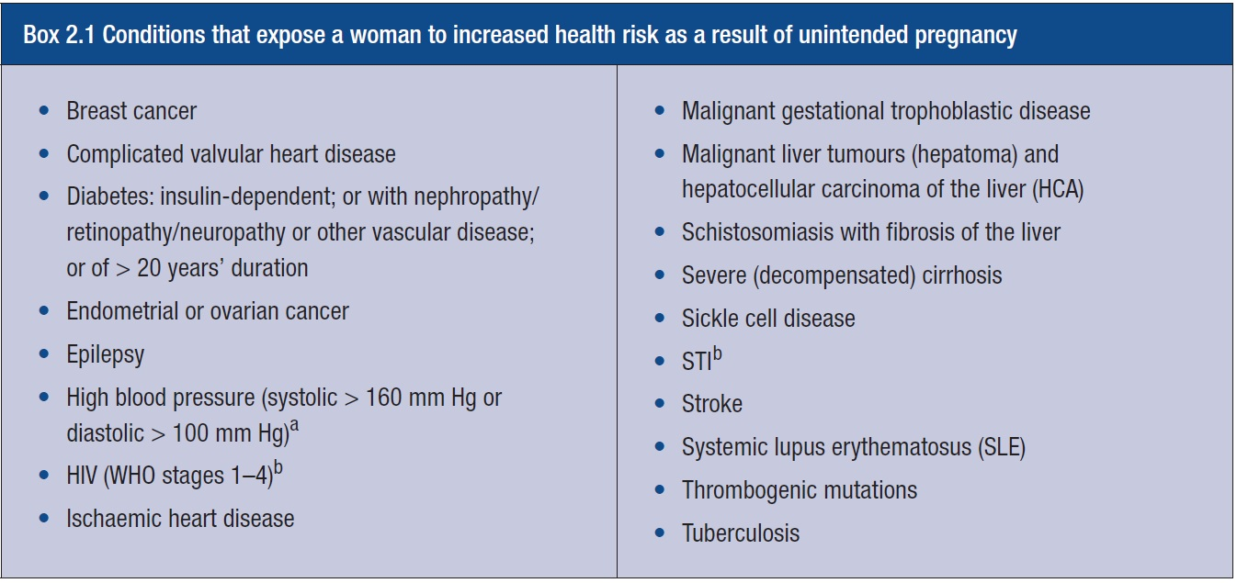
Medical eligibility criteria for contraceptive use 5th ed. – Using the recommendations
Conditions that expose a woman to increased risk as a result of unintended pregnancy (p 101)

Slide 12
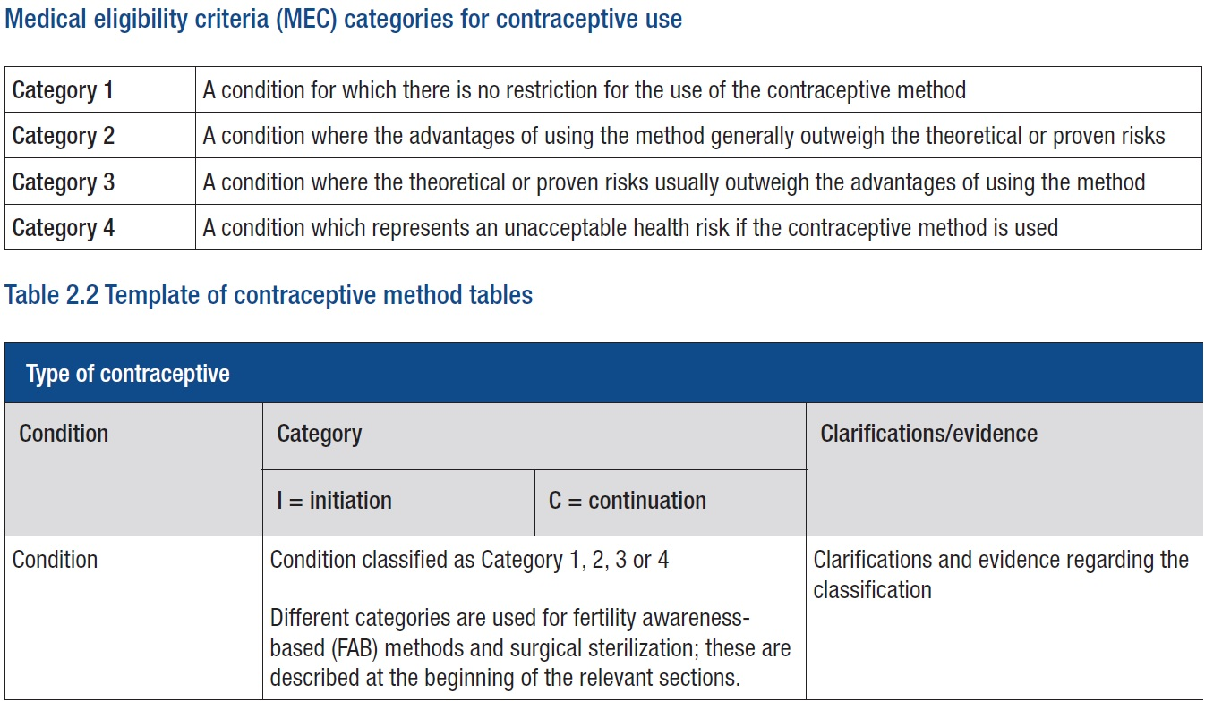
Medical eligibility criteria for contraceptive use 5th ed. – Using the recommendations (p 105)
Notes:
The present document is intended for use by policy-makers, family planning programme managers and the scientific community.
It aims to provide guidance to national family planning and reproductive health programmes in the preparation of guidelines for delivery of contraceptive services. It is not meant to serve as the actual guidelines but rather as a reference.
The guidance in this document is intended for interpretation at country and programme levels in a manner that reflects the diversity of situations and settings in which contraceptives are provided.
Initiation and continuation
The assessment of continuation criteria is clinically relevant whenever a woman develops the condition while she is using the method.
As shown in Table 2.2 in a simplified template of the tables for each contraceptive (provided in section 2.7), the first column indicates the conditions (each in a separate row). Several conditions are subdivided to differentiate between varying degrees of the condition. The second column classifies the condition for initiation and/or continuation into one of the four MEC categories, as described in section 2.3. The third column provides space for any necessary clarifications or presentation of evidence regarding the classification

Slide 13
Medical eligibility criteria for contraceptive use 5th ed. – Using the recommendations
Using the recommendations in practice
  Categories 1 and 4
  Category 2 indicates the method can generally be used, but careful follow-up may be required.
  Category 3 requires careful clinical judgment and access to clinical services; for such a woman, the severity of the condition and the availability, practicality and acceptability of alternative methods should be taken into account.
Where resources for clinical judgment are limited, such as in community-based services, the four-category classification framework can be simplified into two categories.

Slide 14
MEC Categories
  Where warranted, recommendations will differ if a woman is
  starting a method (I = initiation) or
  continuing a method (C = continuation)

Slide 15
Medical eligibility criteria for contraceptive use 5th ed. – Using the recommendations
Programmatic implications
  informed choice
  elements of quality of care
  essential screening procedures for administering the methods
  provider training and skills
  referral and follow-up for contraceptive use as appropriate
Clients with special needs
  People with disabilities
  Adolescents

Slide 16
Medical eligibility criteria for contraceptive use 5th ed. – Summary of the changes (p 108)
Recommendations in the MEC 5th edition enable programmes to further expand contraceptive choice
  Breastfeeding women have more contraceptive choices during the postpartum period
  Women living with HIV, including women taking ART have more contraceptive options
  Four new methods of contraception added to the 5th edition
  Adolescents can use all methods of contraception, including IUDs and implants

Slide 17
Breastfeeding and postpartum
Time period | Progestogen-only pill | DMPA/NET-EN injectable | Levorgestrel/ Etonogestrel implants
< 6 weeks postpartum | 2 | 3 | 2
≥ 6 weeks postpartum | 1 | 1 | 1
Time period | LNG-IUD
<48 hours including insertion immediately after cesearan section | not breastfeeding = 1 breastfeeding = 2
≥ 48 hours to < 4 weeks | 3
≥ 4 weeks | 1
Evidence is reassuring that progestogen-only contraceptives do not compromise a woman’s ability to breastfeed.
Evidence is reassuring that progestogen-only contraceptives do not adversely affect infant health, growth, or development in the first year postpartum.
Effects, or absence of effects, beyond the first year post-partum is not established.
Notes:
Evidence is reassuring that progestogen-only contraceptives do not compromise a woman’s ability to breastfeed.
Evidence is reassuring that progestogen-only contraceptives do not adversely affect infant health, growth, or development in the first year postpartum.
Effects, or absence of effects, beyond the first year post-partum is not established.

Slide 18
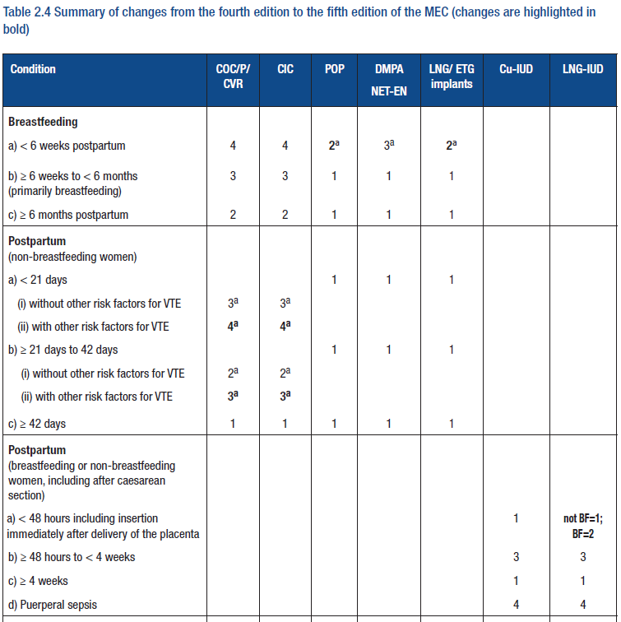
Breastfeeding and postpartum
Notes:
.

Slide 19
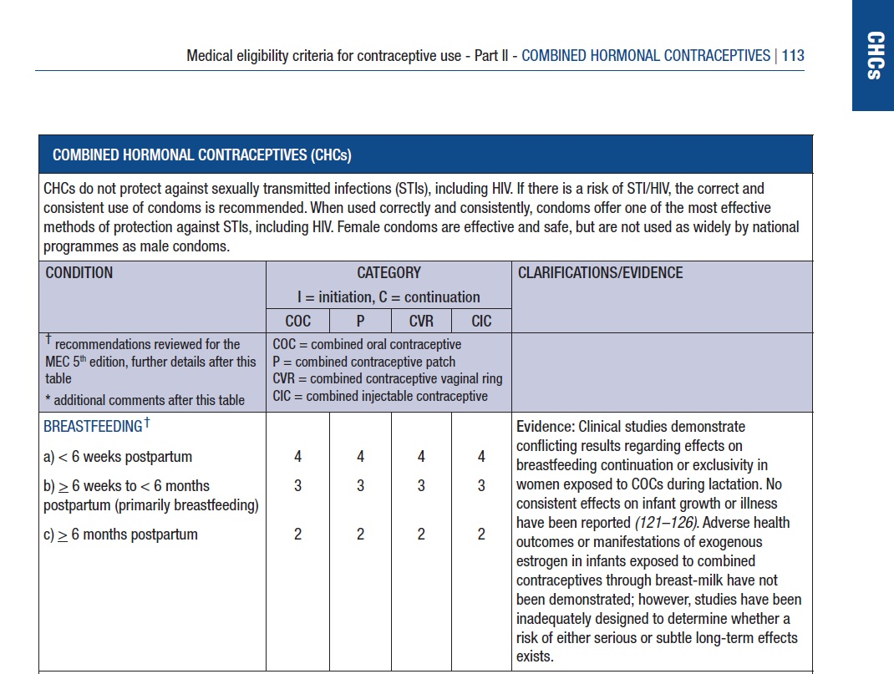
Breastfeeding and postpartum
Notes:
Evidence is reassuring that progestogen-only contraceptives do not compromise a woman’s ability to breastfeed.
Evidence is reassuring that progestogen-only contraceptives do not adversely affect infant health, growth, or development in the first year postpartum.
Effects, or absence of effects, beyond the first year post-partum is not established.

Slide 20
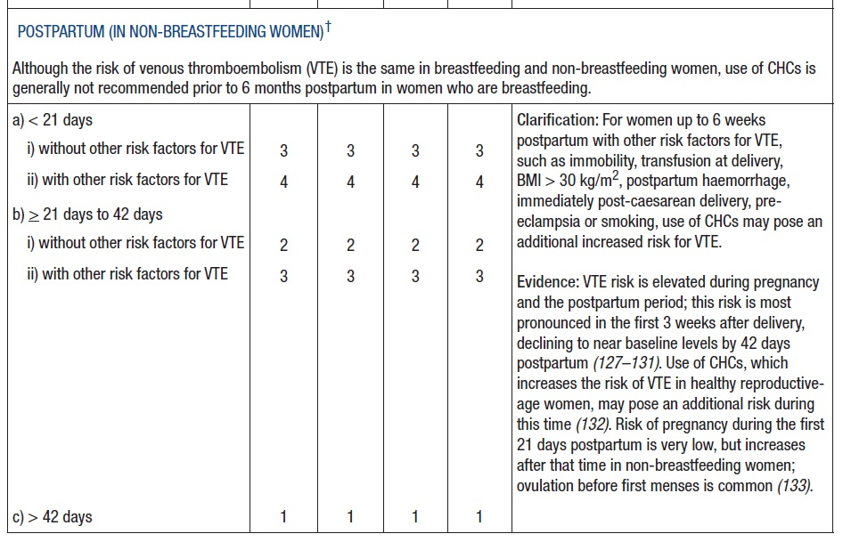
Breastfeeding and postpartum

Slide 21
Breastfeeding and postpartum (p 28)
Part I
  Explanation of development
  Question 1: Among breastfeeding women, does initiation of combined hormonal contraceptives (CHCs) at < 6 weeks postpartum have negative effects on breastfeeding outcomes or infant outcomes, compared with no contraception or non-hormonal contraception? (Direct evidence)
  PICO and databases searched
  Recommendations
  Remarks
  Summary of the evidence
  Quality of the evidence
  Tables and references

Slide 22
Medical eligibility criteria for contraceptive use 5th ed. – Summary of the changes
Recommendations in the MEC 5th edition enable programmes to further expand contraceptive choice
  Breastfeeding women have more contraceptive choices during the postpartum period
  Women living with HIV, including women taking ART have more contraceptive options
  Four new methods of contraception added to the 5th edition
  Adolescents can use all methods of contraception, including IUDs and implants

Slide 23
Medical eligibility criteria for contraceptive use 5th ed. – Summary of the changes
Recommendations in the MEC 5th edition enable programmes to further expand contraceptive choice
  Breastfeeding women have more contraceptive choices during the postpartum period
  Women living with HIV, including women taking ART have more contraceptive options
  Four new methods of contraception added to the 5th edition
  Adolescents can use all methods of contraception, including IUDs and implants

Slide 24
Methods of contraception
Combined oral contraceptives
Combined hormonal contraceptives (1 month injectables, patch, vaginal ring)
Progestogen-only contraceptives
(pills, implants, 2-3 month injectables)
  DMPA subcutaneous (NEW method)
  Sino-implant (II) (NEW method)
Emergency contraceptive pills
  Ulipristal acetate (NEW method)
IUDs (copper bearing and levonorgestrel)
Emergency IUD
Barrier methods (condoms, spermicides
& diaphragm)
Fertility awareness-based methods
Lactational amenorrhoea (LAM)
Progesterone-releasing vaginal ring (NEW method)
Coitus Interruptus
Sterilization (male and female)
Notes:
Subcutaneously-administered depot medroxyprogesterone acetate(DMPA-SC)
Sino implant (II)
Ulipristal acetate (UPA)
Progesterone-releasing vaginal ring (PVR)
As a reminder, the evidence-based recommendations contained within the MEC do not indicate a “best” method that should be used given a particular medical context; rather, review of the recommendations allows for consideration of multiple methods that could be used safely by people with certain health conditions (e.g. hypertension) or characteristics (e.g. age).
Further, the MEC does not offer recommendations about which specific product or brand (e.g. particular COC formulation) to use after selection of a particular contraceptive method.
Ultimately, decision-making regarding contraceptive methods usually requires the need to make trade-offs among the advantages and disadvantages of different methods, and these vary according to individual circumstances, perceptions and interpretations. In addition to medical eligibility, factors to consider when choosing a particular contraceptive method include the characteristics of the potential user, the baseline risk of disease, the adverse effects profile of different products, cost, availability and patient preferences.
Evidence shows that the respect, protection and fulfilment of human rights contribute to positive health outcomes. The provision of contraceptive information and services that respect individual privacy, confidentiality and informed choice, along with a wide range of safe contraceptive methods, increase people’s satisfaction and continued use of contraception.
Methods covered by the previous edition of the MEC guidance included all hormonal contraceptives, intrauterine devices, barrier methods, fertility awareness-based methods, coitus interruptus, lactational amenorrhoea method, male and female sterilization, and emergency contraception.

Slide 25
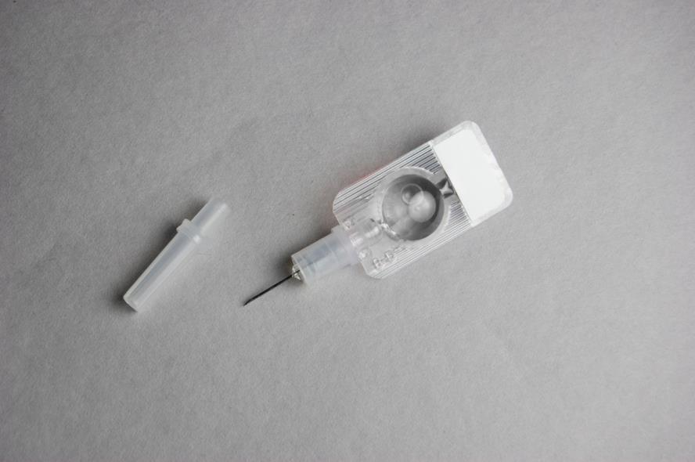
DMPA-subcutaneous injectable (DMPA SC)
Depot medroxyprogesterone acetate is delivered subcutaneously (DMPA SC) at dose of 104 mg/0.65 mL
  Also feasible for self-administration
Guideline group determined all recommendations for DMPA SC should follow existing DMPA intramuscular injectable recommendations
Notes:
The progestin-only injectable contraceptive, depot medroxyprogesterone (DMPA), has traditionally been formulated as a crystalline suspension delivered intramuscularly at a dose of 150 mg/mL every 3 months.
A new, lower dose formulation of depot medroxyprogesterone allows for subcutaneous delivery; this formulation was developed as a 16% weight/volume solution resulting in a final dose of 104 mg/0.65 mL that cannot be achieved solely by diluting the original DMPA suspension.
The package labelling recommends injection at the abdomen and anterior thigh, but evidence suggests that administration in the upper arm may also offer sufficient contraceptive protection and be acceptable to women.
Absorption of medroxyprogesterone acetate is immediate following injection and achieves concentrations sufficient for contraceptive protection within 24 hours.
This method may offer some important service delivery advantages over DMPA-IM.
Studies demonstrate that self-administration of DMPA-SC is feasible and acceptable among both adolescent and adult women and is associated with similar continuation and satisfaction rates.
Based on a review of the evidence, the Guideline Development Group determined that no change to the existing recommendations for DMPA was warranted with inclusion of DMPA-SC as a new method.

Slide 26
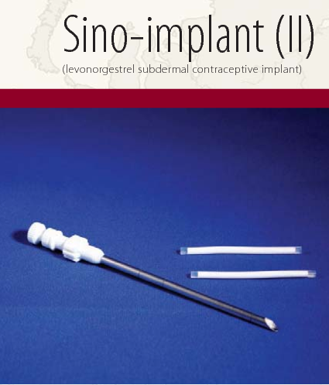
Sino-implant (II)
2-rod, 150 mg LNG implant manufactured in China
Guideline group determined that all Sino-implant (II) recommendations should follow existing LNG implant recommendations
Notes:
2-rod LNG implant manufactured in China (also known as Femplant® or Zarin®)
MEC currently has recommendations for Jadelle® (also a 2-rod, 150 mg LNG implant)

Slide 27
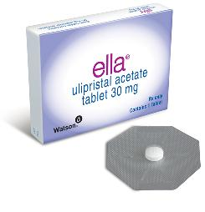
Ulipristal Acetate (UPA)
Delays ovulation
Single dose and effective up to 120 hours
All women can use UPA for emergency contraception
  For example, women with the following conditions and/or characteristics can use UPA: migraine, breastfeeding, obesity, past ectopic pregnancy, taking certain medications, history of severe cardiovascular disease, rape, repeat EC use
Notes:
Ulipristal acetate is a selective progesterone receptor modulator, 30 mg in a single dose
Available since 2009 in the European Union and since 2010 in the US, it is now registered in over 72 countries
It is given as a single dose of 30mg and is effective up to 120 hours in delaying ovulation, It has been shown to delay before the onset of the LH surge or after onset but before the LH peak
Currently registered in 72 countries:
15 in Africa
6 in Asia
9 CIS (Commonwealth independent states-- ex Soviet Union countries like Armenia, Belarus, Georgia, Kazakhstan, etc.)
4 in Latin America
2 in Middle East

Slide 28
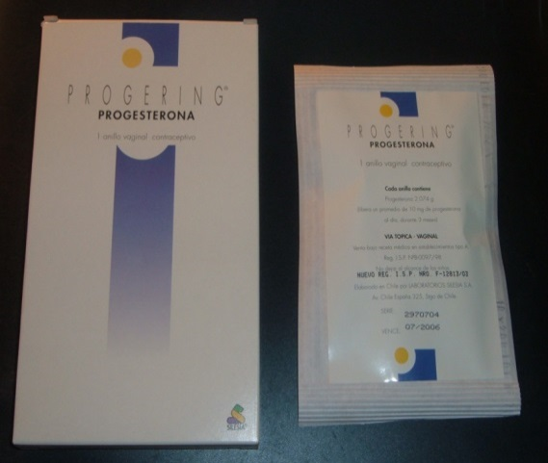
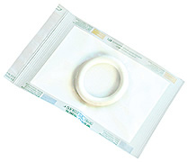
Progesterone-releasing vaginal ring (PVR)
Specifically designed for women who actively breastfeed (at least 4 episodes/day)
Delivers daily low dose of natural progesterone
Currently registered in at least 9 Latin American countries
Women can use the PVR without restriction from 4 weeks post delivery
Notes:
The progesterone-releasing vaginal ring (PVR) is a contraceptive method for women who are actively breastfeeding at least four times a day. It consists of a flexible ring that releases 10 µg/day of progesterone. During use, average plasma concentrations of 20 nmol/L are achieved, which are similar to those detected in the average luteal phase in normal fertile women. The PVR is worn continuously for three-month periods (approximately 90 days) and can be initiated at six weeks after childbirth. Use of the PVR during breastfeeding requires replacing the used ring with a new ring at three-month intervals (± two weeks). The mechanism of contraceptive action of the PVR is through the inhibition of ovulation (1, 2).

Slide 29
Medical eligibility criteria for contraceptive use 5th ed. – Summary of the changes
Recommendations in the MEC 5th edition enable programmes to further expand contraceptive choice
  Breastfeeding women have more contraceptive choices during the postpartum period
  Women living with HIV, including women taking ART have more contraceptive options
  Four new methods of contraception added to the 5th edition
  Adolescents can use all methods of contraception, including IUDs and implants

Slide 30
Summary of MEC Recommendations for AGE
 | COC | P | R | CIC | POP | POI | Implant | IUD Cu LNG
Menarche to < 40 years > 40 years | 1 2 | 1 2 | 1 2 | 1 2
Menarche to < 18 years 18 to 45 years > 45 years |  |  |  |  | 1 1 1 | 2 1 2 | 1 1 1
Menarche to < 20 years > 20 years |  |  |  |  |  |  |  | 2 1 | 2 1
Notes:
In general, adolescents are eligible to use all the same methods of contraception as adults, and must have access to a variety of contraceptive choices.
This table summarizes current MEC recommendations for combined hormonal oral contraceptive pills, patch, ring, and injectables, progestogen-only pills, injectables and implants as well as both the copper and levonorgestrel-releasing IUD. As you can see, the MEC assigns a category 1 or 2 to all of these effective, reversible contraceptive methods, indicating that these methods can be used safely both by adolescents and older women.
Age alone does not constitute a medical reason for denying any method to adolescents.

Slide 31
Adolescents and IUD
 | Cu-IUD | LNG-IUD
Menarche to < 20 years > 20 years | 2 1 | 2 1
Evidence: Risks of pregnancy, infection and perforation are low among IUD users of any age. Heavy bleeding or removals for bleeding do not seem to be associated with age. Young women using Cu-IUDs may have an increased risk of expulsion compared with older Cu-IUD users.
Notes:
According to the MEC, young women generally can use both the Cu and LNG-releasing IUDs.
A recently conducted systematic review on this topic (forthcoming in publication) found that risks of pregnancy, infection and perforation are low among IUD users of any age. Heavy bleeding or removals for bleeding do not seem to be associated with age. Young women using Cu-IUDs may have an increased risk of expulsion compared with older Cu-IUD users .

Slide 32
Adolescents and Emergency Contraception
Adolescents and adult women of reproductive age may need emergency contraception at some point to avoid an unintended pregnancy.
All women and girls, regardless of age, can use emergency contraceptive pills (combined hormonal, levonorgestrel or ulipristal acetate)
  There are no medical conditions for which the risks of ECP use outweigh any potential benefits.
Cu-IUD can be inserted within five days of unprotected intercourse for emergency contraception
Notes:
Adolescents and adult woman of reproductive age may need emergency contraception at some point to avoid an unintended pregnancy.
All women and girls, regardless of age, can use emergency contraceptive pills (combined hormonal, levonorgestrel or ulipristal acetate); there are no medical conditions for which the risks of ECP use outweigh any potential benefits.
Use of a copper-bearing IUD (Cu-IUD) for emergency contraception (E-IUD) is highly effective for preventing pregnancy.
For this purpose, a Cu-IUD can be inserted within five days of unprotected intercourse. However, when the time of ovulation can be estimated, the Cu-IUD can be inserted beyond five days after intercourse, if necessary, as long as the insertion does not occur more than five days after ovulation.
The eligibility criteria for general Cu-IUD insertion also applies for the insertion of Cu-IUDs for emergency contraception; therefore, adolescents generally can use the Cu-IUD in this setting as well.

Slide 33
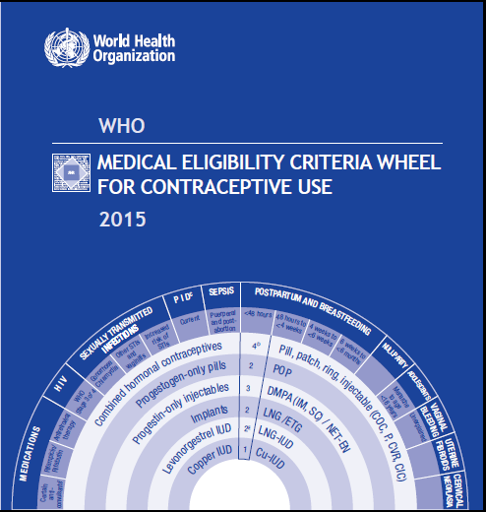
MEC Wheel
Contains the MEC for starting use of contraceptive methods

Slide 34
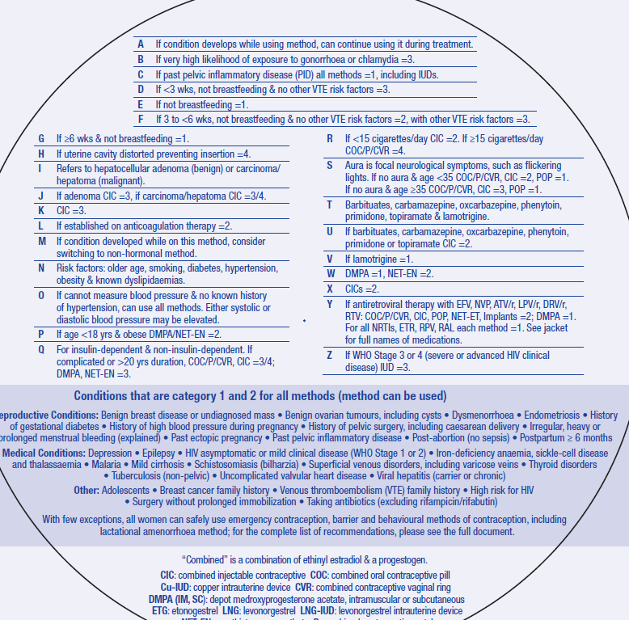
MEC Wheel
Selected methods
Medical or health conditions
MEC category
Comments

Slide 36
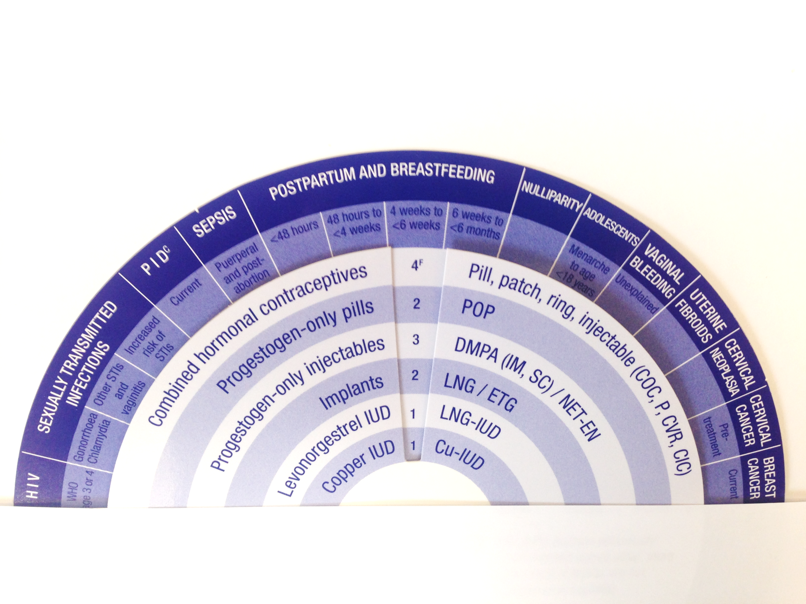
Breastfeeding and postpartum
Part I
  Explanation of development
  Question 1: Among breastfeeding women, does initiation of combined hormonal contraceptives (CHCs) at < 6 weeks postpartum have negative effects on breastfeeding outcomes or infant outcomes, compared with no contraception or non-hormonal contraception? (Direct evidence)
  PICO and databases searched
  Recommendations
  Remarks
  Summary of the evidence
  Quality of the evidence
  Tables and references

Slide 38
Summary
Purpose: Who can safely use contraceptive methods?
Target audience: policy-makers, family planning programme managers and the scientific community.
Guidance and reference: interpretation that reflects the diversity of situations and settings in which contraceptives are provided.

Slide 39
Summary
Part 1: Development of the
Medical eligibility criteria for contraceptive use, fifth edition
Part II: Using the recommendations
MEC wheel

Slide 40
Thank You!
Follow us on Twitter @HRPresearch
Visit our website
https://www.who.int/teams/sexual-and-reproductive-health-and-research-(srh)/

