Slide 1
Contraceptive eligibility for women at high risk of HIV: WHO guidance statement
Petrus Steyn, WHO/ SRH/ CFC

Slide 2
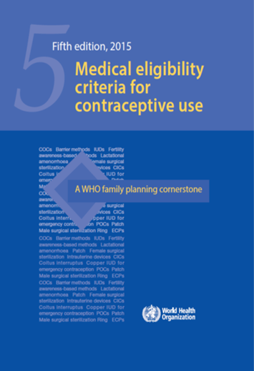
Medical eligibility criteria for contraceptive use (MEC)
Provides recommendations (> 2000) on eligibility for 25 methods of contraception
Conditions include:
  A physiological status (e.g. parity, breastfeeding)
  A group with special needs (adolescents, perimenopausal women)
  A health problem (e.g. headache, irregular bleeding)
  A known pre-existing medical condition
  (e.g. hypertension, STI, diabetes)
  High risk of HIV infection

Slide 3
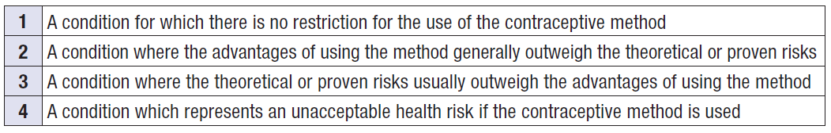
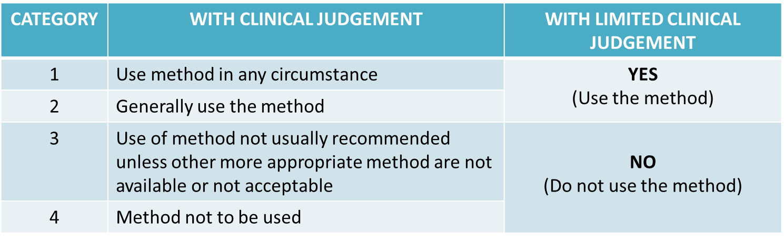
MEC Categories
  Where warranted, recommendations will differ if a woman is starting a method (I = initiation) or continuing a method (C = continuation)

Slide 4
Clarifications
In cases where the number itself does not adequately communicate the essence of the recommendation, a clarification accompanies the numerical recommendation
  Appears in the right hand column of the MEC document
  Responsibility of expert working group

Slide 5
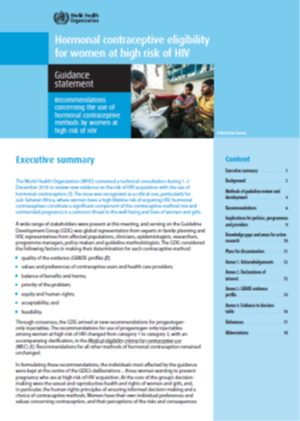
2017 Guidance statement
Hormonal contraceptive eligibility for women at high risk of HIV

Slide 6
Recommendations for progestogen-only contraceptives
Condition | POP | DMPA NET-EN | LNG/ETG implants | Clarifications/evidence | Clarifications/evidence
POP = progestogen-only pill LNG/ETG = levonorgestrel and etonogestrel (implants) DMPA = depot medroxyprogesterone acetate (injectable) NET-EN = norethisterone enanthate (injectable)
High risk of HIV | 1 | 2 | 1 | CLARIFICATION: There continues to be evidence of a possible increased risk of acquiring HIV among progestogen-only injectable users. Uncertainty exists about whether this is due to methodological issues with the evidence or a real biological effect. In many settings, unintended pregnancies and/or pregnancy-related morbidity and mortality are common, and progestogen-only injectables are among the few types of methods widely available. Women should not be denied the use of progestogen-only injectables because of concerns about the possible increased risk. Women considering progestogen-only injectables should be advised about this possible increased risk, about the uncertainty about whether there is a causal association, and how to minimise their risk of acquiring HIV. EVIDENCE: Evidence from 13 observational studies of DMPA, NET-EN, or non-specified progestogen-only injectables, which were considered to be “informative but with important limitations”,⁶ continues to show some association between use of progestogen-only injectables and risk of HIV acquisition, but it remains unclear whether this results from a causal association or methodologic limitations. Two small studies assessing levonorgestrel implants, which were considered to be “informative but with important limitations”, did not suggest an elevated risk, although the risk estimates were imprecise. One study reported no association between use of progestogen-only pills and HIV acquisition.

Slide 7
Recommendations for other methods
Condition | COC/P/R | CIC | Cu-IUD | LNG-IUD
COC = combined hormonal contraceptive P = combined contraceptive patch R = combined contraceptive vaginal ring CIC = combined injectable contraceptive Cu-IUD = copper-bearing intrauterine device (IUD) LNG-IUD = levonorgestrel-releasing IUD
At high risk of HIV | 1 | 1 | 2 | 2
Note: The condition ‘at high risk of HIV’ has been classified as MEC category 2 because STI conditions are generally classified as MEC category 2 for Cu-IUD or LNG-IUD use.

Slide 8
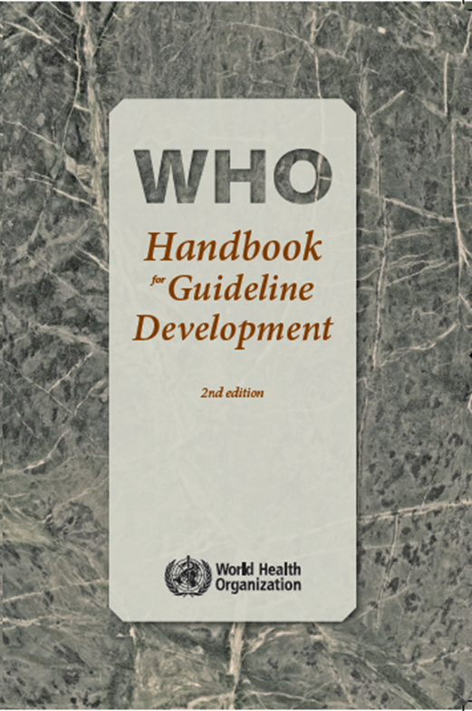
WHO standards for guideline development

Slide 9




Process
Presentations providing context
Values & preferences of contraceptive users
Summary of systematic reviews
Review of the biological data

Slide 10
Process
Presentations providing context
Current WHO recommendations
Review of implementation experience
Summary of systematic reviews
ECHO Study results
2 systematic reviews:
  Hormonal methods
  Copper-bearing IUDs
Review of GRADE evidence tables

Slide 11
Process
Values & preferences of contraceptive users
Systematic review of published studies
Consultative engagements with affected populations
Perspectives from affected populations
Review of the biological data

Slide 12

Guideline Development Group
Reviewed GRADE profiles;
Used Evidence to Decision framework to formulate recommendations;
Identified evidence gaps;
Reviewed & approved guideline for submission to WHO Guidelines Review Committee (GRC).
Notes:
.

Slide 13
Combined hormonal contraceptives: No change
Condition | COC | P | CVR | CIC | Clarification/evidence
COC = combined oral contraceptive P = combined contraceptive patch CVR = combined vaginal ring CIC = combined injectable contraceptive
At high risk of HIV | 1 | 1 | 1 | 1 | Evidence: Low-moderate quality evidence from eleven observational studies suggested no association between COC use (it was assumed that studies which did not specify OC type, examined mostly, if not exclusively, COC use) and HIV acquisition (4, 6). No studies of P, CVR or CIC were identified.
4. Polis CB, Curtis KM, Hannaford PC, Phillips SJ, Chipato T, Kiarie JN, et al. An updated systematic review of epidemiological evidence on hormonal contraceptive methods and HIV acquisition in women. AIDS. 2016;30(17):2665-83.
6. Sabo MC, Richardson BA, Lavreys L, Martin HL, Jr., Jaoko W, Mandaliya K, et al. Does bacterial vaginosis modify the effect of hormonal contraception on HIV seroconversion. AIDS. 2019;33(7):1225-30.

Slide 14
Reviewed recommendations
Progestogen-only contraceptives and intrauterine devices

Slide 15
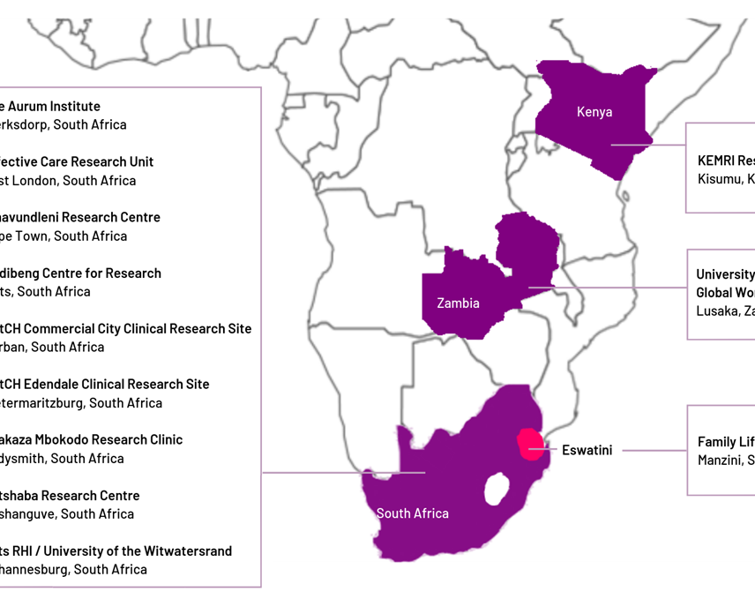
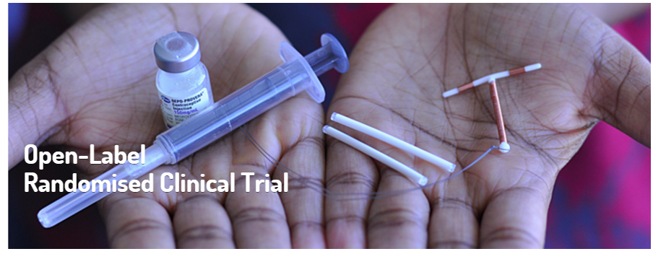
ECHO Trial
1 site
1 site
9 sites
1 site
7,800 women ages 16-35 wanting to prevent pregnancy and willing to be randomized
Randomize
(1:1:1 ratio)
DMPA
(2,600 women)
LNG implant
(2,600 women)
Copper IUD
(2,600 women)
Notes:
Average age 23 (range 16-35), 63% <25 years of age
Most (81%) were not married & most (81%) had previously been pregnant at least once
STIs were common: 18% had C. trachomatis, 5% N. gonorrhoeae, and 38% HSV-2
Half did not use a condom with their last sex act, but only 7% reported >1 partner in the prior 3 months
MPA levels in blood samples were tested in a subset of participants from the enrolment visit – 13% had levels suggesting potential use in the prior 6 months

Slide 16
GRADE table for progestogen-only contraceptives
Outcome | Studies | Limitations | Inconsistency | Imprecision | Indirectness | Overall quality | Estimate of effect
DMPA versus non-hormonal contraception
HIV acquisition | 1 randomized trial(3) (7829)^ | Few limitations† | No serious inconsistency | No serious imprecision | No indirectness | High | Adjusted HR 1.04 (0.82-1.33) for DMPA versus Cu-IUD
Implant versus non-hormonal contraception
HIV acquisition | 1 randomized trial(3) (7829)^ | Few limitations† | No serious inconsistency | No serious imprecision | No indirectness | High | Adjusted HR 1.18 (0.91-1.53) for Cu-IUD versus LNG-implant
NET-EN versus non-hormonal contraception or no method
HIV acquisition | 6 cohorts studies(5, 33, 35, 36, 38, 39) + 1 individual patient data meta-analysis of 7 studies(40)* (29922)^ | Some limitations** | No serious inconsistency | No serious imprecision | No indirectness | Low | Adjusted HR range 0.87 to 1.76, 5 studies increased risk (HR range 1.20 to 1.76), none statistically significant; 2 studies no effect (Adjusted HR range 0.87-1.05). Pooled adjusted HR 1.14 (0.93-1.39).
^Sample size is for the entire study population. † Few limitations note in the trial, but not serious enough to downgrade the level of evidence. While the study was unblinded for participants and health care providers, data was analysed centrally by statisticians who were blinded to the group. *Restricted to studies classified as "informative with but with important limitations“.
**Some limitations or imprecision noted across the body of evidence, but not serious enough to downgrade the level of evidence.

Slide 17
GRADE table for Cu-IUD
Outcome | Studies | Limitations | Inconsistency | Imprecision | Indirectness | Overall quality | Estimate of effect
IUD use vs. DMPA
HIV acquisition | 1 randomized trial* (7829) ^ | Few limitations† | No serious inconsistency | No serious imprecision | No indirectness | High | Adjusted HR 1.04 (0.82-1.33) for DMPA-IM versus Cu-IUD
IUD use vs. Implant
HIV acquisition | 1 randomized trial* (7829) ^ | Few limitations† | No serious inconsistency | No serious imprecision | No indirectness | High | Adjusted HR 1.18 (0.91-1.53) for Cu-IUD versus LNG implant
^Sample size is for the entire study population. *Restricted to studies classified as "informative with but with important limitations“. † Few limitations noted in the trial, but not serious enough to downgrade the level of evidence

Slide 18
Contraceptive values and preferences
Systematic review, engagement with sex workers, community perspectives

Slide 19
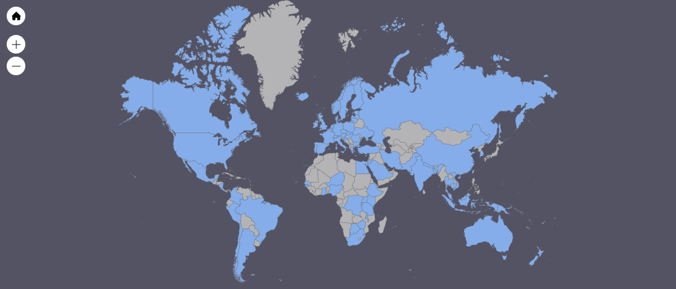
Systematic Review
Search results: 375 studies met inclusion criteria
AFRO: n= 84
PAHO: n= 153 (122 US)
SEAR: n= 18
EURO: n= 94 (27 UK)
EMRO: n= 13
WRPO: n= 31 (20 Australia)

Slide 20
Conclusions
Contraceptive users want:
    A range of contraceptive methods
    Methods that are efficacious, easy to use, few side effects
    Control over final method choice, but consultation with providers that emphasizes their values and preferences
    Comprehensive information about available methods and side effects
Wide variability in values and preferences within and across studies
Values and preferences shaped by context and available options
    Counseling can change method choice, but providers may sometimes have incorrect knowledge

Slide 21
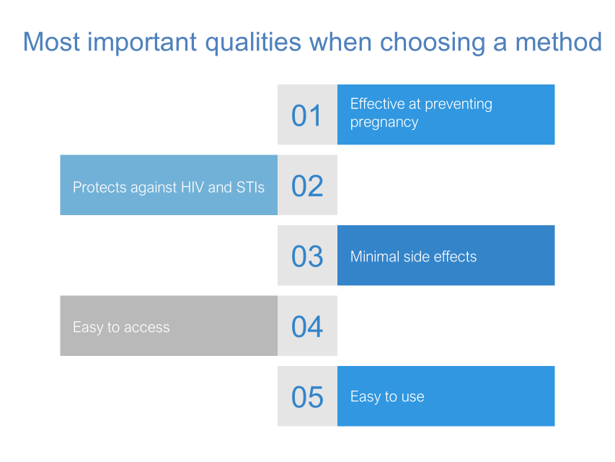
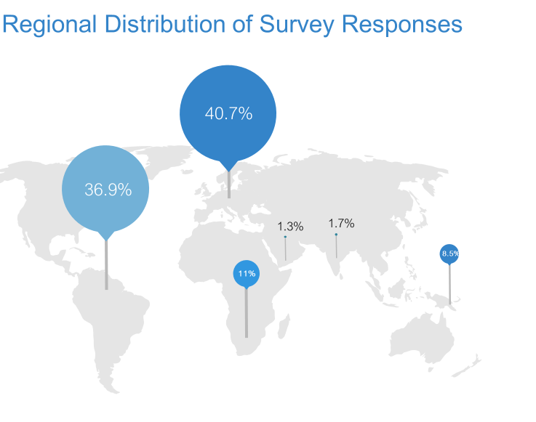
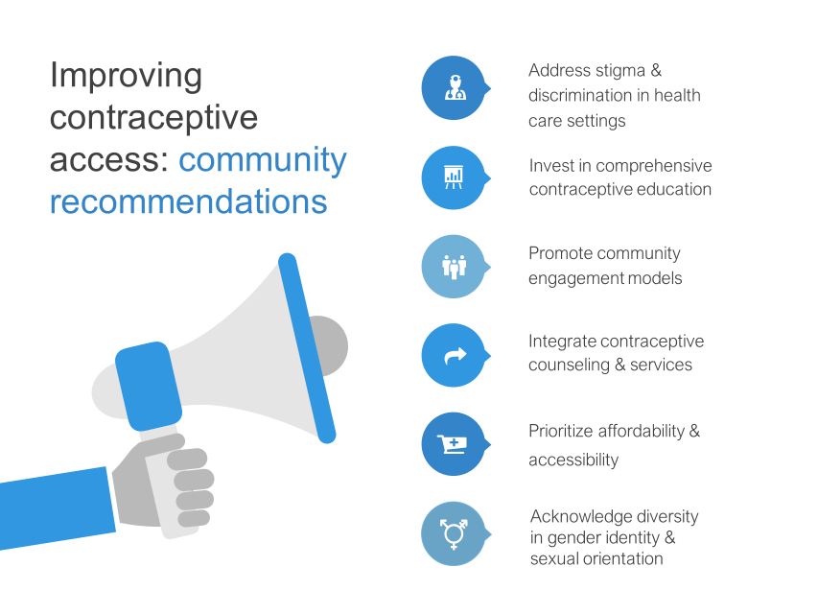
Sex worker survey

Slide 22
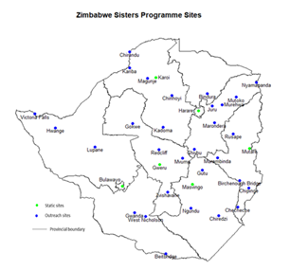
Zimbabwe Qualitative Study
Participatory focus groups
  Role play scenarios
Cost, accessibility, side effects, care at clinics influence use of contraception
Condom-less sex is common
Male partners/clients influence contraceptive use

Slide 23
Voices from the HC-HIV advocacy group
Guidelines work for women when they reflect their concerns – which are diverse and vary.
  “For some women, any level of HIV risk is too much. ECHO does not say that there is ‘no risk’.”
Stories from women’s lives gathered through extensive community dialogues show that true contraceptive choice is a myth for many women
Any changes to the guideline should reflect in clear, straightforward terms, these two critical points.

Slide 24
Biological Data
Multiple biologic mechanisms could theoretically modify HIV acquisition risk
  Unclear which are clinically relevant
  Likely to be multifactorial
Variable effects by hormone, concentration, mode of administration
Applicability of data from animal and laboratory studies for clinical outcomes in humans uncertain

Slide 25
Evidence to decision making and recommendations

Slide 26
Evidence to decision table: Quality of evidence and benefits vs. harms
Factor | Explanation/evidence |  | Judgement
Quality of evidence | POCs | High quality for DMPA-IM & LNG implants; low quality for NET-EN; absent for DMPA-SC, LNG IUDs, and ETG implants. NET-EN, DMPA-SC evidence extrapolated from DMPA-IM evidence. LNG implant evidence extrapolated from ETG implants. | High, low or absent depending on method
 | IUDs | High quality for Cu-IUD. Evidence absent for LNG-IUDs. For LNG-IUDs, extrapolated from evidence on Cu-IUD and other LNG containing products. | High or absent depending on method
Balance of benefits vs. harms | POCs | Contraception is a life-saving intervention with well-recognized health, social and economic benefits. All POCs and IUDs are highly effective, reversible methods. For DMPA-SC or ETG implants, indirect evidence from DMPA-IM & LNG implants, and no biological or clinical reasons to believe differential HIV risk. For LNG-IUDs, recommendations extrapolated from evidence on Cu-IUDs and other LNG-containing products | Balance is in favor or benefits of POCs
 | IUDs |  | Balance is in favor or benefits of IUDs

Slide 27
Evidence to decision table: Values & preferences, equity & human rights, feasibility
Factor | Judgement
Values & preferences | Support for optimizing informed contraceptive choice and the availability of a wide range of contraceptive options.
Priority of the problem | Effective contraception and HIV prevention are both public health priorities.
Equity & human rights | Recommendations in WHO’s human rights guidance are the paramount principles for decision-making on this topic. Non-discrimination, availability, accessibility, acceptability, quality, informed decision-making, privacy and confidentiality, participation, and accountability.
Feasibility | Clear guidance and a woman-centred approach are essential for successful implementation.

Slide 28
Recommendations for progestogen-only contraceptives
Condition | POP | DMPA/NET-EN | LNG/ETG | Clarification/evidence
POP = progestogen-only pill LNG/ETG = levonorgestrel and etonogestrel (implants) DMPA = depot medroxyprogesterone acetate (injectable) NET-EN = norethisterone enanthate (injectable)
High risk of HIV | 1 | 1 | 1 | EVIDENCE: High quality evidence from one RCT observed no statistically significant differences in HIV acquisition between: DMPA-IM versus Cu-IUD, DMPA-IM versus LNG implant, and Cu-IUD versus LNG implant (3). Of the low-moderate quality evidence from 14 observational studies, some studies suggested a possible increased risk of HIV with progestogen-only injectable use, which was most likely due to unmeasured confounding (4-6). Low quality evidence from 3 observational studies did not suggest an increased HIV risk for implant users (4-6). No studies of sufficient quality were identified for POPs.
3. Evidence for Contraceptive Options and HIV Outcomes (ECHO) Trial Consortium. HIV incidence among women using intramuscular depot medroxyprogesterone acetate, a copper intrauterine device, or a levonorgestrel implant for contraception: a randomized, multicentre, open-label trial. The Lancet. 2019;394:303-313.
4. Polis CB, Curtis KM, Hannaford PC, Phillips SJ, Chipato T, Kiarie JN, et al. An updated systematic review of epidemiological evidence on hormonal contraceptive methods and HIV acquisition in women. AIDS. 2016;30(17):2665-83.
5. Palanee-Phillips T, Brown ER, Szydlo D, Matovu Kiweewa F, Pather A, Harkoo I, et al. Risk of HIV-1 acquisition among South African women using a variety of contraceptive methods in a prospective study. AIDS. 2019;33(10):1619-22.
6. Sabo MC, Richardson BA, Lavreys L, Martin HL, Jr., Jaoko W, Mandaliya K, et al. Does bacterial vaginosis modify the effect of hormonal contraception on HIV seroconversion. AIDS. 2019;33(7):1225-30.

Slide 29
Recommendations for intrauterine devices
Condition | Cu-IUD | LNG-IUD | Clarifications/evidence
At high risk of HIV | 1 | 1 | CLARIFICATION: Many women at high risk of HIV are also at risk of other STIs. For these women, refer to the MEC recommendation on women at increased risk of STIs and the Selected practice recommendations for contraceptive use recommendations on STI screening before IUD insertion (7). EVIDENCE: High quality evidence from one RCT, along with low quality evidence from two observational studies, suggested no increased risk of HIV acquisition with Cu-IUD use (3, 5, 8). No studies were identified for LNG-IUDs.
3. Evidence for Contraceptive Options and HIV Outcomes (ECHO) Trial Consortium. HIV incidence among women using intramuscular depot medroxyprogesterone acetate, a copper intrauterine device, or a levonorgestrel implant for contraception: a randomized, multicentre, open-label trial. The Lancet. 2019;394:303-313.
5. Palanee-Phillips T, Brown ER, Szydlo D, Matovu Kiweewa F, Pather A, Harkoo I, et al. Risk of HIV-1 acquisition among South African women using a variety of contraceptive methods in a prospective study. AIDS. 2019;33(10):1619-22.
7. WHO. Selected Practice Recommendations for Contraceptive Use. Geneva; 2016.
8. Lavreys L, Baeten JM, Martin Jr HL, Overbaugh J, Mandaliya K, Ndinya-Achola J, et al. Hormonal contraception and risk of HIV-1 acquisition: Results of a 10-year prospective study. AIDS. 2004;18(4):695-7.

Slide 30




Implications for policies, programmes and providers
A woman’s risk should not restrict her contraceptive choice
Efforts to expand access to contraceptive options must continue
Renewed emphasis on HIV/STI testing services is urgently needed
Integration of family planning and HIV prevention services is essential in high prevalence areas
  Low prevalence settings can offer HIV testing and prevention services to women who request them

Slide 31
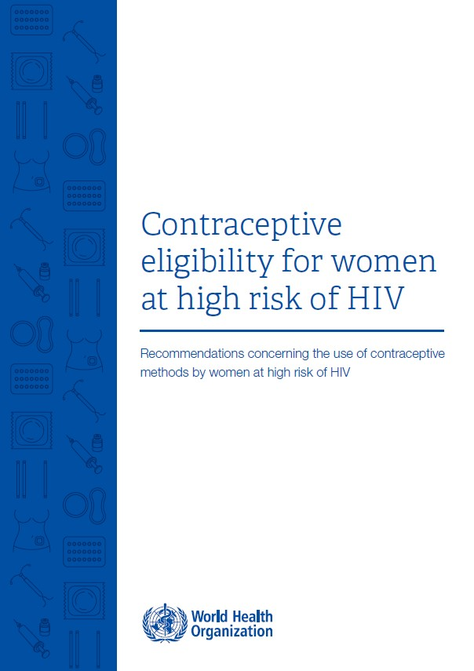
Conclusions: WHO’s updated guidance
For women at high risk of HIV, there are no medical restrictions for any contraceptive method
  Progestogen-only contraceptives (pills, injectables, implants)
  IUDs
  Combined hormonal contraceptives (pills, ring, patch, injectable)
https://www.who.int/publications/i/item/9789241550574

Slide 32
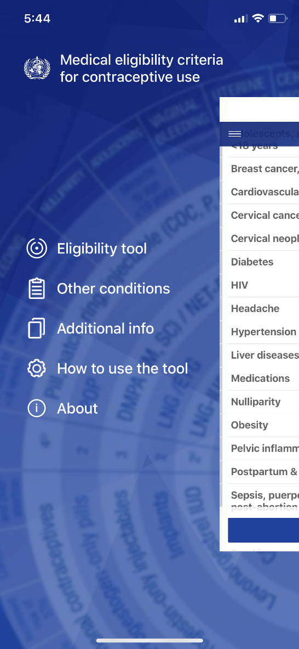
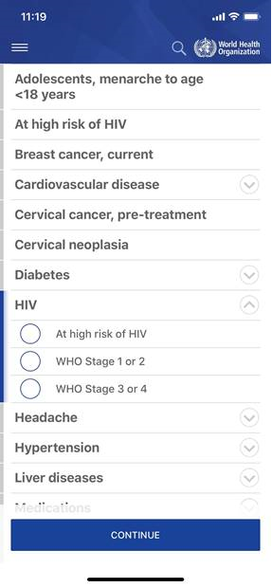
MEC app
https://www.who.int/news/item/29-08-2019-new-app-for-who-s-medical-eligibility-criteria-for-contraceptive-use
This update of the Medical eligibility criteria for contraceptive use app provides new recommendations for women who are at high risk of HIV.

Slide 33
Thank You!
Follow us on Twitter @HRPresearch
Visit our website
https://www.who.int/teams/sexual-and-reproductive-health-and-research-(srh)

