Slide 1
Family planning training resource package
Petrus Steyn
World Health Organization, Geneva

Slide 2
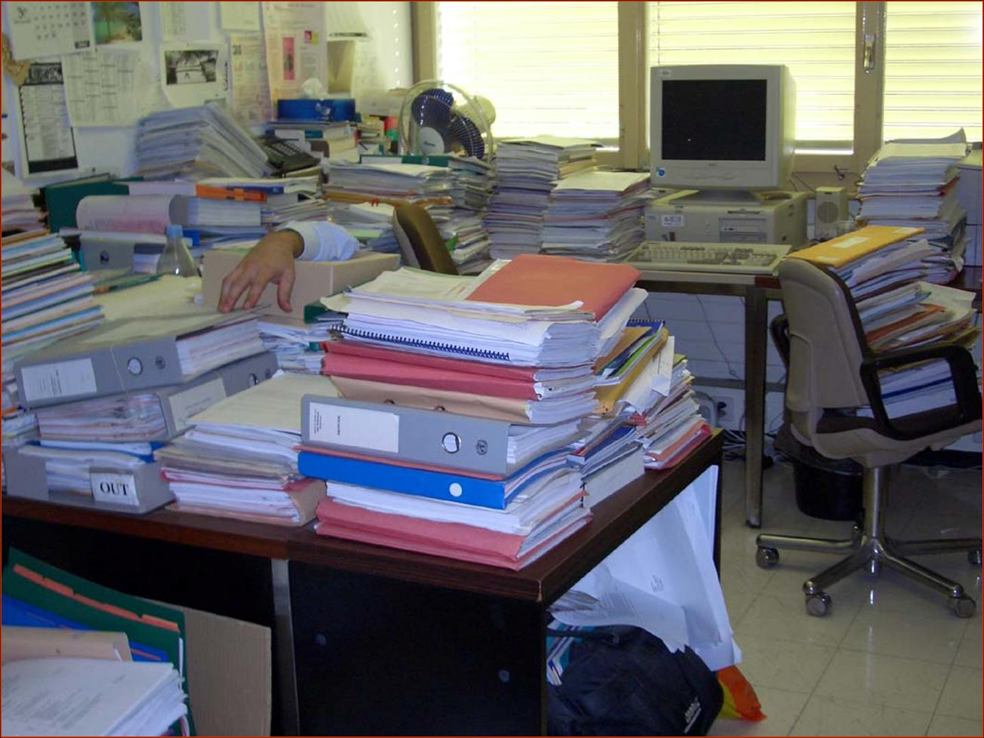
Keeping up with the updated materials...

Slide 3
What, When, Where, How, Why
Do We Need Standardized Training Materials?
Internet is a common source for training materials
Too many and non-standardized tools
Lots of materials are outdated
Not sure which material is based on evidence
Materials do not use adult based educational methods
  Too many lectures
  Minimal interactive and participatory sessions
  Inappropriate use of role plays and discussions, etc.
Not competency based

Slide 4
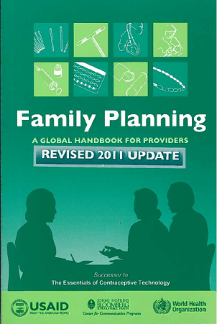
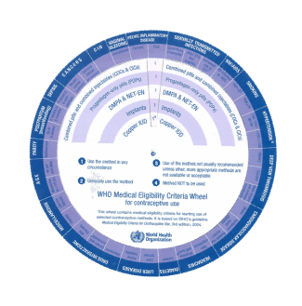
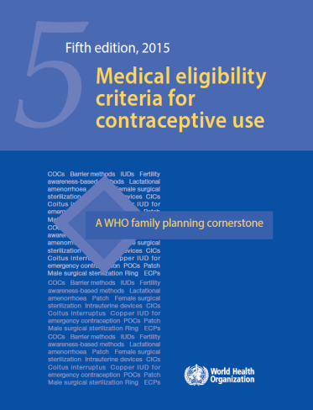

A Training Resource Package for Family Planning (TRP)
A comprehensive set of materials designed to support up to date training in family planning and reproductive health.
Used evidence based technical information from WHO publications: Family Planning: A Global Handbook for Providers (WHO), MEC, and SPR.
A web-based collection of the curricular components and tools needed to design, implement and evaluate training.

Slide 5
A Training Resource Package for Family Planning
Can be used by facilitators and curriculum developers to implement high quality training and education.
The materials are appropriate for pre-service and in service training and applicable in both the public and private sectors.
Incorporates up-to-date technical content and proven training methodologies.
Content can be customized to meet needs of specific training audiences.
Can be used by trainers with different levels of training experience – guidance is provided (facilitator’s guide).

Slide 6
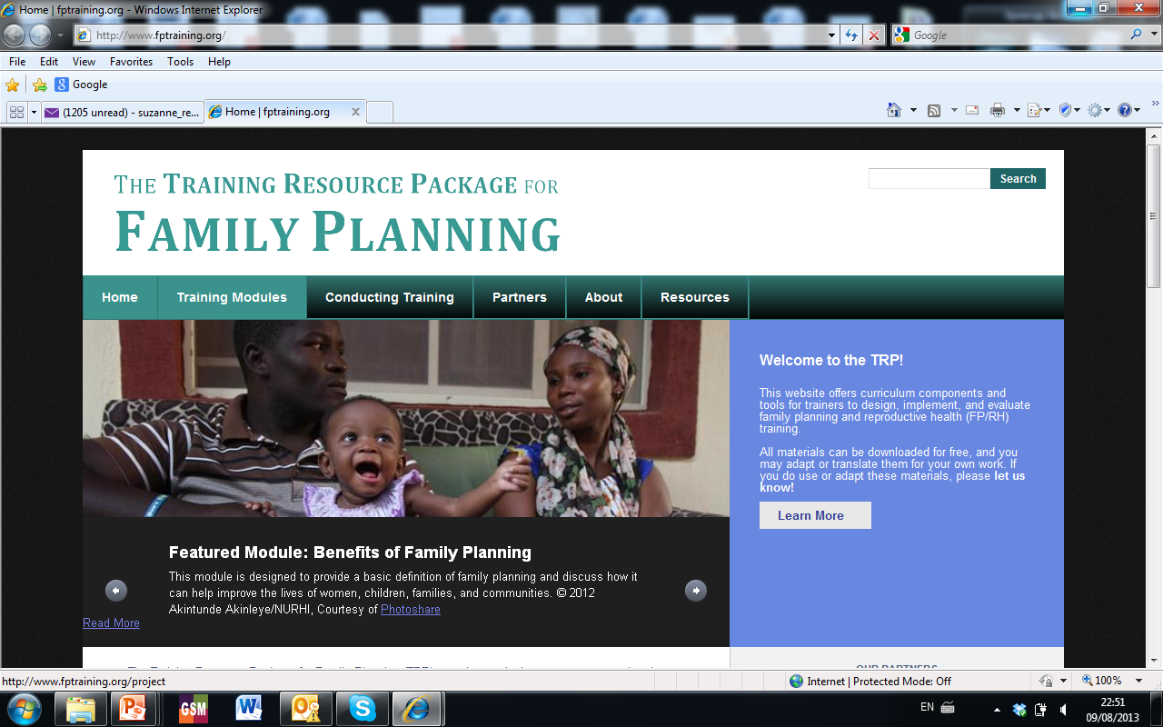

Slide 7



A Partnership in Development, Review and Dissemination
Joint effort of USAID, WHO and UNFPA, in collaboration with many Cooperating Agencies and organizations, including
  FHI 360
  CDC
  IPPF
  Engender Health
  Institute for Reproductive Health
  IntraHealth
  Jhpiego
  Johns Hopkins University
  Management Sciences for Health
  Pathfinder International (current secretariat)

Slide 8
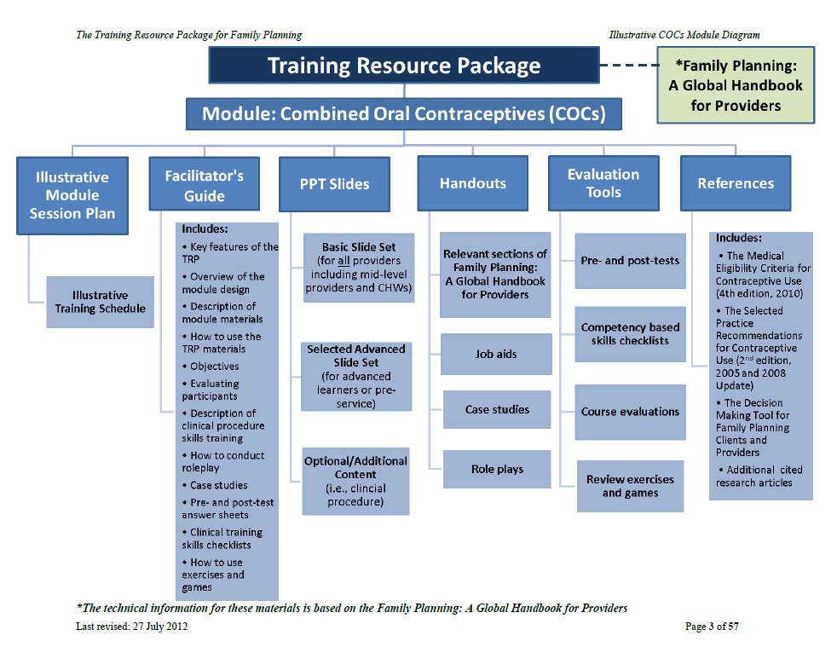

Slide 9
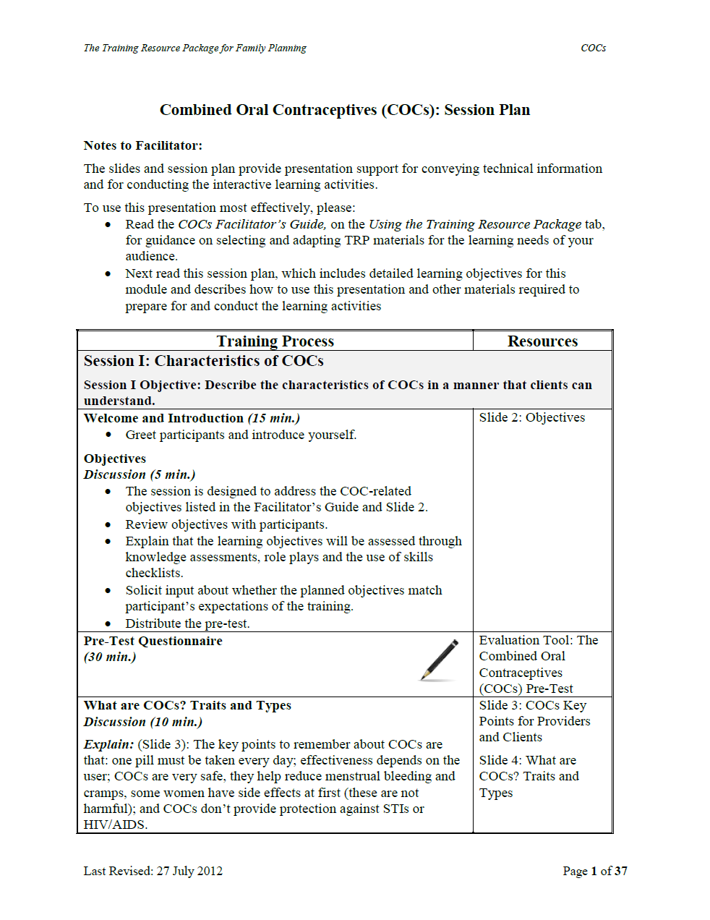
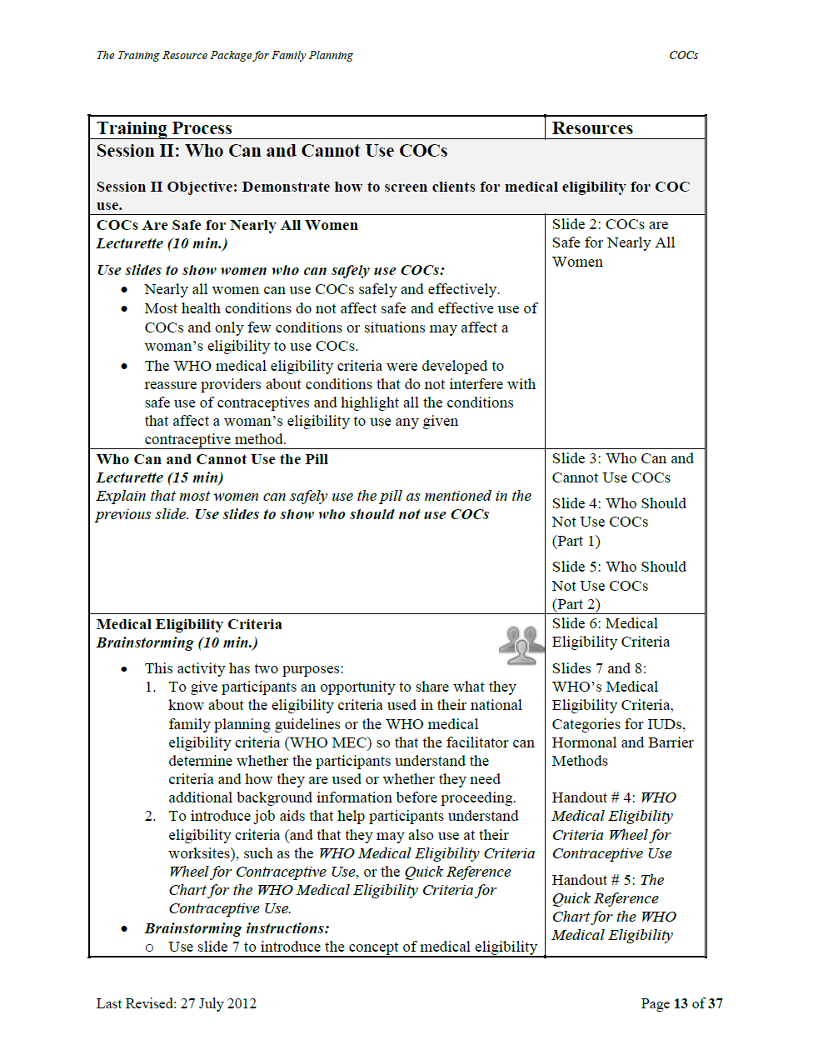
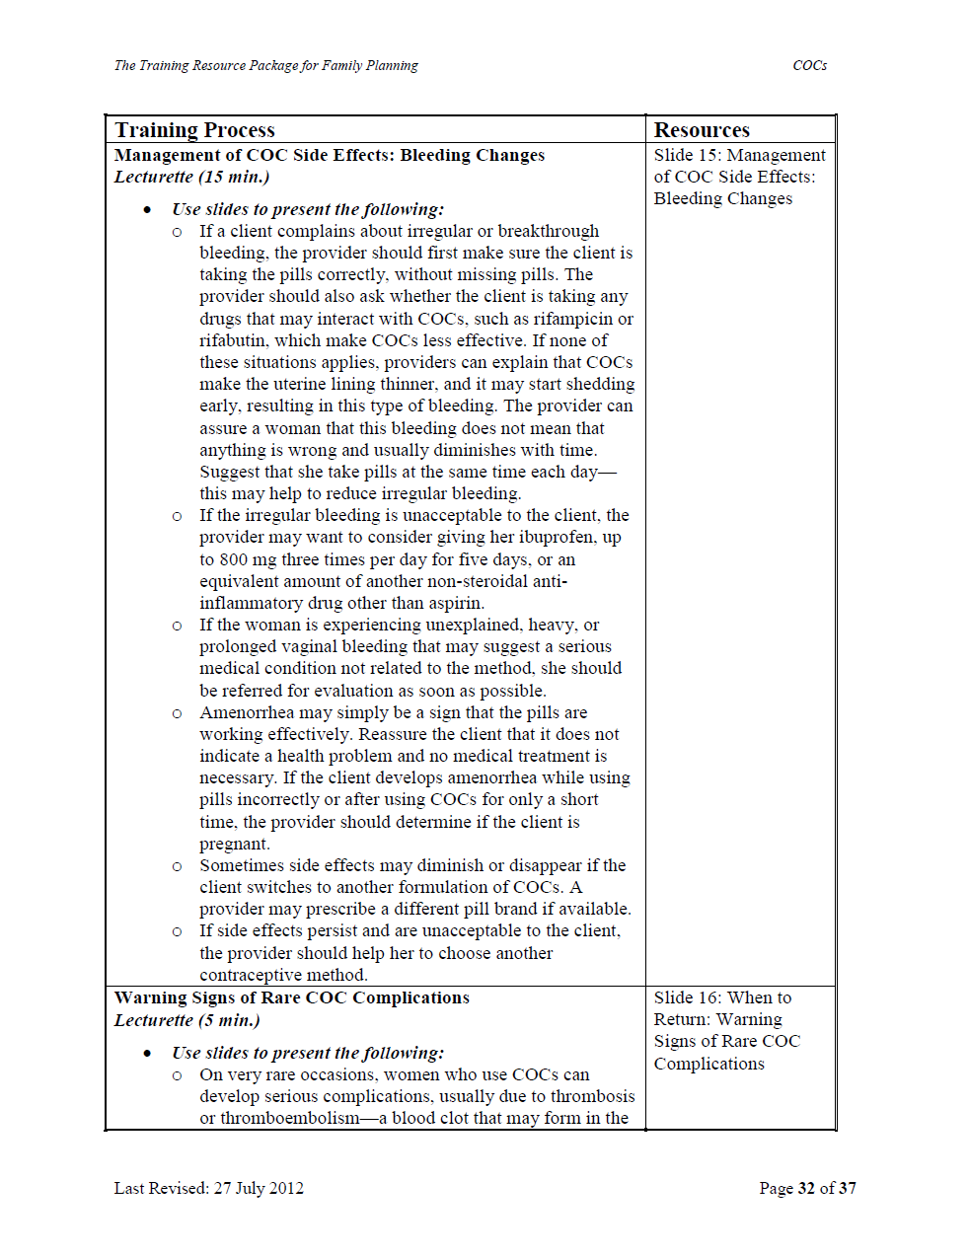
Module Session Plan

Slide 10
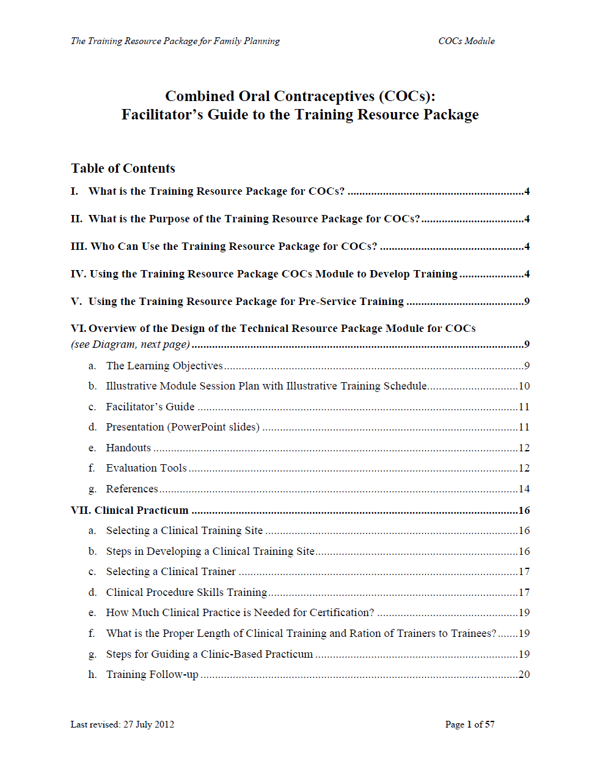
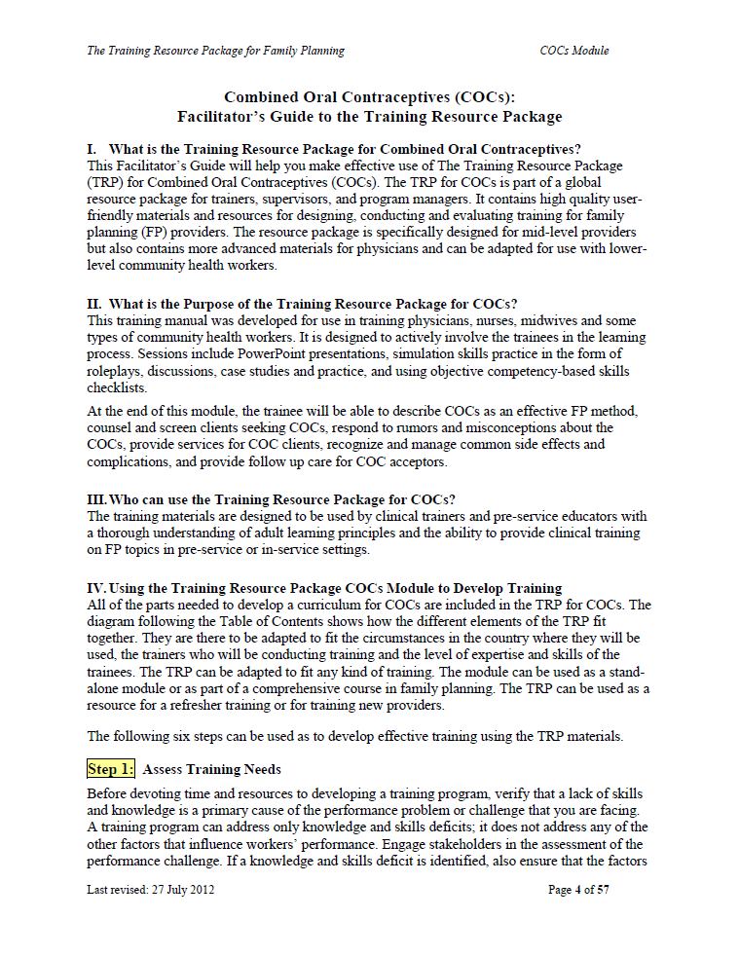
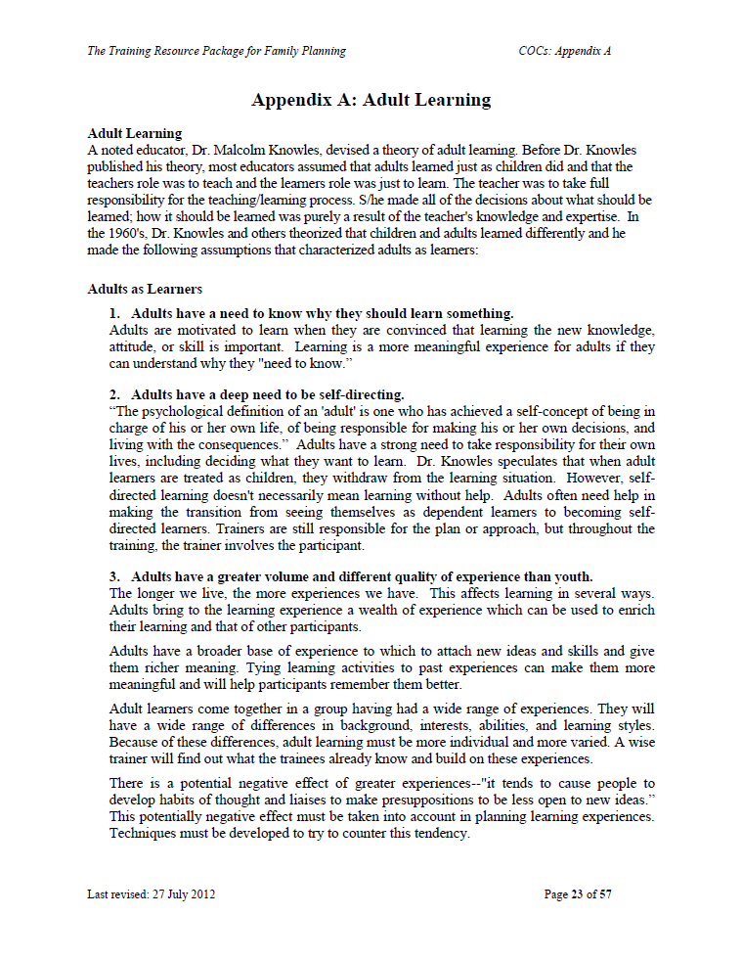
Facilitators’ Guide

Slide 11
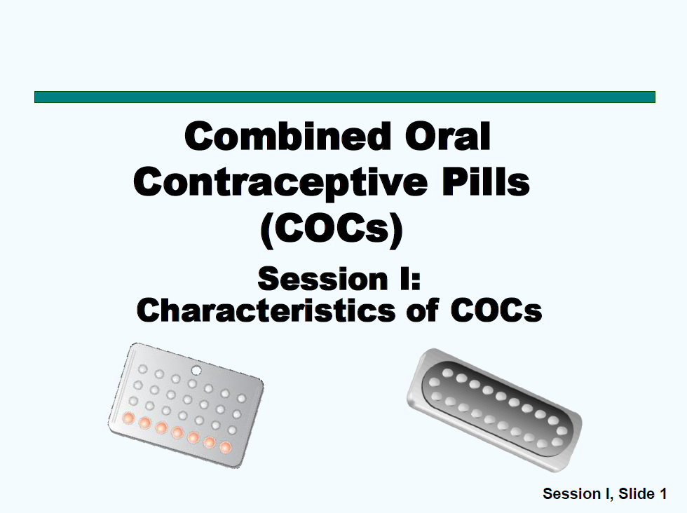
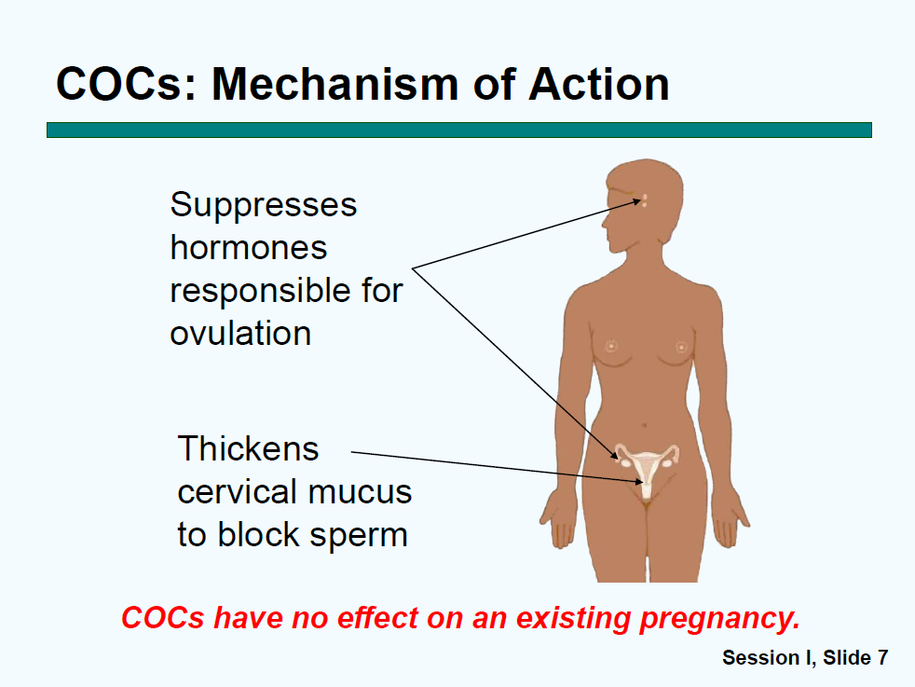
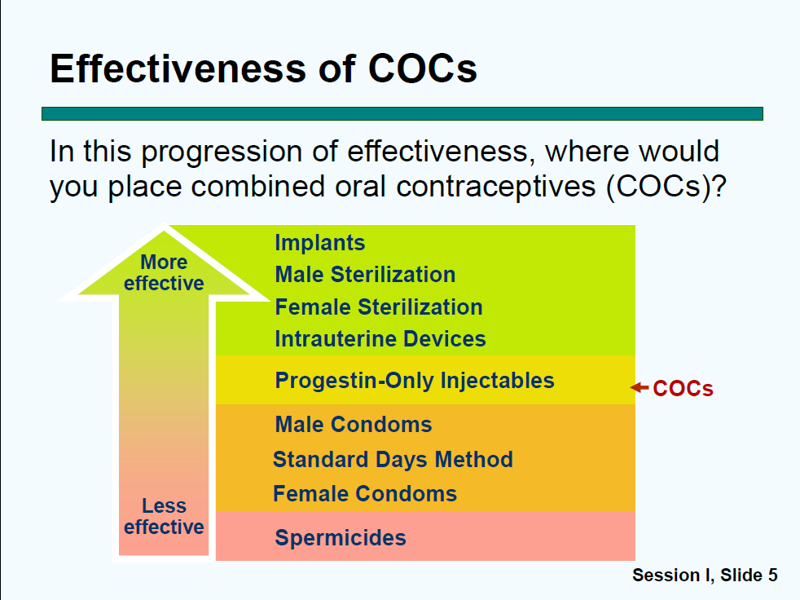
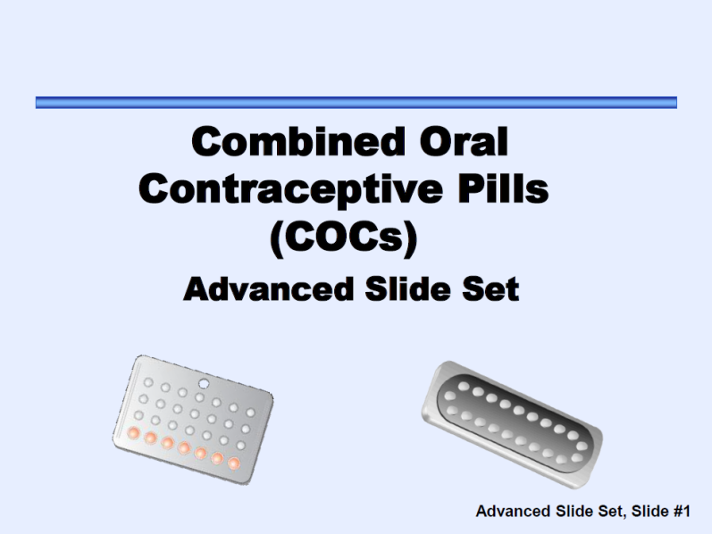
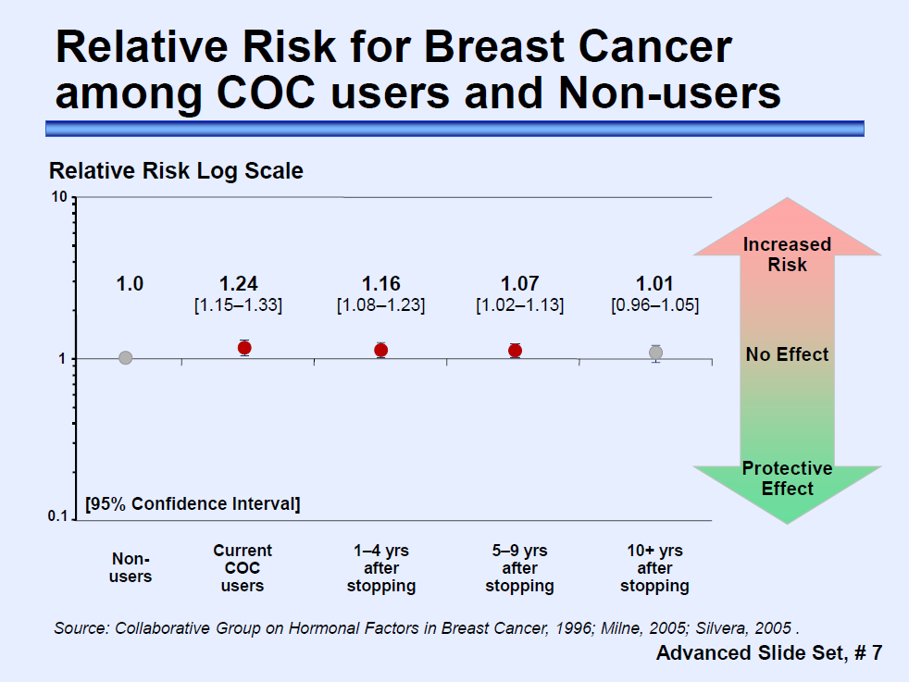
POWERPOINTS
Notes:
These are examples of some of the PowerPoint pages.
Title page
Group activities
Questions to consider
(same for the next few slides, just to show the audience how it looks like).

Slide 12
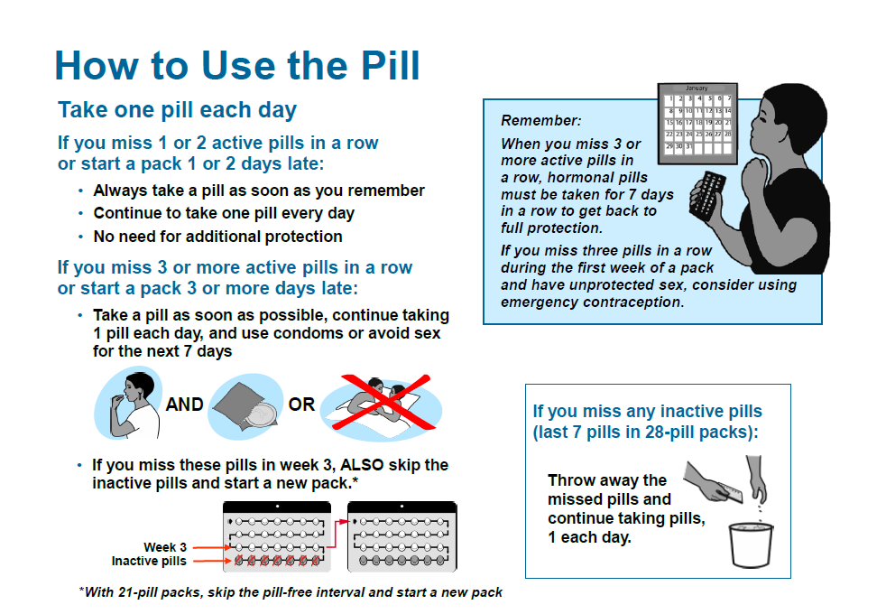
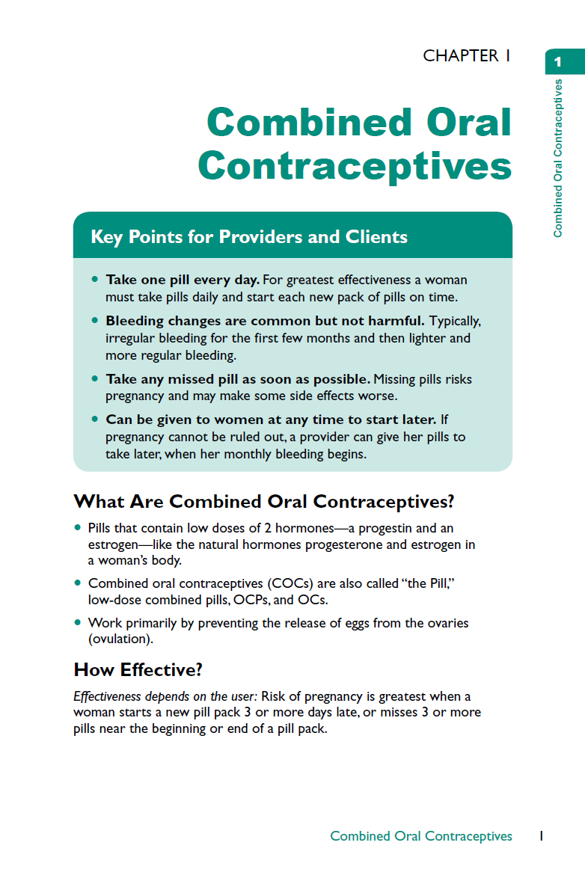
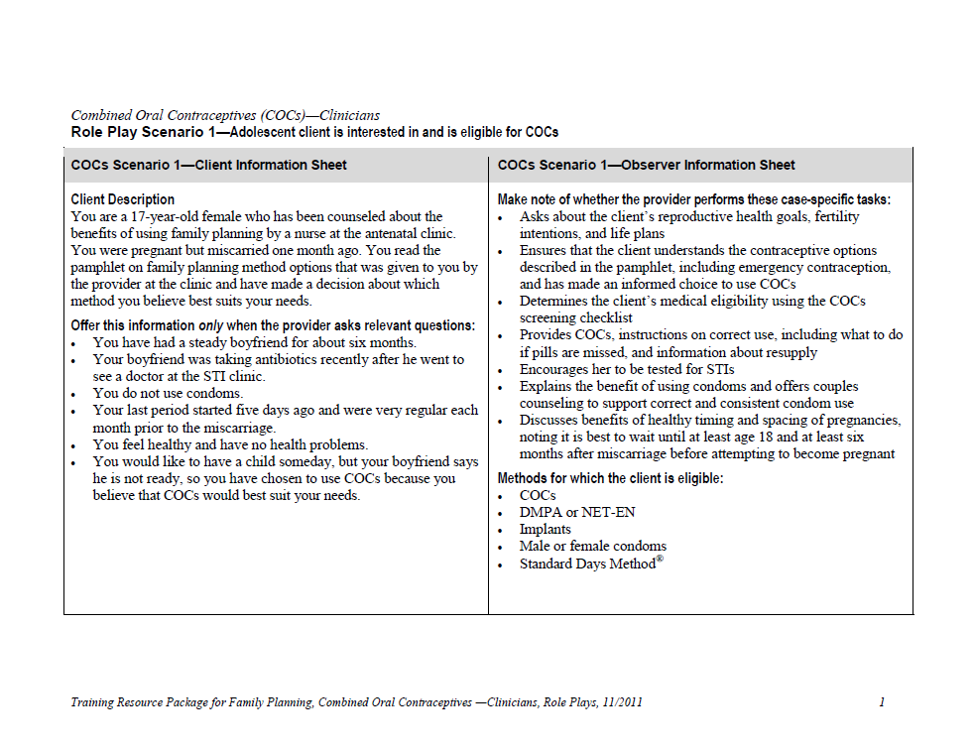
HANDOUTS

Slide 13
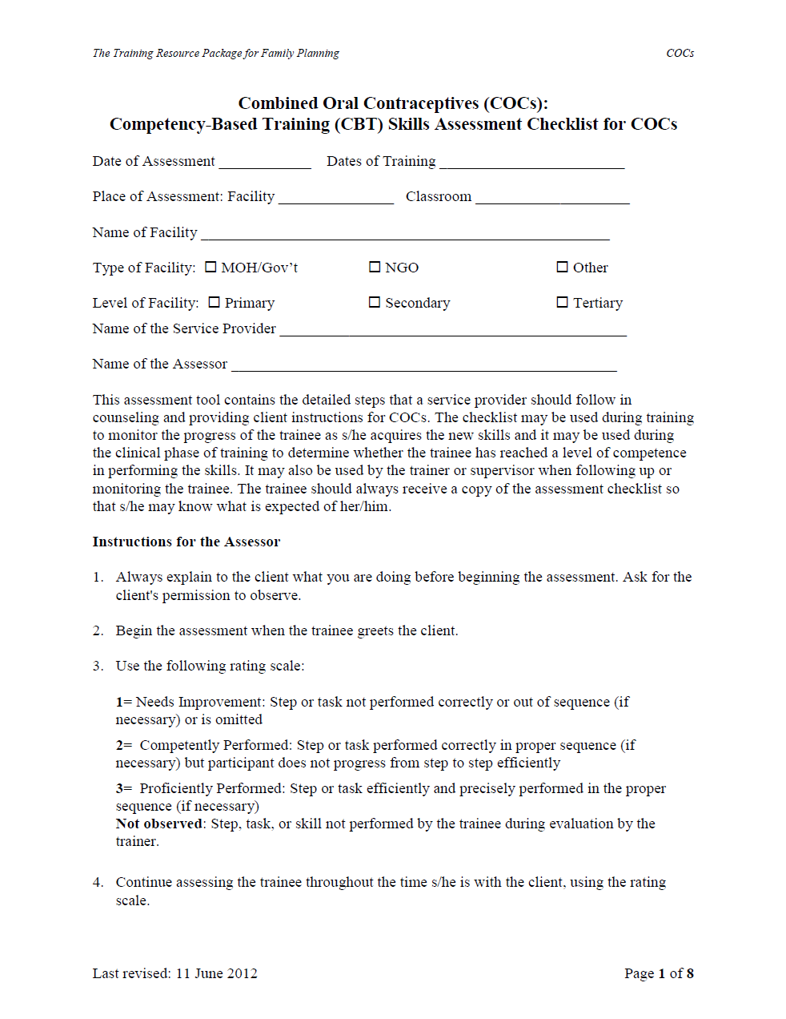
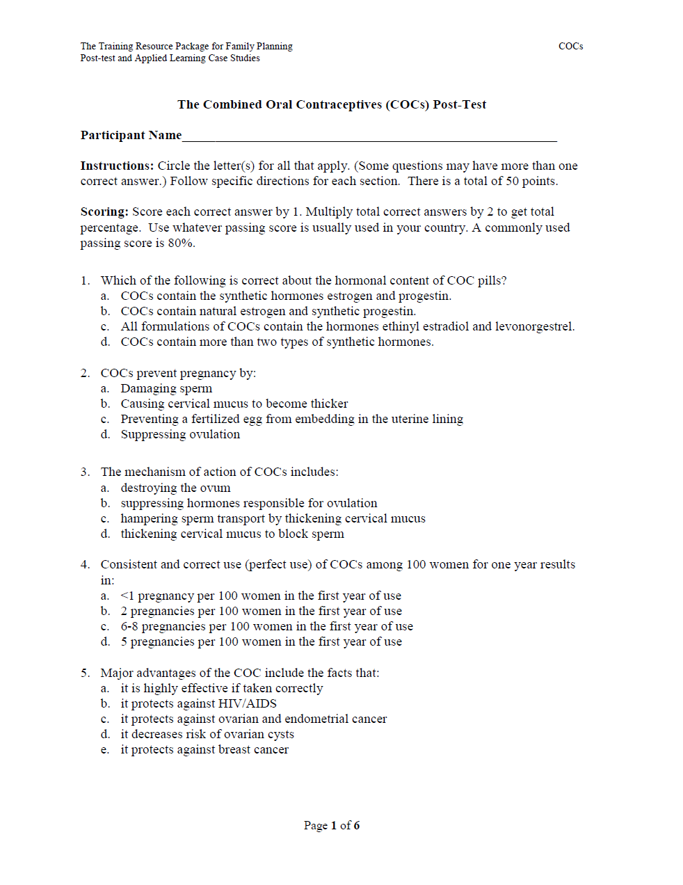
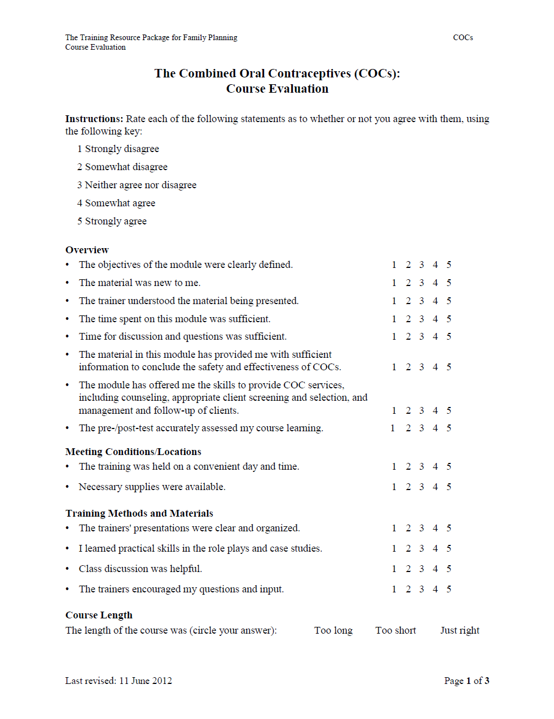
EVALUATION TOOLS

Slide 14
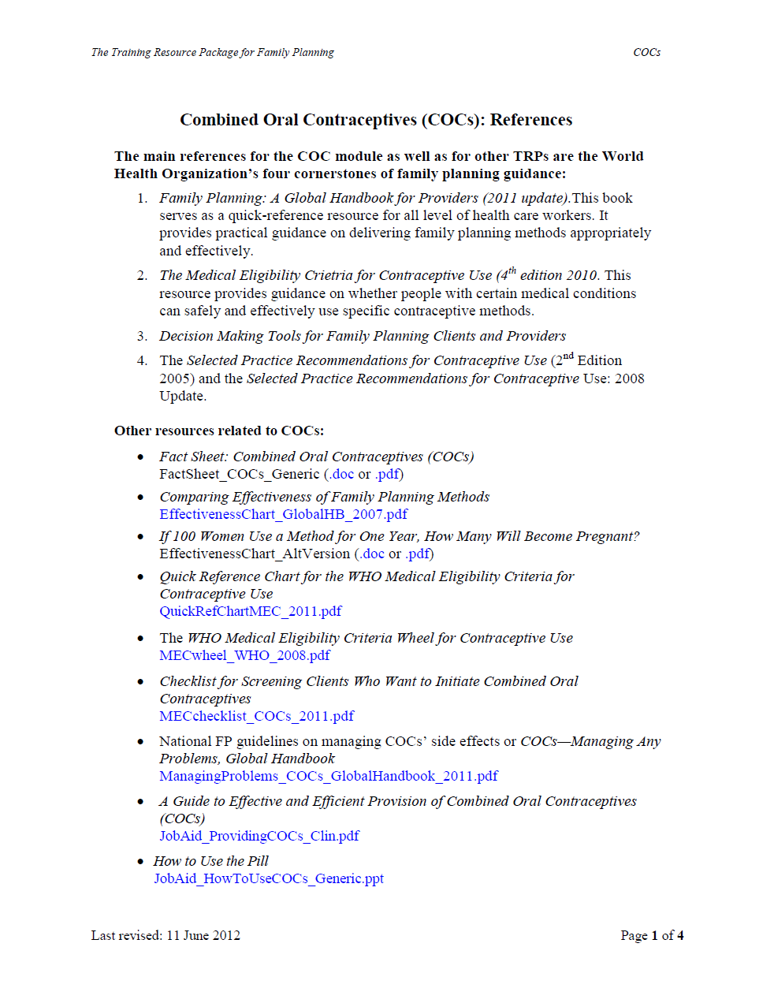
REFERENCES

Slide 15
Modules presently available
  Benefits of Family Planning (VF)
  Combined Oral Contraceptives (VF)
  Condoms- Male (VF)
  Condoms- Female (VF)
  Contraceptive Implants (VF)
  Emergency Contraceptive Pills (ECP)
  Emergency Contraceptive Pills (ECP) for Pharmacists
  Family Planning Counseling (VF)
  Intrauterine Devices (IUDs) (VF)
  Lactational Amenorrhea (VF)
  Progestin-only Injectable Contraception (Injectables) (VF)
  Standard Days Method
  WHO's FP Guidance documents and Job Aids (VF)
Other modules still under development- Permanent Methods
Plans for wider dissemination and technical support
Plans for regular updating
New French versions of other modules coming soon

Slide 16
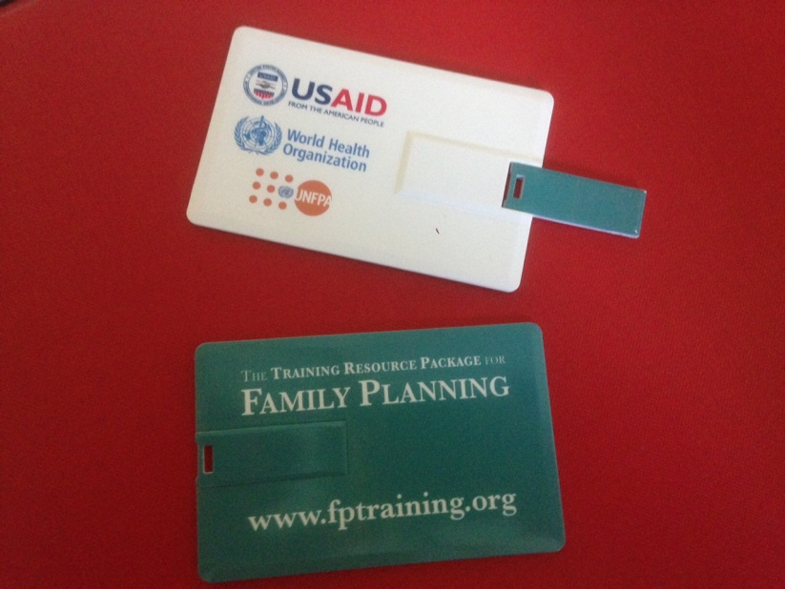
www.fptraining.org
USB drive

Slide 17
Thank You!
Follow us on Twitter @HRPresearch
Visit our website
https://www.who.int/teams/sexual-and-reproductive-health-and-research-(srh)/

